Slide 1
Transformer Architecture – Attention Is All You Need
Ramesh Fernando
14/06/2024

Slide 2
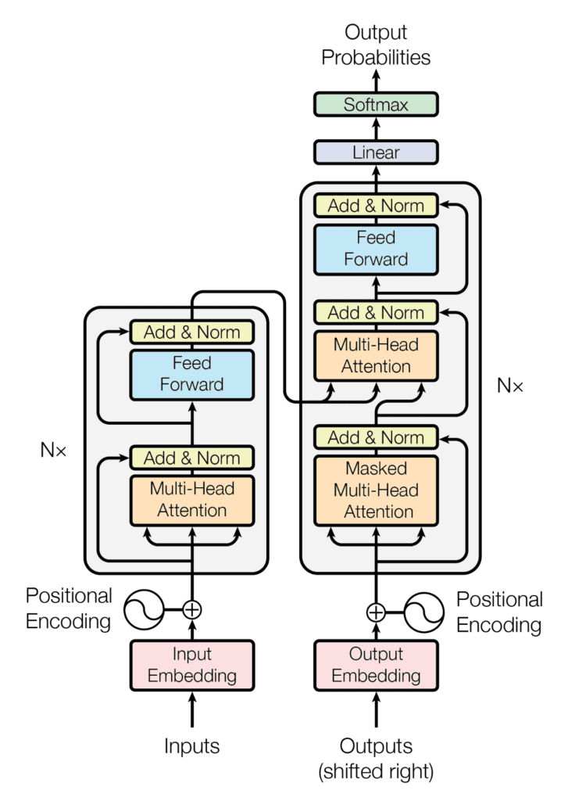
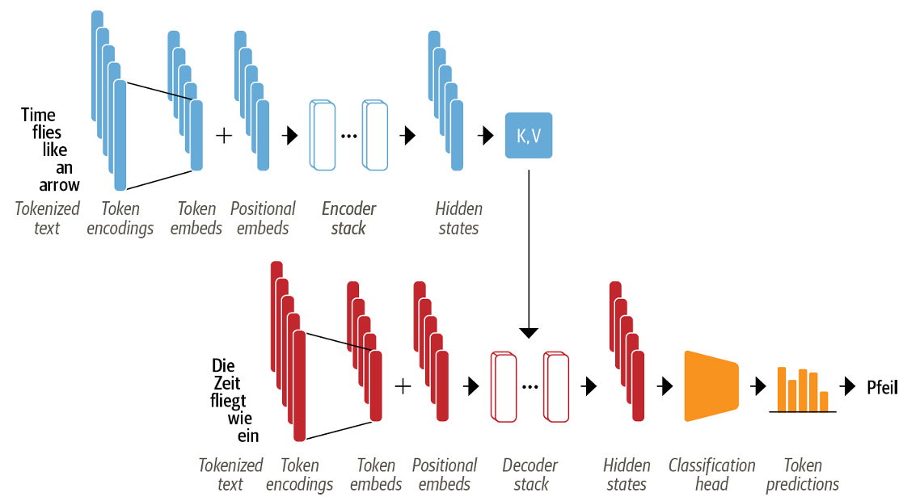
What are Transformers
Neural networks that specialize in “learning context from the data”.
How do they learn from context?
Using the attention mechanism
<Encoder-decoder architecture of the transformer [3]>
The encoder-decoder structure of the
Transformer architecture [1]
Source: [1] Attention Is All You Need: https://doi.org/10.48550/arXiv.1706.03762
[2] https://towardsdatascience.com/deep-dive-into-self-attention-by-hand-%EF%B8%8E-f02876e49857
[3] Natural Language Processing with Transformers - Lewis Tunstall

Slide 3
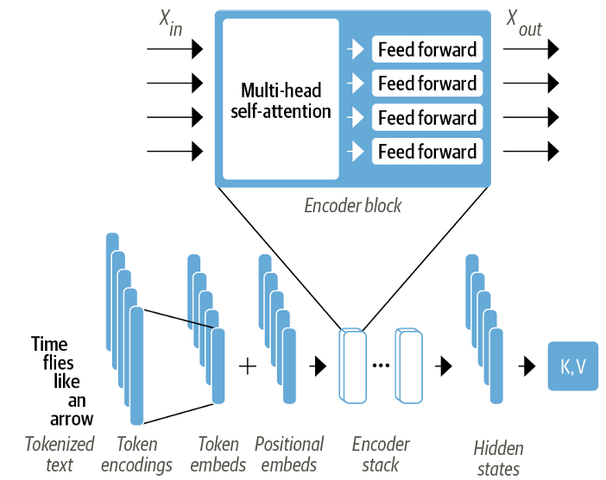
Transformer Encoder
The transformer encoder consists of N identical layers, where each layer consists of two main sub-layers:
Multi-head attention mechanism that receives queries, keys and values as inputs.
A second sub-layer comprises a fully connected feed-forward network.
Layer Normalization.
Multiple feed forward layers.
The encoder maps the contextuality of each word in the given vocabulary:
Semantically and Syntactically.
Finally, it is the contextual understanding!
Source: [3] Natural Language Processing with Transformers - Lewis Tunstall
The encoder-decoder structure of the Transformer architecture [3]

Slide 4
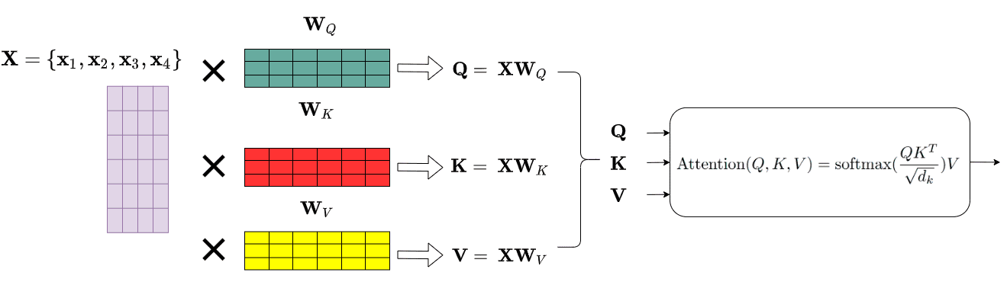
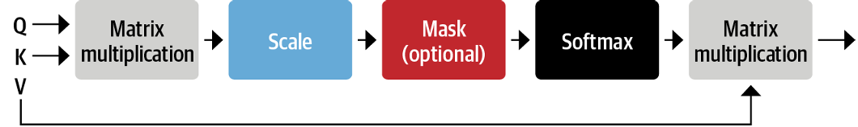
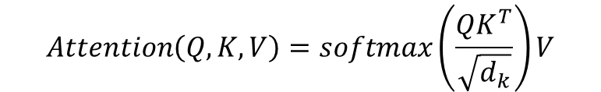

Self-Attention
$$X∈ℝ^{batch×{tokens×d}_{model} }$$
$$Attention\left(Q, K, V\right)=softmax\left(\frac{QK^{T}}{\sqrt{d_{k}}}\right)V$$

Slide 5
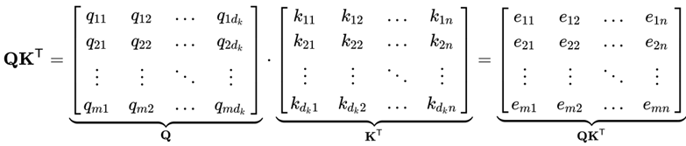




Self-Attention in a nutshell
Querying a YouTube video that explains the transformers
Q – Queries
K – Keys
V – Values
Videos that explain transformers
Deep Learning Lectures
Attention is all you need
Videos relevant to the keys
$$W_{Q}∈ℝ^{d×d_{q} }$$
$$W_{K}∈ℝ^{d×d_{k} }$$
$$W_{V}∈ℝ^{d×d_{v} }$$
$$With d_{k}=d_{q}$$
Match the query Q and the database (keys K) – Dot product similarity
<Source: Book>
The alignment scores of all words of the target sentence over all words of the source sentence are computed.

Slide 6
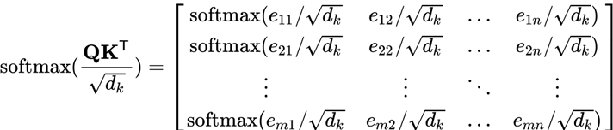
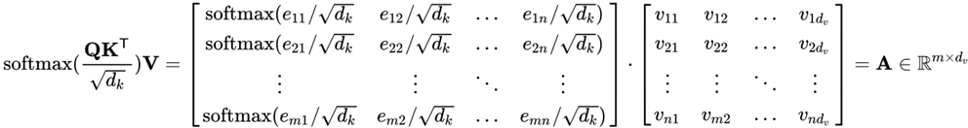
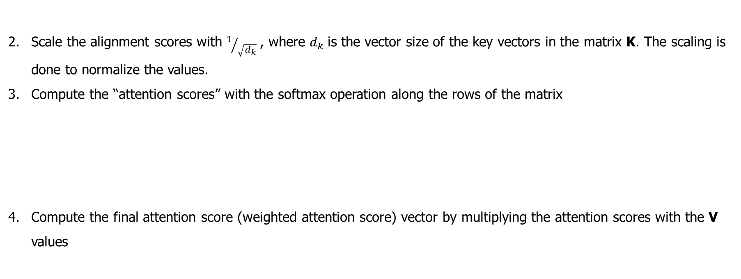
Self-Attention in a nutshell - cont
Scale the alignment scores with $1/{\sqrt{d_{k}}}$, where $d_{k}$is the vector size of the key vectors in the matrix K. The scaling is done to normalize the values.
Compute the “attention scores” with the softmax operation along the rows of the matrix
Compute the final attention score (weighted attention score) vector by multiplying the attention scores with the V values

Slide 7
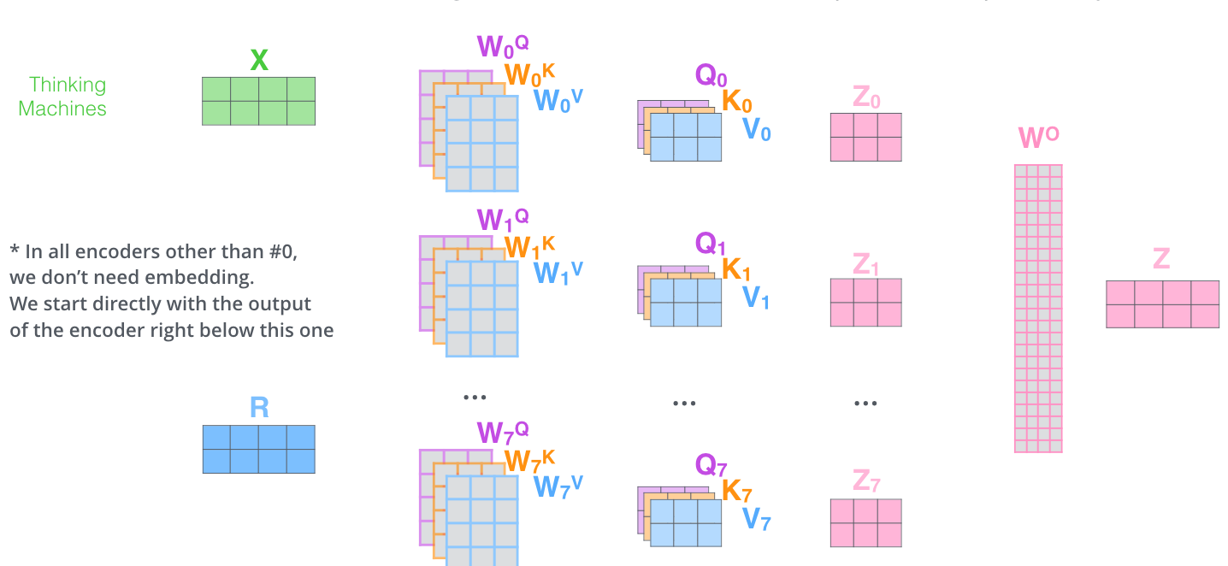

Multihead-Attention
$$Multihead\left(Q, K, V\right)=Concat\left({head}_{1},{head}_{2},{….., head}_{h}\right)W^{O}$$
$$where{ head}_{i}=Attention(QW_{i}^{Q},KW_{i}^{K},VW_{i}^{V})$$
The initial embedding dimension $d_{model}$ is decomposed to $h×d_{head}$ and the computation per head carried out separately.

Slide 8
Why Multihead-Attention works?
Multiple heads enable to attend independently to “parts of” the sequence.
The routing of information from one encoder layer to another will enable global representation which consists of local representation (Contextual understanding as the humans)
<Continue: Need to read more on this>

Slide 9
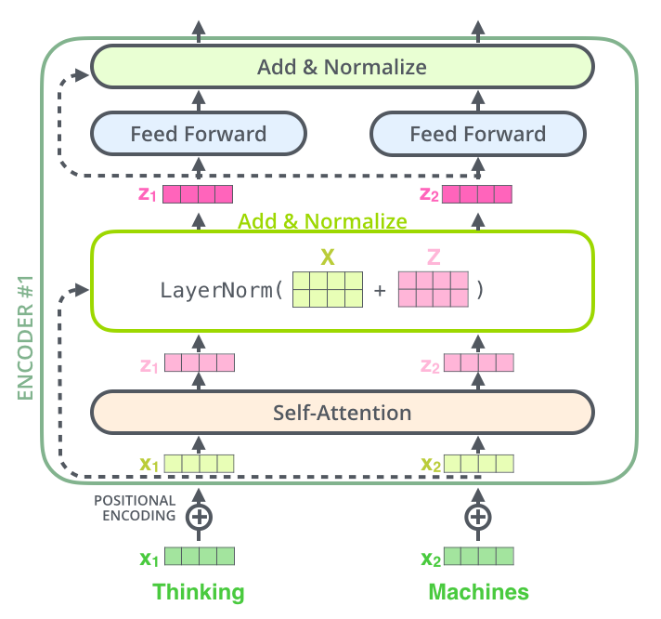
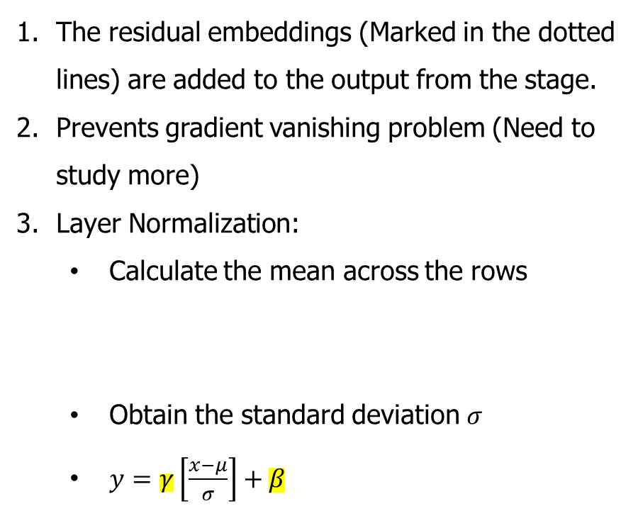

Add and Normalize
The residual embeddings (Marked in the dotted lines) are added to the output from the stage.
Prevents gradient vanishing problem (Need to study more)
Layer Normalization:
Calculate the mean across the rows
Obtain the standard deviation $σ$
$y=γ\left[\frac{x−μ}{σ}\right]+β$
$$μ=\frac{0.2+0.4−0.1+0.7}{4}$$
$$μ=0.3$$
0.2
0.4
-0.1
0.7

Slide 10
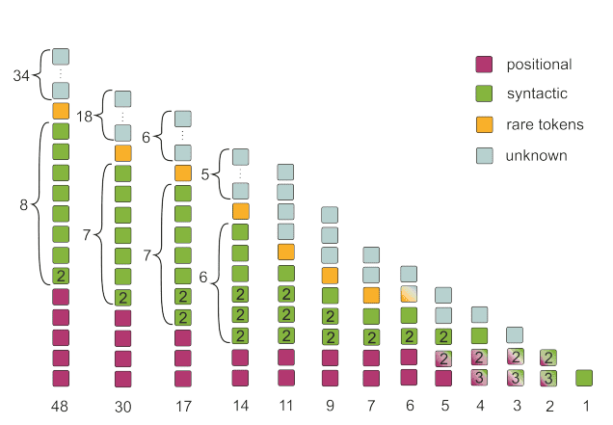
Research Opportunities
Weight Quantization [Paper: https://doi.org/10.48550/arXiv.2306.00978]
Which one to prune?
Which one to remove?
Encoder weights can be classified and pruned efficiently [Paper: https://doi.org/10.48550/arXiv.1905.09418]
(Source: Why multi-head self attention works: math, intuitions and 10+1 hidden insights | AI Summer (theaisummer.com)
The reference is vanilla transformer from the original paper.
8 heads x 6 layers

Slide 11
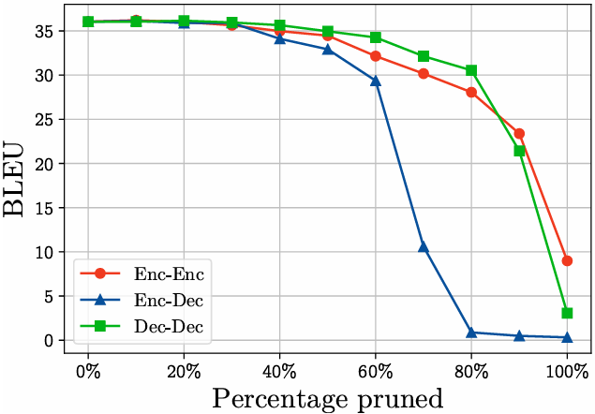
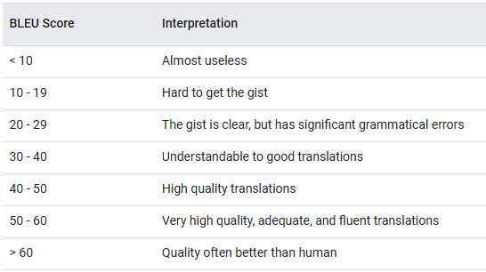
Research Opportunities - cont
The BLEU score interpretation with the output quality
BLEU when the incremental pruning is done for each attention type in the WMT model.
Source: Are Sixteen Heads Really Better than One? [Paper: https://doi.org/10.48550/arXiv.1905.10650]

Slide 12
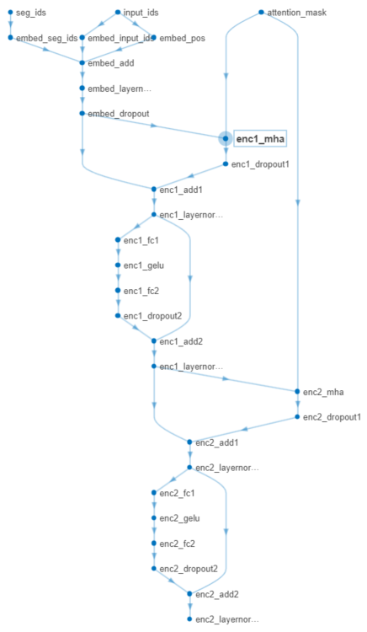
BERT-Tiny Dataflow
Type: Self Attention
Learnable Parameters:
QueryWeights (Q) – 128 x 128
KeyWeights (K) – 128 x 128
ValueWeights (V) – 128 x 128
OutputWeights – 128 x 128
Query Bias – 128 x 1
Key Bias – 128 x 1
Value Bias – 128 x 1
Output Bias – 128 x 1

Slide 13
References
The Illustrated Transformer – Jay Alammar – Visualizing machine learning one concept at a time. (jalammar.github.io)
Youtube Channel: https://www.youtube.com/@CodeEmporium
Books:
Advanced Deep Learning with Python – Ivan Vasilev
Natural Language Processing with Transformers - Lewis Tunstall, Leandro von Werra and Thomas Wolf
Attention Is All You Need: https://doi.org/10.48550/arXiv.1706.03762
Notebooks shared by Andres.

Slide 14
Thank You!

