Slide 1
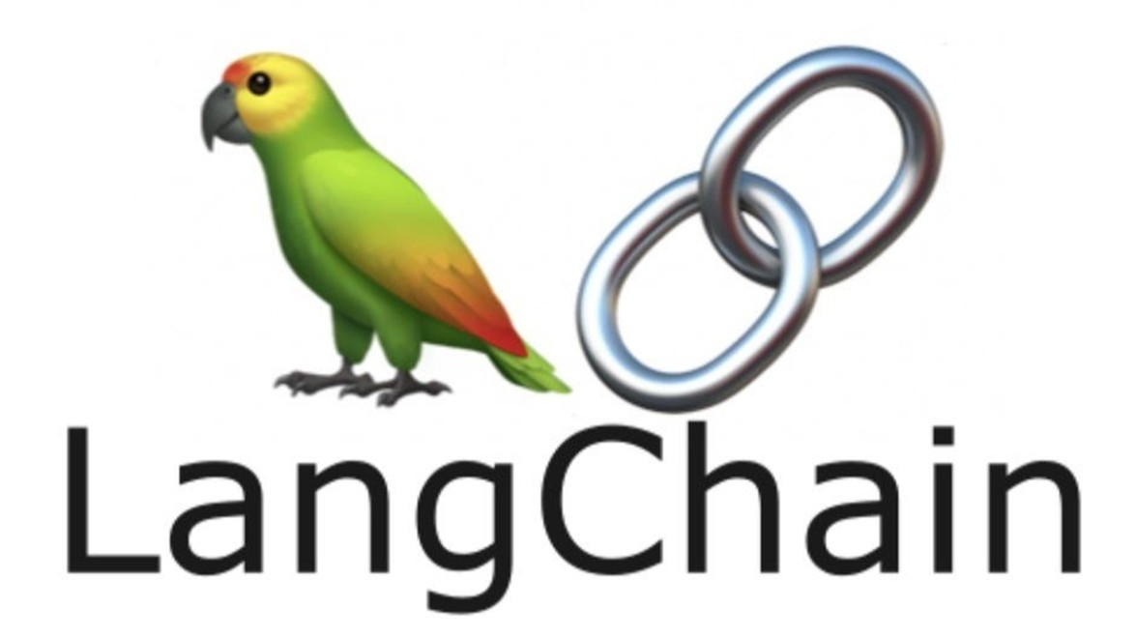

Slide 2
Course Setup: Prerequisites
A GitHub account
Basic command line knowledge
Text editor or IDE (eg VS Code, Cursor)

Slide 3
Course Setup: Local Development
Step 1: Install Python
python –version
Pip –version
Git --version
Step 2: Clone the Repository
git clone https://github.com/rameshgorrila/langchain-for-beginners
cd langchain-for-beginners
python -m venv venv
venv\Scripts\activate
python -m pip install --upgrade pip setuptools wheel
pip cache purge
pip install -r requirements.txt

Slide 4
Course Setup: Local Development
Step 3: Create GitHub Personal Access Token
Visit: https://github.com/settings/tokens/new
Create token with name langchain-course
Step 4: Configure Environment Variables
copy .env.example .env
Enter apikey, endpoint, and model name
AI_API_KEY=ghp_your_github_token_here
AI_ENDPOINT=https://models.inference.ai.azure.com
AI_MODEL=gpt-5-mini
Step 5: Test Setup
python scripts/test_setup.py

Slide 5
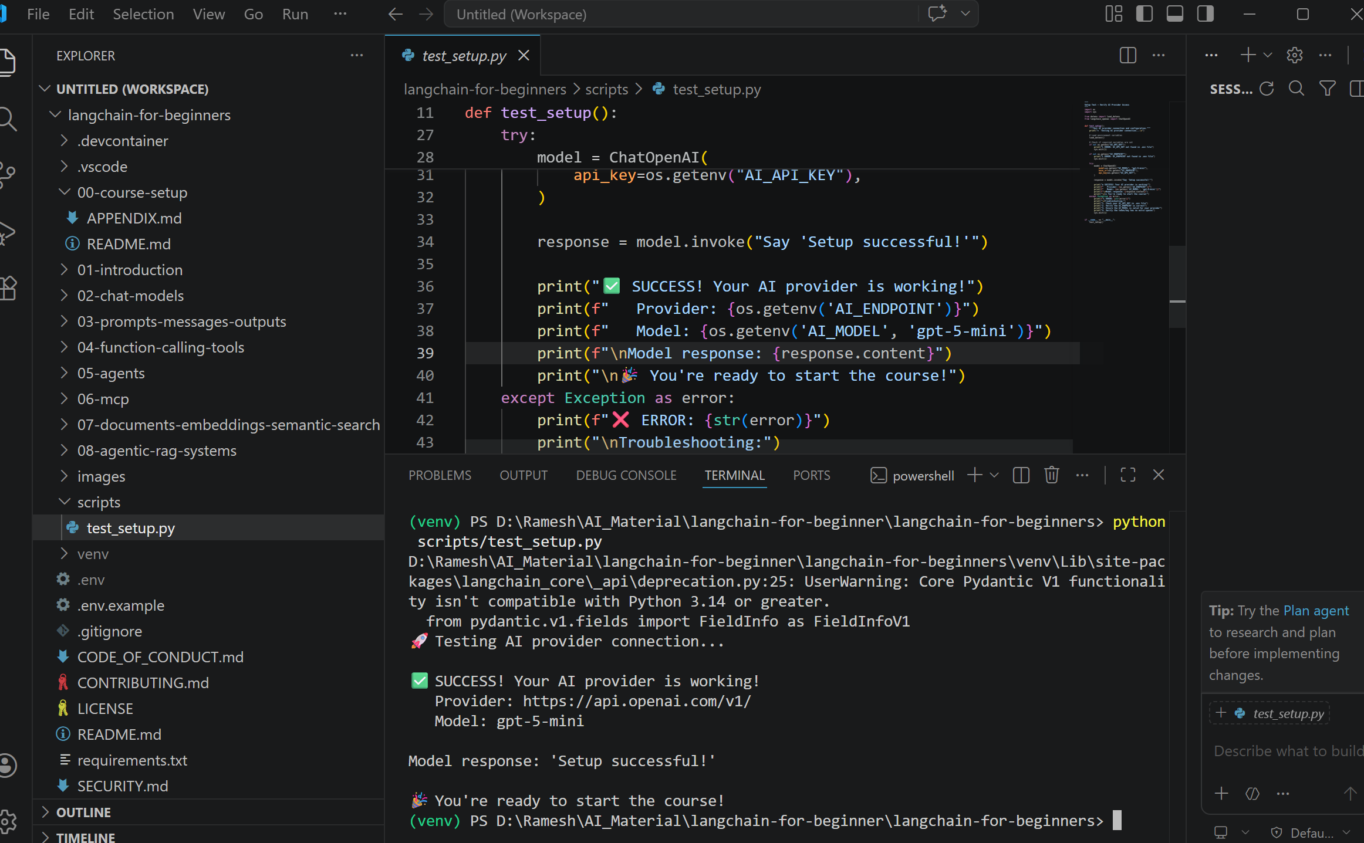
Course Setup: Local Development

Slide 6
Introduction to LangChain
LangChain is a framework for building AI-powered applications using Large Language Models (LLMs).

Slide 7
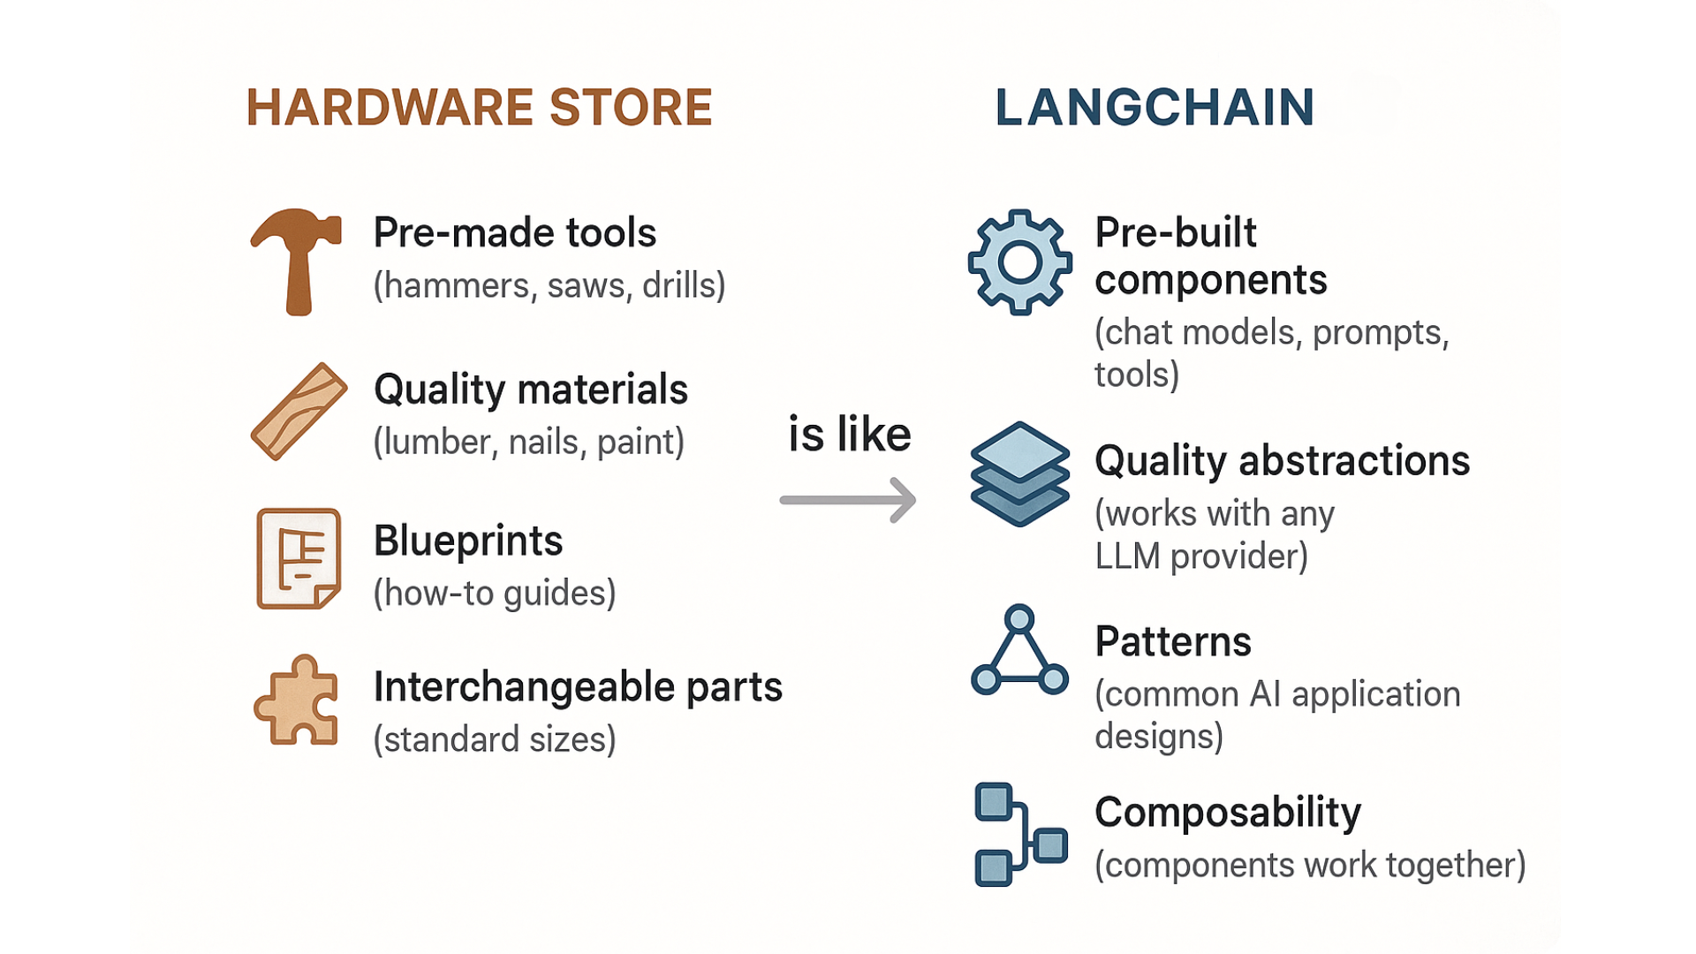
Introduction to LangChain

Slide 8
Introduction to LangChain : Problems it solves
Without LangChain, you'd need to:
Write different code for each LLM provider (OpenAI, Anthropic, Azure, etc.)
Build your own prompt management system
Create custom tools and function calling logic
Implement memory and conversation handling from scratch
Build agent systems without any structure
With LangChain, you get:
Provider abstraction - Switch between OpenAI, Azure, Anthropic with minimal code changes
Prompt templates - Reusable, testable prompts
Tools - Extend AI with custom functions and APIs
Memory - Built-in conversation history
Agents - Decision-making AI that can use tools

Slide 9
Introduction to LangChain : Core Concepts
LangChain is built around 5 core concepts you'll learn throughout this course:
Models: AI "brains" that process inputs and generate outputs.
Prompts: How you communicate with AI models using reusable templates.
Tools: Extend AI capabilities with external functions and APIs.
Agents: AI systems that reason and decide which tools to use autonomously.
Memory: Remember context across interactions.

Slide 10
How it works?
User Input
Memory
Prompts
Tools/Agents
Models
Response

Slide 11
Hands-On: Your First LLM Call
Step 1: Import what we need
from langchain_openai import ChatOpenAI
from dotenv import load_dotenv
import os
load_dotenv()

Slide 12
Hands-On: Your First LLM Call
Step 2: Create the AI Model
model = ChatOpenAI(
model=os.getenv("AI_MODEL"),
base_url=os.getenv("AI_ENDPOINT"),
api_key=os.getenv("AI_API_KEY")
)

Slide 13
Hands-On: Your First LLM Call
Step 3: Ask the LLM a question
response = model.invoke("What is LangChain in one sentence?")
print("AI Response:", response.content)

Slide 14
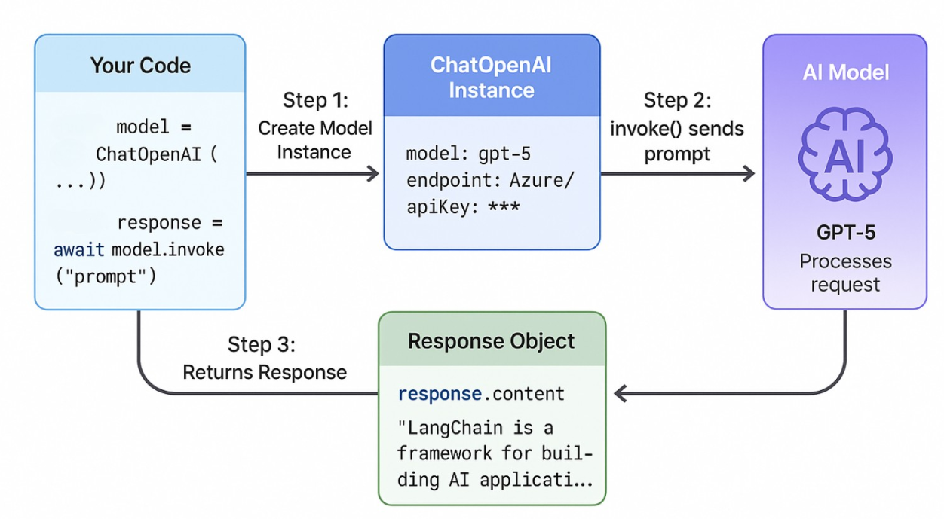
Hands-On: Your First LLM Call

Slide 15
Hands-On: Message types
from langchain_core.messages import HumanMessage, SystemMessage
model = ChatOpenAI(
model=os.getenv("AI_MODEL"),
base_url=os.getenv("AI_ENDPOINT"),
api_key=os.getenv("AI_API_KEY")
)
# Using structured messages for better control
messages = [
SystemMessage(content="You are a helpful AI assistant who explains things simply."),
HumanMessage(content="Explain quantum computing to a 10-year-old."),
]

