Slide 1
Architecture of web Application
by Ilakkiya R

Slide 2
Types of Software Architecture:
One Tier Architecture:
Two-Tier Architecture:
Three-Tier Architecture:

Slide 3
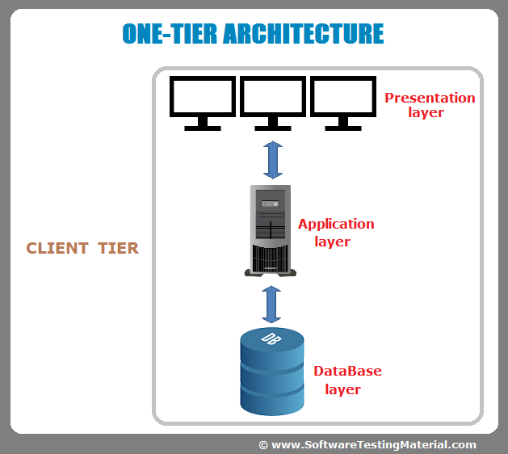
One Tier Architecture:-One Tier application Standalone application

Slide 4
One-tire:
One-tier architecture has all the layers such as Presentation, Business, Data Access layers in a single software package.
The data is stored in the local system or a shared drive.
Ex: Applications that handle all the three tiers such as MP3 player, MS Office come under the one-tier application.
One-tier architecture involves putting all of the required components for a software application or technology on a single server or platform.

Slide 5
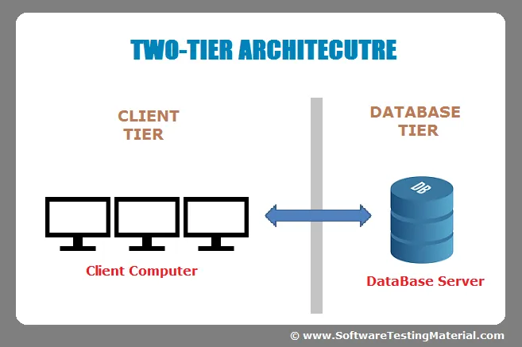
Two-Tier Architecture:-Two Tier application Client-Server application

Slide 6
The Two-tier architecture is divided into two parts:
1. Client Application (Client Tier)
2. Database (Data Tier)
The client system handles both Presentation and Application layers and the Server system handles the Database layer. It is also known as a client-server application.
The communication takes place between the Client and the Server. The client system sends the request to the server system and the Server system processes the request and sends back the data to the Client System

Slide 7
It is like Client-Server architecture, where communication takes place between client and server.
In this type of software architecture, the presentation layer or user interface layer runs on the client side while dataset layer gets executed and stored on server side.
There is no Business logic layer or immediate layer in between client and server.
Two-tier architecture is the original client-server architecture, consisting of a presentation tier and a data tier; the business logic lives in the presentation tier, the data tier or both. In two-tier architecture the presentation tier - and consequently the end user - has direct access to the data tier, and the business logic is often limited. A simple contact management application, where users can enter and retrieve contact data, is an example of a two-tier application.

Slide 8
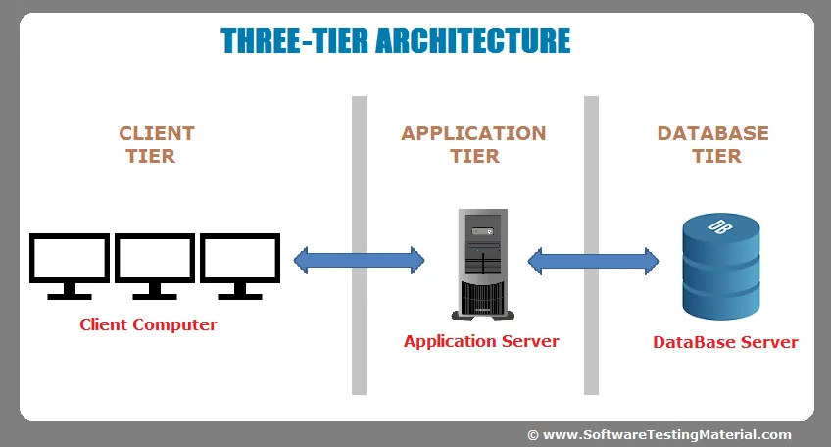
Three-Tier Architecture:-Three Tier application Web Based application

Slide 9
The Three-tier architecture is divided into three parts:
1. Presentation layer (Client Tier)
2. Application layer (Business Tier)
3. Database layer (Data Tier)

Slide 10
The client system handles the Presentation layer, the Application server handles the Application layer, and the Server system handles the Database layer.
It is suitable to support enterprise level client-server applications by providing solutions to scalability, security, fault tolerance, reusability, and maintainability. It helps developers to create flexible and reusable applications.

Slide 11
N-Tier application
Another layer is the N-Tier application. N-Tier application Distributed application. It is similar to the three-tier architecture but the number of application servers is increased and represented in individual tiers in order to distribute the business logic so that the logic will be distributed.
An N-Tier Application program is one that is distributed among three or more separate computers in a distributed network.
The most common form of n-tier is the 3-tier Application, and it is classified into three categories.
User interface programming in the user’s computer
Business logic in a more centralized computer, and
Required data in a computer that manages a database.

Slide 12
Presentation Tier/Web server:
The web server is the presentation tier and provides the user interface. This is usually a web page or web site, such as an ecommerce site where the user adds products to the shopping cart, adds payment details or creates an account. The content can be static or dynamic, and is usually developed using HTML, CSS and Javascript .

Slide 13
Application tier/Application Server
The application tier, also known as the logic tier or middle tier, is the heart of the application. In this tier, information collected in the presentation tier is processed - sometimes against other information in the data tier - using business logic, a specific set of business rules. The application tier can also add, delete or modify data in the data tier.
The application tier is typically developed using Python, Java, Perl, PHP or Ruby, and communicates with the data tier using API calls.
The application server corresponds to the middle tier, housing the business logic used to process user inputs. To continue the ecommerce example, this is the tier that queries the inventory database to return product availability, or adds details to a customer's profile. This layer often developed using Python, Ruby or PHP and runs a framework such as e Django, Rails, Symphony or ASP.NET, for example.

Slide 14
Data Tier/Database Server:
The database server is the data or backend tier of a web application. It runs on database management software, such as MySQL, Oracle, DB2 or PostgreSQL, for example.

