Slide 1
Constraint Satisfaction Problems
Tuomas Sandholm
Carnegie Mellon University
Computer Science Department
[Read Chapter 6 of Russell & Norvig]

Slide 2
Constraint satisfaction problems (CSPs)
Standard search problem: state is a "black box“ – any data structure that supports successor function and goal test
  state is defined by variables X_{i} with values from domain D_{i}
  goal test is a set of constraints specifying allowable combinations of values for subsets of variables
Simple example of a formal representation language
Allows useful general-purpose algorithms with more power than standard search algorithms
CSP:

Slide 3

Example: Map-Coloring
Variables WA, NT, Q, NSW, V, SA, T
Domains D_{i} = {red,green,blue}
Constraints: adjacent regions must have different colors
e.g., WA ≠ NT, or (WA,NT) in {(red,green),(red,blue),(green,red), (green,blue),(blue,red),(blue,green)}

Slide 4

Example: Map-Coloring
Solutions are complete and consistent assignments
e.g., WA = red, NT = green, Q = red, NSW = green,V = red,SA = blue,T = green

Slide 5

Constraint graph
Binary CSP: each constraint relates two variables
Constraint graph: nodes are variables, arcs are constraints

Slide 6
Varieties of CSPs
Discrete variables
  finite domains:
    n variables, domain size d → O(d^{n}) complete assignments
    e.g., Boolean CSPs, incl. Boolean satisfiability (NP-complete)
  infinite domains:
    integers, strings, etc.
    e.g., job scheduling, variables are start/end days for each job
    need a constraint language, e.g., StartJob₁ + 5 ≤ StartJob₃
Continuous variables
  e.g., start/end times for Hubble Space Telescope observations
  linear constraints solvable in polynomial time by LP

Slide 7
Varieties of constraints
Unary constraints involve a single variable,
  e.g., SA ≠ green
Binary constraints involve pairs of variables,
  e.g., SA ≠ WA
Higher-order constraints involve 3 or more variables,
  e.g., cryptarithmetic column constraints

Slide 8

Example: Cryptarithmetic
Variables: F T U W
R O X₁ X₂ X₃
Domains: {0,1,2,3,4,5,6,7,8,9}
Constraints: Alldiff (F,T,U,W,R,O)
  O + O = R + 10 · X₁
  X₁ + W + W = U + 10 · X₂
  X₂ + T + T = O + 10 · X₃
  X₃ = F, T ≠ 0, F ≠ 0

Slide 9
Real-world CSPs
Assignment problems
  e.g., who teaches what class
Timetabling problems
  e.g., which class is offered when and where?
Transportation scheduling
Factory scheduling
Notice that many real-world problems involve real-valued variables

Slide 10
Standard search formulation (incremental)
Let's start with the straightforward approach, then fix it
States are defined by the values assigned so far
Initial state: the empty assignment { }
Successor function: assign a value to an unassigned variable that does not conflict with current assignment
  → fail if no legal assignments
Goal test: the current assignment is complete
This is the same for all CSPs
Every solution appears at depth n with n variables
→ use depth-first search
Path is irrelevant, so can also use complete-state formulation
b = (n - l )d at depth l, hence n! · d^{n} leaves

Slide 11
Backtracking search
Variable assignments are commutative, i.e.,
[ WA = red then NT = green ] same as [ NT = green then WA = red ]
=> Only need to consider assignments to a single variable at each node
Depth-first search for CSPs with single-variable assignments is called backtracking search
Can solve n-queens for n ≈ 25

Slide 12

Backtracking search

Slide 13

Backtracking example

Slide 14

Backtracking example

Slide 15

Backtracking example

Slide 16

Backtracking example

Slide 17
Improving backtracking efficiency
General-purpose methods can give huge gains in speed:
  Which variable should be assigned next?
  In what order should its values be tried?
  Can we detect inevitable failure early?

Slide 18

Most constrained variable
Most constrained variable:
  choose the variable with the fewest legal values
a.k.a. minimum remaining values (MRV) heuristic

Slide 19

Most constraining variable
A good idea is to use it as a tie-breaker among most constrained variables
Most constraining variable:
  choose the variable with the most constraints on remaining variables

Slide 20

Least constraining value
Given a variable to assign, choose the least constraining value:
  the one that rules out the fewest values in the remaining variables
Combining these heuristics makes 1000 queens feasible

Slide 21

Forward checking
Idea:
  Keep track of remaining legal values for unassigned variables
  Terminate search when any variable has no legal values

Slide 22

Forward checking
Idea:
  Keep track of remaining legal values for unassigned variables
  Terminate search when any variable has no legal values

Slide 23

Forward checking
Idea:
  Keep track of remaining legal values for unassigned variables
  Terminate search when any variable has no legal values

Slide 24

Forward checking
Idea:
  Keep track of remaining legal values for unassigned variables
  Terminate search when any variable has no legal values

Slide 25
Constraint propagation
Forward checking propagates information from assigned to unassigned variables, but doesn't provide early detection for all failures:
NT and SA cannot both be blue!
Constraint propagation algorithms repeatedly enforce constraints locally…

Slide 26

Arc consistency
Simplest form of propagation makes each arc consistent
X →Y is consistent iff
  for every value x of X there is some allowed y

Slide 27

Arc consistency
Simplest form of propagation makes each arc consistent
X →Y is consistent iff
  for every value x of X there is some allowed y

Slide 28

Arc consistency
Simplest form of propagation makes each arc consistent
X →Y is consistent iff
  for every value x of X there is some allowed y
If X loses a value, neighbors of X need to be rechecked

Slide 29

Arc consistency
Simplest form of propagation makes each arc consistent
X →Y is consistent iff
  for every value x of X there is some allowed y
If X loses a value, neighbors of X need to be rechecked
Arc consistency detects failure earlier than forward checking
Can be run as a preprocessor or after each assignment

Slide 30

Arc consistency algorithm AC-3
Time complexity: O(#constraints |domain|³)
Checking consistency of an arc is O(|domain|²)

Slide 31
k-consistency
A CSP is k-consistent if, for any set of k-1 variables, and for any consistent assignment to those variables, a consistent value can always be assigned to any kth variable
1-consistency is node consistency
2-consistency is arc consistency
For binary constraint networks, 3-consistency is the same as path consistency
Getting k-consistency requires time and space exponential in k
Strong k-consistency means k’-consistency for all k’ from 1 to k
  Once strong k-consistency for k=#variables has been obtained, solution can be constructed trivially
Tradeoff between propagation and branching
Practitioners usually use 2-consistency and less commonly 3-consistency

Slide 32
Other techniques for CSPs
Global constraints
  E.g., Alldiff
  E.g., Atmost(10,P1,P2,P3), i.e., sum of the 3 vars ≤ 10
  Special propagation algorithms
    Bounds propagation
      E.g., number of people on two flight D1 = [0, 165] and D2 = [0, 385]
      Constraint that the total number of people has to be at least 420
      Propagating bounds constraints yields D1 = [35, 165] and D2 = [255, 385]
    …
Symmetry breaking

Slide 33
Structured CSPs

Slide 34
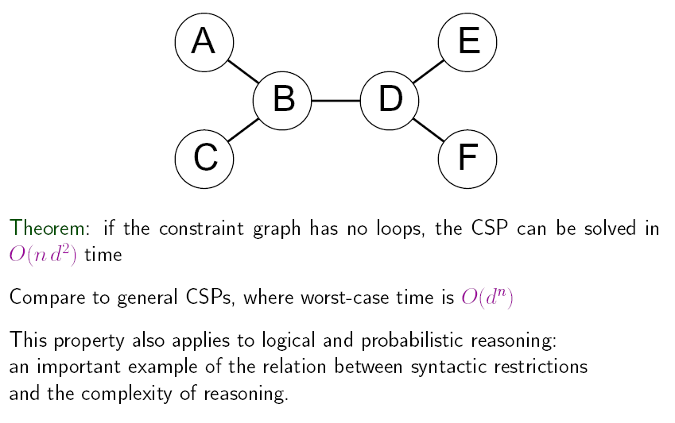
Tree-structured CSPs

Slide 35
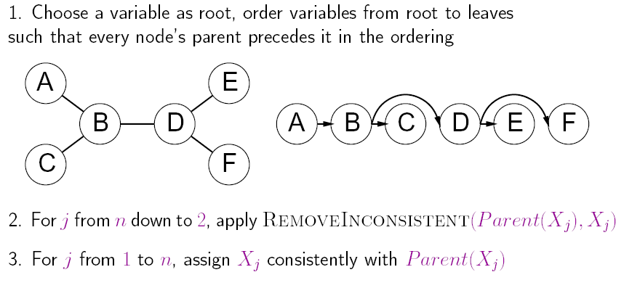
Algorithm for tree-structured CSPs

Slide 36
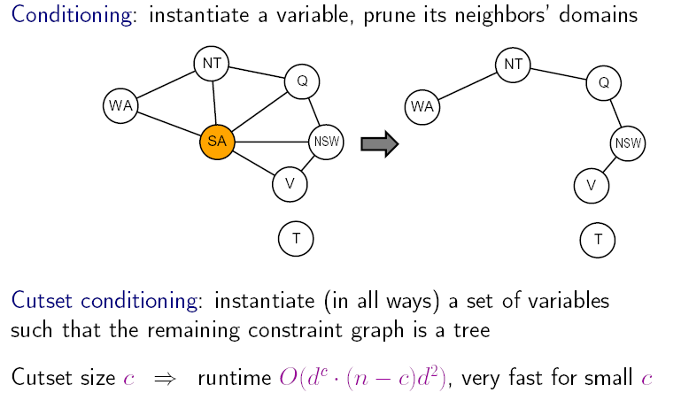
Nearly tree-structured CSPs
(Finding the minimum cutset is NP-complete.)

Slide 37
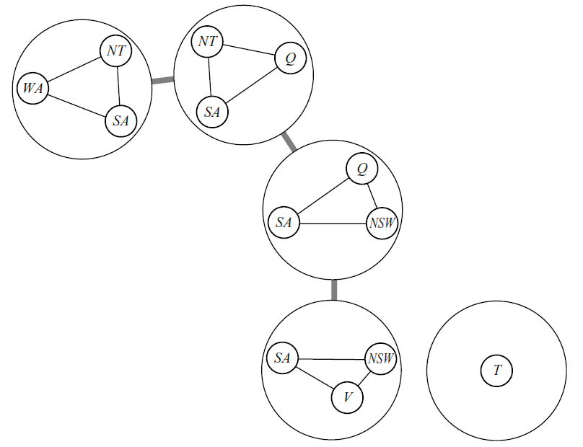
Tree decomposition
Every variable in original problem must appear in at least one subproblem
If two variables are connected in the original problem, they must appear together (along with the constraint) in at least one subproblem
If a variable occurs in two subproblems in the tree, it must appear in every subproblem on the path that connects the two
Algorithm: solve for all solutions of each subproblem. Then, use the tree-structured algorithm, treating the subproblem solutions as variables for those subproblems.
O(nd^{w+1}) where w is the treewidth (= one less than size of largest subproblem)
Finding a tree decomposition of smallest treewidth is NP-complete, but good heuristic methods exists

Slide 38
Local search for CSPs
Hill-climbing, simulated annealing typically work with "complete" states, i.e., all variables assigned
To apply to CSPs:
  allow states with unsatisfied constraints
  operators reassign variable values
Variable selection: randomly select any conflicted variable
Value selection by min-conflicts heuristic:
  choose value that violates the fewest constraints
  i.e., hill-climb with h(n) = total number of violated constraints

Slide 39

Example: 4-Queens
States: 4 queens in 4 columns (4⁴ = 256 states)
Actions: move queen in column
Goal test: no attacks
Evaluation: h(n) = number of attacks
Given random initial state, can solve n-queens in almost constant time for arbitrary n with high probability (e.g., n = 10,000,000)

Slide 40
Summary
CSPs are a special kind of problem:
  states defined by values of a fixed set of variables
  goal test defined by constraints on variable values
Backtracking = depth-first search with one variable assigned per node
Variable ordering and value selection heuristics help significantly
Forward checking prevents assignments that guarantee later failure
Constraint propagation (e.g., arc consistency) does additional work to constrain values and detect inconsistencies
Iterative min-conflicts is usually effective in practice

Slide 41
An example CSP application: satisfiability

Slide 42

Davis-Putnam-Logemann-Loveland (DPLL) tree search algorithm
clause
E.g. for 3SAT
∃? s.t. (p₁∨¬p₃∨p₄) ∧ (¬p₁∨p₂∨¬p₃) ∧ …
Backtrack when some clause becomes empty
Unit propagation (for variable & value ordering): if some clause only has one literal left, assign that variable the value that satisfies the clause (never need to check the other branch)
Boolean Constraint Propagation (BCP): Iteratively apply unit propagation until there is no unit clause available
p₁
T
p₂
F
T
F
p₃
p₄
Complete

Slide 43
A helpful observation for the DPLL procedure
P₁ ∧ P₂ ∧ … ∧ P_{n} ⇒ Q (Horn)
is equivalent to
¬(P₁ ∧ P₂ ∧ … ∧ P_{n}) ∨ Q (Horn)
is equivalent to
¬P₁ ∨ ¬P₂ ∨ … ∨ ¬P_{n} ∨ Q (Horn clause)
Thrm. If a propositional theory consists only of Horn clauses (i.e., clauses that have at most one non-negated variable) and unit propagation does not result in an explicit contradiction (i.e., Pi and ¬Pi for some Pi), then the theory is satisfiable.
Proof. On the next page.
…so, Davis-Putnam algorithm does not need to branch on variables which only occur in Horn clauses

Slide 44
Proof of the thrm
Assume the theory is Horn, and that unit propagation has completed (without contradiction). We can remove all the clauses that were satisfied by the assignments that unit propagation made. From the unsatisfied clauses, we remove the variables that were assigned values by unit propagation. The remaining theory has the following two types of clauses that contain unassigned variables only:
¬P₁ ∨ ¬P₂ ∨ … ∨ ¬P_{n} ∨ Q and
¬P₁ ∨ ¬P₂ ∨ … ∨ ¬P_{n}
Each remaining clause has at least two variables (otherwise unit propagation would have applied to the clause). Therefore, each remaining clause has at least one negated variable. Therefore, we can satisfy all remaining clauses by assigning each remaining variable to False.

Slide 45
Variable ordering heuristic for DPLL [Crawford & Auton AAAI-93]
Heuristic: Pick a non-negated variable that occurs in a non-Horn (more than 1 non-negated variable) clause with a minimal number of non-negated variables.
Motivation: This is effectively a “most constrained first” heuristic if we view each non-Horn clause as a “variable” that has to be satisfied by setting one of its non-negated variables to True. In that view, the branching factor is the number of non-negated variables the clause contains.
Q: Why is branching constrained to non-negated variables?
A: We can ignore any negated variables in the non-Horn clauses because
  whenever any one of the non-negated variables is set to True the clause becomes redundant (satisfied), and
  whenever all but one of the non-negated variables is set to False the clause becomes Horn.
Variable ordering heuristics can make several orders of magnitude difference in speed.

Slide 46
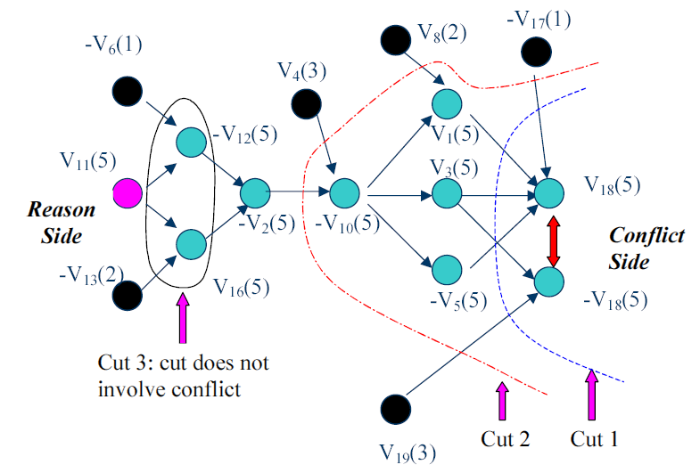
Constraint learning aka nogood learning aka clause learning used by state-of-the-art SAT solvers (and CSP more generally)
Conflict graph
Nodes are literals
Number in parens shows the search tree level
where that node got decided or implied
Cut 2 gives the first-unique-implication-point (i.e., 1 UIP on reason side) constraint
(v2 or –v4 or –v8 or v17 or -v19). That schemes performs well in practice.
Any cut would give a valid clause. Which cuts should we use? Should we delete some?
The learned clauses apply to all other parts of the tree as well.

Slide 47
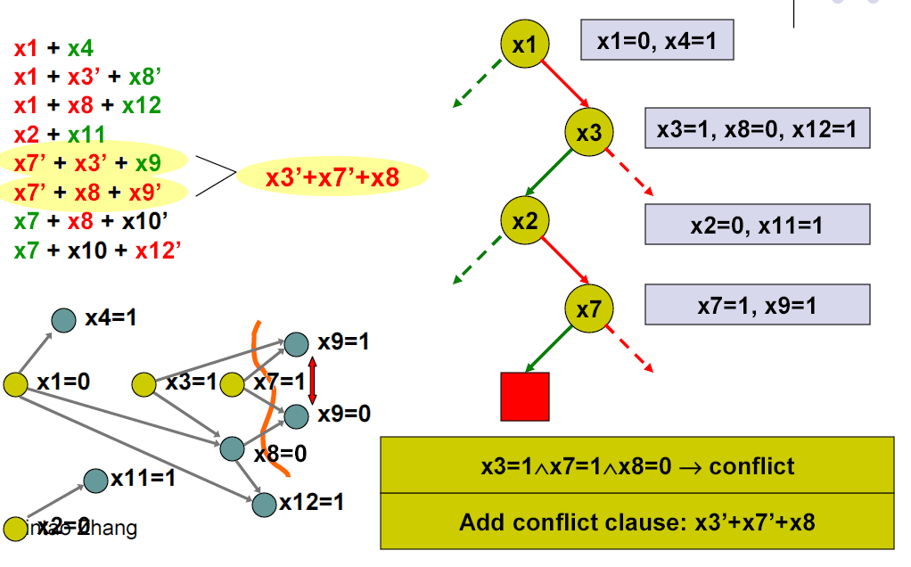
Conflict-directed backjumping
x7=0
Failure-driven assertion (not a branching decision):
Learned clause is a unit clause under this path, so
BCP automatically sets x7=0.
x2=0
Then backjump to the decision level of x3=1,
keeping x3=1 (for now), and
forcing the implied fact x7=0 for that x3=1 branch
WHAT’S THE POINT? A: No need to just backtrack to x2

Slide 48
Classic readings on conflict-directed backjumping, clause learning, and heuristics for SAT
“GRASP: A Search Algorithm for Propositional Satisfiability”, Marques-Silva & Sakallah, IEEE Trans. Computers, C-48, 5:506-521,1999. (Conference version 1996.)
(“Using CSP look-back techniques to solve real world SAT instances”, Bayardo & Schrag, Proc. AAAI, pp. 203-208, 1997)
“Chaff: Engineering an Efficient SAT Solver”, Moskewicz, Madigan, Zhao, Zhang & Malik, 2001 (www.princeton.edu/~chaff/publication/DAC2001v56.pdf)
“BerkMin: A Fast and Robust Sat-Solver”, Goldberg & Novikov, Proc. DATE 2002, pp. 142-149
See also slides at http://www.princeton.edu/~sharad/CMUSATSeminar.pdf

Slide 49
More on conflict-directed backjumping (CBJ)
These are for general CSPs, not SAT specifically:
Read Section 6.3.3. of Russell & Norvig for an easy description of conflict-directed backjumping for general CSP
“Conflict-directed backjumping revisited” by Chen and van Beek, Journal of AI Research, 14, 53-81, 2001:
  As the level of local consistency checking (lookahead) is increased, CBJ becomes less helpful
    A dynamic variable ordering exists that makes CBJ redundant
  Nevertheless, adding CBJ to backtracking search that maintains generalized arc consistency leads to orders of magnitude speed improvement experimentally
“Generalized NoGoods in CSPs” by Katsirelos & Bacchus, National Conference on Artificial Intelligence (AAAI-2005) pages 390-396, 2005.
  This paper generalizes the notion of nogoods, and shows that nogood learning (then) can speed up (even non-SAT) CSPs significantly

Slide 50
Random restarts
Sometimes it makes sense to keep restarting the CSP/SAT algorithm, using randomization in variable ordering
  Avoids the very long run times of unlucky variable ordering
  On many problems, yields faster algorithms
  Clauses learned can be carried over across restarts
  Experiments suggest it does not help on optimization problems (e.g., [Sandholm et al. IJCAI-01, Management Science 2006])

Slide 51
Phase transitions in CSPs

Slide 52
“Order parameter” for 3SAT [Mitchell, Selman, Levesque AAAI-92]
β = #clauses / # variables
This predicts
  satisfiability
  hardness of finding a model

Slide 53
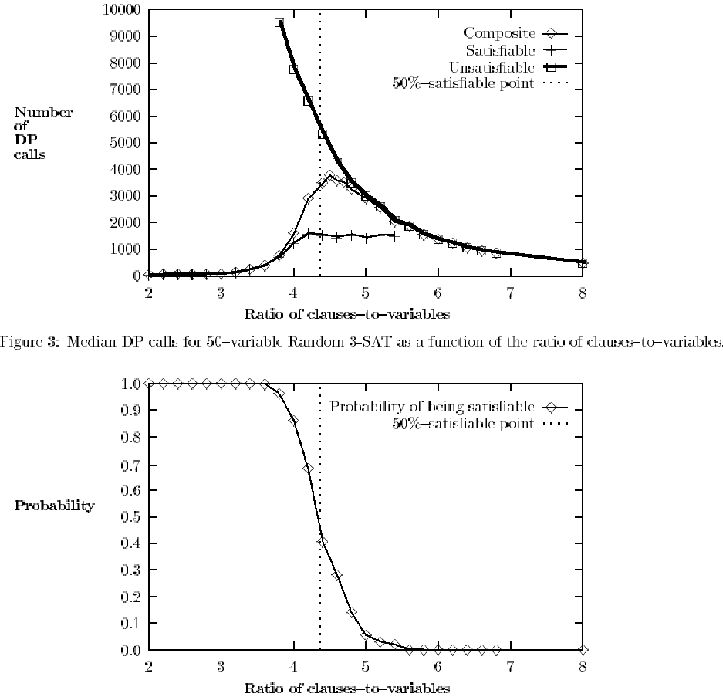

Slide 54
How would you capitalize on the phase transition in an algorithm?

Slide 55
Generality of the order parameter β
The results seem quite general across model finding algorithms
Other constraint satisfaction problems have order parameters as well

Slide 56
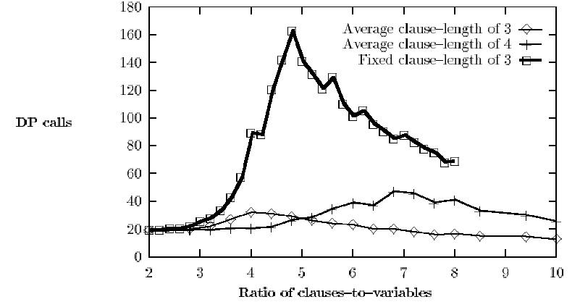
…but the complexity peak does not occur (at least not in the same place) under all ways of generating SAT instances

Slide 57
Iterative refinement algorithms for SAT

Slide 58
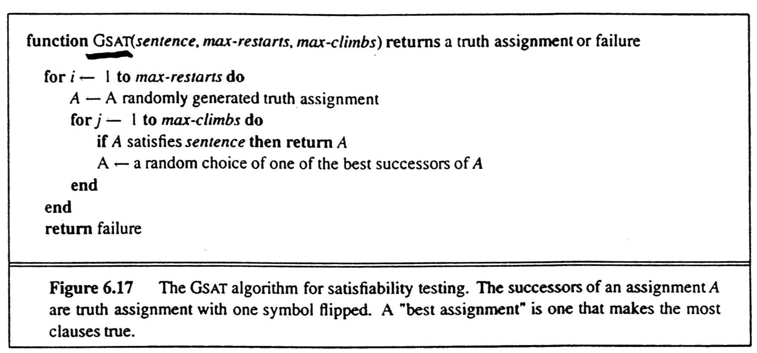
GSAT [Selman, Levesque, Mitchell AAAI-92]
(= a local search algorithm for model finding)
Incomplete (unless restart a lot)
Avg. total flips
2000
1600
1200
800
400
50 variables, 215 3SAT clauses
Greediness is not essential as long as climbs and sideways moves are preferred over downward moves.
max-climbs
100 200

Slide 59
Restarting
vs.
Escaping

Slide 60
BREAKOUT algorithm [Morris AAAI-93]
Initialize all variables Pi randomly
UNTIL current state is a solution
IF current state is not a local minimum
THEN make any local change that reduces the total cost (i.e. flip one Pi)
ELSE increase weights of all unsatisfied clause by one
Incomplete, but very efficient on large (easy) satisfiable problems.
Reason for incompleteness: the cost increase of the current local optimum spills over to other solutions because they share unsatisfied clauses.

Slide 61
Summary of the algorithms we covered for inference in propositional logic
Truth table method
Inference rules, e.g., resolution
Model finding algorithms
  Davis-Putnam (Systematic backtracking)
    Early backtracking when a clause is empty
    Unit propagation
    Variable (& value?) ordering heuristics
  GSAT
  BREAKOUT

