Slide 1
Solving problems by searching
Chapter 3

Slide 2
Why Search?
To achieve goals or to maximize our utility we need to predict what the result of our actions in the future will be.
There are many sequences of actions, each with their own utility.
We want to find, or search for, the best one.

Slide 3
Search Overview
Watch this video on search algorithms:
http://videolectures.net/aaai2010_thayer_bis/

Slide 4
Example: Romania
On holiday in Romania; currently in Arad.
Flight leaves tomorrow from Bucharest
Formulate goal:
  be in Bucharest
Formulate problem:
  states: various cities
  actions: drive between cities or choose next city
Find solution:
  sequence of cities, e.g., Arad, Sibiu, Fagaras, Bucharest

Slide 5

Example: Romania

Slide 6
Task Environment
Static / Dynamic
Previous problem was static: no attention to changes in environment
Observable / Partially Observable / Unobservable
Previous problem was observable: it knew its states at all times.
Deterministic / Stochastic
Previous problem was deterministic: no new percepts
were necessary, we can predict the future perfectly given our actions
Discrete / continuous
Previous problem was discrete: we can enumerate all possibilities
Single Agent
No other agents interacting with your cost function
Sequential
Decisions depend on past decisions

Slide 7

Example: vacuum world
Observable, start in #5. Solution?

Slide 8
Example: vacuum world
Observable, start in #5.
Solution? [Right, Suck]
Unobservable, start in
{1,2,3,4,5,6,7,8} e.g.,
Solution?

Slide 9
Example: vacuum world
Unobservable, start in
{1,2,3,4,5,6,7,8} e.g.,
Solution?
[Right,Suck,Left,Suck]

Slide 10
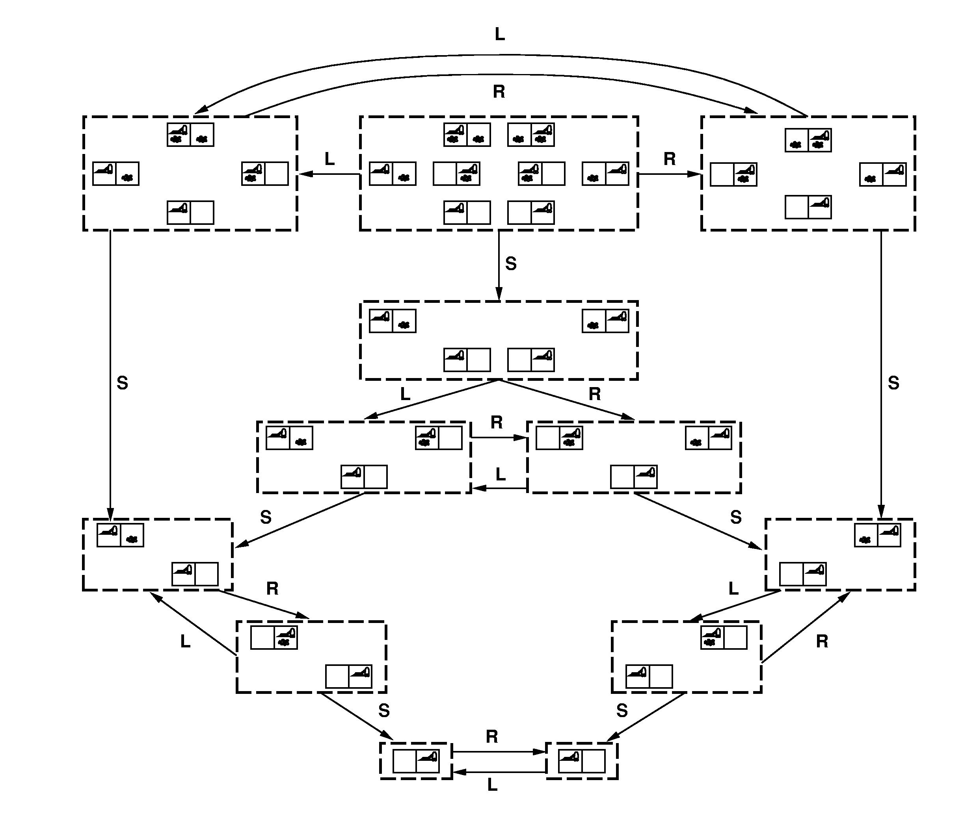

Slide 11
Problem Formulation
A problem is defined by four items:
initial state e.g., "at Arad“
actions set of possible actions in current state x.
transition model Result(x,a) = state that follows from applying action
a in state x. e.g., Result(X2 (Arad), A4 (Arad → Zerind)) = X3 (Zerind)
goal test, e.g., x = "at Bucharest”, Checkmate(x)
path cost (additive)
  e.g., sum of distances, number of actions executed, etc.
  c(x,a,y) is the step cost, assumed to be ≥ 0
A solution is a sequence of actions leading from the initial state to a goal state

Slide 12
Selecting a state space
Real world is absurdly complex
  state space must be abstracted for problem solving
(Abstract) state ← set of real states
(Abstract) action ← complex combination of real actions
  e.g., "Arad → Zerind" represents a complex set of possible routes, detours, rest stops, etc.
For guaranteed realizability, any real state "in Arad” must get to some real state "in Zerind”
(Abstract) solution ← set of real paths that are solutions in the real world
Each abstract action should be "easier" than the original problem

Slide 13

Vacuum world state space graph
states? discrete: dirt and robot location
initial state? any
actions? Left, Right, Suck
goal test? no dirt at all locations
path cost? 1 per action

Slide 14
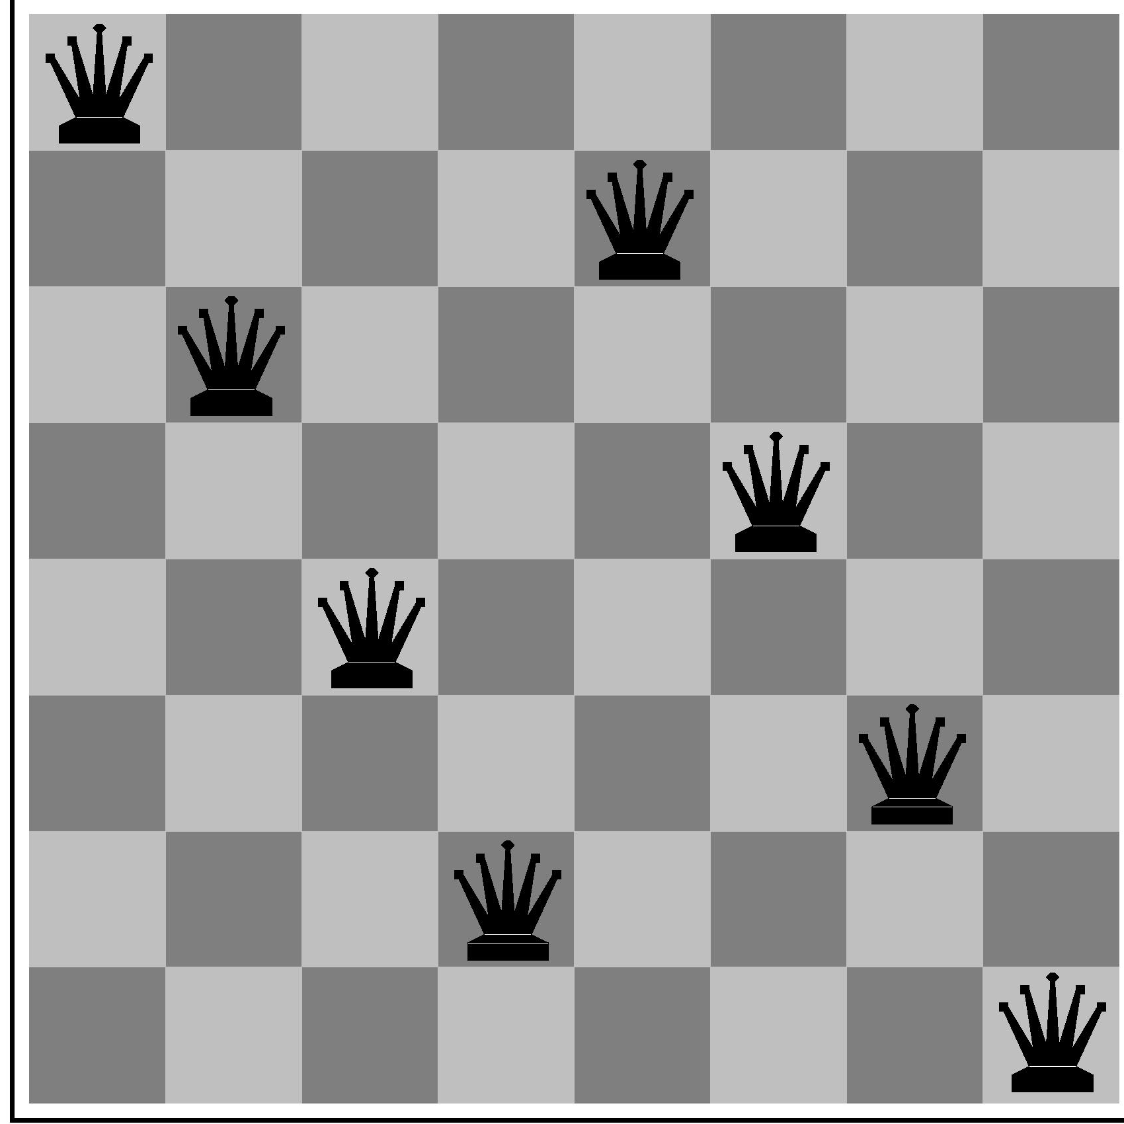
Example: 8-Queens
states? -any arrangement of n<=8 queens
-or arrangements of n<=8 queens in leftmost n
columns, 1 per column, such that no queen
attacks any other.
initial state? no queens on the board
actions? -add queen to any empty square
-or add queen to leftmost empty square such that it is not attacked by other queens.
goal test? 8 queens on the board, none attacked.
path cost? 1 per move

Slide 15

Example: robotic assembly
states?: real-valued coordinates of robot joint angles parts of the object to be assembled
initial state?: rest configuration
actions?: continuous motions of robot joints
goal test?: complete assembly
path cost?: time to execute+energy used

Slide 16

Example: The 8-puzzle
states?
initial state?
actions?
goal test?
path cost?
Try yourselves

Slide 17
Example: The 8-puzzle
states? locations of tiles
initial state? given
actions? move blank left, right, up, down
goal test? goal state (given)
path cost? 1 per move
[Note: optimal solution of n-Puzzle family is NP-hard]

Slide 18
Tree search algorithms
Basic idea:
  Exploration of state space by generating successors of already-explored states (a.k.a.~expanding states).
  Every states is evaluated: is it a goal state?

Slide 19

Tree search example

Slide 20

Tree search example

Slide 21


Tree search example

Slide 22

Repeated states
Failure to detect repeated states can turn a linear problem into an exponential one!

Slide 23
Solutions to Repeated States
S
B
S
B
C
C
C
S
B
S
State Space
Example of a Search Tree
Graph search
  never generate a state generated before
    must keep track of all possible states (uses a lot of memory)
    e.g., 8-puzzle problem, we have 9! = 362,880 states
optimal but memory inefficient

Slide 24
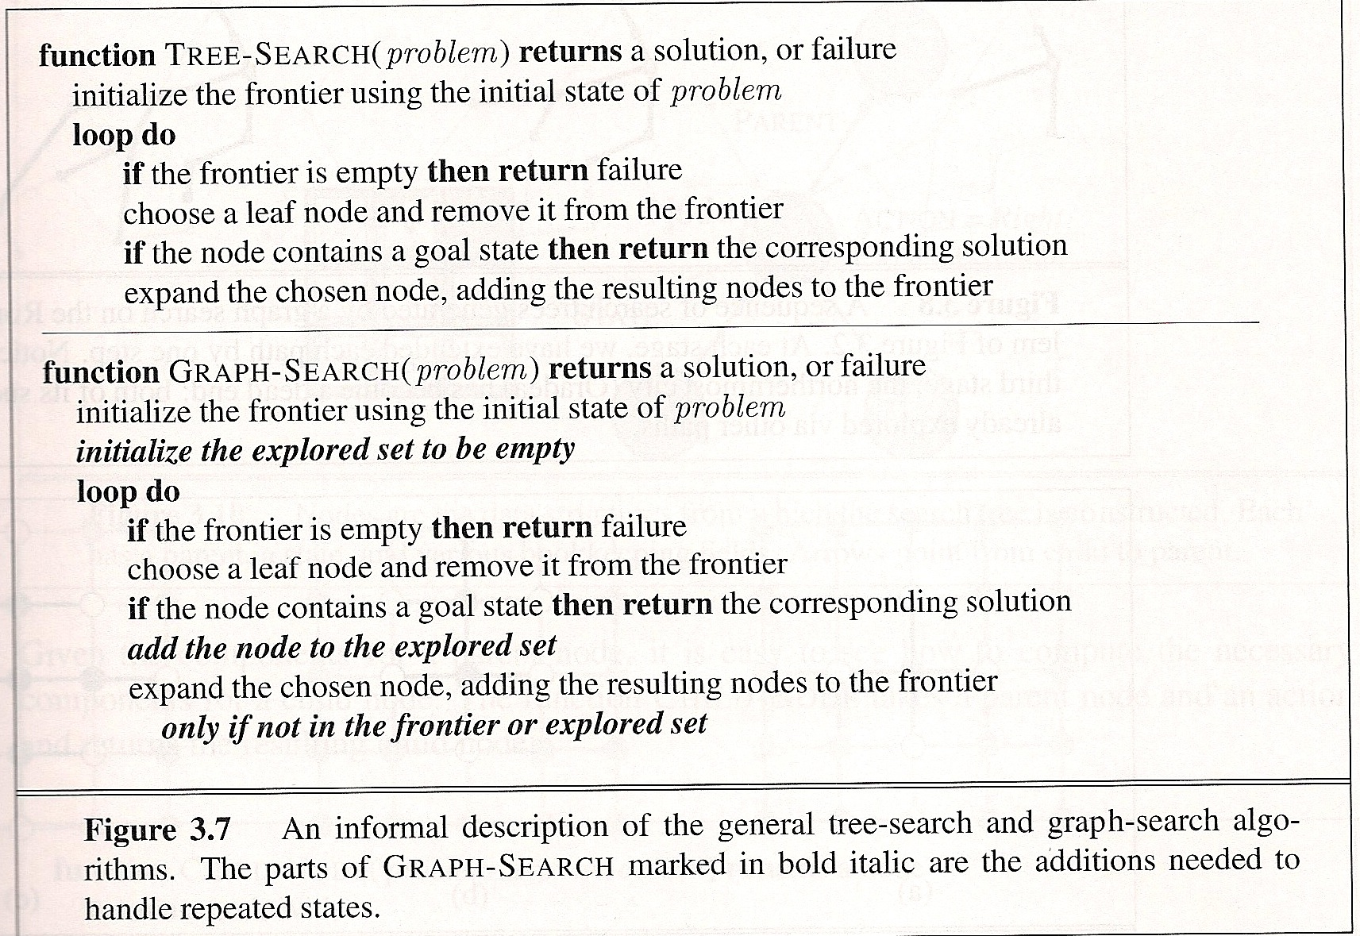
Graph Search vs Tree Search
(see also blog entry: http://qaintroai.blogspot.com/2009/10/q-how-is-graph-search-different-from.html)

Slide 25

Implementation: states vs. nodes
A state is a (representation of) a physical configuration
A node is a data structure constituting part of a search tree contains info such as: state, parent node, action, path cost g(x), depth
The Expand function creates new nodes, filling in the various fields and using the SuccessorFn of the problem to create the corresponding states.

Slide 26
Search strategies
A search strategy is defined by picking the order of node expansion
Strategies are evaluated along the following dimensions:
  completeness: does it always find a solution if one exists?
  time complexity: number of nodes generated
  space complexity: maximum number of nodes in memory
  optimality: does it always find a least-cost solution?
Time and space complexity are measured in terms of
  b: maximum branching factor of the search tree
  d: depth of the least-cost solution
  m: maximum depth of the state space (may be ∞)

Slide 27
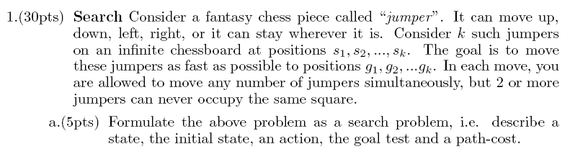

Slide 28
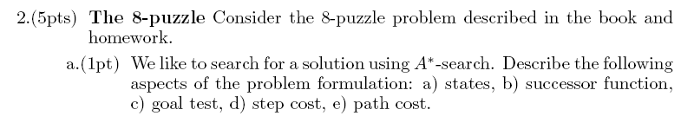

Slide 29
Uninformed Search

Slide 30
Complexity Recap (app.A)
We often want to characterize algorithms independent of their
implementation.
“This algorithm took 1 hour and 43 seconds on my laptop”.
Is not very useful, because tomorrow computers are faster.
Better is:
“This algorithm takes O(nlog(n)) time to run and O(n) to store”.
because this statement abstracts away from irrelevant details.
Time(n) = O(f(n)) means:
Time(n) < constant x f(n) for n>n0 for some n0
Space(n) idem.
n is some variable which characterizes the size of the problem,
e.g. number of data-points, number of dimensions, branching-factor
of search tree, etc.
Worst case analysis versus average case analyis

Slide 31
Uninformed search strategies
Uninformed: While searching you have no clue whether one non-goal state is better than any other. Your search is blind. You don’t know if your current exploration is likely to be fruitful.
Various blind strategies:
Breadth-first search
Uniform-cost search
Depth-first search
Iterative deepening search

Slide 32

Breadth-first search
Expand shallowest unexpanded node
Fringe: nodes waiting in a queue to be explored
Implementation:
  fringe is a first-in-first-out (FIFO) queue, i.e., new successors go at end of the queue.
Is A a goal state?

Slide 33

Breadth-first search
Expand shallowest unexpanded node
Implementation:
  fringe is a FIFO queue, i.e., new successors go at end
Expand:
fringe = [B,C]
Is B a goal state?

Slide 34

Breadth-first search
Expand shallowest unexpanded node
Implementation:
  fringe is a FIFO queue, i.e., new successors go at end
Expand:
fringe=[C,D,E]
Is C a goal state?

Slide 35

Breadth-first search
Expand shallowest unexpanded node
Implementation:
  fringe is a FIFO queue, i.e., new successors go at end
Expand:
fringe=[D,E,F,G]
Is D a goal state?

Slide 36
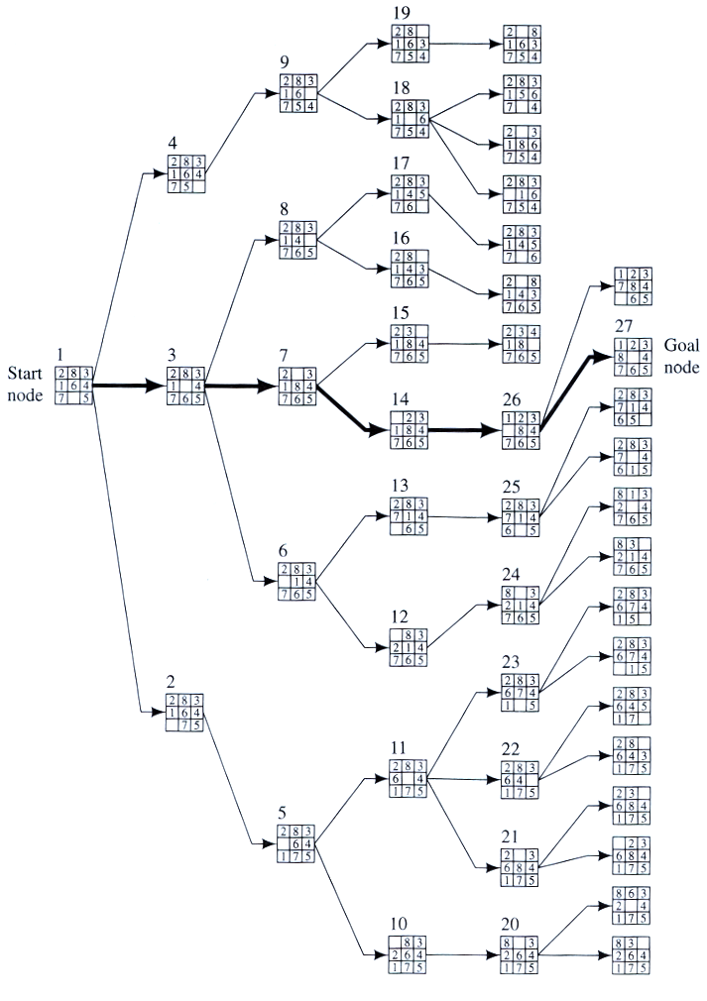
Example
BFS

Slide 37
Properties of breadth-first search
Complete? Yes it always reaches goal (if b is finite)
Time? 1+b+b²+b³+… +b^{d} + (b^{d+1}-b)) = O(b^{d+1})
(this is the number of nodes we generate)
Space? O(b^{d+1}) (keeps every node in memory,
either in fringe or on a path to fringe).
Optimal? Yes (if we guarantee that deeper solutions are less optimal, e.g. step-cost=1).
Space is the bigger problem (more than time)
Note: in the new edition Space & Time complexity was O(b^{d}) because we
postpone the expansion.

Slide 38
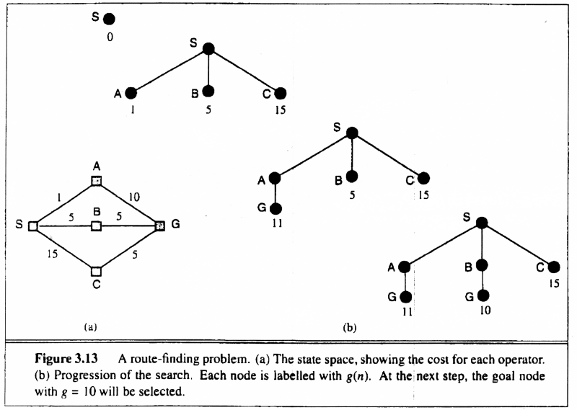
Uniform-cost search
Breadth-first is only optimal if step costs is increasing with depth (e.g. constant). Can we guarantee optimality for any step cost?
Uniform-cost Search: Expand node with
smallest path cost g(n).
Proof Completeness:
Given that every step will cost more than 0,
and assuming a finite branching factor, there
is a finite number of expansions required before
the total path cost is equal to the path cost of the
goal state. Hence, we will reach it.
Proof of optimality given completeness:
Assume UCS is not optimal.
Then there must be an (optimal) goal state with
path cost smaller than the found (suboptimal) goal
state (invoking completeness).
However, this is impossible because UCS would
have expanded that node first by definition.
Contradiction.

Slide 39
Uniform-cost search
Implementation: fringe = queue ordered by path cost
Equivalent to breadth-first if all step costs all equal.
Complete? Yes, if step cost ≥ ε
(otherwise it can get stuck in infinite loops)
Time? # of nodes with path cost ≤ cost of optimal solution.
Space? # of nodes with path cost ≤ cost of optimal solution.
Optimal? Yes, for any step cost ≥ ε

Slide 40
A
6
D
1
F
3
1
S
2
4
8
G
B
E
1
20
C
The graph above shows the step-costs for different paths going from the start (S) to
the goal (G).
Use uniform cost search to find the optimal path to the goal.
Exercise

Slide 41

Depth-first search
Expand deepest unexpanded node
Implementation:
  fringe = Last In First Out (LIPO) queue, i.e., put successors at front
Is A a goal state?

Slide 42

Depth-first search
Expand deepest unexpanded node
Implementation:
  fringe = LIFO queue, i.e., put successors at front
queue=[B,C]
Is B a goal state?

Slide 43

Depth-first search
Expand deepest unexpanded node
Implementation:
  fringe = LIFO queue, i.e., put successors at front
queue=[D,E,C]
Is D = goal state?

Slide 44

Depth-first search
Expand deepest unexpanded node
Implementation:
  fringe = LIFO queue, i.e., put successors at front
queue=[H,I,E,C]
Is H = goal state?

Slide 45

Depth-first search
Expand deepest unexpanded node
Implementation:
  fringe = LIFO queue, i.e., put successors at front
queue=[I,E,C]
Is I = goal state?

Slide 46

Depth-first search
Expand deepest unexpanded node
Implementation:
  fringe = LIFO queue, i.e., put successors at front
queue=[E,C]
Is E = goal state?

Slide 47

Depth-first search
Expand deepest unexpanded node
Implementation:
  fringe = LIFO queue, i.e., put successors at front
queue=[J,K,C]
Is J = goal state?

Slide 48

Depth-first search
Expand deepest unexpanded node
Implementation:
  fringe = LIFO queue, i.e., put successors at front
queue=[K,C]
Is K = goal state?

Slide 49

Depth-first search
Expand deepest unexpanded node
Implementation:
  fringe = LIFO queue, i.e., put successors at front
queue=[C]
Is C = goal state?

Slide 50

Depth-first search
Expand deepest unexpanded node
Implementation:
  fringe = LIFO queue, i.e., put successors at front
queue=[F,G]
Is F = goal state?

Slide 51

Depth-first search
Expand deepest unexpanded node
Implementation:
  fringe = LIFO queue, i.e., put successors at front
queue=[L,M,G]
Is L = goal state?

Slide 52

Depth-first search
Expand deepest unexpanded node
Implementation:
  fringe = LIFO queue, i.e., put successors at front
queue=[M,G]
Is M = goal state?

Slide 53
Properties of depth-first search
A
Complete? No: fails in infinite-depth spaces
Can modify to avoid repeated states along path
Time? O(b^{m}) with m=maximum depth
terrible if m is much larger than d
  but if solutions are dense, may be much faster than
  breadth-first
Space? O(bm), i.e., linear space! (we only need to
remember a single path + expanded unexplored nodes)
Optimal? No (It may find a non-optimal goal first)
B
C

Slide 54
Iterative deepening search
To avoid the infinite depth problem of DFS, we can
decide to only search until depth L, i.e. we don’t expand beyond depth L.
→ Depth-Limited Search
What if solution is deeper than L? → Increase L iteratively.
→ Iterative Deepening Search
As we shall see: this inherits the memory advantage of Depth-First
search, and is better in terms of time complexity than Breadth first search.

Slide 55

Iterative deepening search L=0

Slide 56

Iterative deepening search L=1

Slide 57

Iterative deepening search L=2

Slide 58

Iterative Deepening Search L=3

Slide 59


Iterative deepening search
Number of nodes generated in a depth-limited search to depth d with branching factor b:
N_{DLS} = b⁰ + b¹ + b² + … + b^{d-2} + b^{d-1} + b^{d}
Number of nodes generated in an iterative deepening search to depth d with branching factor b:
N_{IDS} = (d+1)b⁰ + d b¹ + (d-1)b² + … + 3b^{d-2} +2b^{d-1} + 1b^{d} =
For b = 10, d = 5,
  N_{DLS} = 1 + 10 + 100 + 1,000 + 10,000 + 100,000 = 111,111
  N_{IDS} = 6 + 50 + 400 + 3,000 + 20,000 + 100,000 = 123,450
  NBFS = ............................................................................................ = 1,111,100
BFS
Note: BFS can also be adapted to be by waiting to expand until all nodes at depth d are checked

Slide 60
Properties of iterative deepening search
Complete? Yes
Time? O(b^{d})
Space? O(bd)
Optimal? Yes, if step cost = 1 or increasing function of depth.

Slide 61
Bidirectional Search
Idea
  simultaneously search forward from S and backwards from G
  stop when both “meet in the middle”
  need to keep track of the intersection of 2 open sets of nodes
What does searching backwards from G mean
  need a way to specify the predecessors of G
    this can be difficult,
    e.g., predecessors of checkmate in chess?
  which to take if there are multiple goal states?
  where to start if there is only a goal test, no explicit list?

Slide 62

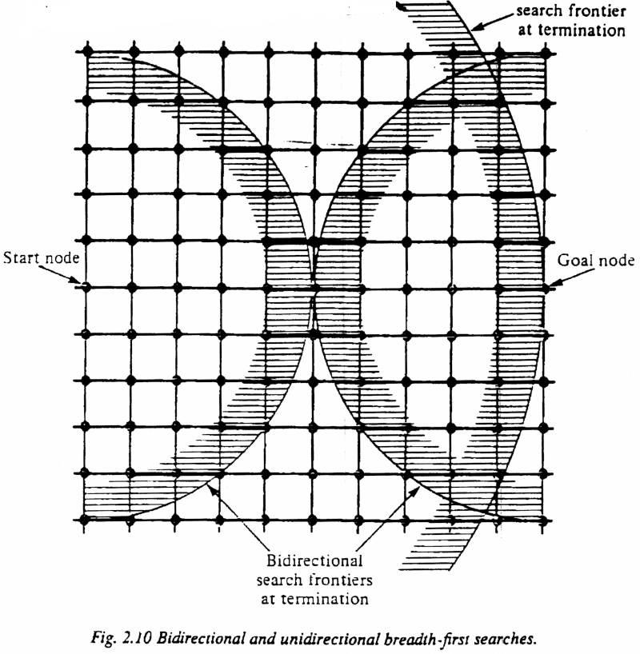
Bi-Directional Search
Complexity: time and space complexity are:

Slide 63
Graph Search vs Tree Search
S
B
S
B
C
C
C
S
B
S
State Space
Example of a Search Tree
Graph search
  never generate a state generated before
    must keep track of all possible states (uses a lot of memory)
    e.g., 8-puzzle problem, we have 9! = 362,880 states
    approximation for DFS/DLS: only avoid states in its (limited) memory: avoid looping paths.
    Graph search optimal for BFS and UCS (do you understand why?)
optimal but memory inefficient

Slide 64

Summary of algorithms
even complete
if step cost is not
increasing with depth.
preferred
uninformed
search strategy
Third edition has
O(b^{d})

Slide 65
Summary
Problem formulation usually requires abstracting away real-world details to define a state space that can feasibly be explored
Variety of uninformed search strategies
Iterative deepening search uses only linear space and not much more time than other uninformed algorithms
http://www.cs.rmit.edu.au/AI-Search/Product/
http://aima.cs.berkeley.edu/demos.html (for more demos)

Slide 66
Exercise
2. Consider the graph below:
[2pt] Draw the first 3 levels of the full search tree with root node given by A.
Use graph search, i.e. avoid repeated states.
b) [2pt] Give an order in which we visit nodes if we search the tree breadth first.
c) [2pt] Express time and space complexity for general breadth-first search in terms
of the branching factor, b, and the depth of the goal state, d.
d) [2pt] If the step-cost for a search problem is not constant, is breadth first search
always optimal? Is BFS graph search optimal?
e) [2pt] Now assume the constant step-cost.
Is BSF tree search optimal? Is BFS graph search optimal?
B
D
A
F
E
C

Slide 67
Next time
Questions?

