Slide 1


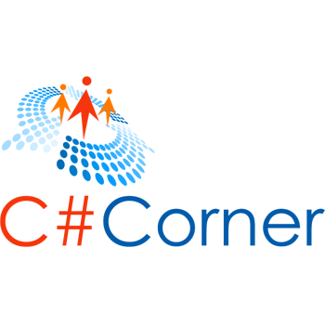
TYPE SCRIPT
Programming in Typescript
Rameshkartik.RS
https://techcarvings.wordpress.com
@rameshkartikrs

Slide 2

Agenda
Introduction to TypeScript
Typescript Types,Variables,Properties
Classes , Interfaces & Inheritance
Loaders
Summary

Slide 3
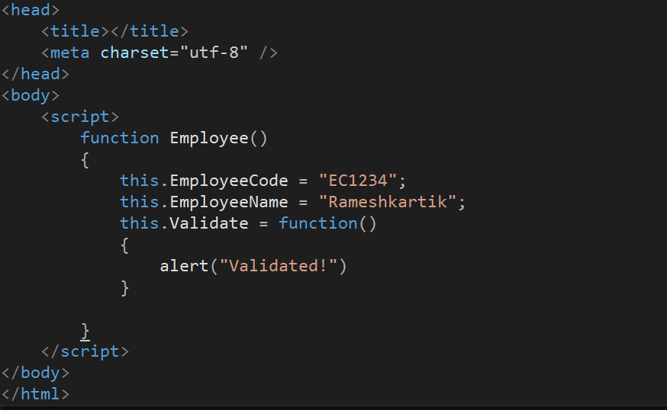
Why do we need TS?

Slide 4

What is TypeScript?
JavaScript can feel messy!

Slide 5

What is TypeScript?
Maintainable Code

Slide 6
What is TypeScript?
TypeScript is a typed superset of JavaScript that compiles to a plain JavaScript
JavaScript

Slide 7

What is TypeScript?
<OPEN SOURCE>
2010 - Anders begin development
2012 - First public version 0.8 released
2013 - Typescript 0.9 released
2014 - Typescript 1.0 released
2017 - Typescript 2.1 released

Slide 8

What is TypeScript?
Any BROWSER / OS

Slide 9

What is TypeScript?
{execution}
TS
TS
TS
JS

Slide 10


What is TypeScript?
Animal
Can Run
Can Fly
Has 2 legs
Has 4 legs

Slide 11



JavaScript Alternatives
Limitations of JS
CoffeeScript <- Ruby,Python

Slide 12

Environment Setup
npm install –g typescript
https://www.typescriptlang.org/#Download

Slide 13
TypeScript Types
Any
Built-in types
User Defined Types

Slide 14
TypeScript Types
Built-in
User Defined
Number
Arrays
String
Enums
Boolean
Classes
Void
Interfaces
Null, Undefined

Slide 15
Variable Declaration
var
identifier
:
[type-annotation]
=
value
;
var name: string =“String Data”;
identifier
var
identifier
:
[type-annotation]
;
var name: string;

Slide 16
Variable Declaration
var
[identifier]
=
value
;
var name = “Data”;
identifier
var
[identifier]
;
var name;

Slide 17
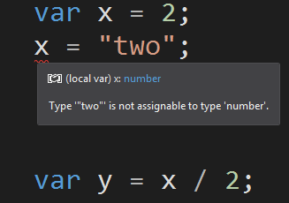
Static Typing
Example 1:

Slide 18
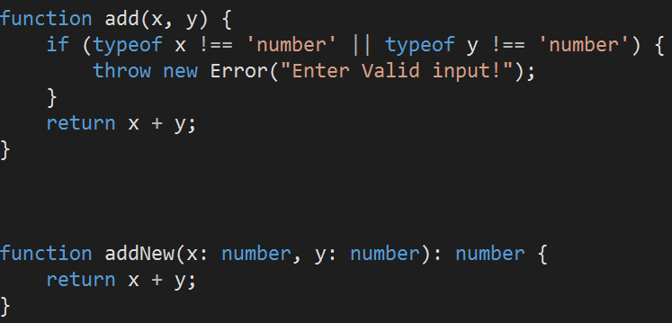
Static Typing
Example 2:
Java script Code
TypeScript Code

Slide 19
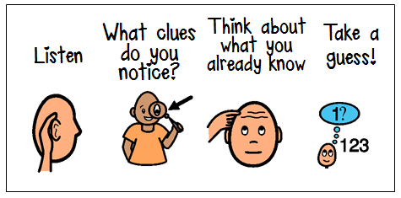
Inference

Slide 20
Type Inference
Process of determining the types of un-annotated variables
var any
any type
var num: 3
Type Inference(number)
var res: num + 100;
Type Inference(number)
var res: num + ‘string data’;
Type Inference(string)
var res: number = num + ‘string data’;
Error

Slide 21
Type Annotations
Types are annotated using : symbols
var num: number
Type annotation
var num: number =3
Type ann value setting
var res: number = num +‘string data’;
Error

Slide 22
Creating Classes
Class encapsulates data for the object
Class Customer
{
//class scope
}
Class keyword is followed by the Class name

Slide 23
Creating Interfaces
Interface defines properties, methods and events
Interface Customer
{
Add();
Delete();
}
Interface are not to be converted to JS. Its part of TS

Slide 24
Creating Inheritance
Dervied class can inherit the definitions of one or more classes
Class SpecialCustomer extends Customer
{
AddCustomer();
DeleteCustomer();
}
JS does not have a concept of Inheritance

Slide 25
Creating Properties
Accessors of a property contain executable statements associated with getting or setting the property
Set CompanyCode(value:string)
{
if (value.length == 0)
{
throw “Company Code Required”
}
}
Get CompanyCode():string
{
Return this._companyCode;
}

Slide 26
Loaders
Why Module Loader?
Customer.JS
Available Frameworks : SystemJS/Webpack/RequireJS
Orders.JS
Loader
npm install systemjs
[System.JS,
Webpack,
Require.JS]
Ease of Maintenance, Increases Reusability

Slide 27
System JS
Module Loader built on top of a original ES6 module
File 1
File 3
File 2
File 2
File 3
File 1
Loading Files
Instantiation

Slide 28

Questions

Slide 29




Thank you!
rameshkartik@gmail.com
rameshkartikrs
github.com/Rameshkartik/TypeScript_Basics

