Slide 1
ITSC 2214 Data Structures & Algorithms
Module 3: Linked Lists

Slide 2
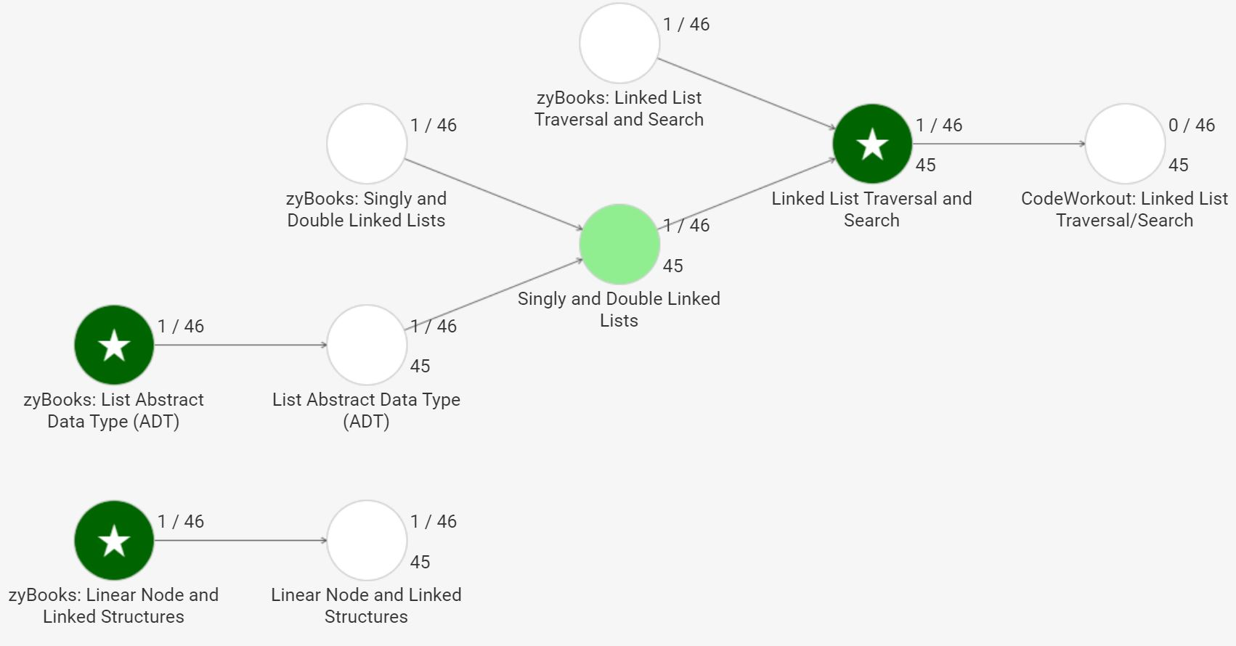
78
82%
84%
81
83%
78
64
80
87%
86%
82
81
88%
89%
82
84%
81
91%

Slide 4
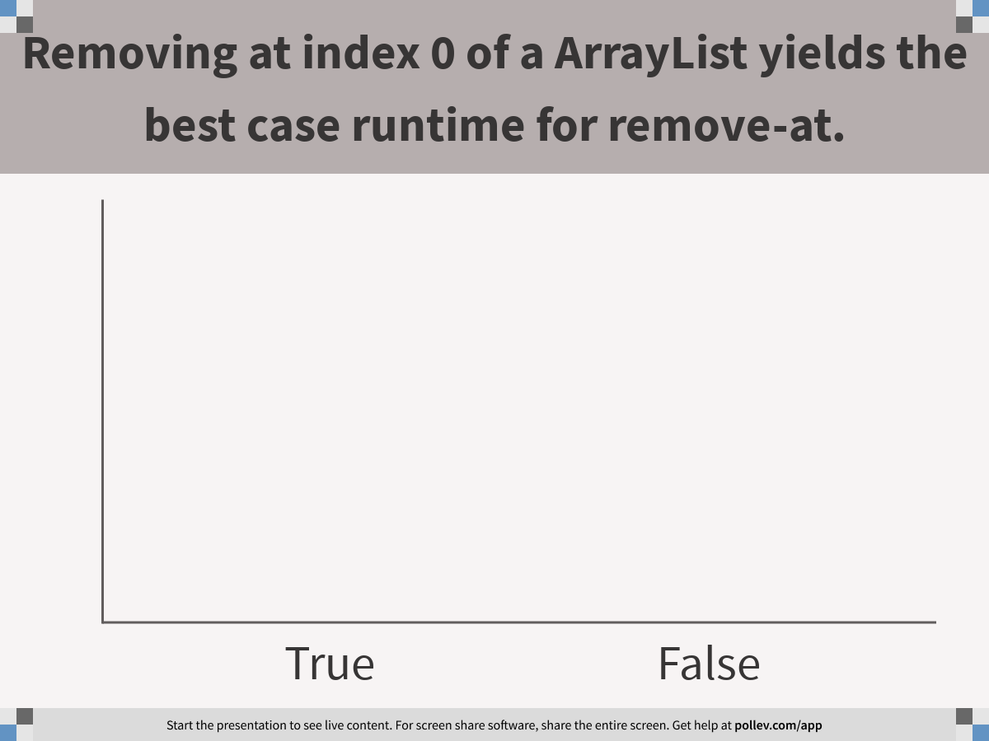
Notes:
Poll Title: Removing at index 0 of a ArrayList yields the best case runtime for remove-at. https://www.polleverywhere.com/multiple_choice_polls/2jssvEWgU5r0BAwEghfy6

Slide 5
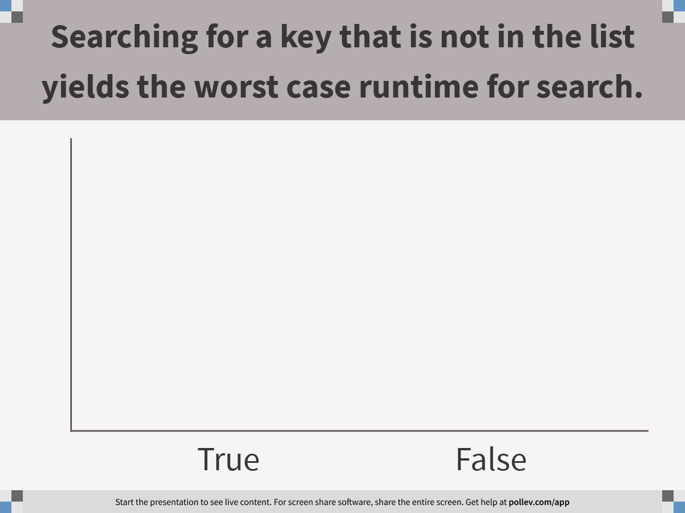
Notes:
Poll Title: Searching for a key that is not in the list yields the worst case runtime for search. https://www.polleverywhere.com/multiple_choice_polls/8voanth5zTdjPx3S54AhA

Slide 6
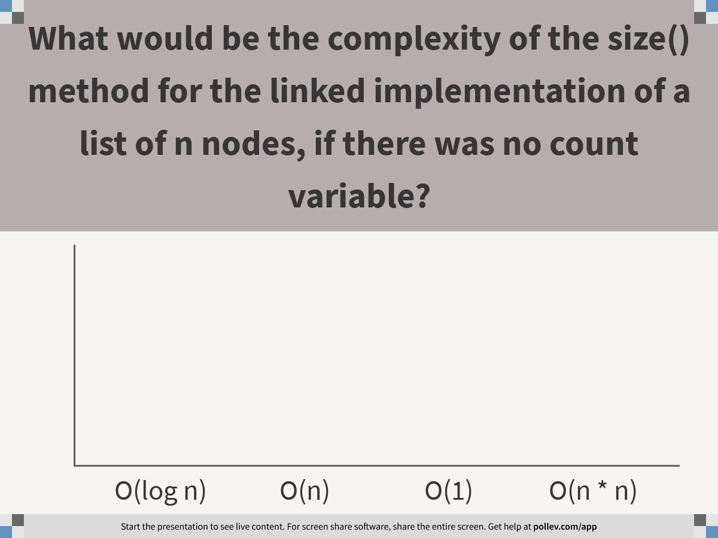
Notes:
Poll Title: What would be the complexity of the size() method for the linked implementation of a list of n nodes, if there was no count variable? https://www.polleverywhere.com/multiple_choice_polls/FJ2a7bEbw0cqjUQfZOlfa

Slide 7
Compare Arrays and ArrayList

Slide 8
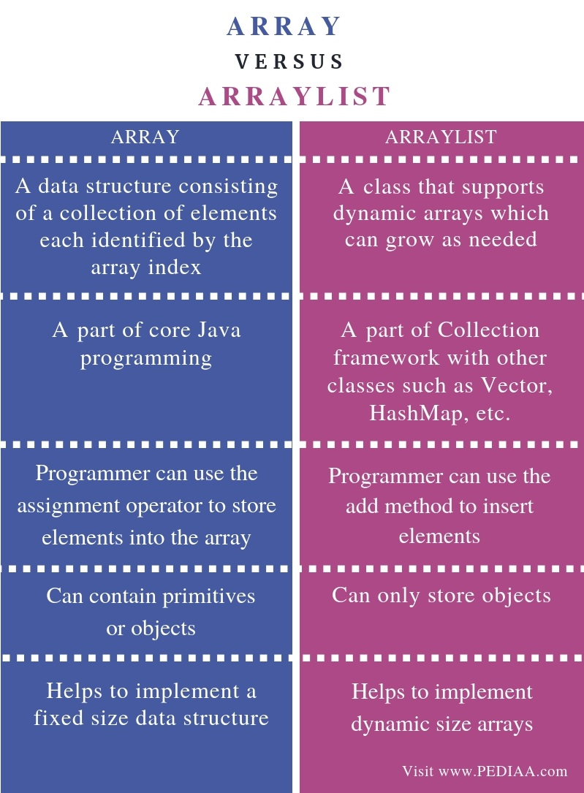
Array versus ArrayList
The array is a native programming component or data structure but ArrayList is a class from Java Collections framework, an API. In fact, ArrayList is internally implemented using an array in Java. Since ArrayList is a class it holds all properties of a class e.g. you can create objects and call methods but even though the array is an object in Java it doesn't provide any method. It just exposes a length attribute to give you the length of the array, which is constant.

Slide 9
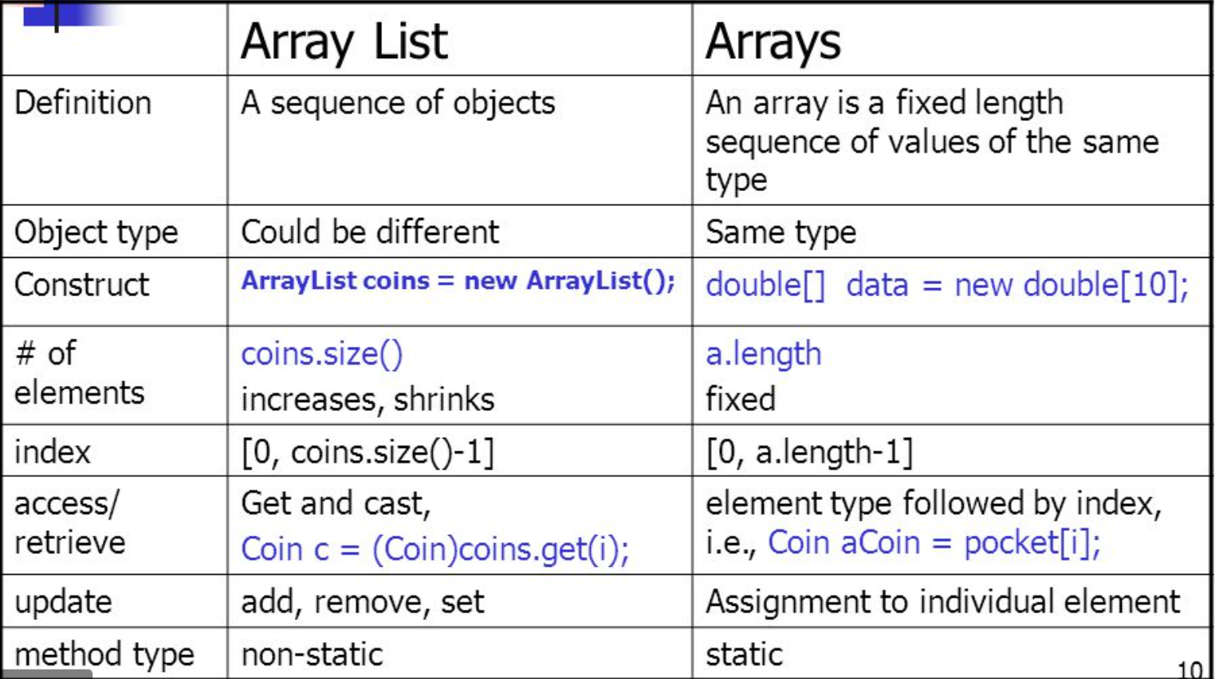

Slide 10
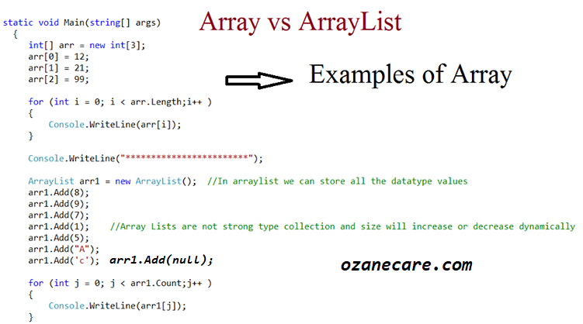

Slide 11
ArrayList

Slide 12
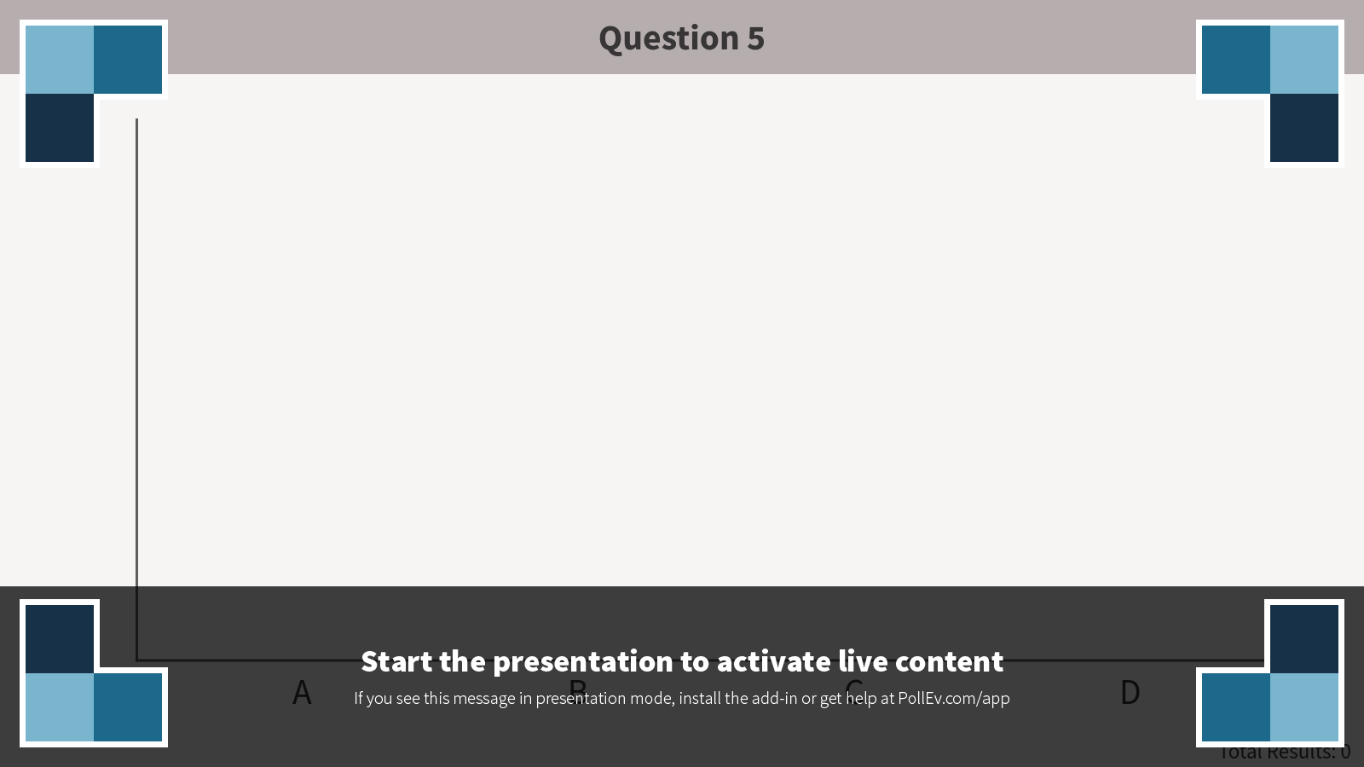
5. In an array-based list, what is the worst case scenario for addAfter(index, element)? (assume the array has some capacity)
The element has to be added after the first element in the list
The element has to be added after the last element in the list
The element has to be added after the middle element in the list
These are all equivalent
Notes:
Question 5
https://www.polleverywhere.com/multiple_choice_polls/ircHuO1QIG9T0y6ZdH8zr
Correct Answer: A
Purpose: to note that inserting into an arraylist is expensive

Slide 13
Linked Lists
Use linked node to make a linked list
Add a node
Remove a node
Walk through a linked list

Slide 14
Double Linked List – Basic Structure
Doubly linked node
Pointer to the next node
next
Pointer to the previous node
prev
Pointer to the object referenced by this node
element
Object that we’re managing with this data structure

Slide 15
Double Linked List – Basic Structure – Code Example
DoublyLinkedNode that handles objects of type T
public class DoublyLinkedNode<T> {
private DoublyLinkedNode<T> next;
private DoublyLinkedNode<T> prev;
private T element;
// Default constructor creates an empty node
public DoublyLinkedNode() {
next = null;
prev = null;
element = null;
}
}
Doubly linked node
next
prev
element
Pointers to other DoublyLinkedNodes that handle T objects
Object of type T: String, Integer, etc.

Slide 16
last
first
Double Linked List – How it Fits Together
Doubly linked node
Doubly linked node
Doubly linked node
num
next
next
next
3
null
prev
prev
prev
null
element
element
element
Object
Object
Object
Note: first and last are of type DoublyLinkedNode<T> so they can point to the type of DoublyLinkedNodes we’re handling in this list.

Slide 17
last
removeFirst()
first
Doubly linked node
Doubly linked node
Doubly linked node
num
next
next
next
3
2
null
prev
prev
prev
null
null
result
element
element
element
Object
Object
Object
Object
1. Create result pointer then set result = first.getElement()
2. first = first.getNext()
removeFirst() removes the first node in the list and returns the object being managed by that node to whoever called removeFirst().
3. first.prev = null
4. (Garbage collection removes old first node)
5. Decrement num counter
6. Return result

Slide 18
last
removeFirst()
Special Case - One Node
first
null
null
Doubly linked node
num
next
0
1
null
prev
null
result
element
Object
Object
1. Create result pointer then set result = first.getElement()
2. first = null
3. last = null
4. (Garbage collection removes old first node)
5. Decrement num counter
6. Return result

Slide 19
last
removeLast()
first
Doubly linked node
Doubly linked node
Doubly linked node
num
next
next
next
3
2
null
null
prev
prev
prev
result
null
element
element
element
Object
Object
Object
1. Create result pointer then set result = last.getElement()
2. last = last.getPrev()
3. last.setNext() = null
4. (Garbage collection removes old last node)
5. Decrement num counter
6. Return result

Slide 20
last
removeLast()
Special Case - One Node
first
null
null
Doubly linked node
num
next
1
0
null
prev
result
null
element
Object
1. Create result pointer then set result = last.getElement()
2. last = null
3. first = null
4. (Garbage collection removes old last node)
5. Decrement num counter
6. Return result

Slide 21

2. A single-linked list has what properties, by definition?
Ordered
Indexed
Sorted
A & B
A & C
Notes:
Question 2
https://www.polleverywhere.com/multiple_choice_polls/cpA3BFdFBAd4fA6PKEaGc
Correct Answer: A
Purpose: While the Java LinkedList implementation allows you to add/remove items at indices, a linked list stores things only in whatever order you put them in

Slide 22

4. In a single-linked list with 40 nodes, how many next references will be null?
0
1
40
39
Notes:
Question 4
https://www.polleverywhere.com/multiple_choice_polls/97uVN2Ca873GVIf5ST5CT
Correct Answer: B
Purpose to get students to be able to picture the structure and understand that all the next references will be pointing to the next node, except the very last one, which will be null.

Slide 23

6. In a single-linked list containing only a head reference and no tail reference, what is the worst case scenario for addAfter(existing, element)?
The element has to be added after the first element in the list
The element has to be added after the last element in the list
The element has to be added after the middle element in the list
There are no elements in the list already
Notes:
Question 6
https://www.polleverywhere.com/multiple_choice_polls/wy6i73ZqHx4oygJexgS3K
Correct Answer: B
Purpose: to understand that the expense in linked structures is the lack of an index and the requirement to iterate across the structure

Slide 24

[Multiple Correct Choices] 9. If you need to keep track of groceries to buy at the store, what type of data structure is most suitable?
Stack
Queue
Ordered List
Sorted List
Notes:
Question 9
https://www.polleverywhere.com/multiple_choice_polls/M512kn1NOIS7dfKcFYoxY
Correct Answer: C & D
Purpose: To note that shopping lists are at least ordered, and may be sorted by some aspect of the data

Slide 25
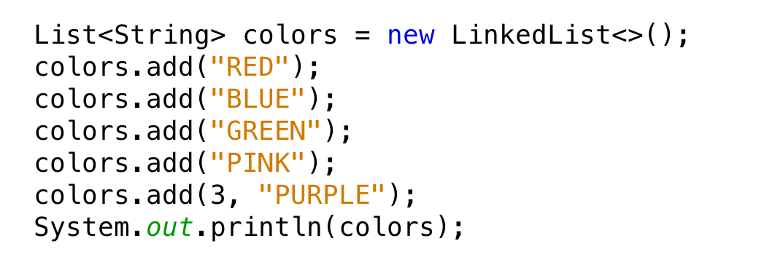
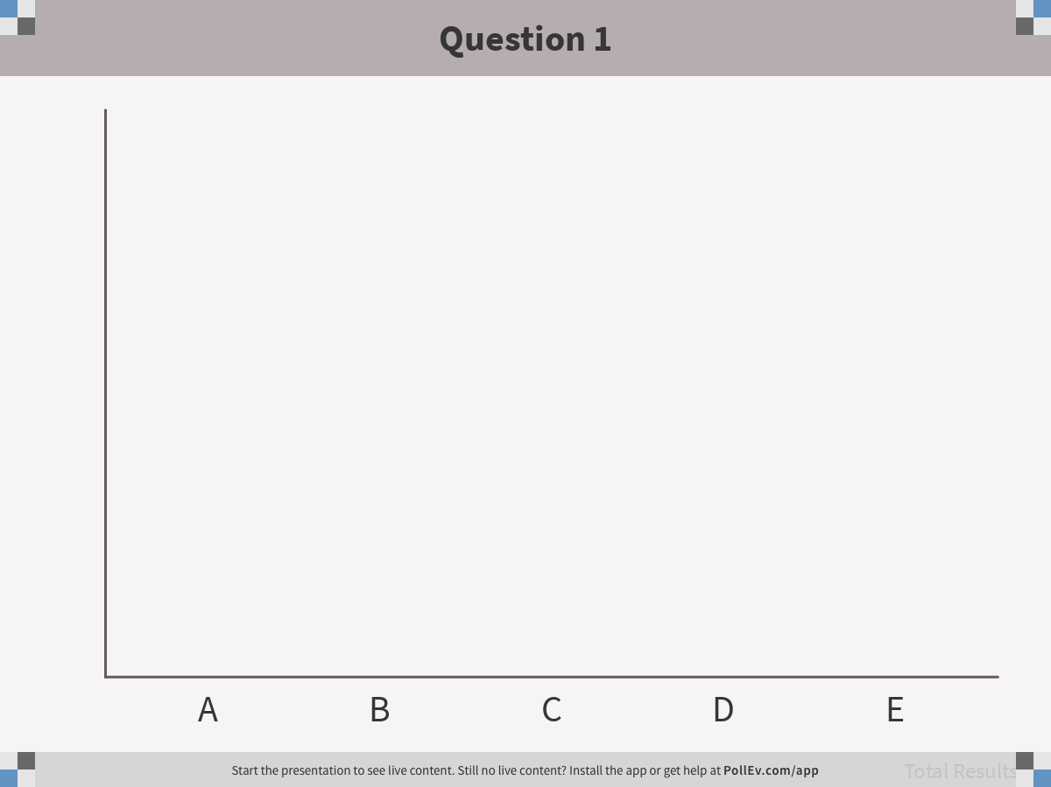
1. What will the following code print:
Unknown, list could be in any order
[RED, BLUE, GREEN, PURPLE]
[RED, BLUE, GREEN, PINK, PURPLE]
[RED, BLUE, GREEN, PURPLE, PINK]
[RED, BLUE, GREEN, PINK]
Notes:
Question 1
https://www.polleverywhere.com/multiple_choice_polls/QaQSjlXJSh7Ap1W1V2Deb
Correct answer: D
Purpose: to note that when you use the List reference variable, it is going to treat the list as an indexed list, even if using a linked data structure. But that the last add operation here is costly, because the list has to be iterated over to get to the specified index

Slide 26

10. If you have an ArrayList containing 50K items and a LinkedList containing 50K items, and you need to add 1000 items, one at a time, to the front of each list, which one will be faster?
ArrayList
LinkedList
They are the same
It depends
Notes:
Question 10
https://www.polleverywhere.com/multiple_choice_polls/8qjy2RIQgWygpOJZQ6lbP
Correct Answer: B
Purpose: Linked list way faster, because items don’t have to be shifted

