Slide 1
Basic UML Diagrams
ITSC 2214 Data Structures
Lab 2 – Vote Counter

Slide 2
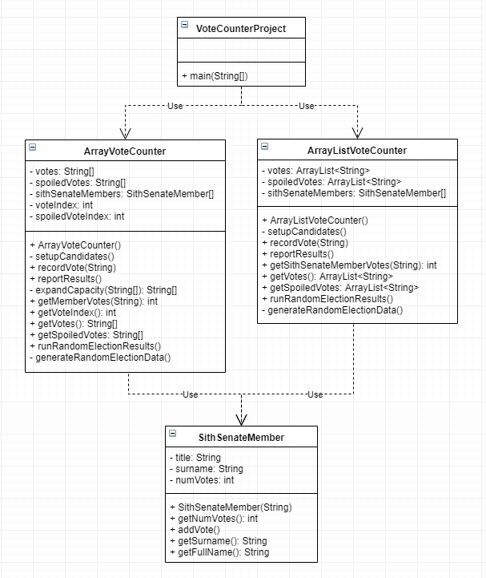
Here’s the complete UML diagram for the project.

Slide 3
UML Class diagrams have three sections:
Class Name
Attributes
Methods

Slide 4
An attribute is data that describes instances of the class.
Visibility:
+ Public
- Private
# Protected
~ Package
Variable name
Data type
This indicates that each object of the ArrayVoteCounter class includes a private integer variable named voteIndex:
private int voteIndex;

Slide 5
Methods are behaviors objects of this class exhibits.
This indicates that each object of the ArrayVoteCounter class includes a public getVoteIndex method that returns an integer:
public int getVoteIndex() { … }
Visibility (same as for attributes)
Method name
Return type

Slide 6
Methods are behaviors objects of this class exhibits.
This indicates that each object of the ArrayVoteCounter class includes a public reportResults method that returns nothing:
public void reportResults() { … }
This method doesn’t return anything so it’s return type is void.

Slide 7
A dependency relationship shows that some element(s) require (i.e., depend on there being) other elements. This is modeled with a dashed line and an open arrowhead: The arrow points to the element being used.
Use
For example, the VoteCounterProject uses both the ArrayVoteCounter class and the ArrayListVoteCounter class.
You don’t see it on the UML diagram but if you look at the code for the VoteCounterProject you’ll see calls to:
ArrayVoteCounter.runRandomElectionResults();
and
ArrayListVoteCounter.runRandomElectionResults();

Slide 8
Similarly, both the ArrayVoteCounter class and the ArrayListVoteCounter class use the SithSenateMember class.
Each class contains an attribute that is an array of elements of the SithSenateMember data type.
In addition, each class contains methods that access those arrays (even though they’re named slightly differently).
So both these classes use (i.e., depend on) the SithSenateMember class.

