Slide 1
Infill Prediction Configurations 10x75, 10x112.5, 10x120
Department :
Operations
Client :
xxxxx
Author :
Date: 12 Apr 2020

Slide 2
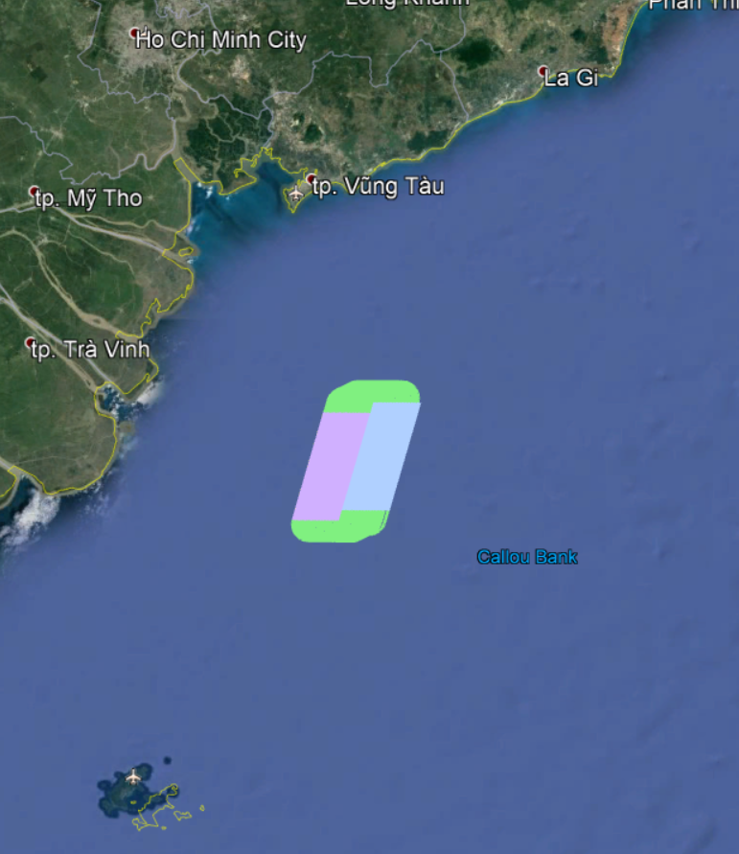
Introduction
This report summarizes infill prediction analysis for the Vietnam B16-2 Surveys;
10x75 10x112.5 10x120 Acquisition scheduled for 2020
Client:xxxx
The below table contains the parameters used in the modelling.
 | 10x75 | 10x112.5 | 10x120
Direction | 16.0° | 16.0° | 16.0°
Configuration | DSx10x75x6000 TSx10x113x6750 TSx10x120x6750
SPI / Clean Record Length | 25m 16.667m / 9000ms 6000ms
Max Bottom Speed | 5.4 knots 5.4 knots
Vessel Water Speed | 4.0 - 5.0 knots, with 0.100 knots increment
Fan Mode | No Fan 50% Fan
Gap Allowance(s) Fars | 75m
Min Allowed Water Speed | 3.0 knots
Surveys Starting Dates | 1 Jun – 1 Jul
Database Years Used | 2015 - 2019

Slide 3
Executive Summary of Infill Prediction Acquisition scheduled for 2020
The table below shows the mean (and standard deviation) predicted infill percentage and maximum feather angle, for all cases in this report.
The modelling is based on :
Historical circulation currents from 2015 - 2019 and calculated tidal currents for the actual dates.
Survey start times
Infill coverage gap allowance
Production water speed
Minimum allowed water speed
Configuration
: 1 Jun – 1 Jul
: 75m for the far offset group.
: 4.0 - 5.0 knots (0.100 knots increment).
: 3.0 Knots.
: Listed in table. Format: DS/TS(dual/triple Source)|SPI|RecLen|numStrm x strmSep x strmLen
 | B16-2 10x75 | B16-2 10x112.5 | B16-2 10x120
 | 16.0°/196.0° | 16.0°/196.0° | 16.0°/196.0°
Configuration | DS|25|9|10x75x6000 | TS|17|6|10x113x6750 | TS|17|6|10x120x6750
Max Feather (°) | 29.7 (±3.3) | 28.2 (±3.7) | 27.9 (±3.7)
Infill (%) No Fan | 38.9 (±3.6) | 43.2 (±1.7) | 41.0 (±2.6)
Infill (%) 50% Fan | 24.3 (±5.4) | 25.4 (±2.5) | 22.3 (±2.3)

Slide 4
Infill Prediction 10x75 Azimuth: 16.00°/196.00°, Dual Source 10x75x6000, SPI: 25m, RL: 9000ms

Slide 5
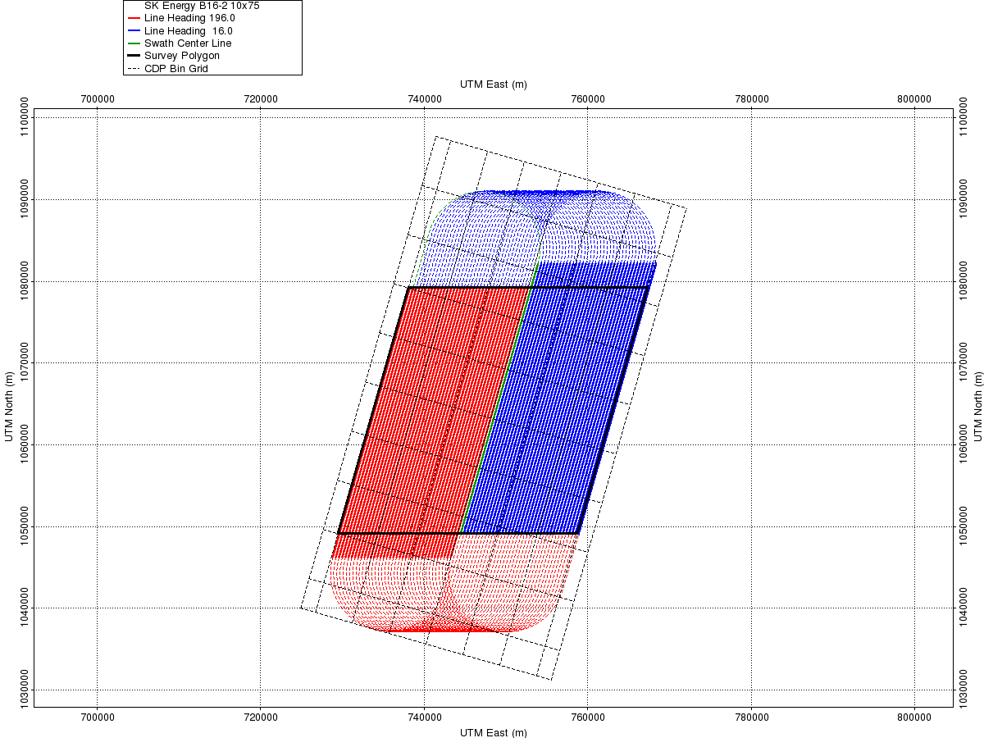
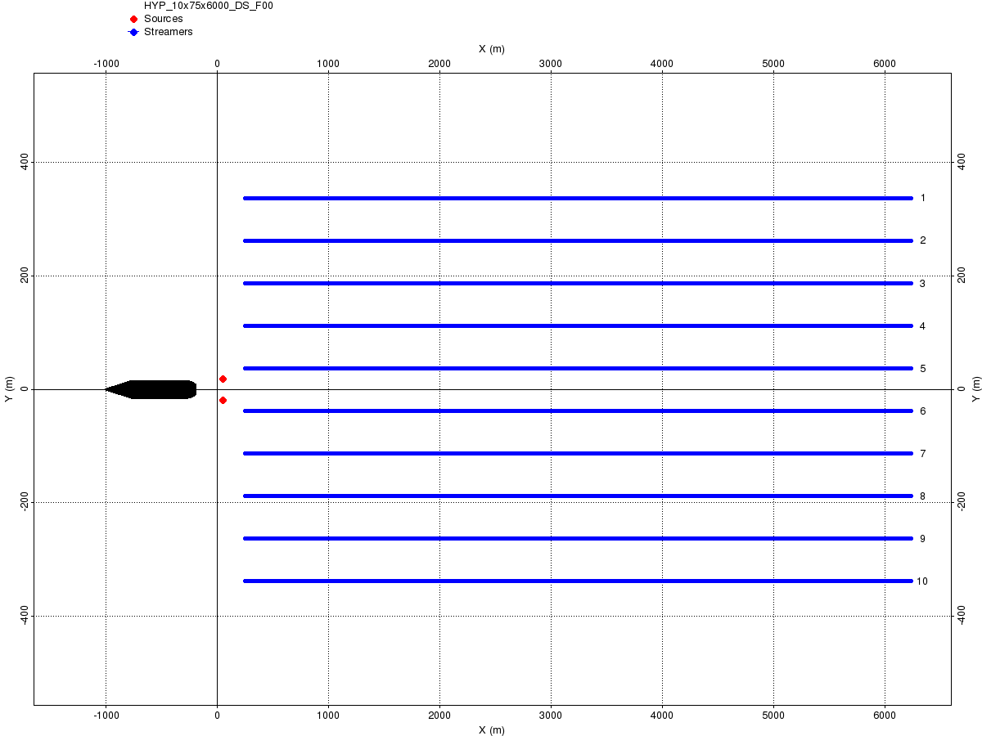
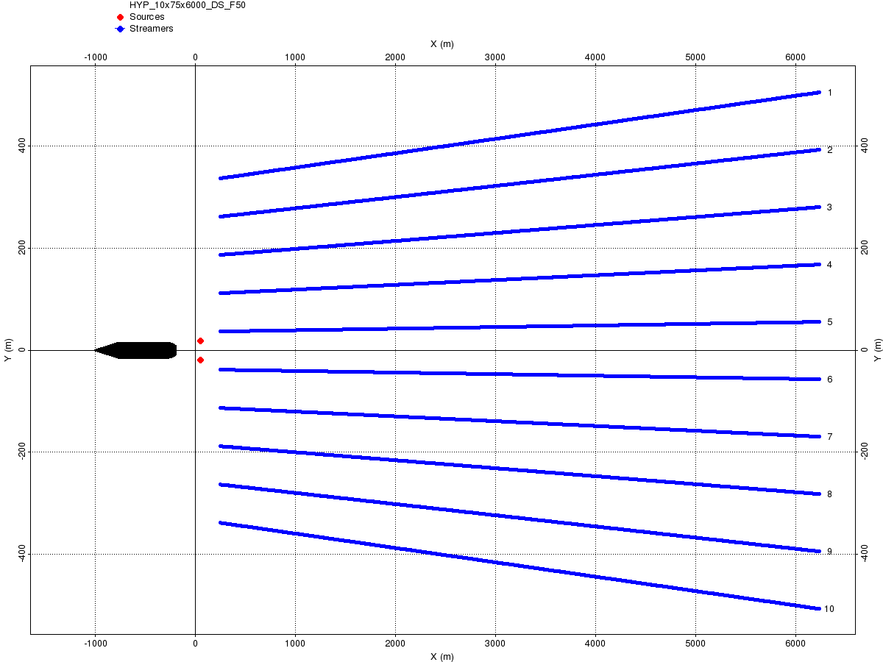
Infill Prediction 10x75 Dual Source10x75x6000, SPI: 25m, RL: 9000ms: Pre-Plot and Vessel Layout
Pre-Plot
Vessel Layout No Fan
Vessel Layout with 150% Fan
76 Sail Lines
Survey Duration: 22 days
Turn Radius: 7100m
Run-in: 3000m
This slide shows pre-plot survey and vessel configuration for Dual Source 10 x 75 x 6000 acquisition configuration.
The pre-plot survey is calculated by SurvOpt with 16.00°/196.00° shooting direction. Currents are not used when calculating shooting pattern.

Slide 6
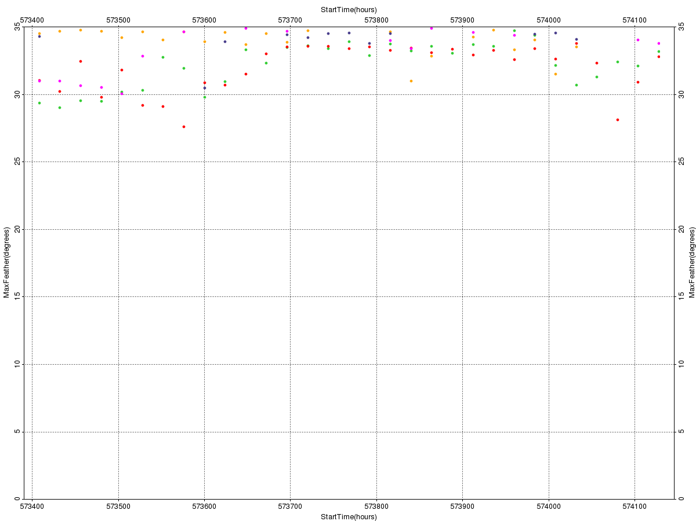
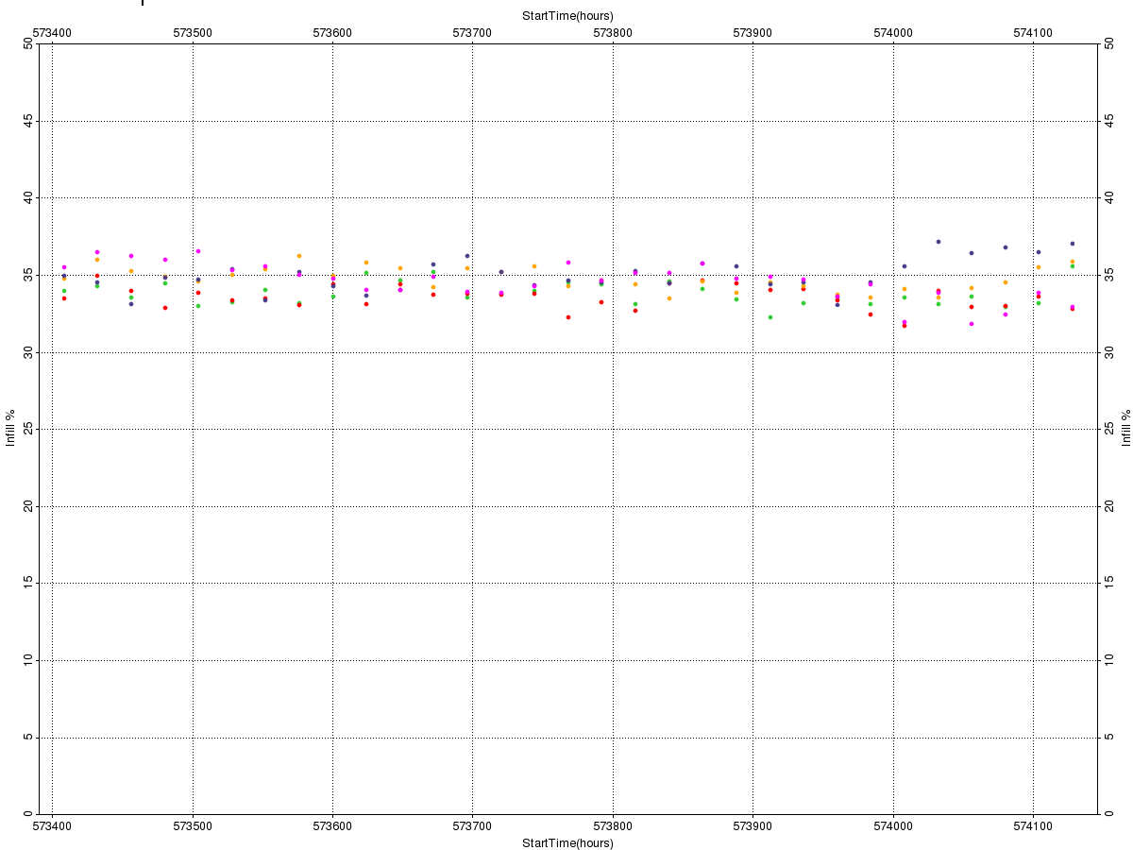
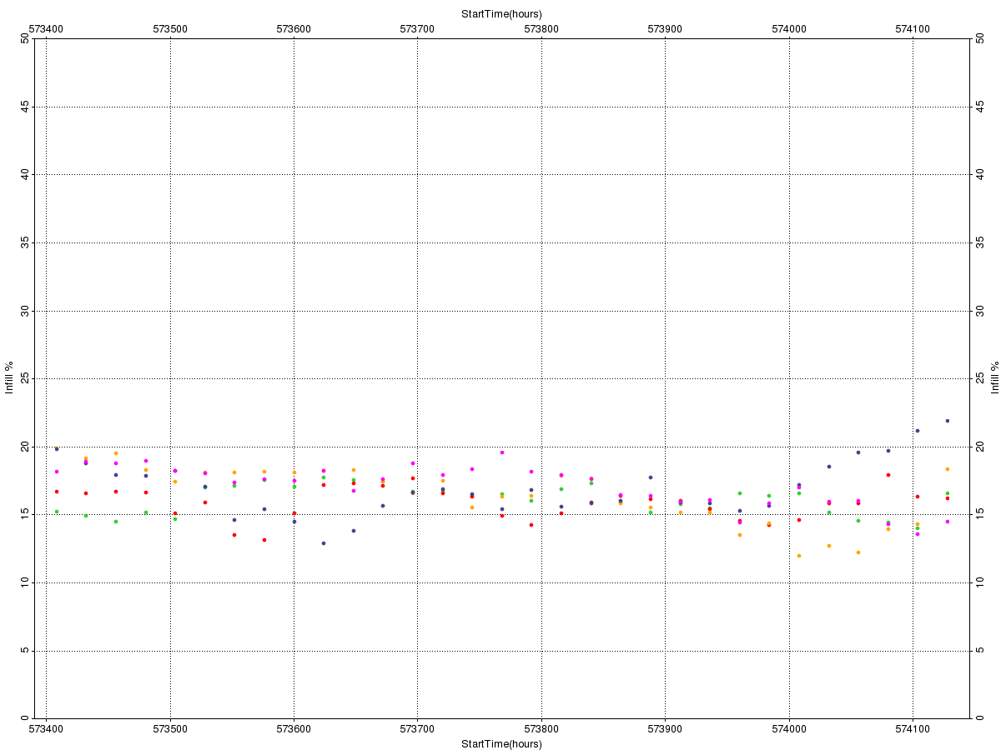
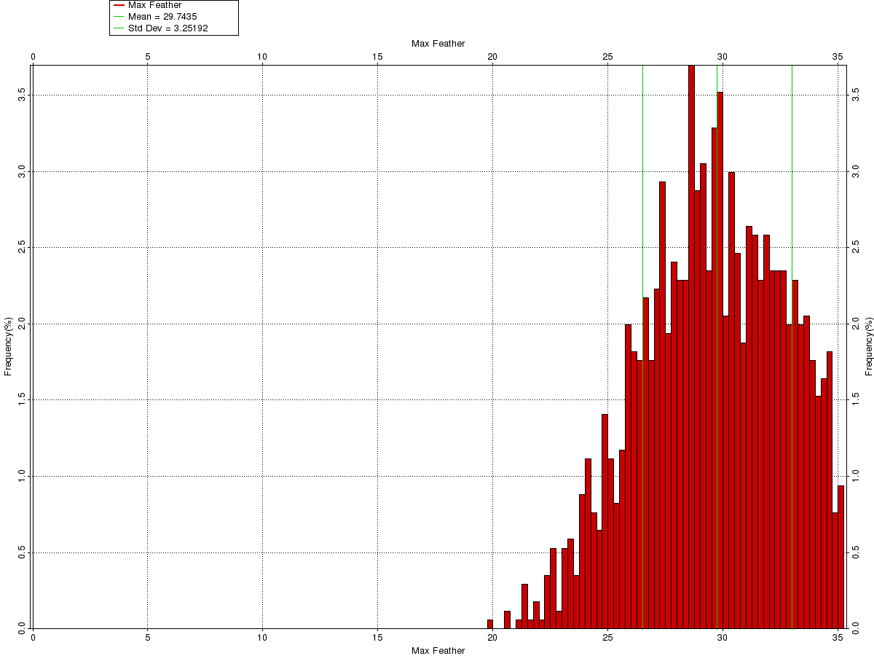
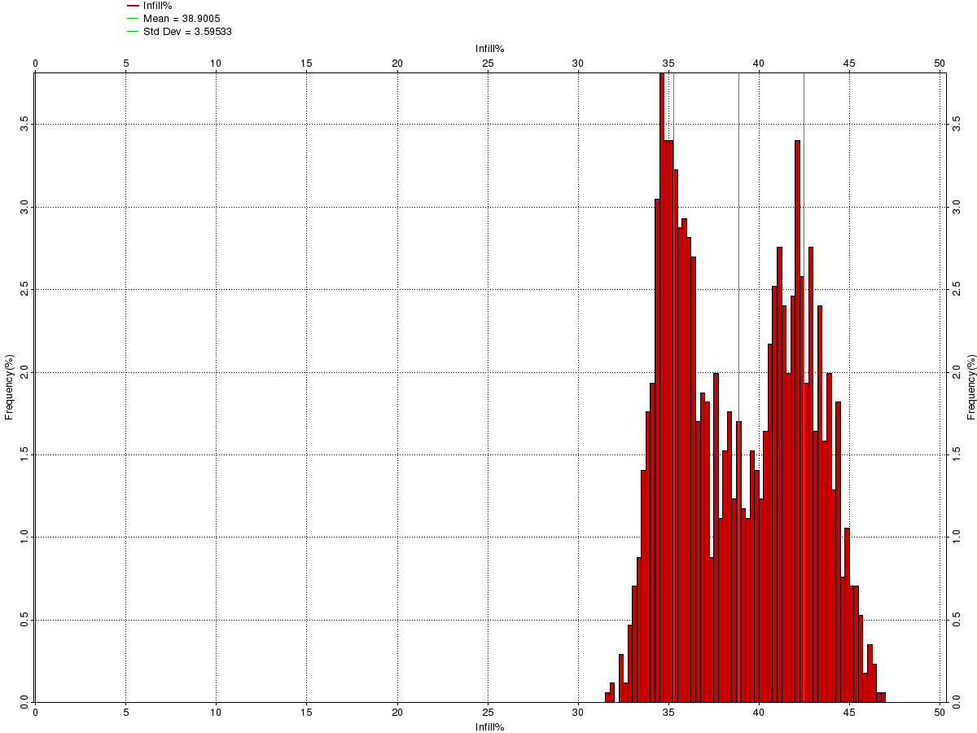
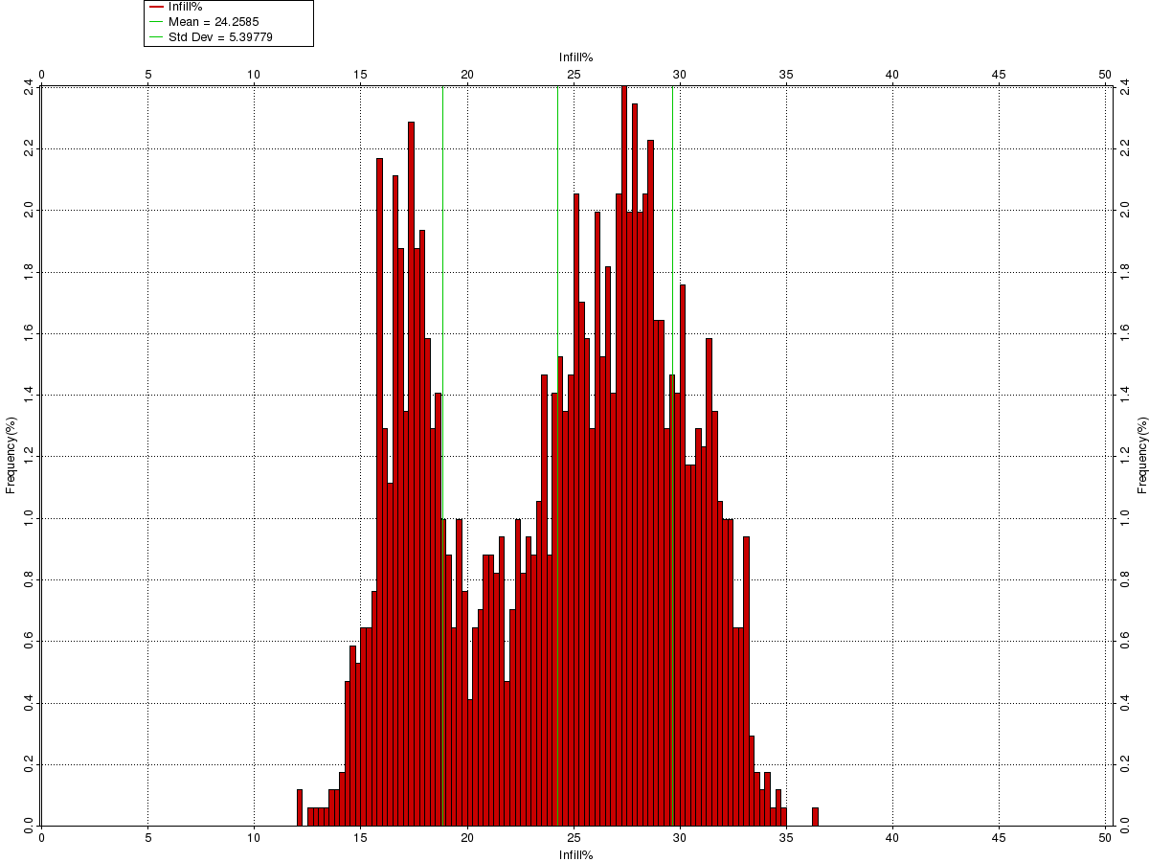
Infill Prediction B16-2 10x75 Dual Source 10x75x6000, SPI: 25m, RL: 9000ms, No Fan & Fan 150%, 75m gap allowance: Modelling results
Max Feather – Time Series
Infill Prediction – Time Series
Time series plots (top row):
Survey start dates: 1 Jun – 1 Jul.
Start time incr.: 1 day
Years: 2015 – 2019, colour coded:
35°
50%
50%
2015
2016
2017
2018
2019
1 Jun
1 Jul
1 Jun
1 Jul
1 Jun
1 Jul
Max Feather – Histogram
Infill Prediction – Histogram
Histograms (bottom row):
Data from all years combined
Summary
Max. Feather (⁰) | 29.7 (±3.3)
Infill Prediction (%) No Fan | 38.9 (±3.6)
Infill Prediction (%) Fan 150% | 24.3 (±5.4)
0°
35°
0%
No Fan
50%
0%
Fan 150%
50%

Slide 7
Infill Prediction 10x112.5 Azimuth: 16.00°/196.00°, Triple Source 10x113x6750, SPI: 16.667m, RL: 6000ms

Slide 8
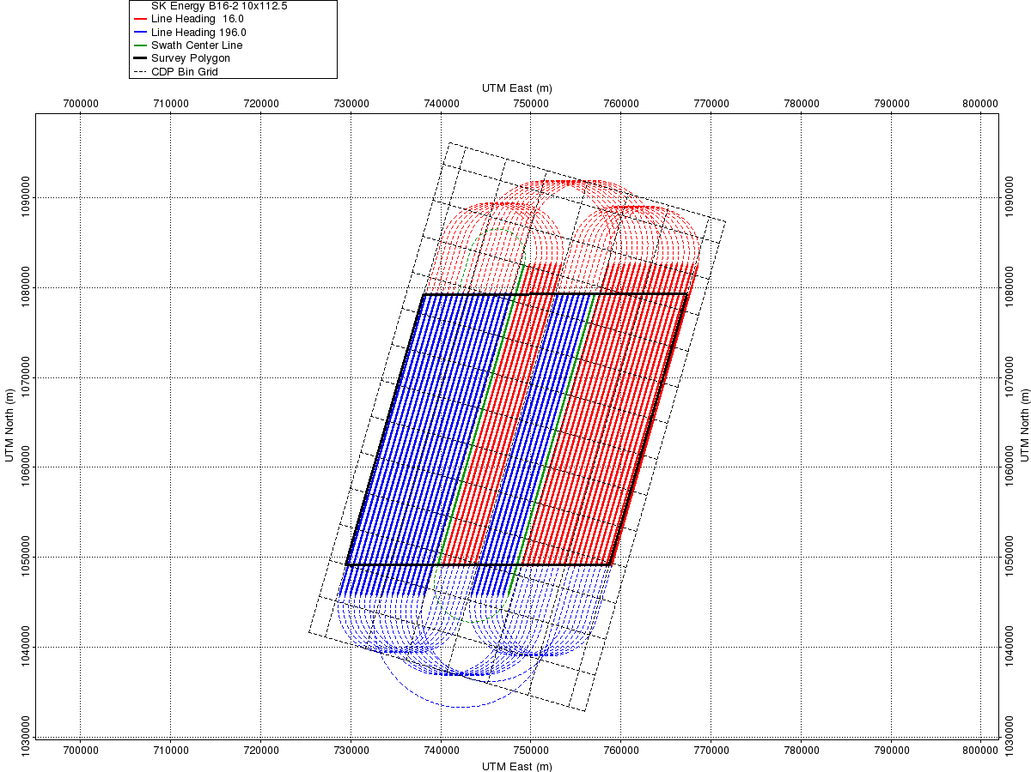


Infill Prediction 10x112.5 Triple Source10x113x6750, SPI: 16.667m, RL: 6000ms: Pre-Plot and Vessel Layout
Pre-Plot
Vessel Layout No Fan
Vessel Layout with 150% Fan
51 Sail Lines
Survey Duration: 15 days
Turn Radius: 5100m
Run-in: 3375m
This slide shows pre-plot survey and vessel configuration for Triple Source 10 x 113 x 6750 acquisition configuration.
The pre-plot survey is calculated by SurvOpt with 16.00°/196.00° shooting direction. Currents are not used when calculating shooting pattern.

Slide 9
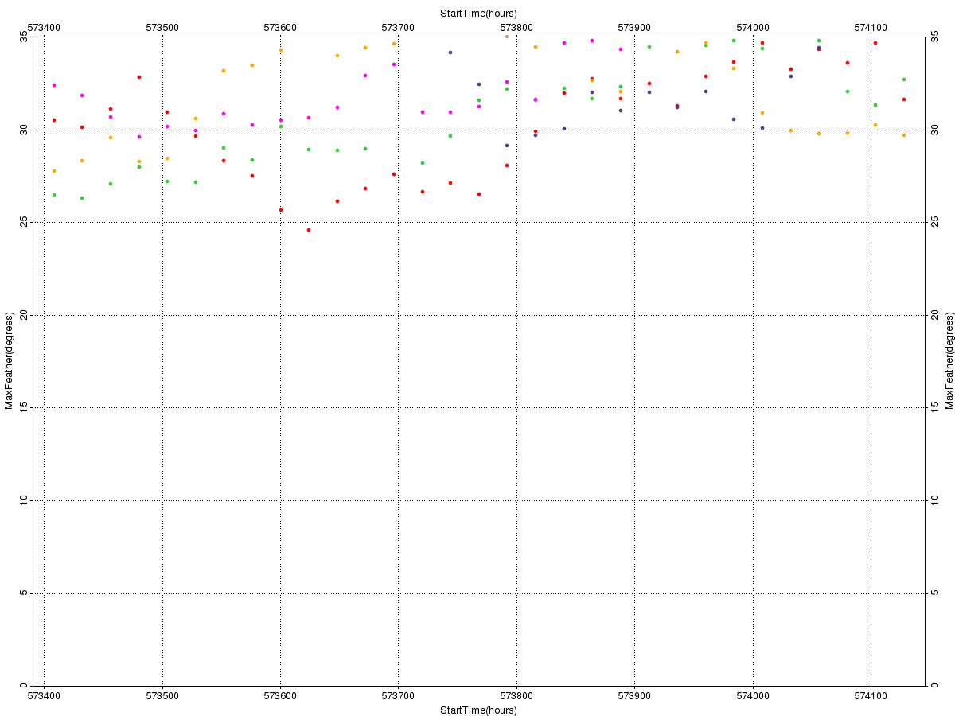
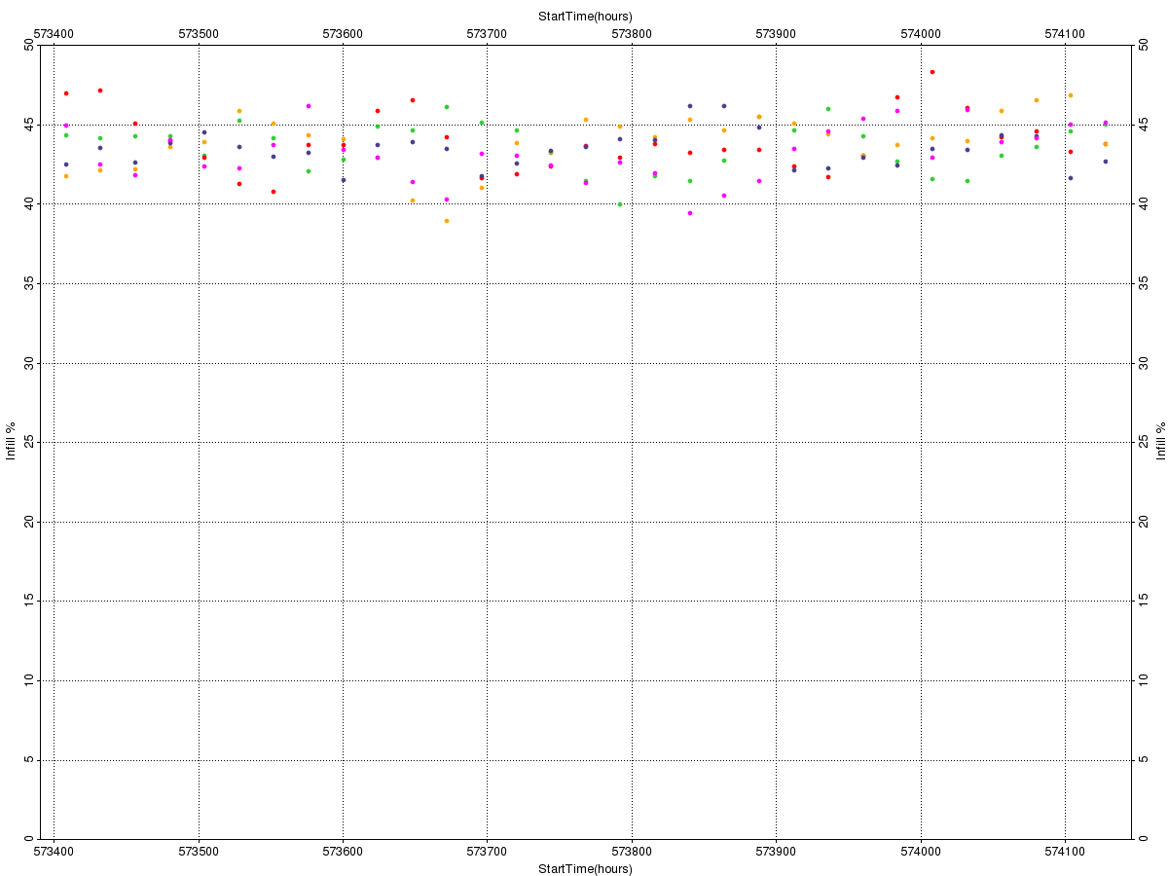
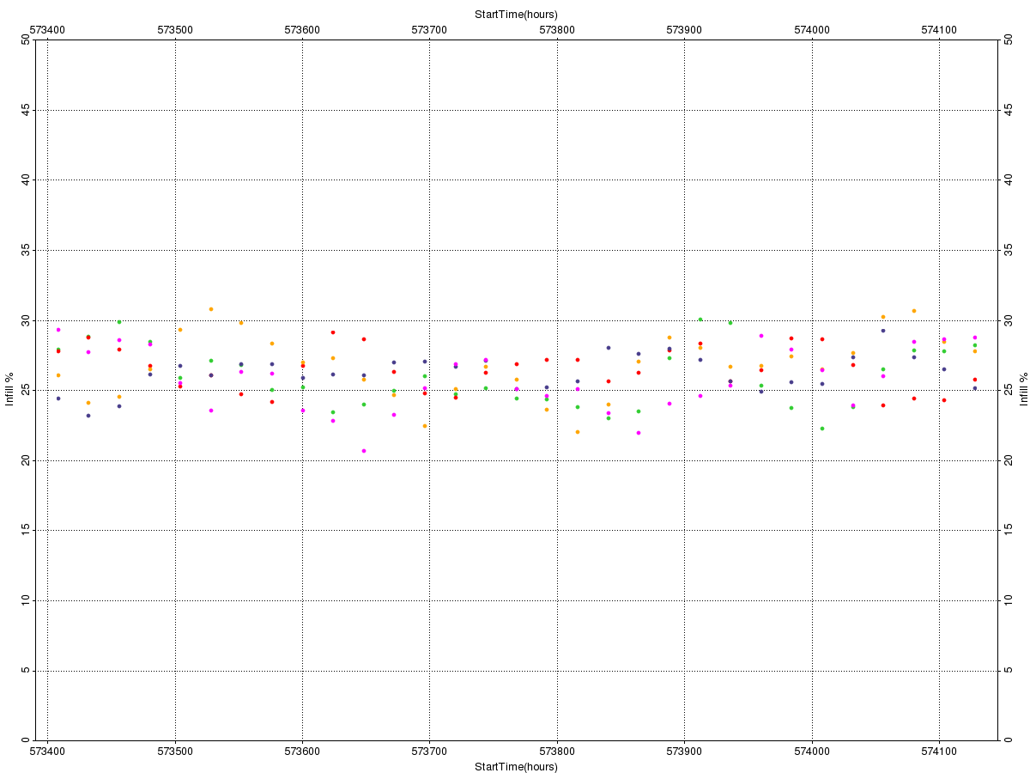
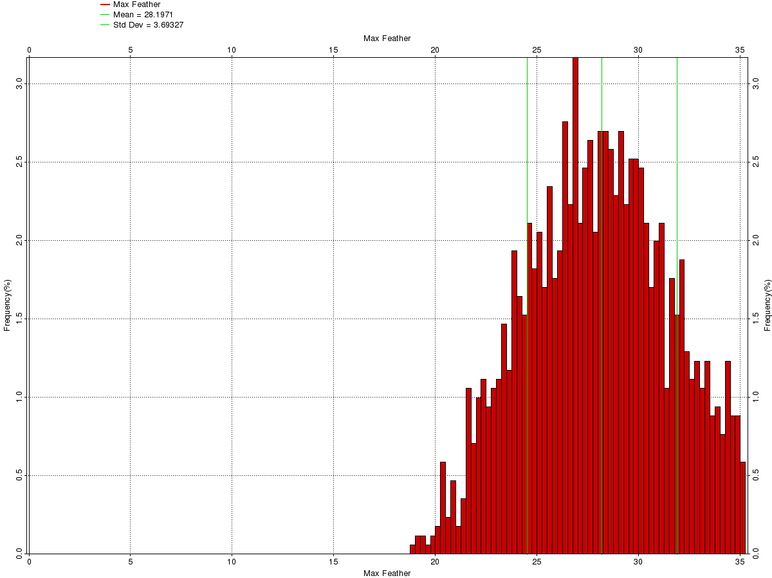
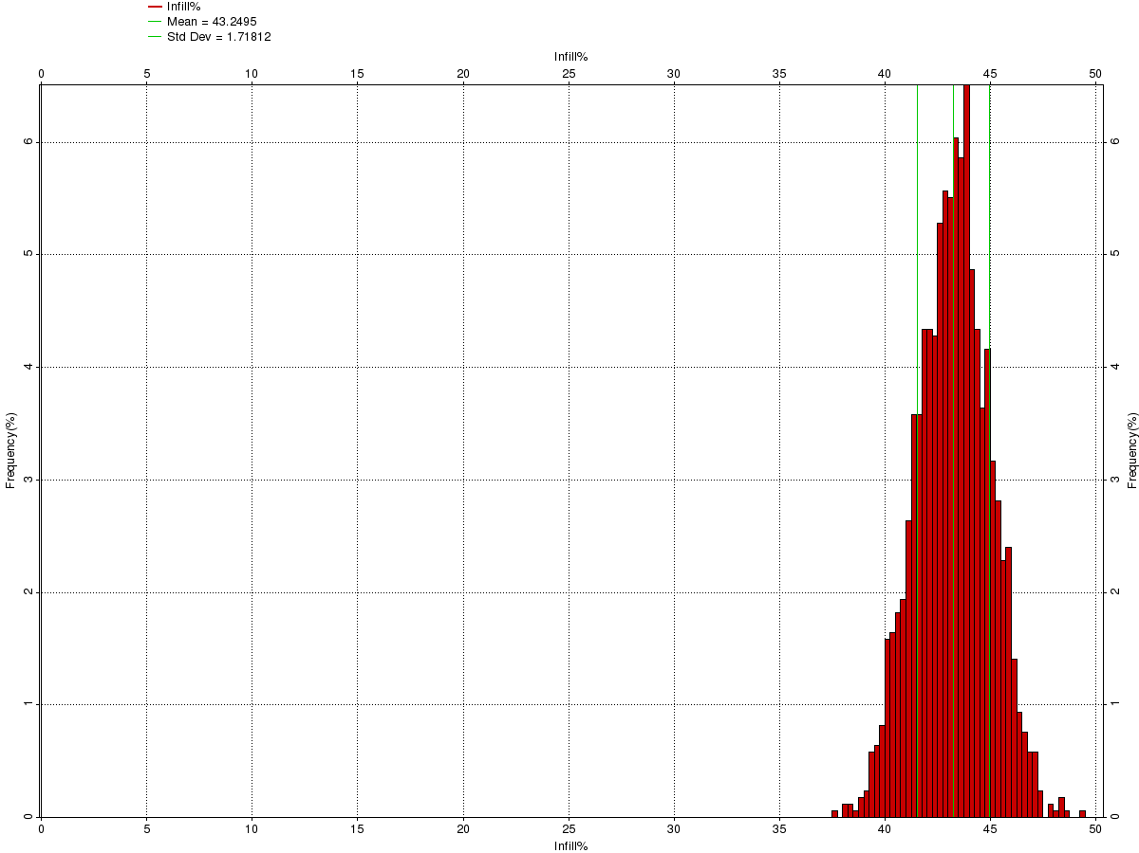
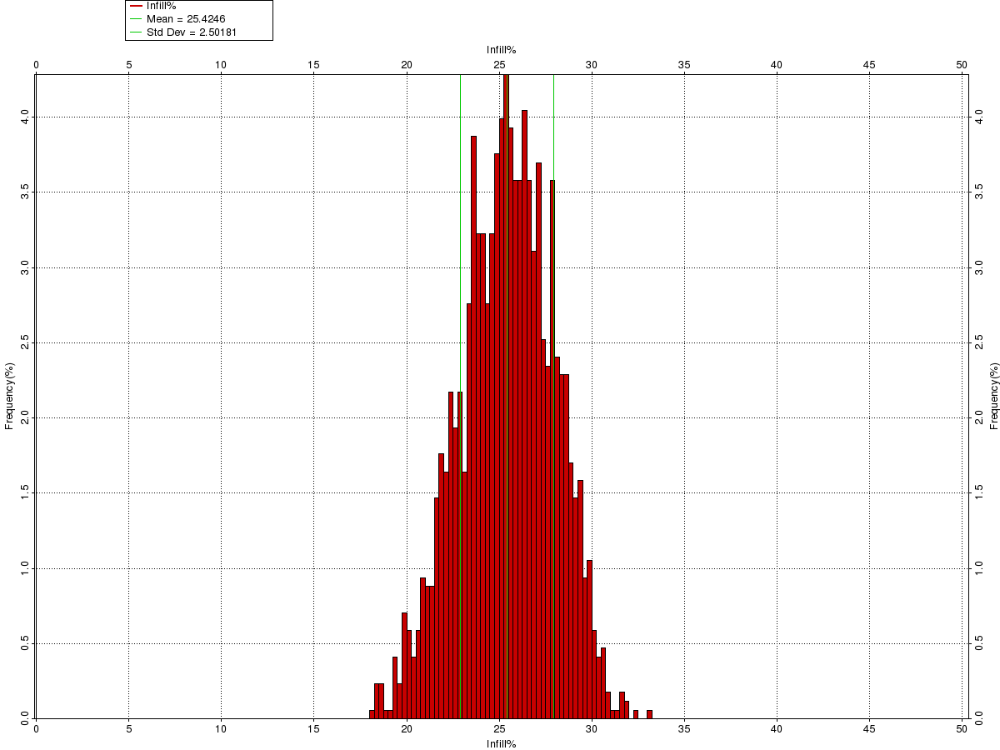
Infill Prediction B16-2 10x112.5 Triple Source 10x113x6750, SPI: 16.667m, RL: 6000ms, No Fan & Fan 150%, 75m gap allowance: Modelling results
Max Feather – Time Series
Infill Prediction – Time Series
Time series plots (top row):
Survey start dates: 1 Jun – 1 Jul.
Start time incr.: 1 day
Years: 2015 – 2019, colour coded:
35°
50%
50%
2015
2016
2017
2018
2019
1 Jun
1 Jul
1 Jun
1 Jul
1 Jun
1 Jul
Max Feather – Histogram
Infill Prediction – Histogram
Histograms (bottom row):
Data from all years combined
Summary
Max. Feather (⁰) | 28.2 (±3.7)
Infill Prediction (%) No Fan | 43.2 (±1.7)
Infill Prediction (%) Fan 150% | 25.4 (±2.5)
0°
35°
0%
No Fan
50%
0%
Fan 150%
50%

Slide 10
Infill Prediction 10x120 Azimuth: 16.00°/196.00°, Triple Source 10x120x6750, SPI: 16.667m, RL: 6000ms

Slide 11
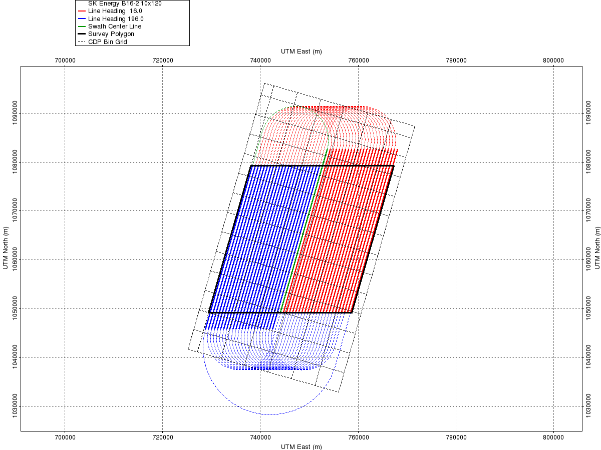


Infill Prediction 10x120 Triple Source10x120x6750, SPI: 16.667m, RL: 6000ms: Pre-Plot and Vessel Layout
Pre-Plot
Vessel Layout No Fan
Vessel Layout with 150% Fan
47 Sail Lines
Survey Duration: 14 days
Turn Radius: 6900m
Run-in: 3375m
This slide shows pre-plot survey and vessel configuration for Triple Source 10 x 120 x 6750 acquisition configuration.
The pre-plot survey is calculated by SurvOpt with 16.00°/196.00° shooting direction. Currents are not used when calculating shooting pattern.

Slide 12
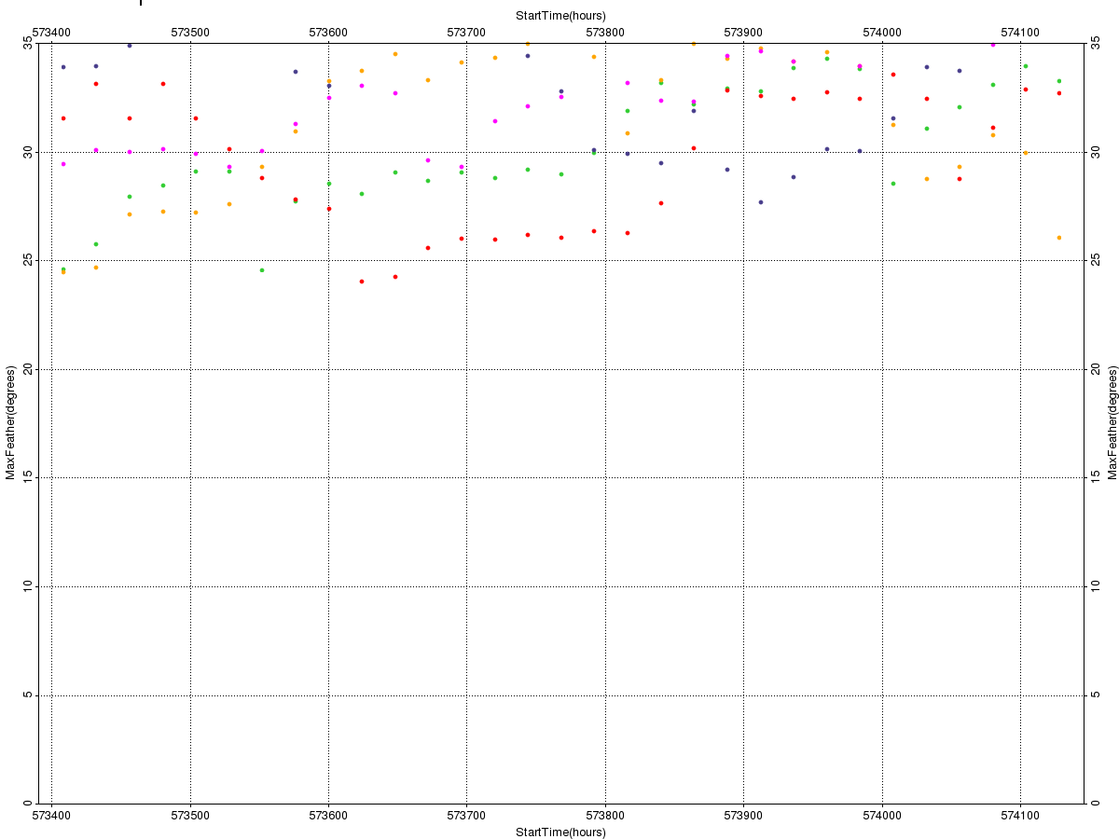
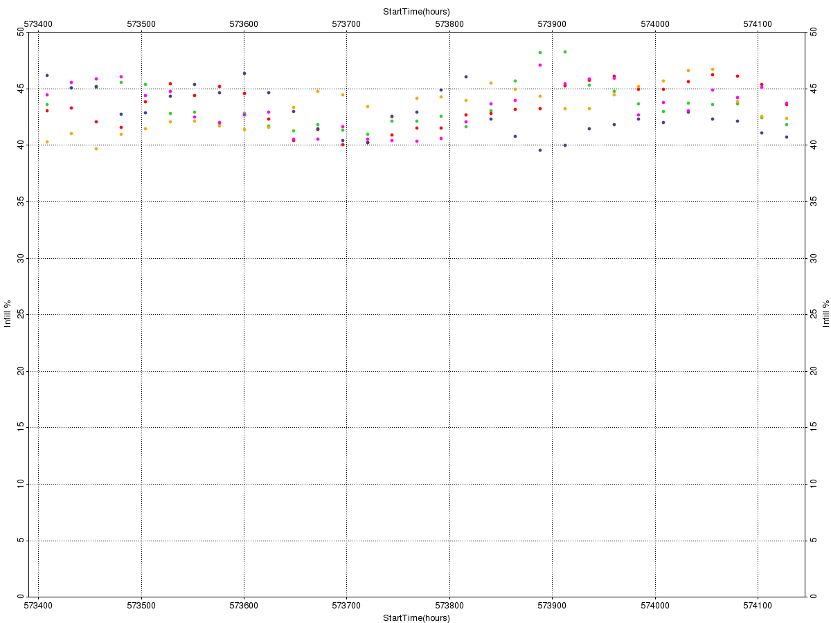
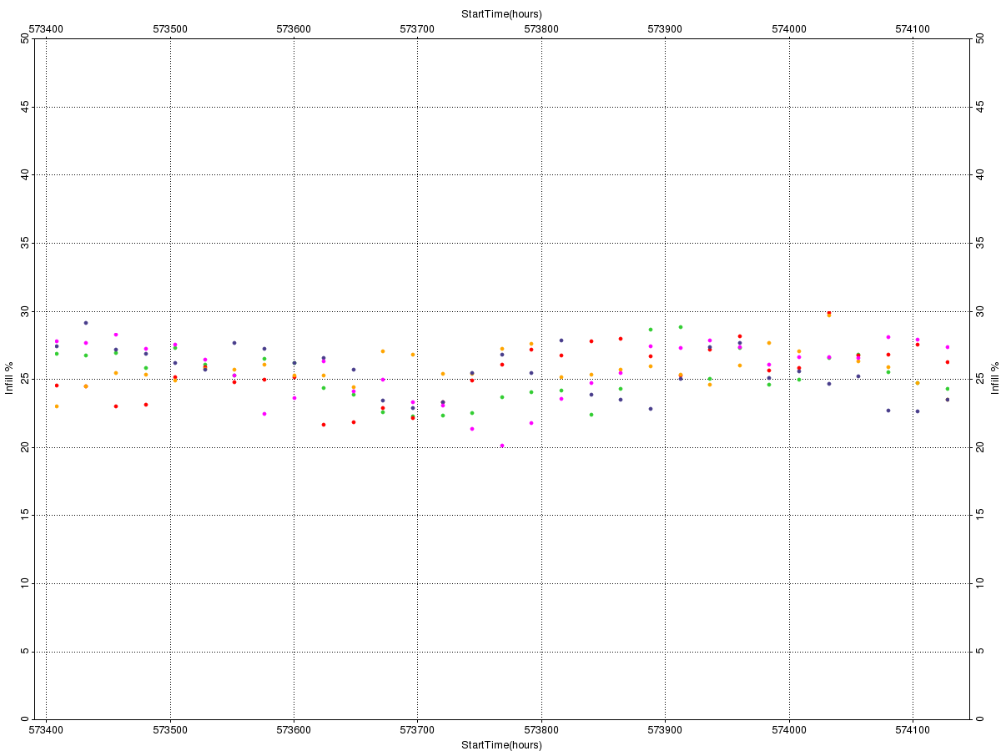
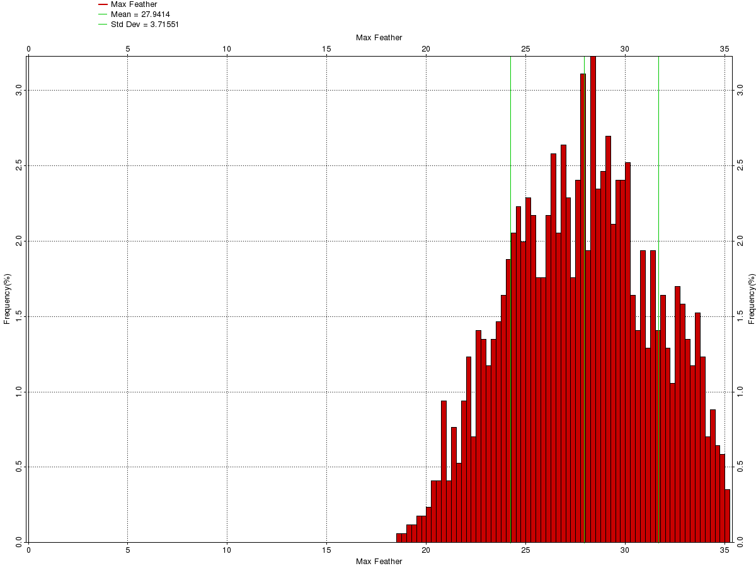
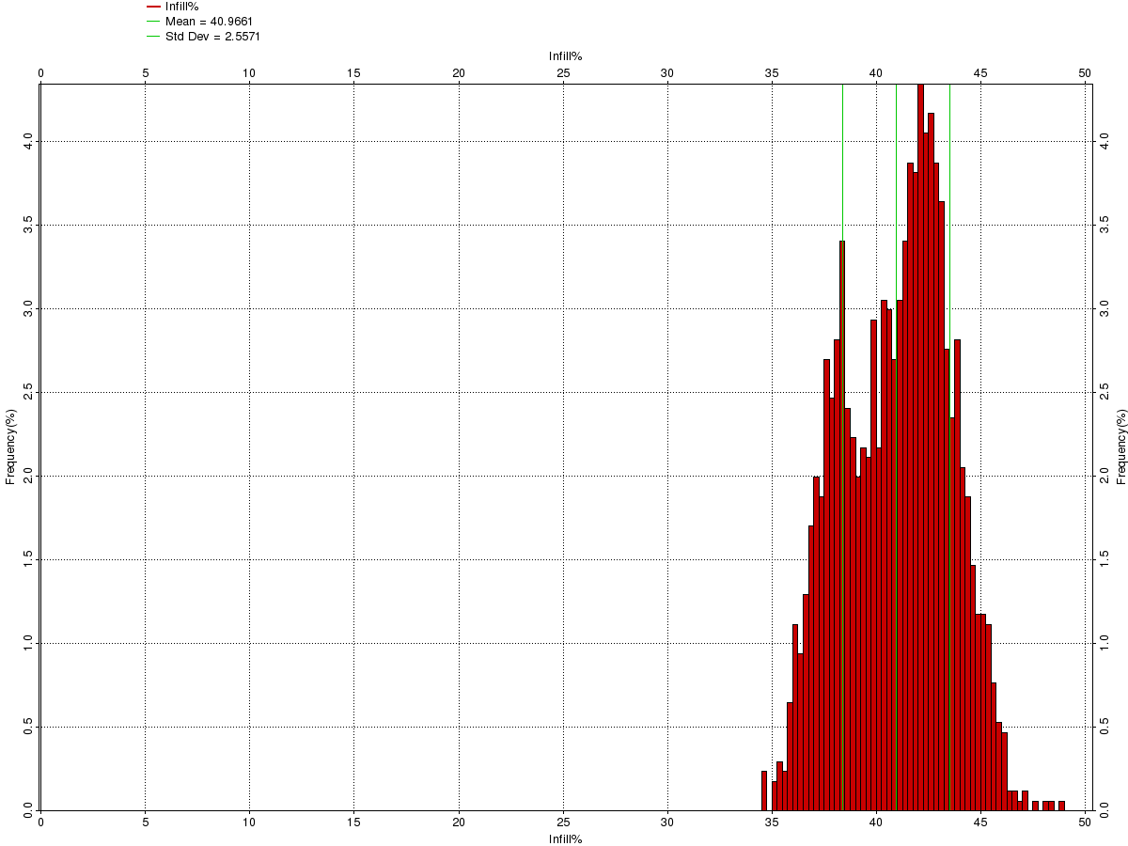
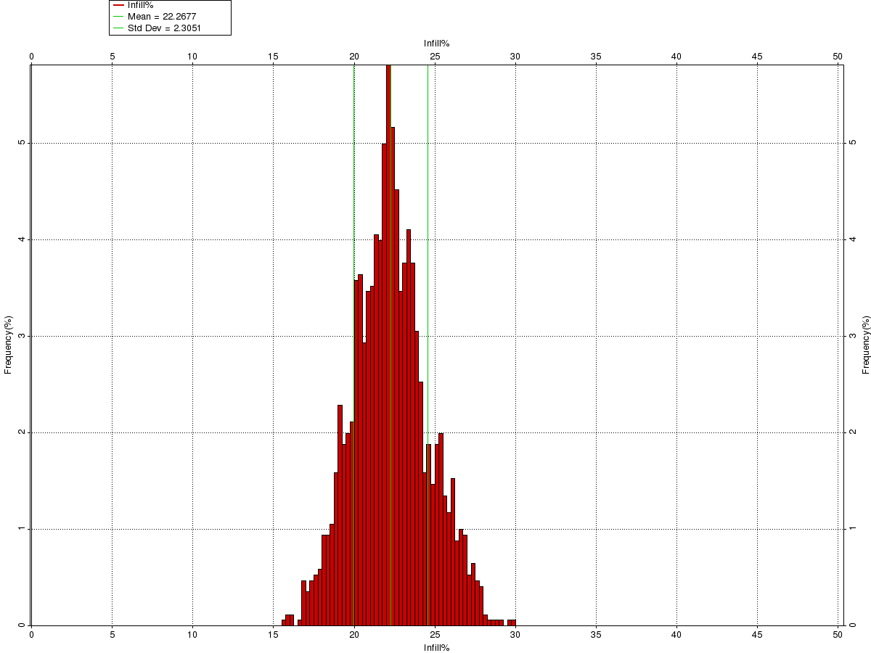
Infill Prediction 10x120 Triple Source 10x120x6750, SPI: 16.667m, RL: 6000ms, No Fan & Fan 150%, 75m gap allowance: Modelling results
Max Feather – Time Series
Infill Prediction – Time Series
Time series plots (top row):
Survey start dates: 1 Jun – 1 Jul.
Start time incr.: 1 day
Years: 2015 – 2019, colour coded:
35°
50%
50%
2015
2016
2017
2018
2019
1 Jun
1 Jul
1 Jun
1 Jul
1 Jun
1 Jul
Max Feather – Histogram
Infill Prediction – Histogram
Histograms (bottom row):
Data from all years combined
Summary
Max. Feather (⁰) | 27.9 (±3.7)
Infill Prediction (%) No Fan | 41.0 (±2.6)
Infill Prediction (%) Fan 150% | 22.3 (±2.3)
0°
35°
0%
No Fan
50%
0%
Fan 150%
50%

