Slide 1
DevOps
Dev + Operations

Slide 2
DevOps
A compound of development (Dev) and operations (Ops), DevOps is the union of people, processes and technology to continually provide value to customers.
What does DevOps mean for teams? DevOps enables formerly siloed roles – development, IT operations, quality engineering and security – to coordinate and collaborate to produce better, more reliable products. By adopting a DevOps culture along with DevOps practices and tools, teams gain the ability to better respond to customer needs, increase confidence in the applications they build and achieve business goals faster.
DevOps URL: https://dev.azure.com/
Azure URL https://portal.azure.com/

Slide 3
What Are the Benefits of Azure DevOps?
Azure DevOps provides DevOps teams with powerful tools.
Timely Access to New Features
Every three weeks, DevOps users receive access to new features. No need to scramble around and wonder what’s new. These are not to be confused with upgrades, and speaking of which:
No Upgrades to Worry About
Users need not worry about upgrading or patching up the toolchain because the Azure DevOps is a SaaS product. Companies that run on a CI/CD model no longer need to slow things down for the sake of upgrading.
Reliability
Azure DevOps is backed by 24 x7 support and a 99.9% SLA.
Flexibility
If your DevOps team doesn’t want or need the full suite of services, they can acquire them independently.
It’s Platform-agnostic
DevOps is designed to run on any platform (Linux, macOS, and Windows) or language (e.g., Android, C/C++, Node.js, Python, Java, PHP, Ruby, .Net, and iOS apps).
It’s Cloud-agnostic
Azure DevOps works with AWS (Azure Web Services) and GCP (Google Cloud Platform)

Slide 4
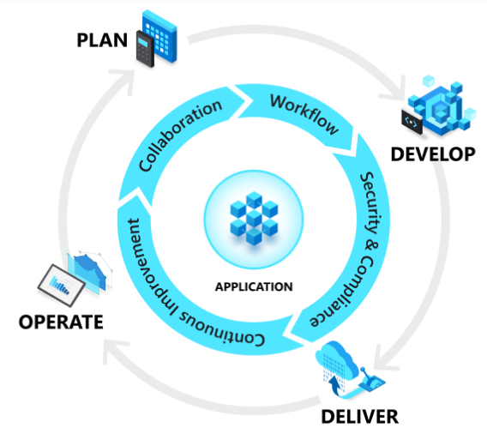
DevOps and the application lifecycle

Slide 5
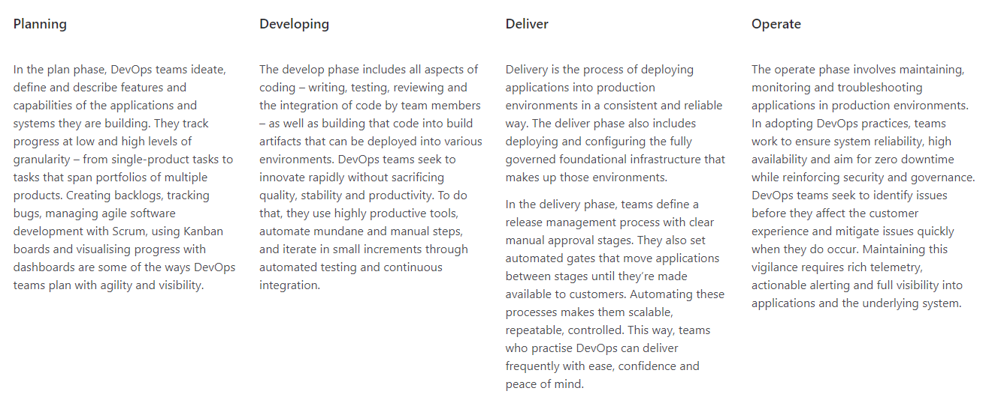
DevOps and the application lifecycle

Slide 6
What Are the Features of Azure DevOps?
Azure DevOps services offer a great selection of features for development teams. For instance:
Dashboard Control
Using the DevOps dashboard feature, you can quickly navigate to different areas of the project, add and manage dashboards, and configure dashboard widgets.
Improved Source Control
Azure DevOps systems support two popular types of source control: Git (distributed) or Team Foundation Version Control (TFVC), which is a centralized, client-server system. You can add and manage Azure Git tags, review, download, and edit files to see change history.
Plan and Track Your Work
Azure DevOps systems provide you with a couple of types of work items used to monitor features, requirements, user stories, tasks, bugs, and more. For planning purposes, you can access several kinds of backlogs and boards to support the main agile methods: Scrum, Scrumban, or Kanban. You can add and update relevant work items, manage product backlog, use sprint backlogs to plan sprints, and use Kanban boards to visualize the workflow and update statuses.
Continuous Integration and Deployment (CI/CD)
Many developers employ the practice of CI/CD, and Azure DevOps supports them. By using Azure pipelines, developers can automate many of the design processes, including defining builds and their steps, creating test instructions, and manage simultaneous releases.
Support for Manual and Exploratory Testing
Azure DevOps’ test features facilitate manual, exploratory, and continuous testing, including workflow customization, end-to-end traceability, criteria-based selection, and real-time charts that track test activity.
Integrated Collaboration Services
The feature that enables teams to collaborate across with the entire collection of Azure DevOps features and functions:
Team dashboards
Project wiki
Discussion within work item forms
Linking work items, commits, pull requests, and other artifacts that support traceability
Alerts and change notifications managed per user, team, project, or organization
The ability to request and manage feedback
Analytics service, analytic views, and Power BI reporting
Azure Cloud-hosted Services
Azure provides DevOps teams with cloud-hosted services that support application development and deployment. These services can be used by themselves or in combination with Azure DevOps.

Slide 7



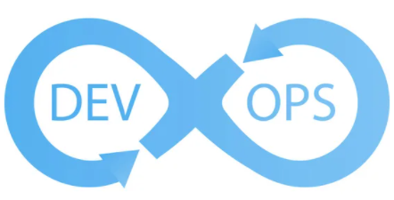






Azure DevOps Execution Approach
Code
Automate & Validate Locally
Check-in to Git Repo
Integrate with CI/CD pipeline
Integrate with release pipelines
Monitor for stability & reliability
Enables daily schedules / riggers
Generate Build Artifacts
Configure alerts & notifications
Dashboard for live metrics
6

Slide 8
Thank You

