Slide 1
Innovation Stream: Watch · Evaluate · Build
[Your name] | [Date]
WEB process for every project:
Watch the ecosystem
Evaluate with discipline
Build reusable infrastructure
Notes:
Thanks everyone. Every project in this stream goes through WEB:
Watch what's happening, Evaluate what is practical for us, and Build infrastructure
that other teams can use immediately.

Slide 2
Agenda (20 Minutes)
0. Opening — 1 min
1. How We Think About Innovation — 4 min
2. What We’ve Built — 8 min
3. Where We’re Going — 5 min
4. Close — 2 min
Throughline: WEB = Watch → Evaluate → Build
Notes:
Keep the audience anchored to timing.
Tell them the talk is structured around WEB and they will see how each project maps to it.

Slide 3
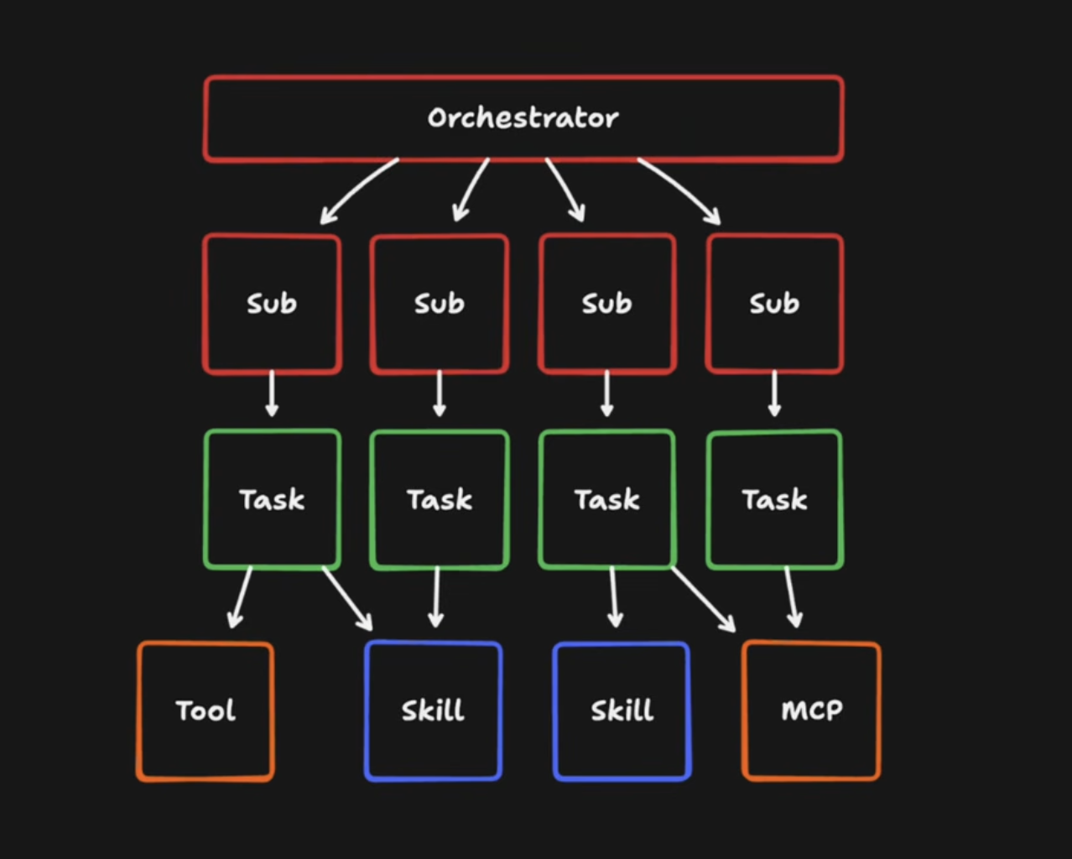
How We Think: The Agent Loop
An agent is just a loop
Prompt → Pick Tool → Execute → Observe → Repeat
Agents use real tools: shell, file system, git, web/MCP
Subagents run tasks in parallel with isolated context windows
Notes:
Anchor on the loop model first.
Explain that this is not just text generation: agents can inspect code, run commands,
edit files, and verify outcomes. Subagents parallelize menial tasks while stronger models do deep reasoning.

Slide 4
Shift: Prompt Engineering → Context Engineering
PROMPT ENGINEERING
"How you ask"
CONTEXT ENGINEERING
"What the agent knows"
→
Same agent + better context = dramatically better output
Context engineering is the system design discipline behind better agent outcomes.
Centralized skills + org memory are the implementation path.
Notes:
The key shift: quality depends more on what the agent knows than phrasing.
Skills, docs, historical decisions, and memory are first-class context.
This is the backbone for centralized skills and organizational knowledge.

Slide 5
Open Source Evaluation Framework
☑ Deployable — Can we run it in our environment today?
☑ Cross-team — Does it serve more than one team?
☑ Forward path — Does roadmap align with industry direction?
☑ Community health — Is the project active and accelerating?
Strategy: follow community convergence, not hype.
Notes:
This is the E in WEB. Be explicit that unpredictable pace makes trend prediction weak.
Following open-source convergence is the practical signal for long-term direction.

Slide 6
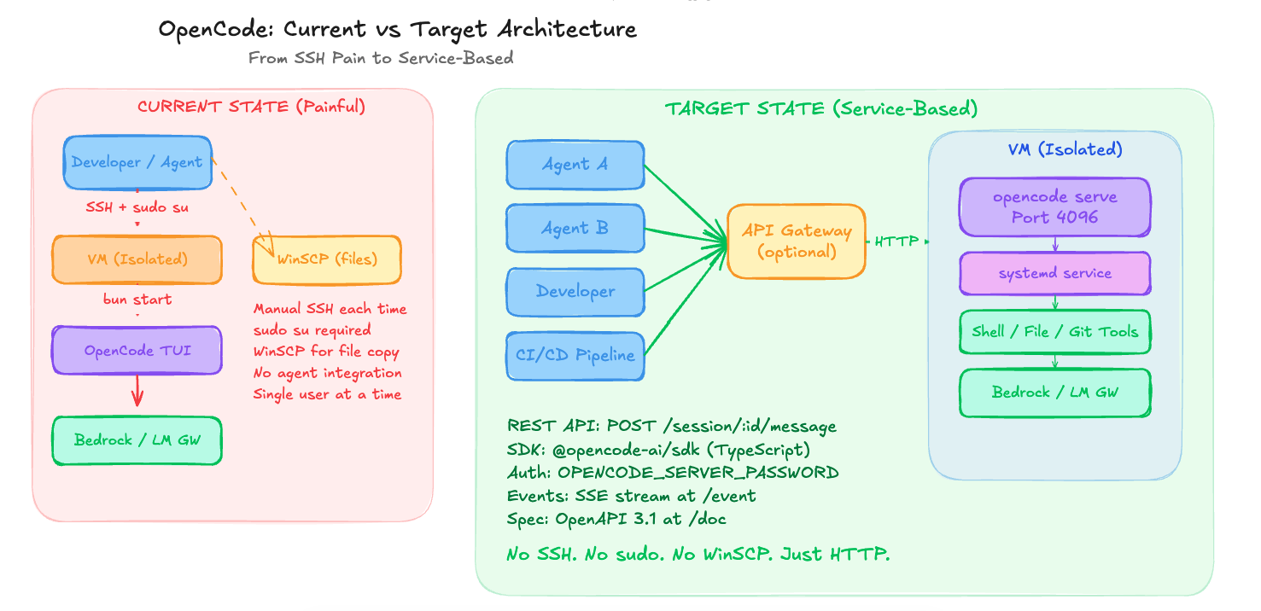
What We’ve Built: OpenCode (Current vs Target)
Notes:
Current pain: SSH + sudo + manual startup + WinSCP + single-user workflow.
Target: always-on HTTP service (port 4096), API-first access, SSE events, OpenAPI spec.
No SSH ceremony; any developer, agent, or CI pipeline can use it.

Slide 7
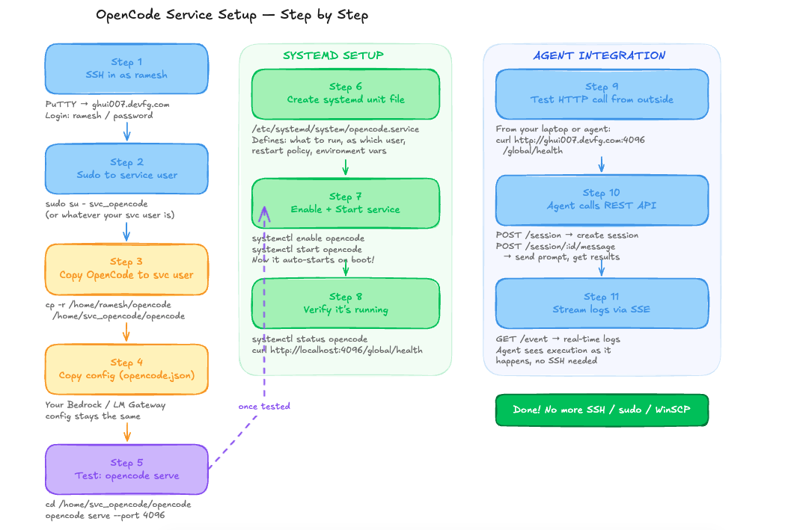
OpenCode Service Setup (Implementation Path)
Notes:
Highlight migration from manual VM workflow to systemd-managed service.
Show the transition from direct SSH usage to API access and SSE observability.

Slide 8
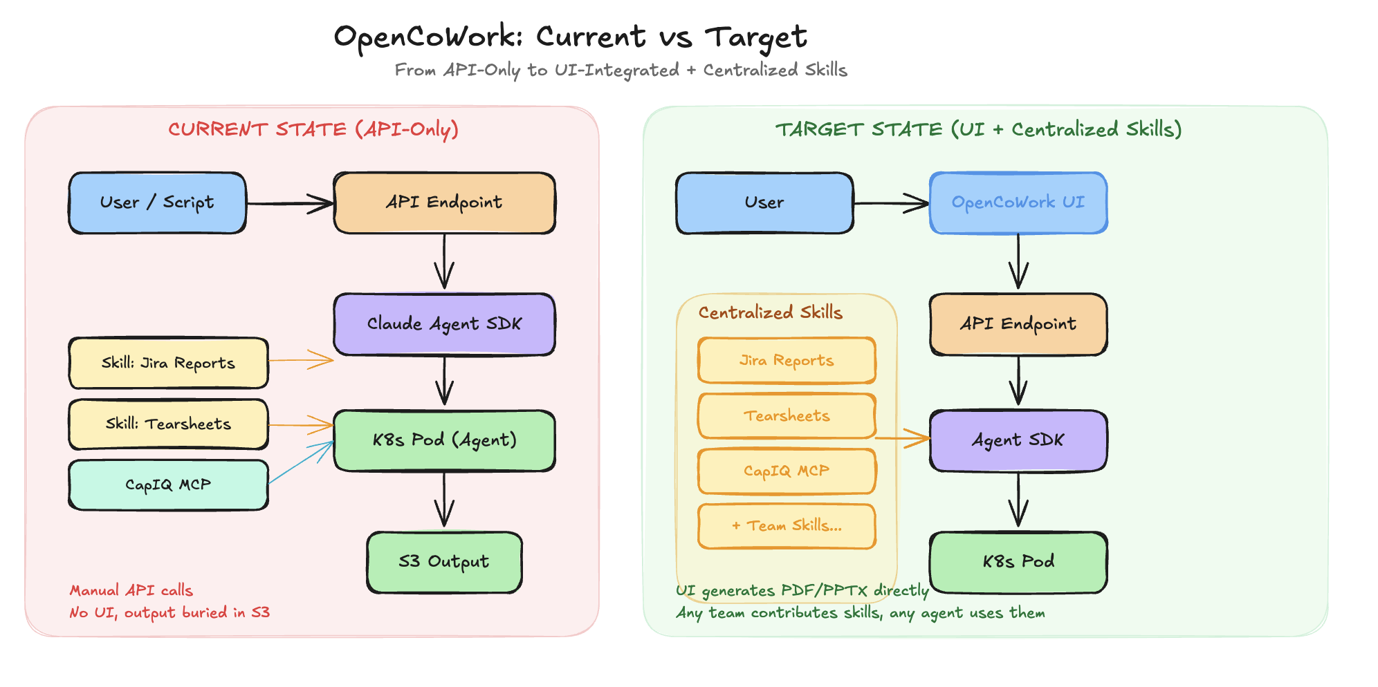
What We’ve Built: OpenCoWork
Notes:
OpenCoWork hosts domain intelligence through reusable skills.
Today: API-driven execution to S3.
Target: centralized skills and direct UI outputs (PDF/PPT/report) without manual API or bucket digging.

Slide 9
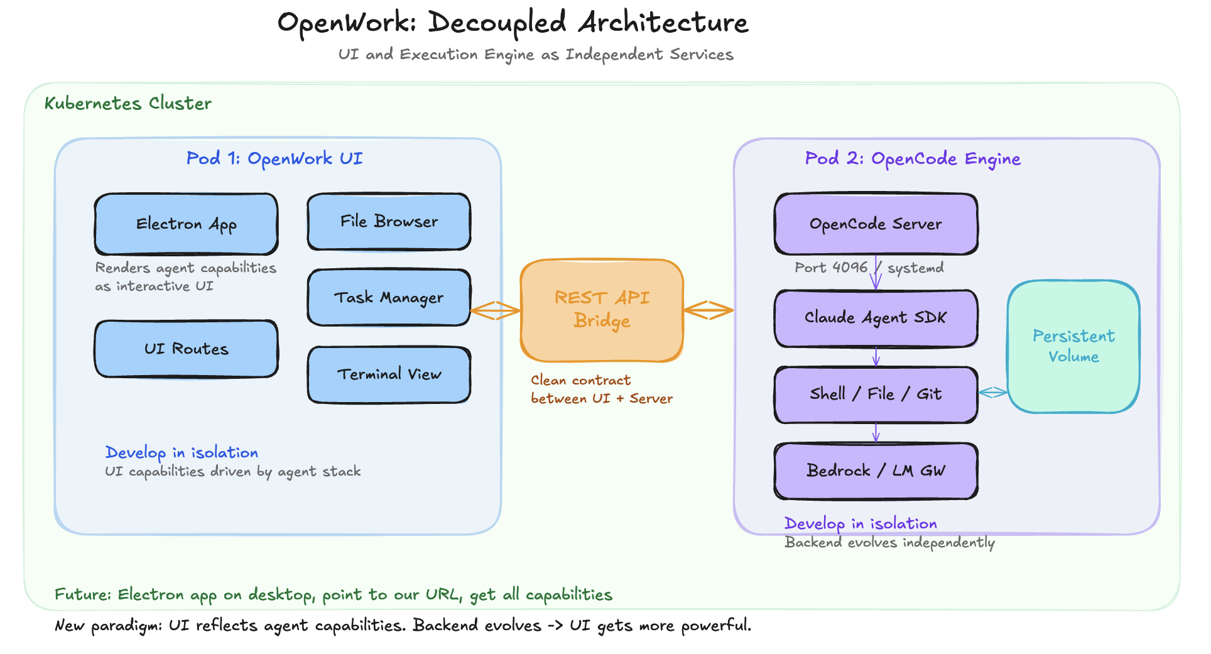
What We’ve Built: OpenWork (Decoupled Architecture)
Notes:
Core idea: decouple UI and execution engine as independent services.
The difference is not just microservices plumbing; the agent stack defines capabilities,
and UI focuses on reusable output patterns rather than one feature page per workflow.

Slide 10
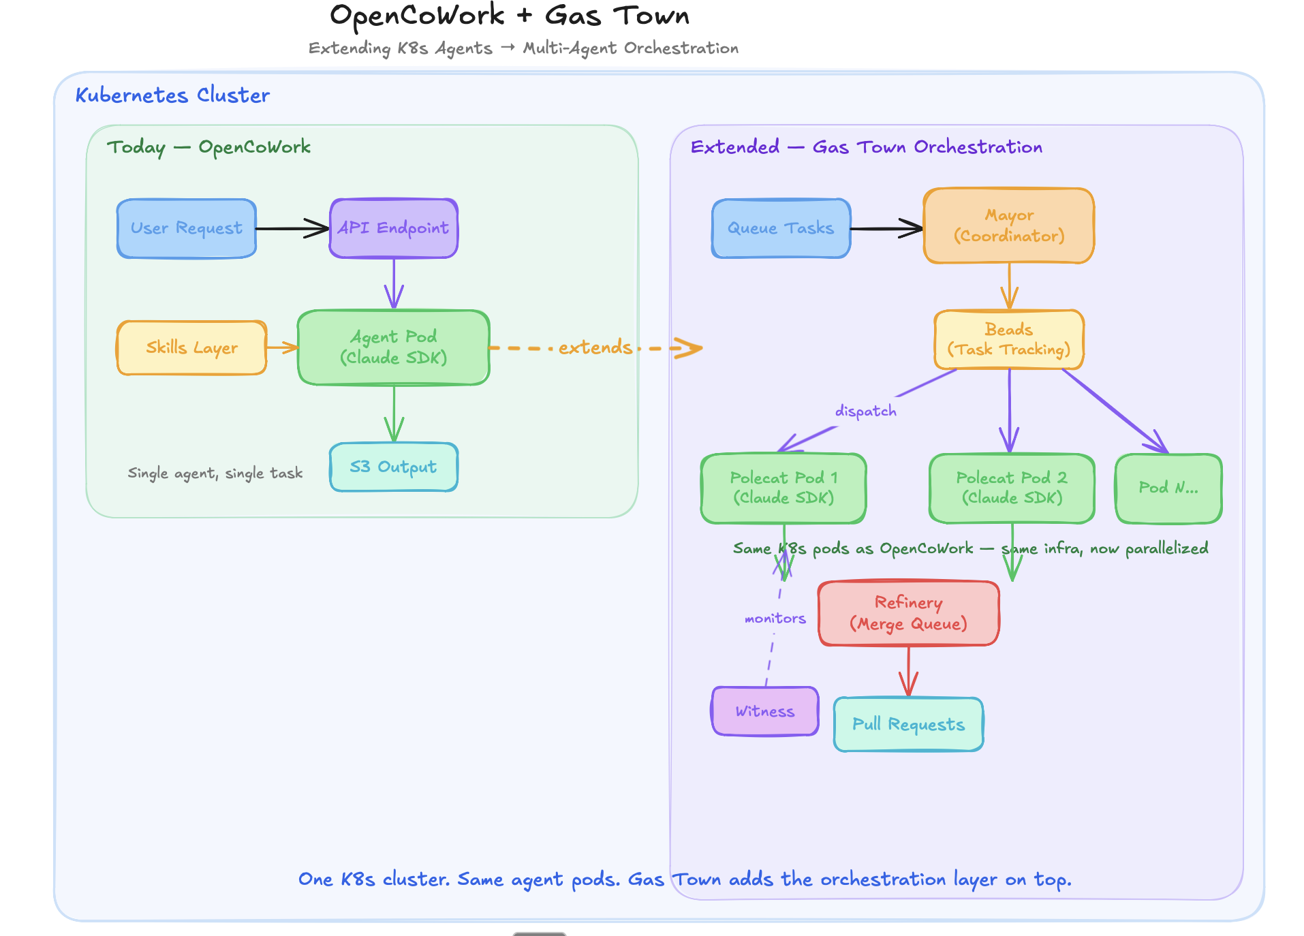
Where We’re Going: Gas Town Multi-Agent Orchestration
Notes:
Extend existing OpenCoWork K8s setup with orchestration layer.
Mayor coordinates, Beads tracks tasks, Polecats execute in parallel pods,
Refinery controls merge queue. Goal: parallel delivery with lower babysitting overhead.

Slide 11
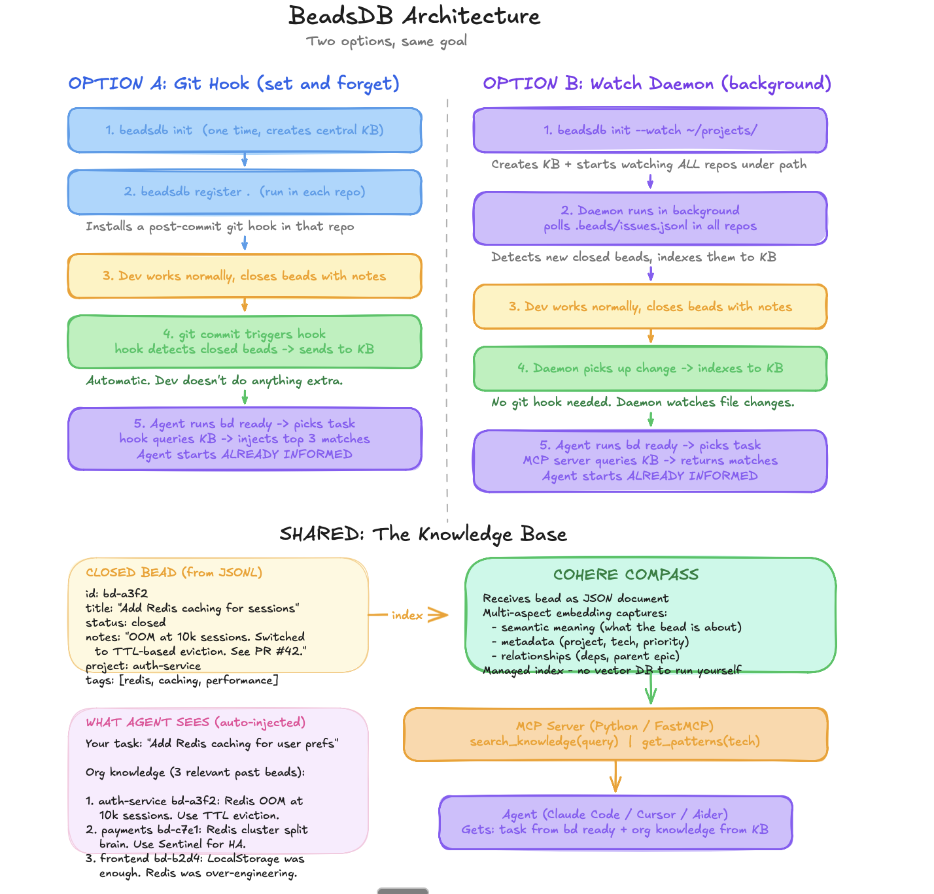
Where We’re Going: Organizational Knowledge
Notes:
Big bet: zero-effort memory.
Closed tasks become indexed lessons. When an agent starts new work, relevant prior decisions
are injected automatically so mistakes are not repeated.

Slide 12
Summary + Ask
1. WEB PROCESS — Watch ecosystem, Evaluate with discipline, Build infrastructure.
2. PROJECTS — OpenCode (execution) + OpenCoWork (skills) + OpenWork (decoupled UI).
3. FORWARD — K8s sandboxes + Multi-agent orchestration + Org knowledge.
[ASK] Align on pilot teams + sponsorship for production hardening.
Notes:
Close on WEB throughline.
State the ask directly: pilot teams, capacity for productionization, and governance alignment.
End with Q&A.

