Slide 1
Numpy in Python
Ramesh Ragala
VIT Chennai

Slide 2
Random number with python
Creating random float numbers with the random function of the random module.
  it shouldn't be used to generate sensitive information
  use the class SystemRandom of the random module to generate random data
  The fastest and most efficient way will be using the random package of the numpy module.
  Example – 1:
Random Numbers Satisfying sum-to-one Condition
  It's very easy to create a list of random numbers satisfying the condition that they sum up to one.
  Example – 2:
Generating Random Strings or Passwords with Python
  strong random password generator, which uses the SystemRandom class
  Example – 3:

Slide 3
Random number with python
Random Integer Number:
  numpy.random.randint(low, high=None, size=None)
  It returns random integers (in discrete form) from 'low' (inclusive) to 'high' (exclusive).
  The parameter 'size' defines the shape of the output. If 'size' is None, a single int will be the output.
  Example – 4:
Random Choices with Python
  The random module contains a function for random choices.
  This function can be used to choose a random element from a non-empty sequence.
  This function is capable of picking a random character from a string or a random element from a list or a tuple.
  choice(possible_destinations, size, replace)
  Example – 5:

Slide 4
Random number with python
Random sample with python:
  A sample can be understood as a representative part from a larger group, usually called a "population".
  The module numpy.random contains a function random_sample, which returns random floats in the half open interval [0.0, 1.0).
    The results are from the "continuous uniform" distribution over the stated interval.
    This function takes just one parameter "size", which defines the output shape.
  Example – 6:
  The standard module random of Python has a more general function "sample", which produces samples from a population.
    The population can be a sequence or a set.
    sample(population, k)
    The function creates a list, which contains "k" elements from the "population".

Slide 5
Matrix Arithmetics under NumPy and Python
Vector addition and subtraction:
  x = np.array([3,2])
  y = np.array([5,1])
  z = x + y → check the output
  x = np.array([1,2,3])
  y = np.array([-7,8,9])
  np.dot(x,y) → check the output
  dot = np.dot(x,y)
  x_modulus = np.sqrt((x*x).sum())
  y_modulus = np.sqrt((y*y).sum())
  cos_angle = dot / x_modulus / y_modulus # cosine of angle between x and y
  angle = np.arccos(cos_angle)
  angle
  angle * 360 / 2 / np.pi # angle in degrees

Slide 6
Matrix Arithmetics under NumPy and Python
Matrix class:
  matrix objects are a subclass of the numpy arrays (ndarray).
  Example – 8:
Matrix Product:
  Example – 9:
Cross Product:
  The cross product or vector product is a binary operation on two vectors in three-dimensional space.
  The result is a vector which is perpendicular to the vectors being multiplied and normal to the plane containing them.
  Example – 10:

Slide 7
Reading and Writing Data Files
Functions for reading and writing data files:
  savetxt
  loadtxt
  tofile
  fromfile
  save
  load
  genfromtxt

Slide 8
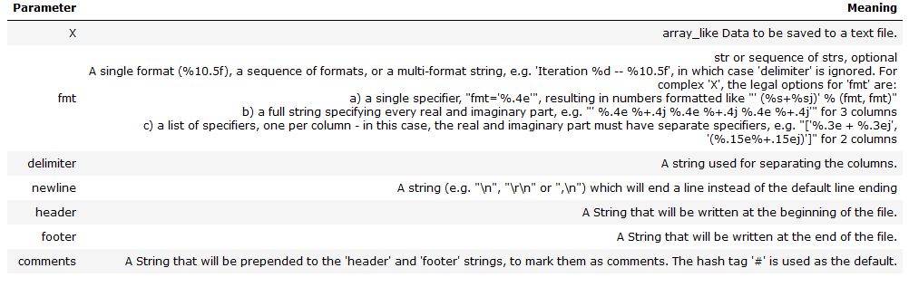
Reading and Writing Data Files
Saving textfiles with savetxt:
  Example – 11
  The syntax of savetext is
  savetxt(fname, X, fmt='%.18e', delimiter=' ', newline='\n', header='', footer='', comments='# ')

Slide 9
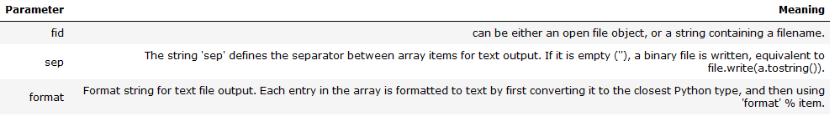
Reading and Writing Data Files
Loading Textfiles with loadtxt
  Example – 12
tofile:
  tofile is a function to write the content of an array to a file both in binary, which is the default, and text format.
  The syntax is
    A.tofile(fid, sep="", format="%s")
  The data of the A ndarry is always written in 'C' order, regardless of the order of A.
  The data file written by this method can be reloaded with the function fromfile(). → Example - 13

Slide 10
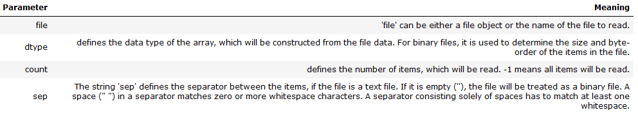
Reading and Writing Data Files
fromfile
  fromfile to read in data, which has been written with the tofile function
  It's possible to read binary data, if the data type is known.
  The general syntax is
    numpy.fromfile(file, dtype=float, count=-1, sep='')
  tofile is a function to write the content of an array to a file both in binary, which is the default, and text format.

Slide 11
Example
Develop a python program to Automatically generated password. The length of the password contains minimum of 8 letter to 12 letters only. The password should contains, maximum of 4 uppercase alphabets, maximum of 4 lowercase alphabets, at least 2 number and at least 1 special-symbol. And also the password should have the combination of all these set of character such as uppercase, lowercase alphabets, numbers and special symbols.

