Slide 1
Numpy in Python
Ramesh Ragala
VIT Chennai

Slide 2
Creating Arrays with Ones, Zeros and Empty
Two way to initialize the Arrays with Zeros or Ones.
First Method:
  The method ones(t) takes a tuple t with the shape of the array and fills the array accordingly with ones.
  By default it will be filled with Ones of type float.
  If you need integer Ones, you have to set the optional parameter dtype to int.
Example – 1:
The same above procedure is also used for method zeros() also.
Example – 2:

Slide 3
Creating Arrays with Ones, Zeros and Empty
Second Method:
  ones_like(a) and zeros_like(a): where a is an existing array. The result of the these methods produce the same shape as array – a only.
Example – 3:
empty():
  It creates and returns a reference to a new array of given shape and type, without initializing the entries.
  Sometimes the entries are zeros.
Example – 4:

Slide 4
Copying Arrays
The syntax of copy(): (numpy.copy())
  copy(obj, order='K'). It returns an array copy of the given object 'obj'.
  Obj → array_like input data.
  Order
    The possible values are {'C', 'F', 'A', 'K'}.
    This parameter controls the memory layout of the copy.
    'C' means C-order, 'F' means Fortran-order, 'A' means 'F' if the object 'obj' is Fortran contiguous, 'C' otherwise. 'K' means match the layout of 'obj' as closely as possible.
Example – 5:

Slide 5
Copying Arrays
The syntax of copy(): (ndarray.copy())
  a.copy(order='C'). Returns a copy of the array 'a'. The default values for the order arguments are different.
  Order
    The same as with numpy.copy, but 'C' is the default value for order.
Example – 6:

Slide 6
Identity Array
The identity matrix, or unit matrix, of size n is the n × n square matrix with ones on the main diagonal and zeros elsewhere.
Two methods
  Identity
  eye
The syntax for creation of identity arrays using identity function:
  identity(n, dtype=None)
  n → An integer number defining the number of rows and columns of the output.
  dtype → An optional argument, defining the data-type of the output. The default is 'float'
Example – 7:

Slide 7
Identity Array
The syntax for creation of identity arrays using eye function:
  eye(N, M=None, k=0, dtype=float)
  N → An integer number defining the rows of the output array.
  M → An optional integer for setting the number of columns in the output. If it is None, it defaults to 'N'.
  K → Defining the position of the diagonal. The default is 0. 0 refers to the main diagonal. A positive value refers to an upper diagonal, and a negative value to a lower diagonal.
  dtype → Optional data-type of the returned array.
Example – 8:

Slide 8
Examples
Create an arbitrary one dimensional array called “data20".
Create a new array which consists of the odd indices of previously created array “data20".
Create a new array in backwards ordering from data20.
Create a new array which consists of the even indices of previously created array “data20".
Create a new array in backwards ordering from data20.
Create a two dimensional array called “data21".

Slide 9
Examples
Create a new array from data21, in which the elements of each row are in reverse order.
Another one, where the rows are in reverse order.
Create an array from data21, where columns and rows are in reverse order.
Cut of the first and last row and the first and last column.

Slide 10
Data Type Objects, dtype
dtype:
  It is an instance of numpy.dtype class.
  It can be created with numpy.dtype.
  With the aid of dtype we are capable to create "Structured Arrays", - also known as "Record Arrays".
  The structured arrays provide us with the ability to have different data types per column.
  It has similarity to the structure of excel or csv documents.
  This makes it possible to define data like the one in the table with dtype.

Slide 11
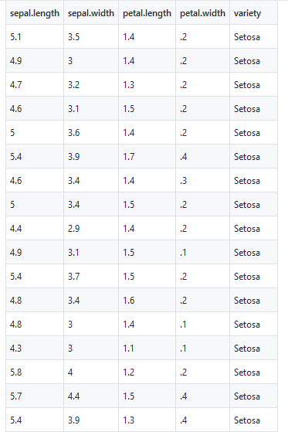
Data Type Objects, dtype
iris dataset:

Slide 12
Data Type Objects, dtype
dtype:
  Simple example with data type as int16.
Example – 9:
Structured Arrays:
  ndarrays are homogeneous data objects, i.e. all elements of an array have to be of the same data type.
  The data type dytpe on the other hand allows as to define separate data types for each column.

Slide 13
Data Type Objects, dtype
Input and Output of Structured Array:
Savetxt()
  In most applications it will be necessary to save the data from a program into a file
  Use a command savetxt().
Example – 11:
Loadtxt()
  savetxt() is more difficult to use, because it returns the strings as binary strings!.
  To overcome this problem, we can use loadtxt with a converter function for the first column.
Example – 12:
Unicode Strings in Array:
  To get unicode strings we exchange this with the definition.

Slide 14
Questions
Create an 2D array with size as (5,8) that should have all data element belongs to integer.
Create an 2D array with size as (5,8) that should have all data element’s value as zero.
Create a 2D array with a size of (2,4) using ones_like() and zeros_like(). The input parameter for these functions is an array.
Use the following link to create structure table table with European countries and the information on population, area and population density. https://www.python-course.eu/numpy_dtype.php

Slide 15
Questions
Define a structured array with two columns. The first column contains the product ID, which can be defined as an int32. The second column shall contain the price for the product. How can you print out the column with the product IDs, the first row and the price for the third article of this structured array?
Figure out a data type definition for time records with entries for hours, minutes and seconds.

Slide 16
Questions
Define a structured array with two columns. The first column contains the product ID, which can be defined as an int32. The second column shall contain the price for the product. How can you print out the column with the product IDs, the first row and the price for the third article of this structured array?
Figure out a data type definition for time records with entries for hours, minutes and seconds. And also add temperatures to the all records.

