Slide 1
Numpy in Python
Ramesh Ragala
VIT Chennai

Slide 2
Numerical Operations on Numpy Arrays
The operator signs are overloaded in Numpy.
Using Scalars:
  Example – 1:
Arithmetic Operations with two Arrays
  Example – 2:
  Matrix multiplication using np.dot(a, b, out=None)
    For 1-D arrays it is the same as the inner product of vectors
    For 2-D arrays the dot product is equivalent to matrix multiplication.
    For N dimensions it is a sum product over the last axis of 'a' and the second-to-last of 'b‘
    a → array or array like argument
    b → array or array like argument
    'out' is an optional parameter. This is a performance feature.

Slide 3
Numerical Operations on Numpy Arrays
dot() → returns the dot product of 'a' and 'b'.
  If 'a' and 'b' are both scalars or both 1-D arrays then a scalar is returned;
  otherwise an array will returned.
  It will raise a ValueError, if the shape of the last dimension of 'a' is not the same size as the shape of the second-to-last dimension of 'b', i.e. a.shape[-1] == b.shape[-2]
  Example – 3: dot product of 2-D
  Example – 4: dot product of 3-D
Matrices vs. Two-Dimensional Arrays:
  Some may have taken two-dimensional arrays of Numpy as matrices.
  There are "real" matrices in Numpy.
  They are a subset of the two-dimensional arrays.
  It can be turn a two-dimensional array into a matrix by applying the "mat" function.

Slide 4
Numerical Operations on Numpy Arrays
Matrices vs. Two-Dimensional Arrays:
  The main difference shows, if you multiply two two-dimensional arrays or two matrices.
  We get real matrix multiplication by multiplying two matrices, but the two-dimensional arrays will be only multiplied component-wise:
  Example - 5:
It is possible to compare the complete arrays for equality.
  np.array_equal()
  Example – 6:
It is possibile to apply the logical 'or' and the logical 'and' to arrays elementwise.
  Example – 7:

Slide 5
Numerical Operations on Numpy Arrays
Broadcasting:
  It allows to perform arithmetic operations on arrays of different shapes.
  This means that we have a smaller array and a larger array, and we transform or apply the smaller array multiple times to perform some operation on the larger array.
  In other words: Under certain conditions, the smaller array is "broadcasted" in a way that it has the same shape as the larger array.
  With the aid of broadcasting we can avoid loops in our Python program.
  We also avoid creating unnecessary copies of our data.
  Example - 8

Slide 6
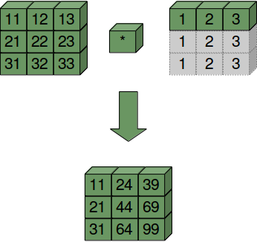
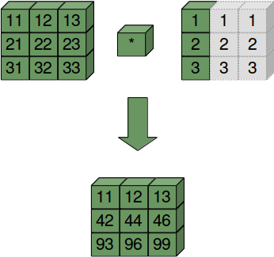
Numerical Operations on Numpy Arrays
Broadcasting:

Slide 7
Numerical Operations on Numpy Arrays
Distance matrix example in following link
https://www.python-course.eu/numpy_numerical_operations_on_numpy_arrays.php

Slide 8
Concatenating, Flattening and Adding Dimensions in numpy
In this section, we will discuss about the functions to manipulate the shape or dimension of arrays.
Flatten and Reshape Arrays
  Two method to flatten a multidimensional array
    flatten()
    ravel()
flatten():
  The flatten() is a ndarry method with an optional keyword parameter "order“.
  order can have the values "C", "F" and "A".
  The default of order is "C".

Slide 9
Concatenating, Flattening and Adding Dimensions in numpy
flatten():
  "C" means to flatten C style in row-major ordering, i.e. the rightmost index "changes the fastest" or in other words: In row-major order, the row index varies the slowest, and the column index the quickest, so that a[0,1] follows [0,0].
  "F" stands for Fortran column-major ordering. "A" means preserve the C/Fortran ordering.
  Example - 9:

Slide 10
Concatenating, Flattening and Adding Dimensions in numpy
ravel ():
  The order of the elements in the array returned by ravel() is normally "C-style".
  The syntax is ravel(a, order='C')
  ravel returns a flattened one-dimensional array.
  The optional keyword parameter "order" can be 'C','F', 'A', or 'K‘
  'C': C-like order, with the last axis index changing fastest, back to the first axis index changing slowest. "C" is the default!
  'F': Fortran-like index order with the first index changing fastest, and the last index changing slowest.

Slide 11
Concatenating, Flattening and Adding Dimensions in numpy
ravel ():
  'A': Fortran-like index order if the array "a" is Fortran contiguous in memory, C-like order otherwise.
  'K': read the elements in the order they occur in memory, except for reversing the data when strides are negative.
  Example – 10:

Slide 12
Concatenating, Flattening and Adding Dimensions in numpy
reshape ():
  The method reshape() gives a new shape to an array without changing its data, i.e. it returns a new array with a new shape.
  The syntax is reshape(a, newshape, order='C')
  a → array_like, Array to be reshaped.
  newshape → int or tuple of ints
  order → 'C', 'F', 'A', like in flatten or ravel
  Example - 11

Slide 13
Concatenating, Flattening and Adding Dimensions in numpy
Concatenating Arrays:
  It is used to concatenate the arrays
  Example – 12 → concatenate three one-dimensional arrays to one array. The elements of the second array are appended to the first array. After this the elements of the third array are appended.
  concatenating multidimensional arrays → we can concatenate the arrays according to axis → Arrays must have the same shape to be concatenated with concatenate() → In the case of multidimensional arrays, we can arrange them according to the axis. The default value is axis = 0.

Slide 14
Concatenating, Flattening and Adding Dimensions in numpy
Adding New Dimensions:
  New dimensions can be added to an array by using slicing and np.newaxis.
  Example – 13
Repeating Patterns, The "tile" Method:
  Sometimes, you want to or have to create a new matrix by repeating an existing matrix multiple times to create a new matrix with a different shape or even dimension.
  You may have for example a one-dimensional array array([ 3.4]) and you want to turn it into an array array([ 3.4, 3.4, 3.4, 3.4, 3.4])
  Example – 14

Slide 15
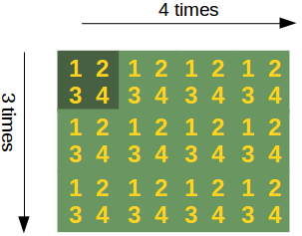
Concatenating, Flattening and Adding Dimensions in numpy
Repeating Patterns, The "tile" Method:
  The formal syntax of tile looks like this: tile(A, reps)
  An array is constructed by repeating A the number of times given by reps.
  'reps' is usually a tuple (or list) which defines the number of repetitions along the corresponding axis / directions.

