Slide 1

Pig Latin: A Not-So-Foreign Language for Data Processing
Christopher Olsten, Benjamin Reed, Utkarsh Srivastava, Ravi Kumar, Andrew Tomkins
Acknowledgement : Modified the slides from University of Waterloo

Slide 2

Motivation
 You‟re a procedural programmer  You have huge data
 You want to analyze it
2

Slide 3
Motivation
 As a procedural programmer…
 May find writing queries in SQL unnatural and too restrictive
 More comfortable with writing code; a series of statements as opposed to a long query. (Ex: MapReduce is so successful).
3

Slide 4
Motivation
 Data analysis goals
 Quick
 Exploit parallel processing power of a distributed system  Easy
 Be able to write a program or query without a huge learning curve  Have some common analysis tasks predefined
 Flexible
 Transform a data set(s) into a workable structure without much overhead
 Perform customized processing  Transparent
 Have a say in how the data processing is executed on the system
5

Slide 5
Motivation
 Relational Distributed Databases
 Parallel database products expensive  Rigid schemas
 Processing requires declarative SQL query construction
 Map-Reduce
 Relies on custom code for even common operations
 Need to do workarounds for tasks that have different data flows other than the expected Map→Combine→Reduce
6

Slide 6
Motivation
 Relational Distributed Databases
 Sweet Spot: Take the best of both SQL and Map-Reduce; combine high-level declarative querying with low-level procedural programming…Pig Latin!
 Map-Reduce
7

Slide 7
Pig Latin Example
Table urls: (url,category, pagerank)
Find for each suffciently large category, the average pagerank of high-pagerank urls in that category
SQL:
SELECT category, AVG(pagerank)
FROM urls WHERE pagerank > 0.2
GROUP BY category HAVING COUNT(*) > 10^6
Pig Latin:
good_urls = FILTER urls BY pagerank > 0.2;
groups = GROUP good_urls BY category;
big_groups = FILTER groups BY COUNT(good_urls)>10^6;
output = FOREACH big_groups GENERATE category, AVG(good_urls.pagerank);

Slide 8
Outline
 System Overview
 Pig Latin (The Language)
 Data Structures
 Commands
 Pig (The Compiler)
 Logical & Physical Plans  Optimization
 Efficiency
 Pig Pen (The Debugger)  Conclusion
8

Slide 9
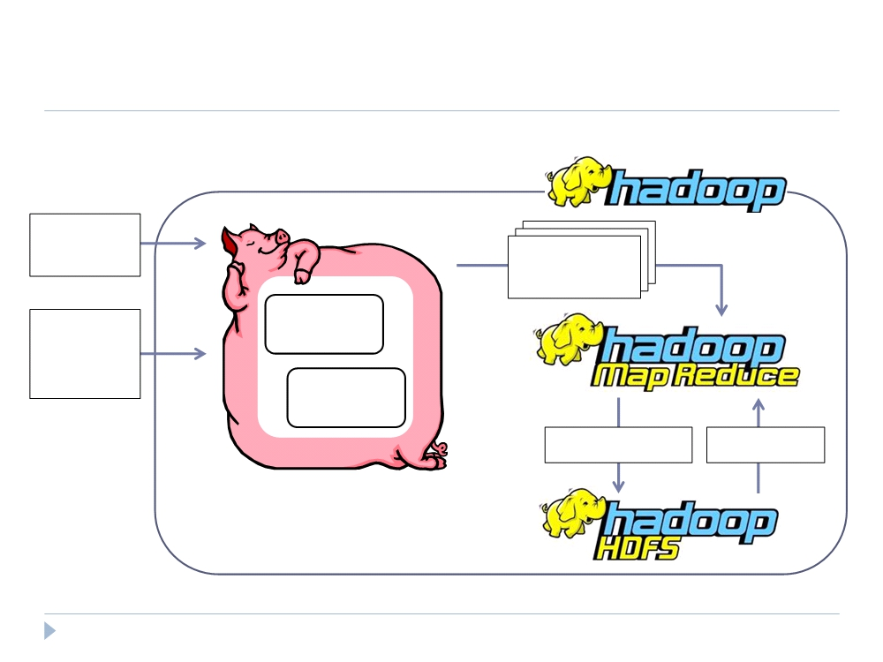
Big Picture
Pig
Pig Latin Script
Map-Reduce Statements
User-
Compile
Defined
Functions
Optimize
Write Results Read Data
10

Slide 10
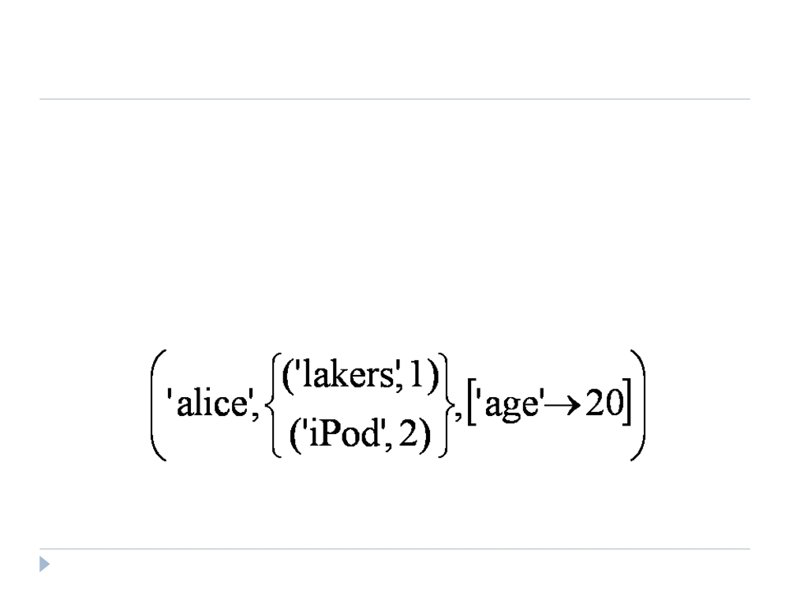
Data Model
 Atom - simple atomic value (ie: number or string)  Tuple
 Bag  Map
11

Slide 11
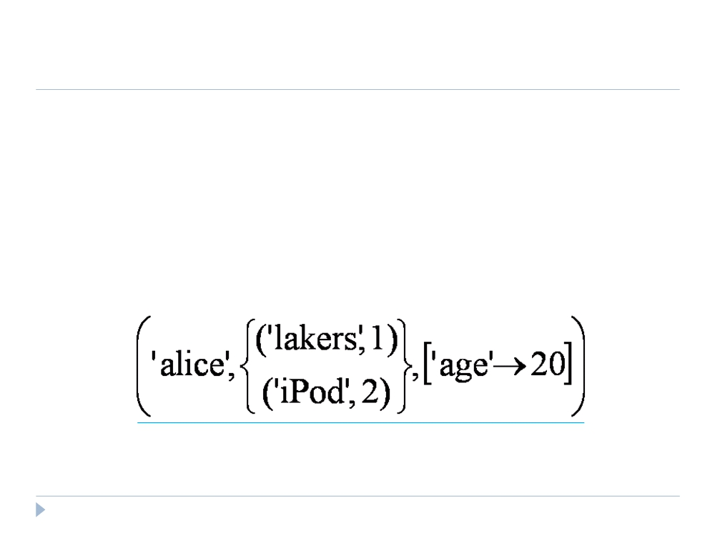
Data Model
 Atom
 Tuple - sequence of fields; each field any type  Bag
 Map
12

Slide 12
Data Model
 Atom
 Tuple
 Bag - collection of tuples
 Duplicates possible
 Tuples in a bag can have different field lengths and field types  Map
13

Slide 13
Data Model
 Atom
 Tuple  Bag
 Map - collection of key-value pairs
 Key is an atom; value can be any type
14

Slide 14
Data Model
 Control over dataflow
Ex 1 (less efficient)
spam_urls = FILTER urls BY isSpam(url);
culprit_urls = FILTER spam_urls BY pagerank > 0.8;
Ex 2 (most efficient)
highpgr_urls = FILTER urls BY pagerank > 0.8;
spam_urls = FILTER highpgr_urls BY isSpam(url);
 Fully nested
 More natural for procedural programmers (target user) than normalization
 Data is often stored on disk in a nested fashion  Facilitates ease of writing user-defined functions
 No schema required
15

Slide 15
Data Model
 User-Defined Functions (UDFs)
 Ex: spam_urls = FILTER urls BY isSpam(url);
 Can be used in many Pig Latin statements  Useful for custom processing tasks
 Can use non-atomic values for input and output  Currently must be written in Java
16

Slide 16
Speaking Pig Latin
 LOAD
 Input is assumed to be a bag (sequence of tuples)  Can specify a deserializer with “USING‟  Can provide a schema with “AS‟
newBag = LOAD ‘filename’ <USING functionName() >
<AS (fieldName1, fieldName2,…)>;
Queries = LOAD ‘query_log.txt’ USING myLoad()
AS (userID,queryString, timeStamp)
17

Slide 17
Speaking Pig Latin
 FOREACH
 Apply some processing to each tuple in a bag  Each field can be:
 A fieldname of the bag  A constant
 A simple expression (ie: f1+f2)
 A predefined function (ie: SUM, AVG, COUNT, FLATTEN)  A UDF (ie: sumTaxes(gst, pst) )
newBag =
FOREACH bagName
GENERATE field1, field2, …;
18

Slide 18
Speaking Pig Latin
 FILTER
 Select a subset of the tuples in a bag
newBag = FILTER bagName BY expression ;
 Expression uses simple comparison operators (==, !=, <, >, …) and Logical connectors (AND, NOT, OR)
some_apples =
FILTER apples BY colour != ‘red’;
 Can use UDFs
some_apples =
FILTER apples BY NOT isRed(colour);
19

Slide 19
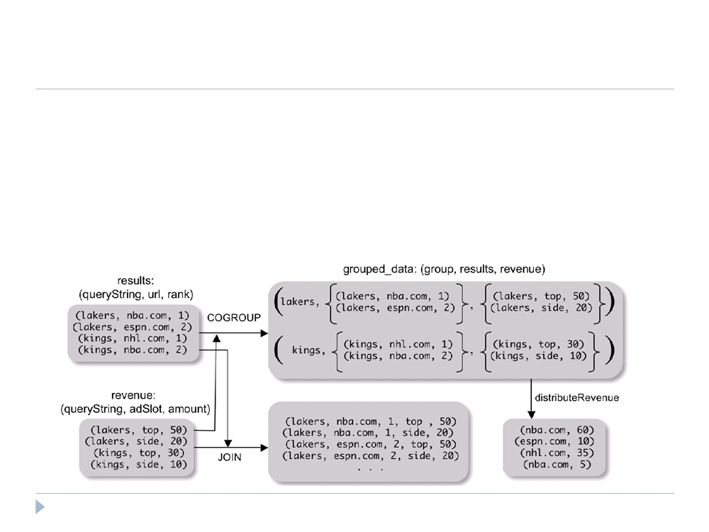
Speaking Pig Latin
 COGROUP
 Group two datasets together by a common attribute  Groups data into nested bags
grouped_data = COGROUP results BY queryString, revenue BY queryString;
20

Slide 20
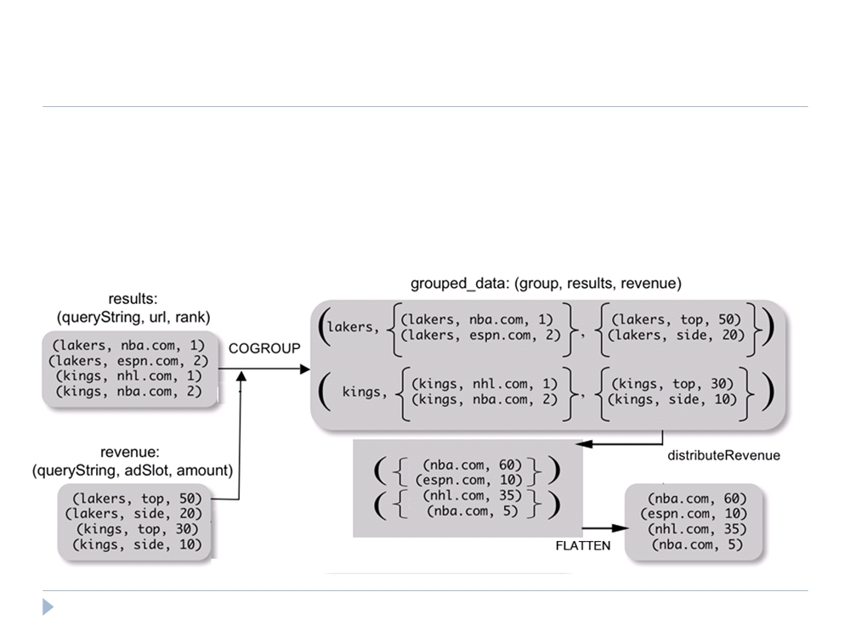
Speaking Pig Latin
 Why COGROUP and not JOIN?
url_revenues =
FOREACH grouped_data GENERATE
FLATTEN(distributeRev(results, revenue));
21

Slide 21
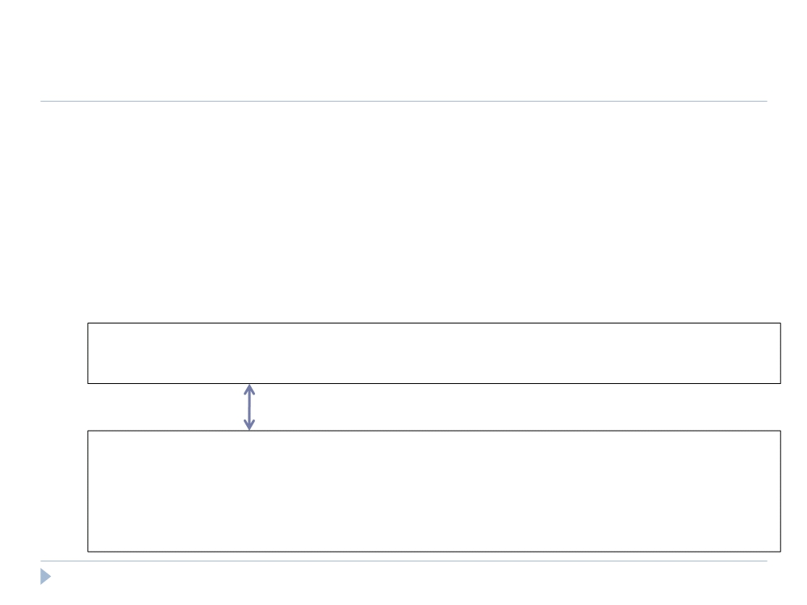
Speaking Pig Latin
 Why COGROUP and not JOIN?
 May want to process nested bags of tuples before taking the cross product.
 Keeps to the goal of a single high-level data transformation per pig-latin statement.
 However, JOIN keyword is still available:
JOIN results BY queryString, revenue BY queryString;
Equivalent
temp = COGROUP results BY queryString, revenue BY queryString;
join_result = FOREACH temp GENERATE
FLATTEN(results), FLATTEN(revenue);
22

Slide 22
Speaking Pig Latin
 STORE (& DUMP)
 Output data to a file (or screen)
STORE bagName INTO ‘filename’ <USING deserializer ()>;
 Other Commands (incomplete)
 UNION - return the union of two or more bags
 CROSS - take the cross product of two or more bags  ORDER - order tuples by a specified field(s)  DISTINCT - eliminate duplicate tuples in a bag  LIMIT - Limit results to a subset
23

Slide 23
Compilation
 Pig system does two tasks:
 Builds a Logical Plan from a Pig Latin script
 Supports execution platform independence
 No processing of data performed at this stage
 Compiles the Logical Plan to a Physical Plan and Executes
 Convert the Logical Plan into a series of Map-Reduce statements to be executed (in this case) by Hadoop Map-Reduce
24

Slide 24
Compilation
 Building a Logical Plan
 Verify input files and bags referred to are valid  Create a logical plan for each bag(variable) defined
25

Slide 25

Compilation
 Building a Logical Plan Example
A = LOAD ‘user.dat’ AS (name, age, city);
Load(user.dat)
B = GROUP A BY city;
C = FOREACH B GENERATE group AS city, COUNT(A);
D = FILTER C BY city IS ‘kitchener’ OR city IS ‘waterloo’;
STORE D INTO ‘local_user_count.dat’;
26

Slide 26
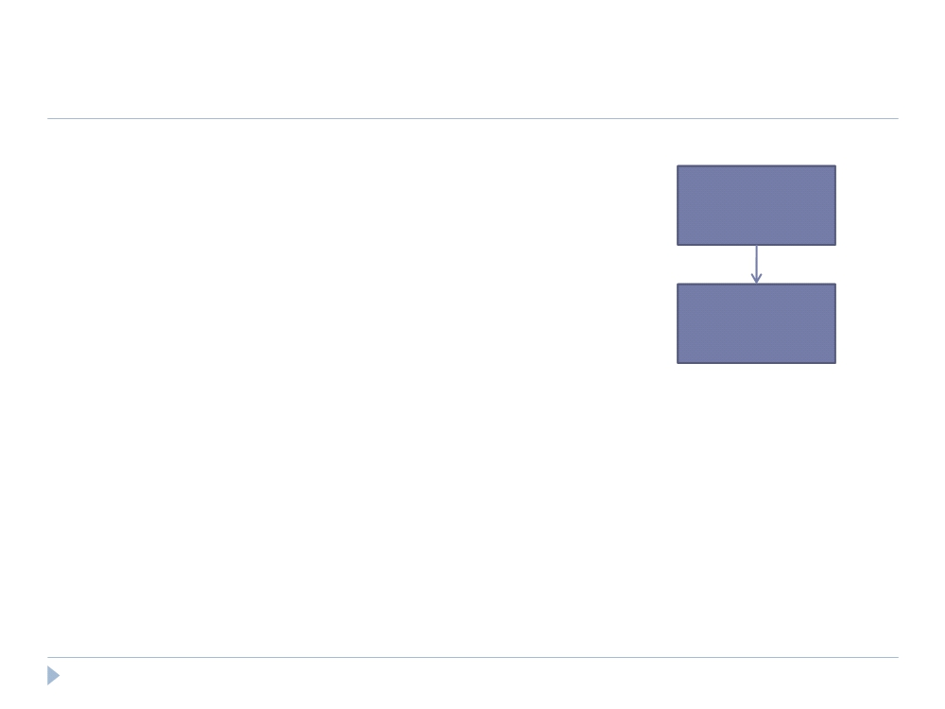
Compilation
 Building a Logical Plan Example
A = LOAD ‘user.dat’ AS (name, age, city);
Load(user.dat)
B = GROUP A BY city;
C = FOREACH B GENERATE group AS city, COUNT(A);
D = FILTER C BY city IS ‘kitchener’
Group
OR city IS ‘waterloo’;
STORE D INTO ‘local_user_count.dat’;
27

Slide 27
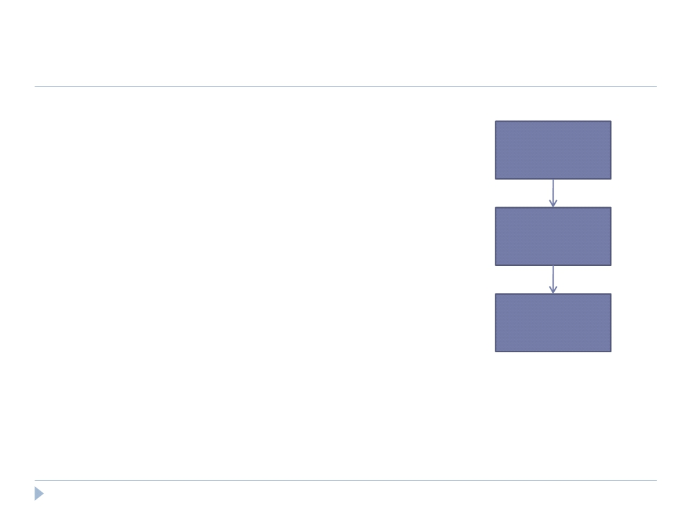
Compilation
 Building a Logical Plan Example
A = LOAD ‘user.dat’ AS (name, age, city);
Load(user.dat)
B = GROUP A BY city;
C = FOREACH B GENERATE group AS city, COUNT(A);
D = FILTER C BY city IS ‘kitchener’
Group
OR city IS ‘waterloo’;
STORE D INTO ‘local_user_count.dat’;
Foreach
28

Slide 28
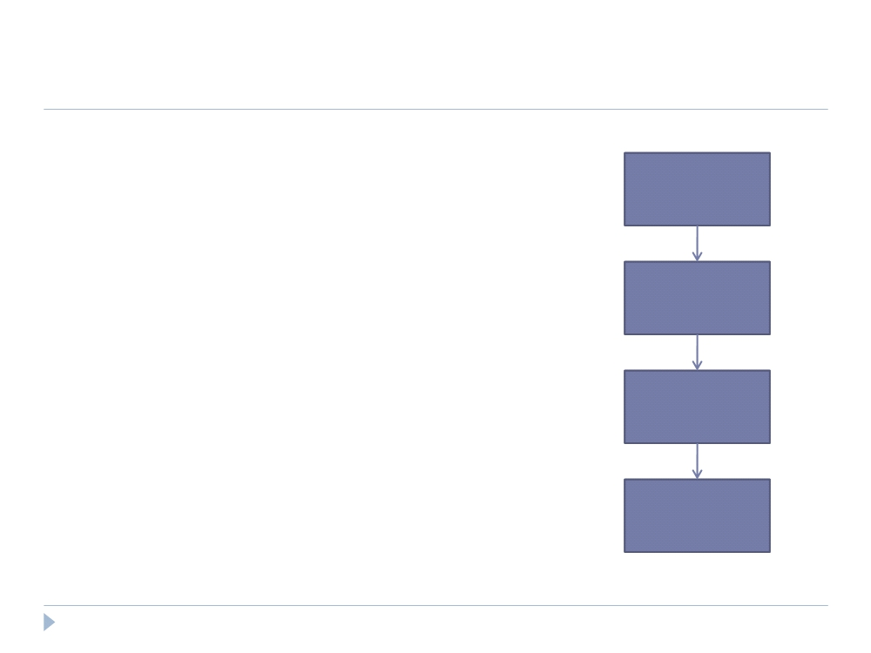
Compilation
 Building a Logical Plan Example
A = LOAD ‘user.dat’ AS (name, age, city);
Load(user.dat)
B = GROUP A BY city;
C = FOREACH B GENERATE group AS city, COUNT(A);
D = FILTER C BY city IS ‘kitchener’
Group
OR city IS ‘waterloo’;
STORE D INTO ‘local_user_count.dat’;
Foreach
Filter
29

Slide 29
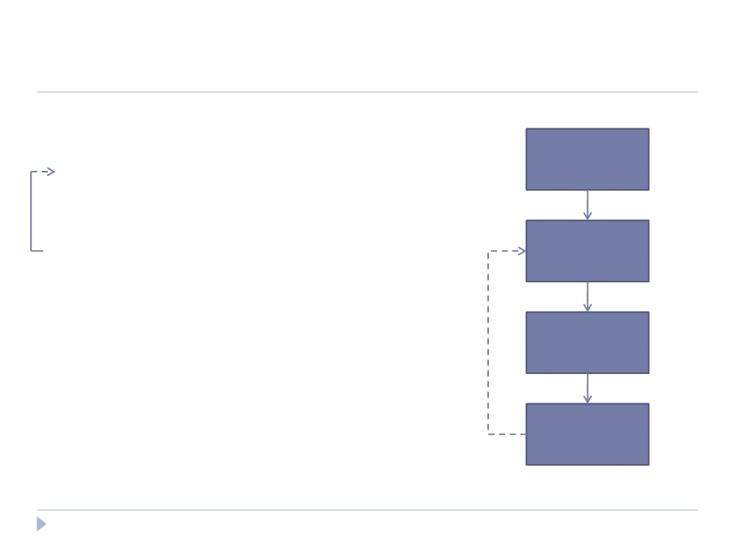
Compilation
 Building a Logical Plan Example
A = LOAD ‘user.dat’ AS (name, age, city);
Load(user.dat)
B = GROUP A BY city;
C = FOREACH B GENERATE group AS city, COUNT(A);
D = FILTER C BY city IS ‘kitchener’
Filter
OR city IS ‘waterloo’;
STORE D INTO ‘local_user_count.dat’;
Group
Foreach
30

Slide 30
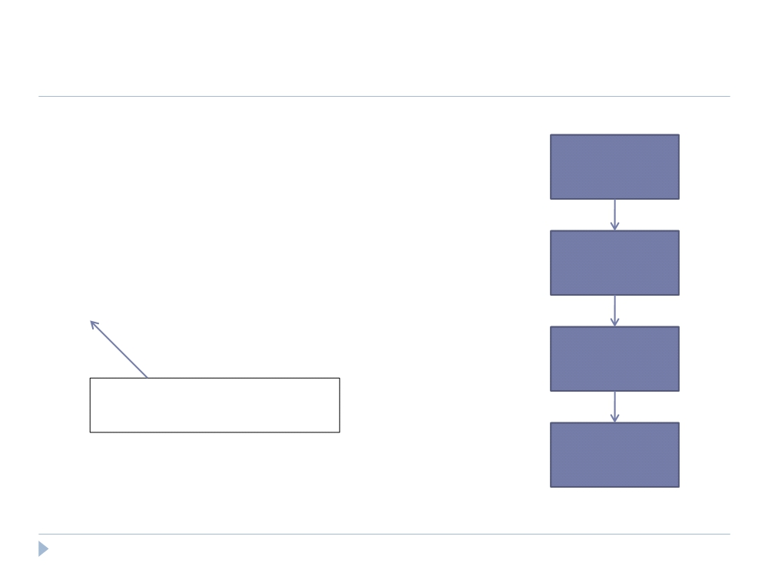
Compilation
 Building a Physical Plan
A = LOAD ‘user.dat’ AS (name, age, city);
Load(user.dat)
B = GROUP A BY city;
C = FOREACH B GENERATE group AS city, COUNT(A);
D = FILTER C BY city IS ‘kitchener’
Filter
OR city IS ‘waterloo’;
STORE D INTO ‘local_user_count.dat’;
Group
Only happens when output is specified by STORE or DUMP
Foreach
32

Slide 31
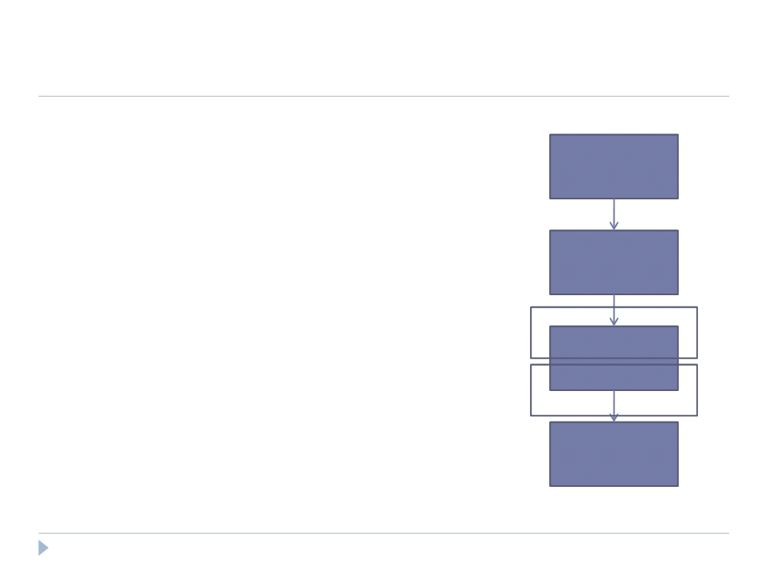
Compilation
 Building a Physical Plan
 Step 1: Create a map-reduce job for each COGROUP
Load(user.dat)
Filter
Map
Group
Reduce
Foreach
33

Slide 32
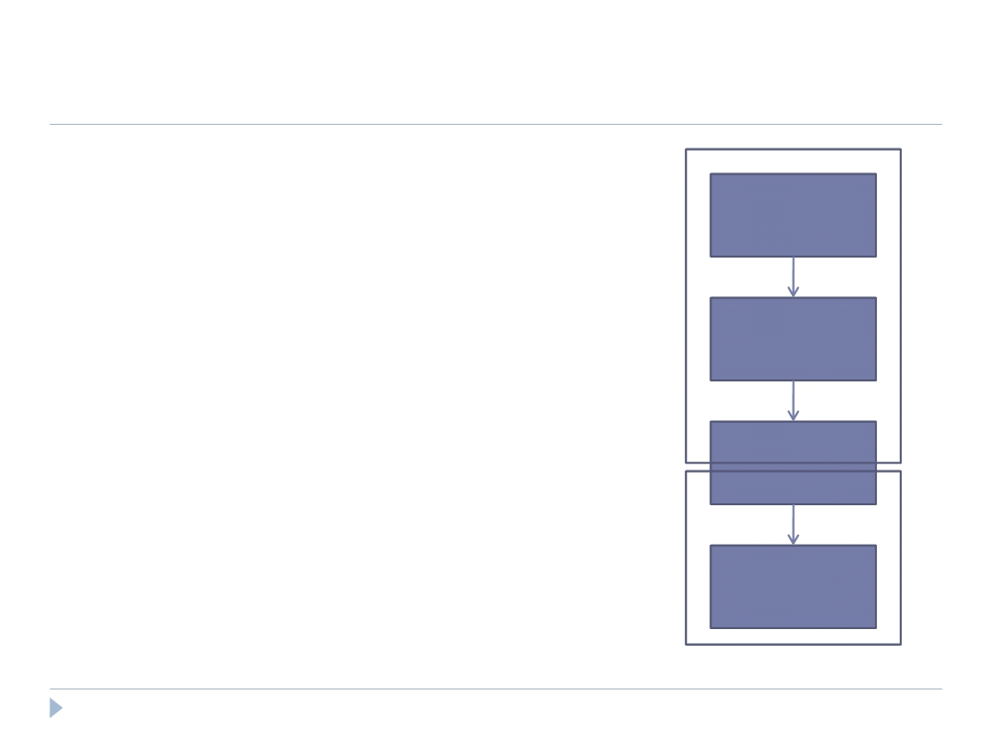
Compilation
 Building a Physical Plan
 Step 1: Create a map-reduce job for each COGROUP
Load(user.dat)
 Step 2: Push other commands into the map and reduce functions where Map
Filter
possible
 May be the case certain commands
Group
require their own map-reduce
job (ie: ORDER needs separate map-
Reduce
reduce jobs)
Foreach
34

Slide 33
Compilation
 Efficiency in Execution
 Parallelism
 Loading data - Files are loaded from HDFS
 Statements are compiled into map-reduce jobs
35

Slide 34
Compilation
 Efficiency with Nested Bags
 In many cases, the nested bags created in each tuple of a COGROUP statement never need to physically materialize
 Generally perform aggregation after a COGROUP and the
statements for said aggregation are pushed into the reduce function
 Applies to algebraic functions (ie: COUNT, MAX, MIN, SUM, AVG)
36

Slide 35
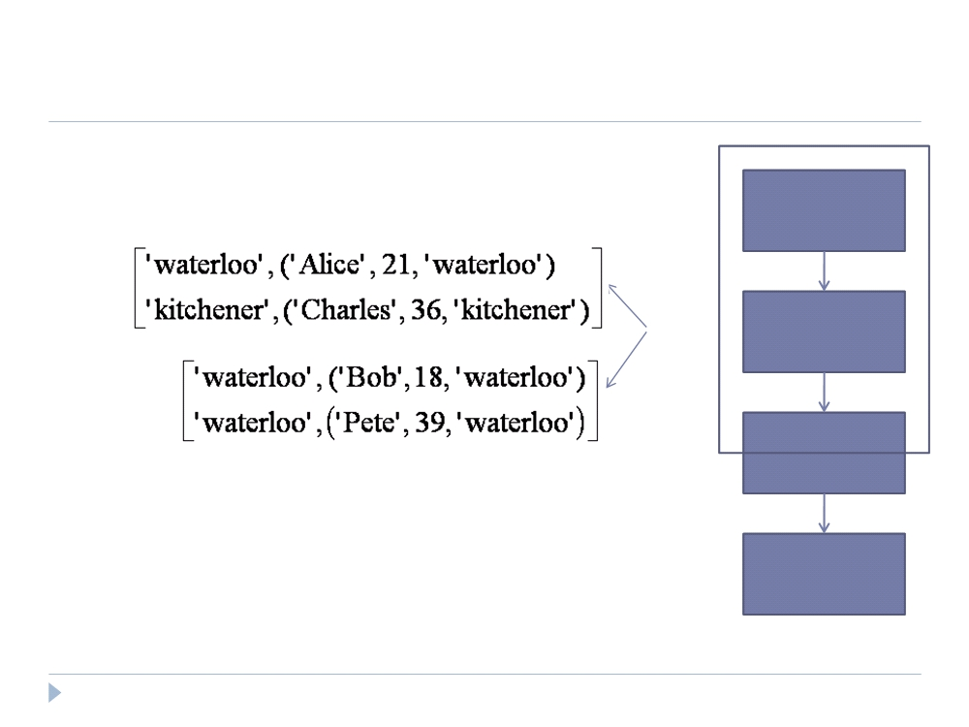
Compilation
 Efficiency with Nested Bags
Load(user.dat)
Map
Filter
Group
Foreach
37

Slide 36
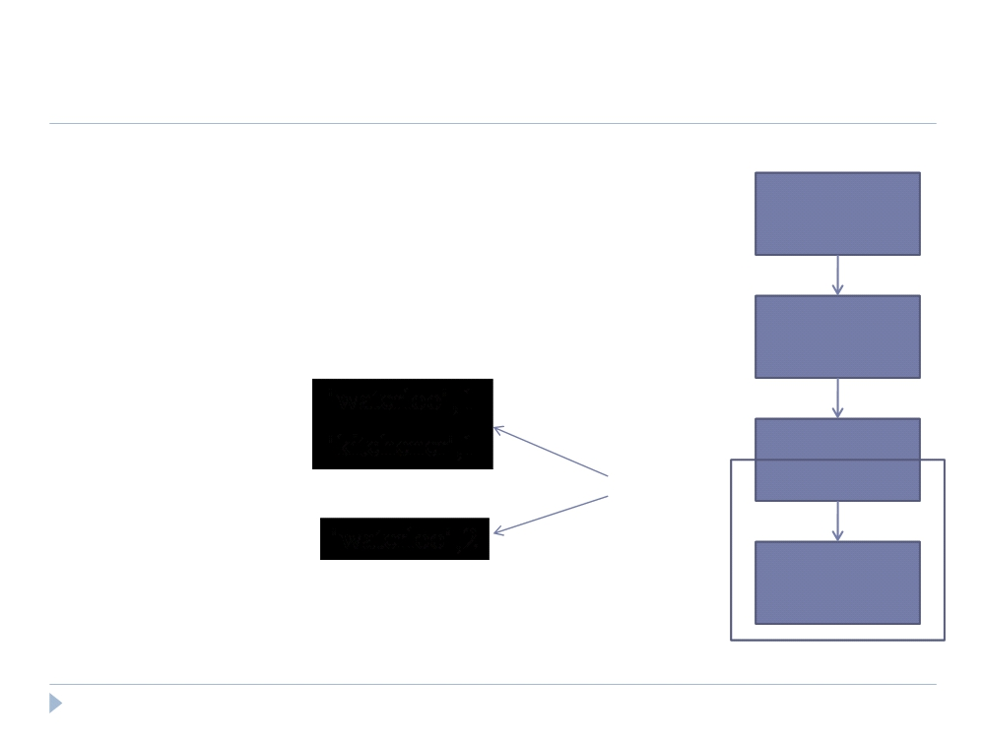
Compilation
 Efficiency with Nested Bags
Load(user.dat)
Filter
Group
Combine
Foreach
38

Slide 37
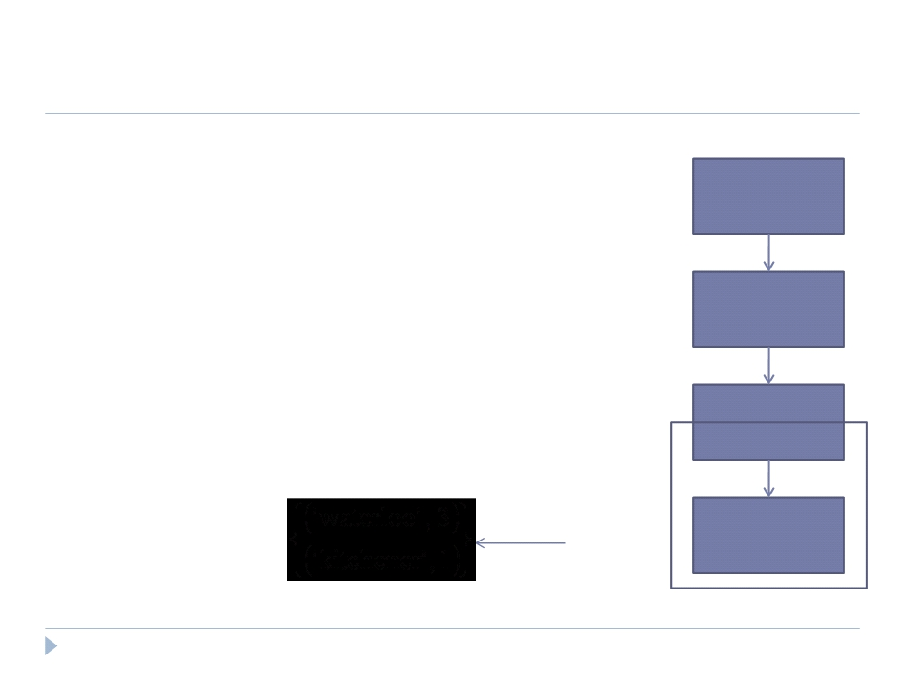
Compilation
 Efficiency with Nested Bags
Load(user.dat)
Filter
Group
Reduce
Foreach
39

Slide 38
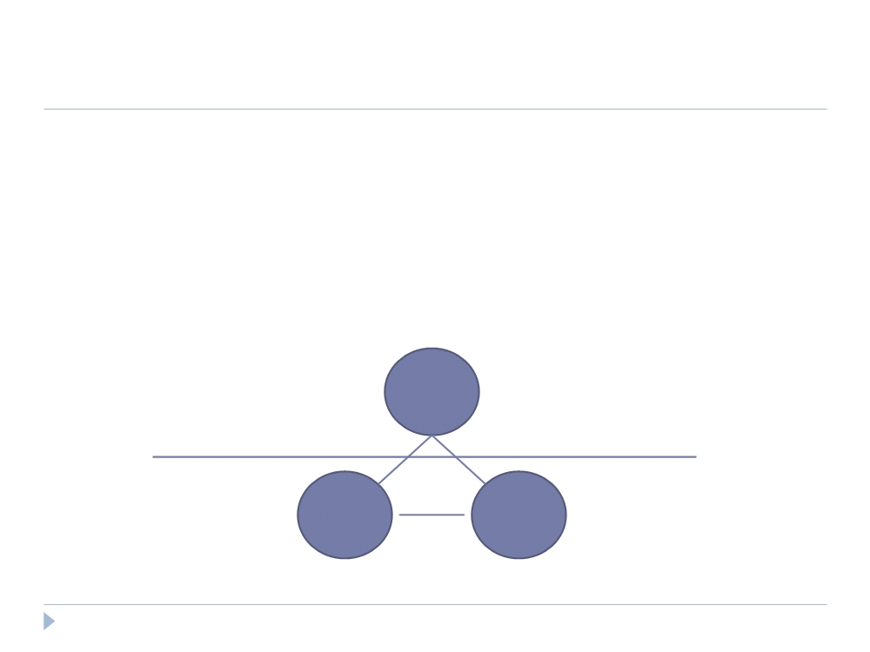
Compilation
 Efficiency with Nested Bags
 Why this works:
◻ COUNT is an algebraic function; it can be structured as a tree of sub- functions with each leaf working on a subset of the data
Reduce
SUM
Combine
COUNT
COUNT
40

Slide 39
Compilation
 Efficiency with Nested Bags
 Pig provides an interface for writing algebraic UDFs so they can take advantage of this optimization as well.
 Inefficiencies
 Non-algebraic aggregate functions (ie: MEDIAN) need entire bag to materialize; may cause a very large bag to spill to disk if it doesn‟t fit in memory
 Every map-reduce job requires data be written and replicated to the HDFS (although this is offset by parallelism achieved)
41

Slide 40
Debugging
How to verify the semantics of an analysis program
Run the program against whole data set. Might take hours!
Generate sample dataset
Empty result set may occur on few operations like join, filter
Generally, testing with sample dataset is difficult
Pig-Pen
Samples data from large dataset for Pig statements
Apply individual Pig-Latin commands against the dataset
In case of empty result, pig system resamples
Remove redundant samples
42

Slide 41
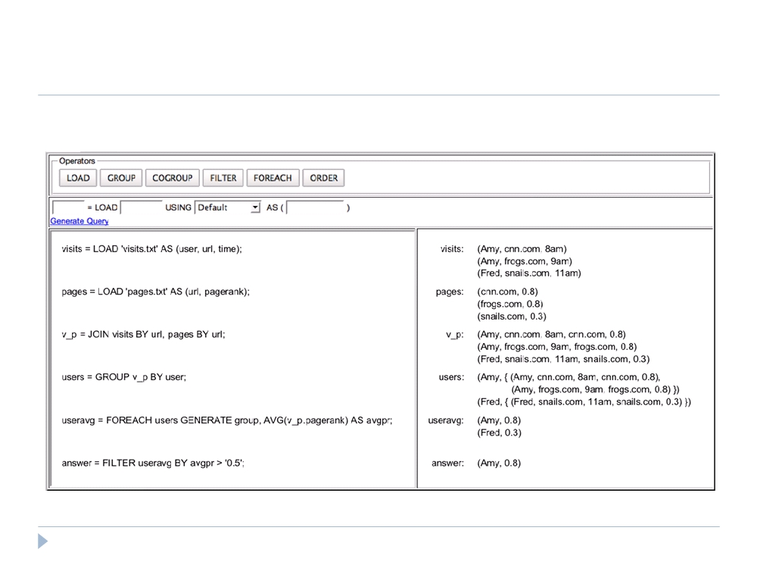
Debugging
 Pig-Pen
42

Slide 42
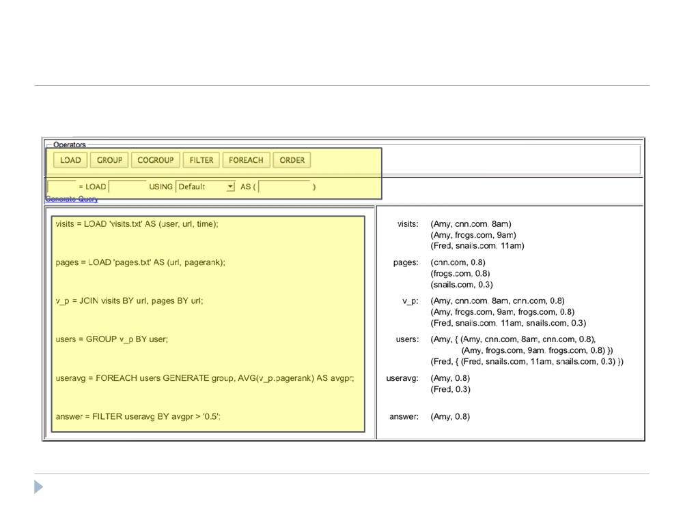
Debugging
 Pig-Latin command window and command generator
43

Slide 43
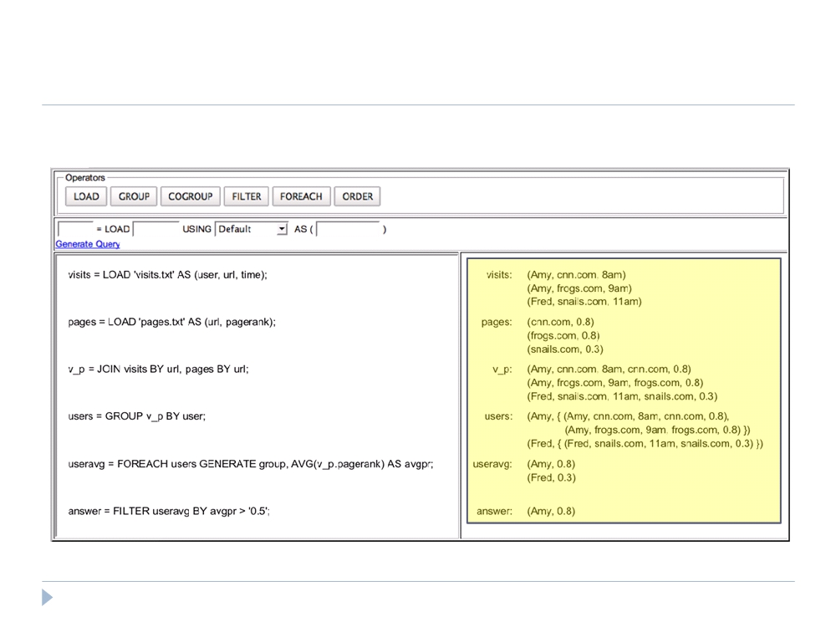
Debugging
 Sand Box Dataset (generated automatically!)
44

Slide 44
Debugging
 Pig-Pen
 Provides sample data that is:
 Real - taken from actual data  Concise - as small as possible
 Complete - collectively illustrate the key semantics of each command
 Helps with schema definition
 Facilitates incremental program writing
45

Slide 45
Conclusion
 Pig is a data processing environment in Hadoop that is specifically targeted towards procedural programmers who perform large-scale data analysis.
 Pig-Latin offers high-level data manipulation in a procedural style.
 Pig-Pen is a debugging environment for Pig-Latin commands that generates samples from real data.
47

Slide 46

More Info
 Pig, http://hadoop.apache.org/pig/  Hadoop, http://hadoop.apache.org
Anks-
Thay!
48

