Slide 1
High Level Language: Pig Latin
Hui Li
Judy Qiu
Some material adapted from slides by Adam Kawa the 3rd meeting of WHUG June 21, 2012

Slide 2

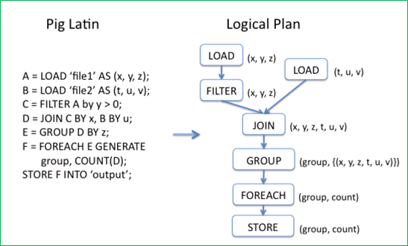
What is Pig
Framework for analyzing large un-structured and semi-structured data on top of Hadoop.
Pig Engine Parses, compiles Pig Latin scripts into MapReduce jobs run on top of Hadoop.
Pig Latin is declarative, SQL-like language; the high level language interface for Hadoop.
Notes:
Write pig latin job is as simple as writing sql queries, for complex cases, the developers can integrate user defined function into the pig statements.

Slide 3
Motivation of Using Pig
Faster development
Fewer lines of code (Writing map reduce like writing SQL queries)
Re-use the code (Pig library, Piggy bank)
One test: Find the top 5 words with most high frequency
10 lines of Pig Latin V.S 200 lines in Java
15 minutes in Pig Latin V.S 4 hours in Java
Notes:
Accelerate development process, many company such as Yahoo, Twitter, using Pig Latin to process large scale data.

Slide 4
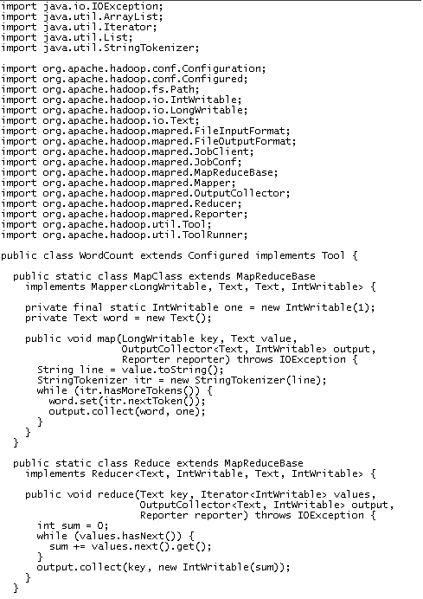
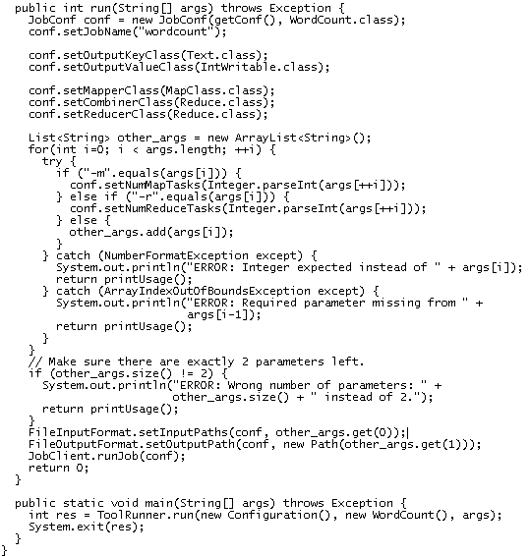
Word Count using MapReduce

Slide 5
Word Count using Pig
Lines=LOAD ‘input/hadoop.log’ AS (line: chararray);
Words = FOREACH Lines GENERATE FLATTEN(TOKENIZE(line)) AS word;
Groups = GROUP Words BY word;
Counts = FOREACH Groups GENERATE group, COUNT(Words);
Results = ORDER Words BY Counts DESC;
Top5 = LIMIT Results 5;
STORE Top5 INTO /output/top5words;

Slide 6
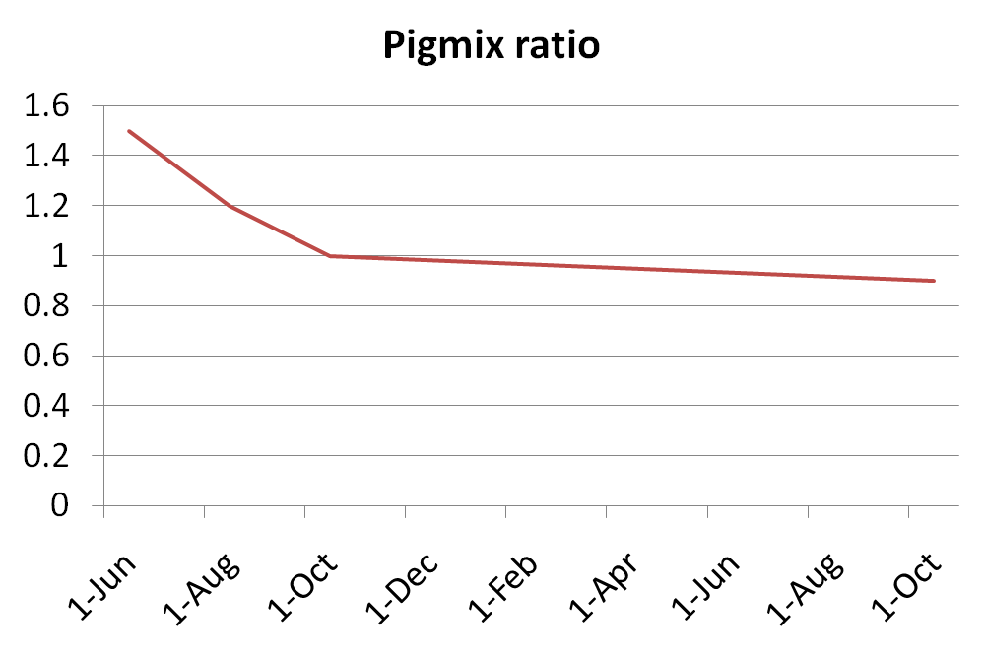
Pig performance VS MapReduce
Pigmix : pig vs mapreduce
Notes:
Where does pig stand, compared to java MR in terms of performance ?
We have what we call Pigmix, which is a set of queries used to test pig performance from release to release.
PigMix is a set of queries used test pig performance from release to release. There are queries that test latency (how long does it take to run this query?), and queries that test scalability (how many fields or records can pig handle before it fails?). In addition it includes a set of map reduce java programs to run equivalent map reduce jobs directly
http://wiki.apache.org/pig/PigMix
6

Slide 7
Pig Highlights
UDFs can be written to take advantage of the combiner
Four join implementations are built in
Writing load and store functions is easy once an InputFormat and OutputFormat exist
Multi-query: pig will combine certain types of operations together in a single pipeline to reduce the number of times data is scanned.
Order by provides total ordering across reducers in a balanced way
Piggybank, a collection of user contributed UDFs
Notes:
Inner join, out join, exclusive, inclusive; User defined functions (UDFs) can be written for column transformation (TOUPPER), or aggregation
Merge join; skewed join; replicated join; spare-marge join

Slide 8
Who uses Pig for What
70% of production jobs at Yahoo (10ks per day)
Twitter, LinkedIn, Ebay, AOL,…
Used to
Process web logs
Build user behavior models
Process images
Build maps of the web
Do research on large data sets
Notes:
Pig is used for processing large scale data sets

Slide 9
Pig Hands-on
Accessing Pig
Basic Pig knowledge: (Word Count)
Pig Data Types
Pig Operations
How to run Pig Scripts
Advanced Pig features: (Kmeans Clustering)
Embedding Pig within Python
User Defined Function

Slide 10
Accessing Pig
Accessing approaches:
Batch mode: submit a script directly
Interactive mode: Grunt, the pig shell
PigServer Java class, a JDBC like interface
Execution mode:
Local mode: pig –x local
Mapreduce mode: pig –x mapreduce

Slide 11
Pig Data Types
Scalar Types:
Int, long, float, double, boolean, null, chararray, bytearry;
Complex Types: fields, tuples, bags, relations;
A Field is a piece of data
A Tuple is an ordered set of fields
A Bag is a collection of tuples
A Relation is a bag
Samples:
Tuple → Row in Database
( 0002576169, Tome, 20, 4.0)
Bag → Table or View in Database
{(0002576169 , Tome, 20, 4.0),
(0002576170, Mike, 20, 3.6),
(0002576171 Lucy, 19, 4.0), …. }
Notes:
Map a set of keyval pair; A Pig relation is a bag of tuples. A Pig relation is similar to a table in a relational database, where the tuples in the bag correspond to the rows in a table. Unlike a relational table, however, Pig relations don't require that every tuple contain the same number of fields or that the fields in the same position (column) have the same type.

Slide 12
Pig Operations
Loading data
LOAD loads input data
Lines=LOAD ‘input/access.log’ AS (line: chararray);
Projection
FOREACH … GENERTE … (similar to SELECT)
takes a set of expressions and applies them to every record.
Grouping
GROUP collects together records with the same key
Dump/Store
DUMP displays results to screen, STORE save results to file system
Aggregation
AVG, COUNT, MAX, MIN, SUM
Notes:
There are more than 20 Pig operations

Slide 13
Pig Operations
Pig Data Loader
PigStorage: loads/stores relations using field-delimited text format
TextLoader: loads relations from a plain-text format
BinStorage:loads/stores relations from or to binary files
PigDump: stores relations by writing the toString() representation of tuples, one per line
(John,18,4.0F)
(Mary,19,3.8F)
(Bill,20,3.9F)
students = load 'student.txt' using PigStorage('\t')
as (studentid: int, name:chararray, age:int, gpa:double);

Slide 14
Pig Operations - Foreach
Foreach ... Generate
The Foreach … Generate statement iterates over the members of a bag
The result of a Foreach is another bag
Elements are named as in the input bag
studentid = FOREACH students GENERATE studentid, name;

Slide 15
Pig Operations – Positional Reference
Fields are referred to by positional notation or by name (alias).
students = LOAD 'student.txt' USING PigStorage() AS (name:chararray, age:int, gpa:float);
DUMP A;
(John,18,4.0F)
(Mary,19,3.8F)
(Bill,20,3.9F)
studentname = Foreach students Generate $1 as studentname;
 | First Field | Second Field | Third Field
Data Type | chararray | int | float
Position notation | $0 | $1 | $2
Name (variable) | name | age | Gpa
Field value | Tom | 19 | 3.9
Notes:
Fields are referred to by positional notation or by name (alias).
Positional notation is generated by the system. Positional notation is indicated with the dollar sign ($) and begins with zero (0); for example, $0, $1, $2.
Names are assigned by you using schemas (or, in the case of the GROUP operator and some functions, by the system). You can use any name that is not a Pig keyword; for example, f1, f2, f3 or a, b, c or name, age, gpa.
Given relation A above, the three fields are separated out in this table.

Slide 16
Pig Operations- Group
Groups the data in one or more relations
The GROUP and COGROUP operators are identical.
Both operators work with one or more relations.
For readability GROUP is used in statements involving one relation
COGROUP is used in statements involving two or more relations. Jointly Group the tuples from A and B.
B = GROUP A BY age;
C = COGROUP A BY name, B BY name;

Slide 17
Pig Operations – Dump&Store
DUMP Operator:
display output results, will always trigger execution
STORE Operator:
Pig will parse entire script prior to writing for efficiency purposes
A = LOAD ‘input/pig/multiquery/A’;
B = FILTER A by $1 == “apple”;
C = FILTER A by $1 == “apple”;
SOTRE B INTO “output/b”
STORE C INTO “output/c”
Relations B&C both derived from A
Prior this would create two MapReduce jobs
Pig will now create one MapReduce job with output results
Notes:
Push results to stand output

Slide 18
Pig Operations - Count
Compute the number of elements in a bag
Use the COUNT function to compute the number of elements in a bag.
COUNT requires a preceding GROUP ALL statement for global counts and GROUP BY statement for group counts.
X = FOREACH B GENERATE COUNT(A);

Slide 19
Pig Operation - Order
Sorts a relation based on one or more fields
In Pig, relations are unordered. If you order relation A to produce relation X relations A and X still contain the same elements.
student = ORDER students BY gpa DESC;

Slide 20
How to run Pig Latin scripts
Local mode
Local host and local file system is used
Neither Hadoop nor HDFS is required
Useful for prototyping and debugging
MapReduce mode
Run on a Hadoop cluster and HDFS
Batch mode - run a script directly
Pig –x local my_pig_script.pig
Pig –x mapreduce my_pig_script.pig
Interactive mode use the Pig shell to run script
Grunt> Lines = LOAD ‘/input/input.txt’ AS (line:chararray);
Grunt> Unique = DISTINCT Lines;
Grunt> DUMP Unique;

Slide 21
Hands-on: Word Count using Pig Latin
Get and Setup Hand-on VM from: http://salsahpc.indiana.edu/ScienceCloud/virtualbox_appliance_guide.html
cd pigtutorial/pig-hands-on/
tar –xf pig-wordcount.tar
cd pig-wordcount
Batch mode
pig –x local wordcount.pig
Iterative mode
grunt> Lines=LOAD ‘input.txt’ AS (line: chararray);
grunt>Words = FOREACH Lines GENERATE FLATTEN(TOKENIZE(line)) AS word;
grunt>Groups = GROUP Words BY word;
grunt>counts = FOREACH Groups GENERATE group, COUNT(Words);
grunt>DUMP counts;

Slide 22
TOKENIZE&FLATTEN
TOKENIZE returns a new bag for each input; “FLATTEN” eliminates bag nesting
A:{line1, line2, line3…}
After Tokenize:{{lineword1,line1word2,…}},{line2word1,line2word2…}}
After Flatten{line1word1,line1word2,line2word1…}

Slide 23
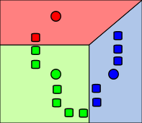

Sample: Kmeans using Pig Latin
A method of cluster analysis which aims to partition n observations into k clusters in which each observation belongs to the cluster with the nearest mean.
Assignment step: Assign each observation to the cluster with the closest mean
Update step: Calculate the new means to be the centroid of the observations in the cluster.
Reference: http://en.wikipedia.org/wiki/K-means_clustering

Slide 24
Kmeans Using Pig Latin
PC = Pig.compile("""register udf.jar
DEFINE find_centroid FindCentroid('$centroids');
students = load 'student.txt' as (name:chararray, age:int, gpa:double);
centroided = foreach students generate gpa, find_centroid(gpa) as centroid;
grouped = group centroided by centroid;
result = Foreach grouped Generate group, AVG(centroided.gpa);
store result into 'output';
""")

Slide 25
Kmeans Using Pig Latin
while iter_num<MAX_ITERATION:
PCB = PC.bind({'centroids':initial_centroids})
results = PCB.runSingle()
iter = results.result("result").iterator()
centroids = [None] * v
distance_move = 0.0
# get new centroid of this iteration, calculate the moving distance with last iteration
for i in range(v):
tuple = iter.next()
centroids[i] = float(str(tuple.get(1)))
distance_move = distance_move + fabs(last_centroids[i]-centroids[i])
distance_move = distance_move / v;
if distance_move<tolerance:
converged = True
break
……

Slide 26
User Defined Function
What is UDF
Way to do an operation on a field or fields
Called from within a pig script
Currently all done in Java
Why use UDF
You need to do more than grouping or filtering
Actually filtering is a UDF
Maybe more comfortable in Java land than in SQL/Pig Latin
P = Pig.compile("""register udf.jar
DEFINE find_centroid FindCentroid('$centroids');

Slide 27
Embedding Python scripts with Pig Statements
Pig does not support flow control statement: if/else, while loop, for loop, etc.
Pig embedding API can leverage all language features provided by Python including control flow:
Loop and exit criteria
Similar to the database embedding API
Easier parameter passing
JavaScript is available as well
The framework is extensible. Any JVM implementation of a language could be integrated

Slide 28
Hands-on Run Pig Latin Kmeans
Get and Setup Hand-on VM from: http://salsahpc.indiana.edu/ScienceCloud/virtualbox_appliance_guide.html
cd pigtutorial/pig-hands-on/
tar –xf pig-kmeans.tar
cd pig-kmeans
export PIG_CLASSPATH= /opt/pig/lib/jython-2.5.0.jar
Hadoop dfs –copyFromLocal input.txt ./input.txt
pig –x mapreduce kmeans.py
pig—x local kmeans.py

Slide 29
Hands-on Pig Latin Kmeans Result
2012-07-14 14:51:24,636 [main] INFO org.apache.pig.scripting.BoundScript - Query to run:
register udf.jar
DEFINE find_centroid FindCentroid('0.0:1.0:2.0:3.0');
students = load 'student.txt' as (name:chararray, age:int, gpa:double);
centroided = foreach students generate gpa, find_centroid(gpa) as centroid;
grouped = group centroided by centroid;
result = foreach grouped generate group, AVG(centroided.gpa);
store result into 'output';
Input(s): Successfully read 10000 records (219190 bytes) from:
"hdfs://iw-ubuntu/user/developer/student.txt"
Output(s): Successfully stored 4 records (134 bytes) in:
"hdfs://iw-ubuntu/user/developer/output“
last centroids: [0.371927835052,1.22406743491,2.24162171881,3.40173705722]

Slide 30


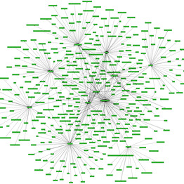
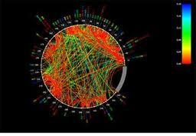





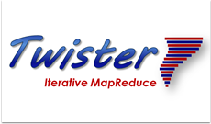


Big Data Challenge
Peta 10^15
Tera 10^12
Giga 10^9
Mega 10^6
Notes:
The primary function of data flow language and runtimes is the management and manipulation of data. The sample systems include the MapReduce architecture pioneered by Google and the open-source implementation called Hadoop. 30 peta new gene data per data. High through put gene sequence data .

Slide 31
Search Engine System with MapReduce Technologies
Search Engine System for Summer School
To give an example of how to use MapReduce technologies to solve big data challenge.
Using Hadoop/HDFS/HBase/Pig
Indexed 656K web pages (540MB in size) selected from Clueweb09 data set.
Calculate ranking values for 2 million web sites.

Slide 32
Architecture for SESSS
Apache Lucene
Inverted Indexing System
PHP script
Web UI
HBase Tables
1. inverted index table
2. page rank table
Hive/Pig script
HBase
Apache Server on Salsa Portal
Thrift client
Thrift server
Pig script
Hadoop Cluster
on FutureGrid
Ranking System

Slide 33
Pig PageRank
P = Pig.compile("""
previous_pagerank = LOAD '$docs_in‘ USING PigStorage('\t')
AS ( url: chararray, pagerank: float, links:{ link: ( url: chararray ) } );
outbound_pagerank = FOREACH previous_pagerank GENERATE pagerank / COUNT ( links ) AS pagerank,
FLATTEN ( links ) AS to_url;
new_pagerank = FOREACH ( COGROUP outbound_pagerank BY to_url, previous_pagerank BY url INNER )
GENERATE group AS url, ( 1 - $d ) + $d * SUM ( outbound_pagerank.pagerank ) AS pagerank,
FLATTEN ( previous_pagerank.links ) AS links;
STORE new_pagerank INTO '$docs_out‘ USING PigStorage('\t'); """)
# 'd' tangling value in pagerank model
params = { 'd': '0.5', 'docs_in': input }
for i in range(1):
output = "output/pagerank_data_" + str(i + 1)
params["docs_out"] = output
# Pig.fs("rmr " + output)
stats = P.bind(params).runSingle()
if not stats.isSuccessful():
raise 'failed'
params["docs_in"] = output

Slide 34
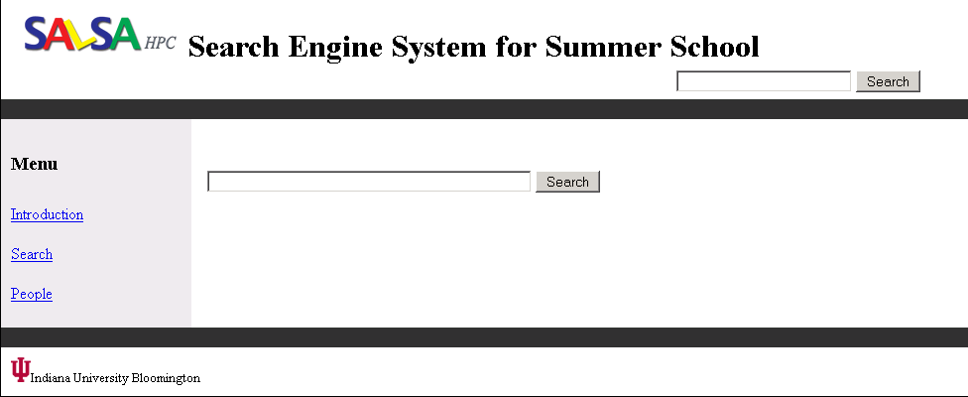
Demo Search Engine System for Summer School
build-index-demo.exe (build index with HBase)
pagerank-demo.exe (compute page rank with Pig)
http://salsahpc.indiana.edu/sesss/index.php

Slide 35
References:
http://pig.apache.org (Pig official site)
http://en.wikipedia.org/wiki/K-means_clustering
Docs http://pig.apache.org/docs/r0.9.0
Papers: http://wiki.apache.org/pig/PigTalksPapers
http://en.wikipedia.org/wiki/Pig_Latin
Slides by Adam Kawa the 3rd meeting of WHUG June 21, 2012
Questions ☺?

Slide 36
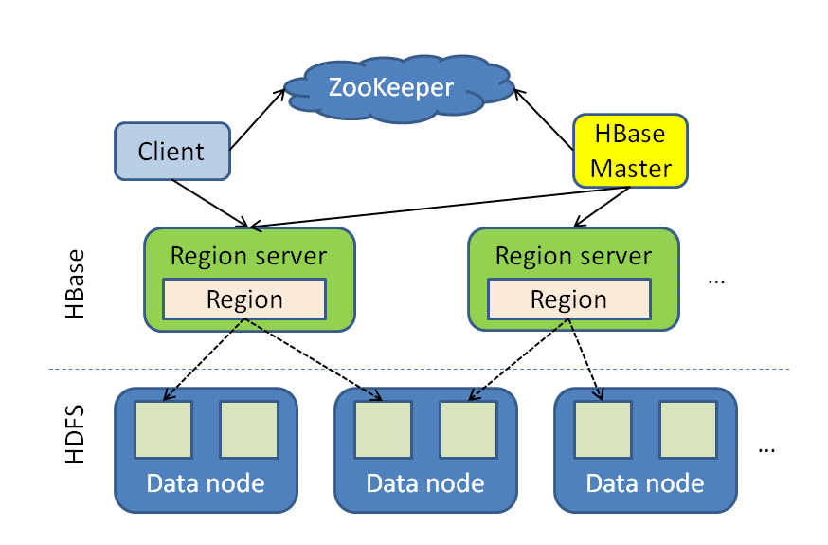
HBase Cluster Architecture
Tables split into regions and served by region servers
Regions vertically divided by column families into “stores”
Stores saved as files on HDFS
Notes:
Region a subset of a table’s rows, like a range parition; region server, serves data for reads and writes, master responsible for coordinating the slaves, assigns regions, detects failures of region

