Slide 1
Working with pig
Cloud computing lecture

Slide 2
Purpose
Get familiar with the pig environment
Advanced features
Walk though some examples

Slide 3
Pig environment
Web site: pig.apache.org
Download the latest version, unzip, and move to an appropriate directory.
Setup your path
  In .profile or .bashrc
  export JAVA_HOME=/to/java/installation
  Add pig’s bin directory to your PATH (optional)

Slide 4
Two modes to run pig
Interactive modes
  Local: “pig –x local”
  Hadoop: “pig –x mapreduce”, or just “pig”
batch mode: all commands in one script file.
  Local: “pig –x local your_script”
  Hadoop: “pig your_script”

Slide 5
Comments
/* */ for multiple lines
-- for single line

Slide 6
First simple program id.pig
A = load ‘/etc/passwd' using PigStorage(':'); -- load the passwd file
B = foreach A generate $0 as id; -- extract the user IDs
store B into ‘id.out’; -- write the results to a file name id.out
Test run it with interactive mode and batch mode

Slide 7
2nd program: student.pig
A = LOAD 'student' USING PigStorage() AS (name:chararray, age:int, gpa:float);
B = FOREACH A GENERATE name;
DUMP B;
----------------------------------
Dump for debugging
Store for final output

Slide 8
Built-in functions
Eval functions
Load/Store functions
Math functions
String functions
Type conversion functions

Slide 9
UDF
Java
Python or Jython
Javascript
Ruby
Piggy bank – a library of user contributed UDF

Slide 10
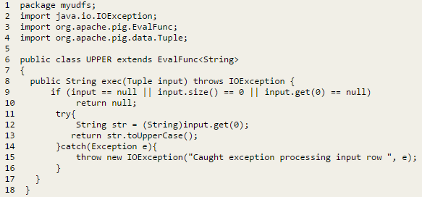
UDF example
Compile it:
  cd myudfs
  javac -cp pig.jar UPPER.java
  cd ..
  jar -cf myudfs.jar myudfs

Slide 11

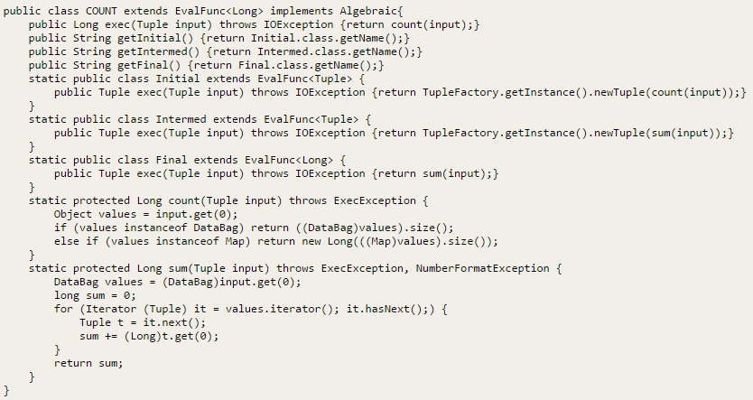
UDF: aggregate function
Long

Slide 12
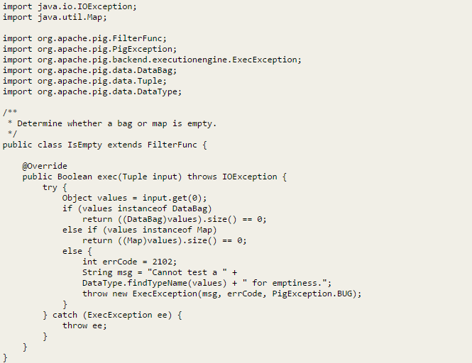
UDF: FilterFunc
B = FILTER A BY isEmpty(A.bagfield);

Slide 13
Check http://pig.apache.org/docs/r0.13.0/udf.html#udf-java
for more java examples.

Slide 14
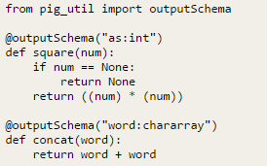
Python UDFs
test.py
How to use it

Slide 15
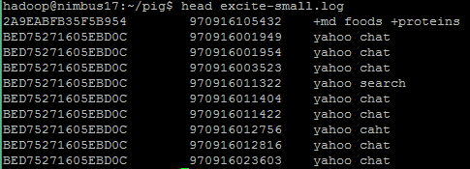
3rd program: script1-local.pig
Query phrase popularity
  processes a search query log file from the Excite search engine and finds search phrases (ngrams) that occur with particular high frequency during certain times of the day.
  How to use UDFs
cookie
YYMMDDHHMMSS
query

Slide 16
1. Register the tutorial JAR file so that the included UDFs can be called in the script.
REGISTER ./tutorial.jar;
2. Use the PigStorage function to load the excite log file (excite.log or excite-small.log) into the “raw” bag as an array of records with the fields user, time, and query.
raw = LOAD 'excite-small.log' USING PigStorage('\t') AS (user, time, query);
3. Call the NonURLDetector UDF to remove records if the query field is empty or a URL.
clean1 = FILTER raw BY org.apache.pig.tutorial.NonURLDetector(query);
4. Call the ToLower UDF to change the query field to lowercase.
clean2 = FOREACH clean1 GENERATE user, time, org.apache.pig.tutorial.ToLower(query) as query;

Slide 17
5. Because the log file only contains queries for a single day, we are only interested in the hour. The excite query log timestamp format is YYMMDDHHMMSS. Call the ExtractHour UDF to extract the hour (HH) from the time field.
houred = FOREACH clean2 GENERATE user, org.apache.pig.tutorial.ExtractHour(time) as hour, query;
6. Call the NGramGenerator UDF to compose the n-grams of the query.
ngramed1 = FOREACH houred GENERATE user, hour, flatten(org.apache.pig.tutorial.NGramGenerator(query)) as ngram;
7. Use the DISTINCT operator to get the unique n-grams for all records.
ngramed2 = DISTINCT ngramed1;
8. Use the GROUP operator to group records by n-gram and hour.
hour_frequency1 = GROUP ngramed2 BY (ngram, hour);

Slide 18
9. Use the COUNT function to get the count (occurrences) of each n-gram.
hour_frequency2 = FOREACH hour_frequency1 GENERATE flatten($0), COUNT($1) as count;
10. Use the GROUP operator to group records by n-gram only. Each group now corresponds to a distinct n-gram and has the count for each hour.
uniq_frequency1 = GROUP hour_frequency2 BY group::ngram;
11. For each group, identify the hour in which this n-gram is used with a particularly high frequency. Call the ScoreGenerator UDF to calculate a "popularity" score for the n-gram.
uniq_frequency2 = FOREACH uniq_frequency1 GENERATE flatten($0), flatten(org.apache.pig.tutorial.ScoreGenerator($1));
12. Use the FOREACH-GENERATE operator to assign names to the fields.
uniq_frequency3 = FOREACH uniq_frequency2 GENERATE $1 as hour, $0 as ngram, $2 as score, $3 as count, $4 as mean;

Slide 19
13. Use the FILTER operator to remove all records with a score less than or equal to 2.0.
filtered_uniq_frequency = FILTER uniq_frequency3 BY score > 2.0;
14. Use the ORDER operator to sort the remaining records by hour and score.
ordered_uniq_frequency = ORDER filtered_uniq_frequency BY hour, score;
15. Use the PigStorage function to store the results. The output file contains a list of n-grams with the following fields: hour, ngram, score, count, mean.
STORE ordered_uniq_frequency INTO '/tmp/tutorial-results' USING PigStorage();

Slide 20
4th program: Script2-local.pig
Temporal query phrase popularity
  processes a search query log file from the Excite search engine and compares the occurrence of frequency of search phrases across two time periods separated by twelve hours.
  Use Join

Slide 21
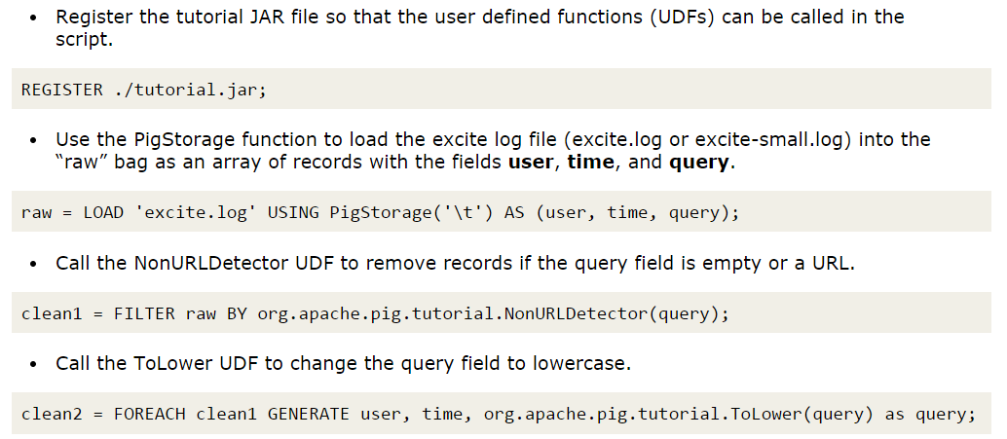

Slide 22
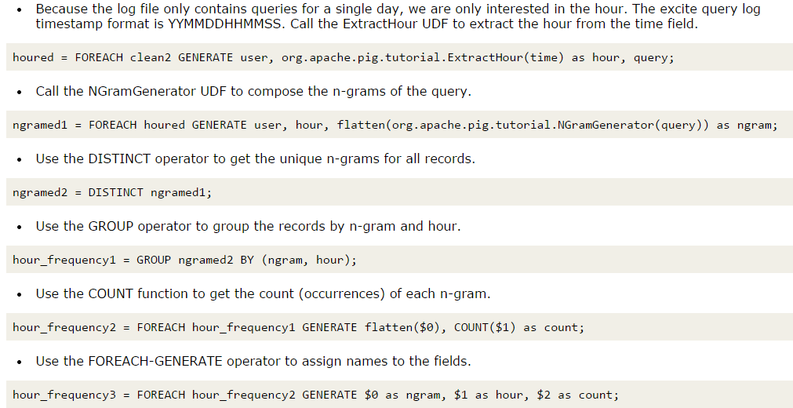

Slide 23
