Slide 1
Data Processing Tools on Hadoop
Ramesh Ragala

Slide 2
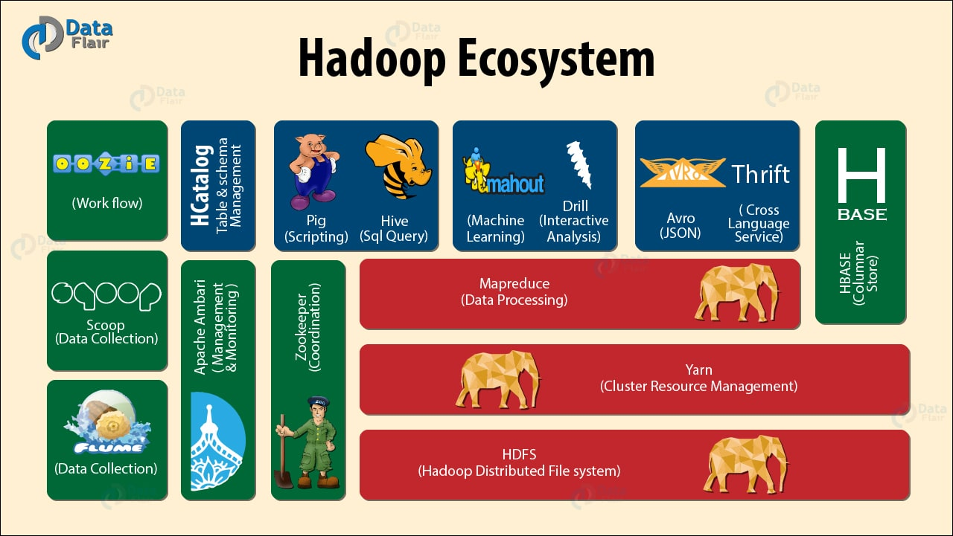
Hadoop Ecosystem

Slide 3
Query Languages for Hadoop
Java: Hadoop’s Native Language
Pig: Query and Workflow Language
Hive: SQL-Based Language
HBase: Column-oriented Database for MapReduce

Slide 4
Java is Hadoop’s Native Language
Hadoop itself is written in Java
Provided Java APIs
  For mappers, reducers, combiners, partitioners
  Input and output formats
Other languages, e.g., Pig or Hive, convert their queries to Java MapReduce code

Slide 5
Levels of Abstraction
Less Hadoop
visible
HBase
Queries against tables
More DB view
Hive
SQL-Like language
Pig
Query and workflow language
Java
Write map-reduce functions
More Hadoop
visible
More map-reduce view

Slide 6
Motivation
Data analysis goals:
1. Quick
  Exploit parallel processing power of a distributed system
2. Easy
  Be able to write a program or query without a huge learning curve
  Have some common analysis tasks predefined
3. Flexible
  Transform a data set(s) into a workable structure without much
  overhead
  Perform customized processing
  4. Transparent
  Have a say in how the data processing is executed on the system

Slide 7
Apache Pig

Slide 8

What is Pig
A platform for analyzing large data sets that consists of a high-level language for expressing data analysis programs.
Compiles down to MapReduce jobs
Developed by Yahoo!
Open-source language

Slide 9
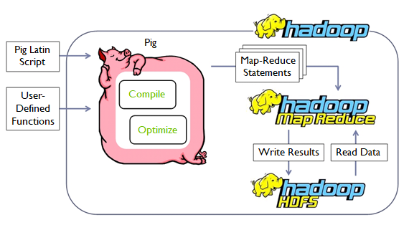
Big Picture

Slide 10
Pig Components
High-level language (Pig Latin)
  Set of commands
Two Main Components
Two execution modes
  Local: reads/write to local file system
  Mapreduce: connects to Hadoop cluster and reads/writes to HDFS
Interactive mode : Console
  Local: “pig –x local”
  Hadoop: “pig –x mapreduce”, or just “pig”
Two modes
Batch mode: All commands in one script file
  Local: “pig –x local your_script”
  Hadoop: “pig your_script”

Slide 11
Why Pig?...Abstraction!
Common design patterns as key words (joins, distinct, counts)
Data flow analysis
  A script can map to multiple map-reduce jobs
Avoids Java-level errors (not everyone can write java code)
Can be interactive mode
  Issue commands and get results

Slide 12
What Pig?...
Framework for analyzing large un-structured and semi-structured data on top of Hadoop.
  Pig Engine Parses, compiles Pig Latin scripts into MapReduce jobs run on top of Hadoop.
  Pig Latin is declarative, SQL-like language; the high level language interface for Hadoop.

Slide 13
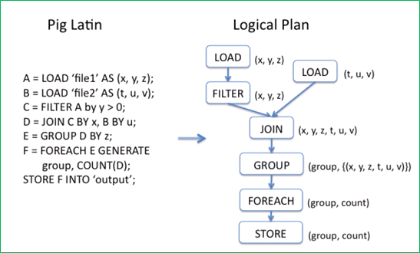
What Pig?...

Slide 14
Example I: More Details
Read file from HDFS
The input format (text, tab delimited)
Define run-time schema
raw = LOAD 'excite.log' USING PigStorage('\t') AS (user, id, time, query);
clean1 = FILTER raw BY id > 20 AND id < 100;
clean2 = FOREACH clean1 GENERATE
user, time,
org.apache.pig.tutorial.sanitze(query) as query;
user_groups = GROUP clean2 BY (user, query);
user_query_counts = FOREACH user_groups
GENERATE group, COUNT(clean2), MIN(clean2.time), MAX(clean2.time);
STORE user_query_counts INTO 'uq_counts.csv' USING PigStorage(',');
Filter the rows on predicates
For each row, do some transformation
Grouping of records
Compute aggregation for each group
Store the output in a file
Text, Comma delimited

Slide 15
Pig: word count
  Lines=LOAD ‘input/hadoop.log’ AS (line: chararray);
  Words = FOREACH Lines GENERATE FLATTEN(TOKENIZE(line)) AS word;
  Groups = GROUP Words BY word;
  Counts = FOREACH Groups GENERATE group, COUNT(Words);
  Results = ORDER Words BY Counts DESC;
  Top5 = LIMIT Results 5;
  STORE Top5 INTO /output/top5words;

Slide 16
Example 2
Script can take arguments
Data are “ctrl-A” delimited
Define types of the columns
A = load '$widerow' using PigStorage('\u0001') as (name: chararray, c0: int, c1: int, c2: int);
B = group A by name parallel 10;
C = foreach B generate group, SUM(A.c0) as c0, SUM(A.c1) as c1, AVG(A.c2) as c2;
D = filter C by c0 > 100 and c1 > 100 and c2 > 100;
store D into '$out';
Specify the need of 10 reduce tasks

Slide 17
Physical Plan
UDFs can be written to take advantage of the combiner
Four join implementations are built in
Writing load and store functions is easy once an InputFormat and OutputFormat exist
Multi-query: pig will combine certain types of operations together in a single pipeline to reduce the number of times data is scanned.
Order by provides total ordering across reducers in a balanced way
Piggybank, a collection of user contributed UDFs

Slide 18
Logic Plan
A=LOAD 'file1' AS (x, y, z);
B=LOAD 'file2' AS (t, u, v);
C=FILTER A by y > 0;
D=JOIN C BY x, B BY u;
E=GROUP D BY z;
F=FOREACH E GENERATE group, COUNT(D);
STORE F INTO 'output';
LOAD
LOAD
FILTER
JOIN
GROUP
FOREACH
STORE

Slide 19
Generation of Physical Plans
If the Join and Group By are on the same key ➔ The two map-reduce jobs would be merged into one.

