Slide 1
Introduction to SQL
Ramesh Ragala
VIT Chennai

Slide 2
Introduction to SQL
Constraint:
  It is property assigned to a column or the set of columns in a table that prevents certain types of inconsistent data values from being placed in the column(s).
  It is used to enforce the data integrity
The following categories of the data integrity exist:
  Entity Integrity:
    It ensures that there are no duplicate rows in a table

Slide 3
Introduction to SQL
Domain Integrity:
  It enforces valid entries for a given column by restricting the type, the format, or the range of possible values.
Referential Integrity:
  It ensures that rows cannot be deleted, which are used by other records.
User-Defined Integrity:
  It enforces some specific business rules that do not fall into entity, domain, or referential integrity categories.

Slide 4
Introduction to SQL
SQL NOT NULL Constraint
  It enforces a column to NOT accept NULL values.
  It enforces a field to always contain a value
  We cannot insert a new record, or update a record without adding a value to this field.
  Example:
  Create table persons( person_id int NOT NULL, lastname varchar(15) NOT NULL, firstname varchar(25), address varchar(25), city varchar(25));

Slide 5
Introduction to SQL
SQL UNIQUE Constraint
  It uniquely identifies each record in a database table.
  The UNIQUE and PRIMARY KEY constraints both provide a guarantee for uniqueness for a column or set of columns
  A PRIMARY KEY constraint automatically has a UNIQUE constraint defined on it.
  Note that you can have many UNIQUE constraints per table, but only one PRIMARY KEY constraint per table
  Example:
  Create table persons( person_id int NOT NULL, lastname varchar(15) NOT NULL, firstname varchar(25), address varchar(25), city varchar(25), UNIQUE(person_id));

Slide 6
Introduction to SQL
SQL PRIMARY KEY Constraint
  It uniquely identifies each record in a database table.
  Primary keys must contain unique values
  A primary key column cannot contain NULL values.
  Each table should have a primary key, and each table can have only ONE primary key.
  Example:
  Create table persons( person_id int NOT NULL, lastname varchar(15) NOT NULL, firstname varchar(25), address varchar(25), city varchar(25), primary key(person_id));

Slide 7
Introduction to SQL
SQL FOREIGN KEY Constraint
  A FOREIGN KEY in one table points to a PRIMARY KEY in another table.
  The SQL FOREIGN KEY CONSTRAINT is used to ensure the referential integrity of the data in one table to match values in another table.
  Example:

Slide 8
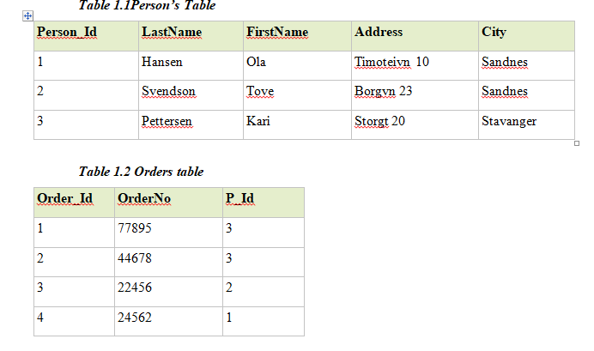
Introduction to SQL
SQL FOREIGN KEY Constraint

Slide 9
Introduction to SQL
SQL FOREIGN KEY Constraint
  Example:
  Create table orders( Order_id int NOT NULL, OrderNo int NOT NULL, person_id int, primary key(Orfer_id), FOREIGN KEY (Person_Id) REFERENCES Persons(Person_Id));

Slide 10
Introduction to SQL
SQL CHECK Constraint
  It is used to limit the value range that can be placed in a column.
  If we define a CHECK constraint on a single column it allows only certain values for this column.
  If we define a CHECK constraint on a table it can limit the values in certain columns based on values in other columns in the row.
  Example:
    Alter table persons ADD CHECK (person_id > 0)

Slide 11
Introduction to SQL
SQL DEFAULT Constraint
  is used to insert a default value into a column.
  The default value will be added to all new records, if no other value is specified.
  Example:
  Create table orders( Order_id int NOT NULL, OrderNo int NOT NULL, person_id int, OrderDate date DEFAULT GETDATE());
  Create table persons( person_id int NOT NULL, lastname varchar(15) NOT NULL, firstname varchar(25), address varchar(25), city varchar2(25) DEFAULT ‘Chennai’ );

