Slide 1
To Run the PL/SQL Program
SQL>set serveroutput on

Slide 2
TRIGGERS
A triggers is a statement that the system executes automatically as a side effect a modification to the database
Triggers are useful mechanism for alerting humans or for starting certain tasks automatically when certain condition are meet

Slide 3
TRIGGERS
A trigger is a pl/sql block structure which is fired when a DML statements like Insert, Delete, Update is executed on a database table.
A trigger is triggered automatically when an associated DML statement is executed
Sometimes a trigger is referred as a special kind of stored procedure in term of procedural code inside its body

Slide 4
TRIGGERS
The difference between a trigger and a stored procedure is that a trigger is activated or called when an event happens in a database table, a stored procedure must be called explicitly.

Slide 5
TRIGGERS
Types of PLSQL Triggers:
There are two types of triggers based on which level it is triggered:
Row Level Triggers:
An event is triggered for each row updated, inserted or deleted.
Statement level trigger :
An event is triggered for each sql statement executed.

Slide 6
TRIGGERS
PL/SQL Trigger Execution Hierarchy:
The following hierarchy is followed when a trigger is fired.
1) BEFORE statement trigger fires first.
2) Next BEFORE row level trigger fires, once for each row affected.
3) Then AFTER row level trigger fires once for each affected row. These events will alternates between BEFORE and AFTER row level triggers.
4) Finally the AFTER statement level trigger fires.

Slide 7
TRIGGERS
Below is the syntax for creating a trigger in Oracle (which differs slightly from standard SQL syntax):
CREATE [OR REPLACE] TRIGGER <trigger_name> {BEFORE|AFTER} {INSERT|DELETE|UPDATE} ON <table_name> [REFERENCING [NEW AS <new_row_name>] [OLD AS <old_row_name>]] [FOR EACH ROW [WHEN (<trigger_condition>)]] <trigger_body>

Slide 8
TRIGGERS
If FOR EACH ROW option is specified, the trigger is row-level; otherwise, the trigger is statement-level.
Only for row-level triggers:
The special variables NEW and OLD are available to refer to new and old tuples respectively.
Note: In the trigger body, NEW and OLD must be preceded by a colon (":"), but in the WHEN clause, they do not have a preceding colon! See example below.
The REFERENCING clause can be used to assign aliases to the variables NEW and OLD.
A trigger restriction can be specified in the WHEN clause, enclosed by parentheses. The trigger restriction is a SQL condition that must be satisfied in order for Oracle to fire the trigger. This condition cannot contain subqueries. Without the WHEN clause, the trigger is fired for each row.
<trigger_body> is a PL/SQL block, rather than sequence of SQL statements

Slide 9
TRIGGERS
CREATE TRIGGER <name> OR:
CREATE OR REPLACE TRIGGER <name>
Useful if there is a trigger with that name and you want to modify the trigger.
If creating the trigger gives:
Warning: Trigger created with compilation errors.
Execute:
show errors → to display the errors.

Slide 10
TRIGGERS
Triggers are either “row-level” or “statement-level.”
FOR EACH ROW indicates row-level; its absence indicates statement-level.
Row level triggers : execute once for each modified tuple.
Statement-level triggers : execute once for an SQL statement, regardless of how many tuples are modified.

Slide 11
TRIGGERS
Any Boolean-valued condition.
Evaluated on the database as it would exist before or after the triggering event, depending on whether BEFORE or AFTER is used.

Slide 12
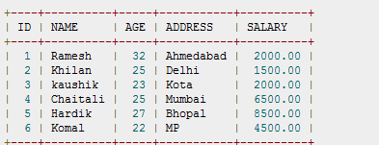
Example - 1
Create customer table and insert the following values

Slide 13
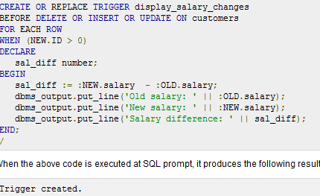
Trigger definition

Slide 14
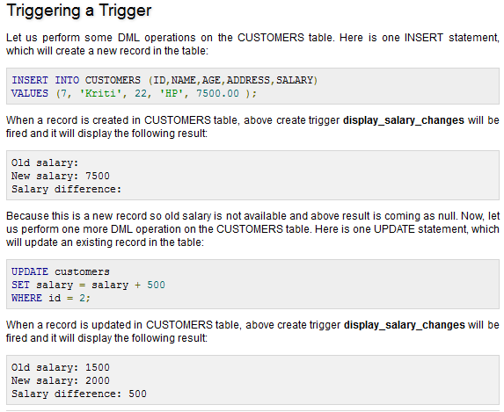

Slide 15
Example - 2
We illustrate Oracle's syntax for creating a trigger through an example based on the following two tables:
CREATE TABLE T4 (a INTEGER, b CHAR(10));
CREATE TABLE T5 (c CHAR(10), d INTEGER);
We create a trigger that may insert a tuple into T5 when a tuple is inserted into T4.
Specifically, the trigger checks whether the new tuple has a first attribute value is 10 or less, and if so inserts the reverse tuple into T5:
CREATE TRIGGER trig1
AFTER INSERT ON T4
REFERENCING NEW AS newRow
FOR EACH ROW
WHEN (newRow.a <= 10)
BEGIN
INSERT INTO T5 VALUES(:newRow.b, :newRow.a);
END trig1;
/
Insert values into table t4 then u can see the insertion into t5

Slide 16
Example - 3
Using Sells(bar, beer, price) and
a unary relation RipOffBars(bar)- maintain a list of bars that raise the price of any beer by more than $1.
CREATE TABLE Sells(
beer VARCHAR(10),
bar VARCHAR(13),
price FLOAT
);
CREATE TABLE RipOffBars(
bar VARCHAR(13)
);

Slide 17
The Trigger- to insert into another table when changes are made in another table
Event:
only changes
to prices
CREATE OR REPLACE TRIGGER PriceTrig
AFTER UPDATE OF price ON Sells
FOR EACH ROW
WHEN(new.price > old.price + 1.00)
BEGIN
INSERT INTO RipoffBars
VALUES(:new.bar);
END PriceTrig;
/
Remark. This and other trigger examples are in ORACLE syntax which differs slightly from standard SQL syntax.
We need to consider
each price change
Condition:
a raise in price > $1
Updates let us talk about old and new tuples.
When the price change is great enough, add the bar to RipoffBars

Slide 18
Example –to insert into self table
CREATE A TABLE S BELOW
CREATE TABLE emp (
empno INT,
ename VARCHAR(30),
deptno INT,
sal FLOAT,
comm FLOAT
);

Slide 19
WRITE A ROW -LEVEL TRIGGER WHICH calculates the commission before inserting a new employee to department 30 and that newly calculated commission is also inserted into the emp table with all the other data.
CREATE OR REPLACE TRIGGER emp_comm_trig
BEFORE INSERT ON emp
FOR EACH ROW
BEGIN
IF :NEW.deptno = 30 THEN
:NEW.comm := :NEW.sal * .4;
END IF;
END;
/

Slide 20
Triggering
INSERT INTO emp VALUES (9005,'ROBERS',30, 3000,NULL);
INSERT INTO emp VALUES (9006,'ALLEN',30, 4500,NULL);
SELECT * FROM emp WHERE empno IN (9005, 9006);
EMPNO ENAME DEPTNO SAL COMM
-----------------------------------
9005 ROBERS 30 3000 1200
9006 ALLEN 30 4500 1800

Slide 21
Miscellaneous about Triggers
Viewing Defined Triggers
To view a list of all defined triggers, use:
SELECT trigger_name
FROM user_triggers;
For seeing the code:
SELECT text
FROM user_source
WHERE name = 'PRICETRIG'
ORDER BY line;
Dropping Triggers
DROP TRIGGER <trigger_name>;
Disabling or Enabling Triggers
ALTER TRIGGER <trigger_name> {DISABLE|ENABLE};
Has to be uppercase.

Slide 22
Statement-Level Trigger
Whenever an insert, update, or delete operation occurs on the emp table, a row is added to the empauditlog table recording the date, user, and action.
First let’s create the empauditlog table:
CREATE TABLE empauditlog (
audit_date DATE,
audit_user VARCHAR2(20),
audit_desc VARCHAR2(20)
);

Slide 23
Triggering
CREATE OR REPLACE TRIGGER emp_audit_trig
AFTER INSERT OR UPDATE OR DELETE ON emp
DECLARE
v_action VARCHAR2(20);
BEGIN
IF INSERTING THEN
v_action := 'Added employee(s)';
ELSIF UPDATING THEN
v_action := 'Updated employee(s)';
ELSIF DELETING THEN
v_action := 'Deleted employee(s)';
END IF;
INSERT INTO empauditlog
VALUES (SYSDATE, USER, v_action);
END;
/

Slide 24
Let’s trigger it…
INSERT INTO emp(empno, ename, deptno) VALUES (9001,'SMITH',50);
INSERT INTO emp(empno, ename, deptno) VALUES (9002,'JONES',50);
UPDATE emp
SET ename = 'SMITH BROWN'
WHERE empno=9001;
DELETE FROM emp WHERE empno IN (9001, 9002);
SELECT TO_CHAR(AUDIT_DATE,'DD-MON-YY HH24:MI:SS') AS "AUDIT DATE",
audit_user, audit_desc
FROM empauditlog
ORDER BY 1 ASC;
AUDIT DATE AUDIT_USER AUDIT_DESC
------------------ -------------------- --------------------
08-FEB-08 09:43:02 THOMO Added employee(s)
08-FEB-08 09:43:02 THOMO Deleted employee(s)
08-FEB-08 09:43:02 THOMO Updated employee(s)
08-FEB-08 09:43:02 THOMO Added employee(s)

Slide 25
To Show Compilation Errors
SELECT line, position, text
FROM user_errors
WHERE name = 'MY_TRIGGER'
AND TYPE = 'TRIGGER‘
In SQL*Plus, you can also use the following shortcut:
SQL> SHOW ERRORS TRIGGER MY_TRIGGER

Slide 26
Exercise
Consider a relation schema Account (num, amount) .Write a trigger where we will allow creation of new accounts only during normal business hours. Indicate whether it is a row level or statement level trigger.

Slide 27
Exercise
Consider the previous class exercise emp relation for the following exercises
Assume wrongly a clerk’s basic salary is quoted at a very high figure [due to some wrong updation, say above 100000], then it should trigger. Design a trigger that checks for rows with basic salary > 100000 and display a message containing the employee id of the clerk and wrong salary figure mentioned in the table.
Trigger to find out whether any employee row has negative salary which is not possible but might have been entered due to a ‘data entry error’. Design a trigger to find out the employee id along with the wrong salary that was entered.
Design a trigger during the insertion time saying ‘you should enter a positive integer’ when you are trying to insert a negative value in the basic salary.

Slide 28
THANK YOU

