Slide 1
BAR AND LINE CHARTS

Slide 2
Outline
Bar charts and line charts
Definitions
Variations
What gets encoded?
Pros and cons

Slide 3
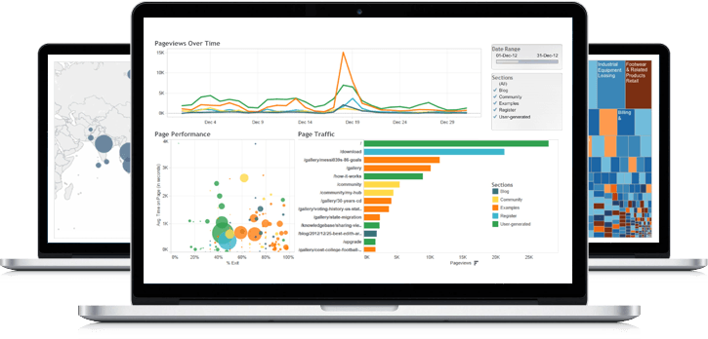
What visualization techniques do we know?

Slide 4
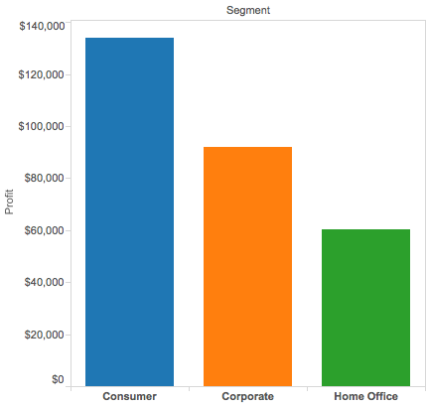
Bar chart
Definition: a visualization that uses either horizontal or vertical bars to show comparisons among categories
One axis shows a quantitative value
The other axis shows the classes (nominal or ordinal) being compared

Slide 5
Variations: vertical
Discrete “bins” along the horizontal (x) axis
Height of bar indicates the total value for each bin
Note: each data point falls into just one category (why is this important?)

Slide 6
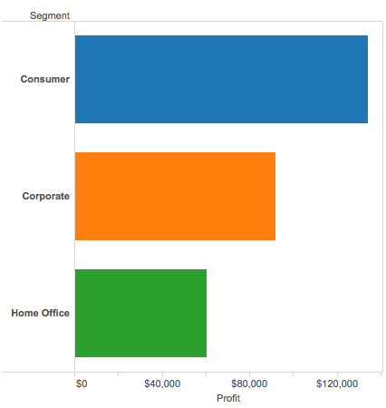
Variations: horizontal
Discrete “bins” along the vertical (y) axis
Width of bar indicates the total value for each bin
Note: each data point falls into just one category (why is this important?)

Slide 7
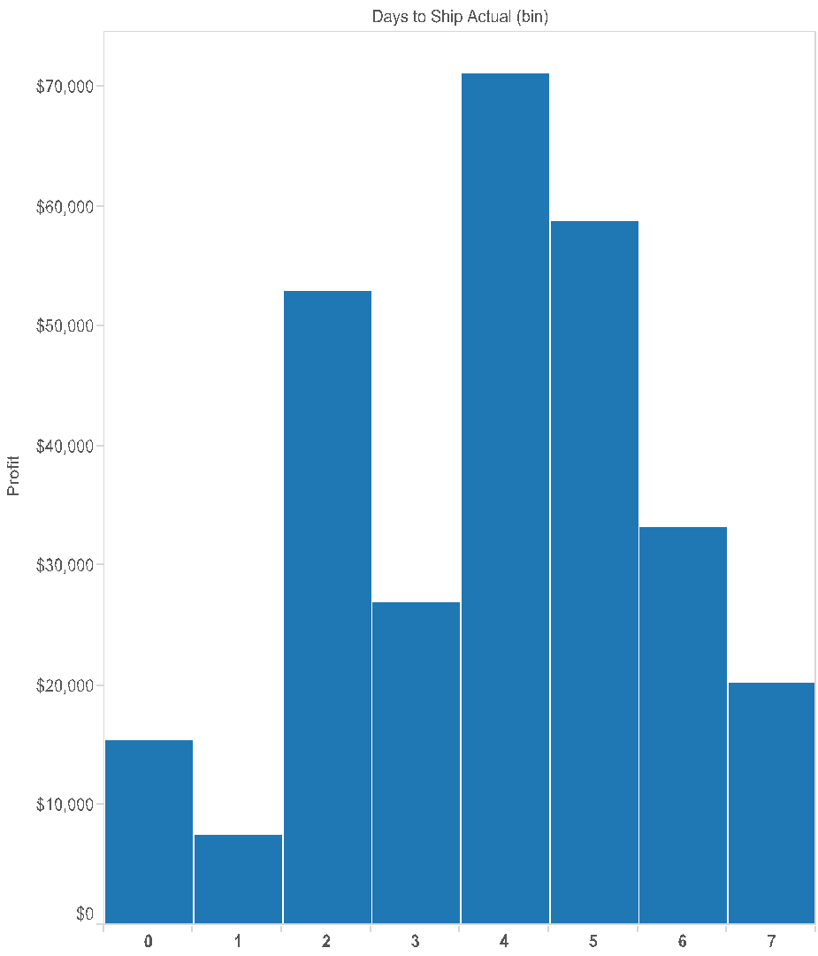
Variations: histogram
Presents continuous data broken into bins
In theory, we could see any value in the range
Often have minimal spacing between bars to help show the “shape”

Slide 8
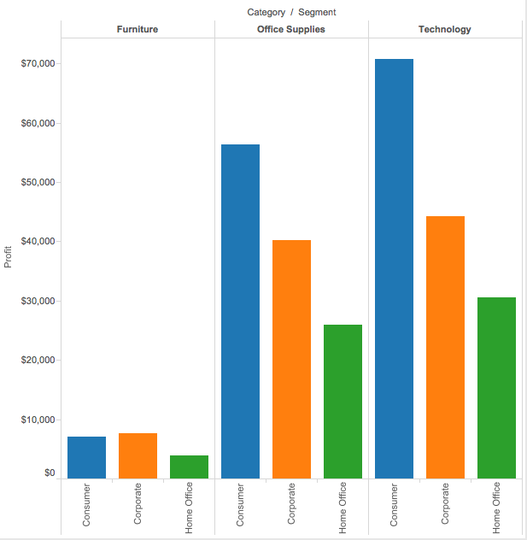
Variations: grouped
Each category is split into sub-categories
Bars in the same top-level category are adjacent to one another
Note: each category is split into the same sub-categories, and they appear in the same order (why is this important?)

Slide 9
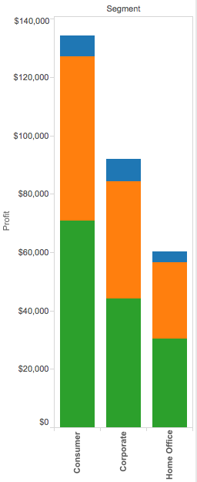
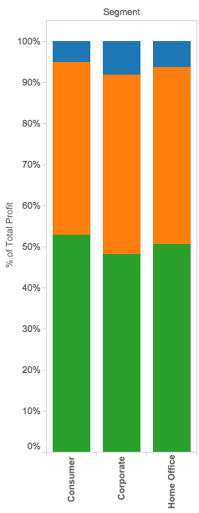
Variations: stacked
Each category is split into sub-categories
Bars in the same top-level category are stacked on top of one another
Note: each category is split into the same sub-categories, and they appear in the same order (why is this important?)
Can also stacking to show part-of-whole relationships

Slide 10
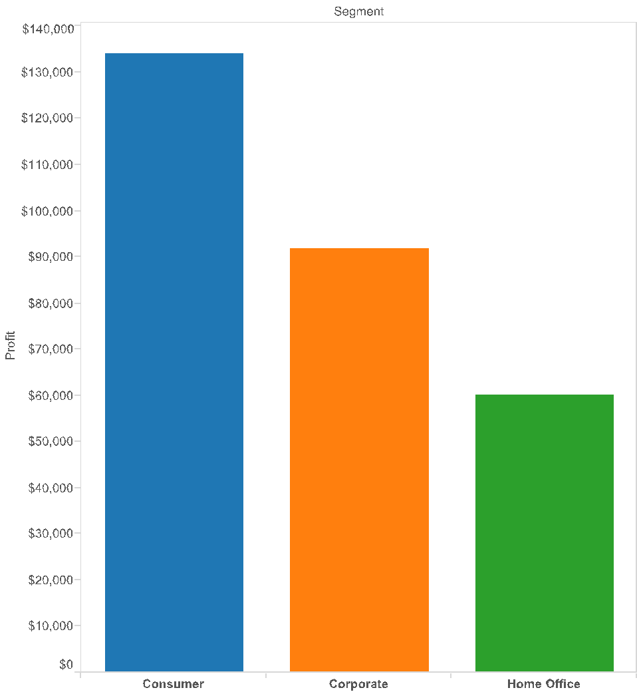

What gets encoded
Maximum value (tallest bar)
Use reference lines to show average value
Range (difference b/t tallest and shortest bars)
Minimum value (shortest bar)

Slide 11

Pros and cons
What’s good about bar charts?
What’s not so good?

Slide 13
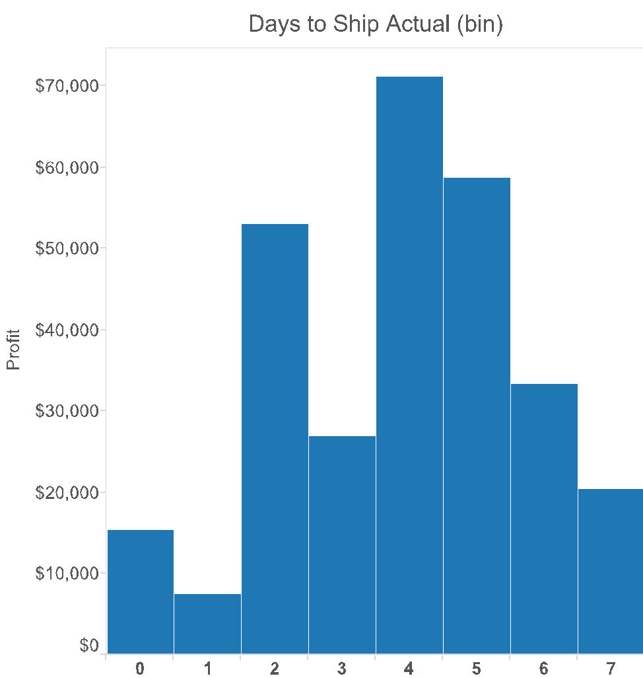
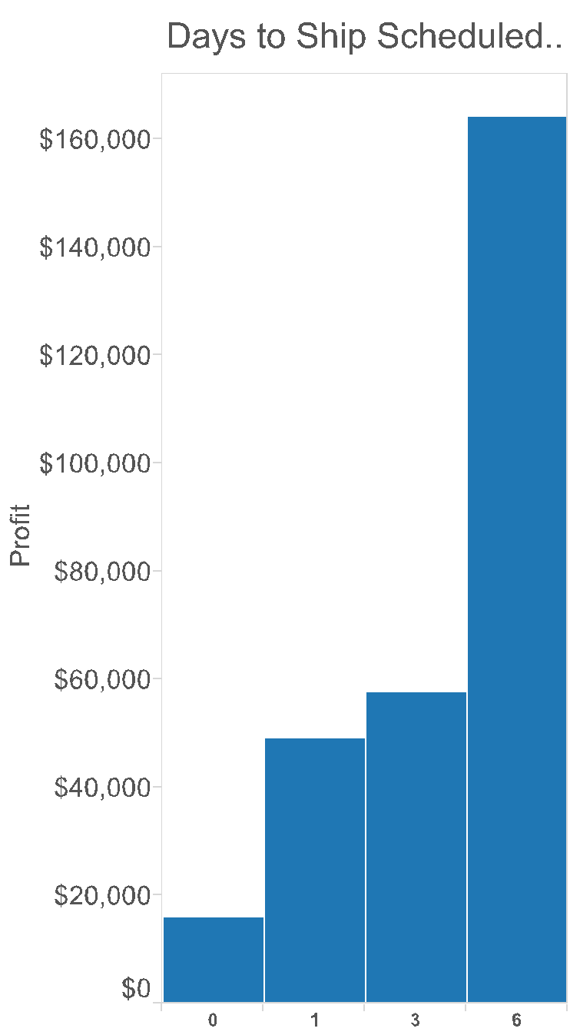
Things to watch out for

Slide 14
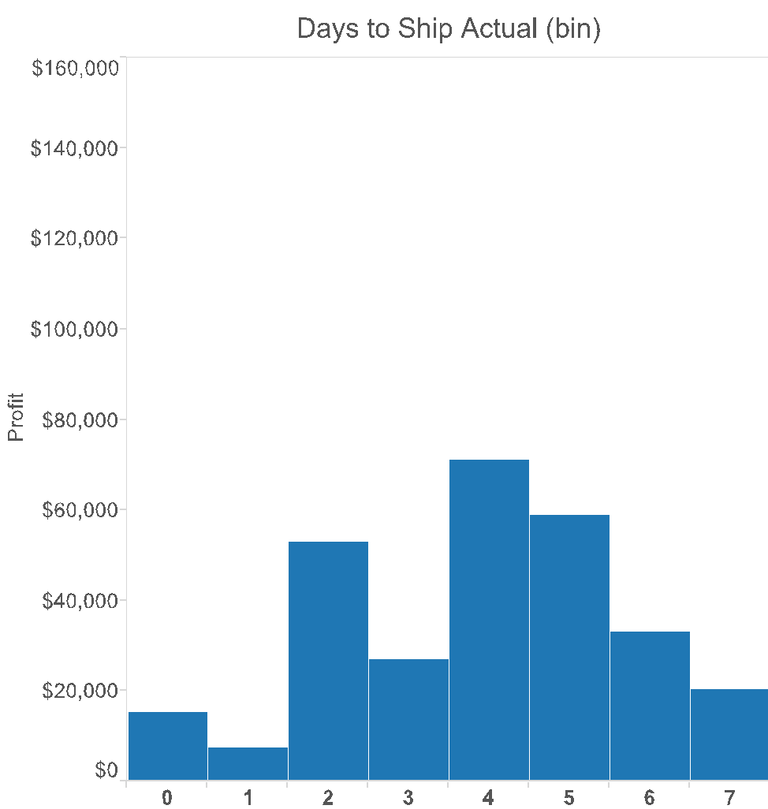
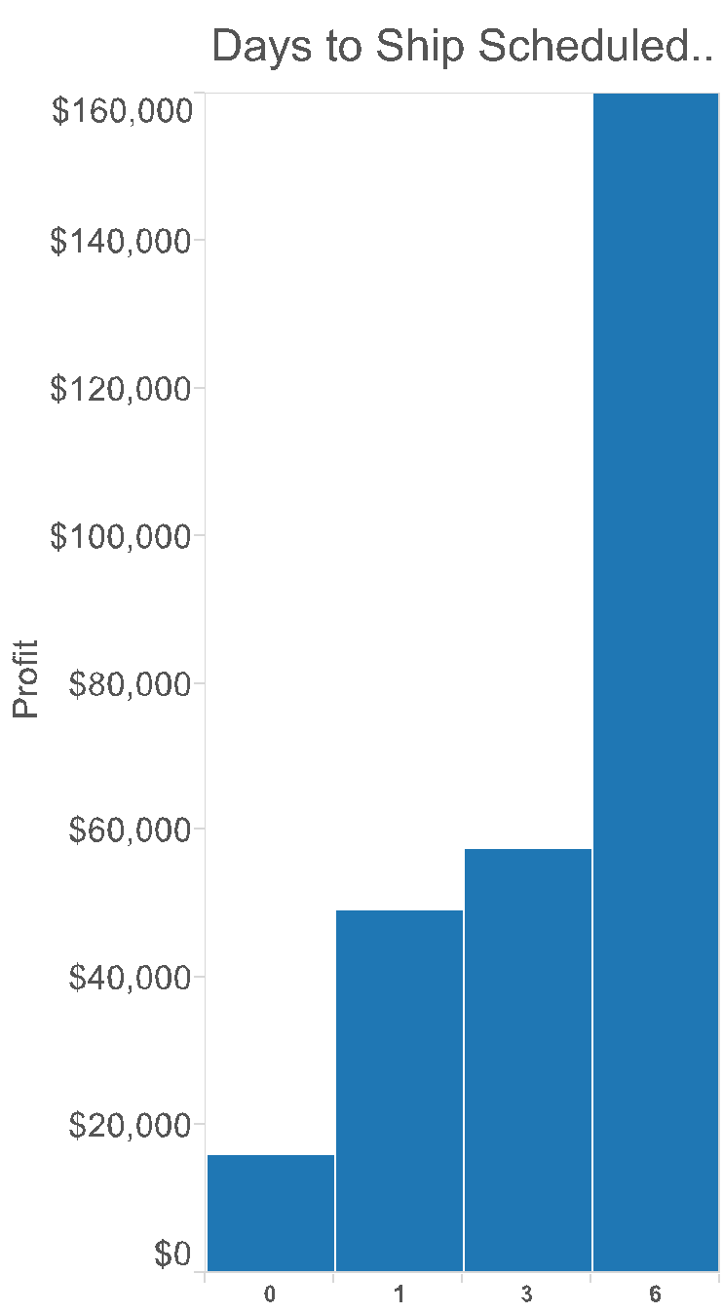
Things to watch out for
Inconsistent scales: if you’re comparing between two or more charts, be sure they have the same scale!

Slide 15
Things to watch out for

Slide 16
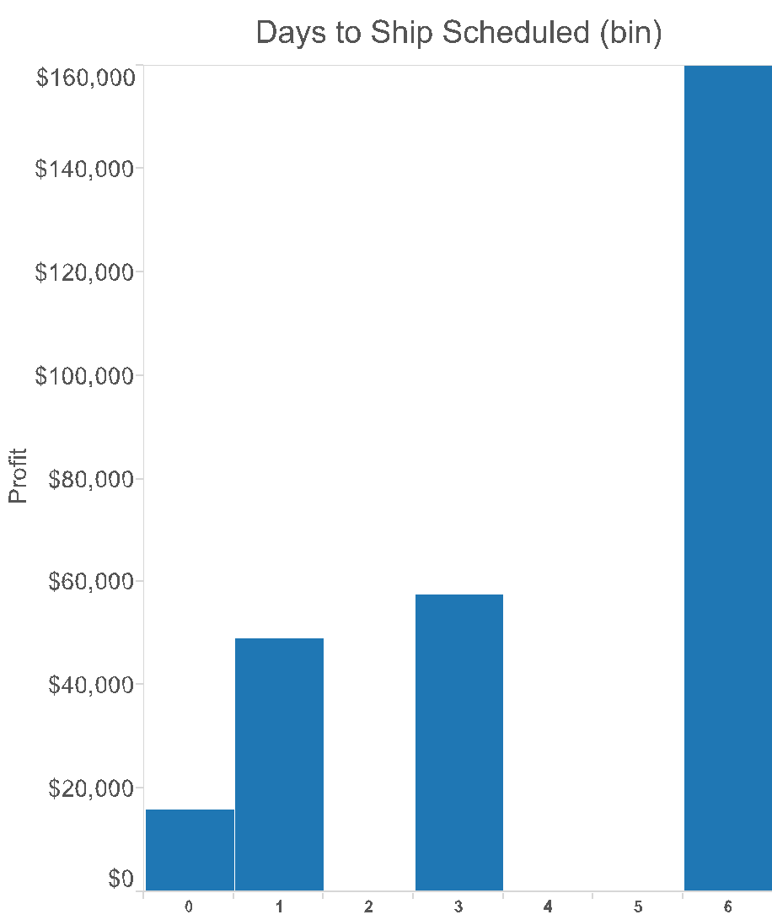
Things to watch out for
Inconsistent intervals: if you’re comparing between two or more charts, be sure they’re divided the same way!

Slide 17
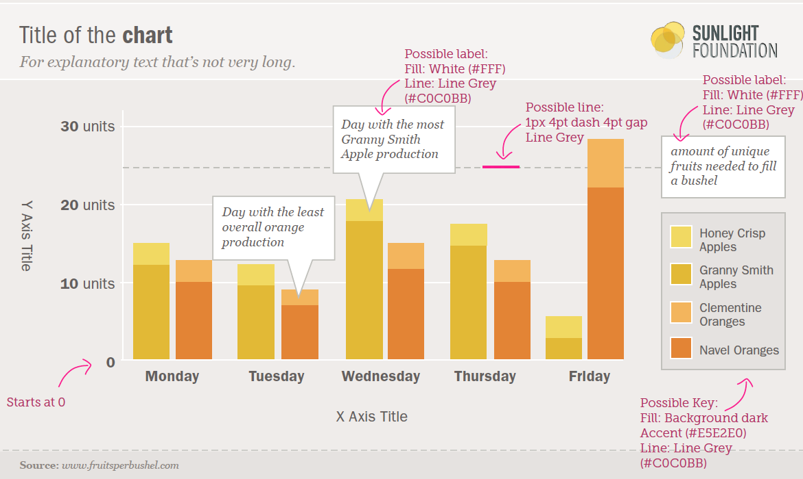
Recap: bar charts
Generally used for comparable variables
Shows quantitative values for different observations
Highlights relative amounts
Grouped/stacked bars can break variables into different sub-groups

Slide 18
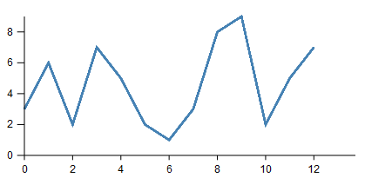
Line chart
Definition: a visualization that uses lines to show changes in continuous data
Vertical axis shows the dependent variable
Horizontal axis shows the independent variable

Slide 19
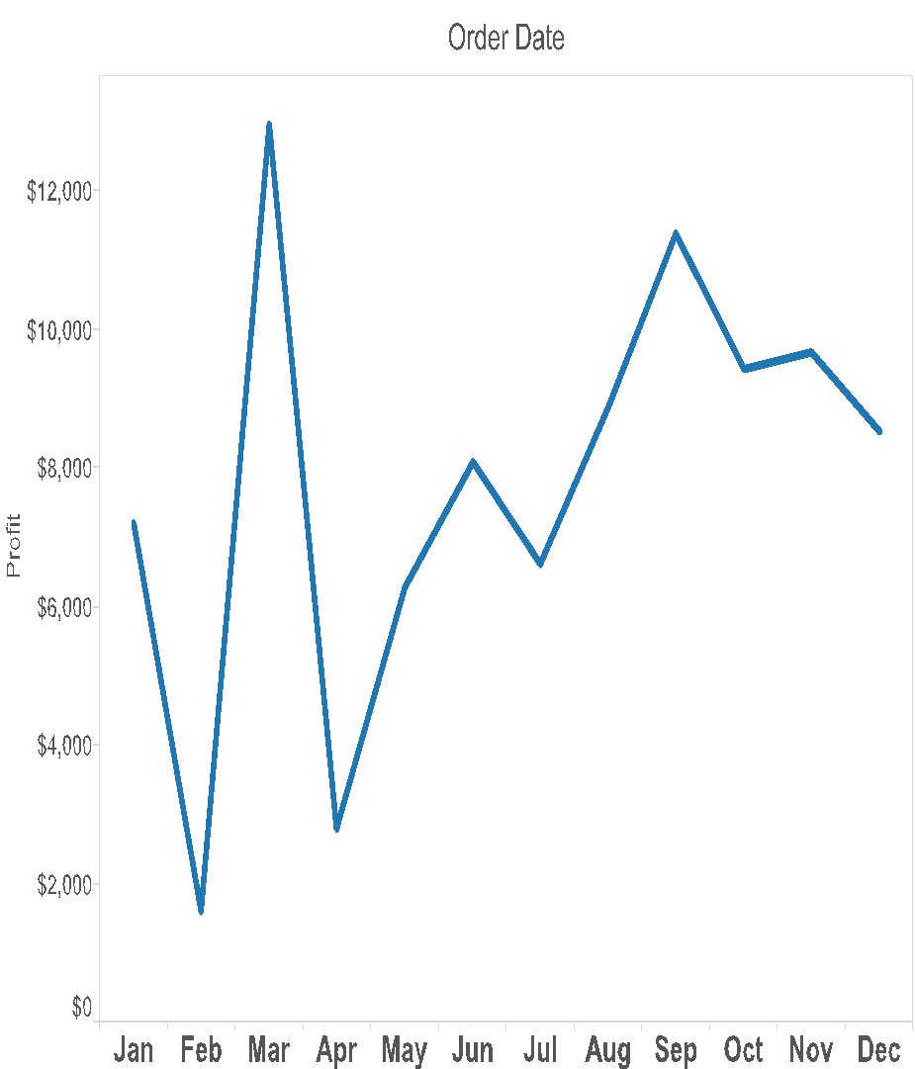
Variations: time series
Most commonly appearing line charts in practice
Used to show data that changes over time

Slide 20
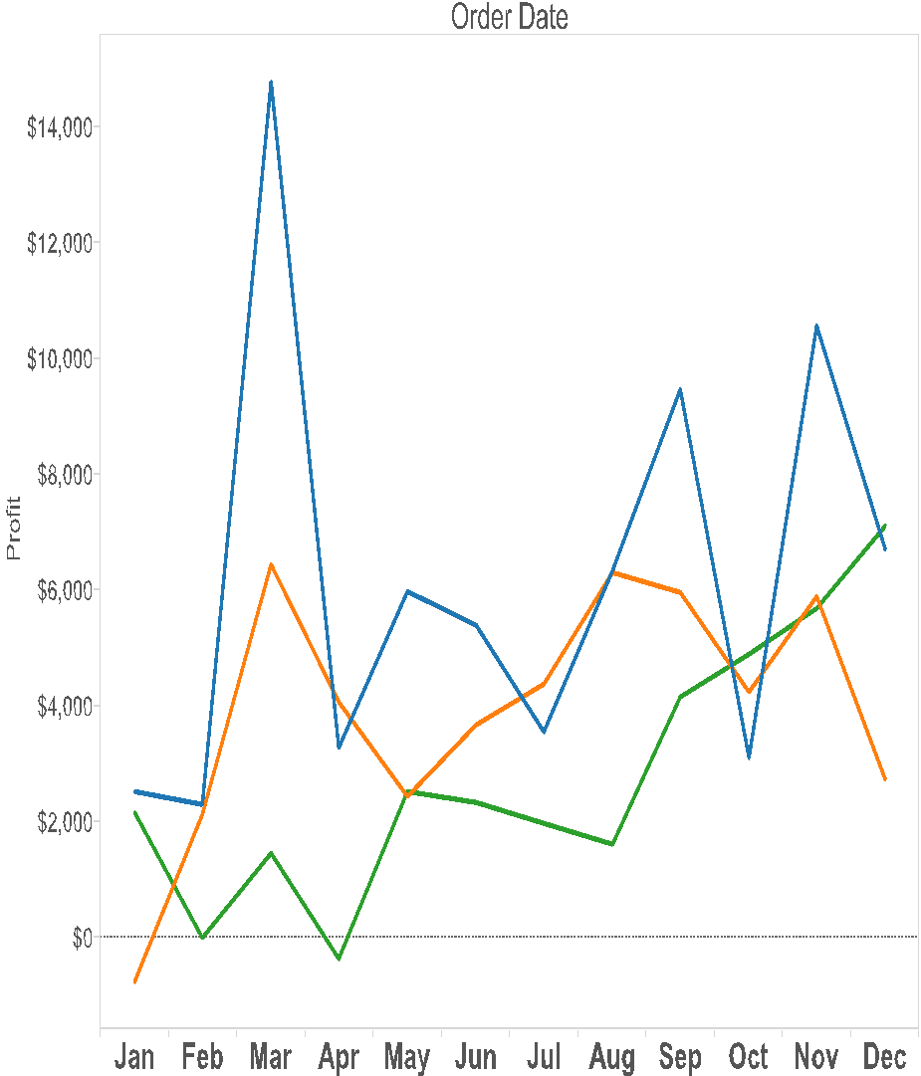

Variations: multiple independent lines
Compare changes across multiple categories
Use a legend to help distinguish between categories
Important: if you’re showing multiple trends, they should all have the same scale (why?)

Slide 21
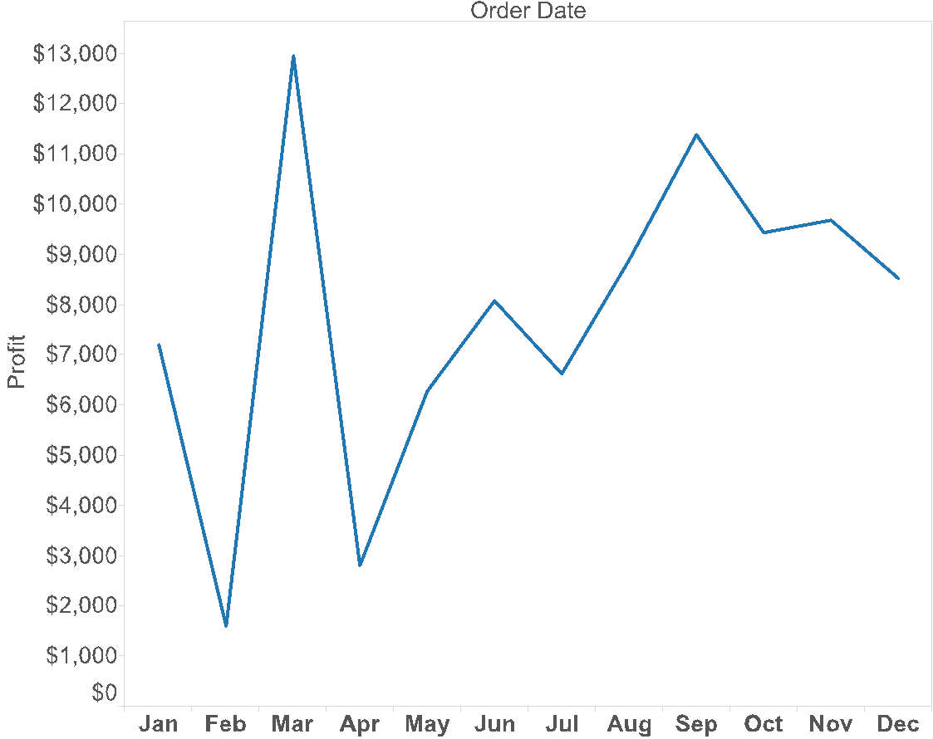
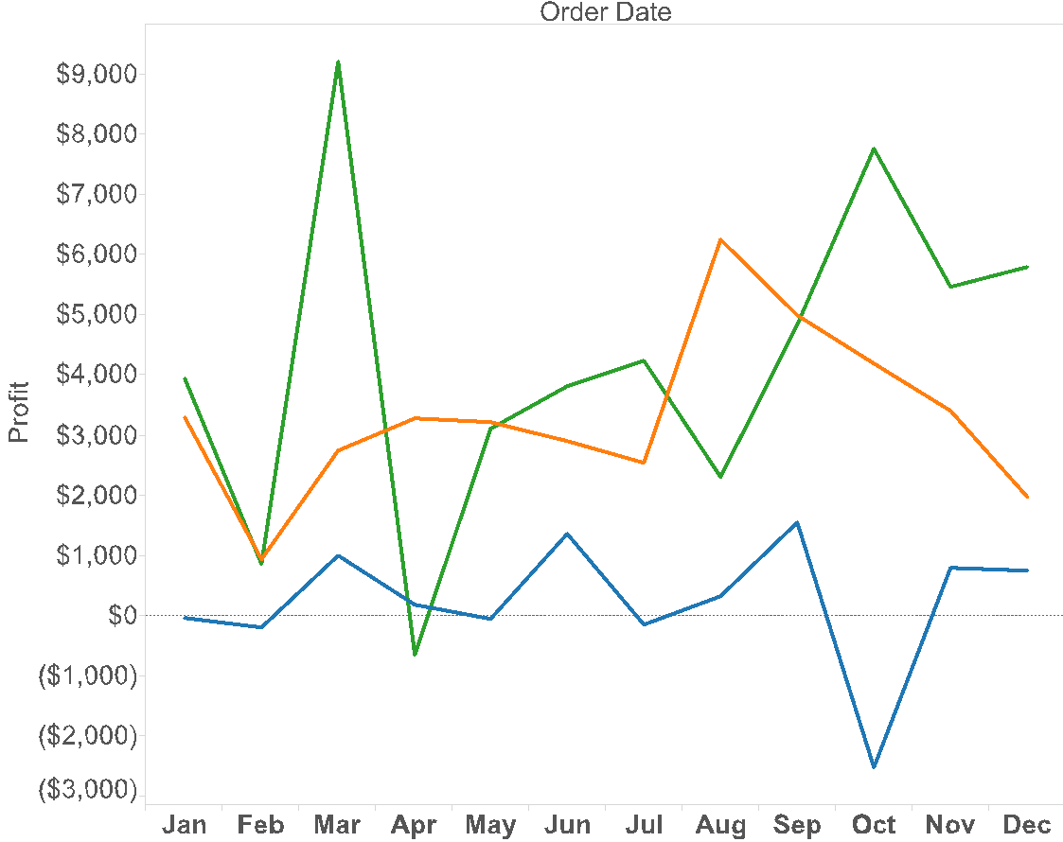
What gets encoded
Use trend lines to show overall rate of change
Maximum value (tallest peak)
Highlights position changes
Minimum value (lowest valley)

Slide 22
Pros and cons
What’s good about line charts?
What’s not so good?

Slide 24
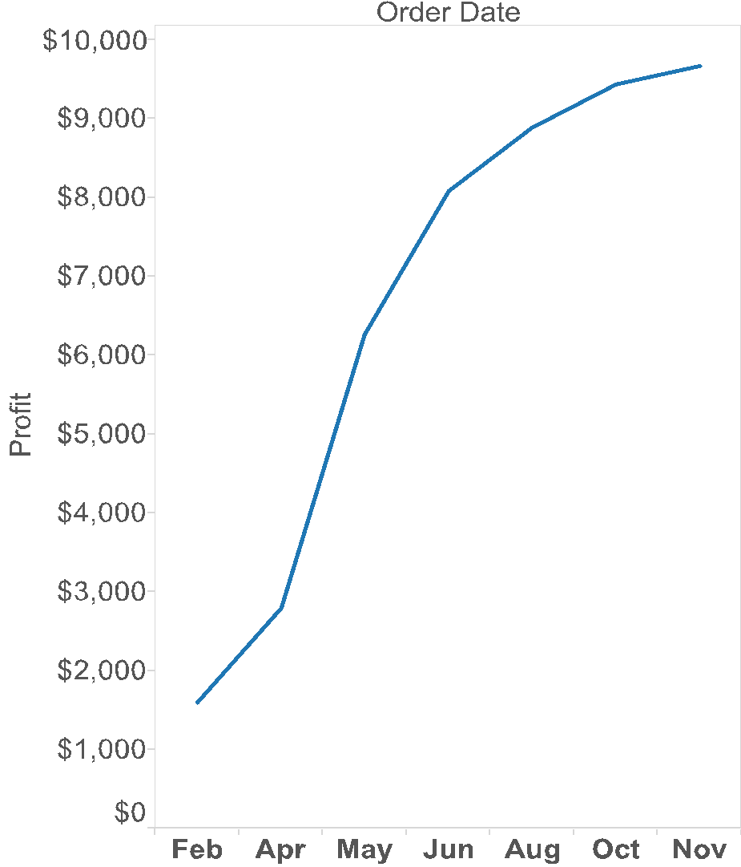
Things to watch out for
Intervals should always be equal in size
If there are missing values, indicate it
But we should only connect values that are adjacent
How might we show missing values?

Slide 25
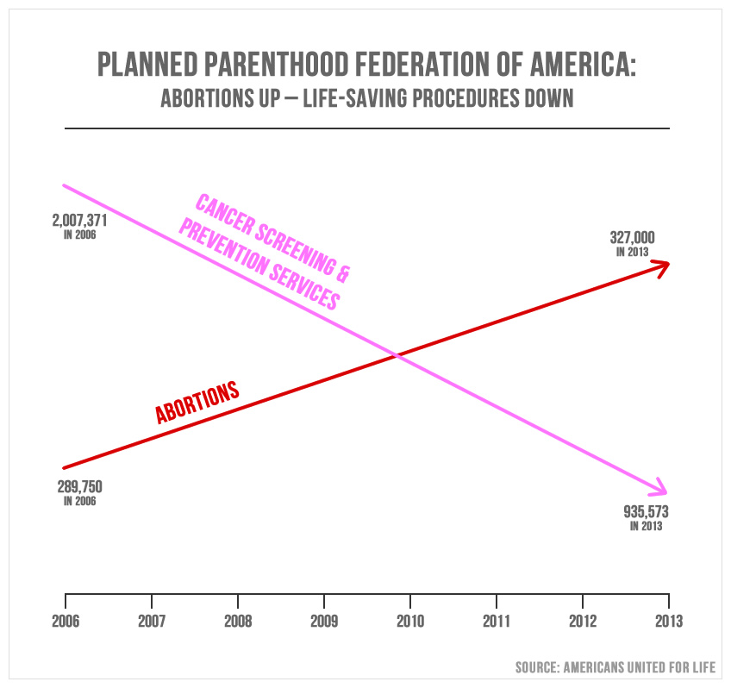
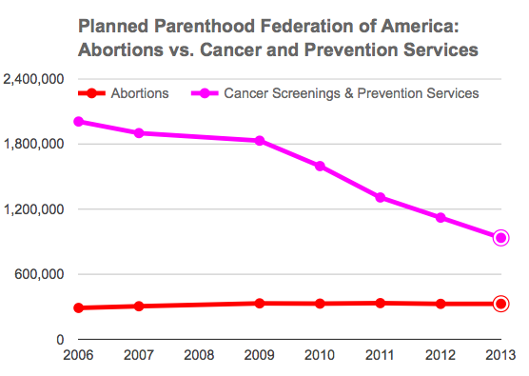
Things to watch out for
Beware comparisons that have different scales!

Slide 26
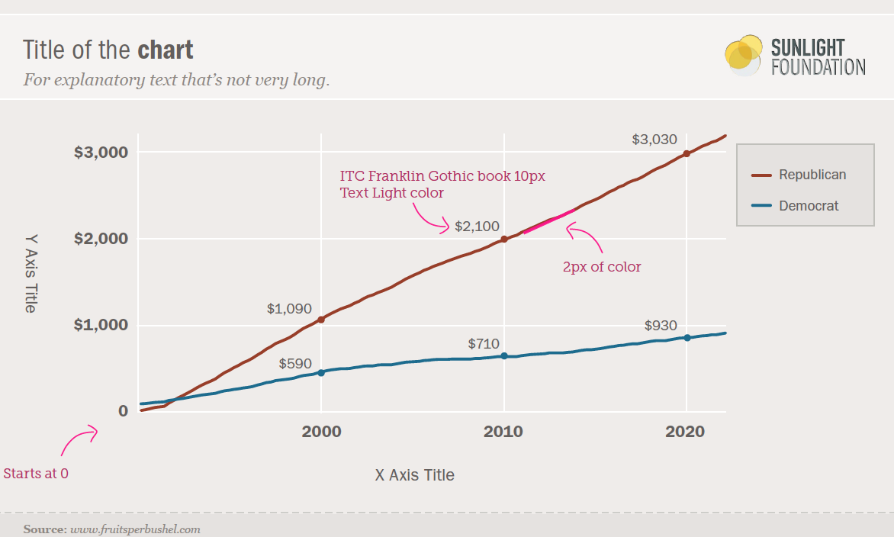
Recap: line charts
Shows the trend in one variable, often over time
Multiple lines can show multiple variables, or the same variable for multiple observations (must have the same scale!)
Highlights “position switches”

