Slide 1
MAPREDUCE
Ramesh Ragala

Slide 2
Introduction
A High level abstracted framework for distributed processing of large datasets
Fault Tolerant , Parallelization
Computation consists of two phases
Map
Reduce
A Master-Slaves architecture
Computations occurs in multiple slave nodes
And it tries to provide data locality as much as possible.

Slide 3
Daemons
JobTracker
Client submits the computation to JobTracker
Assign a task to the TaskTracker who has free slots and where data is stored if possible
It tries to provide data locality as much as possible.
TaskTracker
Spawns a JVM process for each input split as directed by Job Tracker
Send periodic heartbeats to Job Tracker
Notes:
Prepared By Senthil Kumar A
Confidential

Slide 4
Terminology
Job
A complete user defined computation or program.
A full program -- an execution of a Mapper and Reducer across a data set
Tasks
A subset of computation.
Can be either execution of MAP or REDUCE on a slice of data.
Task in Progress (TIP)
Task Attempt
An attempt to run a task.
If an attempt fails, Job Tracker tries to start an another task attempt for the same task.
By Default, total number of task attempts for a task is four.
If the same input causes crashes over and over, that input will eventually be abandoned

Slide 5
Map Reduce : High Level

Slide 6
Nodes, Trackers, Tasks
Master node runs JobTracker instance, which accepts Job requests from clients.
TaskTracker instances run on slave nodes.
TaskTracker forks separate Java process for task instances.
Job Distribution:
MapReduce programs are contained in a Java “jar” file + an XML file containing serialized program configuration options
Running a MapReduce job places these files into the HDFS and notifies TaskTrackers where to retrieve the relevant program code

Slide 7
Input file
1,senthil,paracetamol,male,100
2,kumar,metacin,male,70
3,priya,avil,female,50
4,pradeep,paracetamol,male,25
5,siva,avil,male,45
6,saravana,metacin,male,150
b0
k1 , v1
0 1,senthi,……..,100
2,kumar,………,70
53 3,priya,…………,50
k2 , v2
paracetamol 100
metacin 70
avil 50
b1
b0
map
k3 , v3
avil 50,45
metacin 70,150
paracetamol 100,25
Input
file
shuffle
1.Sorting by key
2.Grouping by key
k4 , v4
avil 95
metacin 220
paracetamol 125
reduce
map
b1
query
select drug,sum(amount) from patient group by drug;
k1 , v1
4,pradeep,………,25
5,siva,…………..,45
96 6,saravana,………,150
k2 , v2
paracetamol 25
avil 45
metacin 150

Slide 8
Anatomy of MR code
Mapper - a Java class to be extended by the developer
Methods – setup, map, run, cleanup
Map method takes a key value and can emit zero or more intermediate key value pairs depending upon the logic implemented by the developer
A JVM running Mapper is launched for each input split.
Reducer – A Java class to be extended by the developer
Methods – setup, reduce, run, cleanup
Reduce method takes a (intermediate key-list of values) and can emit zero or more key value pairs depending upon the logic implemented by the developer
Driver
Configures the job and submits the job to the cluster from the client.

Slide 9
Writables
Writables in Hadoop are present for serialization
What is Serialization??
the process of converting a data structure or object state into a format that can be stored (for example, in a file or memory buffer, or transmitted across a network connection link) and "resurrected" later in the same or another computer environment
Why a separate framework instead of java serialization?
Compact
Fast
Extensible
Interoperable

Slide 10
java | Writable implementation | Serialized size (bytes)
byte | ByteWritable | 1
Boolean | BooleanWritable | 1
Int | IntWritable | 4
 | VIntWritable | 1-5
Float | FloatWritable | 4
Double | DoubleWritable | 8
NullWritable --> usage NullWritable.get()
ArrayWritable
ArrayPrimitiveWritable
TwoDArrayWritable
MapWritable - used Widely ... Look @ Map or HashMap
SortedMapWritable
EnumSetWritable

Slide 11
Block vs. split
split
split
split
1 | 2 | 3 | 4 | 5 | 6 | 7 | 8 | 9 | 10
file lines
Block boundary
Block boundary
Block boundary

Slide 12
Partitioner
It decides which key (with its associated value) goes to reducer.
By default its HashPartitioner.
hashes a record’s key to determine which partition (and thus which reducer) the record belongs in
Number of Partitions is equal to the number of reducers.
public class HashPartitioner<K, V> extends Partitioner<K, V> {
public int getPartition(K key, V value, int numReduceTasks) {
return (key.hashCode() & Integer.MAX_VALUE) % numReduceTasks;
}
}
Notes:
Prepared By Senthil Kumar A
Confidential

Slide 13
mapper jvm/map task(200 mb)
Input split
0 1
merge on(disk)
map
buffer
0 1
0 1
io.sort.mb
100mb(80%)
0 1
partition,sort,spill
reducer jvm(200 mb)
Input file
copy
sort
reduce
To
hdfs
http
from hdfs
copy
sort
reduce
http
mapper jvm/map task(200 mb)
reducer jvm(200 mb)
0 1
map
buffer
0 1
0 1
Input split
io.sort.mb
100mb(80%)
0 1
merge on(disk)
partition,sort,spill

Slide 14
Custom Partitioner
Need Customer partitioner for better load balancing(performance)
To Write a partitioner, follow the steps
Extend partitioner class
Override the method getPartition
input – key,value,number of Reducers
Output –0 to n-1( where n - number of reducer)
job.setPartitionerClass(<yourclassname.class>)

Slide 15
Combiner
To Reduce the intermediate data from mapper to reducer
To reduce Network IO and Disk IO
Runs on a single mapper output(like a mini-reducer)
Extends the Reducer class (new API)
Job.setCombinerClass(*.class);
Combiner may or may not run
Its better to use identical combiner and reducer when both are commutative as well as associative functions

Slide 16
WritableComparable
A WritableComparable is a Writable which is also Comparable
Two WritableComparables can be compared against each other to determine their ‘order’
Keys must be WritableComparables because they are passed to the Reducer in sorted order
We will talk more about WritableComparable later
IntWritable
LongWritable
Text
WritableComparable
Writable
Defines a de/serialization
protocol. Every data type in
Hadoop is a Writable
Defines a sort order. All keys
must be WritableComparable

Slide 17
WritableComparable
WritableComparable is a sub-interface of Writable
Writable is an interface and must inherit following methods
readFields(DataInput in);
write(DataOutput out);
Must implement compareTo, hashCode, equals methods
All keys in MapReduce must be WritableComparable
compareTo method compares the keys in the mapper out to provide sorted
It deserializes the keys and compare the values in java
It is time consuming .instead you can use comparators

Slide 18
Streaming API
To use other languages for writing MR
Python, perl, ruby
RAD, use of existing libraries
Use stdin, stdout for input & output respectively
TextInputFormat –default -- without key
MR emits Key(tab)value
No iterators as that of Java- developers have to make sure to detect change in key
bin/hadoop jar contrib/streaming/hadoop-streaming-1.0.4.jar -file /hadoop/hadoop-docs/mapper.py -mapper /hadoop/hadoop-docs/mapper.py -file /hadoop/hadoop-docs/reducer.py -reducer /hadoop/hadoop-docs/reducer.py -input /data_30lac.txt -output /python_out

Slide 19
To Change Input Split Size
mapred.min.split.size | mapred.max.split.size | dfs.block.size | Split Size
1 (default) | Long.MAX_VALUE (default) | 64 MB (default) | 64 MB
1 (default) | Long.MAX_VALUE (default) | 128 MB | 128 MB
128 MB | Long.MAX_VALUE (default) | 64 MB (default) | 128 MB
1 (default) | 10 MB | 64 MB (default) | 10 MB

Slide 20
InputFormat
Input File
InputSplit
InputSplit
InputFormat
InputFormat
RecordReader
RecordReader
Mapper
Mapper
Responsible for creating inputsplit and dividing them into records

Slide 21
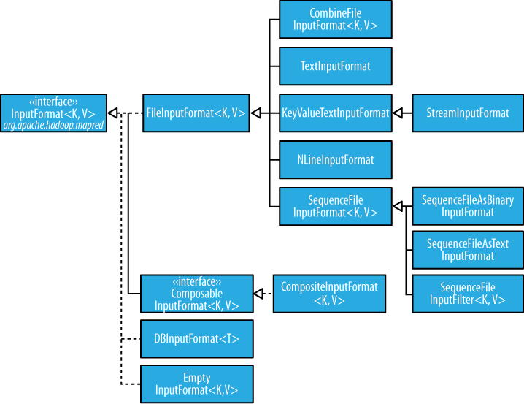

Slide 22
InputFormat | Key | Value
TextInputFormat | Byte offset of the line | Line contents
KeyValueInputFormat | Everything up to the first tab charcter | The remainder of the line
SequenceFileInputFormat | User-defined | User-defined
WholeFileInputFormat | NullWritable | file contents
NLineInputFormat | Byte offset of the line | n Number of lines
MultipleInputs | Per path basis | Per Path Basis
TableInputFormat (HBase) | Rowkey | Value
mapred.line.input.format.linespermap

Slide 23
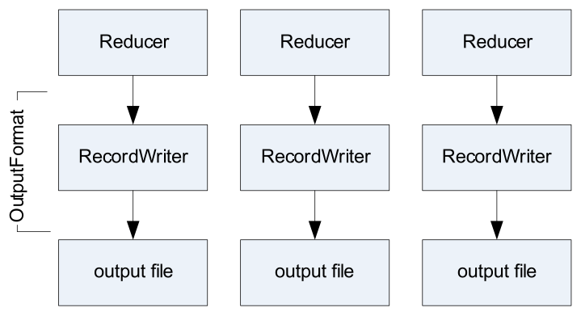
OutPutFormat

Slide 24
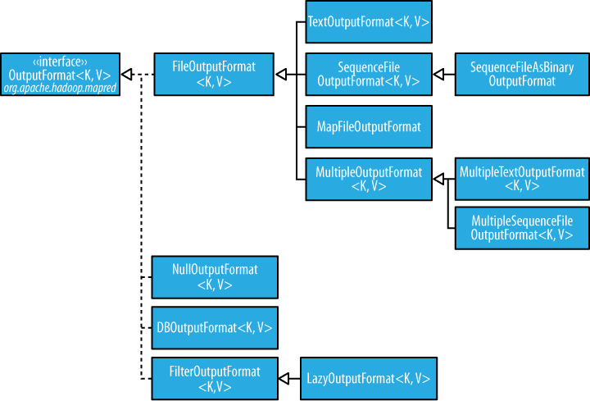

Slide 25
CustomInputFormat
Use FileInputFormat as a starting point
– Extend it
Write your own custom RecordReader
Override getRecordReader method in FileInputFormat
Override isSplittable if you don’t want input files to be split

Slide 26
Some More info
IdentityMapper
mapping inputs directly to outputs
IdentityReducer
Performs no reduction, writing all input values directly to the output.
Single Reducer
Use when complete sort order is required
Use TotalOrderPartitioner as an alternative and merge the results
Zero Reducer
SetNumReduceTasks to 0
Output from maps will go directly to OutputFormat and disk
No Sorting and Shuffling

Slide 27
Counters
for gathering statistics about the job
for quality control
for application level-statistics
Classified into two counters
Built In Counters
Task counters
Job Counters
Custom Counters

Slide 28
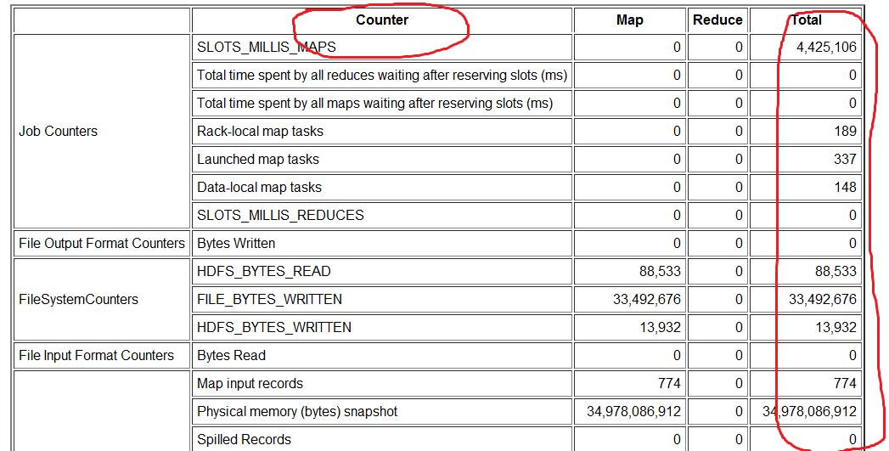
Built in Counter for JOB

Slide 29
Custom Counter
public static enum CUSTOMCOUNTER {
ERROR_COUNT
}
To insert the code in JOB class
To increase the counter value in mapper class
context.getCounter(CUSTOMCOUNTER.ERROR_COUNT).increment(1);
To display the output of the counter in job after completion
job.getCounters().findCounter(COUNTERS.ERROR_COUNT).getValue()

Slide 30
Side Data distribution
To keep some read only data available for all the tasks
Can be achieved using following two ways:
Configuration Object
DistributedCache
Configuration conf = new Configuration();
conf.set(“personName”,”kumar”);

Slide 31
Distributed Cache
Cache files and archive to the task nodes
Usage
As
DistributedCache API
public void addCacheFile(URI uri)
public void addCacheArchive(URI uri)
public void setCacheFiles(URI[] files)
public void setCacheArchives(URI[] archives)
public void addFileToClassPath(Path file)
public void addArchiveToClassPath(Path archive)
public void createSymlink()

Slide 32
GenericOptionsParser, Tool, and ToolRunner
class that interprets common Hadoop command-line options
implement the Tool interface and run your application with the ToolRunner
GenericOptionsParser
-Dproperty=value
-conf file
-fs uri
-jt host:port
-files file1 file2
-archives archive1 archive2
-libjars jar1

Slide 33
Joins
To join data from Multiple datasets
Please try to use PIG or HIVE join if you are using text based files
Two varieties or approaches
Map-side Join
Reduce side Join

Slide 34
Map Side Join
Basic idea for Map-side joins:
Load one set of data into memory, stored in an associative array
Key of the associative array is the join key
Map over the other set of data, and perform a lookup on the associative array using the join key
If the join key is found, you have a successful join
Otherwise, do nothing

Slide 35
Reduce Side Join
Use the same key for the mapper output
Can be performed in two ways
MultipleInputs
Secondary Sort
MultipleInputs.addInputPath(job, InputPath, TextInputFormat.class, CustomMapper.class);

Slide 36
Sorting
In MR, keys from all mappers are sent to the reducers in sorting order
Total sorting can be obtained using single reducer
Reduces the performance
Partial sorting can be obtained using partition
For benchmarking , terasort has been widely used

Slide 37
Secondary Sorting
In MR sorting , the keys are sorted and not the values
To achieve the secondary sorting
Make the key a composite of the natural key and the natural value
The sort comparator should order by the composite key, that is, the natural key and natural value.
The partitioner and grouping comparator for the composite key should consider only the natural key for partitioning and grouping.
Example

Slide 38
Searching
Assignment
Input
A set of input files containing lines
A pattern
OutPut
Pattern with list of filename containing the pattern
Solution:
Set the pattern using Configuration Object
In Mapper(with TextInputFormat), verify for the pattern
If Pattern matches, emit (pattern, filename)
If No pattern , emit nothing
Zero reducer
map.input.file

Slide 39
Inverted Index
an index data structure storing a mapping from content, such as words or numbers, to its locations in a database file, or in a document or a set of documents.
Mapper
For each word , mapper emits (word, filename)
Reducer
For each key (word), it emits (word, file1.txt-file2.txt-………complete list)
knowledge

Slide 40
LocalJobRunner
only designed for simple testing of MapReduceprograms
can’t run more than one reducer
bin/hadoop jar job.jar com.example.wordcount -D mapred.job.tracker=local -D fs.default.name=file:/// (args)
Other tips
Set keep.failed.task.files to true
Use the isolationRunner to run just the failed tasks

Slide 41
MRunit
Easy integration between Mapreduce and standard testing tools
No external test input or output files
Less test harness code
Concise, fast tests
Issues
Tests are not executed in a distributed way
Developed by cloudera. Please visit their site for more info.

Slide 42
Hadoop and compressed Files
Hadoop understands a variety of file compression formats
Including GZip
If a compressed file is included as one of the files to be processed, Hadoop will automatically decompress it and pass the decompressed contents to the Mapper
There is no need for the developer to worry about decompressing the file
However, GZip is not a ‘splittable file format’
A GZipped file can only be decompressed by starting at the beginning of the file and continuing on to the end
You cannot start decompressing the file part of the way through it

Slide 43
Gzip – Non-Splittable
If the MapReduce framework receives a non-splittable file (suchas a GZipped file) it passes the entire file to a single mapper
This can result in one Mapper running for far longer than the others
It is dealing with an entire file, while the others are dealing with smaller portions of files
Speculative execution can occur
Although this will provide no benefit
Typically it is not a good idea to use GZip to compress files which will be processed by MapReduce

Slide 44
LZO – splittable format
LZO is not shipped with Hadoop due to license restrictions
But it is easy to add
See https://github.com/cloudera/hadoop-lzo
LZO files have set points within the file at which compression can begin
InputSplits are calculated based on those points
The point closest to each block boundary is chosen

Slide 45
Snappy
Snappy is a relatively new compression format
Developed at Google, Splittable, Very fast
Snappy does not compress a file and produce, e.g., a file with
a .snappy extension
Instead, it compresses data within a file
That data can be decompressed automatically by Hadoop (or other programs) when the file is read
Works well with SequenceFiles, Avro files

Slide 46
Failures in MapReduce
Task Failure
Application Master Failure
Node Manager Failure
Resource Manager Failure

Slide 47
Failures in MapReduce
Task Failure
Run time exception in thrown in user mapper or reducer task.
if this happens, the task JVM reports the error back to its parent application master before it exits.
The application master marks the task attempt as failed, and frees up the container so its resources are available for another task.
Another failure mode is the sudden exit of the task JVM due to bug in JVM.
In this the node manager notices that the process has exited and informs the application master so it can mark the attempt as failed.
Hanging Task
The application master notices that it hasn’t received a progress update for a while and proceeds to mark the task as failed.
The task JVM process will be killed automatically after this period
If timeout value is set as zero → disables the timeout → long running tasks are never marked failed → never freeup the containers → due to this cluster may be slowndown
When the application master is notified of a task attempt that has failed, it will reschedule execution of the task.
The application master will try to avoid rescheduling the task on a node manager where it has previously failed.
By default, if any task fails four times (or whatever the maximum number of attempts is configured to), the whole job fails.
I

Slide 48
Failures in MapReduce
Task Failure
Few cases, it is undesirable to abort the job if a few tasks fail, as it may be possible to use the results of the job despite some failures.
In this case, the maximum percentage of tasks that are allowed to fail without triggering job failure can be set for the job.
A task attempt may also be killed, which is different from it failing.
A task attempt may be killed because it is a speculative duplicate
Another failure mode is the sudden exit of the task JVM due to bug in JVM.
In this the node manager notices that the process has exited and informs the application master so it can mark the attempt as failed.

Slide 49
Failures in MapReduce
Application Master Failure
Just like MapReduce tasks are given several attempts to succeed (in the face of hardware or network failures), applications in YARN are retried in the event of failure.
The maximum number of attempts to run a MapReduce application master is controlled by the mapreduce.am.max-attempts property.
The default value is 2, so if a MapReduce application master fails twice it will not be tried again and the job will fail.
If you want to increase the number of MapReduce application master attempts, you will have to increase the YARN setting on the cluster, too.
Recovery Works:
An application master sends periodic heartbeats to the resource manager, and in the event of application master failure, the resource manager will detect the failure and start a new instance of the master running in a new container (managed by a node manager).
In the case of the MapReduce application master, it will use the job history to recover the state of the tasks that were already run by the (failed) application so they don’t have to be rerun.
Recovery is enabled by default.
I

Slide 50
Failures in MapReduce
Application Master Failure
The MapReduce client polls the application master for progress reports, but if its application master fails, the client needs to locate the new instance.
During job initialization, the client asks the resource manager for the application master’s address, and then caches it so it doesn’t overload the resource manager with a request every time it needs to poll the application master.
If the application master fails, however, the client will experience a timeout when it issues a status update, at which point the client will go back to the resource manager to ask for the new application master’s address. → This process is transparent to the user.

Slide 51
Failures in MapReduce
Node Manager Failure
If a node manager fails by crashing or running very slowly, it will stop sending heartbeats to the resource manager or send them very infrequently
Timeout is 10 minutes → this can be configured
Any task or application master running on the failed node manager will be recovered using the mechanisms
In addition, the application master arranges for map tasks that were run and completed successfully on the failed node manager to be rerun if they belong to incomplete jobs, since their intermediate output residing on the failed node manager’s local filesystem may not be accessible to the reduce task.
Node managers may be blacklisted if the number of failures for the application is high, even if the node manager itself has not failed.
Blacklisting is done by the application master
For MapReduce the application master will try to reschedule tasks on different nodes if more than three tasks fail on a node manager.
The user may set the threshold for this.

Slide 52
Speculative Execution
If hadoop detects that some tasks is slower than normal, another equivalent backup task is launched.
Which ever completes first, the second one is killed immediately.
It is an optimization, not a feature to make jobs to run more reliably.

