Slide 1
Mining Social-Network Graphs
Direct Discovery of Communities
Partitioning of graphs
Finding overlapping communities
Counting Triangles
Neighborhood properties of graphs

Slide 2
Direct Discovery of Communities
In the previous session, we have discussed the Between to find the communities by partitioning all the individuals in a social network.
Even this approach is an efficient, it has many shortcomings
It is not possible to place an individual in two different communities, and everyone is assigned to a community
A technique for discovering communities directly by looking for subsets of the nodes that have a relatively large number of edges among them. → indirectly this technique finds the large frequent itemsets in graph

Slide 3
Direct Discovery of Communities
How we could find sets of nodes with many edges between them ?
Idea : Finding the large clique.
Clique definition: In the mathematical area of graph theory, a clique is a subset of vertices of an undirected graph such that every two distinct vertices in the clique are adjacent; that is, its induced subgraph is complete.
Finding Maximum clique in a graph is NP-Complete problem.
even approximating the maximal clique is hard.
it is possible to have a set of nodes with almost all edges between them, yet with relatively small cliques.

Slide 4
Direct Discovery of Communities
How we could find sets of nodes with many edges between them ?
Idea : Finding the large clique.
Clique definition: In the mathematical area of graph theory, a clique is a subset of vertices of an undirected graph such that every two distinct vertices in the clique are adjacent; that is, its induced subgraph is complete.
Finding Maximum clique in a graph is NP-Complete problem.
even approximating the maximal clique is hard.
it is possible to have a set of nodes with almost all edges between them, yet with relatively small cliques.

Slide 5
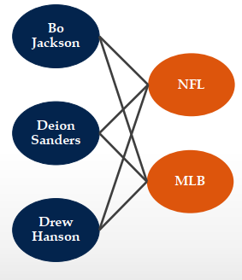
Direct Discovery of Communities
Another Idea : Bipartite Graphs.
A complete bipartite graph consists of s nodes on one side and t nodes on the other side, with all st possible edges between the nodes of one side and the other present. Denote this graph as K_{s,t}.
it is possible to guarantee that a bipartite graph with
many edges has a large complete bipartite subgraph
(unlike cliques). Bipartite subgraph → bi-clique
might be regarded as the nucleus of community

Slide 6
Direct Discovery of Communities
If the graph itself is k-partite then then we can take nodes of two types and the edges between them to form a bipartite graph.
In this bipartite graph, we can search for complete bipartite subgraphs as the nuclei of communities.
complete bipartite subgraphs also used to find community in ordinary graphs where nodes all have the same type.
Divide the nodes into two equal groups at random.
If a community exists, then we would expect about half its nodes to fall into each group, and we would expect that about half its edges would go between groups.
Thus, we still have a reasonable chance of identifying a large complete bipartite subgraph in the community.
To this nucleus we can add nodes from either of the two groups, if they have edges to many of the nodes already identified as belonging to the community.

Slide 7
Direct Discovery of Communities
If the graph itself is k-partite then then we can take nodes of two types and the edges between them to form a bipartite graph.

Slide 8
Partition of Graphs
It is an another approach to organizing social-network graphs.
Problem:
partitioning a graph to minimize the number of edges that connect different components (communities)
Goal:
Minimizing the cut size.
It uses important concepts from Matrix theory such as spectral methods.

Slide 9
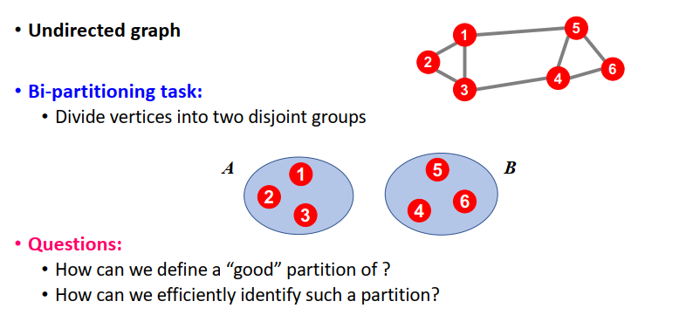
Partition of Graphs

Slide 10
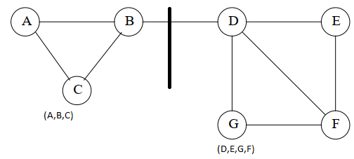
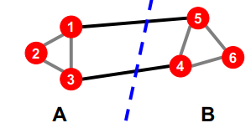
Partition of Graphs
What makes good partition?
Divide nodes into two sets so that the cut (set of edges that connect nodes in different sets) is minimized.
It needs the two sets to be approximately equal in size.
Maximize the number of within-group connections
Minimize the number of between-group connections
Examples:

Slide 11
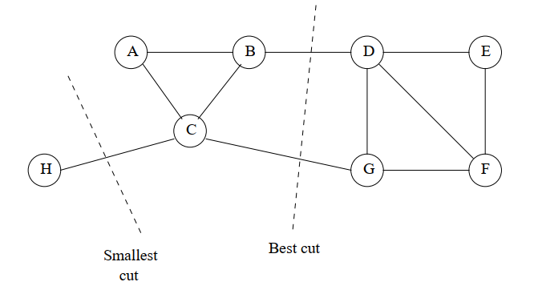
Partition of Graphs
Example – 3:
It is a variant of previous example
If all we wanted was to minimize the size of the cut, then the best choice would be to put H in one set and all the other nodes in the other set.
But is not acceptable, because one set is too small
Better is to use cut with (B,D) and (C,G)
Smallest cut is not necessarily the best cut

Slide 12
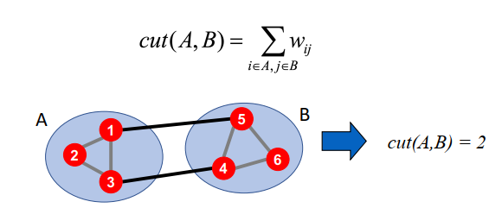
Partition of Graphs
Graph cut..
Express partitioning objectives as a function of the “edge cut” of the partition
CUT: Set of edges with only one vertex in a group

Slide 13
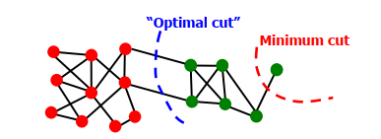
Partition of Graphs
Criterion: Minimum Cut
Minimize weight of connections between groups
arg(MIN_{A,B} CUT(A,B))
Problems:
Only considers external cluster connections
Does not consider internal cluster connectivity

Slide 14
Partition of Graphs
Normalized cut..
Good Cut → It must balance the size of the cut itself against the difference in the sizes of the sets that the cut creates. → this becomes the criterion.
To do this we are using “Normalized cut” [Shi-Malik, ’97]
Connectivity between groups relative to the density of each group
Let us assume the Normalized cut is represented as “ncut”
It is used to produce more balanced partitions
How do we efficiently find a good partition?
Problem: Computing optimal cut is NP-hard

Slide 15

Partition of Graphs
Normalized cut..
Vol(S) defines the volume of the set – S. The volume of the set specifies the number of edges in the set.
Let us assume we partition the nodes of a graph into two disjoint sets S and T
Let Cut(S, T) be the number of edges that connect a node in S to a node in T. Then Normalized Cut :

Slide 16
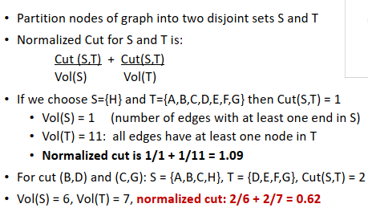
Partition of Graphs
Normalized cut: Example

Slide 17
Partition of Graphs
Matrix representation of a Graph:
1. Adjacency Matrix
2. Degree Matrix
3. Laplacian Matrix

Slide 18
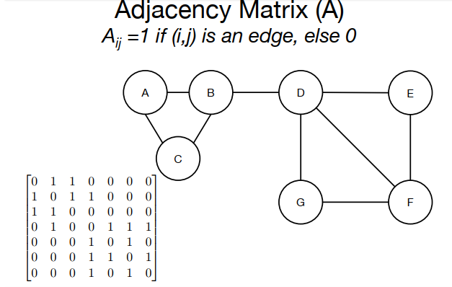
Partition of Graphs

Slide 19
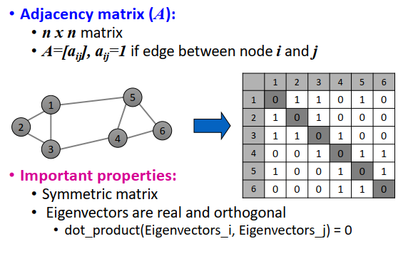
Partition of Graphs

Slide 20
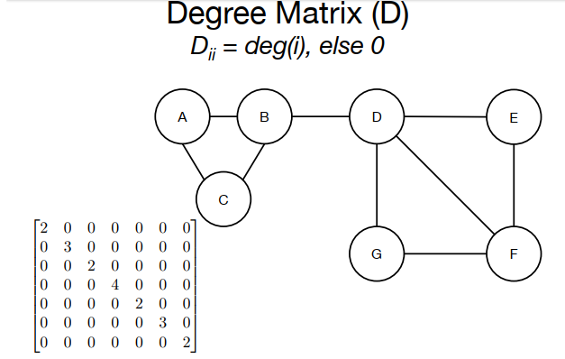
Partition of Graphs

Slide 21
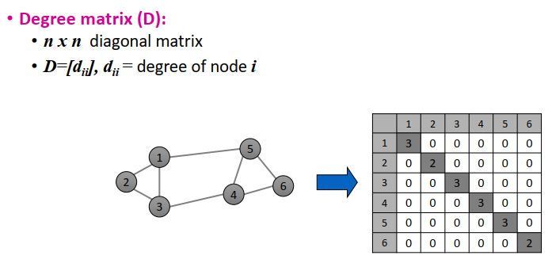
Partition of Graphs

Slide 22
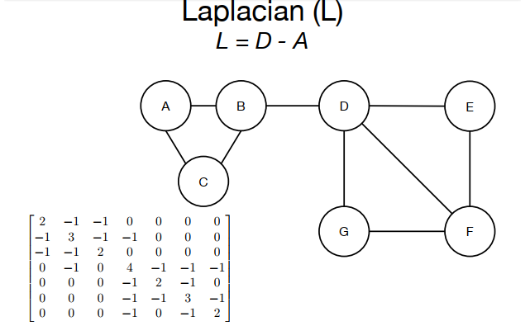
Partition of Graphs

Slide 23
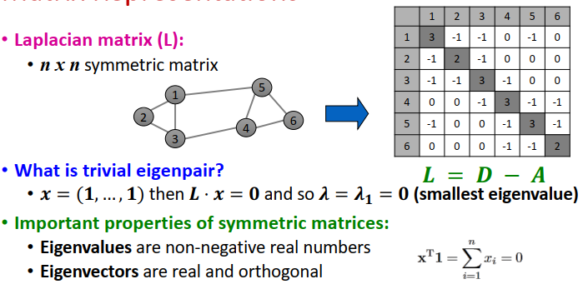
Partition of Graphs

Slide 24
Partition of Graphs
With the help of eigenvalues and eigenvectors of a Laplacian matrix of the given graph, we can get a good idea on best way of partition of a given graph.
When dealing with the Laplacian matrix, however, it turns out that the smallest eigenvalues and their eigenvectors reveal the information we desire.
The smallest eigenvalue for every Laplacian matrix is 0, and its corresponding eigenvector is [1, 1, . . . , 1].
Second smallest eigenvalue of the Laplacian symmetric matrix give the best partition of the given graph.

Slide 25
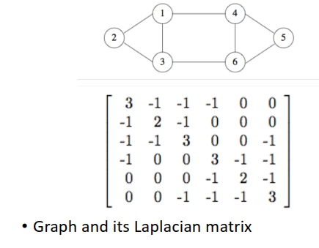
Partition of Graphs

Slide 26
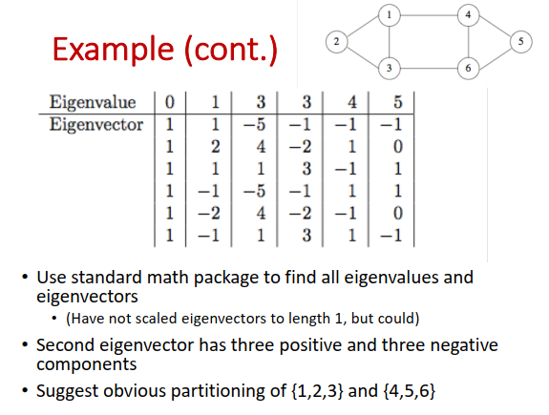
Partition of Graphs

Slide 27
Finding Overlapping Communities
Till that, we have focused on clustering a social graph to find communities.
Communities are rarely disjoint in nature → overlapping
In this session, we are using a method to take social graph and fitting a model to it.
This model should explains how it could have been generated by a mechanism that assumes the probability that two individuals are connected by an edge (are “friends”) increases as they become members of more communities in common.
maximum-likelihood estimation is used in this approach to find the overlapping of communities

Slide 28
Finding Overlapping Communities
The Nature of Communities with example:
Scenario:
Our data is a social graph, where nodes are people and an edge between two nodes represents “friends.”
Assume this social graph relates to the students at school.
The school have two clubs:
Chess Club
Spanish Club
Possibility: Each of these club can form a community.

Slide 29
Finding Overlapping Communities
The Nature of Communities with example:
Scenario:
Two people in their respective club are more likely to be friends in the graph → they know each other from the club.
What if two people are in both clubs?
They now have two reasons why they might know each other, and so we would expect an even greater probability that they will be friends in the social graph.
Conclusion:
The edges are dense within any community
The edges in the intersection of communities are even dense. This is even denser than the edges in the intersection of three communities.

Slide 30
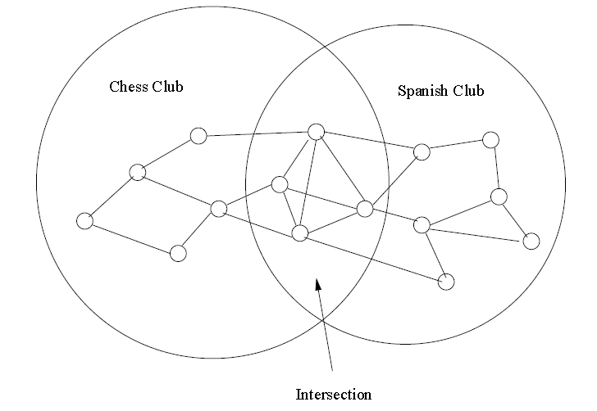
Finding Overlapping Communities
The Nature of Communities with example:
Scenario: The overlap of two communities is denser than the non-overlapping parts of these communities

Slide 31
Finding Overlapping Communities
Maximum-Likelihood Estimation (MLE):
Idea: an assumption about the generative process (i.e model ) which creates instances of some artifact. example, “friends graphs.”
The model has parameters that determine the probability of generating any particular instance of the artifact → this probability is called the likelihood of those parameter values.
We assume that the value of the parameters that gives the largest value of the likelihood is the correct model for the observed artifact.

Slide 32
Finding Overlapping Communities
Maximum-Likelihood Estimation (MLE): Example
Assume, we want to generate a random graph.
Assume that, each edge is present with probability (p) and not present with probability as (1-p).
Assume each edge is chosen independently.
The only parameter that can be adjusted is p.
For each value of p can generate a graph, even through it is a small value.
Following the MLE principle, we shall declare that the true value of p is the one for which the probability of generating the observed graph is the highest.

Slide 33

Finding Overlapping Communities
Maximum-Likelihood Estimation (MLE): Example
Graph which is shown in the top-right corner is used to digger the MLE concept.
This graph consists of 15 nodes and 23 edges.
Total number of pairs (105 pairs) with 15 nodes. 23C₁₅
Each edge is chosen with a probability – p, so the likelihood to generating the exact graph which is there in the image is
p²³(1-p)⁸²
This function does have maximum by applying derivative on that function and equating with zero.

Slide 34
Finding Overlapping Communities
Maximum-Likelihood Estimation (MLE): Example
23p²²(1-p)⁸²-82p²³(1-p)⁸¹ = 0
After simplification
p²²(1-p)⁸¹- (23(1-p)-82p) = 0
The R.H.S value is zero for p = 0, 1 or last factor i.e (23(1-p)-82p) is zero.
When p is 0 or 1, the value of the likelihood function p²³(1-p)⁸² is minimized. → for maximum value the last factor should be zero.
So the likelihood of generating a graph which is same as shown in the image is maximized when
23 – 23p – 82p = 0 → p = 23/105.

Slide 35
Finding Overlapping Communities
The Affiliation-Graph Model (AGM):
Affiliation-Graph Model is used to generate social graph from communities.
It is a probabilistic graphical model of overlapping community structures in networks.
It proposes a likelihood that exhibits the pluralistic homophily property, meaning that the probability of a link between nodes increases with increasing number of shared communities.
The mechanism of finding the values of the parameters that give the maximum likelihood is called community-affiliation graphs.

Slide 36
Finding Overlapping Communities
The Affiliation-Graph Model: Procedure rules
Rule – 1: There is a given number of communities, and there is a given number of individuals (nodes of the graph).
Rule – 2: Each community can have any set of individuals as members. That is, the memberships in the communities are parameters of the model.
Rule – 3: Each community C has a probability pC associated with it, the probability that two members of community C are connected by an edge because they are both members of C. These probabilities are also parameters of the model.
Rule – 4: If a pair of nodes is in two or more communities, then there is an edge between them if any of the communities of which both are members justifies that edge according to Rule – 3.

Slide 37
Finding Overlapping Communities
The Affiliation-Graph Model: Procedure rules
We must compute the likelihood that a given graph with the proper number of nodes is generated by this mechanism.
Key Observation:
how the edge probabilities are computed, given an assignment of individuals to communities and values of the pc’s
Example:
Consider an edge (u, v) between nodes u and v.
Suppose u and v are members of communities – C and D, but not any other communities.
The probability that there is no edge between u and v is the product of the probabilities that there is no edge due to community – C and no edge due to community – D.
No edge between node – u and v with probability : (1-pc) (1-pd)
Edge between the node – u and v with probability: 1 – ((1-pc) (1-pd))

Slide 38

Finding Overlapping Communities
The Affiliation-Graph Model: Procedure rules
More generally, if u and v are members of a nonempty set of communities M and not any others, then p_{uv}, the probability of an edge between u and v is given by:
Special case, if u and v are not belongs to any community, then p_{uv} is ϵ, which is a very tiny number.
But by taking the probability to be very small, we bias our computation to favor solutions such that every observed edge is explained by joint membership in some community.

Slide 39

Finding Overlapping Communities
The Affiliation-Graph Model: Procedure rules
If we know the nodes and their corresponding communities then we can compute the likelihood of the of the given graph for these edge probabilities using a simple generalization discussed earlier.
Let M_{uv} be the set of communities to which both u and v are assigned.
Then the likelihood of E being exactly the set of edges in the observed graph is

Slide 40
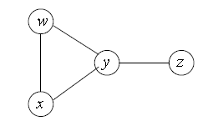
Finding Overlapping Communities
The Affiliation-Graph Model: Example
Assume the above social graph have two communities C and D with associate probabilities p_{C} and p_{D} respectively.
Suppose we have determined (using partitions of the graph) that C = {w,x,y} and D = {w,y,z}.

Slide 41
Finding Overlapping Communities
The Affiliation-Graph Model: Example
Step – 1:
For pair of nodes w and x, M_{wx} = {C} i.e this pair is in community C but not in community D. Then, p_{wx} = 1 – (1-p_{C}) = p_{C}
For pair of nodes x and y, M_{xy}={C}. Then p_{xy} = p_{C}
For pair of node y and z, Myz = {D}, then p_{yz} = p_{D}
For pair of nodes w and z, M_{wz} = {D}, then p_{wz} = p_{D}
Now the pair w and y are together in both communities, M_{wy}= {C, D}, then pwy = 1 – (1 – p_{C}) (1 – p_{D}) = p_{C} + p_{D} + p_{C}p_{D}
For the pair of node x and z are not together in either community, so p_{xz} = ϵ

Slide 42
Finding Overlapping Communities
The Affiliation-Graph Model: Example
Step – 2: Now we can compute the likelihood of the given graph.
This likelihood is the product of the probabilities associated with each of the four pairs of nodes whose edges appear in the graph, times one minus the probability for each of the two pairs whose edges are not there.
p_{wx}p_{wy}p_{xy}p_{yz} (1 – p_{wz})(1 – p_{xz}) → based on the given grpah
Substituting the expressions we developed above for each of these probabilities, then (p_{C})²p_{D}(p_{C}+p_{D}-p_{C}p_{D})(1-p_{D})(1-ϵ)
Note that ϵ is very small, so the last factor is essentially 1 and can be dropped.
We must find the values of p_{C} and p_{D} that maximize the above expression.

Slide 43
Finding Overlapping Communities
The Affiliation-Graph Model: Example
Step – 3:
First, notice that all factors are either independent of p_{C} or grow with p_{C}.
The only hard step in this argument is to remember that p_{D} ≤ 1, so p_{C}+p_{D} – p_{C}p_{D} grow positively with p_{C}.
It follows that the likelihood is maximized when pC is as large as possible; i.e pC = 1.
After substitution of p_{C} in the expression , we get p_{D} as 0.5.
Conclusion:
For a given C and D communities the maximum likelihood for the graph shown in the image occurs when members of C are certain to have an edge between them and there is a 50% chance that joint membership in D will cause an edge between the members.

Slide 44
Finding Overlapping Communities
The Affiliation-Graph Model:
The entire computation is a part of the solution only.
We also need to find an assignment of members to communities such that the maximum likelihood solution for that assignment is the largest solution for any assignment.
Once we fix on an assignment, we can find the probabilities, p_{C}, associated with each community, even for very large graphs with large numbers of communities.
gradient descent technique is used to do this.

Slide 45
Counting Triangles
One of the most useful properties of social-graph is the counting of the triangles and other simple subgraphs.
In this session, we are digress the methods for estimating or getting exact count of triangles in a very large graph.
A triangle means three vertices forming a triangle with edges interconnecting them.
Triangle count refers to the number of triangles passing through each vertex. → The count is a measure of clustering.
Number of triangles in a social network graph is expected to be much larger than a random graph with the same size.
The locality property

Slide 46
Counting Triangles
G=(V,E), |V| = n and |E| = m, a random graph, there will be an expected number of triangles in the graph.
It is not difficult to calculate the count of triangles in the random graph.
There are nc₃ sets of three nodes, or approximately n³/6 sets of three nodes that might be a triangle.
The probability of an edge between any two given nodes being added is m/nc₂, or approximately 2m/n².
The probability that any set of three nodes has edges between each pair, if those edges are independently chosen to be present or absent is approximately, (2m/n²)³ = 8m³/n⁶
Thus, the expected number of triangles in a graph of n nodes and m randomly selected edges is approximately, (8m³/n⁶)(n³/6) = 4/3 (m/n)³

Slide 47
Counting Triangles
The number of triangles in the social-graph is much more than the number of triangles in the random graph.
Reason:
if A and B are friends, and A is also a friend of C, there should be a much greater chance than average that B and C are also friends.
Uses ::
Counting the number of triangles
How much the graph looks like a social network
Age of community is related to the density of triangles
A new community forms
Members bring in their like minded friends
Such new members are expected to eventually connect to
other members directly

Slide 48
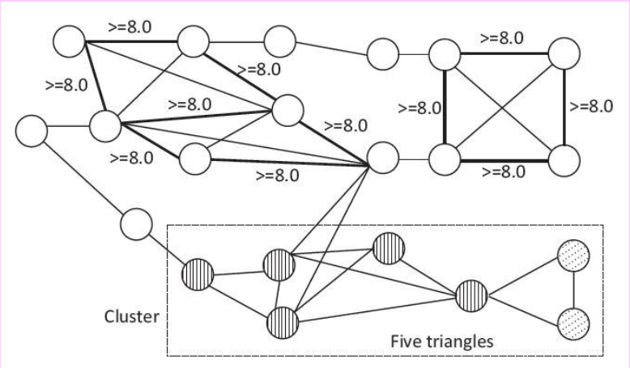
Counting Triangles

Slide 49
Counting Triangles
Counting the number of triangles
How much the graph looks like a social network
Age of community
A new community forms
Members bring in their like minded friends
Such new members are expected to eventually connect to
other members directly

Slide 50
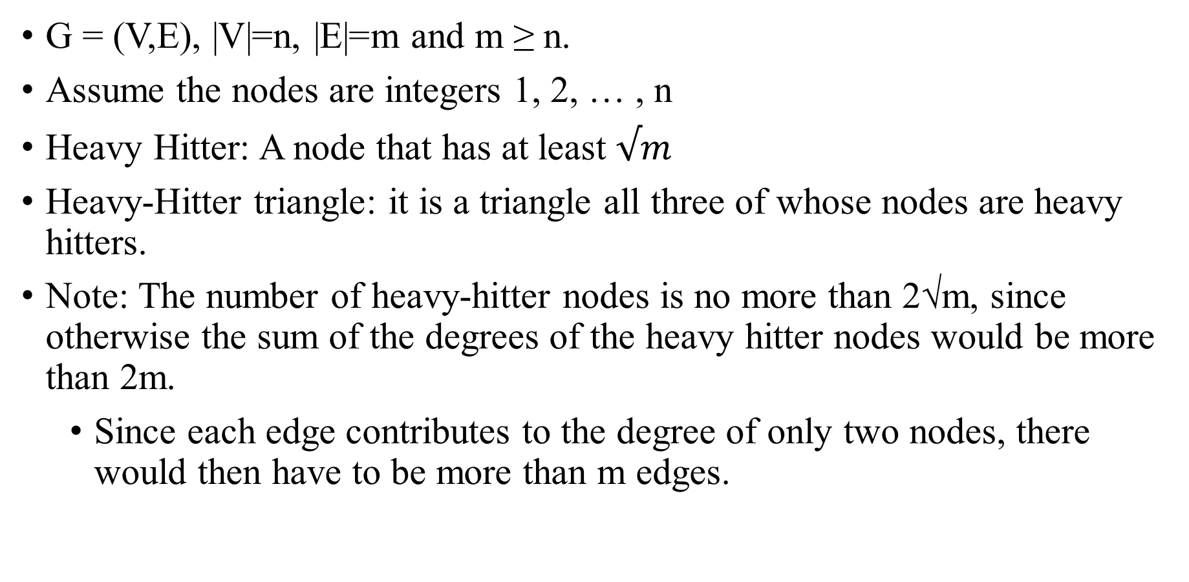
Algorithm for Finding-Counting Triangles
G = (V,E), |V|=n, |E|=m and m ≥ n.
Assume the nodes are integers 1, 2, … , n
Heavy Hitter: A node that has at least $√m$
Heavy-Hitter triangle: it is a triangle all three of whose nodes are heavy hitters.
Note: The number of heavy-hitter nodes is no more than 2√m, since otherwise the sum of the degrees of the heavy hitter nodes would be more than 2m.
Since each edge contributes to the degree of only two nodes, there would then have to be more than m edges.

Slide 51
Algorithm for finding Counting Triangles
G = (V,E), |V|=n, |E|=m and m ≥ n.
Assume the graph is represented by its edges , we pre-process the graph as follows:
Compute the degree of each node. This part requires only that we examine each edge and add 1 to the count of each of its two nodes. The total time required is O(m).
Create an index on edges, with the pair of nodes at its ends as the key. That is, the index allows us to determine, given two nodes, whether the edge between them exists. → A hash table suffices. → It can be constructed in O(m) time
Create another index of edges, this one with key equal to a single node. Given a node v, we can retrieve the nodes adjacent to v in time proportional to the number of those nodes. Again, a hash table, this time with single nodes as the key, suffices in the expected sense.

Slide 52
Algorithm for finding Counting Triangles
Order the nodes as follows:
First, order nodes by degree.
If v and u have the same degree.
Order them numerically, because both v and u are integers.
Simply:
we say v ≺ u if and only if either
The degree of v is less than the degree of u, or
The degrees of u and v are the same, and v < u.

Slide 53
Triangle Counting Algorithm
Graph G = (V,E); |V| = n, |E|=m ::: Mathematical foundation of the algorithm
Step – 1: Compute degree of each node
Examine each edge
Add degree 1 to each of the two nodes
Takes O(m) time
Step – 2: A hash table (v_{i},v_{j}) → 1
So that, given two nodes, we can determine if they have an edge between them
Construction takes O(m) time
Each query ~expected O(1) time, with a proper hash function
Step – 3: An index v → list of nodes adjacent to v
Construction takes O(m) time, querying takes O(1) time

Slide 54
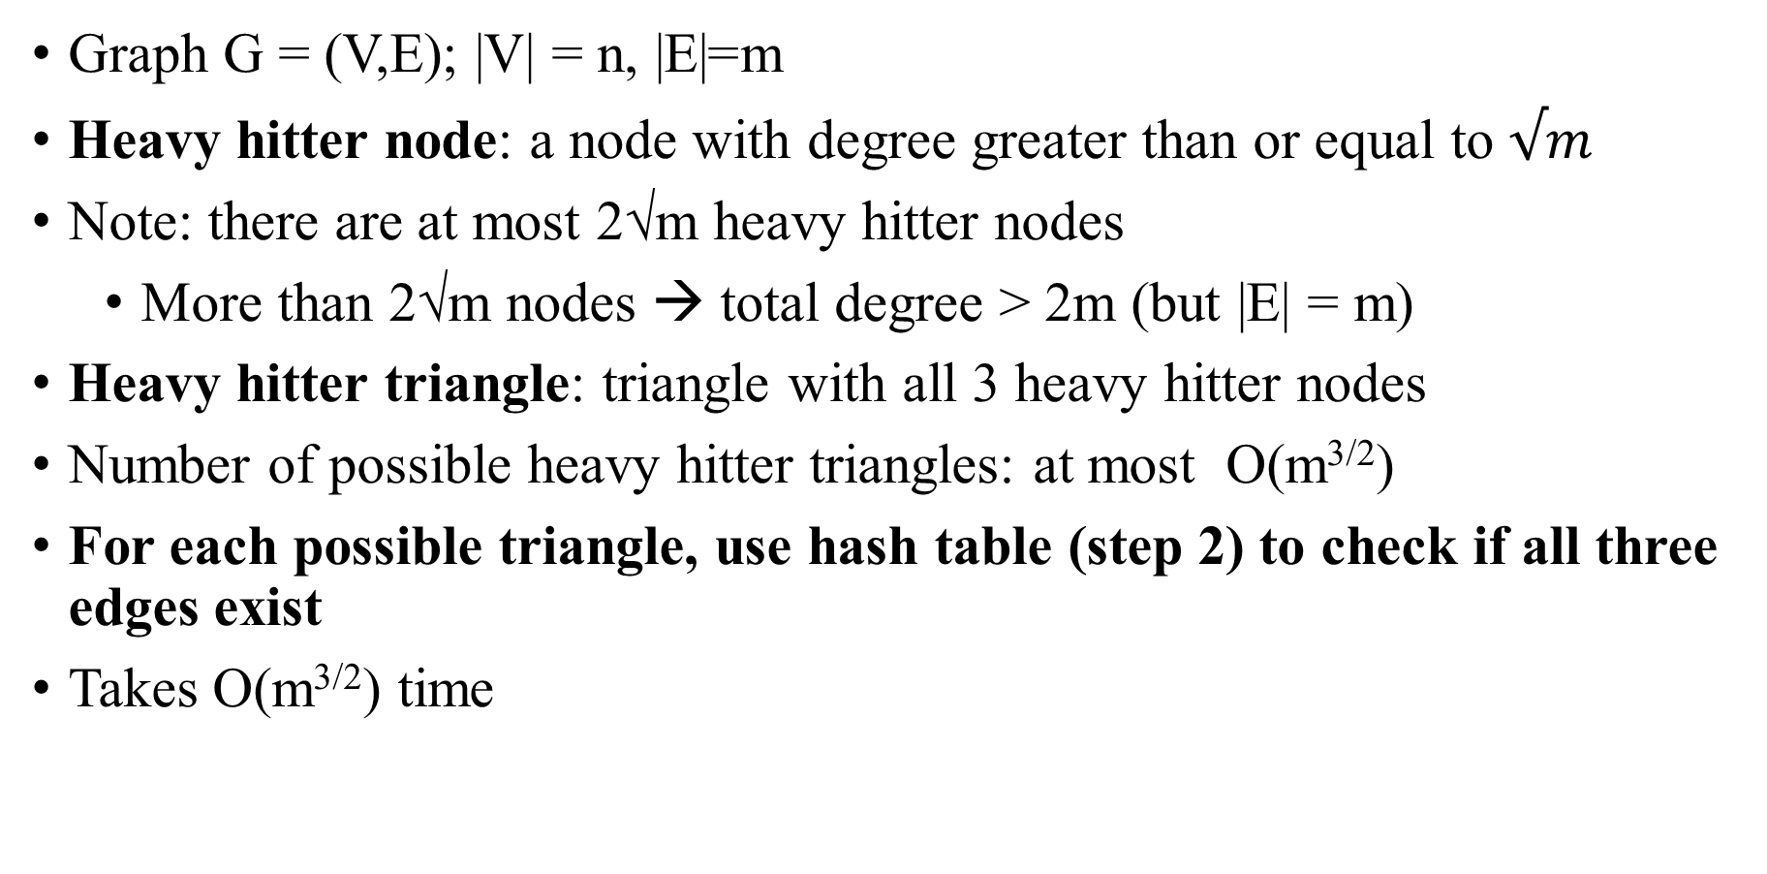
Counting Heavy Hitter Triangles
Graph G = (V,E); |V| = n, |E|=m
Heavy hitter node: a node with degree greater than or equal to $√m$
Note: there are at most 2√m heavy hitter nodes
More than 2√m nodes → total degree > 2m (but |E| = m)
Heavy hitter triangle: triangle with all 3 heavy hitter nodes
Number of possible heavy hitter triangles: at most O(m^{3/2})
For each possible triangle, use hash table (step 2) to check if all three edges exist
Takes O(m^{3/2}) time

Slide 55
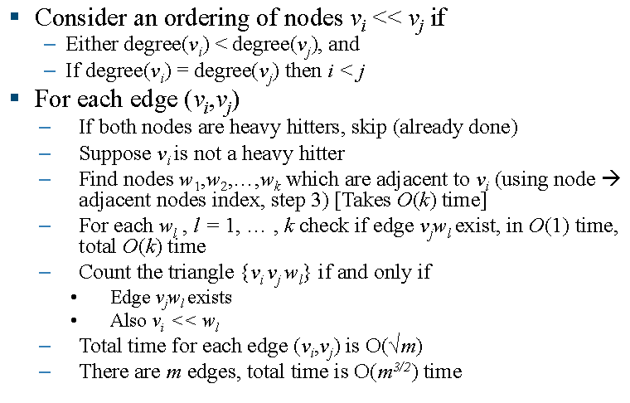
Counting Other Triangles

Slide 56
Optimality of the Triangle-Finding Algorithm
In that algorithm, complete graph is used → graph with n – nodes and m-edges
Total number of edges = nC₂, total number of triangles = nC₃.
Since we cannot enumerate triangles in less time than the number of those triangles, we know any algorithm will take Ω(n³) time on this graph.
However, m = O(n²), so any algorithm takes Ω(m^{3/2}) time on this graph.
Hence it is the lower bound for computing all triangles
Assume: The graph G’ is sparse
Consider a complete graph G’ with n nodes, m edges
Note that m = nC₂ = O(n²)
Construct G from G’ by adding a chain of length n²
The number of triangles remain the same, O(m^{3/2})
The number of edges remain of the same order O(m)
G is quite sparse, lowering edge to node ratio i.e m/n
Still cannot compute the triangles in less than O(m^{3/2}) time

