Slide 1


INTRODUCTION to
Domain Name System
Eng. Yasser Al-eimad
Internet Manager
yasser@yemen.net.ye
Introduction to DNS
Eng. Yasser Al-eimad

Slide 2
CONTENTS
Definitions.
DNS Naming Structure.
DNS Components.
How DNS Servers work.
DNS Organizations.
Summary.
Introduction to DNS
Eng. Yasser Al-eimad

Slide 3
CONTENTS
Definitions.
DNS Naming Structure.
DNS Components.
How DNS Servers work.
DNS Organizations.
Summary.
Introduction to DNS
Eng. Yasser Al-eimad

Slide 4
DNS Definition
Definitions
The “Domain Name System”
  Created in 1983 by Paul Mockapetris (RFCs 1034 and 1035), modified, updated, and enhanced by many of subsequent RFCs
The Internet users use DNS to reference anything by name on the Internet
The mechanism by which Internet software translates names to addresses and vice versa
Introduction to DNS
Eng. Yasser Al-eimad

Slide 5
DNS Definition …
Definitions
IP assigns 32-bit addresses to hosts (interfaces)
  Binary addresses are easy for computers to manage .
  All applications use IP addresses through the TCP/IP protocol software.
  Difficult for humans to remember.
Domain names comprise a hierarchy so that names are unique, easy to remember.
Introduction to DNS
Eng. Yasser Al-eimad

Slide 6
Domain Names
Definitions
A domain name is the sequence of labels from a node to the root, separated by dots (“.”s), read left to right
Example domain names:
  yemen.net.ye
  Yahoo.com
Introduction to DNS
Eng. Yasser Al-eimad

Slide 7
&SubDomain Name
Definitions
one domain is a sub-Domain of another if its domain name ends in the other’s domain name
  So google.com is a subdomain of
    google.com
    com
  google.com is a subdomain of com.
Introduction to DNS
Eng. Yasser Al-eimad

Slide 8
CONTENTS
Definitions.
DNS Naming Structure.
DNS Components.
How DNS Servers work.
DNS Organizations.
Summary.
Introduction to DNS
Eng. Yasser Al-eimad

Slide 9
DNS Naming Structure
DNS Naming Structure
Top level domains TLDs defined by global authority
  com, org,
  edu.
ccTLD: country code TLDs .
  ye
2nd Level Domains.
  net.ye
  google.com
Introduction to DNS
Eng. Yasser Al-eimad

Slide 10
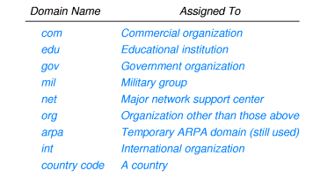
Top-Level Domains (TLDs)
DNS Naming Structure
Introduction to DNS
Eng. Yasser Al-eimad

Slide 11
Country Code Domains
DNS Naming Structure
Top level domains are US-centric .
Geographic TLDs used for organizations in other countries:
TLD Country
.uk United Kingdom
.fr France
.ye Yemen
Countries define their own internal hierarchy:
gov.ye, org.ye ,net.ye , edu.ye and com.ye are used for organizations in Yemen
Introduction to DNS
Eng. Yasser Al-eimad

Slide 12
Second-Level Domains
DNS Naming Structure
Within every top-level domain there is a huge list of 2nd level domains
For example, in the COM second-level domain, you've got:
  yahoo
  msn
  microsoft
  plus millions of others...
Introduction to DNS
Eng. Yasser Al-eimad

Slide 13
DNS Naming Structure
DNS naming structure Example
Examples:
Google .com
yemen .net .ye
2nd LD
TLD
ccTLD
3rd LD
2nd LD
Introduction to DNS
Eng. Yasser Al-eimad

Slide 14
CONTENTS
Definitions.
DNS Naming Structure.
DNS Components.
How DNS Servers work.
DNS Organizations.
Summary.
Introduction to DNS
Eng. Yasser Al-eimad

Slide 15
The Domain
DNS Components
A Domain is a sub tree of a larger tree identified by a domain name
Contains resource records and sub-domains
Some resource records point to authoritative server for sub-domains / zones
eg. the root contains pointers to .ye
Yemen.net.ye is a domain
Introduction to DNS
Eng. Yasser Al-eimad

Slide 16
The Resource Record
DNS Components
A domain contains resource records
Resource records are similar to files
Classified into types
Some of the important types are SOA, NS, A, CNAME and MX
Normally defines in “zone files”
Introduction to DNS
Eng. Yasser Al-eimad

Slide 17
Types of Resource Records
DNS Components
The “A” Record
The “Address” record
One or more normally defines a host
Contains an IPv4 Address (the address computers use to uniquely identify each other on the internet)
Eg. The record:
www A 65.162.184.60
In the yemen.net.ye domain, defines the host uniquely identifiable as “www.yemen.net.ye ” to be reachable at the IPv4 Address 65.162.184.60
Introduction to DNS
Eng. Yasser Al-eimad

Slide 18
Types of Resource Record
DNS Components
The “CNAME” Record
A CNAME (canonical name) defines an alias
The alias will then be resolved, if another CNAME is encountered then the process continues until an A record is found
Eg. The record:
e-rial CNAME www.post.ye.
In the post.ye domain, defines the name uniquely identifiable as “e-rial.post.ye” to be and alias to “www.post.ye”
Introduction to DNS
Eng. Yasser Al-eimad

Slide 19
Types of Resource Record
DNS Components
The “MX” Record
An MX record defines the mail servers for a particular domain
Mail eXchange records hold the name of hosts, and their priorities, able to deliver mail for the domain.
Eg. The record:
yemen.net.ye MX 10 mail
In the yemen.net.ye domain, defines the host mail to be the priority 10 mail server for the “yemen.net.ye” domain.
Introduction to DNS
Eng. Yasser Al-eimad

Slide 20
Types of Resource Record
DNS Components
The “NS” Record
An NS record defines the authoritative Name servers for the domain.
The “Name Server” records also define the name servers of children domains
Eg. The record:
internal NS ns1.yemen.net.ye
In the yemen.net.ye domain, defines the host “ns1.yemen.net.ye” to be a name sever for the “internal.yemen.net.ye” sub-domain
Introduction to DNS
Eng. Yasser Al-eimad

Slide 21
Name Servers
DNS Components
Servers responsible for answering DNS queries
by contacting remote DNS server(s).
Exists at all levels of hierarchy
Authoritative name servers hold part of the DNS database(“zonefile”)
One name server can serve more then one zone
Many name servers “should” serve the same zone
Some name servers are authoritative for certain zones
Introduction to DNS
Eng. Yasser Al-eimad

Slide 22
Name Servers
DNS Components
Iterative vs Recursive Name Servers
  Serve two very different functions
  Shouldn’t mix the two
  Generally the DNS your computer points to is recursive
  Zones are hosted in iterative name servers
  Iterative servers can only answer information they know or have cached
  Recursive know how to ask others for information
Introduction to DNS
Eng. Yasser Al-eimad

Slide 23
CONTENTS
Definitions.
DNS Naming Structure.
DNS Components.
How DNS Servers work.
DNS Organizations.
Summary.
Introduction to DNS
Eng. Yasser Al-eimad

Slide 24
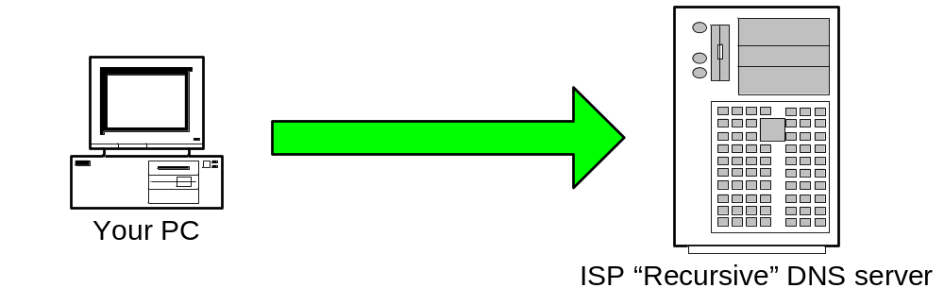
How DNS Servers work(web)
How DNS Servers work
You type http://www.google.com into your web browser and hit enter.
Step 1: Your PC sends a resolution request to its configured DNS Server, typically at your ISP.
Tell me the Address of “www.google.com”
Introduction to DNS
Eng. Yasser Al-eimad

Slide 25
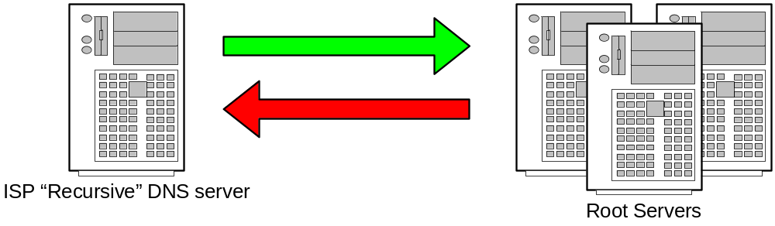
How DNS Servers work(web)
How DNS Servers work
Step 2: Your ISPs recursive name server starts by asking one of the root servers predefined in its “hints” file.
Tell me the Address of “www.google.com”
I don’t know the address but I know who’s authoritative for the ”com” domain ask them
Introduction to DNS
Eng. Yasser Al-eimad

Slide 26
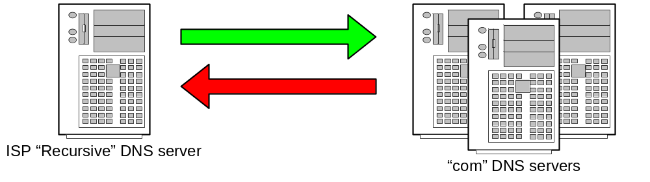
How DNS Servers work(web)
How DNS Servers work
Step 3: Your ISPs recursive name server then asks one of the “com” name servers as directed.
Tell me the Address of “www.google.com”
I don’t know the address but I know who’s authoritative for the ”google.com” domain ask them
Introduction to DNS
Eng. Yasser Al-eimad

Slide 27
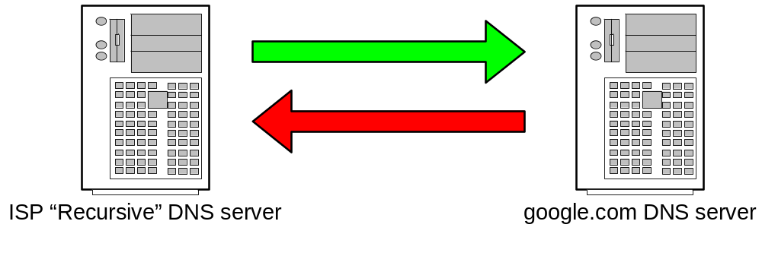
How DNS Servers work(web)
How DNS Servers work
Step 4: Your ISPs recursive name server then asks one of the “google.com” name servers as directed.
Tell me the Address of “www.google.com”
The Address of www.google.com is 216.239.53.99
Introduction to DNS
Eng. Yasser Al-eimad

Slide 28
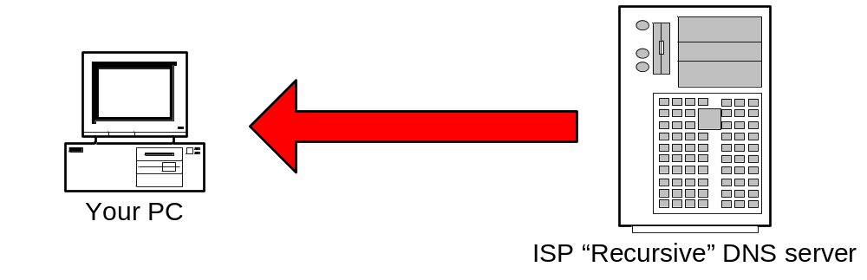
How DNS Servers work(web)
How DNS Servers work
Step 5: ISP DNS server then send the answer back to your PC. The DNS server will “remember” the answer for a period of time.
The Address of www.google.com is 216.239.53.99
Introduction to DNS
Eng. Yasser Al-eimad

Slide 29
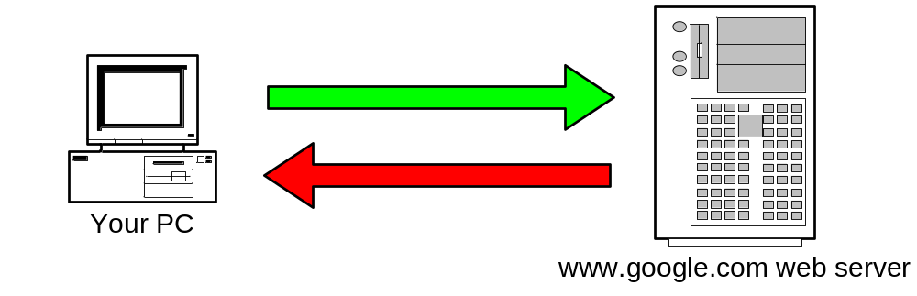
How DNS Servers work(web)
How DNS Servers work
Step 6: Your PC can then make the actual HTTP request to the web server.
Send me the www.google.com web page
Here it is!
Introduction to DNS
Eng. Yasser Al-eimad

Slide 30
How DNS Servers work(mail)
How DNS Servers work
DNS is not just used in HTTP protocol (web pages).
DNS is involved in almost every protocol in use on the internet.
Next example is how DNS facilitates the transfer of electronic mail.
Introduction to DNS
Eng. Yasser Al-eimad

Slide 31

How DNS Servers work(mail)
How DNS Servers work
Step 1: Your PC sends the e-mail to its configured outbound mail server. A DNS request similar to the previous example is required to find the address of the mail server.
Please send this message to “someone@example.com”

Slide 32
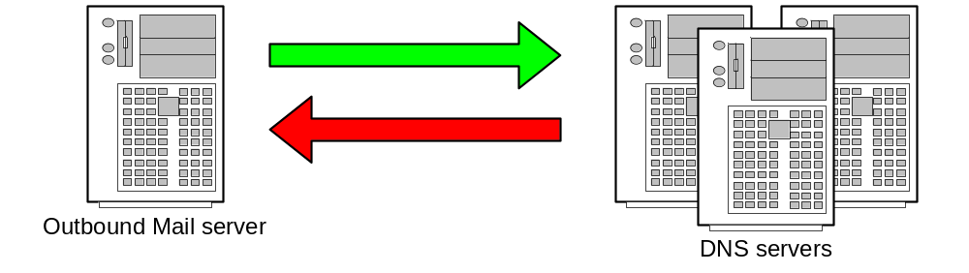
How DNS Servers work(mail)
How DNS Servers work
Step 2: Your mail server follows the same intensive process to find the authoritative servers for “example.com”.
Tell me the name servers for “example.com”
Here are the name servers for “example.com”

Slide 33
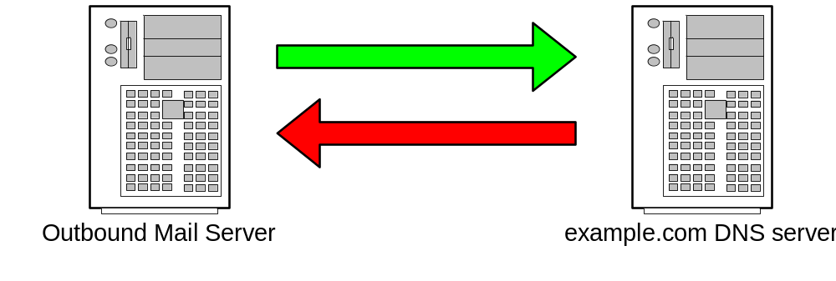
How DNS Servers work(mail)
How DNS Servers work
Step 3: Ask the “example.com” name server for the list of “Mail eXchangers (MX) for that domain.
Tell me the MX’s for “example.com”
The MXs are mx10.example.com and mx20.backmail.com

Slide 34

How DNS Servers work(mail)
How DNS Servers work
Step 4: Select a Mail server and deliver the mail.
Here is some mail for the “example.com” domain
Mail accepted for delivery

Slide 35
CONTENTS
Definitions.
DNS Naming structure.
DNS components.
How DNS Servers work.
DNS Organizations.
Summary.

Slide 36
INTERNIC
DNS Organizations
Internet Network Information Center – US government owned
INTERNIC formerly handled all domain name registration
  www.internic.net
Network Solutions, a private company, processed the registrations (now VeriSign company)
Network Solutions then took over registration
Now several companies can register domains

Slide 37
ICANN Corporation
DNS Organizations
ICANN
The Internet Corporation for Assigned Names and Numbers, is a non-profit corporation that is designated by the U.S. Government to coordinate certain Internet technical functions, including the management of Internet domain name system.
More information about ICANN is available at http://www.icann.org

Slide 38
CONTENTS
Definitions.
DNS Naming Structure.
DNS Components.
How DNS Servers work.
DNS Organizations.
Summary.

Slide 39
Summary
  DNS is integral part in most protocols used on the internet
  Makes the internet human friendly for us all
  Is the world largest distributed database system
  Fits the international model perfectly
  In simple terms is a mapping between names and IP addresses

Slide 40

The End

