Slide 1
Quality of Services
Prof. Ramesh Ragala

Slide 2
Quality of Services
Different Techniques are available to reduce the congestion and increase the performance of network.
With increase in multimedia applications in networks, these measure are not enough to provide guarantee the quality of service in network
It need different protocol design.
A Stream of packets from source to destination is called flow.
In connection oriented n/w all packets follows the same flow
In connection less n/w, packets follow different routes.
So each flow characterized by four parameters 1. Reliability 2. Delay 3. Jitter 4. Bandwidth.

Slide 3
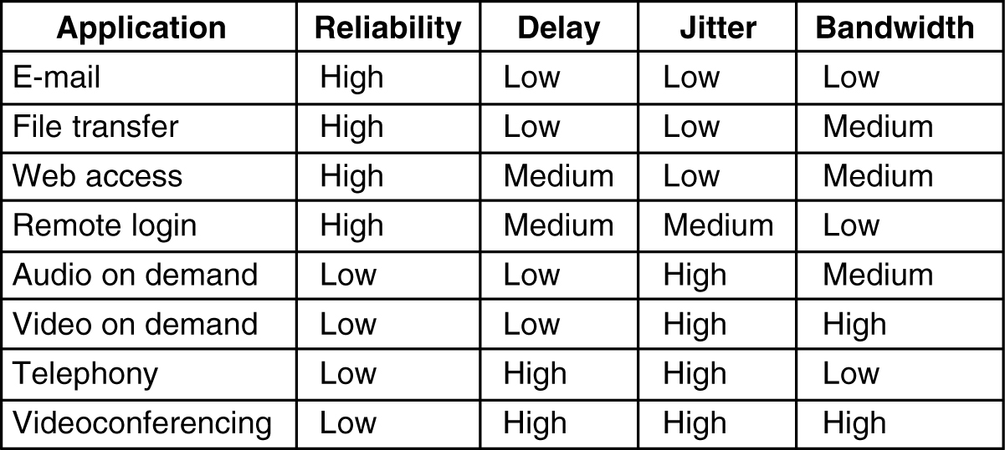
Requirements
5-30
How stringent the quality-of-service requirements are.

Slide 4
Classes of Traffic
ATM networks classify flows in four broad categories w.r.t their QoS demand:
Constant bit rate (e.g., telephony)
Real-time variable bit rate (e.g., video conferencing)
Non-real-time variable bit rate (e.g., video streaming)
Available bit rate (e.g., file transfer)
No single technique will not provide good QoS.

Slide 5
Over provisioning
Provide much router capacity, buffer space and bandwidth
It is expensive.
Now a days it is become practical.

Slide 6
Buffering
Flows can be buffered @ receiver side before delivering.
It does not effect the reliability or bandwidth.
It affects the delay only.
It smoothes out the jitter.
It used in many audio and video applications.

Slide 7
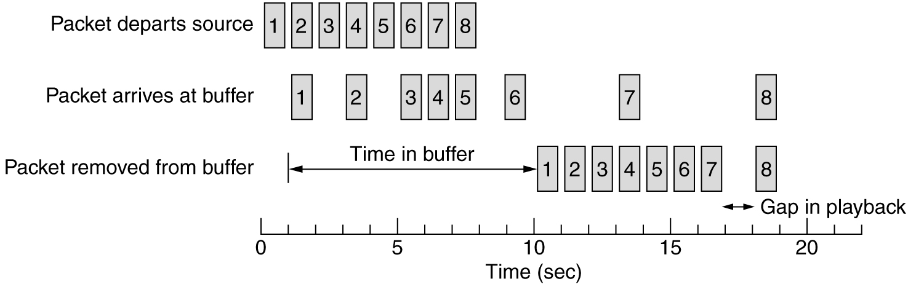
Buffering
Smoothing the output stream by buffering packets.

Slide 8
Traffic Shaping
In Buffering technique, the sender sends the packets with uniform spacing. → this is not always for all applications
It may emit irregularly. → congestion will come in n/w
This type of non uniform output is common, if the server is handling many stream at once.
So to reduce this complexity , we use another technique called Traffic Shaping. It is not always possible
In this technique, we planned to have uniform rating of data @ the server side instead @ client side.
It just regulating average rate of data transmission.
It uses service level agreements. Monitoring traffic flow → traffic policing

Slide 9
Leaky Bucket Algorithm
Imagine a bucket with a small hole in the bottom.
No matter the rate at which water enters in to the bucket, the out flow is always constant rate (Þ)only.
If the bucket is full, then water spills over.
This same concept used in packets.
It was first proposed by Turner (1986)
It is nothing but, single server queuing system with constant service time.
The host is allowed to put one packet per clock tick onto the network.
Byte counting leaky bucket algorithm.

Slide 10
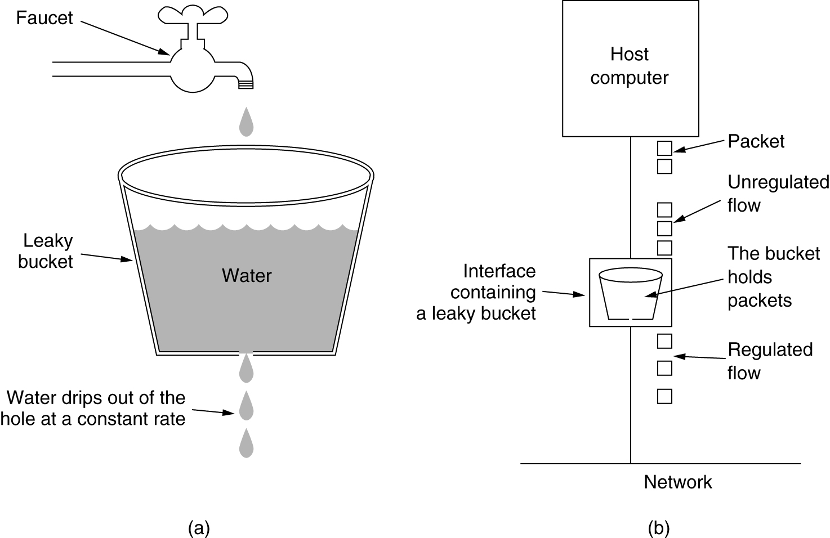
The Leaky Bucket Algorithm
(a) A leaky bucket with water. (b) a leaky bucket with packets.

Slide 11
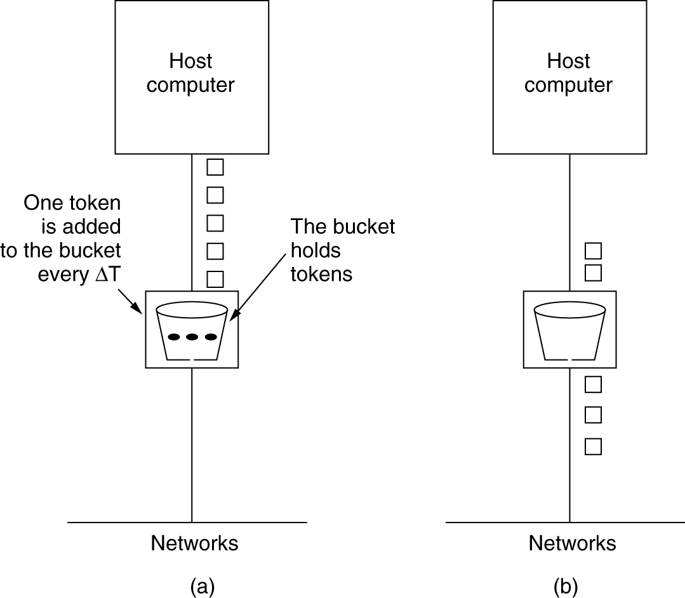
The Token Bucket Algorithm
5-34
(a) Before. (b) After.
Token bucket allows some burstiness (up to the number of token the bucket can hold)

Slide 12
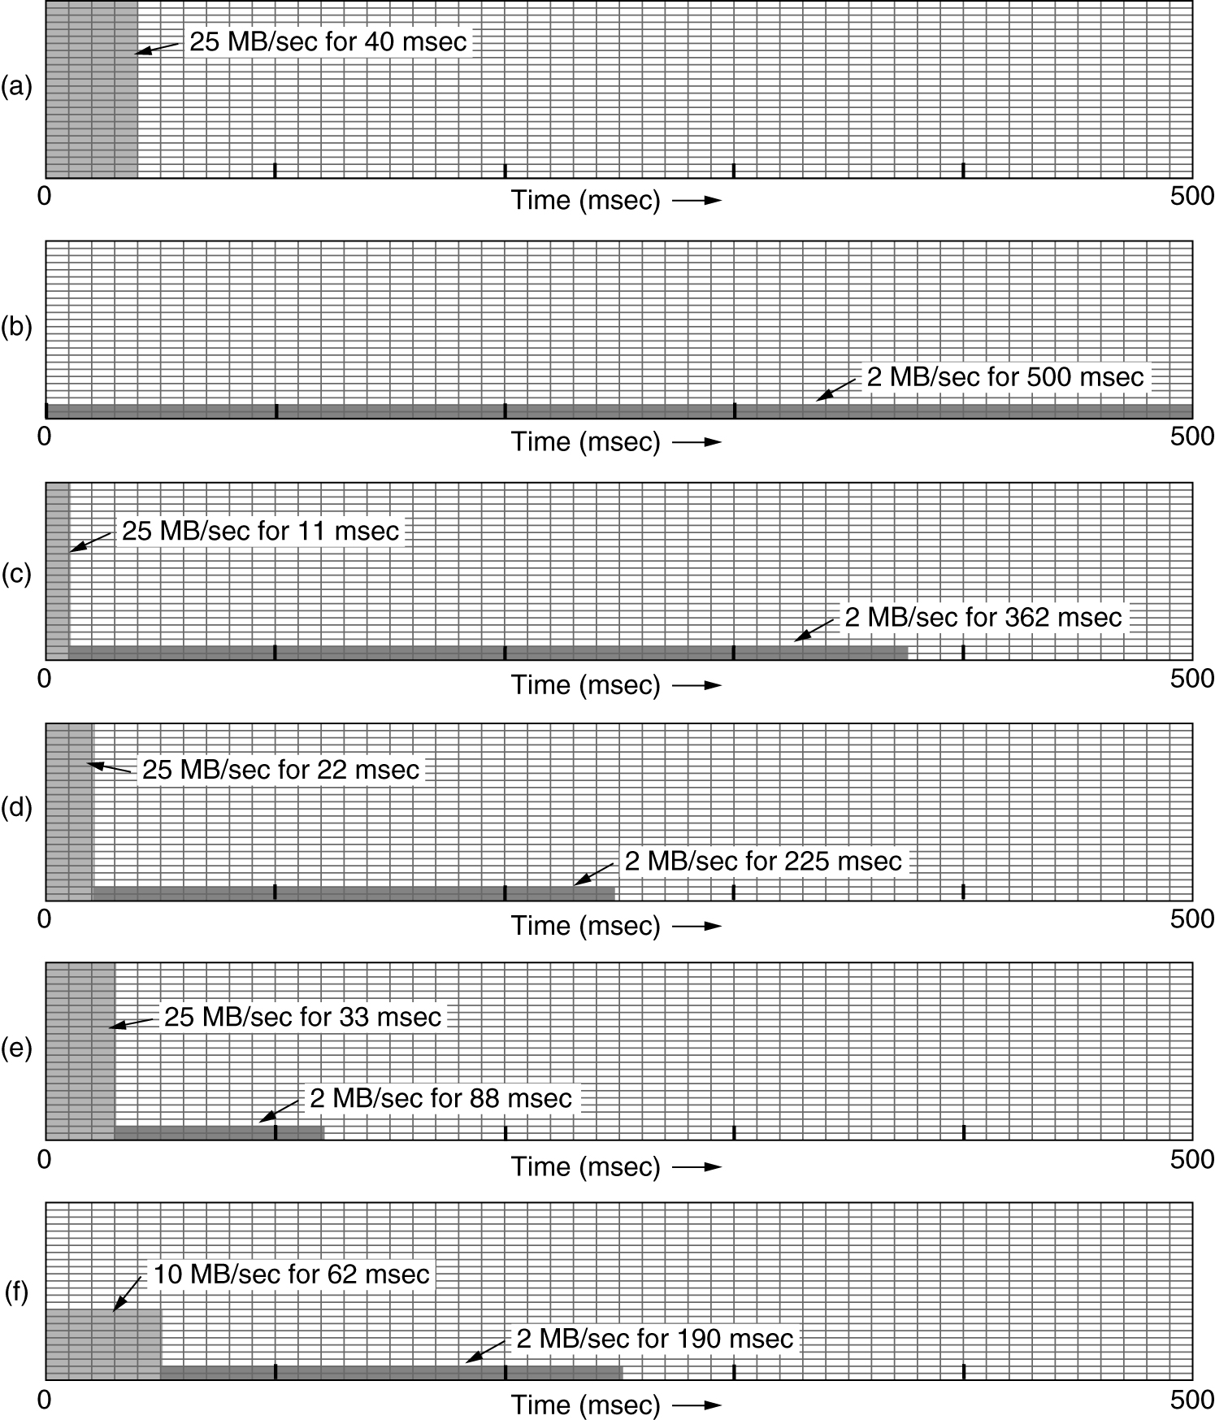
The Leaky and Token Bucket Example
(a) Input to a bucket. (b) Output from a leaky bucket. Output from a token bucket with capacities of (c) 250 KB, (d) 500 KB, (e) 750 KB, (f) Output from a 500KB token bucket feeding a 10-MB/sec leaky bucket.

Slide 13
Resource Reservation
Traffic shaping is more effective when all packets follow the same route.
We can, similar to virtual circuits, assign a specific route to a flow and then reserve resources along that route.
Three kinds of resources can be reserved:
Bitrate
Buffer space
CPU cycles

Slide 14
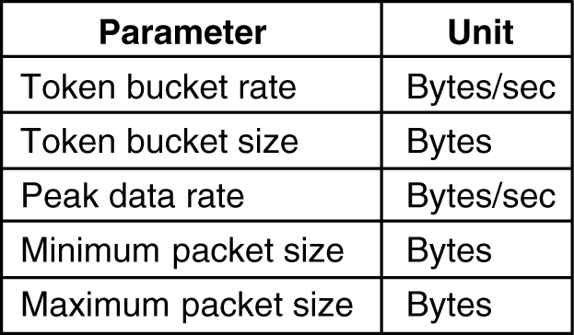
Admission Control
We saw, resource reservation but how can the sender specify required resources ? Also, some applications are tolerant of occasional lapses is QoS. Also, apps might not know what its CPU requirements are.
Hence routers must convert a set of specifications to resource requirements and then decide whether to accept or reject the flow.
An example of flow specification.

Slide 15
Proportional Routing
The idea here very different from what we have seen earlier. Here multiple paths are assigned to each flow and a appropriate fraction of the flow is sent simultaneously over each path.
This technique is also called Multipath routing.

Slide 16
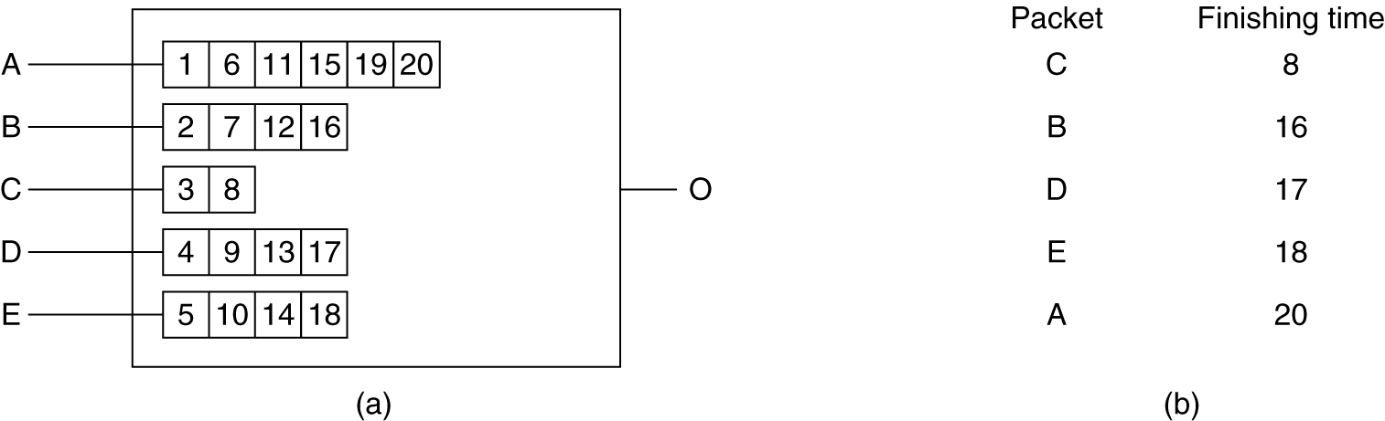
Packet Scheduling
If a router handling multiple flows uses first-come first-served method to process packets, there is possibility of some flows being starved.
Fair queuing
Weighted fair queuing
(a) A router with five packets queued for line O.
(b) Finishing times for the five packets.

