Slide 1
Introduction to Text Classification
Ramesh Ragala
Assistant Professor (Senior)
VIT Chennai

Slide 2
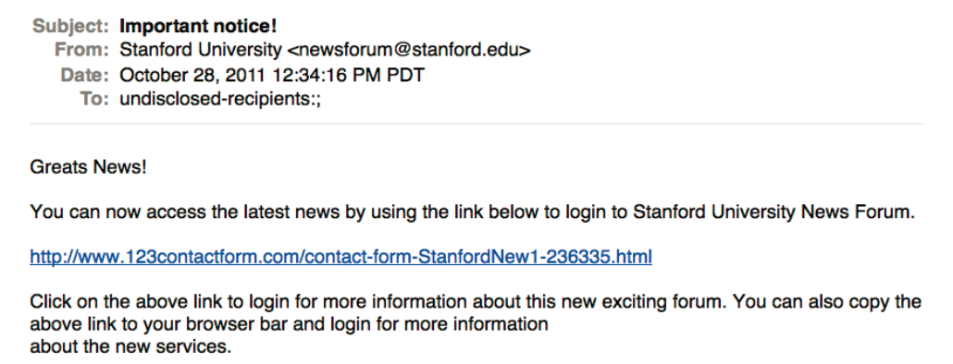
Introduction to Classification
Is This Spam?
Notes:
First, let's define NER!
go through pages, recognize the names of things: "Bill MacCartney", "Stanford University"
the people who came up with this task had a rather precise, philosophically motivated meaning in mind
entity: a discrete, actual thing: Bill MacCartney, but not calcium carbonate or Tuesday or Viagra
named entity: an entity with a name, in a philosophical, Kripke-like sense
(this water bottle is an entity, but not a NAMED entity)
but in practice the definition has been expanded quite a bit in later work
we routinely include dates & times, proteins, drug names
but still, loosely, things that have a name
but NOT references to entities which are not names: "this university", "it”
first task in NER: identifying occurrences of named entities
looking for capital letters is a really good clue! at least in English! but not so much in Hebrew, Chinese, ... non-Latinate alphabets also doesn't really work in German -- all nouns are capitalized!
so that's a pretty useful base-level task -- widely deployed and used
you've probably seen web pages that do this
e.g. financial web sites often mark up stock symbols, names of companies
Microsoft has done work with this, smart tags, entities tagged with metadata
Reuters has web service OpenCalais, you send them docs, they send back NER markup

Slide 3
Introduction to Classification
Positive or Negative Movie Reviews?
Unbelievably disappointing
Full of zany characters and richly applied satire and some great plot twists
This is the greatest screwball comedy ever filmed
It was pathetic. The worst part about it was the boxing scenes.
Notes:
First, let's define NER!
go through pages, recognize the names of things: "Bill MacCartney", "Stanford University"
the people who came up with this task had a rather precise, philosophically motivated meaning in mind
entity: a discrete, actual thing: Bill MacCartney, but not calcium carbonate or Tuesday or Viagra
named entity: an entity with a name, in a philosophical, Kripke-like sense
(this water bottle is an entity, but not a NAMED entity)
but in practice the definition has been expanded quite a bit in later work
we routinely include dates & times, proteins, drug names
but still, loosely, things that have a name
but NOT references to entities which are not names: "this university", "it”
first task in NER: identifying occurrences of named entities
looking for capital letters is a really good clue! at least in English! but not so much in Hebrew, Chinese, ... non-Latinate alphabets also doesn't really work in German -- all nouns are capitalized!
so that's a pretty useful base-level task -- widely deployed and used
you've probably seen web pages that do this
e.g. financial web sites often mark up stock symbols, names of companies
Microsoft has done work with this, smart tags, entities tagged with metadata
Reuters has web service OpenCalais, you send them docs, they send back NER markup

Slide 4
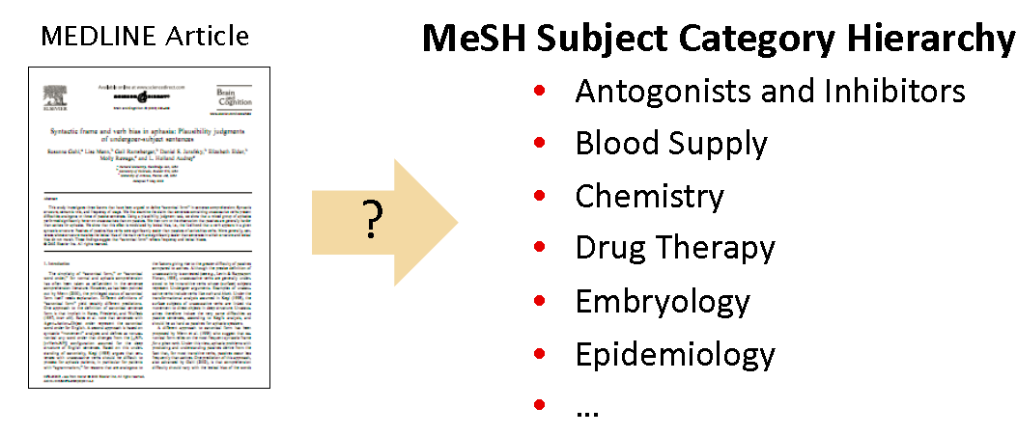
Introduction to Classification
What is the subject of this article?
Notes:
First, let's define NER!
go through pages, recognize the names of things: "Bill MacCartney", "Stanford University"
the people who came up with this task had a rather precise, philosophically motivated meaning in mind
entity: a discrete, actual thing: Bill MacCartney, but not calcium carbonate or Tuesday or Viagra
named entity: an entity with a name, in a philosophical, Kripke-like sense
(this water bottle is an entity, but not a NAMED entity)
but in practice the definition has been expanded quite a bit in later work
we routinely include dates & times, proteins, drug names
but still, loosely, things that have a name
but NOT references to entities which are not names: "this university", "it”
first task in NER: identifying occurrences of named entities
looking for capital letters is a really good clue! at least in English! but not so much in Hebrew, Chinese, ... non-Latinate alphabets also doesn't really work in German -- all nouns are capitalized!
so that's a pretty useful base-level task -- widely deployed and used
you've probably seen web pages that do this
e.g. financial web sites often mark up stock symbols, names of companies
Microsoft has done work with this, smart tags, entities tagged with metadata
Reuters has web service OpenCalais, you send them docs, they send back NER markup

Slide 5
Introduction to Classification
Applications of text classification:
Assigning subject categories, topics, genes, etc
Spam Detection
Authorship Identification
Age/gender Identification
Language Identification
Sentiment Analysis
Notes:
First, let's define NER!
go through pages, recognize the names of things: "Bill MacCartney", "Stanford University"
the people who came up with this task had a rather precise, philosophically motivated meaning in mind
entity: a discrete, actual thing: Bill MacCartney, but not calcium carbonate or Tuesday or Viagra
named entity: an entity with a name, in a philosophical, Kripke-like sense
(this water bottle is an entity, but not a NAMED entity)
but in practice the definition has been expanded quite a bit in later work
we routinely include dates & times, proteins, drug names
but still, loosely, things that have a name
but NOT references to entities which are not names: "this university", "it”
first task in NER: identifying occurrences of named entities
looking for capital letters is a really good clue! at least in English! but not so much in Hebrew, Chinese, ... non-Latinate alphabets also doesn't really work in German -- all nouns are capitalized!
so that's a pretty useful base-level task -- widely deployed and used
you've probably seen web pages that do this
e.g. financial web sites often mark up stock symbols, names of companies
Microsoft has done work with this, smart tags, entities tagged with metadata
Reuters has web service OpenCalais, you send them docs, they send back NER markup

Slide 6
Introduction to Classification
Text Classification: definition
Input
A Document , d
A Fixed set of classes, C = {c₁, c₂, c₃,…c_{j}}
Output:
A predicted class c ∈ C
Notes:
First, let's define NER!
go through pages, recognize the names of things: "Bill MacCartney", "Stanford University"
the people who came up with this task had a rather precise, philosophically motivated meaning in mind
entity: a discrete, actual thing: Bill MacCartney, but not calcium carbonate or Tuesday or Viagra
named entity: an entity with a name, in a philosophical, Kripke-like sense
(this water bottle is an entity, but not a NAMED entity)
but in practice the definition has been expanded quite a bit in later work
we routinely include dates & times, proteins, drug names
but still, loosely, things that have a name
but NOT references to entities which are not names: "this university", "it”
first task in NER: identifying occurrences of named entities
looking for capital letters is a really good clue! at least in English! but not so much in Hebrew, Chinese, ... non-Latinate alphabets also doesn't really work in German -- all nouns are capitalized!
so that's a pretty useful base-level task -- widely deployed and used
you've probably seen web pages that do this
e.g. financial web sites often mark up stock symbols, names of companies
Microsoft has done work with this, smart tags, entities tagged with metadata
Reuters has web service OpenCalais, you send them docs, they send back NER markup

Slide 7
Introduction to Classification
Classification Methods
Many classification tasks have traditionally been solved manually
Expensive to scale
Hand-coded rules
Rules based on combinations of words and other features
Have good scaling property, creating and maintaining is expensive
Example: spam → black-list-address
Accuracy is very high
If rules are defined carefully
Building maintaining these rules are expensive
Supervise Machine Learning
The set of rules or, more generally, the decision criterion of the text classifier, is learned automatically from training data. → statistical text classification. → it uses labelling → the process of annotating each document with its class.
Notes:
First, let's define NER!
go through pages, recognize the names of things: "Bill MacCartney", "Stanford University"
the people who came up with this task had a rather precise, philosophically motivated meaning in mind
entity: a discrete, actual thing: Bill MacCartney, but not calcium carbonate or Tuesday or Viagra
named entity: an entity with a name, in a philosophical, Kripke-like sense
(this water bottle is an entity, but not a NAMED entity)
but in practice the definition has been expanded quite a bit in later work
we routinely include dates & times, proteins, drug names
but still, loosely, things that have a name
but NOT references to entities which are not names: "this university", "it”
first task in NER: identifying occurrences of named entities
looking for capital letters is a really good clue! at least in English! but not so much in Hebrew, Chinese, ... non-Latinate alphabets also doesn't really work in German -- all nouns are capitalized!
so that's a pretty useful base-level task -- widely deployed and used
you've probably seen web pages that do this
e.g. financial web sites often mark up stock symbols, names of companies
Microsoft has done work with this, smart tags, entities tagged with metadata
Reuters has web service OpenCalais, you send them docs, they send back NER markup

Slide 8
Classification Methods: Supervised Machine Learning
Input:
A document d
A fixed set of classes C = {c₁,c₂,c₃,…c_{J}}
A training set of m- hand-labelled documents (d₁,c₁), (d₂,c₂),…..(d_{m},c_{m})
Output:
A learned classifier: Ɏ : d → c
Notes:
First, let's define NER!
go through pages, recognize the names of things: "Bill MacCartney", "Stanford University"
the people who came up with this task had a rather precise, philosophically motivated meaning in mind
entity: a discrete, actual thing: Bill MacCartney, but not calcium carbonate or Tuesday or Viagra
named entity: an entity with a name, in a philosophical, Kripke-like sense
(this water bottle is an entity, but not a NAMED entity)
but in practice the definition has been expanded quite a bit in later work
we routinely include dates & times, proteins, drug names
but still, loosely, things that have a name
but NOT references to entities which are not names: "this university", "it”
first task in NER: identifying occurrences of named entities
looking for capital letters is a really good clue! at least in English! but not so much in Hebrew, Chinese, ... non-Latinate alphabets also doesn't really work in German -- all nouns are capitalized!
so that's a pretty useful base-level task -- widely deployed and used
you've probably seen web pages that do this
e.g. financial web sites often mark up stock symbols, names of companies
Microsoft has done work with this, smart tags, entities tagged with metadata
Reuters has web service OpenCalais, you send them docs, they send back NER markup

Slide 9
Text Classification Problem:
Input:
A document d
A fixed set of classes C = {c₁,c₂,c₃,…c_{J}}
A training set of m- hand-labelled documents (d₁,c₁), (d₂,c₂),…..(d_{m},c_{m})
Output:
A learned classifier: Ɏ : d → c
Notes:
First, let's define NER!
go through pages, recognize the names of things: "Bill MacCartney", "Stanford University"
the people who came up with this task had a rather precise, philosophically motivated meaning in mind
entity: a discrete, actual thing: Bill MacCartney, but not calcium carbonate or Tuesday or Viagra
named entity: an entity with a name, in a philosophical, Kripke-like sense
(this water bottle is an entity, but not a NAMED entity)
but in practice the definition has been expanded quite a bit in later work
we routinely include dates & times, proteins, drug names
but still, loosely, things that have a name
but NOT references to entities which are not names: "this university", "it”
first task in NER: identifying occurrences of named entities
looking for capital letters is a really good clue! at least in English! but not so much in Hebrew, Chinese, ... non-Latinate alphabets also doesn't really work in German -- all nouns are capitalized!
so that's a pretty useful base-level task -- widely deployed and used
you've probably seen web pages that do this
e.g. financial web sites often mark up stock symbols, names of companies
Microsoft has done work with this, smart tags, entities tagged with metadata
Reuters has web service OpenCalais, you send them docs, they send back NER markup

Slide 10
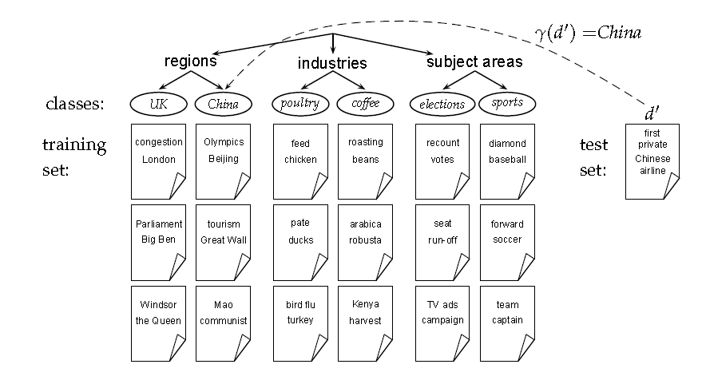
Text Classification Problem:
Notes:
First, let's define NER!
go through pages, recognize the names of things: "Bill MacCartney", "Stanford University"
the people who came up with this task had a rather precise, philosophically motivated meaning in mind
entity: a discrete, actual thing: Bill MacCartney, but not calcium carbonate or Tuesday or Viagra
named entity: an entity with a name, in a philosophical, Kripke-like sense
(this water bottle is an entity, but not a NAMED entity)
but in practice the definition has been expanded quite a bit in later work
we routinely include dates & times, proteins, drug names
but still, loosely, things that have a name
but NOT references to entities which are not names: "this university", "it”
first task in NER: identifying occurrences of named entities
looking for capital letters is a really good clue! at least in English! but not so much in Hebrew, Chinese, ... non-Latinate alphabets also doesn't really work in German -- all nouns are capitalized!
so that's a pretty useful base-level task -- widely deployed and used
you've probably seen web pages that do this
e.g. financial web sites often mark up stock symbols, names of companies
Microsoft has done work with this, smart tags, entities tagged with metadata
Reuters has web service OpenCalais, you send them docs, they send back NER markup

Slide 11
Text Classification
Formal Definition of Text Classification: Training
Given:
A document Space χ
Documents are represented in this space – typically some type of high-dimensional space
A fixed set of classes C = {c₁,c₂,c₃,….c_{J}}
The classes are human defined for the need of an application
A Training set D of labelled documents. Each labelled document (d,c) ϵ X x C
Using a learning method or learning algorithm, we then wish to learn a classifier Ɏ that maps documents to classes:
Ɏ : d → c
Notes:
First, let's define NER!
go through pages, recognize the names of things: "Bill MacCartney", "Stanford University"
the people who came up with this task had a rather precise, philosophically motivated meaning in mind
entity: a discrete, actual thing: Bill MacCartney, but not calcium carbonate or Tuesday or Viagra
named entity: an entity with a name, in a philosophical, Kripke-like sense
(this water bottle is an entity, but not a NAMED entity)
but in practice the definition has been expanded quite a bit in later work
we routinely include dates & times, proteins, drug names
but still, loosely, things that have a name
but NOT references to entities which are not names: "this university", "it”
first task in NER: identifying occurrences of named entities
looking for capital letters is a really good clue! at least in English! but not so much in Hebrew, Chinese, ... non-Latinate alphabets also doesn't really work in German -- all nouns are capitalized!
so that's a pretty useful base-level task -- widely deployed and used
you've probably seen web pages that do this
e.g. financial web sites often mark up stock symbols, names of companies
Microsoft has done work with this, smart tags, entities tagged with metadata
Reuters has web service OpenCalais, you send them docs, they send back NER markup

Slide 12
Text Classification
Formal Definition of Text Classification: Training Example:
China and documents that talk about multicore computer chips in previous example.
(d,c) =(Beijing joins the World Trade Organization, China)
For one-sentence document Beijing joins the World Trade Organization and the class (or label) China
Notes:
First, let's define NER!
go through pages, recognize the names of things: "Bill MacCartney", "Stanford University"
the people who came up with this task had a rather precise, philosophically motivated meaning in mind
entity: a discrete, actual thing: Bill MacCartney, but not calcium carbonate or Tuesday or Viagra
named entity: an entity with a name, in a philosophical, Kripke-like sense
(this water bottle is an entity, but not a NAMED entity)
but in practice the definition has been expanded quite a bit in later work
we routinely include dates & times, proteins, drug names
but still, loosely, things that have a name
but NOT references to entities which are not names: "this university", "it”
first task in NER: identifying occurrences of named entities
looking for capital letters is a really good clue! at least in English! but not so much in Hebrew, Chinese, ... non-Latinate alphabets also doesn't really work in German -- all nouns are capitalized!
so that's a pretty useful base-level task -- widely deployed and used
you've probably seen web pages that do this
e.g. financial web sites often mark up stock symbols, names of companies
Microsoft has done work with this, smart tags, entities tagged with metadata
Reuters has web service OpenCalais, you send them docs, they send back NER markup

Slide 13
Text Classification
Formal Definition of Text Classification: Application / Testing
Given:
A descriptor d ϵ X of a document
Determine:
Ɏ(d) ϵ C, that is, the class most appropriate for d.
The supervised learning method by Ѓ and write Ѓ(D) = Ɏ
The learning method Ѓ takes the training set D as input and returns the learned classification function Ɏ
Notes:
First, let's define NER!
go through pages, recognize the names of things: "Bill MacCartney", "Stanford University"
the people who came up with this task had a rather precise, philosophically motivated meaning in mind
entity: a discrete, actual thing: Bill MacCartney, but not calcium carbonate or Tuesday or Viagra
named entity: an entity with a name, in a philosophical, Kripke-like sense
(this water bottle is an entity, but not a NAMED entity)
but in practice the definition has been expanded quite a bit in later work
we routinely include dates & times, proteins, drug names
but still, loosely, things that have a name
but NOT references to entities which are not names: "this university", "it”
first task in NER: identifying occurrences of named entities
looking for capital letters is a really good clue! at least in English! but not so much in Hebrew, Chinese, ... non-Latinate alphabets also doesn't really work in German -- all nouns are capitalized!
so that's a pretty useful base-level task -- widely deployed and used
you've probably seen web pages that do this
e.g. financial web sites often mark up stock symbols, names of companies
Microsoft has done work with this, smart tags, entities tagged with metadata
Reuters has web service OpenCalais, you send them docs, they send back NER markup

