Slide 1
Introduction to Text Clustering
Ramesh Ragala
Assistant Professor (Senior)
VIT Chennai

Slide 2
Introduction to Cluster
Clustering:
the process of grouping a set of objects into classes of similar objects
Document Clustering:
The process of grouping a set of documents into subsets or clusters.
Documents within a cluster should be similar.
Documents from different clusters should be dissimilar.
The commonest form of unsupervised learning
Unsupervised learning = learning from raw data, as opposed to supervised data where a classification of examples is given.
Notes:
First, let's define NER!
go through pages, recognize the names of things: "Bill MacCartney", "Stanford University"
the people who came up with this task had a rather precise, philosophically motivated meaning in mind
entity: a discrete, actual thing: Bill MacCartney, but not calcium carbonate or Tuesday or Viagra
named entity: an entity with a name, in a philosophical, Kripke-like sense
(this water bottle is an entity, but not a NAMED entity)
but in practice the definition has been expanded quite a bit in later work
we routinely include dates & times, proteins, drug names
but still, loosely, things that have a name
but NOT references to entities which are not names: "this university", "it”
first task in NER: identifying occurrences of named entities
looking for capital letters is a really good clue! at least in English! but not so much in Hebrew, Chinese, ... non-Latinate alphabets also doesn't really work in German -- all nouns are capitalized!
so that's a pretty useful base-level task -- widely deployed and used
you've probably seen web pages that do this
e.g. financial web sites often mark up stock symbols, names of companies
Microsoft has done work with this, smart tags, entities tagged with metadata
Reuters has web service OpenCalais, you send them docs, they send back NER markup

Slide 3
Applications of clustering in IR
Application | What is clustered? | Benefit
Search result clustering | search results | more effective information presentation to user
Scatter-Gather | (subsets of) collection | alternative user interface: “search without typing”
Collection clustering | collection | effective information presentation for exploratory browsing
Cluster-based retrieval | collection | higher efficiency: faster search
3

Slide 4
Yahoo! Hierarchy
www.yahoo.com/Science
… (30)
agriculture
biology
physics
CS
space
...
...
...
...
...
dairy
crops
botany
cell
AI
courses
craft
magnetism
HCI
missions
forestry
agronomy
evolution
relativity
Notes:
Final data set:
Yahoo Science hierarchy, consisting of text of web pages pointed to by Yahoo, gathered summer of 1997.
264 classes, only sample shown here.

Slide 5
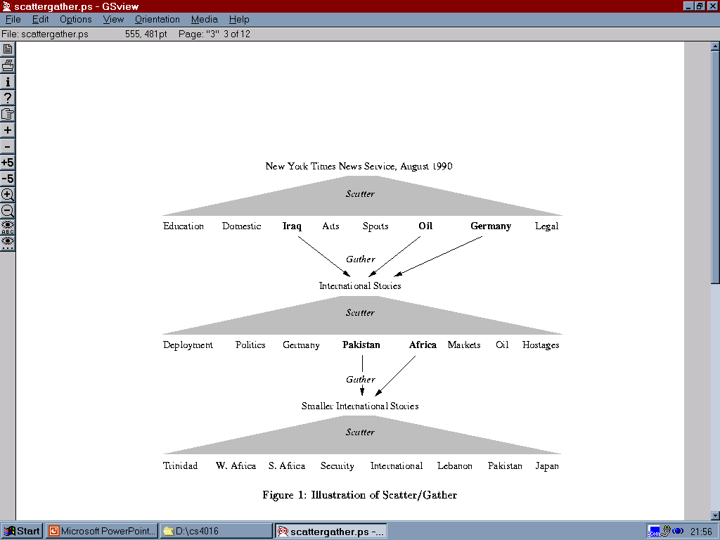
Scatter/Gather: Cutting, Karger, and Pedersen

Slide 6
Clustering for improving recall
To improve search recall:
Cluster docs in collection a priori
When a query matches a doc-d, also return other docs in the cluster containing-d
Hope: if we do this: the query “car” will also return docs containing “automobile”
Because the clustering algorithm groups together docs containing “car” with those containing “automobile”.
Both types of documents contain words like “parts”, “dealer”, “mercedes”, “road trip
Notes:
First, let's define NER!
go through pages, recognize the names of things: "Bill MacCartney", "Stanford University"
the people who came up with this task had a rather precise, philosophically motivated meaning in mind
entity: a discrete, actual thing: Bill MacCartney, but not calcium carbonate or Tuesday or Viagra
named entity: an entity with a name, in a philosophical, Kripke-like sense
(this water bottle is an entity, but not a NAMED entity)
but in practice the definition has been expanded quite a bit in later work
we routinely include dates & times, proteins, drug names
but still, loosely, things that have a name
but NOT references to entities which are not names: "this university", "it”
first task in NER: identifying occurrences of named entities
looking for capital letters is a really good clue! at least in English! but not so much in Hebrew, Chinese, ... non-Latinate alphabets also doesn't really work in German -- all nouns are capitalized!
so that's a pretty useful base-level task -- widely deployed and used
you've probably seen web pages that do this
e.g. financial web sites often mark up stock symbols, names of companies
Microsoft has done work with this, smart tags, entities tagged with metadata
Reuters has web service OpenCalais, you send them docs, they send back NER markup

Slide 7
Issues for Clustering
General goal:
put related docs in the same cluster, put unrelated docs in different clusters.
How do we formalize this?
The number of clusters should be appropriate for the data set we are clustering.
Initially, we will assume the number of clusters K is given.
Later: Semiautomatic methods for determining K
Secondary goals in clustering
Avoid very small and very large clusters
Define clusters that are easy to explain to the user
Notes:
First, let's define NER!
go through pages, recognize the names of things: "Bill MacCartney", "Stanford University"
the people who came up with this task had a rather precise, philosophically motivated meaning in mind
entity: a discrete, actual thing: Bill MacCartney, but not calcium carbonate or Tuesday or Viagra
named entity: an entity with a name, in a philosophical, Kripke-like sense
(this water bottle is an entity, but not a NAMED entity)
but in practice the definition has been expanded quite a bit in later work
we routinely include dates & times, proteins, drug names
but still, loosely, things that have a name
but NOT references to entities which are not names: "this university", "it”
first task in NER: identifying occurrences of named entities
looking for capital letters is a really good clue! at least in English! but not so much in Hebrew, Chinese, ... non-Latinate alphabets also doesn't really work in German -- all nouns are capitalized!
so that's a pretty useful base-level task -- widely deployed and used
you've probably seen web pages that do this
e.g. financial web sites often mark up stock symbols, names of companies
Microsoft has done work with this, smart tags, entities tagged with metadata
Reuters has web service OpenCalais, you send them docs, they send back NER markup

Slide 8
Issues for Clustering
Representation of Clustering:
Document representation
Vector Space Model
Need a notion of similarity / distance
What makes documents “related”?
Ideal:
Semantic similarity
Practical
Statistical similarity
Euclidian distance
Cosine similarity
centroids are not length-normalized (in K-means)
Notes:
First, let's define NER!
go through pages, recognize the names of things: "Bill MacCartney", "Stanford University"
the people who came up with this task had a rather precise, philosophically motivated meaning in mind
entity: a discrete, actual thing: Bill MacCartney, but not calcium carbonate or Tuesday or Viagra
named entity: an entity with a name, in a philosophical, Kripke-like sense
(this water bottle is an entity, but not a NAMED entity)
but in practice the definition has been expanded quite a bit in later work
we routinely include dates & times, proteins, drug names
but still, loosely, things that have a name
but NOT references to entities which are not names: "this university", "it”
first task in NER: identifying occurrences of named entities
looking for capital letters is a really good clue! at least in English! but not so much in Hebrew, Chinese, ... non-Latinate alphabets also doesn't really work in German -- all nouns are capitalized!
so that's a pretty useful base-level task -- widely deployed and used
you've probably seen web pages that do this
e.g. financial web sites often mark up stock symbols, names of companies
Microsoft has done work with this, smart tags, entities tagged with metadata
Reuters has web service OpenCalais, you send them docs, they send back NER markup

Slide 9
Introduction to Cluster
Partitional algorithms / flat algorithms
Usually start with a random (partial) partition
Refine it iteratively
K-means clustering
Model based clustering
Hierarchical algorithms
Create hierarchy
Bottom-up, agglomerative
Top-down, divisive
Notes:
First, let's define NER!
go through pages, recognize the names of things: "Bill MacCartney", "Stanford University"
the people who came up with this task had a rather precise, philosophically motivated meaning in mind
entity: a discrete, actual thing: Bill MacCartney, but not calcium carbonate or Tuesday or Viagra
named entity: an entity with a name, in a philosophical, Kripke-like sense
(this water bottle is an entity, but not a NAMED entity)
but in practice the definition has been expanded quite a bit in later work
we routinely include dates & times, proteins, drug names
but still, loosely, things that have a name
but NOT references to entities which are not names: "this university", "it”
first task in NER: identifying occurrences of named entities
looking for capital letters is a really good clue! at least in English! but not so much in Hebrew, Chinese, ... non-Latinate alphabets also doesn't really work in German -- all nouns are capitalized!
so that's a pretty useful base-level task -- widely deployed and used
you've probably seen web pages that do this
e.g. financial web sites often mark up stock symbols, names of companies
Microsoft has done work with this, smart tags, entities tagged with metadata
Reuters has web service OpenCalais, you send them docs, they send back NER markup

Slide 10
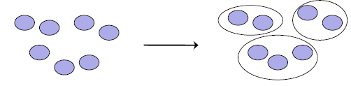
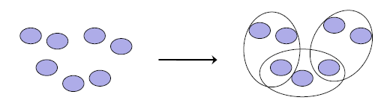
Introduction to Cluster
Hard clustering:
Each document belongs to exactly one cluster.
More common and easier to do
Soft clustering:
A document can belong to more than one cluster.
Makes more sense for applications like creating browsable hierarchies
You may want to put sneakers in two clusters:
sports apparel
shoes
Notes:
First, let's define NER!
go through pages, recognize the names of things: "Bill MacCartney", "Stanford University"
the people who came up with this task had a rather precise, philosophically motivated meaning in mind
entity: a discrete, actual thing: Bill MacCartney, but not calcium carbonate or Tuesday or Viagra
named entity: an entity with a name, in a philosophical, Kripke-like sense
(this water bottle is an entity, but not a NAMED entity)
but in practice the definition has been expanded quite a bit in later work
we routinely include dates & times, proteins, drug names
but still, loosely, things that have a name
but NOT references to entities which are not names: "this university", "it”
first task in NER: identifying occurrences of named entities
looking for capital letters is a really good clue! at least in English! but not so much in Hebrew, Chinese, ... non-Latinate alphabets also doesn't really work in German -- all nouns are capitalized!
so that's a pretty useful base-level task -- widely deployed and used
you've probably seen web pages that do this
e.g. financial web sites often mark up stock symbols, names of companies
Microsoft has done work with this, smart tags, entities tagged with metadata
Reuters has web service OpenCalais, you send them docs, they send back NER markup

Slide 11
Flat Algorithms
Flat algorithms compute a partition of N-documents into a set of K-clusters
Given:
A set of documents and the number-K
Find:
A partition into K-clusters that optimizes the chosen partitioning criterion
Global optimization:
exhaustively enumerate partitions, pick optimal one
Not tractable
Effective heuristic method:
K-means algorithm
Notes:
First, let's define NER!
go through pages, recognize the names of things: "Bill MacCartney", "Stanford University"
the people who came up with this task had a rather precise, philosophically motivated meaning in mind
entity: a discrete, actual thing: Bill MacCartney, but not calcium carbonate or Tuesday or Viagra
named entity: an entity with a name, in a philosophical, Kripke-like sense
(this water bottle is an entity, but not a NAMED entity)
but in practice the definition has been expanded quite a bit in later work
we routinely include dates & times, proteins, drug names
but still, loosely, things that have a name
but NOT references to entities which are not names: "this university", "it”
first task in NER: identifying occurrences of named entities
looking for capital letters is a really good clue! at least in English! but not so much in Hebrew, Chinese, ... non-Latinate alphabets also doesn't really work in German -- all nouns are capitalized!
so that's a pretty useful base-level task -- widely deployed and used
you've probably seen web pages that do this
e.g. financial web sites often mark up stock symbols, names of companies
Microsoft has done work with this, smart tags, entities tagged with metadata
Reuters has web service OpenCalais, you send them docs, they send back NER markup

Slide 12
K-means Algorithm
Perhaps the best known clustering algorithm
Simple, works well in many cases
Use as default / baseline for clustering documents
Notes:
First, let's define NER!
go through pages, recognize the names of things: "Bill MacCartney", "Stanford University"
the people who came up with this task had a rather precise, philosophically motivated meaning in mind
entity: a discrete, actual thing: Bill MacCartney, but not calcium carbonate or Tuesday or Viagra
named entity: an entity with a name, in a philosophical, Kripke-like sense
(this water bottle is an entity, but not a NAMED entity)
but in practice the definition has been expanded quite a bit in later work
we routinely include dates & times, proteins, drug names
but still, loosely, things that have a name
but NOT references to entities which are not names: "this university", "it”
first task in NER: identifying occurrences of named entities
looking for capital letters is a really good clue! at least in English! but not so much in Hebrew, Chinese, ... non-Latinate alphabets also doesn't really work in German -- all nouns are capitalized!
so that's a pretty useful base-level task -- widely deployed and used
you've probably seen web pages that do this
e.g. financial web sites often mark up stock symbols, names of companies
Microsoft has done work with this, smart tags, entities tagged with metadata
Reuters has web service OpenCalais, you send them docs, they send back NER markup

Slide 13

K-means Algorithm
Each cluster in K-means is defined by a centroid.
Objective/partitioning criterion:
minimize the average squared difference from the centroid
Recall definition of centroid:
where we use ω to denote a cluster.
We try to find the minimum average squared difference by iterating two steps:
reassignment: assign each vector to its closest centroid
recomputation: precompute each centroid as the average of the vectors that were assigned to it in reassignment
Notes:
First, let's define NER!
go through pages, recognize the names of things: "Bill MacCartney", "Stanford University"
the people who came up with this task had a rather precise, philosophically motivated meaning in mind
entity: a discrete, actual thing: Bill MacCartney, but not calcium carbonate or Tuesday or Viagra
named entity: an entity with a name, in a philosophical, Kripke-like sense
(this water bottle is an entity, but not a NAMED entity)
but in practice the definition has been expanded quite a bit in later work
we routinely include dates & times, proteins, drug names
but still, loosely, things that have a name
but NOT references to entities which are not names: "this university", "it”
first task in NER: identifying occurrences of named entities
looking for capital letters is a really good clue! at least in English! but not so much in Hebrew, Chinese, ... non-Latinate alphabets also doesn't really work in German -- all nouns are capitalized!
so that's a pretty useful base-level task -- widely deployed and used
you've probably seen web pages that do this
e.g. financial web sites often mark up stock symbols, names of companies
Microsoft has done work with this, smart tags, entities tagged with metadata
Reuters has web service OpenCalais, you send them docs, they send back NER markup

Slide 14
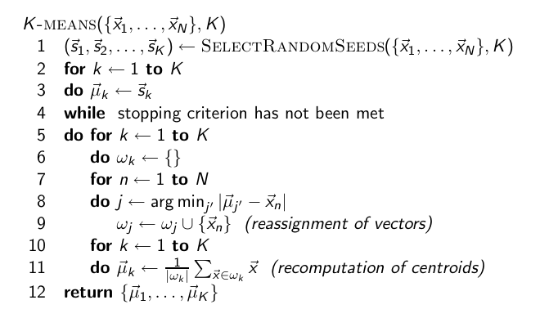
K-means Algorithm
Notes:
First, let's define NER!
go through pages, recognize the names of things: "Bill MacCartney", "Stanford University"
the people who came up with this task had a rather precise, philosophically motivated meaning in mind
entity: a discrete, actual thing: Bill MacCartney, but not calcium carbonate or Tuesday or Viagra
named entity: an entity with a name, in a philosophical, Kripke-like sense
(this water bottle is an entity, but not a NAMED entity)
but in practice the definition has been expanded quite a bit in later work
we routinely include dates & times, proteins, drug names
but still, loosely, things that have a name
but NOT references to entities which are not names: "this university", "it”
first task in NER: identifying occurrences of named entities
looking for capital letters is a really good clue! at least in English! but not so much in Hebrew, Chinese, ... non-Latinate alphabets also doesn't really work in German -- all nouns are capitalized!
so that's a pretty useful base-level task -- widely deployed and used
you've probably seen web pages that do this
e.g. financial web sites often mark up stock symbols, names of companies
Microsoft has done work with this, smart tags, entities tagged with metadata
Reuters has web service OpenCalais, you send them docs, they send back NER markup

Slide 15
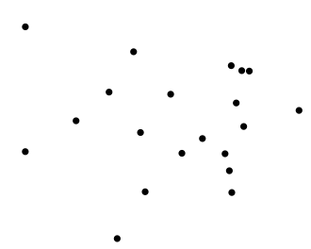
Worked Example: Set of to be clustered

Slide 16
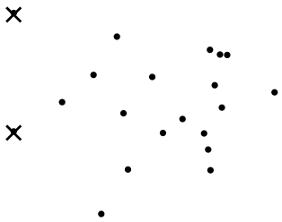
Worked Example: Random selection of initial
centroids
Exercise: (i) Guess what the
optimal clustering into two clusters is in this case; (ii) compute the
centroids of the clusters
16

Slide 17
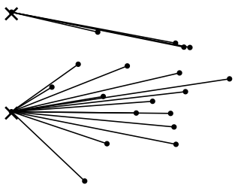
Worked Example: Assign points to closest center

Slide 18
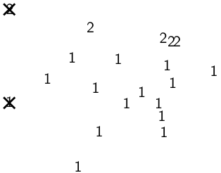
Worked Example: Assignment

Slide 19
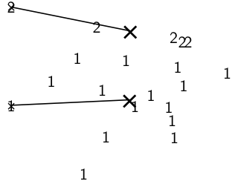
Worked Example: Recompute cluster centroids

Slide 20
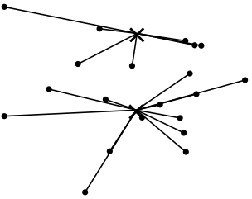
Worked Example: Assign points to closest centroid

Slide 21
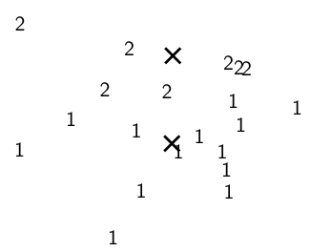
Worked Example: Assignment

Slide 22
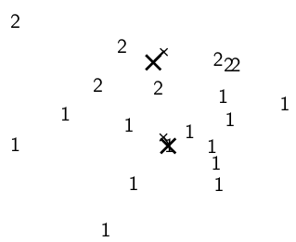
Worked Example: Recompute cluster centroids

Slide 23
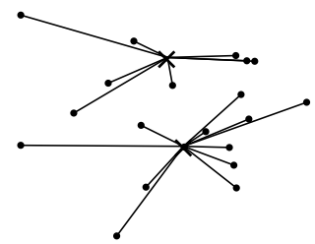
Worked Example: Assign points to closest centroid

Slide 24
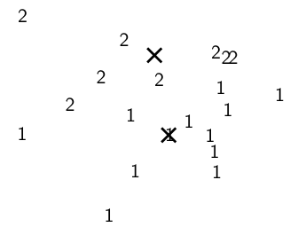
Worked Example: Assignment

Slide 25
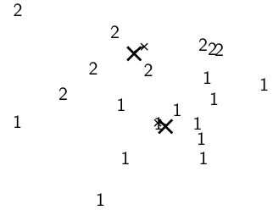
Worked Example: Recompute cluster centroids

Slide 26
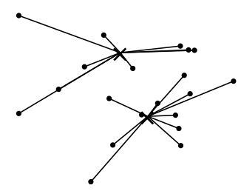
Worked Example: Assign points to closest centroid

Slide 27
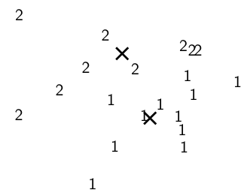
Worked Example: Assignment

Slide 28
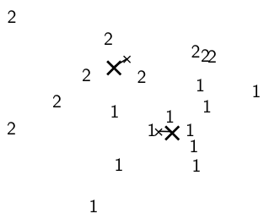
Worked Example: Recompute cluster centroids

Slide 29
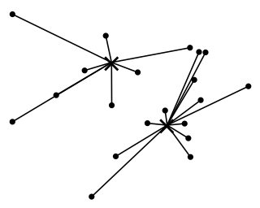
Worked Example: Assign points to closest centroid

Slide 30
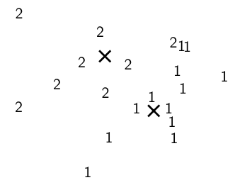
Worked Example: Assignment

Slide 31
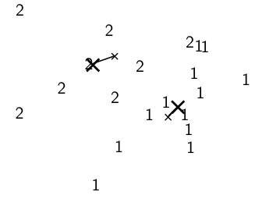
Worked Example: Recompute cluster centroids

Slide 32
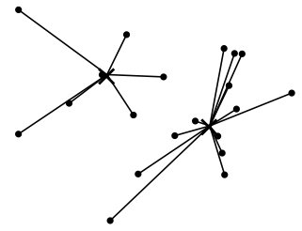
Worked Example: Assign points to closest centroid

Slide 33
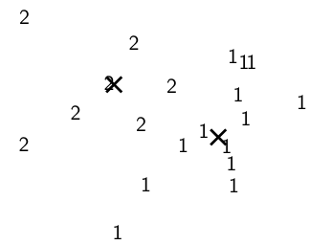
Worked Example: Assignment

Slide 34
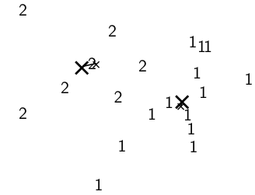
Worked Example: Recompute cluster centroids

Slide 35
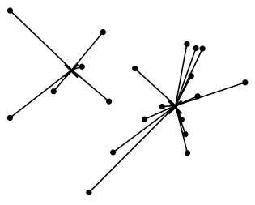
Worked Example: Assign points to closest centroid

Slide 36
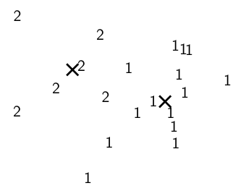
Worked Example: Assignment

Slide 37
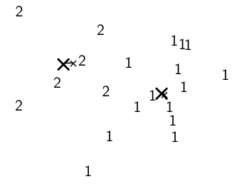
Worked Example: Recompute cluster caentroids

Slide 38
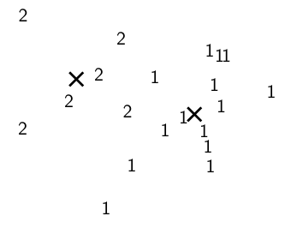
Worked Ex.: Centroids and assignments after convergence

Slide 39
K-Means Algorithm
Initialization of K-Means:
Random seed selection is just one of many ways K-means can be initialized
Random seed selection is not very robust: It’s easy to get a suboptimal clustering.
Better ways of computing initial centroids:
Select seeds not randomly, but using some heuristic (e.g., filter out outliers or find a set of seeds that has “good coverage” of the document space)
Use hierarchical clustering to find good seeds
Select i (e.g., i = 10) different random sets of seeds, do a K-means clustering for each, select the clustering with lowest RSS
Notes:
First, let's define NER!
go through pages, recognize the names of things: "Bill MacCartney", "Stanford University"
the people who came up with this task had a rather precise, philosophically motivated meaning in mind
entity: a discrete, actual thing: Bill MacCartney, but not calcium carbonate or Tuesday or Viagra
named entity: an entity with a name, in a philosophical, Kripke-like sense
(this water bottle is an entity, but not a NAMED entity)
but in practice the definition has been expanded quite a bit in later work
we routinely include dates & times, proteins, drug names
but still, loosely, things that have a name
but NOT references to entities which are not names: "this university", "it”
first task in NER: identifying occurrences of named entities
looking for capital letters is a really good clue! at least in English! but not so much in Hebrew, Chinese, ... non-Latinate alphabets also doesn't really work in German -- all nouns are capitalized!
so that's a pretty useful base-level task -- widely deployed and used
you've probably seen web pages that do this
e.g. financial web sites often mark up stock symbols, names of companies
Microsoft has done work with this, smart tags, entities tagged with metadata
Reuters has web service OpenCalais, you send them docs, they send back NER markup

Slide 40
K-Means Algorithm
Termination conditions:
A fixed number of iterations has been applied.
This condition limits the runtime of the clustering algorithm.
Poor quality of clustering with an insufficient number of iterations.
Assignment of documents to clusters does not change between iterations.
Except for cases for bad local minima, it produce good clustering but runtime may be unacceptably long.
Centroid do not change between iterations.
this is equivalent to not change in partition function
Terminate when RSS(residual sum of squares) falls below threshold.
It ensures that the clustering is of a desired quality after termination.
In practice we need to combine it with a bound on the number of iterations to guarantee termination.
Notes:
First, let's define NER!
go through pages, recognize the names of things: "Bill MacCartney", "Stanford University"
the people who came up with this task had a rather precise, philosophically motivated meaning in mind
entity: a discrete, actual thing: Bill MacCartney, but not calcium carbonate or Tuesday or Viagra
named entity: an entity with a name, in a philosophical, Kripke-like sense
(this water bottle is an entity, but not a NAMED entity)
but in practice the definition has been expanded quite a bit in later work
we routinely include dates & times, proteins, drug names
but still, loosely, things that have a name
but NOT references to entities which are not names: "this university", "it”
first task in NER: identifying occurrences of named entities
looking for capital letters is a really good clue! at least in English! but not so much in Hebrew, Chinese, ... non-Latinate alphabets also doesn't really work in German -- all nouns are capitalized!
so that's a pretty useful base-level task -- widely deployed and used
you've probably seen web pages that do this
e.g. financial web sites often mark up stock symbols, names of companies
Microsoft has done work with this, smart tags, entities tagged with metadata
Reuters has web service OpenCalais, you send them docs, they send back NER markup

Slide 41
K-Means Algorithm
Time Complexity:
Computing one distance of two vectors is O(M).
Reassignment step: O(KNM) (we need to compute KN document-centroid distances)
Recomputation step: O(NM) (we need to add each of the document’s < M values to one of the centroids)
Assume number of iterations bounded by I
Overall complexity: O(IKNM) – linear in all important dimensions
However: This is not a real worst-case analysis.
In pathological cases, complexity can be worse than linear.
Notes:
First, let's define NER!
go through pages, recognize the names of things: "Bill MacCartney", "Stanford University"
the people who came up with this task had a rather precise, philosophically motivated meaning in mind
entity: a discrete, actual thing: Bill MacCartney, but not calcium carbonate or Tuesday or Viagra
named entity: an entity with a name, in a philosophical, Kripke-like sense
(this water bottle is an entity, but not a NAMED entity)
but in practice the definition has been expanded quite a bit in later work
we routinely include dates & times, proteins, drug names
but still, loosely, things that have a name
but NOT references to entities which are not names: "this university", "it”
first task in NER: identifying occurrences of named entities
looking for capital letters is a really good clue! at least in English! but not so much in Hebrew, Chinese, ... non-Latinate alphabets also doesn't really work in German -- all nouns are capitalized!
so that's a pretty useful base-level task -- widely deployed and used
you've probably seen web pages that do this
e.g. financial web sites often mark up stock symbols, names of companies
Microsoft has done work with this, smart tags, entities tagged with metadata
Reuters has web service OpenCalais, you send them docs, they send back NER markup

Slide 42
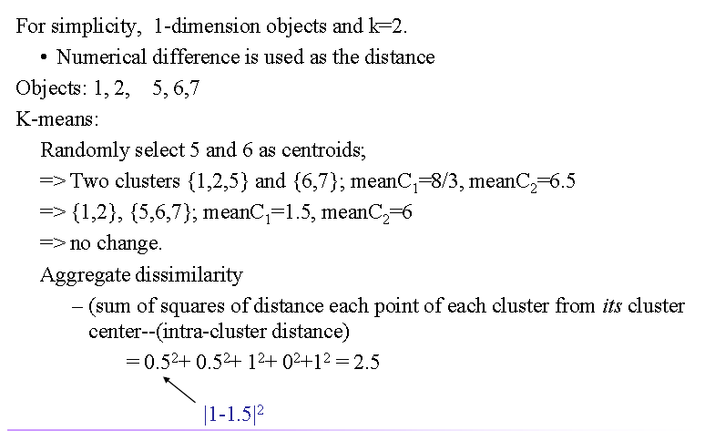
K-Means Example
Notes:
First, let's define NER!
go through pages, recognize the names of things: "Bill MacCartney", "Stanford University"
the people who came up with this task had a rather precise, philosophically motivated meaning in mind
entity: a discrete, actual thing: Bill MacCartney, but not calcium carbonate or Tuesday or Viagra
named entity: an entity with a name, in a philosophical, Kripke-like sense
(this water bottle is an entity, but not a NAMED entity)
but in practice the definition has been expanded quite a bit in later work
we routinely include dates & times, proteins, drug names
but still, loosely, things that have a name
but NOT references to entities which are not names: "this university", "it”
first task in NER: identifying occurrences of named entities
looking for capital letters is a really good clue! at least in English! but not so much in Hebrew, Chinese, ... non-Latinate alphabets also doesn't really work in German -- all nouns are capitalized!
so that's a pretty useful base-level task -- widely deployed and used
you've probably seen web pages that do this
e.g. financial web sites often mark up stock symbols, names of companies
Microsoft has done work with this, smart tags, entities tagged with metadata
Reuters has web service OpenCalais, you send them docs, they send back NER markup

Slide 43
K Means Example (K=2)
Sec. 16.4
Pick seeds
Reassign clusters
Compute centroids
Reassign clusters
x
x
x
Compute centroids
x
x
x
Reassign clusters
Converged!

Slide 44
Hierarchical Clustering
Ch. 17
Build a tree-based hierarchical taxonomy (dendrogram) from a set of documents.
One approach: recursive application of a partitional clustering algorithm.
animal
vertebrate
invertebrate
fish reptile amphib. mammal worm insect crustacean

Slide 45
Dendrogram: Hierarchical Clustering
Clustering obtained by cutting the dendrogram at a desired level: each connected component forms a cluster.

Slide 46
Hierarchical Agglomerative Clustering (HAC)
Sec. 17.1
Starts with each doc in a separate cluster
then repeatedly joins the closest pair of clusters, until there is only one cluster.
The history of merging forms a binary tree or hierarchy.
Note: the resulting clusters are still “hard” and induce a partition

Slide 47
Closest pair of clusters
Sec. 17.2
Many variants to defining closest pair of clusters
Single-link
Similarity of the most cosine-similar (single-link)
Complete-link
Similarity of the “furthest” points, the least cosine-similar
Centroid
Clusters whose centroids (centers of gravity) are the most cosine-similar
Average-link
Average cosine between all pairs of elements

Slide 48
Single Link Agglomerative Clustering
Sec. 17.2
Use maximum similarity of pairs:
Can result in “straggly” (long and thin) clusters due to chaining effect.
After merging c_{i} and c_{j}, the similarity of the resulting cluster to another cluster, c_{k}, is:

Slide 49
Single Link Example
Sec. 17.2

Slide 50
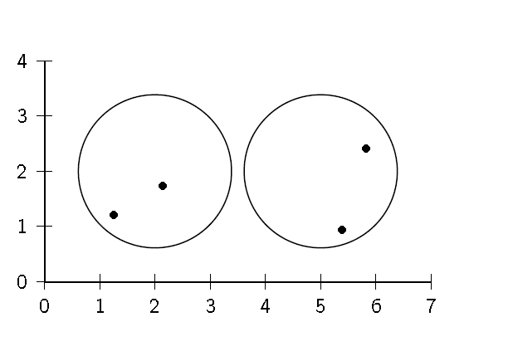
Clustering Similarity: Example
Sec. 17.2

Slide 51
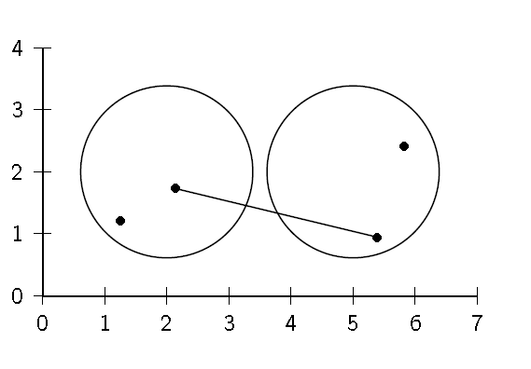
Single Link : Maximum Similarity
Sec. 17.2

Slide 52
Single-link clustering: example
5
1
3
5
2
1
2
3
6
4
4
Nested Clusters
Dendrogram

Slide 53
Complete Link
Sec. 17.2
Use minimum similarity of pairs:
Makes “tighter,” spherical clusters that are typically preferable.
After merging c_{i} and c_{j}, the similarity of the resulting cluster to another cluster, c_{k}, is:
C_{i}
C_{j}
C_{k}

Slide 54
Complete Link Example
Sec. 17.2

Slide 55
Clustering Similarity: Example
Sec. 17.2

Slide 56
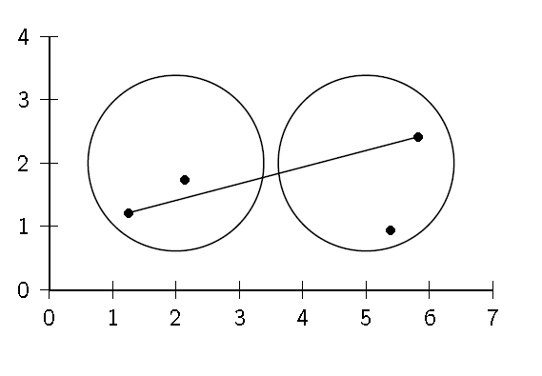
Complete Link: Minimum Similarity
Sec. 17.2

Slide 57
Centroid Average Similarity: Example
Sec. 17.2
intersimilarity = similarity of two documents in different clusters

Slide 58
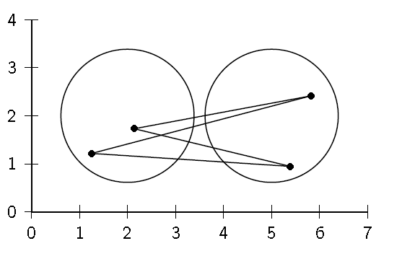
Centroid Average Similarity: Example
Sec. 17.2
intersimilarity = similarity of two documents in different clusters

Slide 59
General HAC algorithm and complexity
Compute similarity between all pairs of documents
Do N – 1 times
Find closest pair of documents/clusters to merge
Update similarity of all documents/clusters to new cluster
O(N²)
Naïve: O(N²)
Priority Queue: O(N)
Single link: O(N)
Best merge
persistent!
Naïve:
O(N)
Priority Queue:
O(N log N)
Single link:
O(N)

Slide 60
Group Average
Sec. 17.3
Similarity of two clusters = average similarity of all pairs within merged cluster.
Compromise between single and complete link.
Two options:
Averaged across all ordered pairs in the merged cluster
Averaged over all pairs between the two original clusters
No clear difference in efficacy

Slide 61
Group Average : Average Intrasimilarity
Sec. 17.2
intrasimilarity = similarity of any pair, including cases where the two documents are in the same cluster

Slide 62
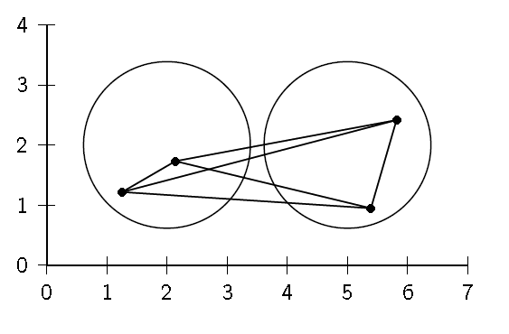
Group Average : Average Intrasimilarity
Sec. 17.2
intrasimilarity = similarity of any pair, including cases where the two documents are in the same cluster

Slide 63
Computing Group Average Similarity
Sec. 17.3
Always maintain sum of vectors in each cluster.
Compute similarity of clusters in constant time:

Slide 64
What Is A Good Clustering?
Sec. 16.3
Internal criterion: A good clustering will produce high quality clusters in which:
the intra-class (that is, intra-cluster) similarity is high
the inter-class similarity is low
The measured quality of a clustering depends on both the document representation and the similarity measure used

Slide 65
External criteria for clustering quality
Sec. 16.3
Quality measured by its ability to discover some or all of the hidden patterns or latent classes in gold standard data
Assesses a clustering with respect to ground truth … requires labeled data
Assume documents with C gold standard classes, while our clustering algorithms produce K clusters, ω₁, ω₂, …, ω_{K} with n_{i} members.

Slide 66
External Evaluation of Cluster Quality
Sec. 16.3
Simple measure: purity, the ratio between the dominant class in the cluster ω_{i} and the size of cluster ω_{i}
Biased because having n clusters maximizes purity
Others are entropy of classes in clusters (or mutual information between classes and clusters)

Slide 67
Purity example
Sec. 16.3
• •
• •
• •
• •
• •
• •
• •
• •
•
Cluster I
Cluster II
Cluster III
Cluster I: Purity = 1/6 (max(5, 1, 0)) = 5/6
Cluster II: Purity = 1/6 (max(1, 4, 1)) = 4/6
Cluster III: Purity = 1/5 (max(2, 0, 3)) = 3/5

