Slide 1
Introduction to Text Mining
Ramesh Ragala
Assistant Professor (Senior)
VIT Chennai

Slide 2
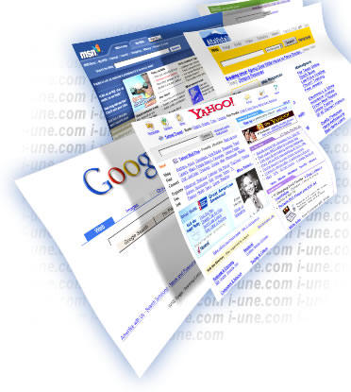
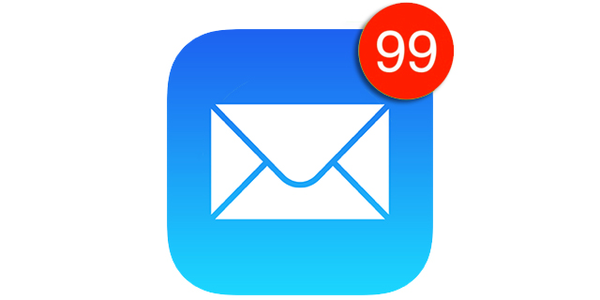


Motivation for Text Mining
Approximately 90% of the World’s data is held in unstructured formats: (mostly in text format)
1

Slide 3
Application of Text Mining
Social media data analytics
Text analytics can address both by analyzing large volumes of unstructured data, extracting opinions, emotions and sentiment and their relations with brands and products.
Business Intelligence
text mining really makes the difference, enabling the analyst to quickly jump at the answer even when analyzing petabytes of internal and open source data.
Risk Management:
Risk Management Software based on text mining technology can dramatically increase the ability to mitigate risk.
Able to access the right information at the right time.
1

Slide 4
Application of Text Mining
Content Enrichment
Text mining techniques enrich content, providing a scalable layer to tag, organize and summarize the available content that makes it suitable for a variety of purposes.
Fraud detection through claims investigation :
Insurance companies are taking advantage of text mining technologies by combining the results of text analysis with structured data to prevent frauds and swiftly process claims.
CS@UVa
CS6501: Text Mining
1

Slide 5
Application of Text Mining
Classification of news stories, web pages, … , according to their content
Email and news filtering
Organize repositories of document-related meta-information for search and retrieval (search engines)
Clustering documents or web pages
Gain insights about trends, relations between people, places and/or organizations
Find associations among entities…
CS@UVa
CS6501: Text Mining
1

Slide 6
What is Text Mining
“Text mining, also referred to as text data mining, roughly equivalent to text analytics, refers to the process of deriving high-quality information from text.” - wikipedia
“Another way to view text data mining is as a process of exploratory data analysis that leads to heretofore unknown information, or to answers for questions for which the answer is not currently known.” - Hearst, 1999
CS@UVa
CS6501: Text Mining
1

Slide 7
Introduction to Text Mining
Text Mining ~ Text Analytics
Mining → more on process
Analytics → more on results
Turns text data into high-quality information or actionable knowledge.
Minimize human effort.
Supplies knowledge for optimal decision making
Related to text retrieval, which is an essential component in any text mining system
Text retrieval can be a preprocessor for text mining
Text retrieval is needed for knowledge provenance
1

Slide 8
Challenges
Information is in unstructured textual form
Large textual data base
almost all publications are also in electronic form
Very high number of possible “dimensions” (but sparse):
all possible word and phrase types in the language!!
Complex and subtle relationships between concepts in text
“AOL merges with Time-Warner” “Time-Warner is bought by AOL”
Word ambiguity and context sensitivity
automobile = car = vehicle = Toyota
Apple (the company) or apple (the fruit)
Noisy Data
Example: Spelling mistakes
1

Slide 9
Semi – Structured Data
Text Databases are, in general , semi-structured
Example:
Title
Author
Publication Date
Length
Category
Abstract
Content
1

Slide 10
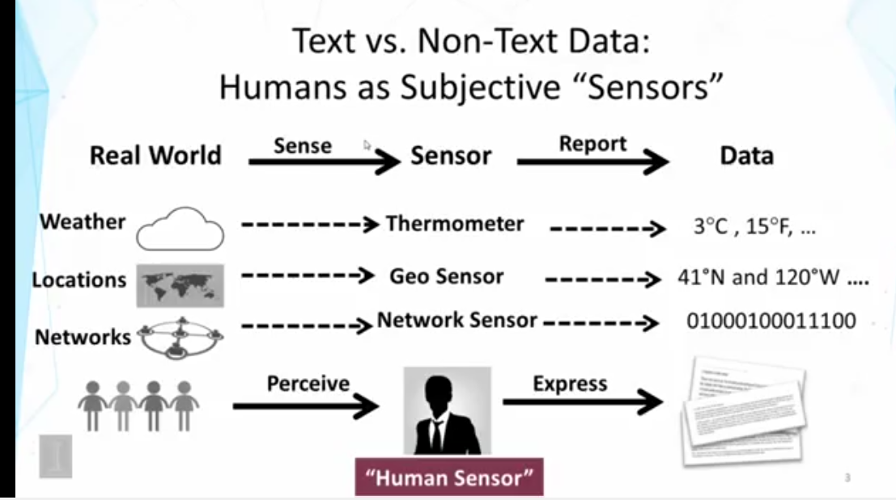
1

Slide 11
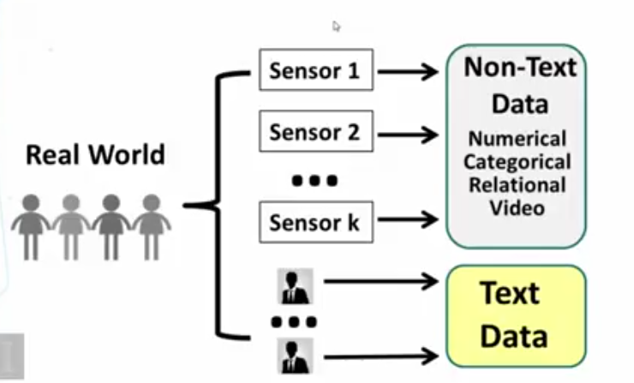
General Problem of Data Mining
CS@UVa
CS6501: Text Mining
1

Slide 12
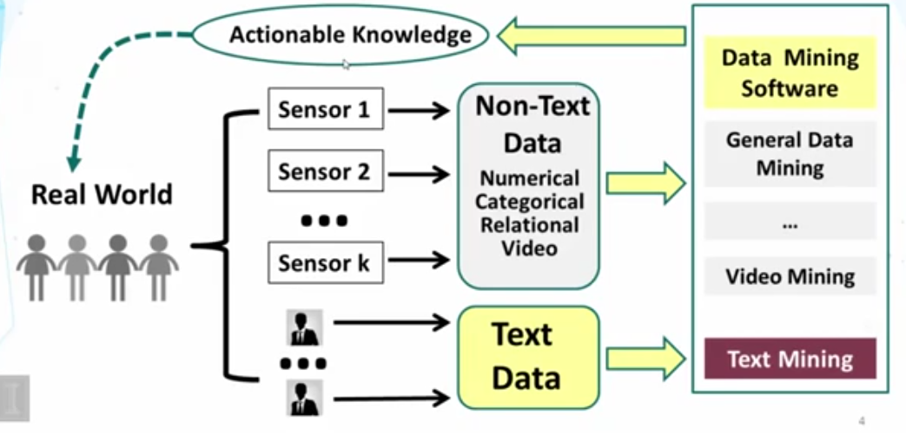
General Problem of Data Mining
1

Slide 13
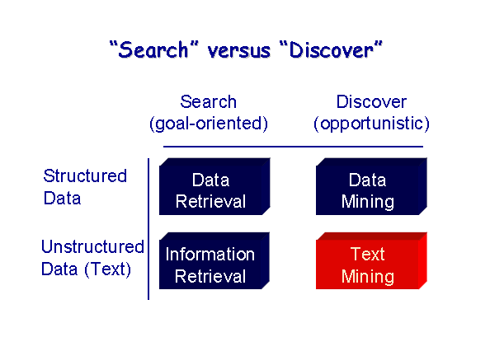
Introduction to Text Mining
1

Slide 14
Handling Text Data
Modeling semi-structured data
Information Retrieval (IR) from unstructured documents
Locates relevant documents and Ranks documents
Keyword based (Boolean matching)
Similarity based
Text mining
Classify documents
Cluster documents
Find patterns or trends across documents
1

Slide 15
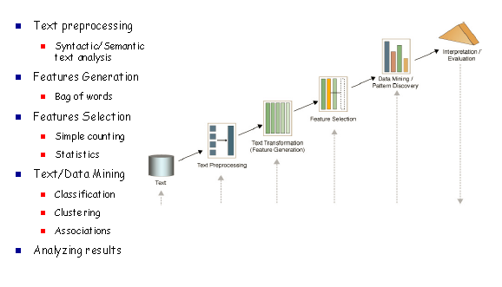
Text Mining Process
1

Slide 16
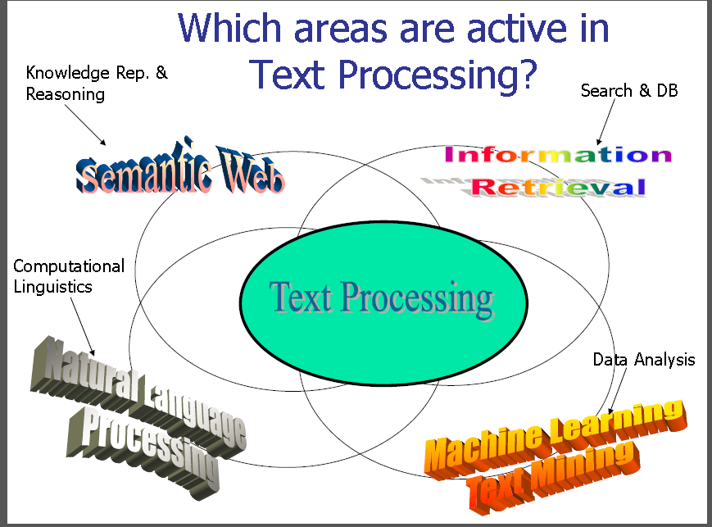
1

Slide 17
Preprocessing
Input files usually need some cleanup before processing can start:
Remove “fluff” from web pages (ads, navigation bars, . . .)
Normalize text converted from PDF, Doc, or other binary formats
Deal with errors in OCR’d documents
Deal with tables, figures, captions, formulas, . . .
1

Slide 18
Tokenization
Text is splitted into basic units called Tokens:
Word tokens
Number tokens
Space tokens
Consistent tokenization is important for all later processing steps
1

Slide 19

Tokenization
Given a character sequence and a defined document unit,
tokenization is the task of chopping it up into pieces, called tokens,
perhaps at the same time throwing away certain characters → such as punctuation.
Example:
1

Slide 20
Tokenization
These tokens are often loosely referred to as terms or words.
“A token is an instance of a sequence of characters in some particular document that are grouped together as a useful semantic unit for processing”.
The major question of the tokenization phase is what are the correct tokens to use?
1

Slide 21
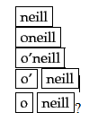
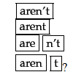
Tokenization
Mr. O'Neill thinks that the boys' stories about Chile's capital aren't amusing.
For O'Neill, which of the following is the desired tokenization?
And for aren't, is it:
simple strategy is to just split on all non-alphanumeric characters → but aren’t is bad
1

Slide 22
Tokenization
The choices determine which Boolean queries will match
A query of neill AND capital will match in three cases but not the other two.
In how many cases would a query of o'neill AND capital match?
Only one → if no processing of query done
For either Boolean or free text queries → processing queries with the same tokenizer → This guarantees that a sequence of characters in a text will always match the same sequence typed in a query
1

Slide 23
Tokenization
These issues of tokenization are language-specific.
It thus requires the language of the document to be known
Computer technology has introduced new types of character sequences that a tokenizer should probably tokenize as a single token
email addresses (jblack@mail.yahoo.com)
web URLs (http://stuff.big.com/new/specials.html)
numeric IP addresses (142.32.48.231)
1

Slide 24
Tokenization
In English, hyphenation is used for various purposes ranging from splitting up vowels in words to joining nouns as name to a copyediting device to show word grouping
co-education
Hewlett-Packard
the hold-him-back-and-drag-him-away maneuver
Handling hyphens automatically can thus be complex
it can either be done as a classification problem
some heuristic rules
1

Slide 25
Tokenization
Conceptually, splitting on white space can also split what should be regarded as a single token.
San Francisco
Los Angeles
au fait → borrowed foreign phrase
et at.
Few compounds that are sometimes written as a single word and sometimes space separated
White Space vs whitespace
Other cases with internal spaces that we might wish to regard as a single token include phone numbers, dates
June 21st 2018
1

Slide 26
Tokenization
Splitting tokens on spaces can cause bad retrieval results
search for York University → it may returns documents containing New York University
The problems of hyphens and non-separating whitespace can even interact.
Advertisements for air fares frequently contain items like San Francisco-Los Angeles, where simply doing whitespace splitting would give unfortunate results.
1

Slide 27
Tokenization
issues of tokenization interact with handling phrase queries, particularly if we would like queries for all of lowercase, lower-case and lower case to return the same results
The last two can be handled by splitting on hyphens and using a phrase index
One effective strategy in practice, which is used by some Boolean retrieval systems such as Westlaw and Lexis-Nexis (westlaw)
1

Slide 28
Tokenization
Unfortunately, even tokenization can be difficult:
Is John’s sick one token or two?
If one → problems in parsing (where’s the verb?)
If two → what do we do with John’s house?
What to do with hyphens?
Example: database vs. data-base vs. data base
what to do with “C++”, “A/C”, “:-)”, “. . .”?
1

Slide 29
Tokenization
Some languages don’t use whitespace (e.g., Chinese)
need to run a word segmentation first
Heavy compounding e.g. in German, decomposition necessary
“Rinderbraten” (roast beef) ! Rind|erbraten?
Rind|erb|raten? Rinder|braten?
1

Slide 30
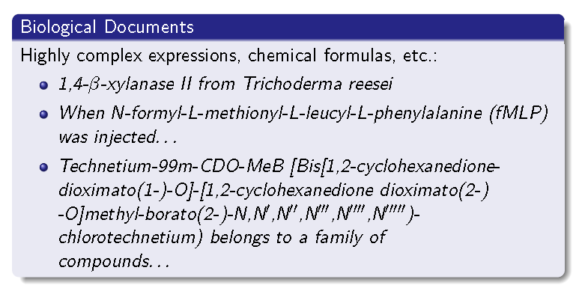
Tokenization
Tokenization can become even more difficult in specific domains
1

Slide 31
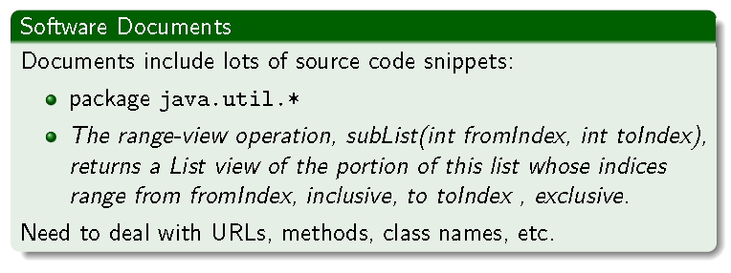
Tokenization
Tokenization can become even more difficult in specific domains
1

Slide 32
Morphological Analysis
Words are changed through a morphological process called inflection:
typically indicates changes in case, gender, number, tense, etc.
Example: car → cars, give → gives, gave, given
Goal : “Normalize” words
Two Main Approaches to normalization
Stemming → Reduce words to base form
Lemmatization → Reduce words to their lemma
1

Slide 33
Stemming
Stemming techniques is used in IR systems:
Can be achieved with rule-based algorithms, usually based on suffix-stripping
Standard algorithm for English: the Porter stemmer
Advantages: simple & fast
Disadvantages:
Rules are language-dependent
Can create words that do not exist in the language
Ex: computers → comput
Often reduces different words to the same stem
Example: army, arm → arm ::: stocks, stockings → stock
1

Slide 34
Lemmatization
Lemmatization is the process of deriving the base form, or lemma, of a word from one of its inflected forms.
This requires a morphological analysis, which in turn typically requires a lexicon.
Advantages:
identifies the lemma (root form), which is an actual word
less errors than in stemming
Disadvantages:
more complex than stemming, slower
requires additional language-dependent resources
While stemming is good enough for Information Retrieval, Text Mining often requires lemmatization
Semantics is more important (we need to distinguish an army and an arm!)
Errors in low-level components can multiply when running downstream
1

Slide 35
Lemmatization
Stemming
Introduction, Introducing, Introduces → Introduc
gone, going, goes → go
Lemmatizing:
Introduction, Introducing, Introduces → Introduce
gone, going, goes, went → go
1

Slide 36
Stemming
Stemming is a pre-processing step in Text Mining.
Word stemming is an important feature supported by indexing and search systems.
Indexing and searching are used in many applications of Text Mining, NLP and IR.
“The purpose of stemming is to reduce different grammatical forms / word forms of a word like its noun, adjective, verb, adverb etc. to its root form.” → derivationally related form
1

Slide 37
Stemming
Stemming is usually done by removing any attached suffixes and prefixes (affixes).
morphological variants of words have similar semantic interpretations.
Since the meaning is same but the word form is different it is necessary to identify each word form with its base form.
Stemming algorithms attempts to convert the morphological variants of a word like introduction, introducing, introduces etc. to get mapped to the word ‘introduce’. → Some algorithms may map them to just ‘introduc’,
The key terms of a query or document are represented by stems rather than by the original words.
1

Slide 38
Stemming
Errors in Stemming:
Under-Stemming
Over-Stemming
Under-Stemming:
It refers to words that should be grouped together by stemming, but aren’t.
This causes a single concept to be spread over various different stems.
Over-Stemming:
It refers to words that shouldn’t be grouped together by stemming, but are
1

Slide 39
Stemming
Truncate(n) stemmer:
which simply retains first n-letters of the word, where n is a suitable integer like 4,5, or 6.
If the word has less than n letters to start with, it is returned unchanged.
1

Slide 40
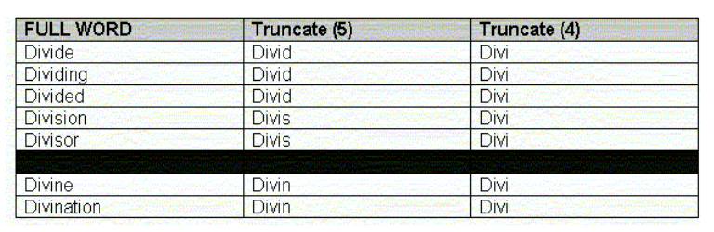
Stemming
Truncate(n) stemmer: Example
1

Slide 41
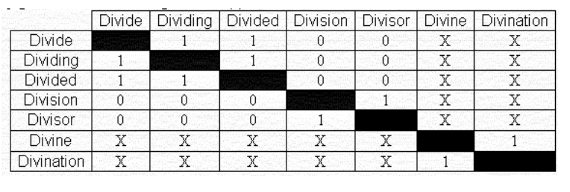
Stemming
Under-Stemming using Truncate(5) Example:
1

Slide 42
Stemming
Under-Stemming using Truncate(5) Example:
1 :
A pair of group-able words with identical stems.
This represents a successful stemming operation.
0 :
A pair of group-able words with non-identical stems.
This represents an Under-stemming error
X:
A pair of non-group able words
These pairs are not considered when counting under stemming errors.
UI → Under-Stemming Index
CI → Conflation Index: proportion of equivalent word pairs which were successfully grouped to the same stem
UI = 1 - CI
The proportion of word pairs successfully merged is 10 out of 22 → UI = 1 – (10/22) = 0.545
1

Slide 43
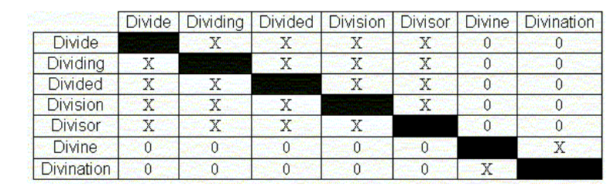
Stemming
Over-Stemming using Truncate(4) Example:
1

Slide 44
Stemming
Over-Stemming using Truncate(4) Example:
0 :
A pair of group-able words with non-identical stems.
This represents an Under-stemming error
X:
A pair of non-group able words
These pairs are not considered when counting under stemming errors.
OI → Under-Stemming Index
DI → Distinctness Index: proportion of non-equivalent word pairs which remained distinct after stemming
OI = 1 - DI
the proportion of word pairs which were correctly not conflated is 0 out of 20 → OI = 1 – (20/20) = 1
1

Slide 45
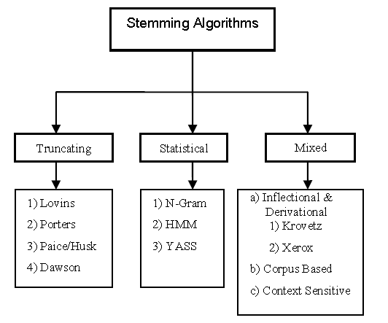
Stemming
Broadly, Stemming algorithms are classified into three groups:
Truncating Methods
Statistical Methods
Mixed Methods
1

Slide 46
Stop-words
Stop-words are words that from non-linguistic view do not carry information
They have mainly functional role
Usually we remove them to help the methods to perform better
Stop words are language dependent – examples:
English: A, ABOUT, ABOVE, ACROSS, AFTER, AGAIN, AGAINST, ALL, ALMOST, ALONE, ALONG, ALREADY, ...
Dutch: de, en, van, ik, te, dat, die, in, een, hij, het, niet, zijn, is, was, op, aan, met, als, voor, had, er, maar, om, hem, dan, zou, of, wat, mijn, men, dit, zo, ...
Notes:
<number>

Slide 47
Stop Words
Useless words for document analysis
Not all words are informative
Remove such words to reduce vocabulary size
No universal definition
Risk: break the original meaning and structure of text
E.g., this is not a good option -> option
1

Slide 48
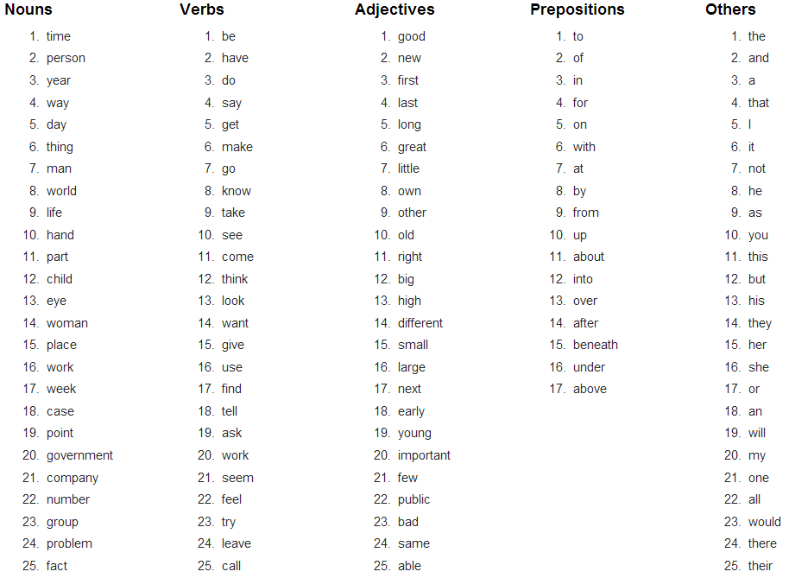
Stop Words
The OEC: Facts about the language
CS@UVa
CS6501: Text Mining
1

Slide 49
Feature Extraction: Task
Task: Extract a good subset of words to represent documents
Document
collection
All unique
words/phrases
Feature
Extraction
All good
words/phrases
Notes:
<number>

Slide 50
Feature Extraction: Task
While more and more textual information
is available online, effective retrieval is
difficult without good indexing of text
content.
16
While-more-and-textual-information-is-available-online-
effective-retrieval-difficult-without-good-indexing-text-content
Feature
Extraction
5
Text-information-online-retrieval-index
2 1 1 1 1
Notes:
<number>
The naive feature space consists of the unique terms that occur in documents, which can be tens or hundreds of thousands of terms of even a moderate-size text collection. The current techniques cannot deal with such large set of terms. It is desirable to reduce the native space without information loss.

Slide 51
Feature Extraction: preprocessing and Indexing
Training
documents
Identification
all unique words
Removal
stop words
non-informative word
ex.{the,and,when,more}
Removal of suffix to
generate word stem
grouping words
increasing the relevance
ex.{walker,walking}→walk
Word Stemming
Term Weighting
Naive terms
Importance of term in Doc
Notes:
<number>

Slide 52
Inverted Index
This is the primary data structure for text indexes
Main Idea:
Invert documents into a big index
Basic steps:
Make a “dictionary” of all the tokens in the collection
For each token, list all the docs it occurs in.
Do a few things to reduce redundancy in the data structure

Slide 53
How Are Inverted Files Created
Documents are parsed to extract tokens. These are saved with the Document ID.
Doc 1
Doc 2
Now is the time
for all good men
to come to the aid
of their country
It was a dark and
stormy night in
the country
manor. The time
was past midnight

Slide 54
How Inverted Files are Created
After all documents have been parsed the inverted file is sorted alphabetically.

Slide 55
How Inverted Files are Created
Multiple term entries for a single document are merged.
Within-document term frequency information is compiled.

Slide 56
How Inverted Files are Created
Then the file can be split into
A Dictionary file
and
A Postings file

Slide 57
How Inverted Files are Created
Dictionary Postings

Slide 58
Inverted Indexes
Permit fast search for individual terms
For each term, you get a list consisting of:
document ID
frequency of term in doc (optional)
position of term in doc (optional)
These lists can be used to solve Boolean queries:
country -> d1, d2
manor -> d2
country AND manor -> d2
Also used for statistical ranking algorithms

Slide 59
How Inverted Files are Used
Query on
“time” AND “dark”
2 docs with “time” in dictionary ->
IDs 1 and 2 from posting file
1 doc with “dark” in dictionary ->
ID 2 from posting file
Therefore, only doc 2 satisfied the query.
Dictionary Postings

Slide 60
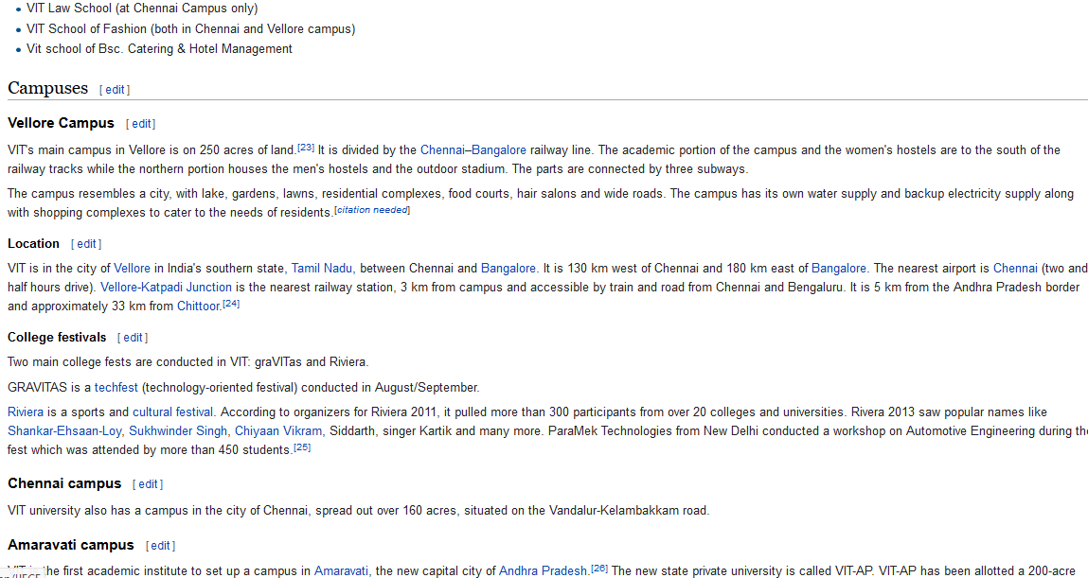
How to represent a document

Slide 61
How to represent a document
Represent by a string?
No semantic meaning
Represent by a list of sentences?
Sentence is just like a short document (recursive definition)

Slide 62
Vector Space Model
This model was proposed by Salton and it incorporates the local as well as global information about terms in a document and corpus.
It is an algebraic model for representing text documents as vectors of identifiers

Slide 63
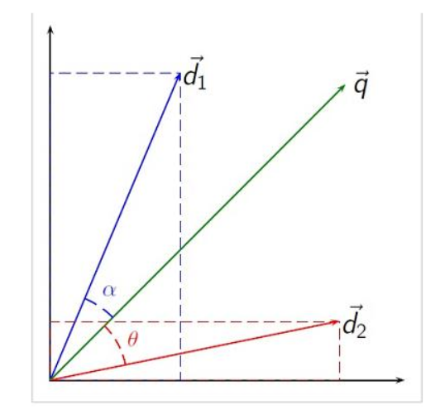
Vector Space Model
The angle between the documents or the query and documents determines the similarity between them

Slide 64
Vector Space Model
Represent documents by concept vectors
Each concept defines one dimension
k concepts define a high-dimensional space
Element of vector corresponds to concept weight
E.g., d=(x₁,…,x_{k}), x_{i} is “importance” of concept i in d
Distance between the vectors in this concept space
Relationship among documents

Slide 65
An illustration of VS model
All documents are projected into this concept space
Finance
|D₂-D₄|
D₂
D₄
D₃
Sports
D₅
D₁
Education
1

Slide 66
What the VS model doesn’t say
How to define/select the “basic concept”
Concepts are assumed to be orthogonal
How to assign weights
Weights indicate how well the concept characterizes the document
How to define the
1

Slide 67
What is a good “Basic Concept”?
Orthogonal
Linearly independent basis vectors
“Non-overlapping” in meaning
No ambiguity
Weights can be assigned automatically and accurately
Few Existing solutions
1

Slide 68
Bag-of-Words representation
Term as the basis for vector space
Doc1: Text mining is to identify useful information.
Doc2: Useful information is mined from text.
 | text | information | identify | mining | mined | is | useful | to | from | apple | delicious
Doc1 | 1 | 1 | 1 | 1 | 0 | 1 | 1 | 1 | 0 | 0 | 0
Doc2 | 1 | 1 | 0 | 0 | 1 | 1 | 1 | 0 | 1 | 0 | 0
Doc3 | 0 | 0 | 0 | 0 | 0 | 1 | 0 | 0 | 0 | 1 | 1
1

Slide 69
Tokenization
Break a stream of text into meaningful units
Tokens: words, phrases, symbols
Input: It’s not straight-forward to perform so-called “tokenization.”
Output(1): 'It’s', 'not', 'straight-forward', 'to', 'perform', 'so-called', '“tokenization.”'
Output(2): 'It', '’', 's', 'not', 'straight', '-', 'forward, 'to', 'perform', 'so', '-', 'called', ‘“', 'tokenization', '.', '”‘
1
Notes:
<number>

Slide 70
Bag-of-Words representation
 | text | information | identify | mining | mined | is | useful | to | from | apple | delicious
Doc1 | 1 | 1 | 1 | 1 | 0 | 1 | 1 | 1 | 0 | 0 | 0
Doc2 | 1 | 1 | 0 | 0 | 1 | 1 | 1 | 0 | 1 | 0 | 0
Doc3 | 0 | 0 | 0 | 0 | 0 | 1 | 0 | 0 | 0 | 1 | 1
Assumption
Words are independent from each other
Pros
Simple
Cons
Basis vectors are clearly not linearly independent!
Grammar and order are missing
The most frequently used document representation
1

Slide 71
Vector Space Model
In the vector space model theory, the weight of a term i in a document j is commonly defined as W _{i,j} = f _{i,j} log(D/d_{i})
where f_{i,j} is a local term weight and where
f_{i,j} = frequency or number of times that term-i occurs in document- j.
d_{i}= document frequency or number of documents that mention term-i.
D = number of documents in a database.
The above formula is used to construct a vector of term weights representing document-j
1

Slide 72
Vector Space Model
Local weight:
In the vector space model formula, w_{i,j} increases with f_{i,j} → This makes the model vulnerable to term repetition. → spamming or spamdexing
documents of equal lengths and with more instances of q are favored during retrieval
longer documents mentioning q tend to consist of words somehow relevant to q
1

Slide 73
Vector Space Model
Global weight:
the log(D/d_{i}) term in vector space model formula is known as the inverse document frequency (IDF_{i})
IDF is a measure of specificity; i.e., of the discriminatory power of a term.
it is evident that keyword weights are affected by
local term counts.
the number of documents in a database.
1

Slide 74
Vector Space Model
Simply w_{i,j} = L_{i,j} G_{i}
where L_{i,j} accounts for the presence of a term in a document
G_{i} across the collection.
The difference between the several models depends on how L_{i,j} and G_{i}
1

Slide 75

Vector Space Model
Binary Model (BNRY):
Simplest Model
local weights are considered independent of term frequencies.
global weights are ignored.
w_{i,j} = L_{i,j} = 1 if the term is in the document; otherwise, w_{i,j} = L_{i,j} = 0.
1

Slide 76
Vector Space Model
Binary Model (BNRY):
It is recommended for pre-weighting or quickly scanning a small index.
for scoring small collections of short titles, abstracts, and documents.
As documents of different lengths are equally weighted, it is a low precision model in the sense that it cannot discriminate between relevant and non-relevant results.
It improve the model by making local weights a linear function of term frequencies. → Term Count Model.
1

Slide 77
Vector Space Model
Term Count Model:
The main assumption in this model is that a document repeating a term several times is likely to be relevant to said term.
This idea was first proposed by Luhn and investigated by Salton and Yang.
local weights a linear function of term frequencies
W_{i,j} = L_{i,j} = f _{i,j}
a linear relationship function between local weights and term frequencies → not a best approaching method → so it can be exploited by simply repeating a term. → Keyword stuffing
1

Slide 78
Vector Space Model
Regardless of the weighting scheme used, documents and queries can be represented as objects (vectors) in an n-dimensional space where each term is a dimension
A document d_{j} with n number of terms can be represented as a point or vector with coordinates d_{j}(w_{1,j}, w_{2,j} … w_{n,j}).
Query can be like q(w_{1,q}, w_{2,q} … w_{n,q}).
1

Slide 79

Vector Space Model
The dot product between a document and a query is obtained by multiplying the coordinates
Example: Document Vector d(3,1,3) and query vector q(0,0,1)
document mentioning [auto] and [insurance] three times each and [car] once
The query consists of the term [insurance].
1

Slide 80

Vector Space Model
1

Slide 81
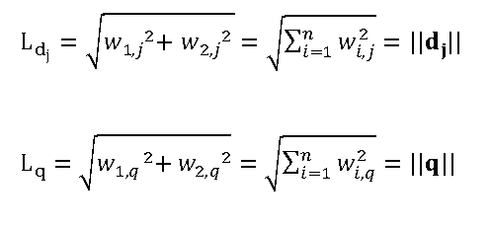
Vector Space Model
The magnitude of a vector is simply its Euclidean length, L, also known as the L2-norm.
Documents and query vectors, dj and q → their absolute magnitudes are
1

Slide 82
Vector Space Model
From dot product of query and documents and Euclidean distance of documents and query can be used to calculate the cosine angle.
If two vectors approach each other, the angle between them, Θ, decreases and the cosine of the angle, cos(Θ), increases.
If the two vectors are superimposed, cos(Θ) = 1, and the two vectors are fully similar to one another.
1

Slide 83
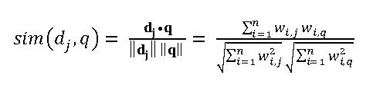
Vector Space Model
The cosine similarity between d_{j} and q, sim(d_{j},q)
1

Slide 84
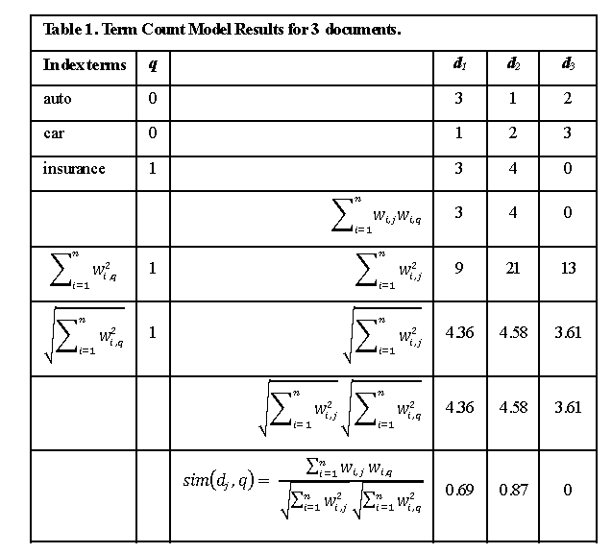
Vector Space Model
Cosine Similarity Calculations
1

Slide 85
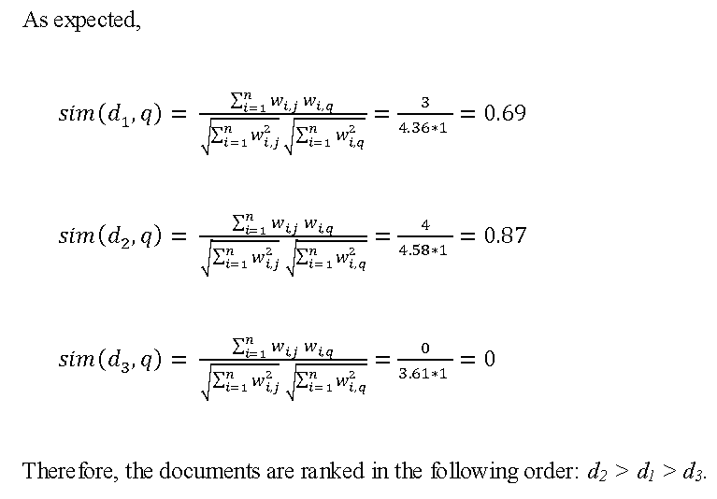
Vector Space Model
1

Slide 86
Vector Space Model
A linear algebra approach that greatly simplifies vector space calculations.
q^{T}A is computed
q^{T} is the transpose of q
A is a matrix of unit vectors.
A unit vector, denoted with a hat (^), is obtained by dividing a vector elements by its magnitude
1

Slide 87
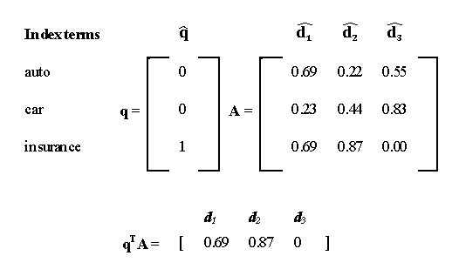
Vector Space Model
1

Slide 88
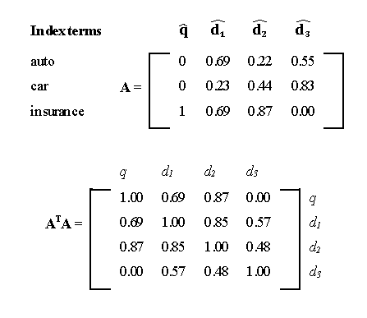
Vector Space Model
Computing the A^{T}A similarity matrix.
The query vector can be placed as the first column vector, like this
1

Slide 89
Vector Space Model
Document vector similarities:
sim(d1, d2) = 0.85
sim(d1, d3) = 0.57
sim(d2, d3) = 0.48
That is, d1 and d2 are the most similar documents.
Binary and Term Count models are based on computing local weights, ignoring global information
Binary Model ignores term frequencies, but Term count Model does not.
1

Slide 90
Vector Space Model
In the Binary Model and Term Count Model, an index of term is constructed by extracting n-number of unique terms from collection of D – Documents
In the Binary model, L_{i,j} is defined based on the presence or absence of an index term – i in document –j , regardless of its frequency f_{i,j} and global weight.
In the Term Count Model, L_{i,j} is defined by considering term frequencies.
1

Slide 91
Vector Space Model
Global weights are included in TF-IDF.
The global weight of an index term across a collection of documents using probability arguments.
Let d_{i} be the number of documents from D and index term – i.
P_{i} = d_{i}/D → probability that a document from D contains an index term i.
To smoothly compare very large and small p_{i} values → the probability scale is compressed by considering logarithms
i.e log(p_{i}) = log(d_{i}/D). Assumption→ index terms are independent.
D >> d_{i} → log(d_{i}/D) <0 → to avoid negative values the ratio inside the parentheses is inverted
This result can be taken as Global weight. → G_{i} = log(D/d_{i}) → This is called Inverse Document Frequency (IDF).
1

Slide 92
Vector Space Model
w_{i,j} = L_{i,j} G_{i} = f_{i,j} log(D/d_{i}) = f_{i,j} IDF_{i}
Classic Term Frequency-Inverse Document Frequency Model or TF-IDF.
IDF was initially formulated by Sparck-Jones
It is a measure of the specificity or level of detail at which a given concept is represented by an index term.
Later It was reformulated as a Global weight in the absence of relevance information.
IDF provides a fair estimate of the discriminatory power of a term index over set of documents.
Intuitively, an index term mentioned in many documents should weigh less than one which occurs in a few documents. → a, and, in etc are low –IDF.
These terms are not specific to a document and cannot be used to summarize topics.
Cannot be used to discriminate between topics and documents
Brand Names, Technical terms and scientific nomenclature words are used for discriminate than high-IDF terms.
1

Slide 93
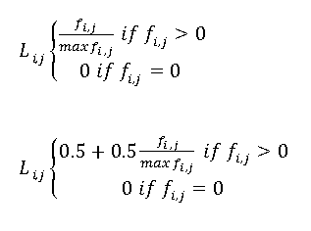
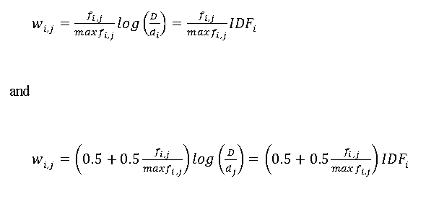
Vector Space Model
TF-IDF based Model:
Some times, L_{ij} can be written by normalizing and then augmenting term frequencies like
max f_{ij} is the maximum frequency
of any index term in document-j
The besides equation is called
augmented frequency model(ATF1)
1

Slide 94


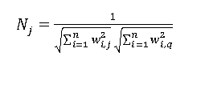
Vector Space Model
TF-IDF based Model:
Dot Product between vectors
cosine similarity
the normalization factor
1

Slide 95
Vector Space Model
TF-IDF based Model: Example
A Collection consisting of three documents (D=3)
Documents are
d1 = Shipment of gold damaged in a fire.
d2 = Delivery of silver arrived in a silver truck.
d3 = Shipment of gold arrived in a truck.
Query is [gold silver truck]
To construct the index of terms, the documents were processed as follows:
Tokenization: Punctuation removed and text lowercased
Filtering: None. Stop-Words were not removed.
Stemming: None. Terms were not reduced to their roots.
1

Slide 96
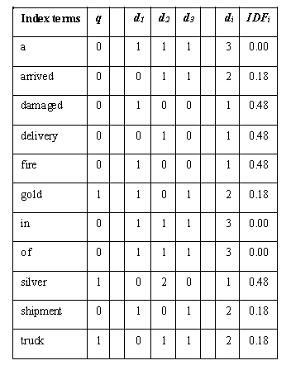
Vector Space Model
TF-IDF based Model: Index terms with raw data
1

Slide 97
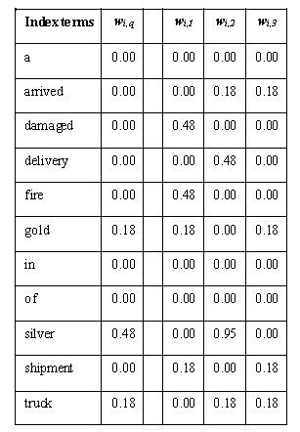
Vector Space Model
TF-IDF based Model: Index terms weights
1

Slide 98
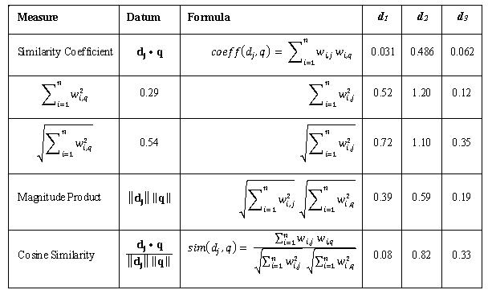
Vector Space Model
TF-IDF based Model: Document-query similarity results
1

Slide 99
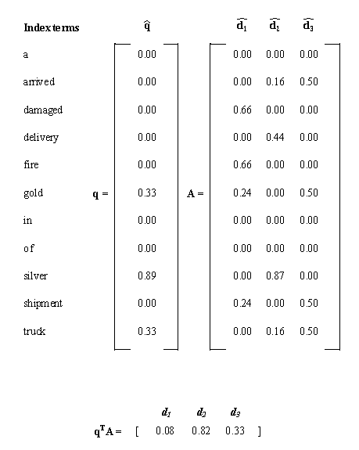
Vector Space Model
TF-IDF based Model: Linear Algebra approach
1

Slide 100
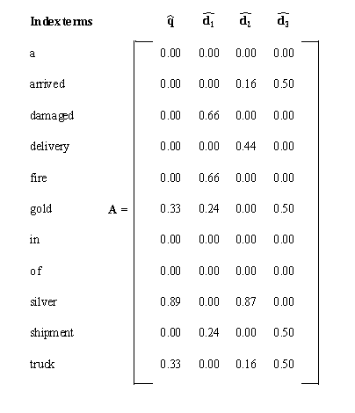
Vector Space Model
TF-IDF based Model: matrix augmentation technique
1

Slide 101
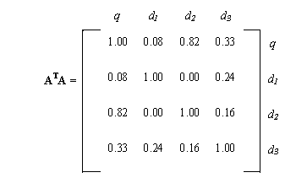
Vector Space Model
TF-IDF based Model: matrix augmentation technique
sim(d1,d2) = 0.0
sim(d1,d3) = 0.24
sim(d2,d3) = 0.16
d₂ and d₃ are more similar to q than d₁ does not necessarily mean that d₃ is more similar to d₂ than to d₁.
1

Slide 102
Vector Space Model
TF-IDF based Model: Limitations
It can be gamed via L_{i,j} weights, i.e., by simply repeating term.
IDF weights are not based on relevance information, but on merely matching terms
Documents sharing high-order co-occurrence and that might be relevant are ignored
A matrix must be recomputed each time a new document is added to a collection.
term independence assumption made with TF-IDF based models
documents are bags of words where terms occur by chance and where their order does not matter
1

Slide 103
Vector Space Model
Terms can be dependent due to
Polysemy: same terms can be used in different contexts
Example: [driving cars] vs. [driving results]
Thus, irrelevant documents can be retrieved because they may share some words from the query. This affects precision.
Synonymity: different terms can be used in the same contexts
Example: [car insurance] vs. [auto insurance]
So relevant documents might not be retrieved. This affects recall
Ordering: different terms can be used in different positions in different contexts
Example: [junior college] vs. [college junior]
This can affect precision and recall.
1

Slide 104
Information Extraction
Information Extraction = Text Mining = e-discovery.
The ultimate goal is to convert unstructured text into structured information (so information of interest can easily be picked up)
Information Extraction systems:
Find and understand limited relevant parts of texts
Gather information from many pieces of text
Produce a structured representation of relevant information:
Relations (in database sense)
Knowledge base
Goal:
Organize the information so that it is useful to people
Put information in a semantically precise form that allows further inference to be made by computer algorithms
1

Slide 105
Information Extraction
Named Entity Recognition is a sub task of identifying names of people, places, organizations, temporal expression, numerical expressions, etc in text.
Example:
Sundar Pichai is CEO of google and lives in America
People → sundar pichai, Organization → google, place → America
The goals of NER is to finding and classify names in text.
Example: used car ads:
For sale, 2002 Toyoto Prius, 20,000 mi, $15k or best offer. Available starting July 20, 2018.
Year, Brand, Model, Price, mileage.
NER: Getting simple structured information out of text
1

Slide 106
Information Extraction
Entity Types:
Identify mentions in text and classify them into a predefined set of categories of interest:
Person Name
Organizations
Locations
Date and Time Expressions
E-mail
Web Address
Name of Drugs
Bibliographic references,
etc,.
1

Slide 107
Information Extraction
NER is difficult?
Too numerous to include in dictionaries
Constantly changing
Appearing in variant forms
Subsequent occurrences might be abbreviated
Ambiguity
1

Slide 108
Named Entity Recognition (NER)
The uses:
Named entities can be indexed, linked off, etc.
Sentiment can be attributed to companies or products
A lot of IE relations are associations between named entities
For question answering, answers are often named entities.
Concretely:
Many web pages tag various entities, with links to bio or topic pages, etc.
Reuters’ OpenCalais, Evri, AlchemyAPI, Yahoo’s Term Extraction, …
Apple/Google/Microsoft/… smart recognizers for document content
Notes:
First, let's define NER!
go through pages, recognize the names of things: "Bill MacCartney", "Stanford University"
the people who came up with this task had a rather precise, philosophically motivated meaning in mind
entity: a discrete, actual thing: Bill MacCartney, but not calcium carbonate or Tuesday or Viagra
named entity: an entity with a name, in a philosophical, Kripke-like sense
(this water bottle is an entity, but not a NAMED entity)
but in practice the definition has been expanded quite a bit in later work
we routinely include dates & times, proteins, drug names
but still, loosely, things that have a name
but NOT references to entities which are not names: "this university", "it”
first task in NER: identifying occurrences of named entities
looking for capital letters is a really good clue! at least in English! but not so much in Hebrew, Chinese, ... non-Latinate alphabets also doesn't really work in German -- all nouns are capitalized!
so that's a pretty useful base-level task -- widely deployed and used
you've probably seen web pages that do this
e.g. financial web sites often mark up stock symbols, names of companies
Microsoft has done work with this, smart tags, entities tagged with metadata
Reuters has web service OpenCalais, you send them docs, they send back NER markup
<number>

Slide 109
N-Grams
Assign probability to a sentence
Probabilities are essential in any task in which we have to identify words in
noisy,
ambiguous input → like speech recognition or handwriting recognition.
Spelling corrections:
Their are two midterms in this class → there
Assigning probabilities to sequences of words is also essential in machine translation.
Notes:
First, let's define NER!
go through pages, recognize the names of things: "Bill MacCartney", "Stanford University"
the people who came up with this task had a rather precise, philosophically motivated meaning in mind
entity: a discrete, actual thing: Bill MacCartney, but not calcium carbonate or Tuesday or Viagra
named entity: an entity with a name, in a philosophical, Kripke-like sense
(this water bottle is an entity, but not a NAMED entity)
but in practice the definition has been expanded quite a bit in later work
we routinely include dates & times, proteins, drug names
but still, loosely, things that have a name
but NOT references to entities which are not names: "this university", "it”
first task in NER: identifying occurrences of named entities
looking for capital letters is a really good clue! at least in English! but not so much in Hebrew, Chinese, ... non-Latinate alphabets also doesn't really work in German -- all nouns are capitalized!
so that's a pretty useful base-level task -- widely deployed and used
you've probably seen web pages that do this
e.g. financial web sites often mark up stock symbols, names of companies
Microsoft has done work with this, smart tags, entities tagged with metadata
Reuters has web service OpenCalais, you send them docs, they send back NER markup
<number>

Slide 110
N-Grams
he introduced reporters to the main contents of the statement
he briefed to reporters the main contents of the statement
he briefed reporters on the main contents of the statement
→ A probabilistic model of word sequences could suggest that briefed reporters on is a more probable English phrase
Notes:
First, let's define NER!
go through pages, recognize the names of things: "Bill MacCartney", "Stanford University"
the people who came up with this task had a rather precise, philosophically motivated meaning in mind
entity: a discrete, actual thing: Bill MacCartney, but not calcium carbonate or Tuesday or Viagra
named entity: an entity with a name, in a philosophical, Kripke-like sense
(this water bottle is an entity, but not a NAMED entity)
but in practice the definition has been expanded quite a bit in later work
we routinely include dates & times, proteins, drug names
but still, loosely, things that have a name
but NOT references to entities which are not names: "this university", "it”
first task in NER: identifying occurrences of named entities
looking for capital letters is a really good clue! at least in English! but not so much in Hebrew, Chinese, ... non-Latinate alphabets also doesn't really work in German -- all nouns are capitalized!
so that's a pretty useful base-level task -- widely deployed and used
you've probably seen web pages that do this
e.g. financial web sites often mark up stock symbols, names of companies
Microsoft has done work with this, smart tags, entities tagged with metadata
Reuters has web service OpenCalais, you send them docs, they send back NER markup
<number>

Slide 111
N-Grams
Models that assign probabilities to sequences of words are called language models or LMs.
The simplest model that assigns probabilities LM to sentences and sequences of words, the N-gram.
N-gram is a sequence of N-words:
2-grams → bigrams → two-word sequence
Example: Please turn, turn your, your homework
3-gram → trigram → three-word sequence
Example: please turn your, turn your homework
Notes:
First, let's define NER!
go through pages, recognize the names of things: "Bill MacCartney", "Stanford University"
the people who came up with this task had a rather precise, philosophically motivated meaning in mind
entity: a discrete, actual thing: Bill MacCartney, but not calcium carbonate or Tuesday or Viagra
named entity: an entity with a name, in a philosophical, Kripke-like sense
(this water bottle is an entity, but not a NAMED entity)
but in practice the definition has been expanded quite a bit in later work
we routinely include dates & times, proteins, drug names
but still, loosely, things that have a name
but NOT references to entities which are not names: "this university", "it”
first task in NER: identifying occurrences of named entities
looking for capital letters is a really good clue! at least in English! but not so much in Hebrew, Chinese, ... non-Latinate alphabets also doesn't really work in German -- all nouns are capitalized!
so that's a pretty useful base-level task -- widely deployed and used
you've probably seen web pages that do this
e.g. financial web sites often mark up stock symbols, names of companies
Microsoft has done work with this, smart tags, entities tagged with metadata
Reuters has web service OpenCalais, you send them docs, they send back NER markup
<number>

