Slide 1
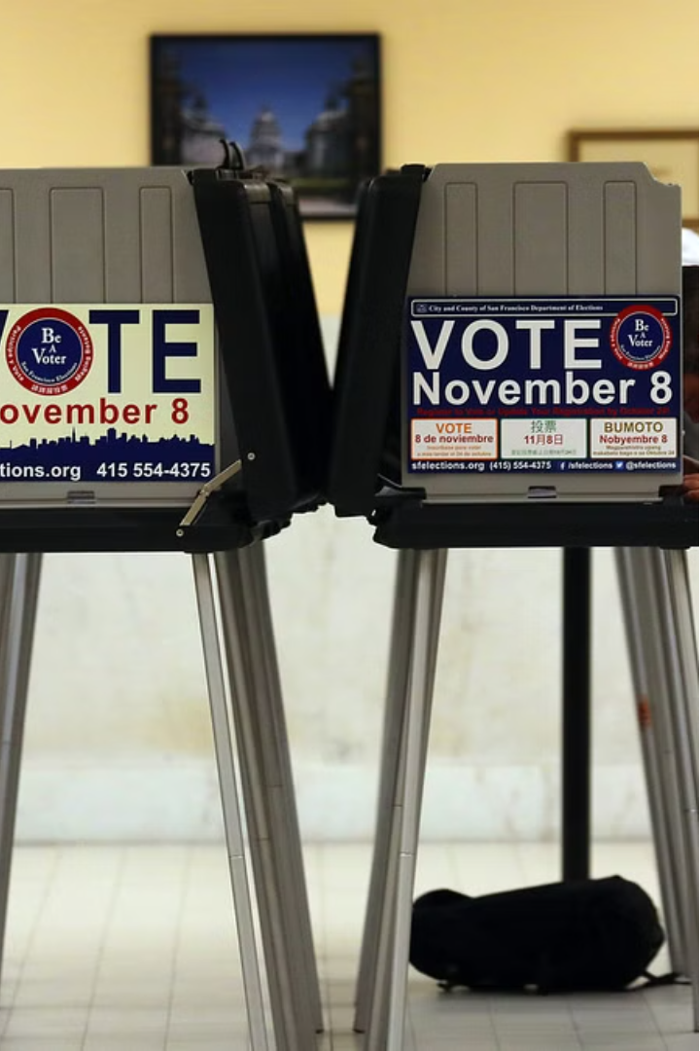
Online Polling System
Online polling systems leverage the internet to gather real-time feedback and insights from a wide audience through surveys, elections, and data collection.
Our platform leverages cutting-edge internet technologies to deliver a reliable and efficient polling experience. Whether you're conducting market research, gathering employee feedback, or engaging with a community, our system provides the tools you need to capture and analyze opinions effectively.
BY
GUIDED BY
Dr.Jayasakthi Velmurugan.K
Nikhill Nandan K (192211750)
Ramesh Reddy B (192211749)
Jyothieswar Reddy M(192211468)

Slide 2
Scope of the Project
User-Friendly Interface
Objective: To develop a web-based application that allows users to create, participate in, and manage polls.
Technology Stack: HTML, CSS, JavaScript (possibly incorporating frameworks like React or Angular for enhanced functionality).
Develop an intuitive and accessible interface that encourages participation and engagement.
Secure Voting
Implement robust security measures to ensure the integrity and confidentiality of the voting process.
Real-Time Analytics
Provide detailed reporting and visualization tools to analyze poll results in real-time.

Slide 3
Existing System & Disadvantages
Paper-Based Polling
Limited Reach
Traditional in-person polling methods can be time-consuming, error-prone, and lack accessibility.
Existing online polling systems often have a limited reach, excluding certain demographics.
Disadvantages:
Lack of Engagement
Current systems sometimes fail to foster user engagement and participation.
Multiple Submissions: Ensuring that each participant votes only once can be challenging, especially if robust verification mechanisms are not in place.
Manipulation: Poll results can be easily skewed by bots or coordinated efforts to influence outcomes.
Outdated Technology
Many existing systems are built on outdated technologies, limiting their functionality and scalability.

Slide 4
Proposed System
Seamless User Experience
Robust Security
Develop a modern, mobile-responsive interface that is intuitive and easy to use.
Implement advanced security measures, including encryption and multi-factor authentication, to ensure the integrity of the voting process.
Real-Time Analytics
Increased Accessibility
Provide interactive dashboards and reporting tools to analyze poll results in real-time.
Ensure the system is accessible to users with disabilities, promoting inclusive participation.

Slide 5
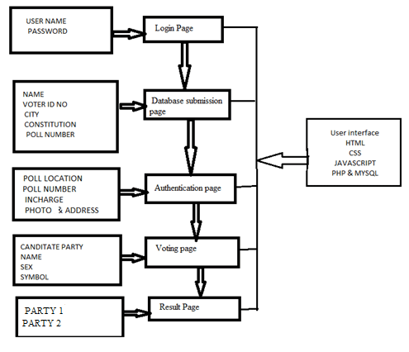
Architecture Diagram
System Architecture
The proposed online polling system will utilize a scalable, cloud-based architecture to handle large volumes of users and data.
This architecture provides a robust framework for an online polling system, ensuring it is user-friendly, secure, scalable, and maintainable.

Slide 6
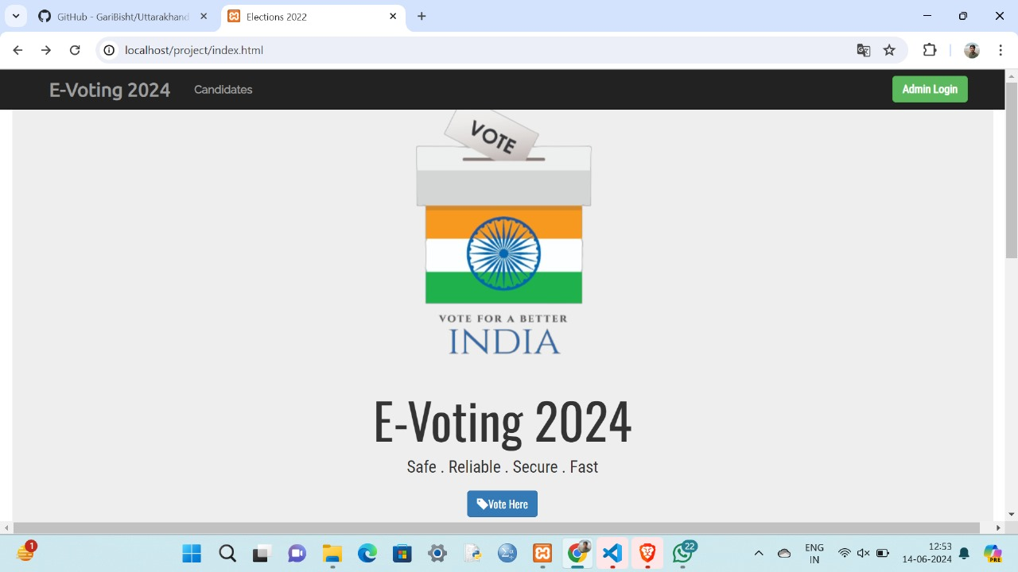
Output

Slide 7
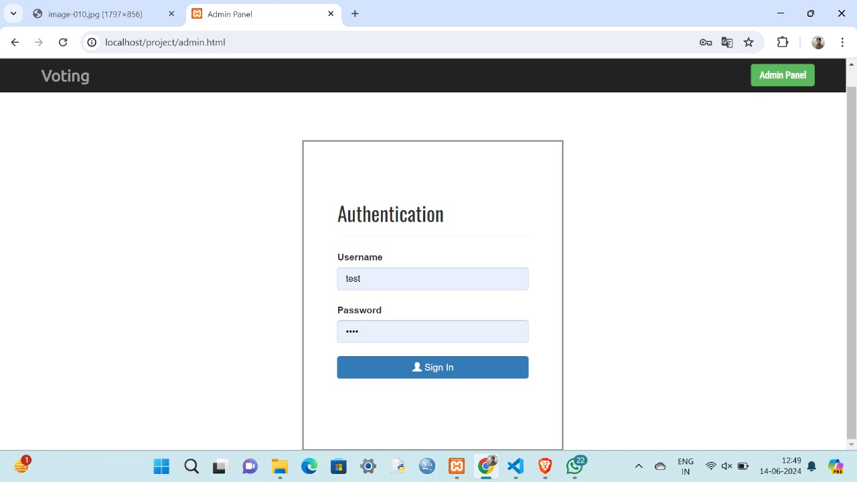

Slide 8
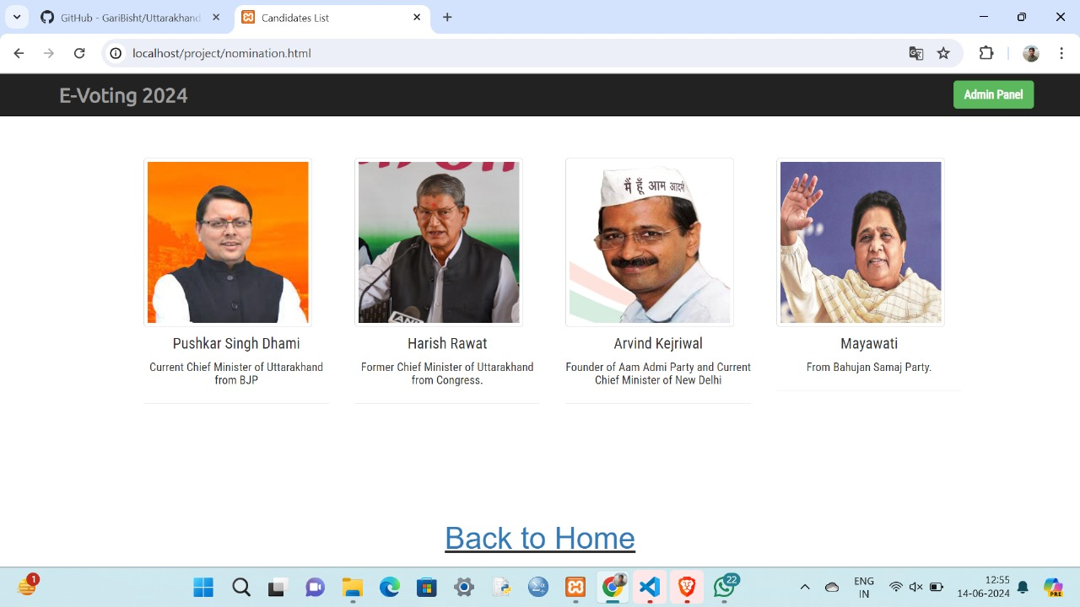

Slide 9
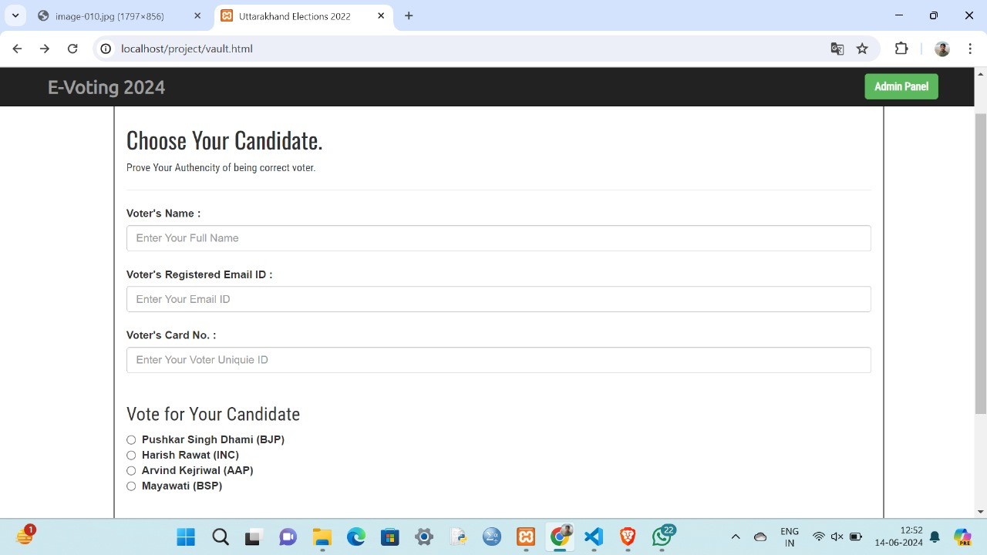

Slide 10
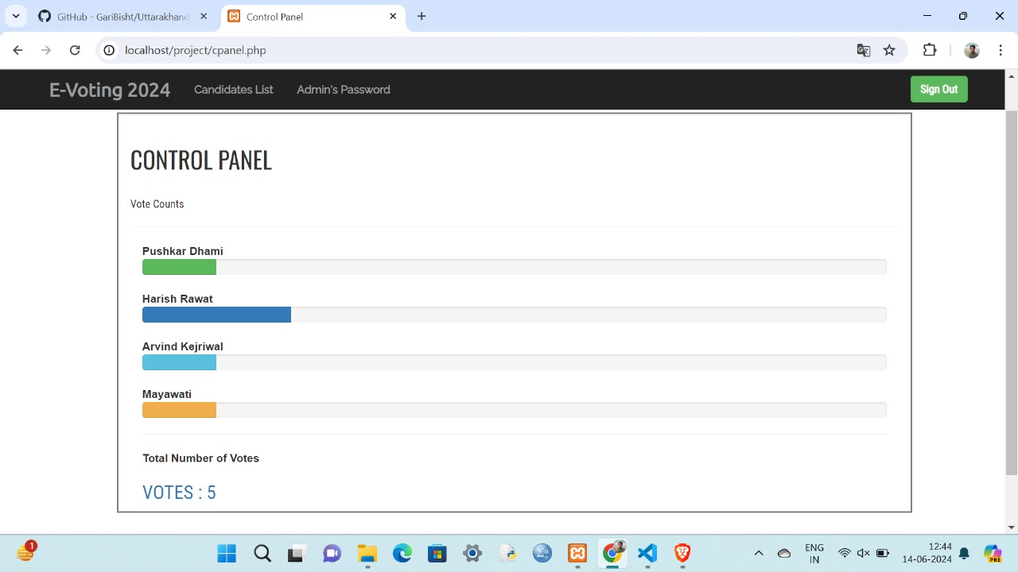
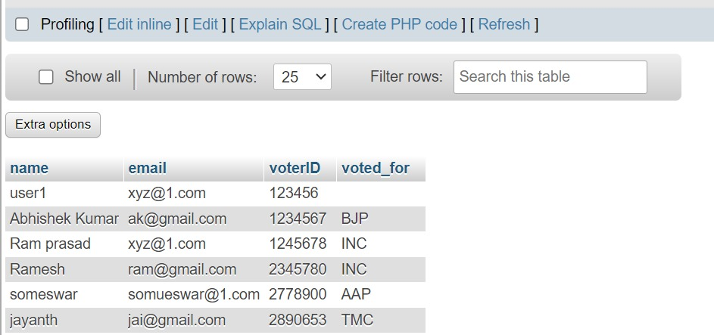
Database

Slide 11



Conclusion and Next Steps
Scalability
Continuous Improvement
Partnerships
Ensure the system can handle increasing user demand and expand to support larger-scale polling efforts.
Gather user feedback and regularly update the system to incorporate new features and best practices.
Explore opportunities to collaborate with organizations and experts in the field of online polling and e-voting.

Slide 12
References
Online Voting Systems: Best Practices and Security Considerations
https://www.example.com/online-voting-best-practices
The Future of Polling: Leveraging Technology for Inclusive Participation
https://www.example.com/future-of-polling
Designing Accessible Online Voting Interfaces
https://www.example.com/accessible-online-voting

Slide 13
Queries
Security Measures
User Authentication
What specific security protocols and technologies will be implemented to ensure the confidentiality and integrity of the voting process?
How will the system verify the identity of users and prevent duplicate or fraudulent votes?
Data Privacy
Accessibility Features
What measures will be taken to protect the personal information and voting data of users?
What accessibility features will be incorporated to ensure the system is inclusive and usable for all users?

