Slide 1
Employee Data Analysis using Excel
STUDENT NAME:PRIYADHARSHINI R
REGISTER NO:312215858
DEPARTMENT:B.COM ACCOUNTING AND FINANCE
COLLEGE:SHRI SHANKARLAL SUNDARBAI SHASUN JAIN COLLEGE FOR WOMEN

Slide 2
PROJECT TITLE
Employee Performance Analysis using Excel

Slide 3


AGENDA
Problem Statement
Project Overview
End Users
Our Solution and Proposition
Dataset Description
Modelling Approach
Results and Discussion
Conclusion
3/21/2024 Annual Review

Slide 4

PROBLEM STATEMENT
"Analyze employee data using Excel to identify patterns, trends, and areas for improvement. The challenge is to effectively manage and interpret diverse data sets to provide actionable insights that enhance employee performance, optimize resource allocation, and support informed decision-making."

Slide 5

PROJECT OVERVIEW
"This project involves analyzing employee performance data using Excel to identify key trends and patterns. It includes data collection, cleaning, and organization, followed by statistical analysis and visualization. The insights gained will help in making informed decisions to enhance employee performance and organizational efficiency."
.

Slide 6

WHO ARE THE END USERS?
HR Managers: To assess employee performance, identify training needs, and manage talent.
Team leaders/Supervisors: To monitor team performance and provide targeted feedback.
Executives: To make strategic decisions regarding staffing and organizational development.
Employees: To receive feedback and track their own performance progress.

Slide 7

OUR SOLUTION AND ITS VALUE PROPOSITION
Solution:
Employee Performance Analysis using Excel
Value Proposition:
Cost Effective: No need for expensive software.
Customizable: Tailor metrics and reports to fit your needs.
User-Friendly: Easy to use and widely known.
Real-time Insights: Quick access to performance data.
Visual Analysis: Dynamic charts and graphs for clear insights.

Slide 8
Dataset Description
Description: This dataset contains employee performance data for a large organization, including: 1. Employee ID 2. Name 3. Business Type 4. Business unit 5. Employee Status 6. Employee classification type 7. Years of Service (Number of years with the organization) 8. Age (Employee age) 9. Gender (Employee gender) 10. Education Level (Highest level of education completed) 11. Training Hours (Number of training hours completed in the past year only.
12. Sales Performance (Sales revenue generated, for sales roles only) 13. Customer Satisfaction (Average customer satisfaction rating, for customer-facing roles only)

Slide 9

THE "WOW" IN OUR SOLUTION
1. Forecast future performance: Identify high-potential employees and predict future performance based on historical data and trends. 2. Detect early warning signs: Flag employees at risk of underperforming or leaving the organization, enabling proactive interventions. 3. Personalized development plans: Generate tailored development recommendations for each employee, aligning with their strengths, weaknesses, and career goals.
3/21/2024 Annual Review
9

Slide 10
MODELLING
Descriptive Analytics: - Data cleaning and pre-processing - Data visualization (charts, tables, etc.) - Summary statistics (means, medians, etc.) 2. Inferential Analytics: - Correlation analysis (relationships between variables) - Regression analysis (predicting performance ratings) - Hypothesis testing (identifying significant differences) 3. Predictive Analytics
- Machine learning algorithms (e.g., decision trees, clustering) - Predictive modeling (forecasting future performance) 4. Prescriptive Analytics: - Optimization techniques (identifying best courses of action) - Simulation modeling (evaluating different scenarios)
10

Slide 11
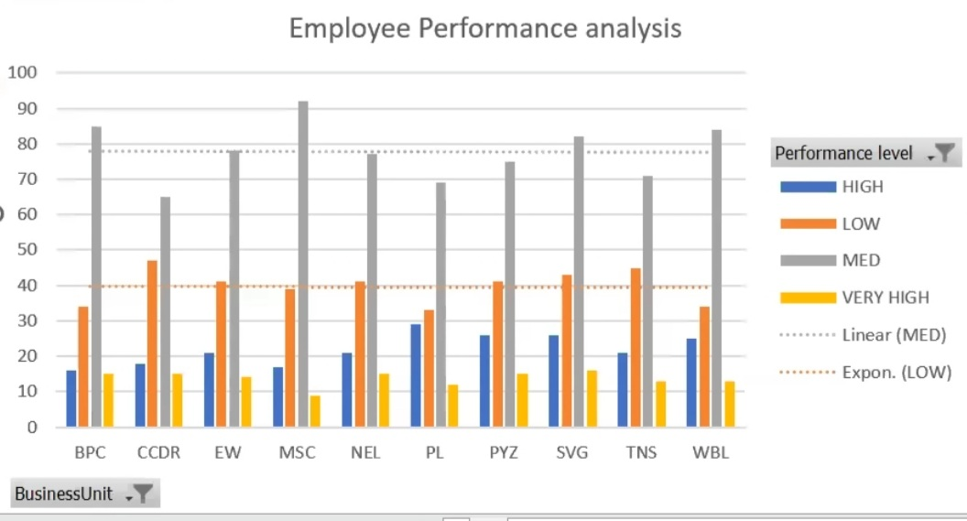
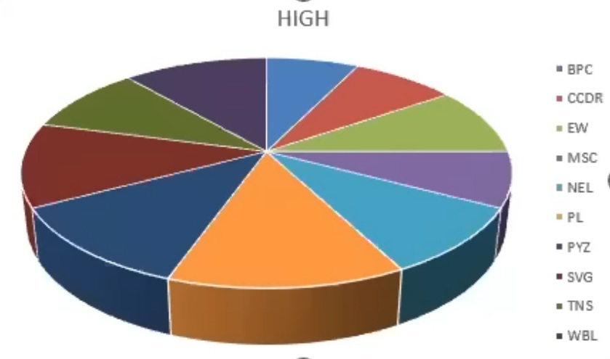
RESULTS
FORMULA =IF(AND(Z8>=5),"VERY HIGH",IF(AND(Z8>=4),"HIGH",IF(AND(Z8>=3),"MED","LOW")))
11

Slide 12
conclusion
The employee performance analysis using Excel has provided valuable insights into the organization's talent landscape. By leveraging data analytics and visualization, we have: 1. Identified top performers and underperforming employees 2. Uncovered departmental and demographic trends influencing performance 3. Developed targeted recommendations for talent development and improvement

