Slide 1

E-Commerce Database Management System
Ramesh Satta
Innomatics Research Labs

Slide 2


Project Overview
Goal: To design and implement a scalable E- Commerce database system.
Features:
Relational structure with 7 tables.
Data (1000 rows) same-like real-world transactions.
Queries to extract business insights.

Slide 3
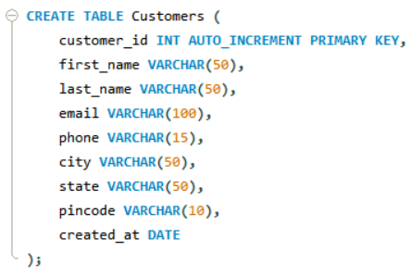
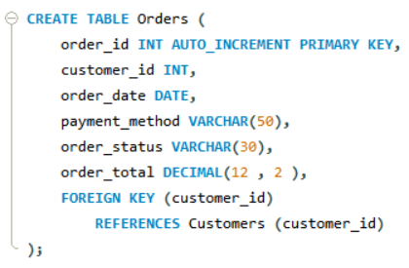
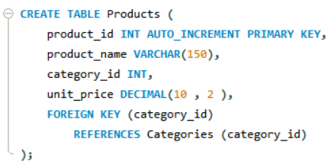
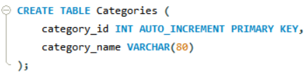
Database Schema
7 Tables in Database
Relationships maintained via Primary & Foreign Keys.
Customers
Orders
Products
Categories

Slide 4
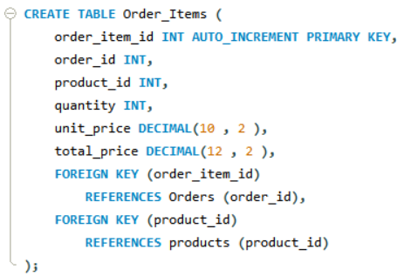
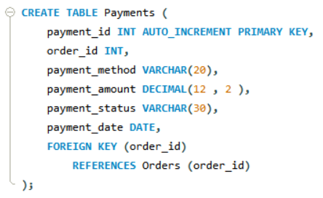
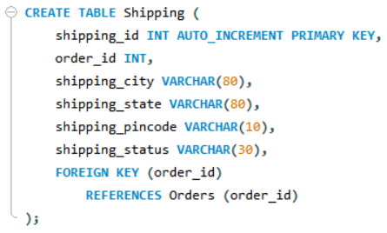
Order_Items
Payments
Shipping

Slide 5
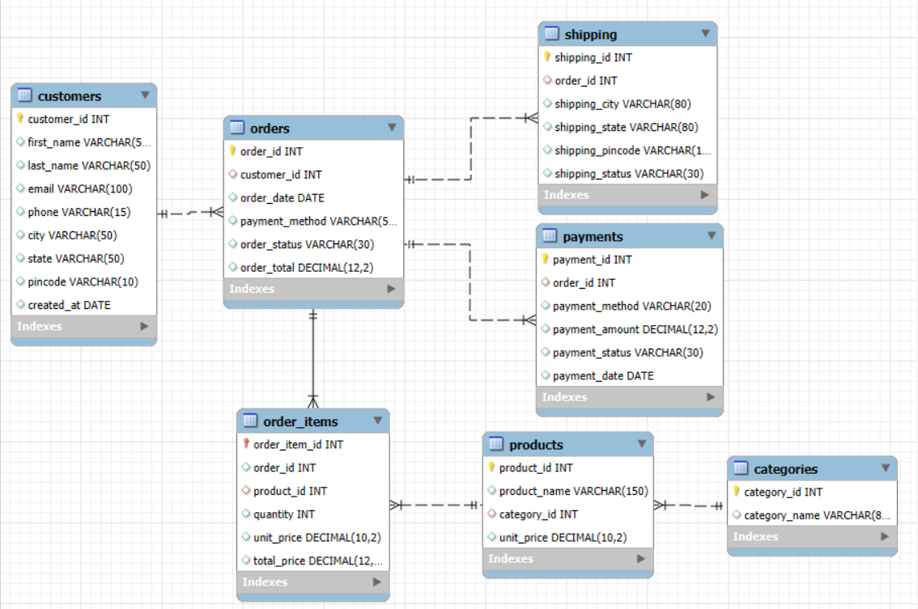
ER Diagram

Slide 6
Data Characteristics
Data Characteristics
Realistic values ensured
Authentic names (all religions, male/female).
Valid emails (randomized).
Cities–States–Pincodes aligned properly..
Prices aligned with market standards.
Payment limits (UPI under RBI cap).
Data prepared using Python & Faker library.
customer_id | first_name | last_name | email | phone | city | state | pincode | product_name | unit_price | payment_method | payment_amount | payment_status
1 | Anjali | Chopra | anjalichopra@yahoo.com | 7837744197 | Hyderabad | Telangana | 500001 | Mamaearth Face Wash | 559 | UPI | 87501 | Success
2 | Karan | Singh | karansingh@outlook.com | 8215704331 | Ahmedabad | Gujarat | 380002 | Sleepwell Mattress | 19955 | UPI | 87352 | Refunded
3 | Nazia | Noor | nazia_noor@outlook.com | 8171545444 | Bengaluru | Karnataka | 560076 | Data Science Handbook | 1575 | UPI | 81323 | Success
4 | John | Paul | johnpaul@hotmail.com | 9181599706 | New Delhi | Delhi | 110001 | Sony Headphones WH-1000XM5 | 25925 | UPI | 78555 | Pending
5 | Sadia | Sheikh | sadiasheikh@gmail.com | 7718274968 | Kochi | Kerala | 682001 | Puma Hoodie | 2093 | UPI | 76743 | Success

Slide 7
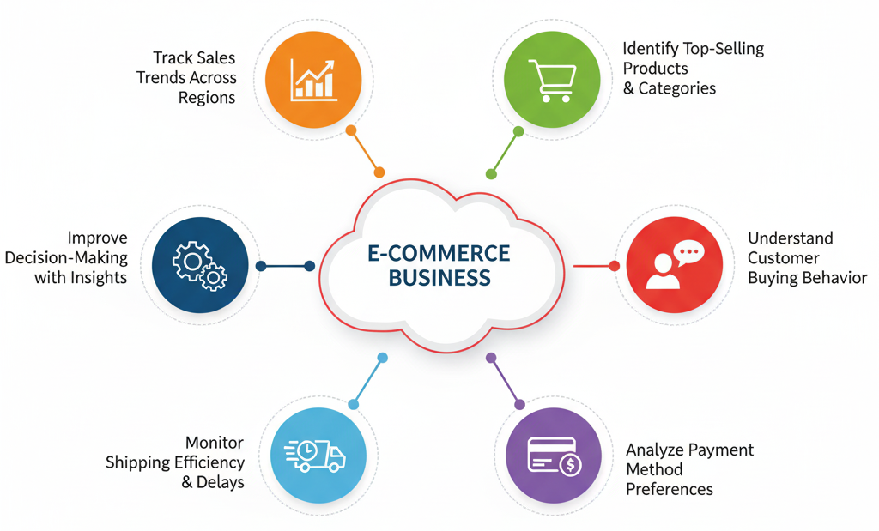
Objectives
We aim to address key business challenges:

Slide 8
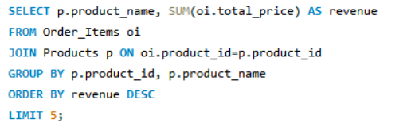
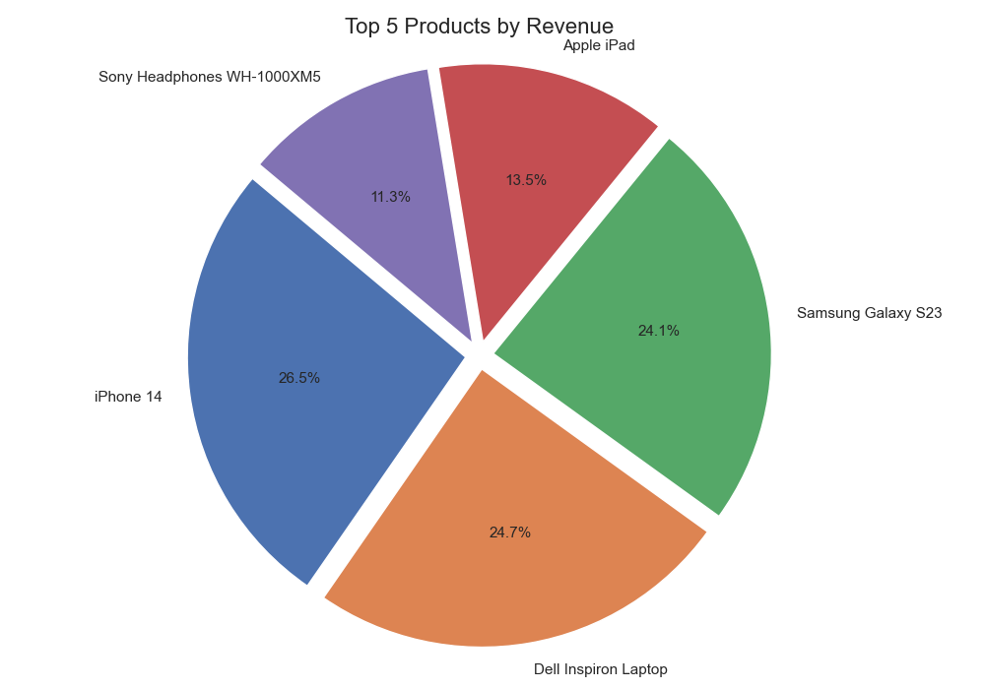
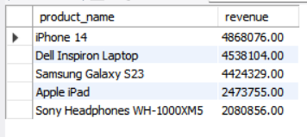
Top 5 Products Driving Revenue
Input
Output

Slide 9
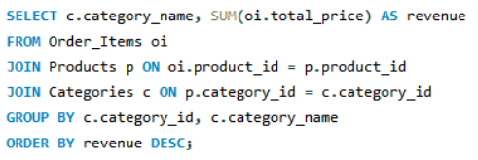
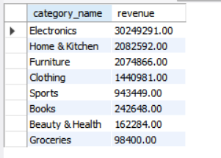
Revenue Contribution by Category
Input
Output

Slide 10
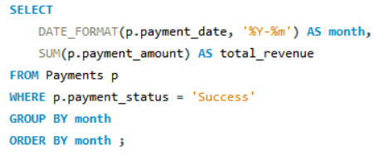
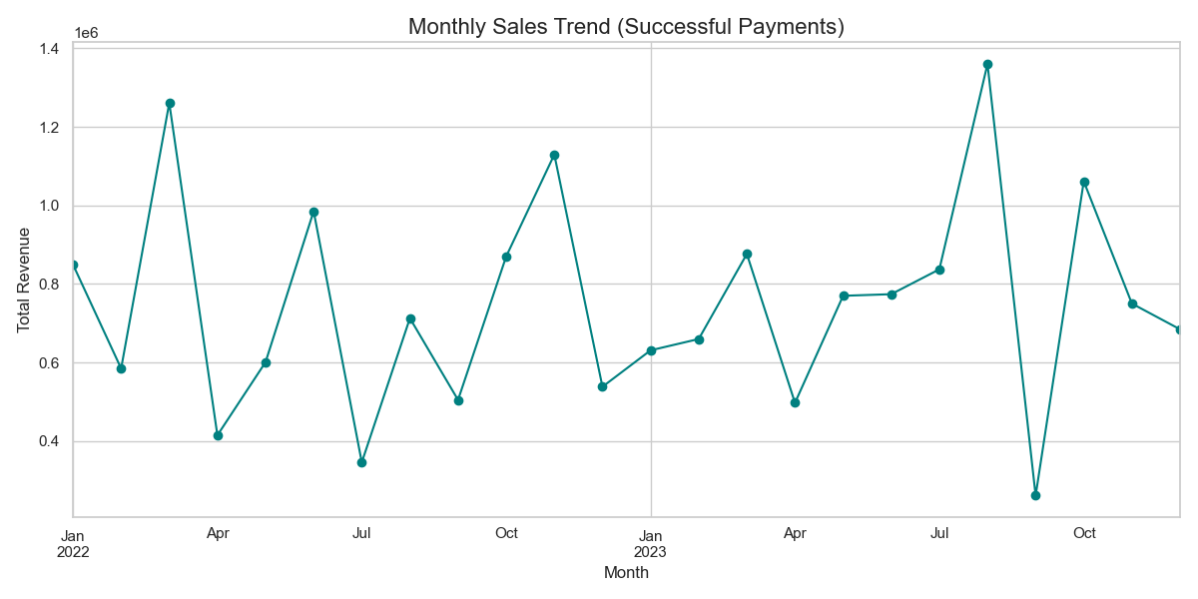
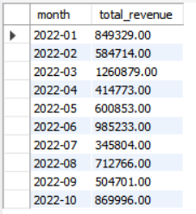
Monthly Sales Trend
Input
Output

Slide 11
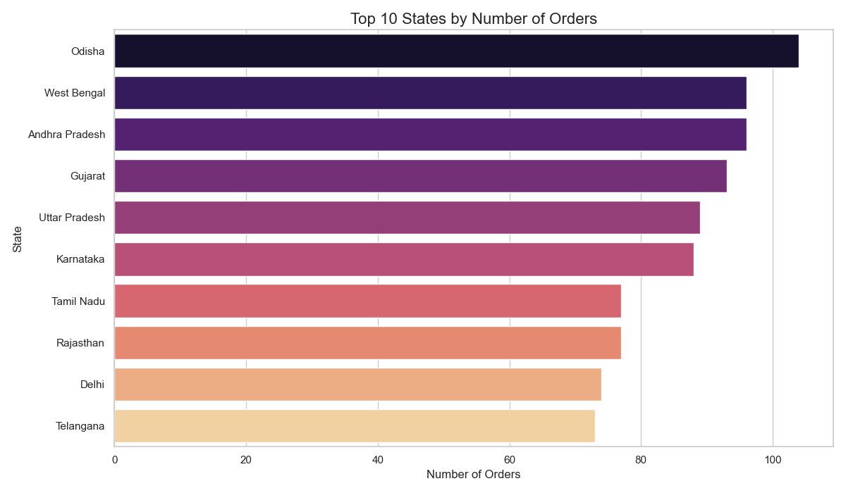
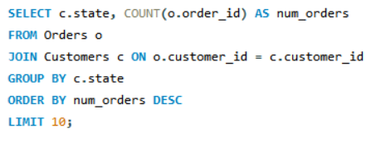
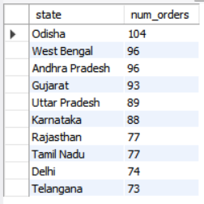
Top States by Order Volume
Input
Output

Slide 12
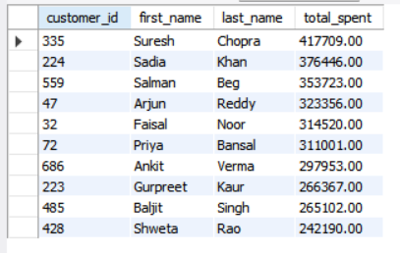
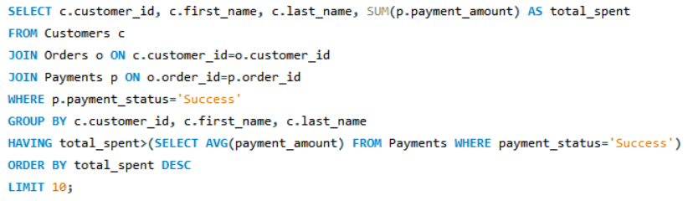
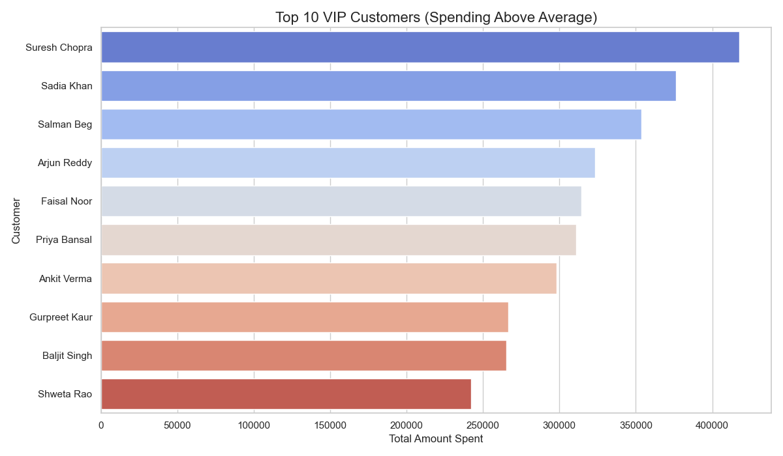
Identifying VIP Customers (High Spenders)
Output
Input

Slide 13
Conclusion and Future Scope
Designed a robust relational database for E-Commerce.
Generated actionable insights from SQL queries.
Enhanced understanding of data management & analysis.
Future Scope
Integrate Inventory Management.
Add Customer Feedback Analysis.
Expand dataset for predictive analytics.

Slide 14
