Slide 1
Beazley modernisation – GPAS & Billing code quality controls and gateways

Slide 2
GPAS & BILLING – Guidewire CODE Quality FOCUS
Continuous process with 360 Degree focus on areas that can influence how and what we develop
SKILL SET
80% of developers & testers GW certified at any point
80% of BA GW certified at any point
30% of team is lead certified
Periodic refresh sessions on coding standards
Continuous certification upgrades
RIGOR
All user stories code reviewed by peers and leads
SurePath plug-in & Server Tests (JaCoCo) run for all check-ins
>60% Gunits coverage, integrated to CICD pipeline
GW Cloud assessment every sprint
Capgemini wider knowledge base exchange
FEEDBACK LOOP
Automation scripts for regression with quick turn around times
Defects RCA in-code fed back for analysis and action
Retrospectives with GW and QA teams for actions

Slide 3
code review controls and gateways
Quality Controls
Robust Code review checklist from experience and expertise
Self review
Peer review
Inspection plugin
GAnalyser (in process to get into Beazley environment)
Quality Gateways
Peer reviews and Lead reviews
Guidewire’s cloud assurance assessments
Essential services -GCAT ( yet to be received)
GAnalyser (in process to get into Beazley environment)

Slide 4
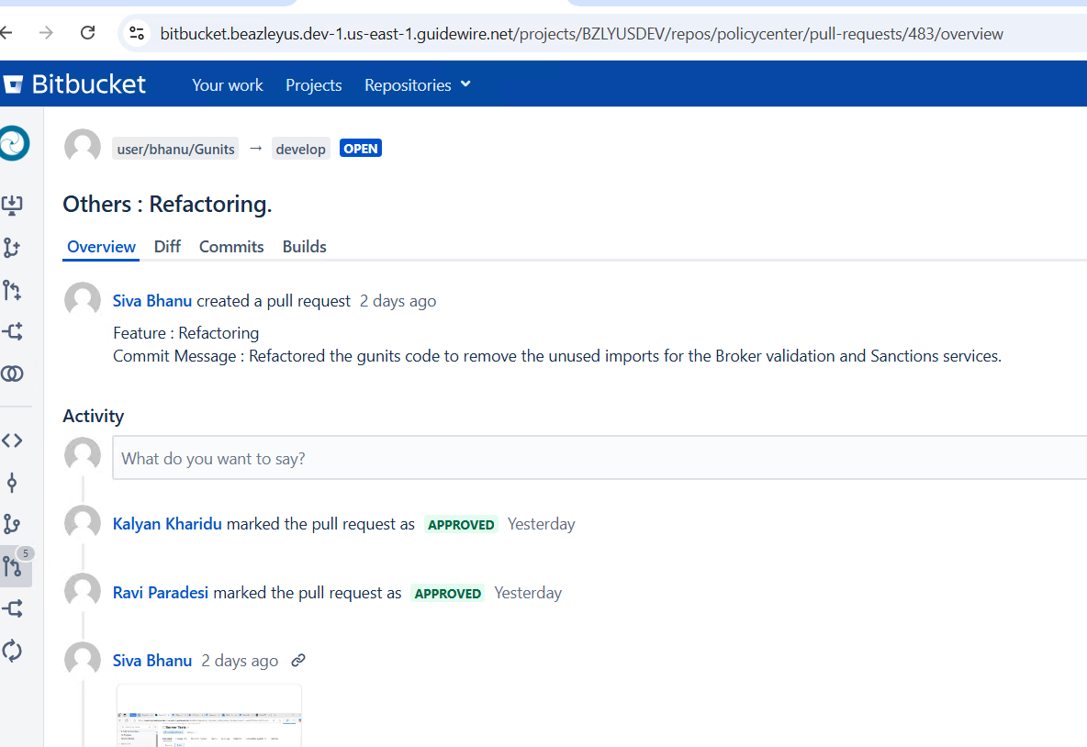
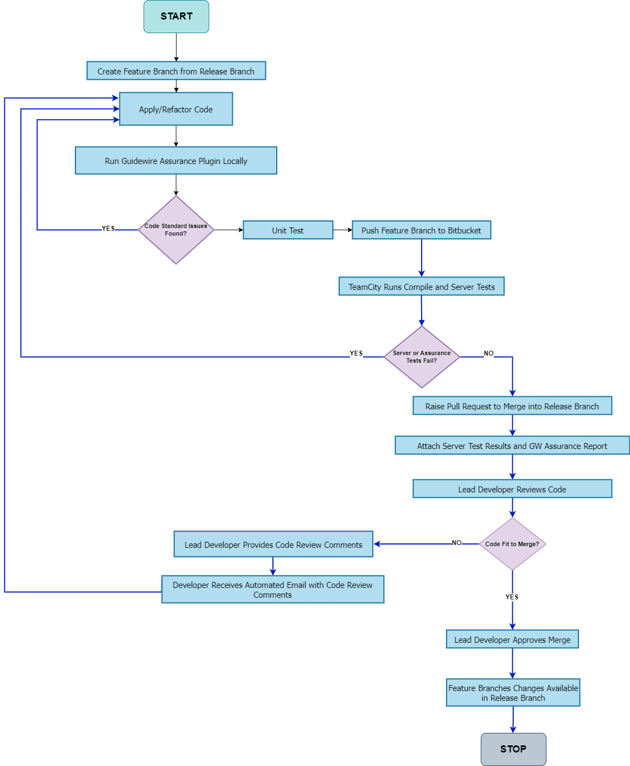
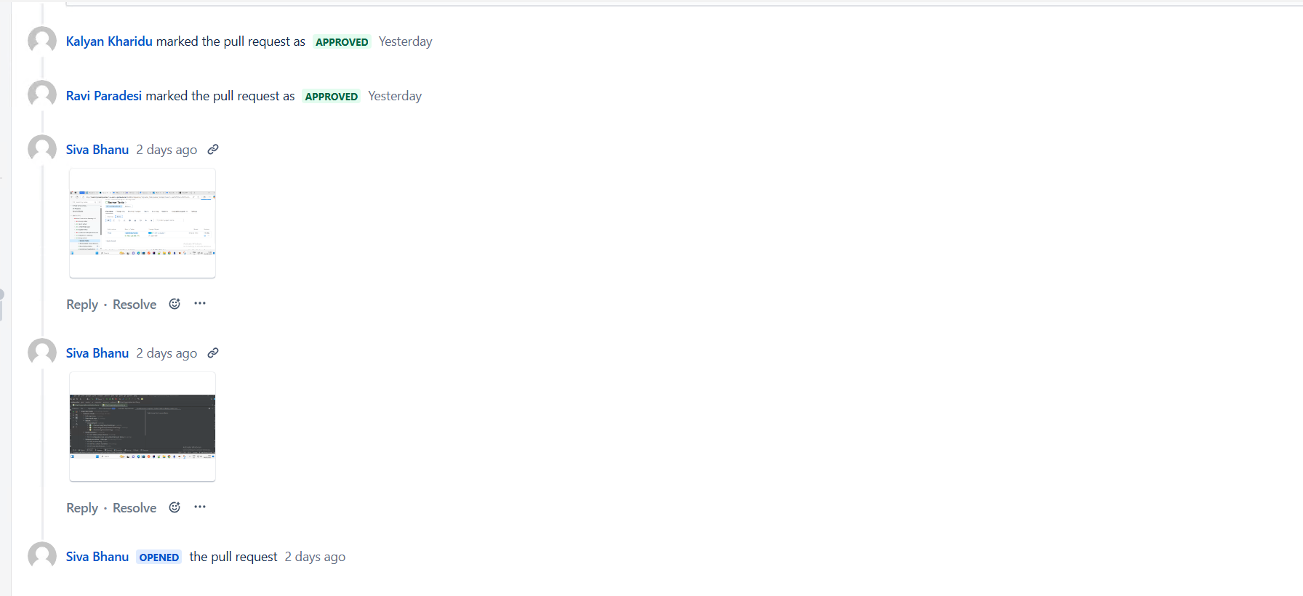
Developer Workflow covering branching, code review & automated checks
Developer Workflow in action – Code Check-ins showing evidences within Bitbucket

Slide 5
Status of cloud assurance observations
GW - Cloud Assessment Report
Date | Sprint | Assurance status | Open Errors | Open Warning
20-Feb-25 | Sprint 6 | Green | 0 | 1
19-Jan-25 | Sprint 5 | Green | 1 | 1
20-Dec-24 | Sprint 4 | Green | 3 | 0
20-Nov-24 | Sprint 3 | Green | 4 | 0
07-Nov-24 | Sprint 2 | Green | 6 | 0
09-Oct-24 | Sprint 1 | Green | 6 | 0
12-Sep-24 | Sprint 0 | Green | 0 | 0
 |  |  | 20 | 2
All 7 assessment cycles till date are GREEN
No outstanding errors or observations as on today
The total 12 errors reported during Sprint 1 & 2 are about Gunit compliance which was on plan for later sprints and is now closed

Slide 6
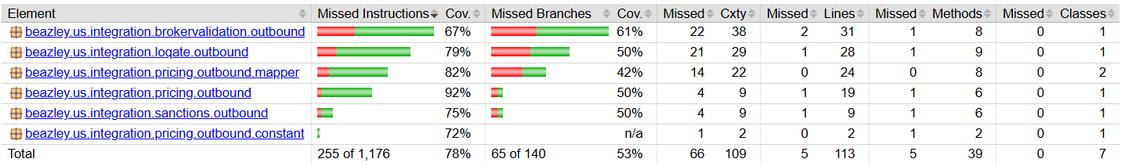
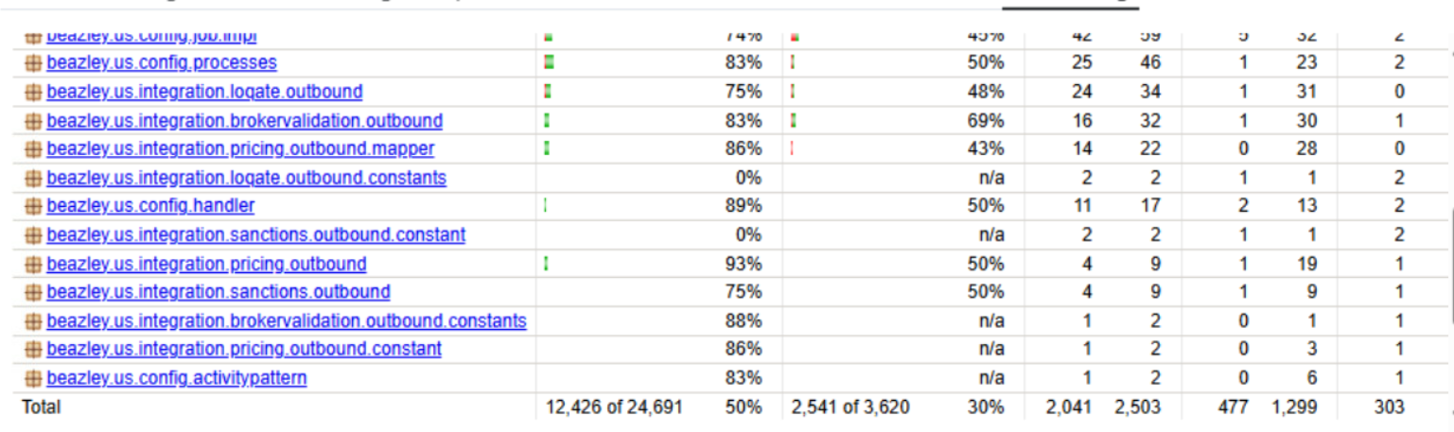
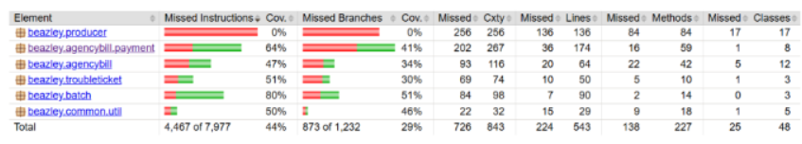
Continuous code coverage & server tests
Integration
PolicyCenter
BillingCenter

