Slide 1
Lending Club Case Study
EDA by Ramesh Velivela
ML61 EPGP in AI & ML

Slide 2
Agenda
Introduction
Problem Statement & Business Objective
Primary Goals & Approach
Data Handling/Prep for EDA
Exploratory Data Analysis (EDA)
Conclusion with Recommendation

Slide 3
Introduction
Contributor: Ramesh Velivela
Topic: EDA
Subject area: Lending Club Case Study
Introduction:
We work for a consumer finance company which specializes in lending various types of loans to urban customers. Company has to make a decision for loan approval based on the applicant’s profile.
Company is looking for detailed insights on various dimensions / driving factors causing the loan default (strong indicators of default), which they can utilize during portfolio planning and risk assessment by their underwriters.

Slide 4
Problem Statement & Business Objective
Problem Statement:
This company is the largest online loan marketplace, facilitating personal loans, business loans, and financing of medical procedures. Borrowers can easily access lower interest rate loans through a fast online interface.
Lending loans to ‘risky’ applicants is the largest source of financial loss (called credit loss). Credit loss is the amount of money lost by the lender when the borrower refuses to pay or runs away with the money owed.
Borrowers who default cause the largest amount of loss to the lenders. In this case, the customers labelled as 'charged-off' are the 'defaulters’.
Problem is to avoid or mitigate risk for lending company while accepting loan applications; minimize “Credit Loss”.
Business Objective:
Generate valuable insights into the complex dynamics of loan default risk, enable Financial Institution to make informed decisions and minimize potential losses.

Slide 5
Primary Goals & Approach
Primary Goals:
The company wish to understand the driving factors (or driver variables) behind loan default, i.e. the variables which are strong indicators of default.
The company wish to utilize this knowledge for its portfolio and risk assessment.
Approach:
Provided Source Data as loan.csv which contains the complete loan data for all loans issued through the time period 2007 to 2011.
“Know your Data” by going through the Data Dictionary spreadsheet to get awareness on the attributes and their values.
Use Python and various other libraries like Numpy, Pandas, Matplotlib, Seaborn to load, cleanse, standardize the inbound data and make it ready for EDA – Uni / Bi / Multi variate analysis. Generate various graphs on multiple variable of data set to present observations.

Slide 6
Data Handling/Prep for EDA Data Loading followed by Data Preparation for Analysis
Dataset Overview:
The source dataset is containing loan data for all loans issued through the 2007–2011
This includes the current loan status (Current, Charged-off, Fully Paid) and latest payment information.
Additional attributes include credit scores, number of finance inquiries, and collections among others.
Default shape of the dataset is about 39 thousand rows and 111 columns.
As a first step, Load Dataset using Python
Perform Data Cleaning & Data Handling
Remove complete NULL columns, irrelevant columns to identify Risk Indicators
Remove rows pertaining to fully paid loans as no risk with such paid loans
Handle Missing Values (remove null rows),
Standardize Data (remove % from Rate of Interest and other column values, move “months” word from term variable), Find Outliers & Treat.
Encode Loan Status as Charged Off as 1 and Fully Paid as 0
Add required derived columns like “month” and “year” values for DATE type variables
Add Bins on required columns with required ranges – i.e., Annual Income Range, Loan Amount Range, DTI Range, and Interest Rate Range.
As part of EDA, perform Univariate Analysis (Categorical/Continuous Features), Bivariate Analysis (Box Plots), Multivariate Analysis (Correlation Heatmaps)

Slide 7
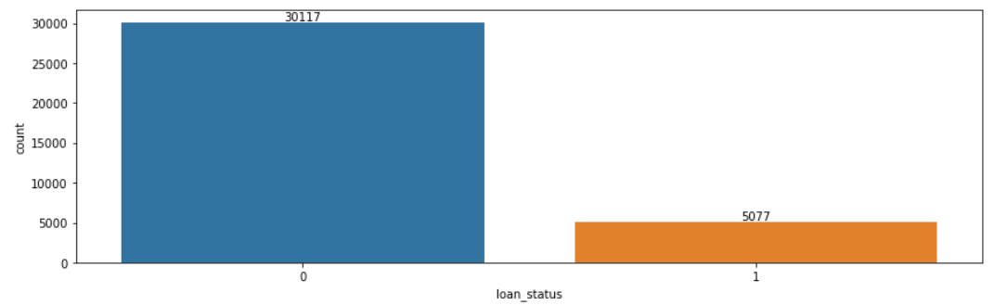
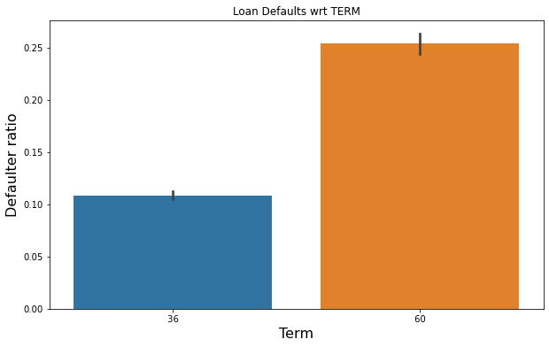
Exploratory Data Analysis (EDA) Univariate Analysis - 1
Distribution of Loans by Loan Status
Observation:
Defaulted loans a.k.a Charged Off loans are less when compared to Fully paid loans
Defaulters group by loan term
Observation:
When compared to 36 months tenure, 60 months term loans are more defaulted.

Slide 8
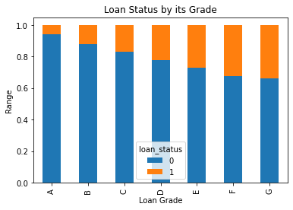
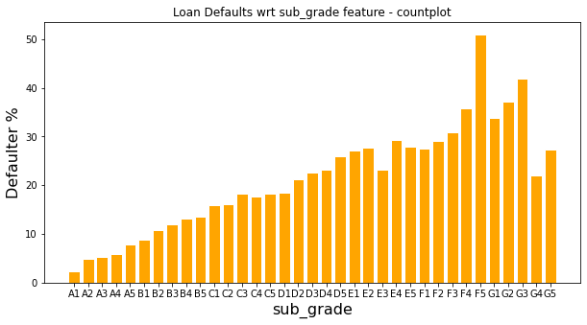
Exploratory Data Analysis (EDA) Univariate Analysis - 2
Loan Status by Loan Grade
Observation:
Loans with LOW grades (towards grade A) are resulting into highly probable fully paid loans.
Loans with HIGH grades (towards grade G) are highly potential as "Defaulted“ loans.
Defaulted loans (%) by "sub Grades"
Observation:
Loan Sub Grades dimension is a great indicative and Defaulted loans are gradually increasing from A1 towards G5 sub grade.

Slide 9
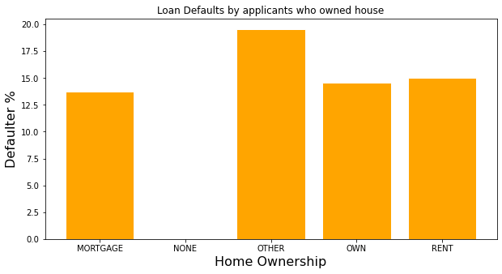
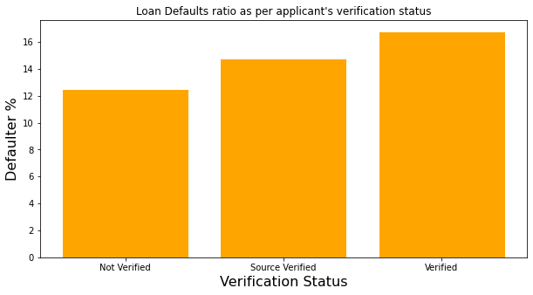
Exploratory Data Analysis (EDA) Univariate Analysis - 3
Defaulted loans (%) as per applicant's home ownership status
Observation:
Home ownership dimension is not helpful to find any risk trends as we observe defaulted loans in every category of home ownership
Defaulted loans (%) basing on applicant's Verification Status
Observation: Similar to Home ownership dimension observation, Verification Status is also not helpful to find any risk trends as we observe defaulted loans in every category of this dimension.

Slide 10
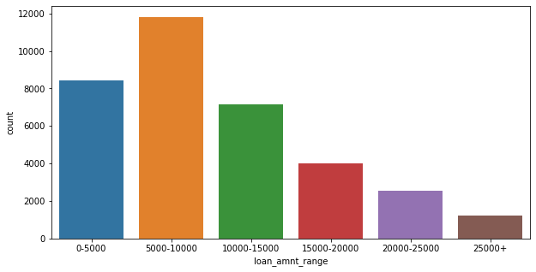
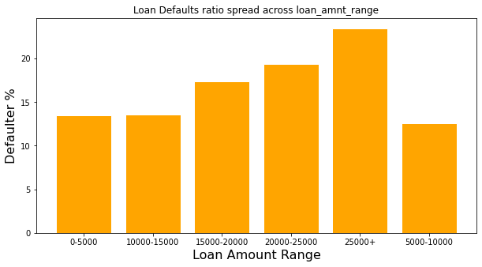
Exploratory Data Analysis (EDA) Univariate Analysis - 4
Loan amount range distribution and find any risk indicators
Observation:
Majority of the loans given in the range of 5k to 10k.
But, we observe defaulters are spread across every range, though 25k+ is dominated followed by 15k-20k and 20k to 25k range.
Hence, Loan Amount Range doesn't give any specific clear risk indicator

Slide 11
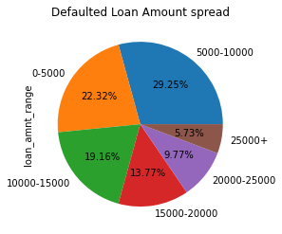
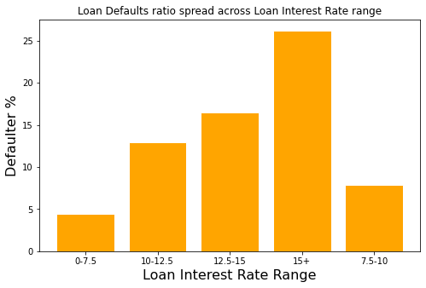
Exploratory Data Analysis (EDA) Univariate Analysis - 5
Defaulted Loans Amount Range
Observation:
Loan amount 5k-10k range is dominated followed by 0-5k and 10k-15k
Defaulted Loans spread across Loan Interest range
Observation:
Rate of Interest seems directly proportional to get the loan defaulted as we observe highest rate of interest is having more number of defaulters.
Lowest defaulters' loan interest rate is between 0 to 7.5, while highest is at 15+ rate of interest.
Largest chunk of defaulters interest rate is above 12.5.

Slide 12
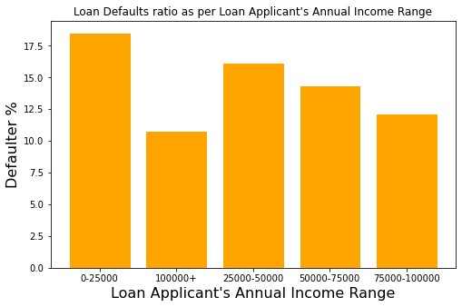
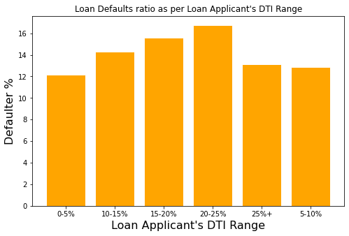
Exploratory Data Analysis (EDA) Univariate Analysis - 6
Defaulted Loans spread across various Annual Income Range
Observation: We have Defaulters spread across every range of applicant's annual income. So, this annual income range dimension is not a dominating factor to realize defaulted loans.
Not a potential risk indicator
Defaulted Loans spread across various DTI Range
Observation: We have Defaulters spread across every range of applicant's DTI. So, this DTI range dimension is not a dominating factor to realize defaulted loans.
Not a potential risk indicator

Slide 13
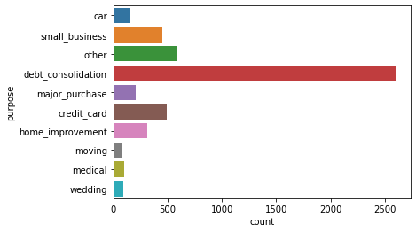
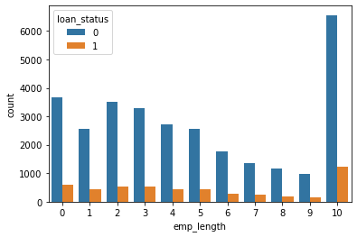
Exploratory Data Analysis (EDA) Univariate Analysis - 7
Defaulted Loans across various "loan purposes" being called out while applying the loan
Observation: Very clear indication that "DEBT CONSOLIDATION" purpose is dominated need for applying loans and the same is acting as major cause to have defaulted loans.
So, this is an important risk indicator to secure from defaulted loans
Loan Status as per applicant's employment tenure
Observation: Clearly evident that 10 and above experienced applicant's are becoming defaulters on their loans.
So, Financial institutions need to observe closely before they approve the loan.

Slide 14
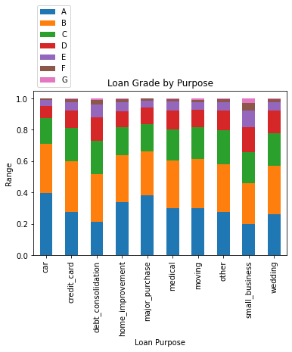
Exploratory Data Analysis (EDA) Univariate Analysis - 8
Crosstab on Loan Grade by Loan Purpose
Observation:
This stacked bar chart depicts loan purpose and grade it belongs to.
Debt consolidation need is the most dominant purpose to apply loans.
Across any loan purpose, majority is contributed from Grades A, B, and C.
Loans for credit card payments is highest in the E and F loan grades, while the proportion of loans for home improvement and small business are highest in the G loan grade.
These are very important risk factors to consider while underwriters are analyzing the loan application and taking the final decision.
They may have to increase the interest rate to mitigate risks based on the purpose they apply for loan. But, this also might not be helpful to avoid Credit Losses.

Slide 15
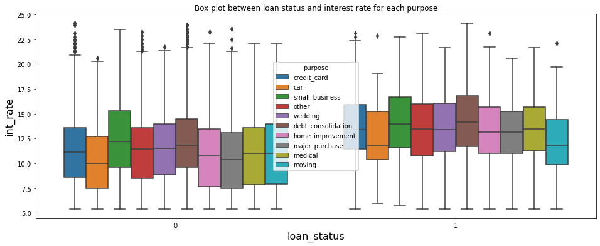
Exploratory Data Analysis (EDA) Bivariate Analysis - 1
Box plot between Loan Status and Interest Rate for each Loan Purpose
Observation: Most importantly, If loan Interest rate increases, then corresponding loan may potentially get defaulted. This scenario seems valid for any kind of loan purpose.
So, it is critical for companies not just simply increase the Rate of Interest (RoI) to mitigate the risk, which may deviate their hypothesis and lead towards facing high number of defaulted loans.

Slide 16
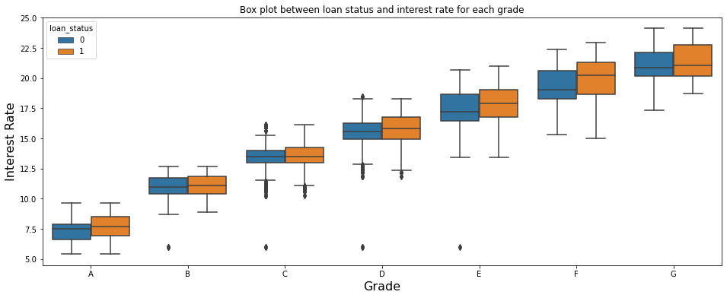
Exploratory Data Analysis (EDA) Bivariate Analysis - 2
Box plot between Loan Status and Grade for each Interest Rate
Observation:
Grade and Interest rate are proportional which leads to face high number of defaulters.
Interest rate is increasing for every grade and also the defaulters for every grade are having their median near the non-defaulter 75% quantile of int_rate.

Slide 17
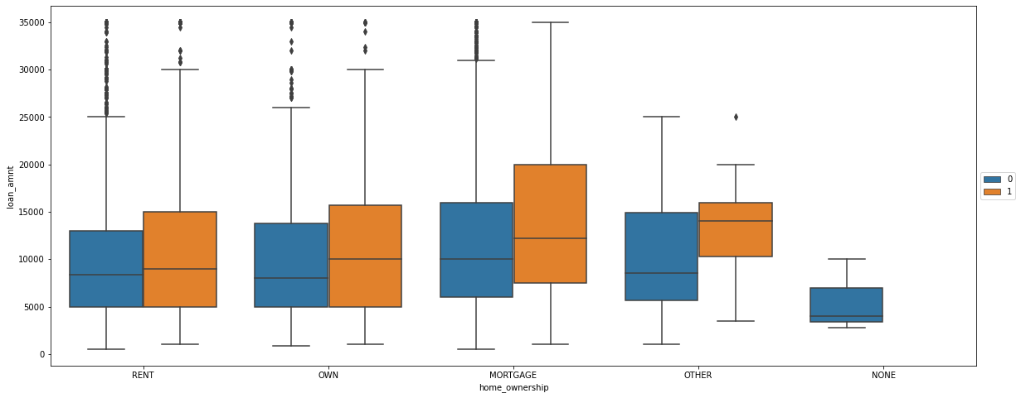
Exploratory Data Analysis (EDA) Bivariate Analysis - 3
Box plot between Home Ownership and Loan Amount for Loan Status
Observation: Out of all types of Home Ownership, loan applicants who has Mortgage are taking high amount as loan and also, they are potential defaulters too.

Slide 18
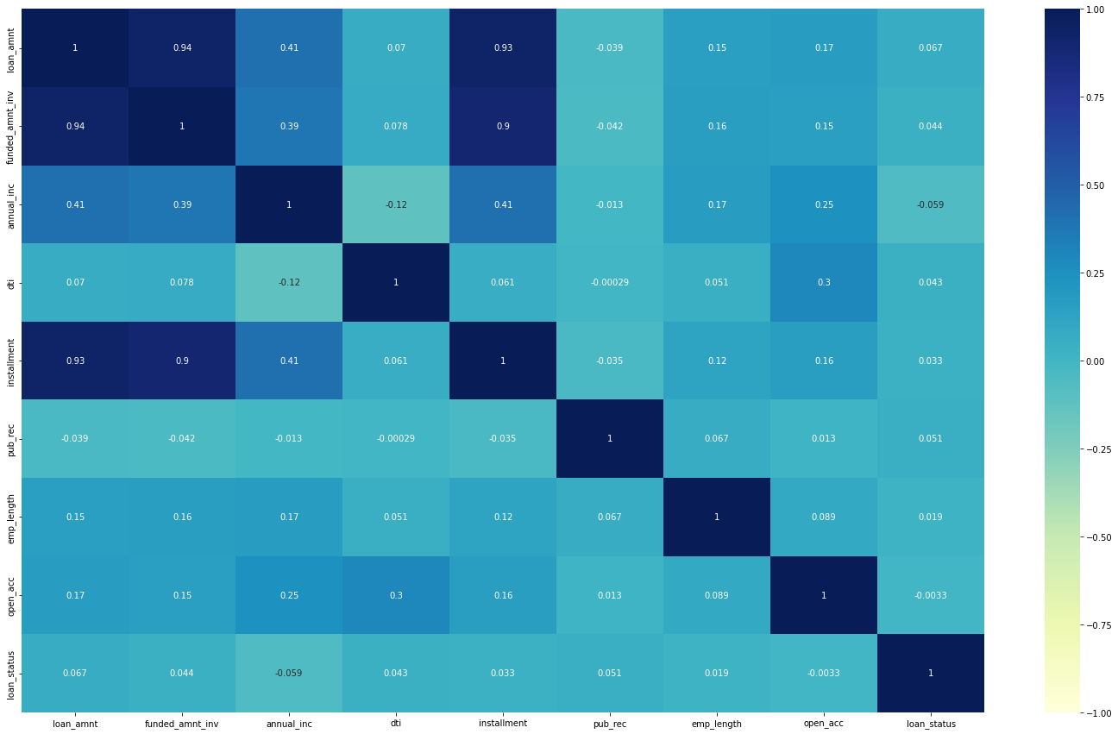
Exploratory Data Analysis (EDA) Correlation Analysis (Multivariate)
Generate the heat map for columns: 'loan_amnt','funded_amnt_inv','annual_inc', 'dti', 'installment','pub_rec', 'emp_length','open_acc','int_rate_range', 'loan_status'
Observation:
Highest positive correlation between loan_amnt, funded_amnt_inv and installment
Negative correlation is between annual_inc and dti

Slide 19
Conclusion with Recommendation
As per the given source loan data, following are few factors / risk indicators which conveys potential loan default scenarios.
High Interest Rate (especially beyond ~13%)
High Annual Income (35+ k Annual income range)
Long Term Loans (60 months)
Loan purpose to consolidate debts and for credit card bill payments
Loan applications from Highly experienced employees who are taking high amounts (better to avoid to mitigate risk) and High Annual Income
In summary, Annual Income, Home Ownership, Purpose of Loan, Loan Amount, Interest Rate, and Loan Term are critical factors to be considered by Company’s Underwriters who perform Risk analysis and decide whether to “accept” or “reject” the loan application.
Final recommendation as per this EDA is to consider the above set of attributes as driving factors (or driver variables) behind loan default, i.e. the variables which are strong indicators of default. Hence, this Lending company can refer this above during upcoming loan application’s risk assessment.

Slide 20
Thanks

