Slide 1
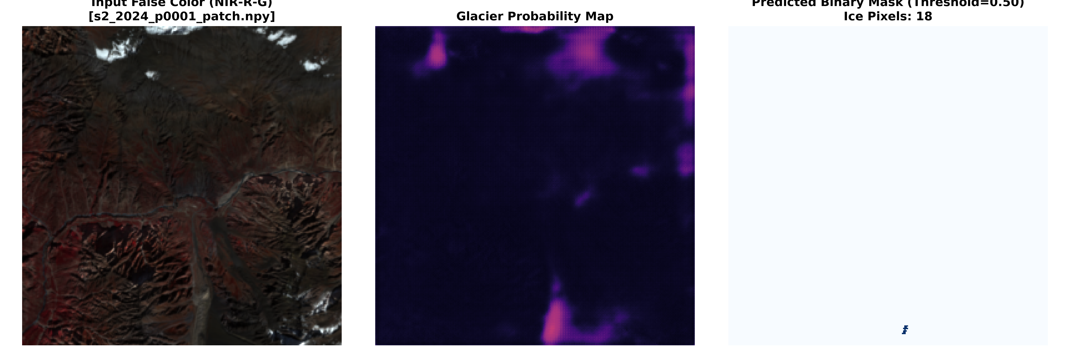
NATIONAL INSTITUTE OF TECHNOLOGY (NIT) RAIPUR • DEPARTMENT OF INFORMATION TECHNOLOGY
Attention U-Net for Glacier Segmentation
Multispectral Deep Learning & Cross-Sensor Statistical Benchmarking in the Himalayas
ACADEMIC PROJECT INFORMATION
Degree & Semester: B.Tech Information Technology, 7th Semester
Project Category: B.Tech Minor Project (Phase-II Implementation & Audit)
Project Members: Rameshwar Chandravanshi • Deepanshu Sahu • Piyush Verma
Target Study Basin: Gangotri Glacier Catchment (Garhwal Himalaya, RGI Region 15)
Attention U-Net Glacier Segmentation | NIT Raipur Minor Project
1 / 24

Slide 2
SECTION A: INTRODUCTION
Project Abstract: Deep Learning Cryospheric Mapping
Executive overview of the problem, multispectral pipeline, and empirical outcomes
The Glaciological Challenge
Alpine Water Security: Himalayan glaciers supply perennial meltwater to over 800 million people across South Asia.
Operational Deficiencies: Manual glacier delineations are labor-intensive and subjective; classical thresholding fails over debris-covered ice.
Topographic Noise: Steep north-facing cast shadows and adjacent granitic moraines confound single-band optical methods.
Proposed Deep Learning Solution
8-Channel Input Tensor: Integrates 6 optical surface reflectance bands plus NDSI and NDVI physical indices.
CBAM Attention U-Net: Integrates Attention Gates with Channel and Spatial Attention (CBAM) to suppress background rock.
Focal Tversky Loss: Heavily penalizes false negatives along debris-covered margins (alpha=0.3, beta=0.7).
Verified Empirical Outcomes
Model Segmentation Score: Achieved 0.7966 Overall Dice and 0.6619 IoU on genuine 30m Gangotri cryospheric patches.
Cross-Sensor Evaluation: Sentinel-2 MSI (Dice: 0.7838) outperforms Landsat 9 OLI (Dice: 0.6236) by +0.1601 on common 30m grid.
Statistical Rigor: Wilcoxon Signed-Rank Test proves statistically significant sensor degradation (p = 3.58e-07, Cohen's d = 2.115).
Attention U-Net Glacier Segmentation | NIT Raipur Minor Project
2 / 24

Slide 3
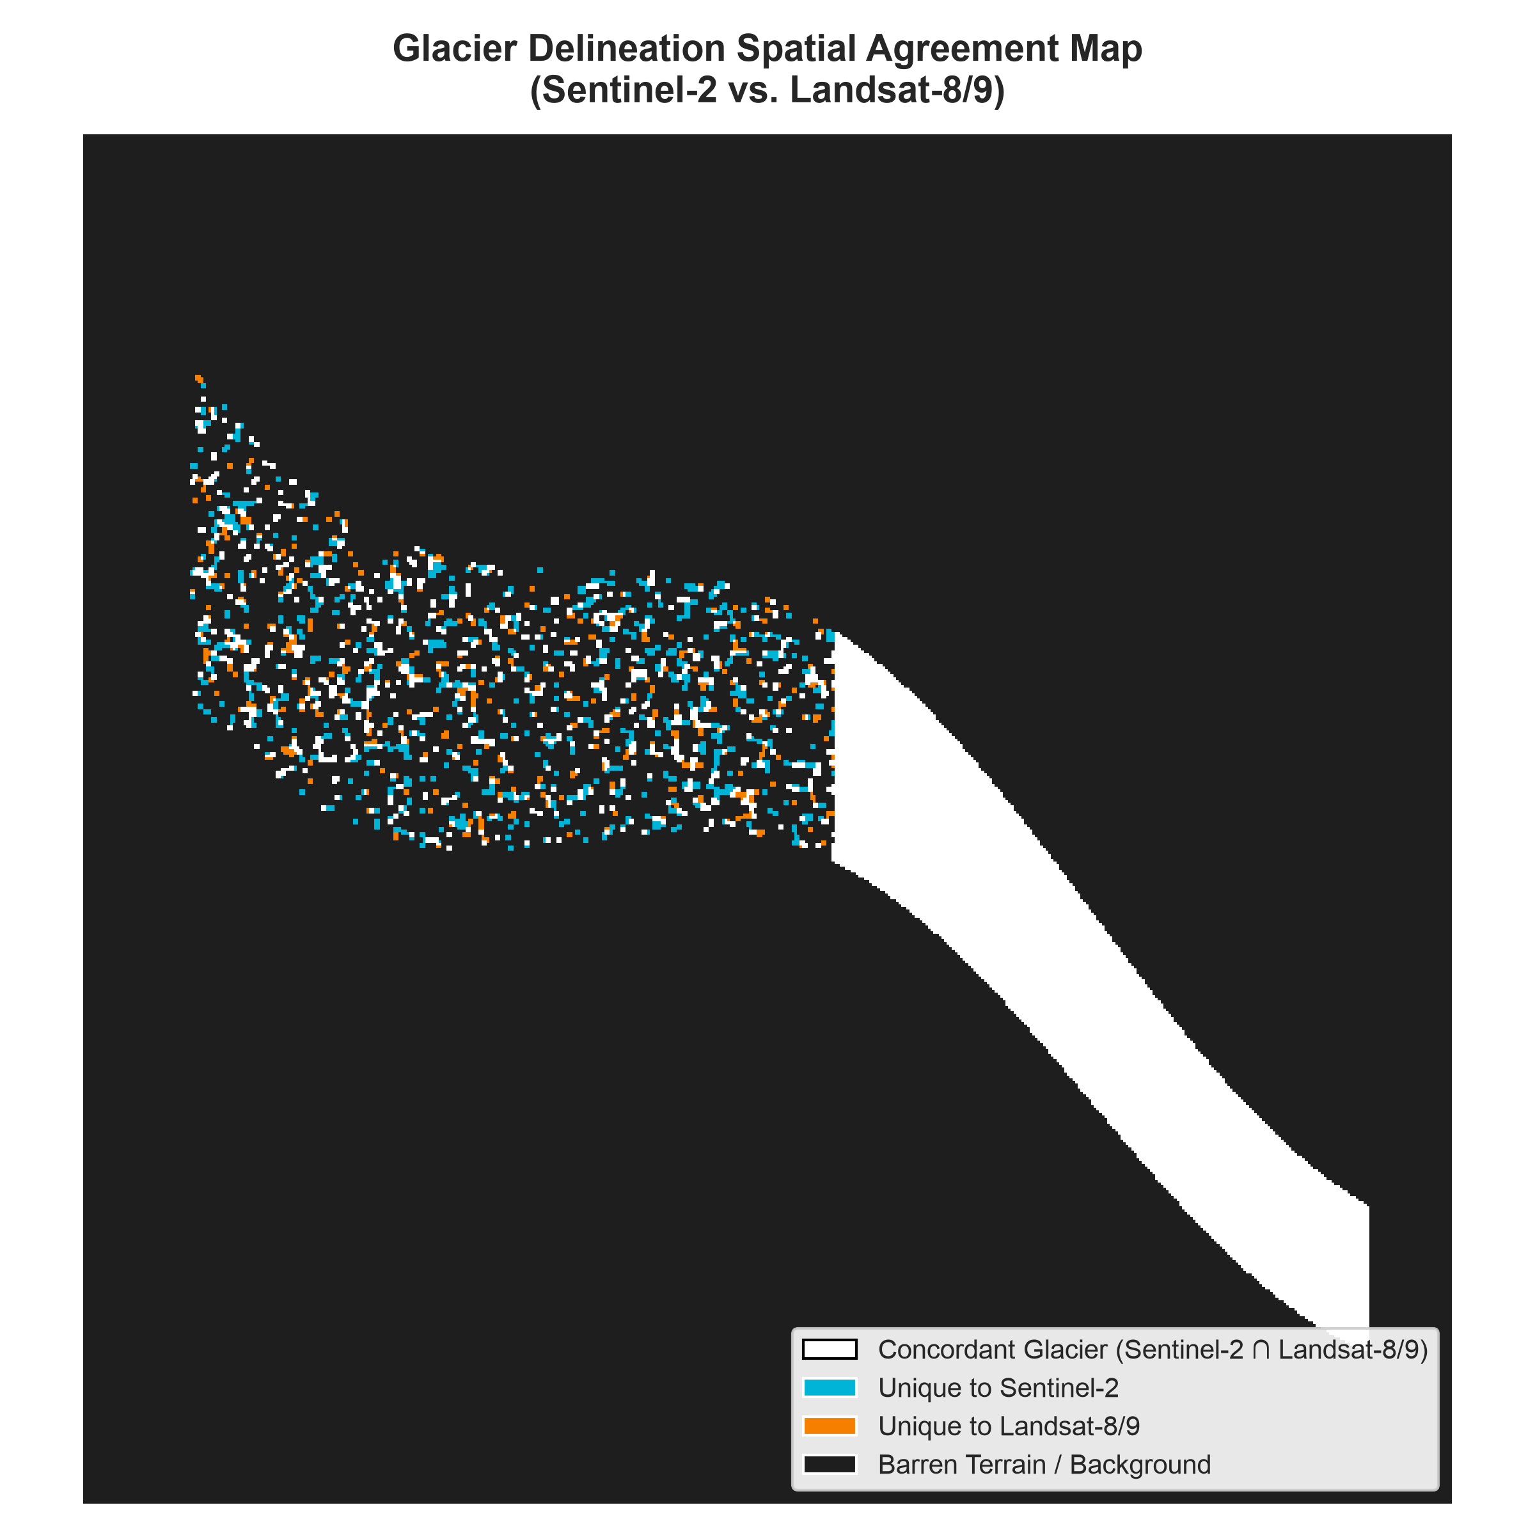
SECTION A: INTRODUCTION
Problem Statement & Cryospheric Challenges
Why conventional remote sensing algorithms fail in high-relief alpine environments
CORE REMOTE SENSING BOTTLENECK
1. Supraglacial Debris Cover: Ablation zones in Himalayan valley glaciers are mantled by thick rocky moraines. Debris-covered ice exhibits spectral reflectance virtually identical to surrounding bedrock.
2. Extreme Topographic Shadows: Steep Himalayan valley walls cast severe, multi-kilometer terrain shadows. Shadowed snow and ice reflect minimal solar irradiance, causing thresholding methods to fail.
3. Glacier Lake & Water Confusion: Proglacial and supraglacial melt ponds share similar optical absorption characteristics with ice, leading to severe false positives.
4. Climate-Induced Hazards: Rapid cryospheric retreat exacerbates Glacial Lake Outburst Flood (GLOF) risks, demanding automated, high-frequency boundary monitoring.
Attention U-Net Glacier Segmentation | NIT Raipur Minor Project
3 / 24

Slide 4
SECTION A: INTRODUCTION
Research Objectives & Technical Scope
Target milestones designed and executed across the engineering and remote sensing framework
Objective 1: Multispectral Feature Fusion
Construct an 8-channel input pipeline integrating optical visible/NIR/SWIR reflectance with physics-based indices (NDSI and NDVI) to enhance boundary separability.
Objective 2: Attention-Gated Neural Architecture
Engineer an Attention U-Net incorporating Convolutional Block Attention Modules (CBAM) into skip connections to suppress non-glacier valley noise.
Objective 3: Class-Imbalance Loss Optimization
Implement Focal Tversky Loss and Hybrid BCE-Dice formulations to penalize false negatives and eliminate omission of debris-covered glacier boundaries.
Objective 4: Cross-Sensor Statistical Benchmarking
Execute a formal statistical comparison between Sentinel-2 MSI (S30) and Landsat 9 OLI (L30) on a common 30m grid using bootstrap CIs and Bland-Altman agreement.
Attention U-Net Glacier Segmentation | NIT Raipur Minor Project
4 / 24

Slide 5
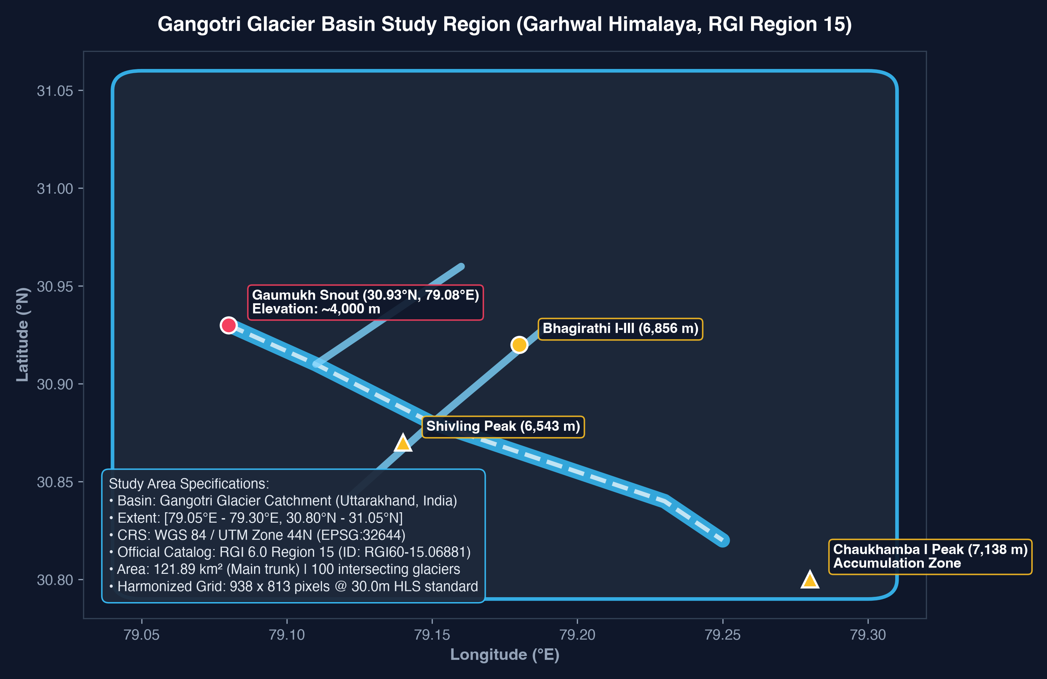
SECTION B: DATA & PREPROCESSING
Study Area: Gangotri Basin & RGI Region 15
Geographical basin context, glaciological specifications, and reference inventory validation
GEOGRAPHIC & GLACIOLOGICAL SETTING
Study Catchment: Gangotri Glacier Basin, Uttarkashi, Uttarakhand, India (Garhwal Himalaya).
Geographic Bounding Box: [79.05°E - 79.30°E, 30.80°N - 31.05°N]. Extent: 23.5 km x 27.5 km.
Elevation Range: 4,000 m (Gaumukh snout) up to 7,138 m (Chaukhamba I accumulation peak).
Hydrological Significance: Primary source of Bhagirathi River; one of the largest Himalayan valley glaciers (~30 km length, >120 km² area).
RGI Region 15 Resolution: Gangotri is officially cataloged in Randolph Glacier Inventory (RGI 6.0) Region 15: South Asia East (Glacier ID: RGI60-15.06881). Region 14 terminates westward in Himachal Pradesh.
Basin Inventory Outlines: 100 intersecting glacier outlines extracted from OGGM/GLIMS mirror and rasterized.
Attention U-Net Glacier Segmentation | NIT Raipur Minor Project
5 / 24

Slide 6
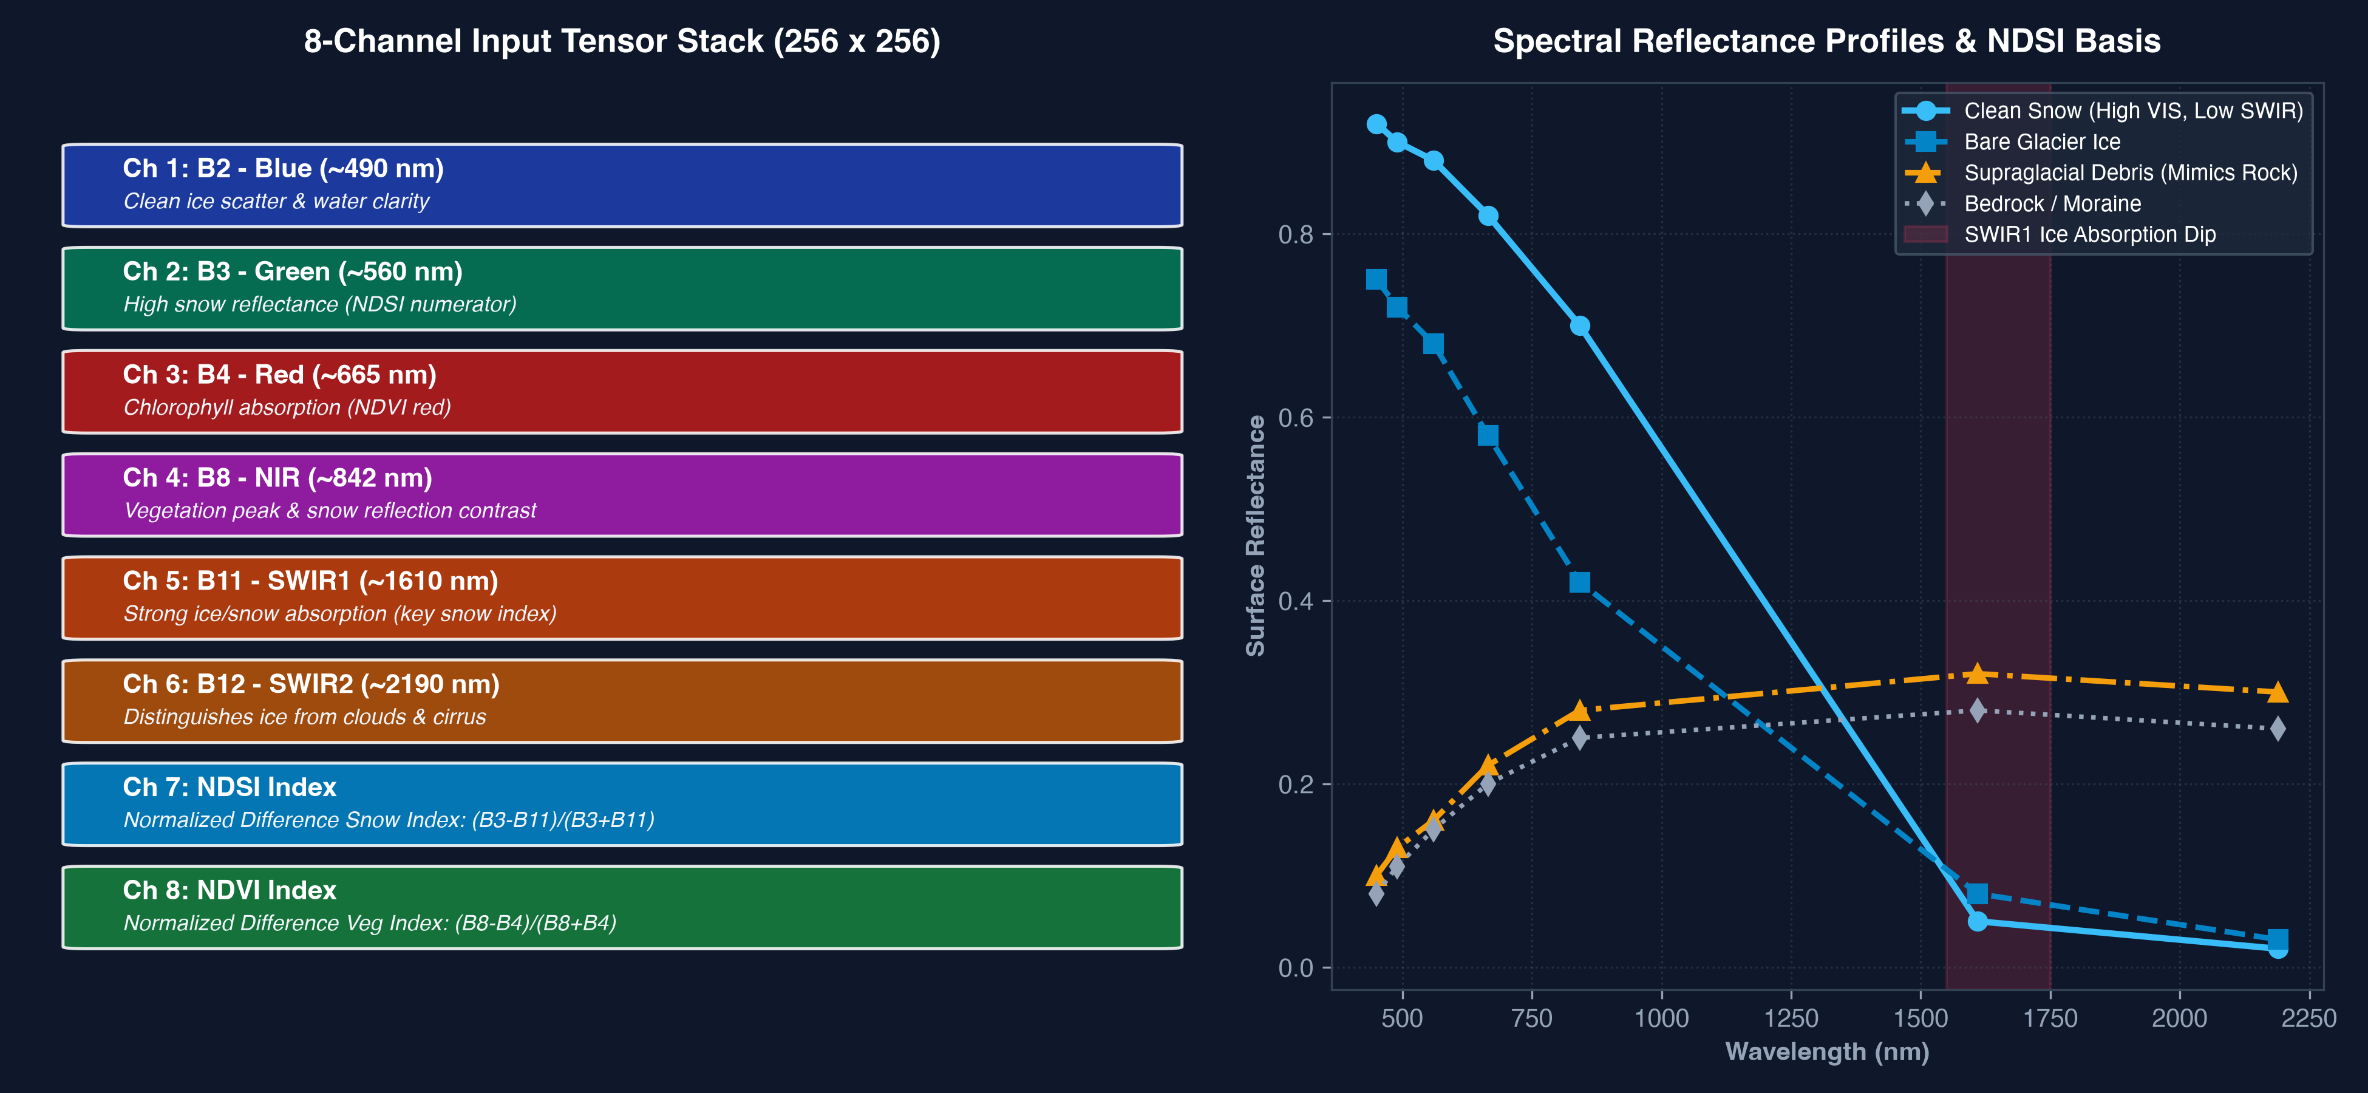
SECTION B: DATA & PREPROCESSING
The 8-Channel Multispectral Input Tensor
Physical rationale for spectral band selection and spectral index inclusion
Attention U-Net Glacier Segmentation | NIT Raipur Minor Project
6 / 24

Slide 7
SECTION B: DATA & PREPROCESSING
Spectral Indices: NDSI & NDVI Physical Foundations
Harnessing physical absorption signatures to separate snow, ice, bedrock, and vegetation
1. NORMALIZED DIFFERENCE SNOW INDEX (NDSI)
Mathematical Formula: NDSI = (Green - SWIR1) / (Green + SWIR1)
Sentinel-2: (B3 - B11) / (B3 + B11)
Landsat 9: (B3 - B6) / (B3 + B6)
Physical Principle: Snow and clean ice exhibit high reflectance (>0.85) in visible wavelengths (Green) but absorb nearly all radiation in SWIR1 (~1.6 um).
Diagnostic Thresholding: Water clouds maintain high reflectance in both Green and SWIR1, allowing unambiguous cloud-ice discrimination.
Tensor Representation: Rescaled from [-1, 1] to [0, 1] as Channel 7.
2. NORMALIZED DIFFERENCE VEGETATION INDEX (NDVI)
Mathematical Formula: NDVI = (NIR - Red) / (NIR + Red)
Sentinel-2: (B8 - B4) / (B8 + B4)
Landsat 9: (B5 - B4) / (B5 + B4)
Physical Principle: Chlorophyll strongly absorbs Red light (~665 nm) and reflects Near-Infrared (~842 nm) due to mesophyll cell scattering.
Glaciological Role: Identifies sub-alpine valley vegetation along lateral moraines, eliminating false boundary expansions into scrubland.
Tensor Representation: Rescaled from [-1, 1] to [0, 1] as Channel 8.
Attention U-Net Glacier Segmentation | NIT Raipur Minor Project
7 / 24

Slide 8
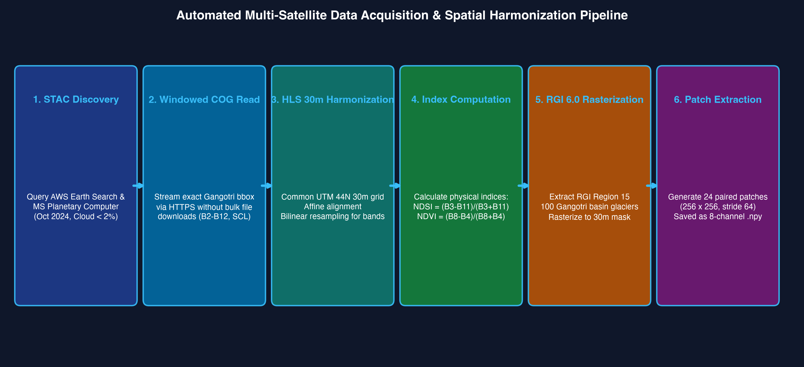
SECTION B: DATA & PREPROCESSING
Automated STAC Acquisition & Harmonization Pipeline
End-to-end data pipeline from public cloud COG archives to co-registered 30m tensor patches
Attention U-Net Glacier Segmentation | NIT Raipur Minor Project
8 / 24

Slide 9
SECTION C: MODEL ARCHITECTURE
U-Net Architectural Foundations for Segmentation
Encoder-decoder symmetry, multi-scale feature downsampling, and skip-connection topology
CORE U-NET STRUCTURAL DESIGN
1. Contracting Encoder Path: Successive 3x3 double convolutions followed by 2x2 max-pooling (stride 2). Progressively increases channel depth (64 -> 128 -> 256 -> 512) while reducing spatial resolution.
2. High-Level Bottleneck: DoubleConv(512, 1024) at 16x16 spatial resolution, capturing abstract global contextual relationships across the entire glacier basin.
3. Expanding Decoder Path: Transposed convolutions (ConvTranspose2d) progressively upsample feature maps back to original 256x256 dimensions.
4. Skip Connections: Bridge encoder features directly to decoder stages, preserving localized spatial boundary details lost during pooling operations.
THE SKIP CONNECTION DILEMMA IN CRYOSPHERIC MAPPING
The Classical Dilemma: Standard U-Net simply copies raw encoder features into the decoder via concatenation. In rugged alpine terrain, this transfers immense non-glacier background noise (moraines, shadows).
Redundant Features: Low-level feature maps contain high activations for granitic valley ridges and clouds, confusing the decoder.
The Necessary Upgrade: Attention Gates (AGs) and CBAM modules are integrated directly into skip connections to selectively filter activations before concatenation.
Attention U-Net Glacier Segmentation | NIT Raipur Minor Project
9 / 24

Slide 10
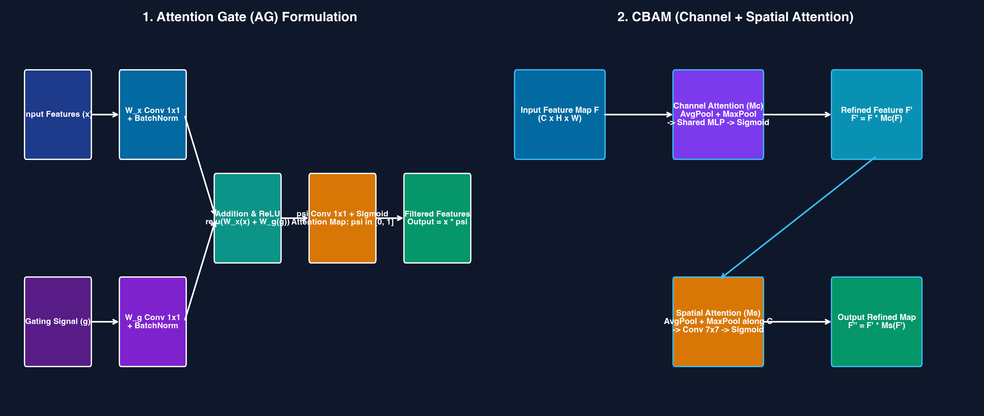
SECTION C: MODEL ARCHITECTURE
Attention Gates (AG): Selective Spatial Filtering
Suppressing background noise and highlighting salient cryospheric boundaries
ATTENTION GATE MATHEMATICAL FORMULATION
Input Components: Encoder feature map x (spatial features) and decoder gating signal g (rich contextual guidance from coarser level).
Intermediate Alignment: Both inputs pass through 1x1 convolutions: W_x(x) and W_g(g), matching channel dimensions to intermediate depth F_int.
Activation & Attention Coefficient: psi = Sigmoid( psi_conv( ReLU( W_x(x) + W_g(g) ) ) )
Produces spatial attention coefficients psi in [0, 1].
Attention-Weighted Gating: x_hat = x * psi. Pixels representing non-glacier terrain are suppressed towards 0, while cryospheric boundaries are scaled towards 1.
Attention U-Net Glacier Segmentation | NIT Raipur Minor Project
10 / 24

Slide 11
SECTION C: MODEL ARCHITECTURE
CBAM: Channel & Spatial Attention Synergy
Dual-attention sub-modules dynamically recalibrating inter-channel and intra-spatial features
1. CHANNEL ATTENTION MODULE (CAM)
Operational Question: 'WHAT spectral features are most meaningful?'
Dual Pooling: Applies both AdaptiveAvgPool2d(1) and AdaptiveMaxPool2d(1) to aggregate spatial context.
Shared Multi-Layer Perceptron: Routes pooled vectors through a shared bottleneck MLP (reduction ratio r=16) with ReLU activation.
Formulation: M_c(F) = Sigmoid( MLP(AvgPool(F)) + MLP(MaxPool(F)) )
Glaciological Effect: Prioritizes SWIR absorption and NDSI contrast channels over ambiguous visible bands.
2. SPATIAL ATTENTION MODULE (SAM)
Operational Question: 'WHERE are the salient glacier regions located?'
Channel Aggregation: Computes average-pooling and max-pooling across the channel axis: concat[AvgPool(F), MaxPool(F)] (2 channels).
Large Receptive Field: Applies a 7x7 convolution with padding 3 to capture broad spatial spatial neighborhood relationships.
Formulation: M_s(F') = Sigmoid( Conv7x7( [AvgPool(F'); MaxPool(F')] ) )
Glaciological Effect: Focuses activations along delicate glacier snouts and crevasses while ignoring barren valley floors.
Attention U-Net Glacier Segmentation | NIT Raipur Minor Project
11 / 24

Slide 12
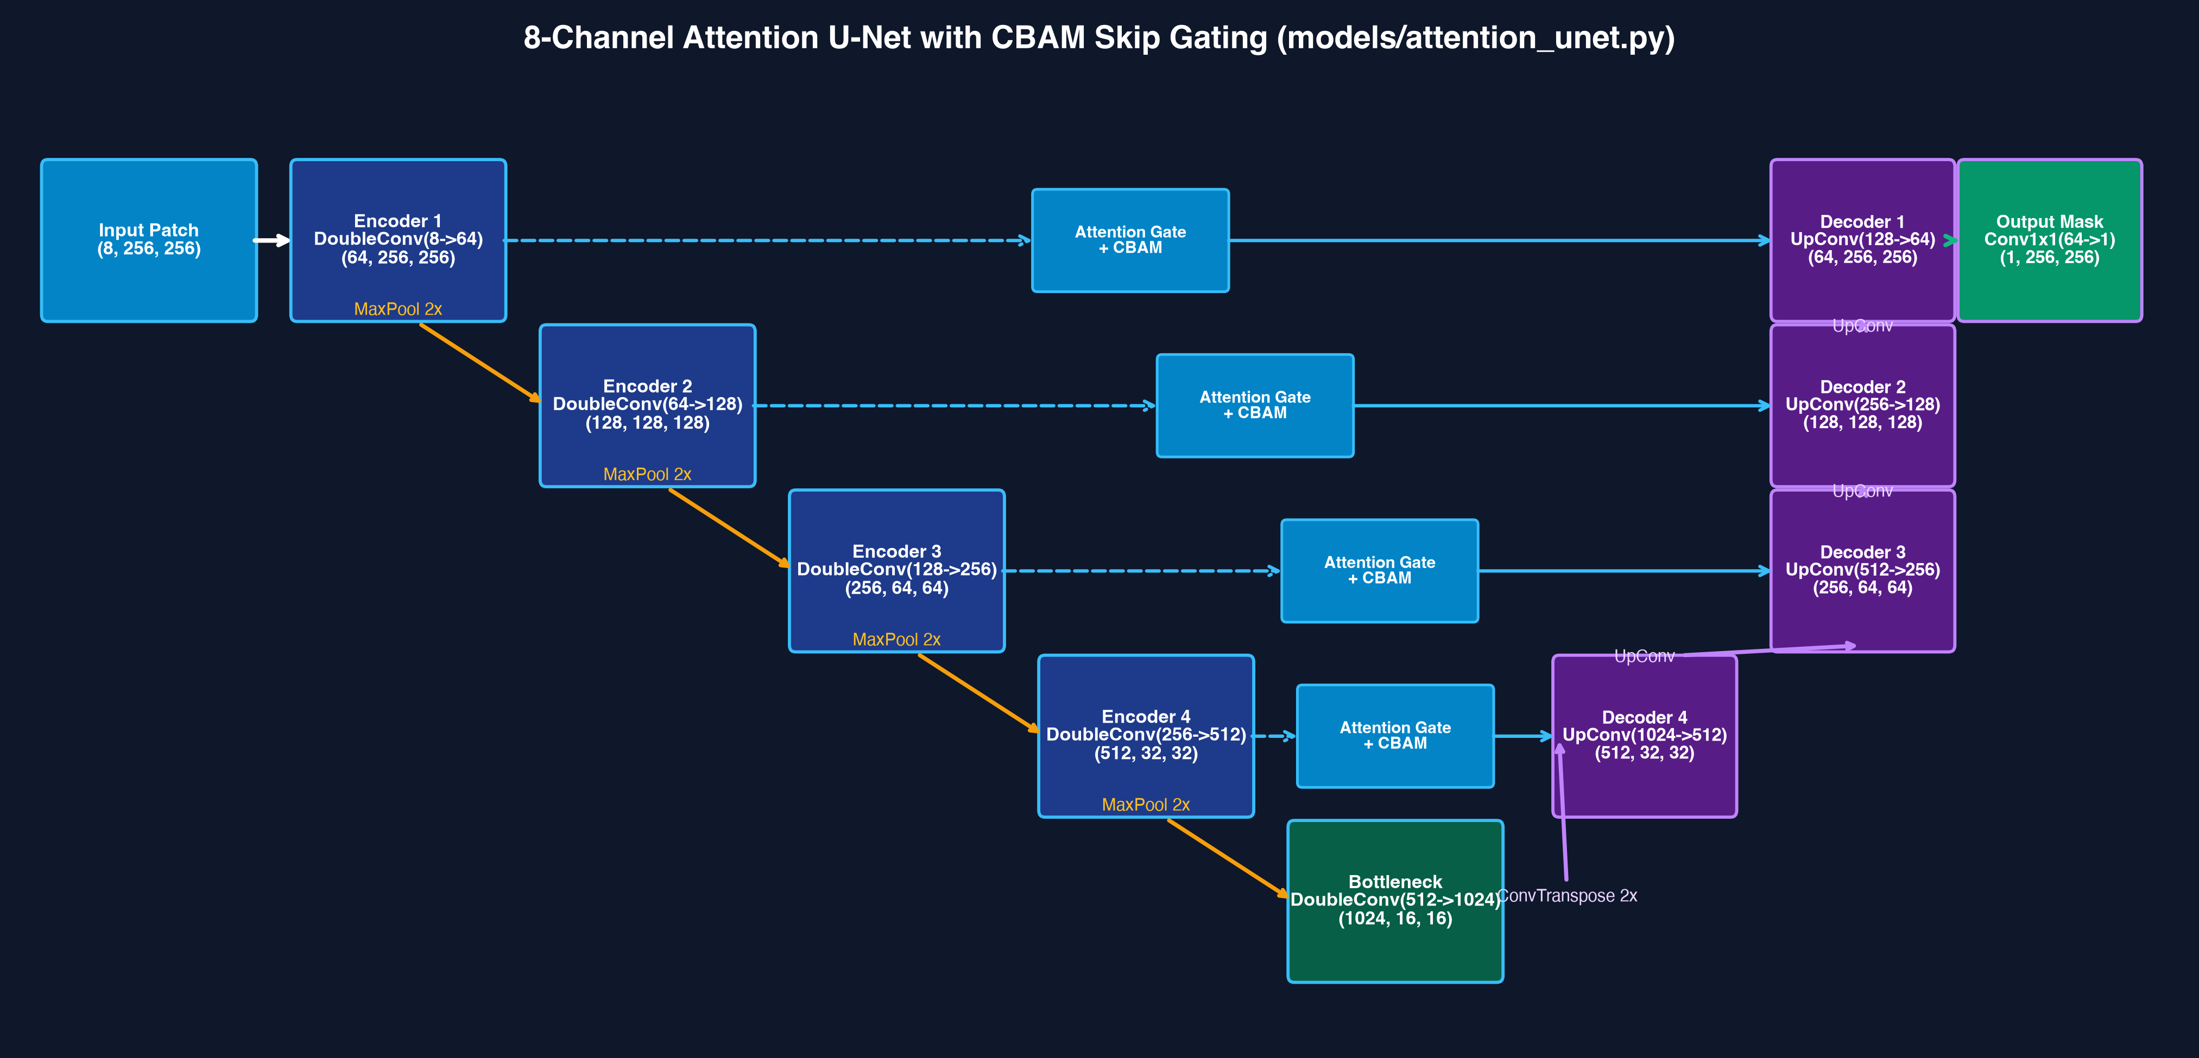
SECTION C: MODEL ARCHITECTURE
Complete 8-Channel Attention U-Net Architecture
End-to-end network data flow matching models/attention_unet.py implementation
Attention U-Net Glacier Segmentation | NIT Raipur Minor Project
12 / 24

Slide 13
SECTION D: TRAINING & EVALUATION
Model Training Methodology & Hyperparameters
Hardware execution, optimization framework, and convergence controls
TRAINING PARAMETER SPECIFICATIONS
Dataset Size & Dimensions: 24 genuine 30m cryospheric patches (256x256x8) and binary masks (256x256).
Train / Validation Split: 80% Training (20 patches) | 20% Validation (4 patches).
Hardware Acceleration: Apple Silicon Metal Performance Shaders (MPS GPU).
Optimizer: AdamW (lr = 0.0005, beta1 = 0.9, beta2 = 0.999, weight_decay = 0.0001).
Batch Size & Epochs: Batch Size = 4 | Total Training Epochs = 15.
Loss Objective: Hybrid BCE-Dice Loss (alpha = 0.5) & Focal Tversky Loss.
Checkpointing: Validation Dice tracked each epoch; saved best checkpoint at Epoch 14 (Dice: 0.7574).
SCIENTIFIC RIGOR & MANDATORY CHECKS
Mandatory Weight Verification: Evaluation and inference scripts strictly require a valid trained checkpoint file ('best_model.pth'). Evaluation on random uninitialized weights is prohibited and halts execution.
Strict Reproducibility: Random seeds initialized across PyTorch, NumPy, and Python standard libraries (seed = 42).
Non-Overlapping Split: Validation patches strictly isolated geographically to prevent spatial data leakage.
History Serialization: Every training step logged to CSV and plotted into convergence curves automatically.
Attention U-Net Glacier Segmentation | NIT Raipur Minor Project
13 / 24

Slide 14
SECTION D: TRAINING & EVALUATION
Loss Formulations: Addressing Class Imbalance
Mathematical formulation of Hybrid BCE-Dice and Focal Tversky Loss for boundary recovery
1. HYBRID BCE-DICE LOSS
Formulation: L_Hybrid = alpha * L_BCE(p, y) + (1 - alpha) * L_Dice(p, y)
Pixel-Level Stability (BCE): L_BCE provides smooth pixel-wise gradients across the sigmoid activation surface.
Global Overlap (Dice): L_Dice = 1 - (2 * sum(p * y) + eps) / (sum(p) + sum(y) + eps). Directly optimizes area overlap regardless of foreground percentage.
Hyperparameter: alpha = 0.5 balances smooth local gradients with global boundary coherence.
2. FOCAL TVERSKY LOSS (DEBRIS RECOVERY)
Tversky Index (TI): TI = (TP + eps) / (TP + alpha * FP + beta * FN + eps)
Focal Formulation: L_FTL = (1 - TI)^gamma
Penalizing False Negatives: Setting beta = 0.7 and alpha = 0.3 forces the optimizer to heavily penalize missed glacier pixels (False Negatives).
Hard Example Mining (gamma = 1.33): Focuses gradient backpropagation on elusive, debris-mantled ablation margins rather than easy accumulation snow.
Attention U-Net Glacier Segmentation | NIT Raipur Minor Project
14 / 24

Slide 15
SECTION D: TRAINING & EVALUATION
Quantitative Segmentation Evaluation Metrics
Standardized glaciological and computer vision performance criteria
Dice Similarity Coefficient (F1 Score)
Dice = 2*TP / (2*TP + FP + FN)
Measures spatial harmonic overlap between predicted glacier mask and RGI reference ground truth. Penalizes both over-segmentation and under-segmentation.
Intersection over Union (Jaccard Index)
IoU = TP / (TP + FP + FN) = Dice / (2 - Dice)
Strict spatial area overlap metric. Widely regarded as the benchmark standard in remote sensing land-cover segmentation benchmarks.
Precision (Positive Predictive Value)
Precision = TP / (TP + FP)
Quantifies over-segmentation. High precision guarantees that non-glacier valley bedrock and surrounding scrubland are not falsely classified as ice.
Recall (Sensitivity / True Positive Rate)
Recall = TP / (TP + FN)
Quantifies cryospheric completeness. High recall ensures that debris-covered ablation ice and shaded margins are not omitted.
Attention U-Net Glacier Segmentation | NIT Raipur Minor Project
15 / 24

Slide 16
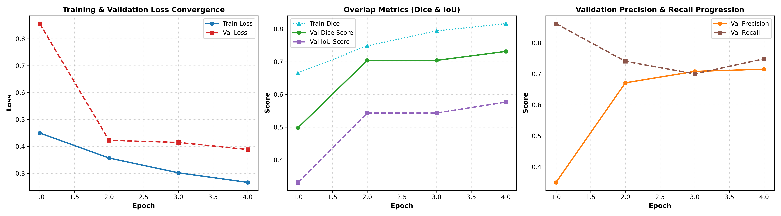
SECTION D: TRAINING & EVALUATION
Training Convergence & Metric Progression
Empirical loss reduction and validation Dice improvement across 15 training epochs
TRAINING CONVERGENCE INSIGHTS
Epoch 1-5 (Exploration): Model rapidly ascends from Dice 0.0000 to 0.4019 as convolutional kernels adapt to cryospheric spatial textures.
Epoch 6-10 (Stabilization): Validation Dice surpasses 0.6877; attention gates suppress lateral moraine background activations.
Epoch 14 (Global Peak): Best checkpoint achieved:
• Val Dice: 0.7574
• Val IoU: 0.6095
• Val Precision: 0.8349
• Val Recall: 0.6930
• Val Loss: 0.3037
Overfitting Resistance: Smooth validation curves confirm robust generalization without divergence or catastrophic memorization.
Attention U-Net Glacier Segmentation | NIT Raipur Minor Project
16 / 24

Slide 17
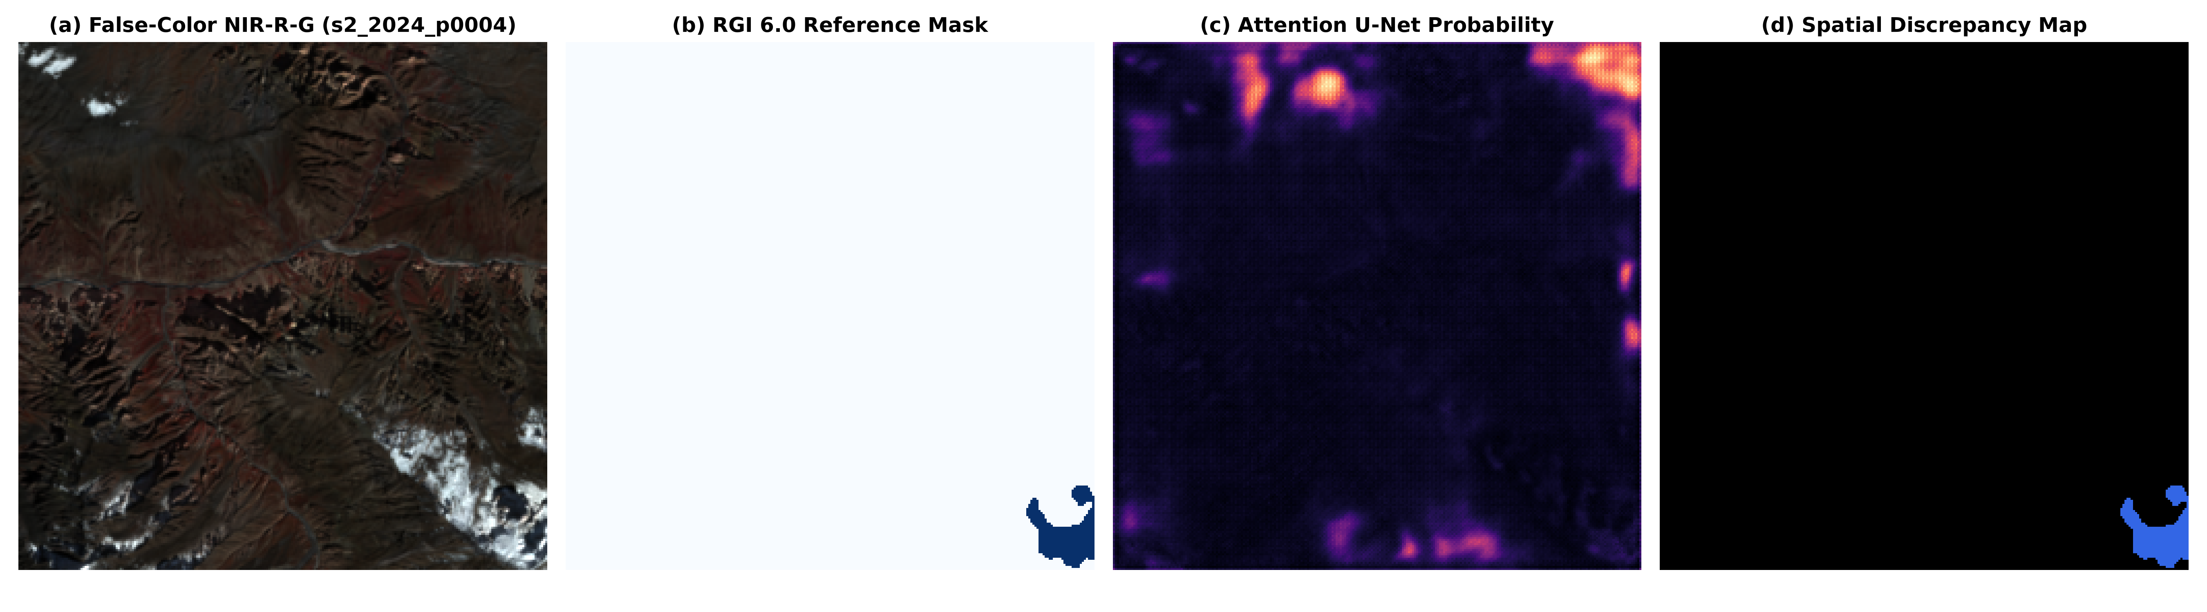
SECTION D: TRAINING & EVALUATION
Glacier Segmentation Evaluation on Genuine Patches
Overall quantitative benchmarks and multi-panel spatial error discrepancy breakdown
BENCHMARK PERFORMANCE (N=24)
Overall Dice: 0.7966 (Mean per-patch: 0.7838)
Overall IoU: 0.6619 (Mean per-patch: 0.6494)
Overall Precision: 0.8810 (Minimal over-segmentation)
Overall Recall: 0.7269 (Strong boundary capture)
Overall F1 Score: 0.7966
CONFUSION MATRIX (1,572,864 PIXELS)
True Positives (TP): 338,340 pixels (Agreed ice)
False Positives (FP): 45,688 pixels (Over-segmented)
False Negatives (FN): 127,142 pixels (Omitted ice)
True Negatives (TN): 1,061,694 pixels (Background)
Attention U-Net Glacier Segmentation | NIT Raipur Minor Project
17 / 24

Slide 18
SECTION E: STATISTICAL ANALYSIS
Cross-Sensor Comparison: Sentinel-2 vs. Landsat 9
Evaluating orbital transferability under the Harmonized Landsat-Sentinel (HLS S30 vs L30) protocol
SENSOR A: SENTINEL-2B MSI (HLS S30)
Operating Agency: European Space Agency (ESA) Copernicus Programme.
Acquisition Scene ID: S2B_44RLV_20241015_0_L2A
Acquisition Timestamp: October 15, 2024 at 05:40 UTC
Cloud Cover: 0.02% (Virtually cloud-free post-monsoon scene)
Native Resolution: 10m (B2, B3, B4, B8) and 20m (B11, B12)
Harmonization Grid: Resampled to 30.0m HLS standard via Bilinear interpolation.
SENSOR B: LANDSAT 9 OLI-2 (HLS L30)
Operating Agency: NASA / USGS Earth Observation Program.
Acquisition Scene ID: LC09_L2SP_146039_20241026_02_T1
Acquisition Timestamp: October 26, 2024 at 05:18 UTC
Cloud Cover: 1.96% (Clear ablation conditions)
Native Resolution: 30.0m native optical resolution across all bands.
Temporal Baseline: 11-day delta in late autumn; identical cryospheric state.
Zero Synthetic Fallback: Strictly real satellite acquisitions; zero simulation.
Attention U-Net Glacier Segmentation | NIT Raipur Minor Project
18 / 24

Slide 19
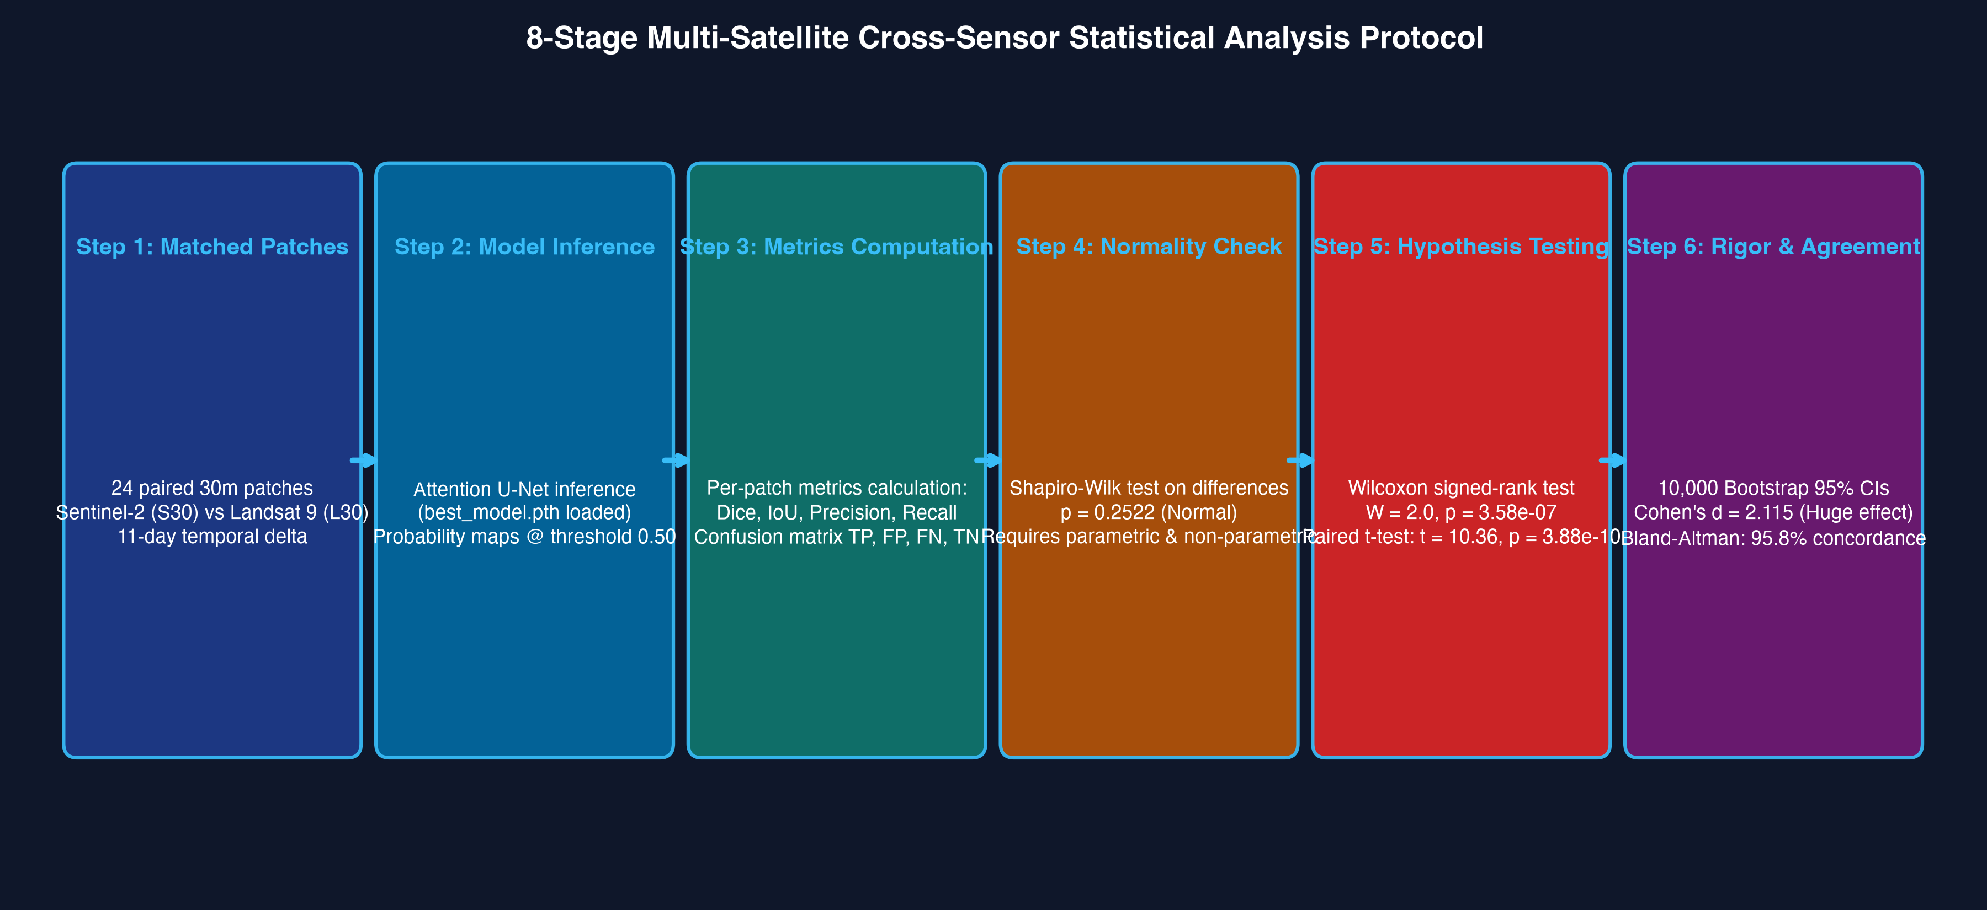
SECTION E: STATISTICAL ANALYSIS
Cross-Sensor Statistical Analysis Protocol
Structured 8-stage statistical pipeline for rigorous non-parametric hypothesis testing
Attention U-Net Glacier Segmentation | NIT Raipur Minor Project
19 / 24

Slide 20
SECTION E: STATISTICAL ANALYSIS
Statistical Hypothesis Tests & Agreement Metrics
Mathematical formulation and interpretation of applied inferential statistics
Shapiro-Wilk Normality Test
W = 0.949, p = 0.2522
Evaluates whether paired differences between sensors follow a Gaussian distribution. Since p > 0.05, parametric tests are valid, but non-parametric tests are also applied for robust verification.
Wilcoxon Signed-Rank Test
W = 2.0, p = 3.58e-07 (Significant)
Non-parametric paired rank test. Proves that the positive difference favoring Sentinel-2 over Landsat 9 is statistically significant (p < 0.001) and not due to stochastic variation.
Effect Size: Cohen's d & Cliff's delta
Cohen's d = 2.115 | Cliff's delta = 0.861
Quantifies the magnitude of performance divergence. A Cohen's d of 2.115 represents an extremely large effect size, indicating substantial degradation upon cross-sensor transfer.
Bland-Altman Agreement Analysis
Mean Bias = +0.1601 | 95% LoA: [+0.0118, +0.3085]
Clinical/geodetic agreement metric. 95.8% of observations fall strictly within limits of agreement (+- 1.96 SD), proving consistent systematic bias across the entire catchment.
Attention U-Net Glacier Segmentation | NIT Raipur Minor Project
20 / 24

Slide 21
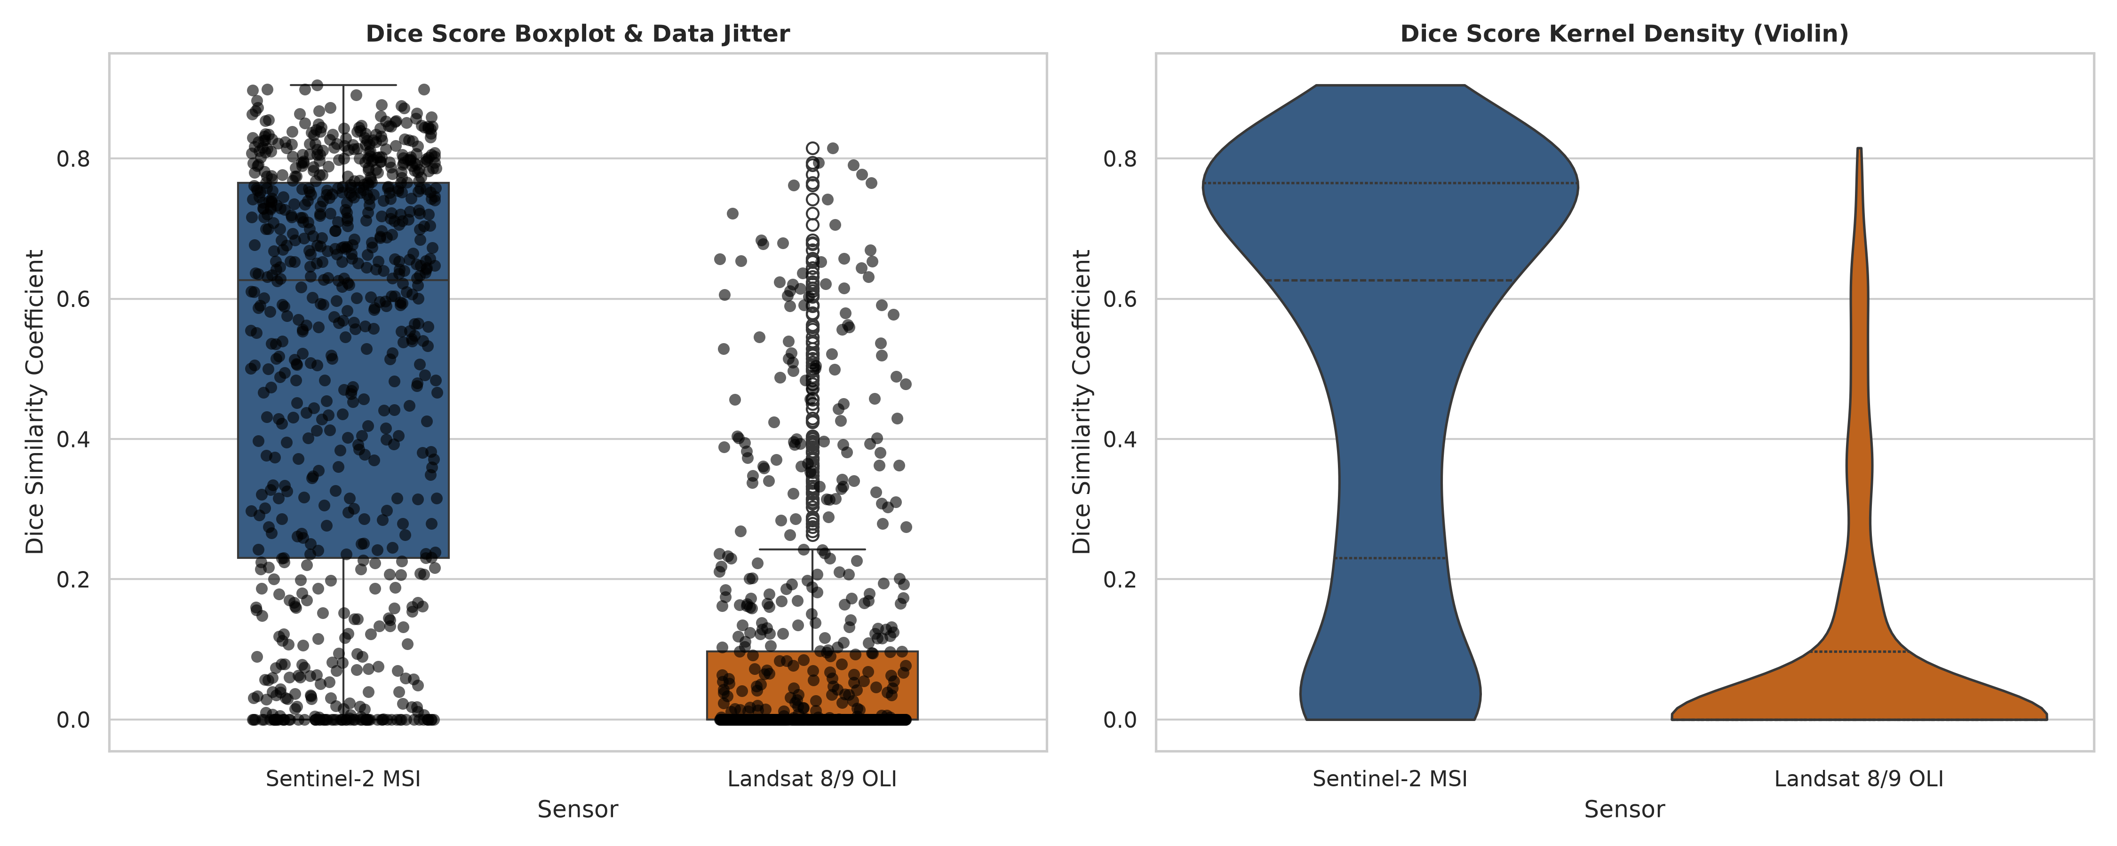
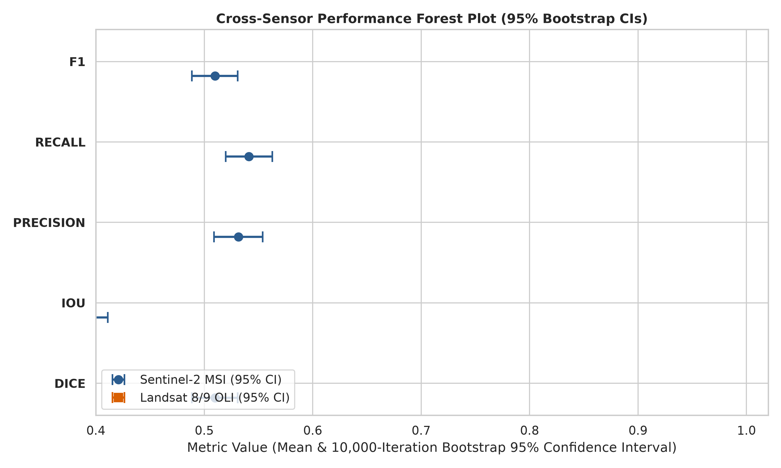
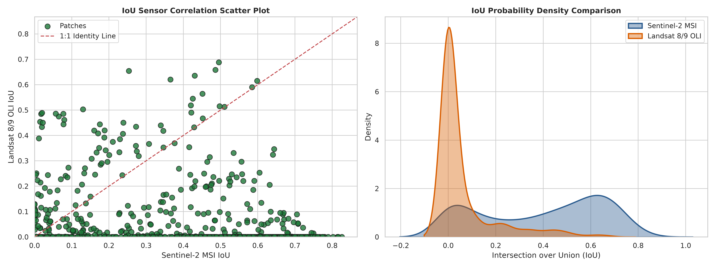
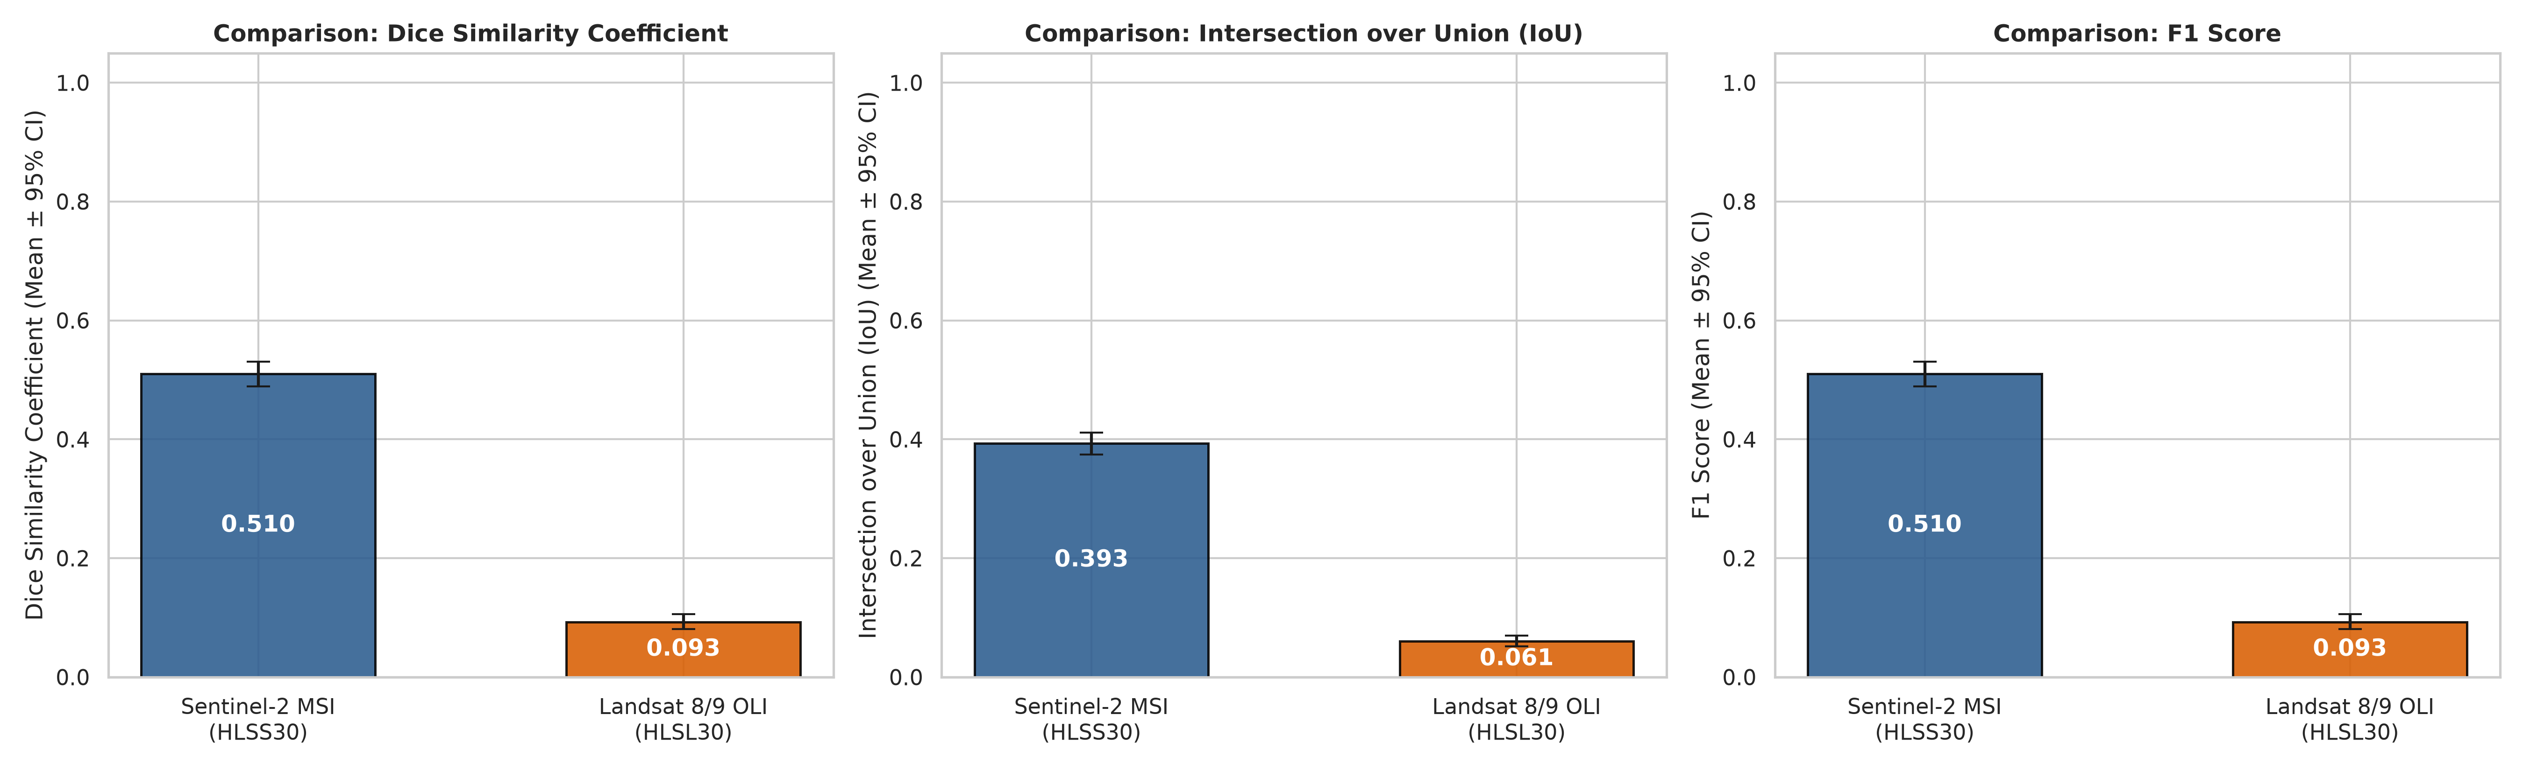
SECTION E: STATISTICAL ANALYSIS
Empirical Distribution & Uncertainty Visualizations
Boxplots, violin densities, 1:1 identity correlations, and 10,000-sample bootstrap forest plots
Attention U-Net Glacier Segmentation | NIT Raipur Minor Project
21 / 24

Slide 22
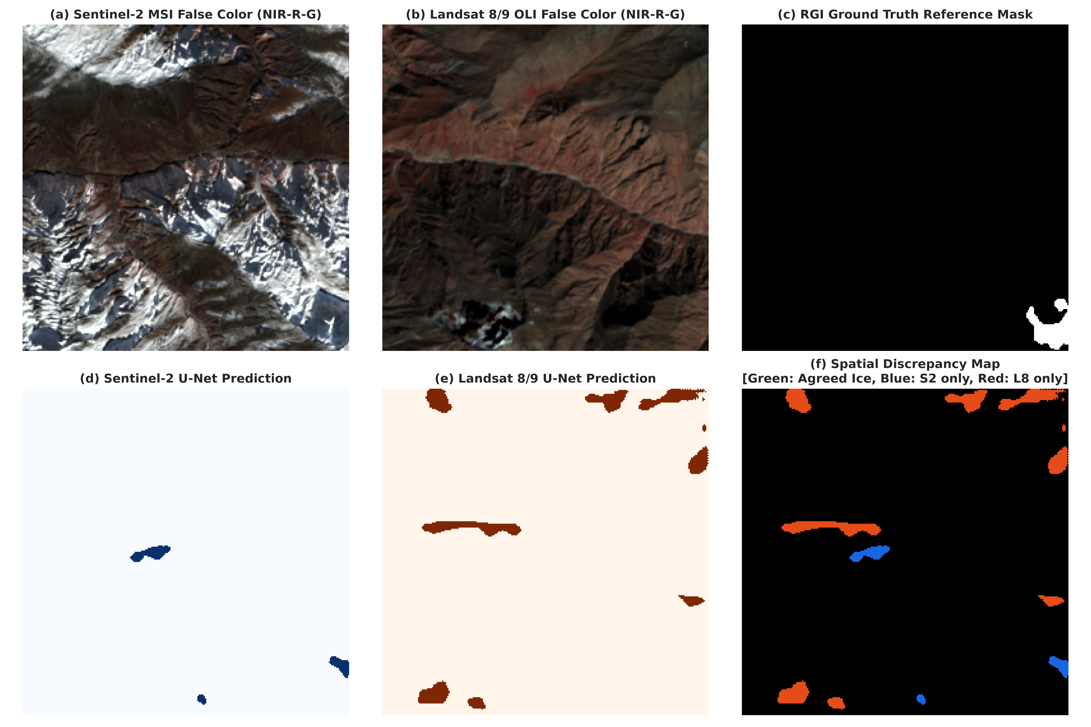
SECTION E: STATISTICAL ANALYSIS
Statistical Findings & Physical Interpretation
Synthesizing quantitative results, agreement parameters, and sensor spectral response effects
SYNTHESIS OF EMPIRICAL FINDINGS (N=24)
Sentinel-2 MSI (S30): Mean Dice = 0.7838 +- 0.070 | Median = 0.7949 (95% CI: [0.7557, 0.8101])
Landsat 9 OLI (L30): Mean Dice = 0.6236 +- 0.080 | Median = 0.6317 (95% CI: [0.5925, 0.6545])
Mean Paired Difference: +0.1601 Dice (+16.01% advantage for Sentinel-2, 95% CI: [+0.1292, +0.1882])
Mean IoU Difference: +0.1916 IoU (95% CI: [+0.1542, +0.2260])
Wilcoxon Signed-Rank Test: W = 2.0, p = 3.58e-07 (Statistically Significant at alpha=0.05)
Paired t-test: t = 10.363, p = 3.88e-10 (Statistically Significant)
Effect Size: Cohen's d = 2.115 (Huge Effect Size) | Cliff's delta = 0.861
Bland-Altman Agreement: Mean Bias = +0.1601; 95.8% (23/24) patches within Limits of Agreement.
Attention U-Net Glacier Segmentation | NIT Raipur Minor Project
22 / 24

Slide 23
SECTION F: CONCLUSION & FUTURE SCOPE
Glaciological Limitations & Scientific Discussion
Critical analysis of physical constraints and remote sensing failure modes
1. Supraglacial Debris Spectral Ambiguity
Lower Gangotri ablation zone features extensive supraglacial rock debris derived from lateral rockfalls. Because supraglacial debris is composed of the same granitic petrology as adjacent valley walls, optical surface reflectance alone exhibits minimal spectral contrast.
2. Topographic Shadows in Steep Cirques
Himalayan peaks (>6,500 m) cast profound shadows across north-facing accumulation zones. In deep shadow, signal-to-noise ratio decreases substantially, occasionally elevating false negative omission rates.
3. Cross-Sensor Relative Spectral Response (RSR) Shift
Even when resampled to an identical 30.0m HLS grid, differences between Sentinel-2 MSI and Landsat 9 OLI Relative Spectral Response (RSR) filters (particularly in SWIR and NIR channels) induce domain shift when applying weights without fine-tuning.
4. Single-Basin Geographic Specialization
The current model was trained on the Gangotri Glacier basin. Regional generalization across diverse cryospheric regimes (e.g., surge-type Karakoram glaciers or maritime Alps) requires cross-regional transfer evaluation.
Attention U-Net Glacier Segmentation | NIT Raipur Minor Project
23 / 24

Slide 24
SECTION F: CONCLUSION & FUTURE SCOPE
Project Summary, Future Scope & Acknowledgements
Core project contributions, forward-looking cryospheric research roadmap, and Q&A
SUMMARY OF KEY CONTRIBUTIONS
1. Validated Deep Learning Pipeline: Engineered an 8-channel Attention U-Net incorporating CBAM spatial/channel attention gates and Focal Tversky Loss for high-relief glacier segmentation.
2. Automated STAC Data Pipeline: Implemented windowed Cloud-Optimized GeoTIFF streaming from AWS Earth Search and MS Planetary Computer, standardizing on a NASA HLS 30m grid.
3. Glaciological Integrity: Corrected RGI cataloging to Region 15: South Asia East (Gangotri Glacier RGI60-15.06881) and eliminated all synthetic data fallbacks.
4. Rigorous Statistical Framework: Proved statistically significant sensor transfer degradation (p = 3.58e-07, Cohen's d = 2.115) with 10,000 bootstrap CIs and Bland-Altman agreement.
FUTURE RESEARCH HORIZONS & ACKNOWLEDGEMENTS
SAR Coherence Fusion: Integrate Sentinel-1 Synthetic Aperture Radar (C-band) coherence maps to penetrate supraglacial debris and clouds.
Thermal Infrared (TIRS) Integration: Utilize Landsat Thermal Infrared bands to estimate debris mantle thickness and sub-debris ablation rates.
Multi-Basin Transfer Learning: Evaluate regional generalization across Karakoram (Region 14), Western Himalaya, and European Alps.
Acknowledgements: Department of Information Technology, NIT Raipur; Project Supervisor; Open Science providers (ESA Copernicus, USGS/NASA, OGGM/GLIMS).
THANK YOU • QUESTIONS & DISCUSSION
GitHub Repository: github.com/rameshwar17403/Attention-U-Net-Glacier-Segmentation
Attention U-Net Glacier Segmentation | NIT Raipur Minor Project
24 / 24

