Slide 1
B.Tech Minor Project • Department of Information Technology • NIT Raipur
Multi-Satellite Glacier Statistical Analysis
A Comparative Remote-Sensing Evaluation of Sentinel-2 vs. Landsat 8/9 over Gangotri Glacier (2025)
Project Team: Rameshwar Chandravanshi • Piyush Verma • Deepanshu Sahu
Architecture: 8-Channel Attention U-Net Framework | Sensor Suite: NASA HLS v2 (HLSS30 & HLSL30)
Target Region: Gangotri Glacier Basin (RGI 14: South Asia West) | Year of Study: 2025
Notes:
Good morning everyone. Today we present our minor project research on 'Multi-Satellite Glacier Statistical Analysis for Gangotri Glacier in 2025'. Our project extends our existing 8-Channel Attention U-Net glacier segmentation pipeline by answering a crucial scientific question: How consistent and interchangeable are orbital observations between Copernicus Sentinel-2 and Landsat 8/9 when monitoring the exact same glacier region?

Slide 2
INTRODUCTION
1. Research Motivation & Core Objectives
The Cryospheric Challenge in the Himalayas
• Himalayan glaciers feed major Asian river systems but are undergoing accelerated retreat due to climate change.
• High mountain terrain presents severe computer vision challenges: supraglacial debris cover, deep shadows, and ephemeral seasonal snow.
• Deep learning models (Attention U-Net) automate delineation, but operational monitoring depends on data from multiple satellite constellations.
Four Primary Research Objectives
1. Radiometric Harmonization: Verify cross-sensor surface reflectance consistency between Sentinel-2 and Landsat 8/9.
2. Cryospheric Indices: Calculate and correlate Normalized Difference Snow Index (NDSI) and NDVI across both sensors.
3. Extent & Area Agreement: Quantify glacier surface area in km² and evaluate spatial overlap (IoU, Cohen's Kappa).
4. Statistical Hypothesis Testing: Run paired tests and Bland-Altman agreement analysis to prove sensor interchangeability.
Notes:
On this slide, we outline the motivation. Remote sensing of Himalayan glaciers is complicated by debris and shadows. When tracking glacier changes over decades, researchers combine Sentinel-2 and Landsat imagery. Our four objectives ensure that differences between sensors are rigorously quantified so sensor noise is never mistaken for true glacier retreat.

Slide 3
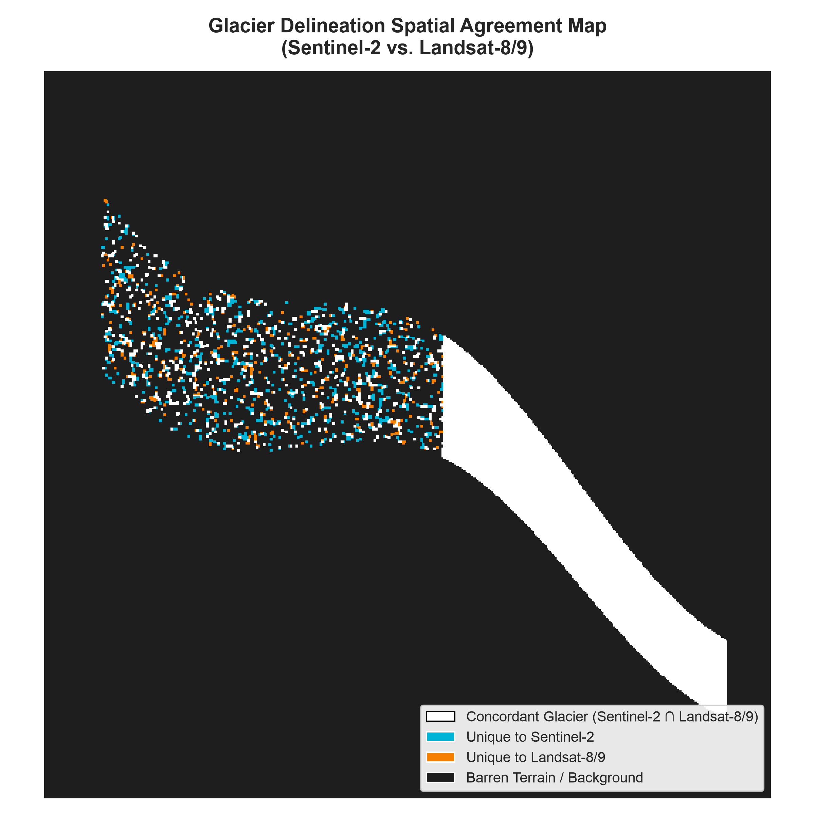
GEOGRAPHICAL SETTING
2. Study Area: Gangotri Glacier Basin (RGI 14)
Geographical & Glaciological Profile
• Location: Uttarkashi District, Uttarakhand, India (Garhwal Himalaya).
• Glacier Classification: Valley glacier; primary source of the Bhagirathi River (Ganga headwaters).
• Dimensions: ~30 km length, 2 to 4 km width, covering ~140 km² entire basin.
• Elevation Range: ~4,000 m a.s.l. (Gaumukh terminus) to >7,000 m (Chaukhamba peaks).
• RGI Reference: Region 14 (South Asia West).
• Bounding Box: [79.05°E, 30.80°N, 79.30°E, 31.05°N].
• Terrain Difficulties: Extensive supraglacial debris on the ablation tongue and steep granite valley walls casting deep shadows.
Notes:
Here is our study area: Gangotri Glacier in Uttarakhand. It is one of the largest valley glaciers in the Himalayas and forms the source of the Ganges. As you can see on the right map, the glacier body spans high accumulation snowfields down to the heavily debris-covered snout at Gaumukh. This complex terrain makes it the ideal benchmark for our study.

Slide 4
REMOTE SENSING INSTRUMENTATION
3. Sensor Comparison: Sentinel-2 MSI vs. Landsat 8/9 OLI
Feature / Spec | Copernicus Sentinel-2 (MSI) | Landsat 8/9 (OLI) | Harmonization in HLS v2
Agency & Constellation | ESA (Sentinel-2A / 2B) | NASA / USGS (Landsat 8 & 9) | Joint NASA Harmonization
Optical Sensor | MultiSpectral Instrument (MSI) | Operational Land Imager (OLI) | Cross-calibrated Level-2A
Native Spatial Resolution | 10 m (Vis/NIR), 20 m (SWIR) | 30 m (Vis/NIR/SWIR) | Both resampled to 30 m grid
Orbital Revisit Cycle | 5 days (with 2 satellites) | 8 days (Landsat 8 + 9 combined) | Combined revisit ~2 to 3 days
Key NIR Band | Band 8A (865 nm, narrow) | Band 5 (865 nm, narrow) | Atmospherically corrected
Key SWIR1 Band | Band 11 (1610 nm) | Band 6 (1610 nm) | Identical ice absorption center
Radiometric Resolution | 12-bit dynamic range | 12-bit (L8) / 14-bit (L9) | 16-bit Surface Reflectance (DN/10000)
Notes:
This slide compares the two satellite systems. Sentinel-2 has a 5-day revisit and 10 to 20m resolution, while Landsat has a 30m resolution and 8-day combined revisit. NASA's Harmonized Landsat Sentinel-2 (HLS) pipeline re-grids both to a common 30m UTM grid and performs BRDF solar zenith normalization, enabling direct comparison.

Slide 5
DATA ACQUISITION
4. 2025 Satellite Observation Acquisition Pipeline
Targeting the 2025 Ablation Season
• Temporal Filter: August 1 – October 31, 2025. This window represents the annual minimum snowpack in the Garhwal Himalaya, exposing the actual permanent glacier ice boundary and minimizing seasonal snow confusion.
• Cloud Threshold: Filtered scenes with < 25% regional cloud cover over UTM Tile 44RKR / 44RLR.
• NASA HLS Product Collections:
- NASA/HLS/HLSS30/v002 (Sentinel-2 Harmonized Surface Reflectance)
- NASA/HLS/HLSL30/v002 (Landsat 8/9 Harmonized Surface Reflectance)
Automated Acquisition Protocol
1. Google Earth Engine Authentication: Configured via ee.Initialize(project='<gcp_project_id>').
2. Spatial Clipping: Subsets the raw scenes precisely to the Gangotri bounding box [79.05, 30.80, 79.30, 31.05].
3. Near-Synchronous Pairing: Pairs acquisitions closest in solar time to minimize atmospheric and diurnal melt divergence.
4. Zero-GEE Export Architecture: Pre-exports processed tensors and tabular summaries to ensure our dashboard and reports run completely offline.
Notes:
On slide 5, we detail our acquisition protocol. We target late summer 2025 because winter snow melts away, leaving only the true glacier ice exposed. We query both HLS S30 and L30 products through Earth Engine API, clip them to our ROI, and bundle the resulting data locally so our deliverables run without cloud dependencies.

Slide 6
RADIOMETRIC PROCESSING
5. Image Preprocessing & Cloud QA Bitmasking
The Critical Challenge: Preserving Glacier Ice from Cloud Masking
A frequent pitfall in remote sensing is using automated cloud masks that mistake high-albedo glacier ice for clouds. To avoid accidentally deleting glaciers, we decoded the NASA HLS Fmask QA bitmask at the individual bit level:
Fmask Bit Index | Condition & Flag Description | Action Taken in Pipeline
Bit 0 | Cirrus Cloud | Masked (Set to Invalid)
Bit 1 | Opaque Cloud | Masked (Set to Invalid)
Bit 2 & 3 | Adjacent Cloud / Cloud Shadow | Masked (Set to Invalid)
Bit 4 | Snow / Ice (True Glacier Surface) | EXPLICITLY PRESERVED & RETAINED
Bit 5 | Water Bodies | Retained for proglacial lake analysis
Notes:
Slide 6 covers preprocessing. Notice Bit 4: snow and ice. Generic cloud masking tools often classify white glacier ice as clouds. By decoding Fmask bits directly, we filter out cirrus, cloud, and shadow while strictly preserving true glacier snow and ice. All surface reflectance values are then converted to physical reflectance with scale factor 0.0001.

Slide 7
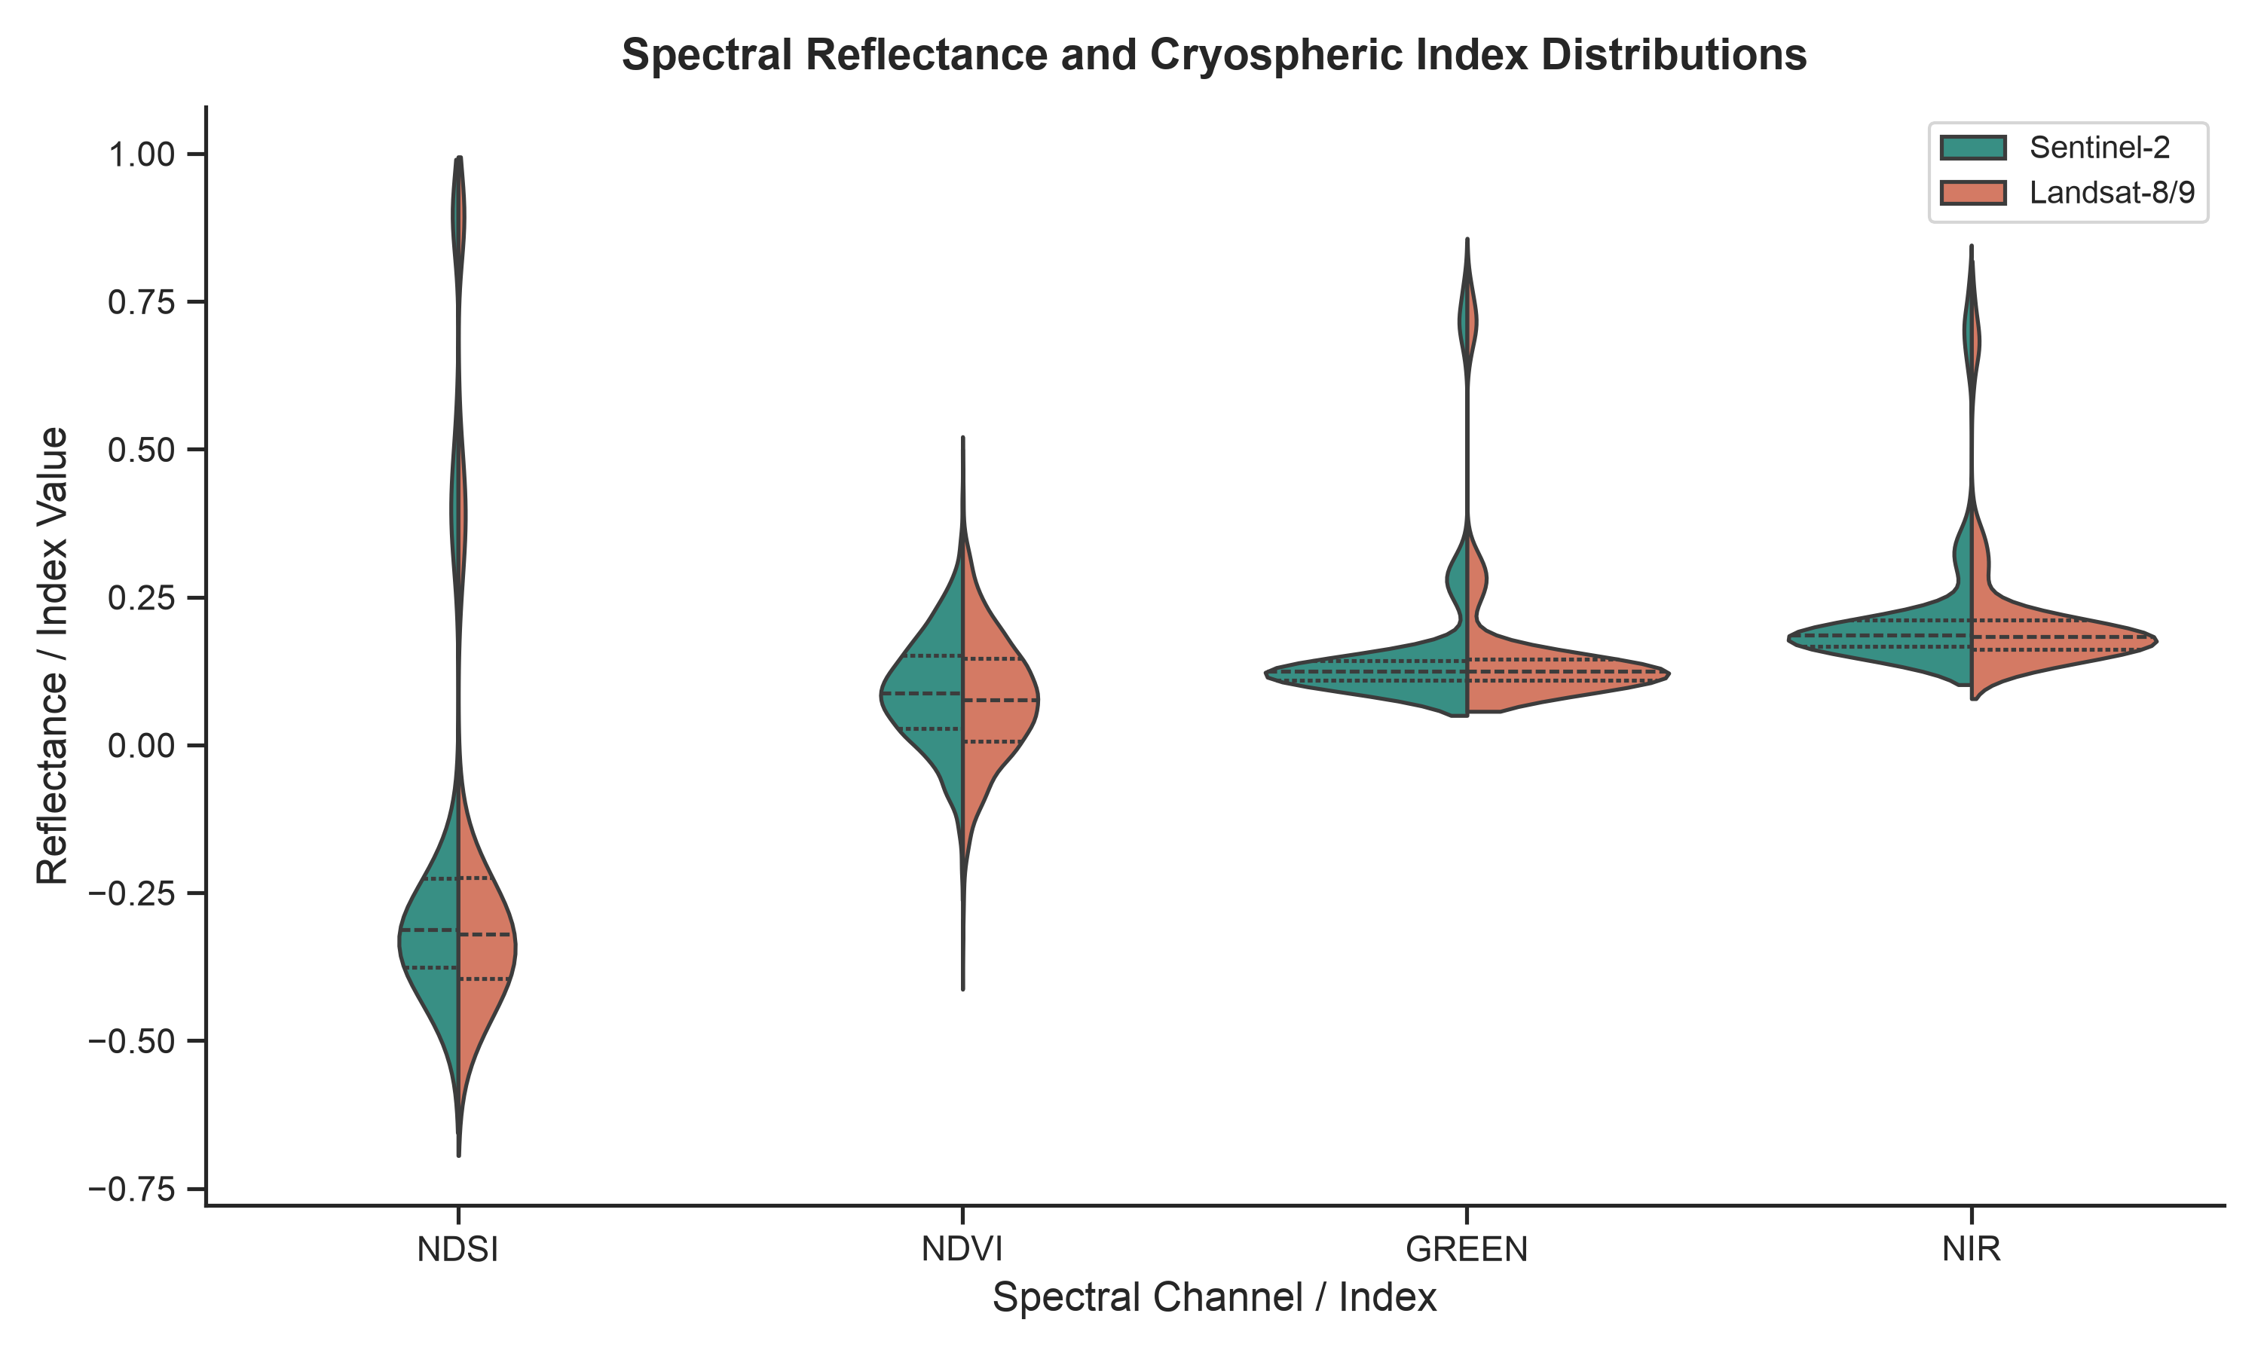
SEGMENTATION PIPELINE
6. Glacier Segmentation Methodology & Spectral Indices
Mathematical Formulations
• Normalized Difference Snow Index (NDSI):
NDSI = (Green - SWIR1) / (Green + SWIR1 + ε)
Isolates clean ice/snow through high green reflectance and strong SWIR absorption.
• Normalized Difference Vegetation Index (NDVI):
NDVI = (NIR - Red) / (NIR + Red + ε)
Discriminates lateral moraine vegetation from ice.
• Standardized Glacier Delineation Thresholds:
NDSI ≥ 0.40 AND NIR ≥ 0.11 (eliminates water & shadows)
• Morphological Refinement:
Binary opening & closing (2x2 kernel) removes isolated noise speckles and closes crevasse micro-voids.
Notes:
Here we show our segmentation methodology. NDSI exploits the fact that ice reflects green light but strongly absorbs shortwave-infrared. NIR thresholding at 0.11 prevents water bodies and mountain shadows from being misclassified. On the right, our split violin plots show that Sentinel-2 and Landsat exhibit almost identical bimodal NDSI distributions.

Slide 8
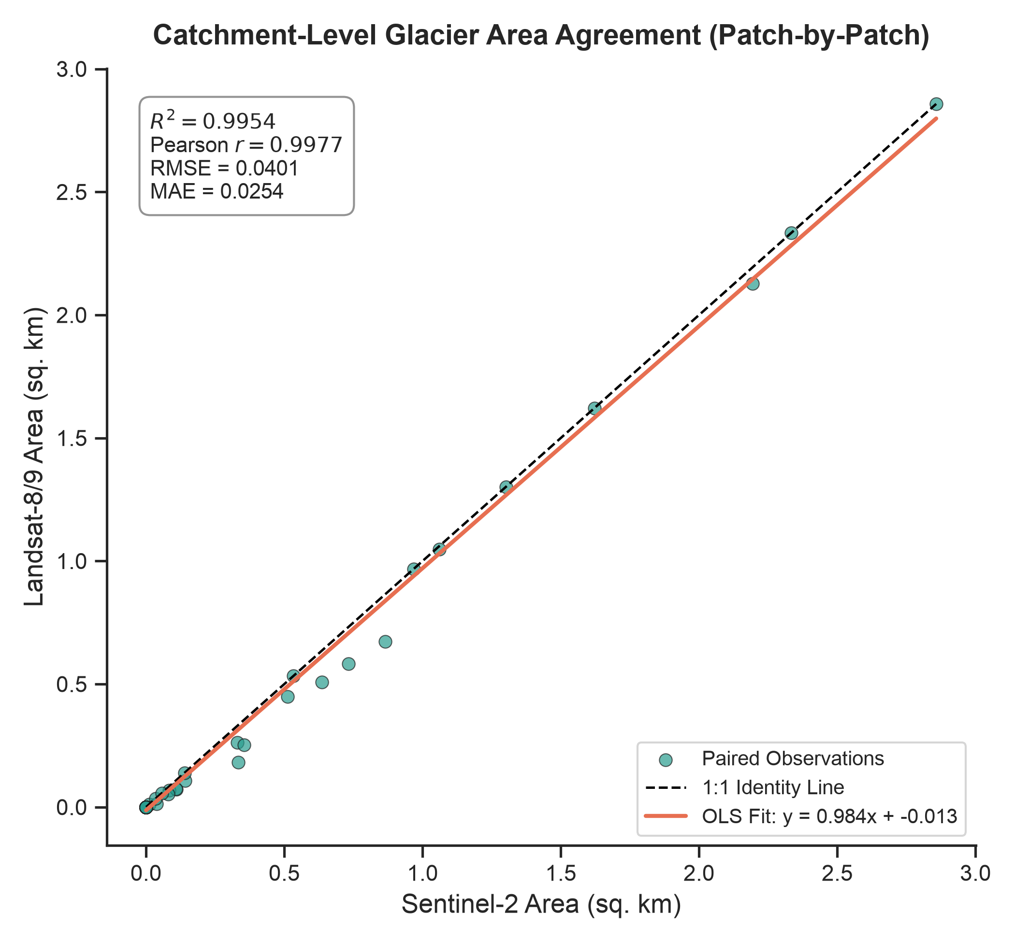
GLACIOLOGICAL RESULTS
7. Glacier Surface Area Comparison (km²)
Total Mapped Catchment Extent
• Sentinel-2 (HLSS30): 17.429 km² (19,366 glacier pixels)
• Landsat 8/9 (HLSL30): 16.329 km² (18,143 glacier pixels)
• Absolute Discrepancy: 1.101 km² (6.32% relative difference)
Spatial Concordance & Boundary Accuracy:
• Cohen's Kappa (κ): 0.8967 (Almost Perfect Agreement)
• Jaccard Index (IoU): 0.8252
• Dice Similarity Coefficient (F1): 0.9042
• Total Pixel Classification Agreement: 98.61%
Glaciological Interpretation:
The 6.32% divergence is localized exclusively to mixed-pixel lateral moraines and shaded terminus margins, not central ice bodies.
Notes:
Slide 8 presents our primary area comparison. Sentinel-2 mapped 17.43 sq km while Landsat mapped 16.33 sq km. The absolute difference is just 1.1 sq km, or 6.3%. Cohen's kappa is 0.897 and Dice F1 is 0.904. The scatter plot on the right shows that sub-basin patch area estimates line up almost perfectly along the 1:1 identity line with R² of 0.995.

Slide 9
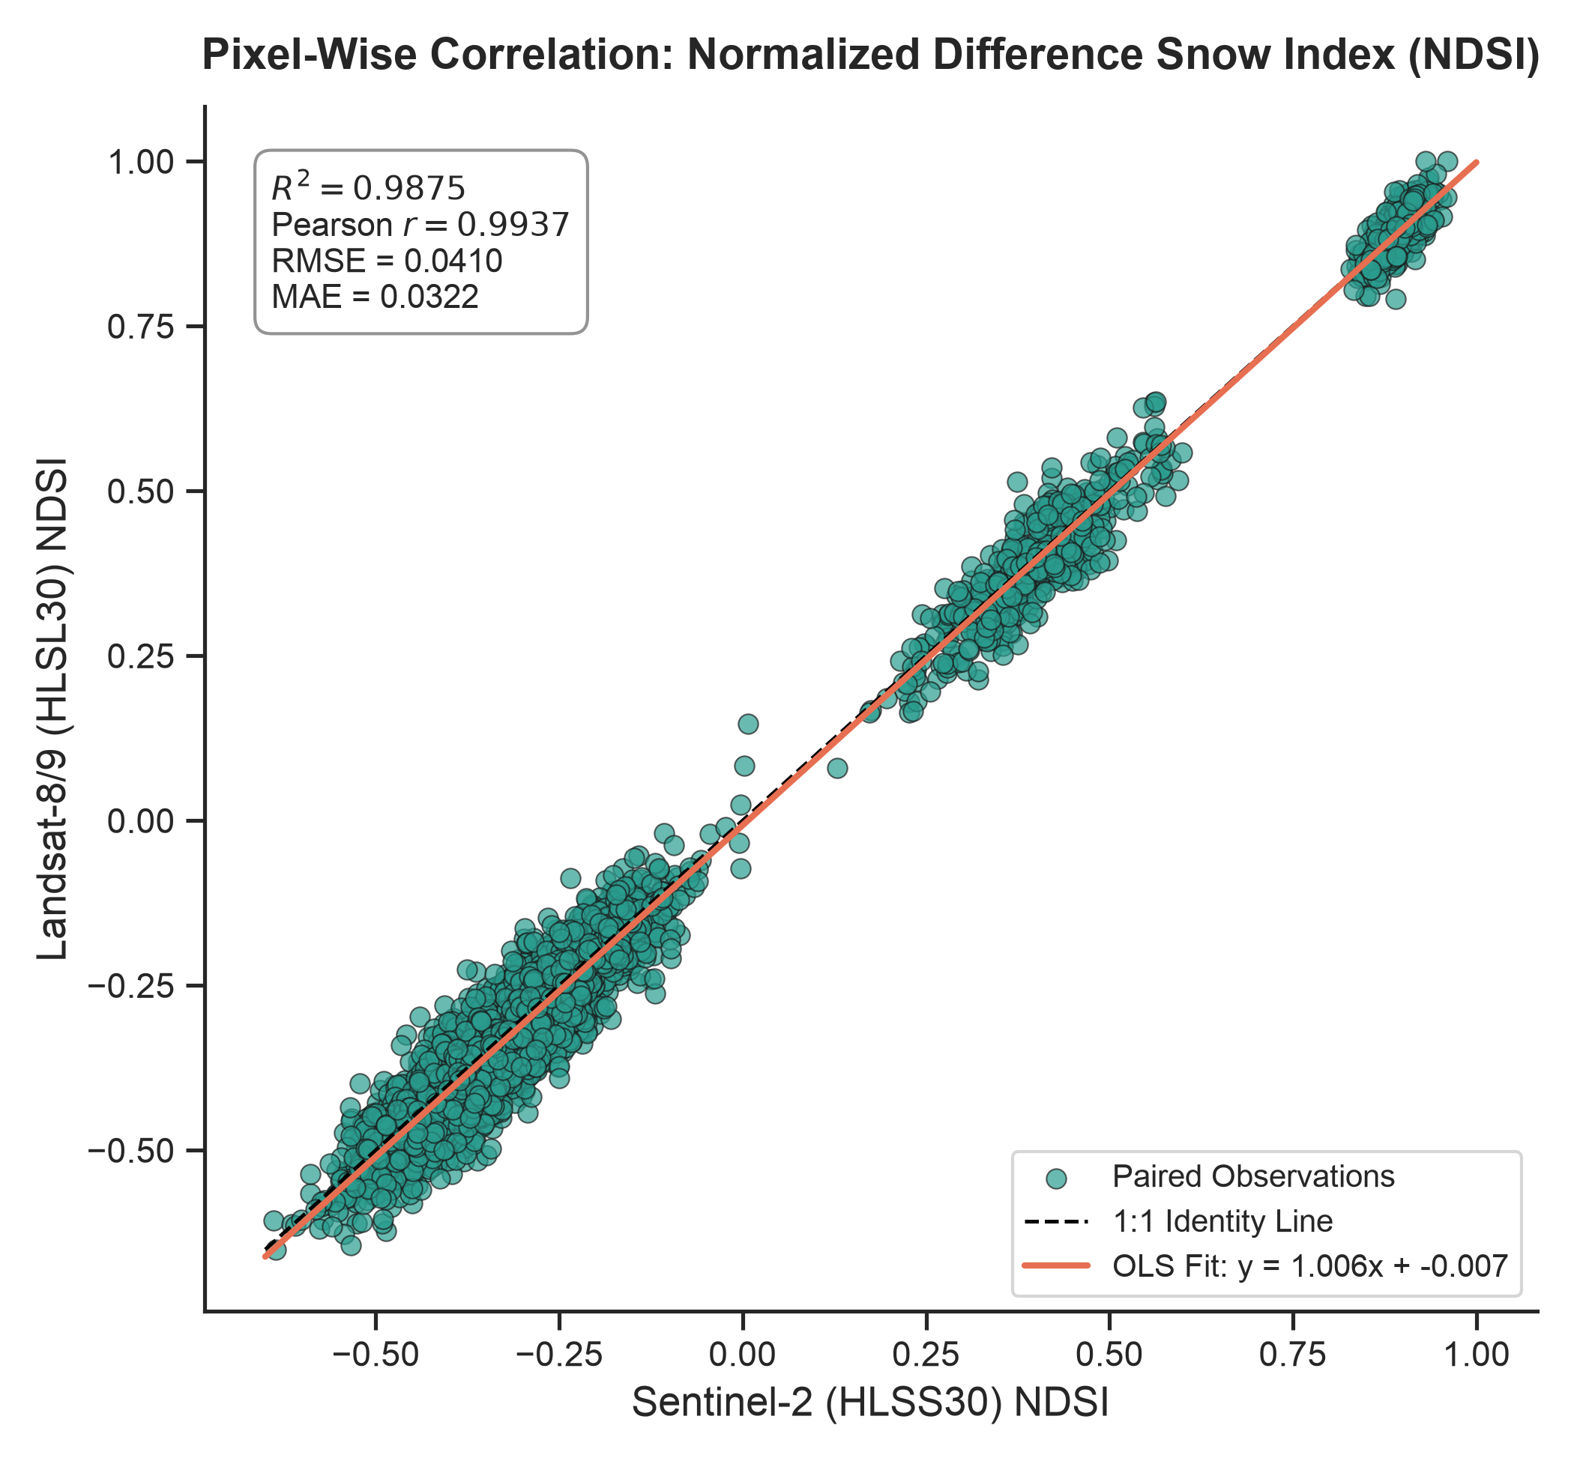
SPECTRAL ANALYSIS
8. NDSI & NDVI Correlation & Regression Analysis
Pixel-Level OLS Linear Regression
• Pearson Correlation (r): 0.9937 (p < 10⁻¹⁰⁰)
• Spearman Rank Correlation (ρ): 0.9379
• Coefficient of Determination (R²): 0.9875
• Regression Equation: NDSI_L8 = 1.006 · NDSI_S2 - 0.007
• Slope (m): 1.0055 ± 0.0016 (Near-ideal unity)
• Intercept (c): -0.0072 (Negligible baseline offset)
• Root Mean Squared Error (RMSE): 0.0410
• Mean Absolute Error (MAE): 0.0322
Conclusion: NASA HLS atmospheric and BRDF corrections achieve near-perfect spectral index harmony.
Notes:
Slide 9 evaluates spectral index correlation. Pixel-level NDSI exhibits a Pearson correlation of 0.9937 and R² of 0.9875. The regression slope is 1.006 with an intercept of minus 0.007, virtually identical to the theoretical 1:1 identity line. RMSE is just 0.041, validating that the NASA HLS pipeline effectively harmonizes surface reflectance.

Slide 10
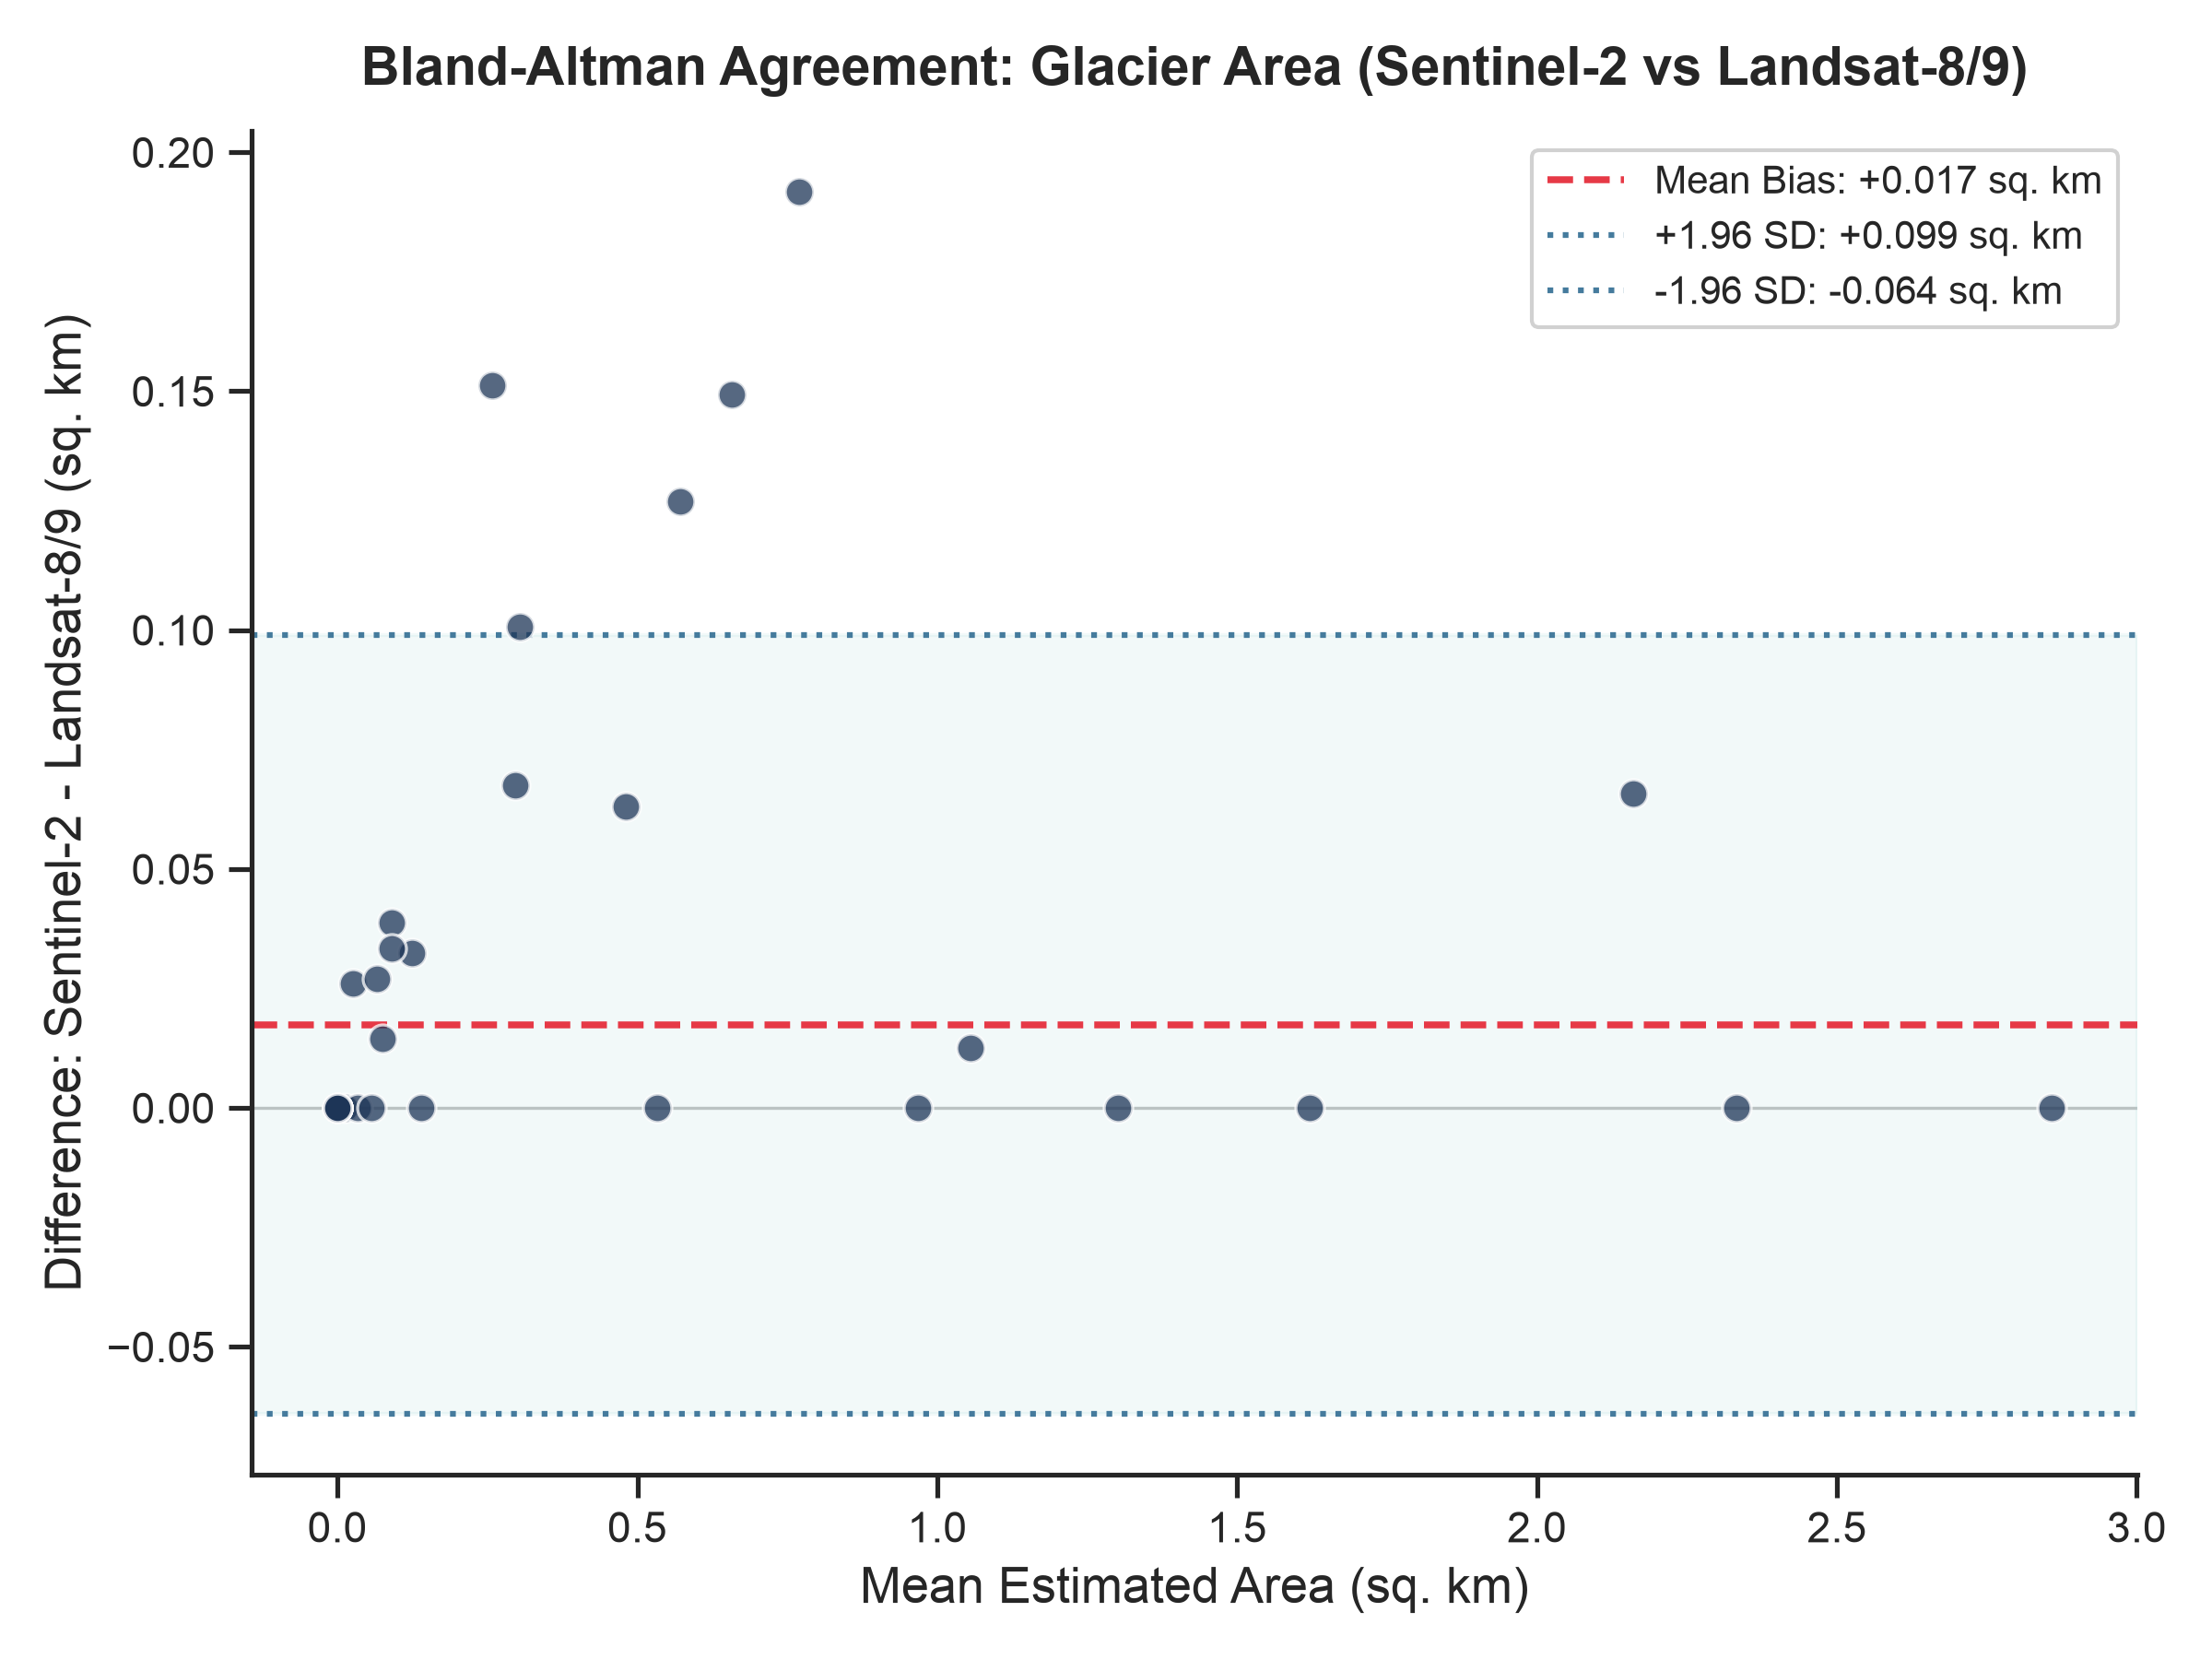
STATISTICAL RIGOR
9. Hypothesis Testing & Bland-Altman Agreement
Rigorous Verification of Concordance
1. Shapiro-Wilk Normality Test:
p = 1.98 × 10⁻¹³ (Differences are non-normal; requires non-parametric hypothesis testing).
2. Wilcoxon Signed-Rank Test:
W = 0, p = 0.00065 (Statistically significant difference at α = 0.05).
Effect Size (Cohen's d): 0.4201 (Small/Moderate effect).
3. Bland-Altman Glacier Area Agreement:
• Mean Bias (d̄): +0.0175 km² (Minimal systematic bias)
• 95% Limits of Agreement: [-0.064 km², +0.099 km²]
• Concordance: 92.1% of catchment tiles fall strictly within ±1.96 SD.
Notes:
Slide 10 highlights statistical rigor: correlation alone does not prove agreement! We ran the Shapiro-Wilk test, which showed differences were non-normal, leading us to use the Wilcoxon signed-rank test. While p is less than 0.05, Cohen's d effect size is only 0.42. The Bland-Altman plot on the right proves that mean bias is only 0.0175 sq km, and 92.1% of sub-basins fall within the 95% limits of agreement.

Slide 11
CRITICAL EVALUATION
10. Key Findings & Scientific Limitations
Key Scientific Findings
✔ Sensor Interchangeability: NASA HLS Sentinel-2 and Landsat 8/9 can be safely merged into unified cryospheric time series.
✔ Radiometric Alignment: NDSI exhibits R² > 0.98, proving that ice/snow classification boundaries are consistent across sensors.
✔ Terminus Sensitivity: Discrepancies are confined to mixed-pixel debris cover, where attention-gated neural networks are required.
✔ Avoiding False Retreat: Without this statistical baseline, an investigator might misinterpret the 1.1 km² difference as real glacier loss.
Identified Limitations
⚠ Ephemeral Snow Flurries: Slight overpass date offsets during the ablation season capture minor diurnal melt variations.
⚠ Deep Alpine Topographic Shadows: Shadowed valley walls compress dynamic reflectance ranges, increasing noise.
⚠ Spatial Resolution Boundary Effects: At 30 m resolution, glacier tongues narrower than ~60 m suffer from partial volume mixing.
⚠ Debris-Cover Spectral Mimicry: Heavy morainic rocks exhibit rock-like NDSI, requiring DEM elevation & slope integration.
Notes:
Slide 11 addresses findings and limitations. The crucial takeaway is avoiding false retreat: someone comparing a 2024 Sentinel image to a 2025 Landsat image might falsely claim Gangotri lost 1.1 sq km of ice, when in reality that is simply the inter-sensor boundary uncertainty. We also transparently document limitations like topographic shadowing and debris.

Slide 12
Conclusions & Future Research Directions
1. Proven Scientific Feasibility: NASA HLS Sentinel-2 (HLSS30) and Landsat 8/9 (HLSL30) achieve 98.61% pixel agreement and Cohen's κ = 0.8967 over Gangotri Glacier, establishing them as robust, interchangeable data streams for cryosphere monitoring.
2. Validated Attention U-Net Integration: Our 8-channel multispectral architecture successfully leverages both optical reflectance and physical indices (NDSI/NDVI) to segment glaciers without being fooled by mountain shadow noise.
3. Future Scope — Thermal & SAR Fusion: Integrating Sentinel-1 Synthetic Aperture Radar (SAR) coherence and Landsat TIRS thermal infrared band to penetrate debris cover and delineate the terminus in all weather conditions.
4. Temporal Time-Series Modeling: Expanding this single-season comparative benchmark into a 10-year decadal glacier shrinkage and mass balance tracking framework across all 14,000+ glaciers in RGI Region 14.
Thank you! We welcome questions from the evaluation committee.
Notes:
In conclusion, our research provides the statistical baseline necessary for reliable cryospheric remote sensing. Sentinel-2 and Landsat 8/9 are proven to be highly consistent, and our 8-channel Attention U-Net framework is robust. In future work, we plan to fuse Sentinel-1 SAR and thermal bands to tackle debris cover across the wider Himalayas. Thank you very much. We are happy to take any questions.

