Slide 1
Airline Operations & Passenger Satisfaction Analysis
SQL and Power BI project using 5.8 million US flight records (2015) and 129,880 passenger survey responses
Presented by Rameshwari Ruplal Sandile
Tools: MySQL | Power BI

Slide 2
Overview
This project analyses US airline operations and passenger satisfaction using SQL and Power BI.
It combines 5.8 million flight records from 2015 with 129,880 passenger survey responses, and turns them into 17 SQL queries, 4 reusable views, a stored procedure, two Power BI dashboards and clear recommendations.
5.8 million
flight records (2015)
129,880
passenger survey responses

Slide 3
Introduction
Airlines are judged on two things: whether their flights run on time and whether their passengers are happy. This project looks at both sides.
The flight data shows how operations perform in terms of delays, cancellations and diversions, while the survey shows how passengers feel about the service. MySQL is used for cleaning and analysis, and Power BI for dashboards. The survey has no airline field, so the two datasets are analysed side by side.
17
SQL queries
2
Power BI dashboards

Slide 4
Problem statement
Delayed and cancelled flights and unhappy passengers cost airlines money and customer loyalty.
In 2015, 1.54% of flights were cancelled (about 90,000 flights), and only 43.45% of surveyed passengers were satisfied. Management needs to know where operations fail, when they fail, and which parts of the passenger experience matter most.
1.54%
of flights cancelled
43.45%
of passengers satisfied

Slide 5
Project objectives
1
Measure delays, cancellations and diversions across 14 airlines
2
Find seasonal, weekly and time-of-day patterns
3
Identify the main causes of delay and cancellation
4
Understand which passengers are least satisfied and why
5
Turn findings into clear, actionable recommendations

Slide 6
About the data
Flights 2015 (US DOT)
Passenger satisfaction survey
5,819,079
129,880
flight records
passenger responses
14 airlines, with airport and cancellation code tables
Delays, cancellations, diversions and delay causes
Used to measure reliability and find causes
14 service ratings on a 1 to 5 scale
Class, travel purpose, age, customer type and delays
Used to find who is unhappy and why
Tools: MySQL 8 | MySQL Workbench | Power BI Desktop
The survey has no airline field, so the two datasets cannot be joined and are analysed side by side. Original tables were left untouched; cleaning rules sit inside the queries and views.

Slide 7
Data quality checks and cleaning
Issue found | Rows affected | Action taken
Missing arrival delay in survey | 393 | Stored as NULL; shown as "Unknown", not as on time
Cancelled flights have no delay values | 89,884 | Excluded from all delay analysis
5-digit airport codes instead of 3-letter codes | 486,165 | Excluded from airport-level analysis
Rating of 0 means "Not applicable" | 3,080 (online boarding) | Treated as missing, not as a low score
Duplicate passenger IDs | 0 | No action needed
The original tables were left untouched. Cleaning rules are applied inside the queries and views, so every result is reproducible.

Slide 8

Key question: How many flights operated in 2015, and what share were cancelled or diverted?
Result
Insight
Of 5.8 million flights in 2015, 1.54% were cancelled and 0.26% were diverted. Disruptions are a small share of total traffic, but they still affect about 90,000 cancelled flights and their passengers.

Slide 9
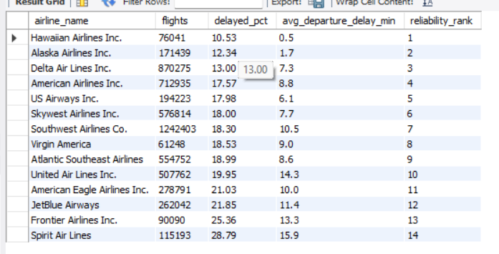
Key question: Which airlines are the most and least punctual?
Result
Insight
Hawaiian Airlines is the most punctual carrier, with 10.53% of flights arriving more than 15 minutes late, while Spirit is the least punctual at 28.79%. The gap of about 18 percentage points shows that delay performance varies widely between airlines.

Slide 10
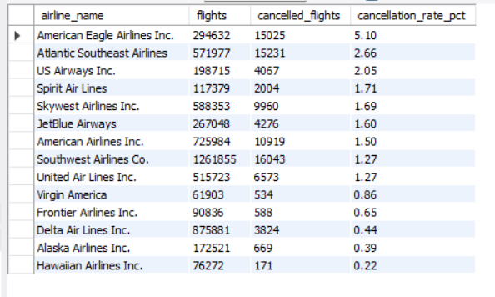
Key question: Which airlines cancel the largest share of their flights?
Result
Insight
American Eagle cancels 5.10% of its flights, roughly 23 times the rate of Hawaiian Airlines (0.22%). Regional carriers sit at the top of the cancellation ranking, so they should be the priority for reliability improvement.

Slide 11
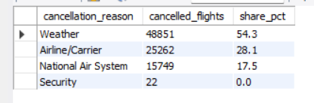
Key question: Why are flights cancelled, and how much of it is within the airline's control?
Result
Insight
Weather caused 54.3% of all cancellations, which airlines cannot control. However, 28.1% (25,262 flights) were caused by the airlines themselves, which is the portion that better crew planning, maintenance scheduling, and operations management can reduce.

Slide 12
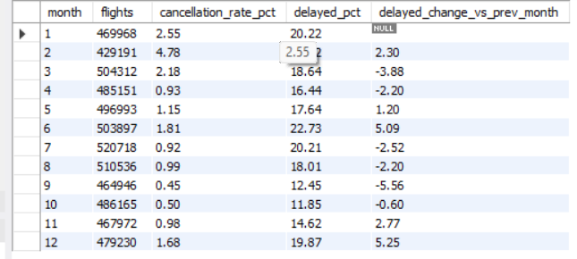
Key question: How do cancellations and delays change from month to month, and which months are the worst?
Result
Insight
Performance is strongly seasonal. February is the worst month for cancellations (4.78%, roughly 10 times the October rate), and June is the worst for delays (22.73%), which points to winter storms and summer thunderstorms plus peak travel. September and October are the most reliable months, so airlines can plan extra crew and standby capacity for winter and early summer.

Slide 13
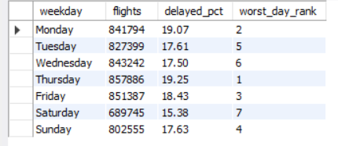
Key question: Which days of the week have the highest share of delayed flights?
Result
Insight
Delays peak on Thursday (19.25%) and Monday (19.07%), which are heavy business-travel days, while Saturday is the most punctual (15.38%). The gap is about 4 percentage points, so day-of-week matters, but much less than month or time of day.

Slide 14
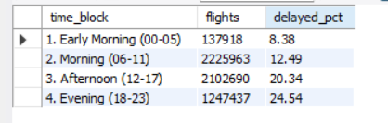
Key question: At what time of day are flights most likely to be delayed?
Result
Insight
Delays build up through the day. Morning flights are delayed 12.49% of the time, but evening flights 24.54%, almost double. Late departures cause knock-on delays for later flights, so scheduling more buffer time in the afternoon and evening, and encouraging passengers to book morning flights, would improve punctuality.

Slide 15
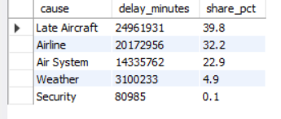
Key question: Which cause accounts for the largest share of total delay minutes?
Result
Insight
Late-arriving aircraft cause the largest share of delay minutes (39.8%), followed by problems within the airline's own control (32.2%). Weather accounts for only 4.9% of delay minutes. Together, aircraft rotation and airline operations explain more than 70% of delay time, so better turnaround planning and maintenance scheduling are the biggest improvement levers.

Slide 16
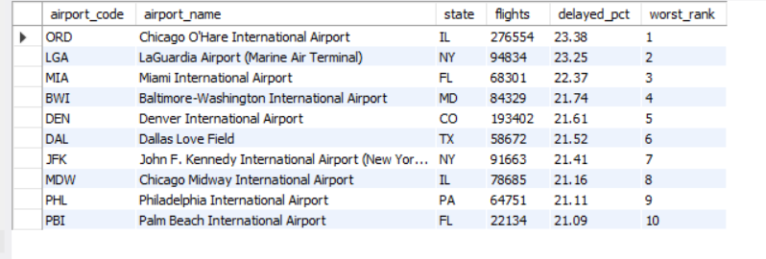
Key question: Which large airports have the highest share of delayed departures?
Result
Insight
Chicago O'Hare (ORD) and New York LaGuardia (LGA) have the highest delay rates, with about 23% of flights arriving late. Hawaii airports are among the best (HNL at 10.10%). Airports are filtered to those with at least 20,000 flights so that small airports with few flights do not distort the ranking.

Slide 17
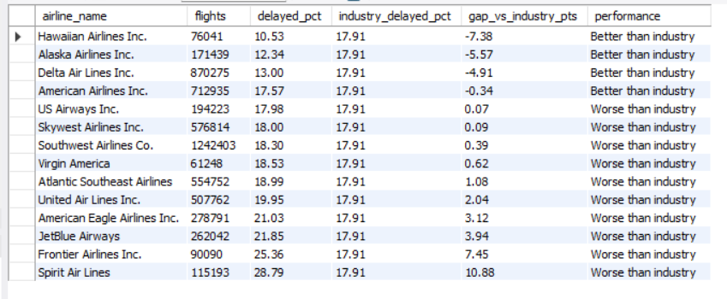
Key question: Which airlines perform better or worse than the industry average for delays?
Result
Insight
Against the industry average of 17.91% late flights, Hawaiian, Alaska and Delta outperform by a wide margin, while Spirit and Frontier lag by 7 to 11 points. Comparing each airline with the industry baseline makes the ranking easier to act on than raw percentages alone.

Slide 18

Key question: What share of surveyed passengers are satisfied with the airline?
Result
Insight
Only 43.45% of the 129,880 surveyed passengers are satisfied, which means more than half are neutral or dissatisfied. The airline is below the 50% mark, so there is clear room to improve the passenger experience.

Slide 19
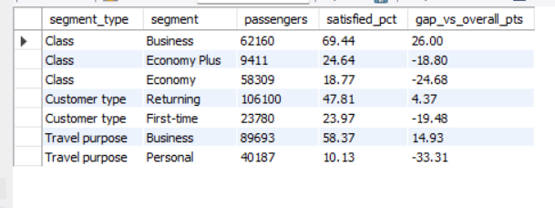
Key question: Which types of passengers (class, travel purpose, customer type) are the most and least satisfied?
Result
Insight
Satisfaction differs sharply by segment. Business class passengers are 69.44% satisfied versus 18.77% in Economy, and business travellers (58.37%) are far happier than personal travellers (10.13%). First-time customers (23.97%) are about half as satisfied as returning ones (47.81%), which suggests the early experience with the airline needs attention.

Slide 20

Key question: Which age groups are the most and least satisfied?
Result
Insight
Passengers aged 36-55 are the most satisfied (54.71%), while those under 18 are the least satisfied (16.73%). Younger passengers are far below the airline average of 43.45%, so the airline should look at the needs of young travellers, such as entertainment, wifi and booking convenience.

Slide 21
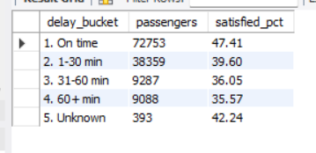
Key question: Does a longer arrival delay lower passenger satisfaction?
Result
Insight
Satisfaction falls from 47.41% for on-time flights to about 36% when the delay exceeds 30 minutes, a drop of around 12 percentage points. Even a short delay of 1-30 minutes costs about 8 points. However, more than a third of passengers on long-delayed flights are still satisfied, so delay alone does not decide satisfaction. Service quality matters more, which the next query shows.

Slide 22
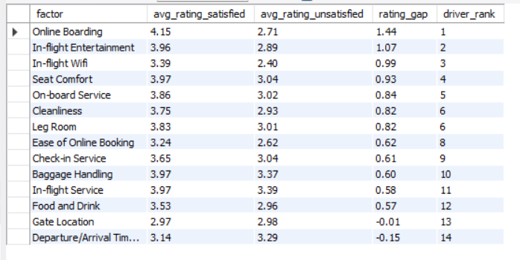
Key question: Which service factors differ the most between satisfied and unsatisfied passengers?
Result
Insight
Online boarding is the biggest driver of satisfaction: satisfied passengers rate it 4.15 versus 2.71 for unsatisfied passengers, a gap of 1.44 points. In-flight entertainment, wifi and seat comfort follow. Gate location and flight-time convenience show almost no difference, so investing in them would not improve satisfaction. Digital boarding, entertainment and wifi should be the top investment priorities.

Slide 23

Key question: For business and personal travellers, which class is the most satisfied?
Result
Insight
Business class ranks first for both travel purposes, but personal travellers are unhappy in every class (under 12%), even in Business class. This means the problem for leisure travellers is not only seat class. Their expectations around price, booking and in-flight experience are not being met.

Slide 24

Key question: Which specific groups of passengers should the airline prioritise for improvement?
Result
Insight
The least satisfied group is personal travellers in Economy, which is also a very large group (32,821 passengers at 10.16% satisfied). First-time business travellers in Economy are the next priority (14.37%). Focusing on these two large groups would raise the overall satisfaction rate the most.

Slide 25



Key question: Can a manager get a one-click performance report for any airline by entering its code?
Result
Insight
One procedure now produces a full reliability report for any airline from its two-letter code, so managers do not need to rewrite SQL. It also compares the airlines directly: Spirit's delay rate (28.79%) is more than twice Hawaiian's (10.53%).

Slide 26


Key question: Did the indexes actually make queries faster?
With index
Without index
Insight: With the airline index, MySQL used idx_f_airline (type ref) and estimated about 1.88 million rows. Without it, MySQL ran a full table scan (type ALL) over an estimated 5.69 million rows. Indexing the filter columns therefore cuts the work MySQL must do on a 5.8-million-row table.

Slide 27
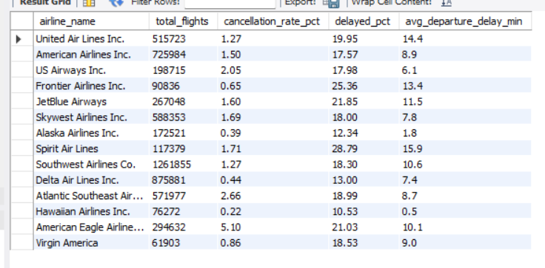
Key question: How does each airline perform on cancellations, delays and departure delay in one table?
Result
Insight
Hawaiian Airlines is the strongest performer overall, with only 10.53% of flights delayed and 0.22% cancelled. Spirit has the highest delay rate at 28.79%, while American Eagle has the highest cancellation rate at 5.10%. Delays and cancellations do not always go together: Spirit is late often but cancels relatively few flights (1.71%), whereas American Eagle cancels the most but is not the worst for delays. Each airline therefore needs its own improvement plan.

Slide 28
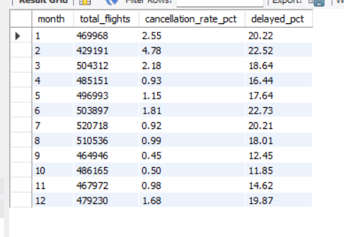
Key question: How do flight volume, cancellations and delays change over the year?
Result
Insight
Performance is strongly seasonal. February has the highest cancellation rate (4.78%), and June has the highest delay rate (22.73%), followed by February (22.52%). September and October are the most reliable months, with about 12% of flights delayed and cancellations at or below 0.5%. Flight volume stays fairly steady through the year (roughly 430,000 to 520,000 flights per month), so the swings are not explained by traffic alone. They likely reflect winter storms in the early months and summer thunderstorms plus peak travel in June.

Slide 29
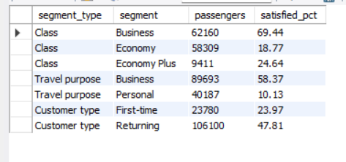
Key question: How satisfied are passengers by class, travel purpose and customer type?
Result
Insight
Satisfaction depends heavily on who the passenger is. Business class passengers are 69.44% satisfied, compared with 24.64% in Economy Plus and only 18.77% in Economy. Business travellers (58.37%) are far happier than personal travellers (10.13%), and returning customers (47.81%) are about twice as satisfied as first-time customers (23.97%). The weakest groups are also the largest: Economy has 58,309 passengers and personal travel has 40,187, so improving their experience would lift the overall satisfaction rate (43.45%) the most.

Slide 30
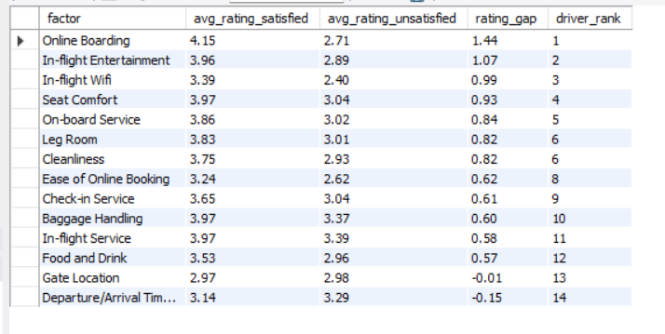
Key question: Which service factors differ the most between satisfied and unsatisfied passengers?
Result
Insight
Online boarding is the biggest driver of satisfaction. Satisfied passengers rate it 4.15 on average, while unsatisfied passengers rate it 2.71, a gap of 1.44 points. In-flight entertainment (gap 1.07), in-flight wifi (0.99), seat comfort (0.93) and on-board service (0.84) follow. Gate location and departure/arrival time convenience show almost no gap, so they do not explain who is satisfied. The airline should prioritise digital boarding, entertainment and wifi.

Slide 31
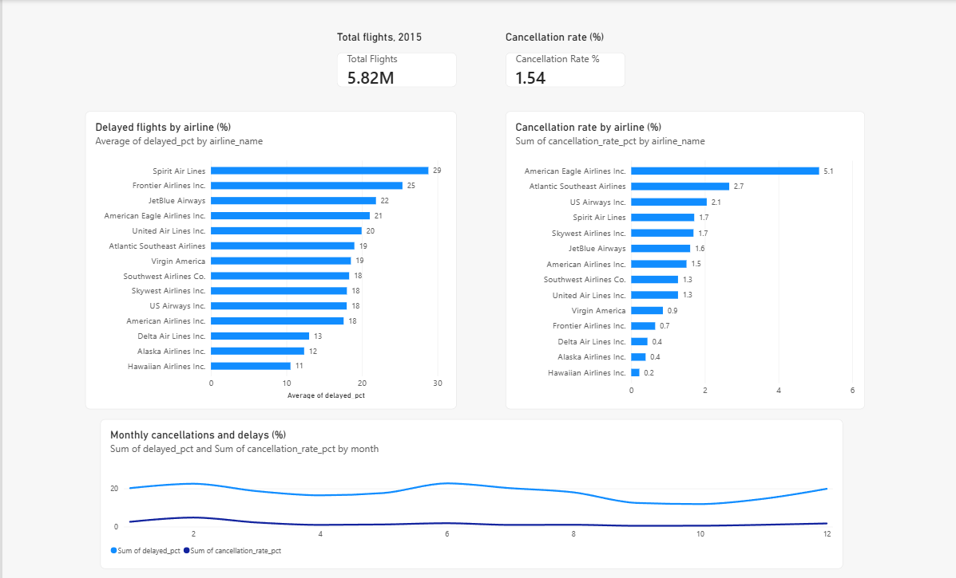
Power BI dashboard: operations
Cards show total flights and the cancellation rate
Airline charts rank delays and cancellations
Line chart shows the monthly trend: February and June peaks
Built on SQL views

Slide 32
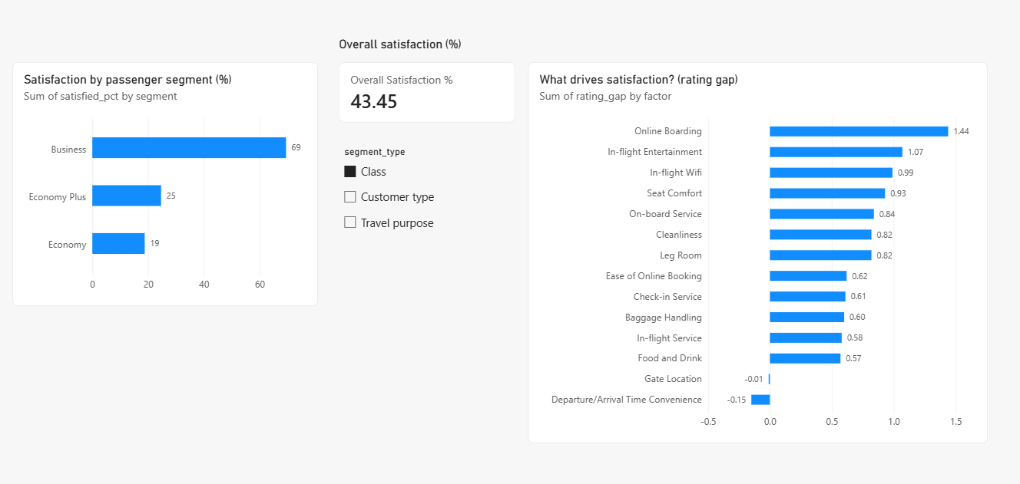
Power BI dashboard: customers
Overall satisfaction card: 43.45%
Slicer switches between class, customer type and travel purpose
Driver chart ranks 14 service factors by rating gap

Slide 33
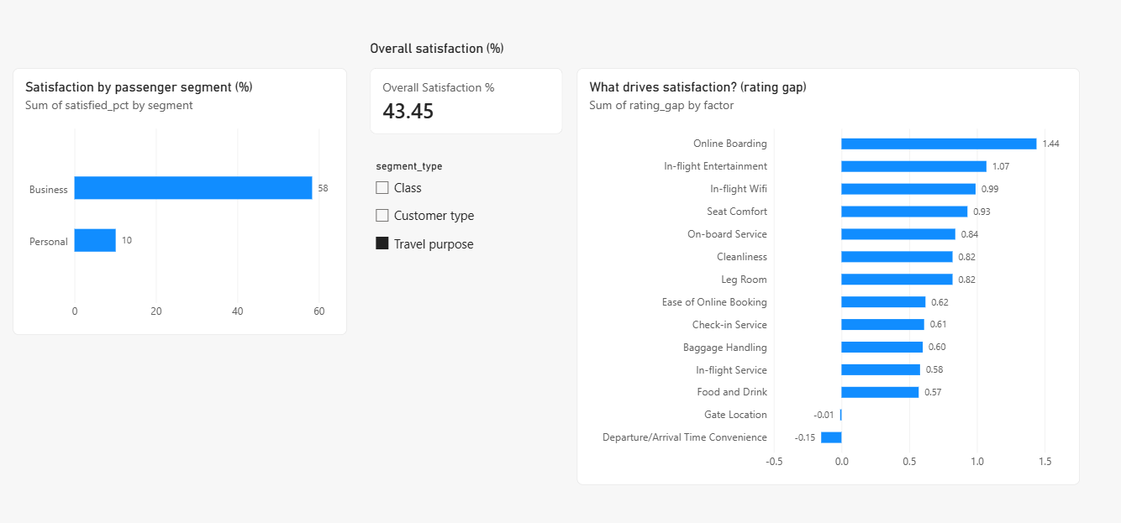
Power BI dashboard: travel purpose
Slicer set to Travel purpose
Business travellers: 58% satisfied
Personal travellers: only 10% satisfied

Slide 34
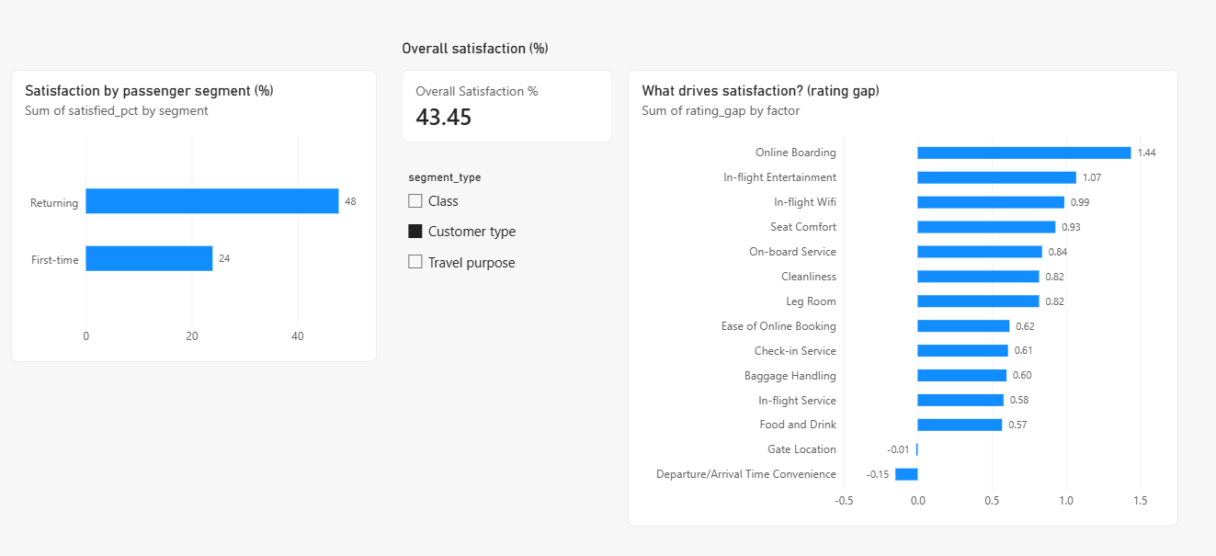
Power BI dashboard: customer type
Slicer set to Customer type
Returning customers: 48% satisfied
First-time customers: only 24% satisfied

Slide 35
Recommendations
1
Reduce avoidable cancellations
2
Plan for season and time of day
28.1% of cancellations are airline-caused. Strengthen crew planning, maintenance scheduling and standby capacity, starting with regional carriers such as American Eagle (5.10%).
February cancellations reach 4.78% and June delays 22.73%. Add buffers and standby crews, and add slack to afternoon and evening schedules.
3
Fix aircraft turnaround
4
Invest in the digital experience
Late-arriving aircraft and airline operations explain about 72% of delay minutes. Better turnaround planning is the biggest lever.
Prioritise online boarding, entertainment and wifi, focusing on Economy, personal and first-time passengers.

Slide 36
Limitations and conclusion
Limitations
Flight data is from 2015
Datasets cannot be joined (no airline in survey)
Delay causes exist only for delayed flights
Drivers show association, not causation
Airport analysis excludes 5-digit code rows
Airlines can improve most by cutting avoidable cancellations, tightening turnaround, and fixing the digital boarding experience.

