Slide 1
Machine Learning - Supervised Algorithms
Algorithms, intuition and evaluation
Learn from labeled examples → discover patterns → predict unseen data
Labeled
Data
Learn
Pattern
Prediction
Regression
Classification
Metrics
Presented By VALLE RAMESH

Slide 2
OVERVIEW
Presentation Roadmap
01
Linear Regression
02
Logistic Regression
03
Decision Tree
Best-fit line
Probability → class
Sequential splits
04
Random Forest
05
Support Vector Machine
06
K-Nearest Neighbors
Many trees → one result
Maximum margin
Nearest observations
Core flow: Problem → Data → Model → Prediction → Evaluation
Supervised Machine Learning
2

Slide 3
BUSINESS APPLICATION
Business Perspective: What Problems Are We Solving?
E-COMMERCE • SALES INTELLIGENCE
HOUSE-RENT / PRICE • ESTIMATION
Business question
Business question
Can we estimate order Net_Sales and classify orders as High or Low sales?
Can property attributes help estimate a property's price?
Potential use
Potential use
Support sales planning, promotion targeting, and prioritization of customer/order segments.
Provide an initial price estimate to support screening and comparison—not a final valuation.
Business value depends on reliable test performance, appropriate use, and human review of predictions.
SUPERVISED MACHINE LEARNING • VALLE RAMESH

Slide 4
PROJECT WORKFLOW
Workflow Followed: From Business Question to Model Evaluation
Define the problem
Understand & prepare data
01
Regression: predict Net_Sales / Price. Classification: assign High–Low sales or price category.
02
Inspect columns, target, missing values and duplicates; clean data and review distributions.
Build X and y
Preprocess safely
03
Separate input features (X) from the target (y); exclude target and identifiers from predictors.
04
Split train/test; impute, encode categories and scale where needed. Fit preprocessing on training data.
Train models
Evaluate & interpret
05
Fit the selected supervised algorithms using the training set; tune settings such as K or estimator count where done.
06
Predict on held-out test data; use Accuracy/Precision/Recall/F1 or MAE/RMSE/R²; connect findings to the business question.
Data split: 80% training / 20% testing in the supplied practical notebooks.
SUPERVISED MACHINE LEARNING • VALLE RAMESH

Slide 5
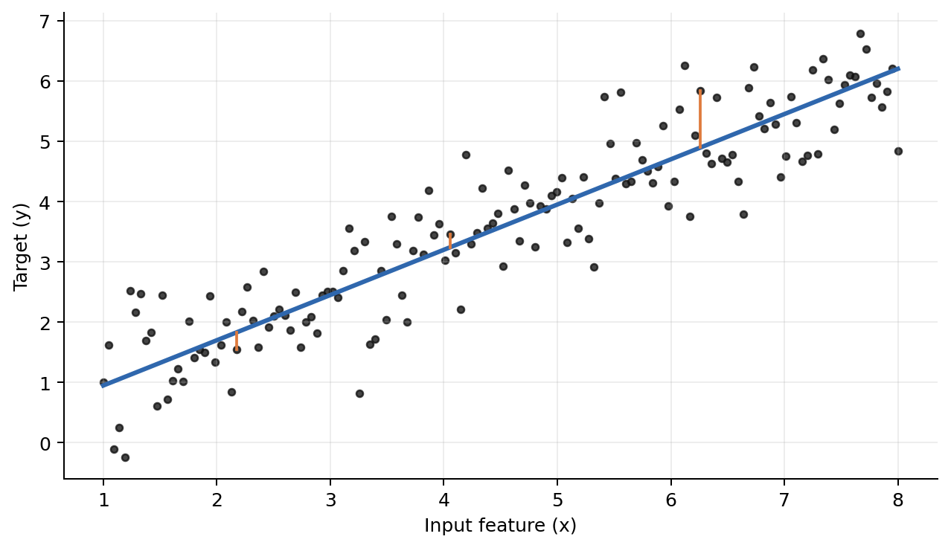
01 • REGRESSION
Linear Regression
Continuous target → best-fit line
Core idea
Find a line that best represents the relationship
between X and a continuous y.
Model equation
ŷ = mx + c
Key terms
m = slope • c = intercept • ŷ = predicted value
More observations → clearer fitted relationship
E-COMMERCE • LINEAR REGRESSION
Target: Net_Sales | Test R² = 0.818 | MAE ≈ 1,474
Conclusion: model explains about 81.8% of test-set variation in Net_Sales.
Supervised Machine Learning
3

Slide 6
01 • REGRESSION
Linear Regression — Errors, assumptions & metrics
4 evaluation metrics
Residual error
eᵢ = yᵢ − ŷᵢ
Actual − Predicted
MAE
MSE
Mean absolute error
Mean squared error
5 assumptions
1
Linearity
2
Independence
3
Homoscedasticity
RMSE
R²
√MSE
Explained variance
Normality
5
No multicollinearity
4
Goal: minimize prediction error while keeping assumptions reasonable.
E-COMMERCE • REGRESSION METRICS
Linear Regression: RMSE ≈ 2,975 | R² = 0.818
Conclusion: predictions are typically evaluated by error size and explained variation.
Supervised Machine Learning
4

Slide 7
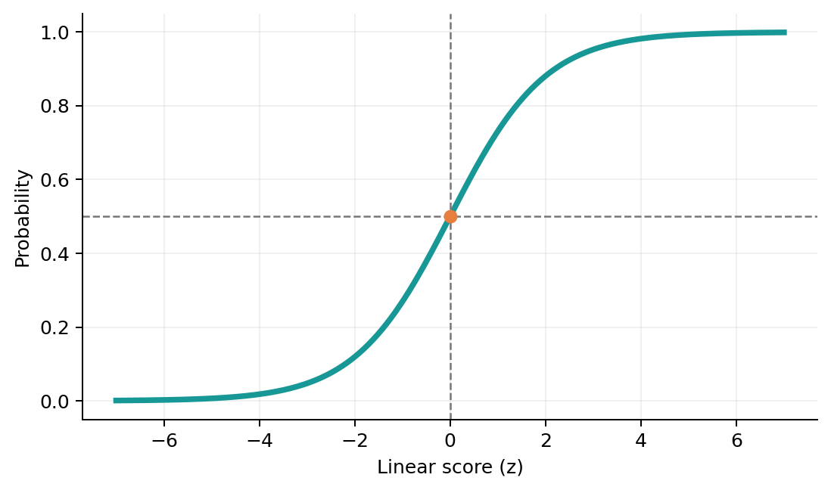
02 • CLASSIFICATION
Logistic Regression
Probability → class label
Sigmoid function
σ(z) = 1 / (1 + e⁻ᶻ)
3 types of classification
Binary
Multiclass
Multilabel
2 classes
3+ classes
multiple labels
Decision rule
Probability ≥ threshold → class 1 | otherwise → class 0
E-COMMERCE • LOGISTIC REGRESSION
Target: Sales_Category (High / Low) | Test accuracy = 90.42%
Conclusion: sigmoid probabilities are converted to High/Low labels using a threshold.
Supervised Machine Learning
5

Slide 8
02 • CLASSIFICATION
Logistic Regression — Confusion matrix & metrics
Confusion Matrix
Evaluation metrics
Predicted +
Predicted −
Actual +
TP
FN
Accuracy
(TP + TN) / Total
Correct +
Missed +
Actual −
FP
TN
Precision
TP / (TP + FP)
False +
Correct −
Recall
TP / (TP + FN)
F1 Score
2 × P × R / (P + R)
Accuracy alone can hide class imbalance → inspect the matrix + Precision/Recall/F1.
E-COMMERCE • CLASSIFICATION CHECK
Logistic Regression test accuracy = 90.42% | Test rows = 553
Conclusion: pair accuracy with confusion matrix, precision, recall and F1.
Supervised Machine Learning
6

Slide 9
03 • TREE
Decision Tree — Classification
Questions → branches → class at leaf
Age
≤ 35?
Split criteria
Gini impurity • Entropy • Information gain
Yes
No
Income
≤ 50K?
Visits
≤ 5?
Structure
Root → internal nodes → branches → leaves
Prediction
Class A
Class B
Class A
Class B
Leaf gives the majority class (classification)
No feature scaling required
E-COMMERCE • DECISION TREE CLASSIFIER
Target: Sales_Category | Test accuracy = 96.02% | Train accuracy = 100%
Conclusion: learned feature splits classify sales category; train/test gap signals possible overfit.
Supervised Machine Learning
7

Slide 10
03 • TREE
Decision Tree — Regression
Leaf prediction = average target value
Area ≤ 1500?
How the leaf value is chosen
No
Average of target values reaching that leaf:
ŷleaf = Σy / n
Yes
Age ≤ 40?
Bedrooms ≤ 3?
Example
₹40L, ₹45L, ₹50L → leaf prediction = ₹45L
Split objective
Leaf A
Mean = ₹42L
Leaf B
Mean = ₹51L
Leaf C
Mean = ₹68L
Leaf D
Mean = ₹82L
Choose splits that reduce prediction error (e.g., MSE / variance).
Key difference: classification leaf → class | regression leaf → numeric average
E-COMMERCE • DECISION TREE REGRESSOR
Target: Net_Sales | Test RMSE ≈ 7,152 | R² = 0.623
Conclusion: each terminal leaf predicts a numeric value based on training targets in that leaf.
Supervised Machine Learning
8

Slide 11
04 • ENSEMBLE
Random Forest
Many decision trees → one robust prediction
Tree 2
Tree N
Tree 1
Tree 3
Vote /
Average
Final prediction
Bootstrap samples
Random feature selection
Bagging
Each tree trains on a random sample
with replacement.
Each split considers a random subset of features.
Trees are built independently → aggregated.
E-COMMERCE • RANDOM FOREST CLASSIFIER
100 trees | Test accuracy = 94.39% | Train accuracy = 100%
Conclusion: tree votes are aggregated to predict High/Low sales category.
Supervised Machine Learning
9

Slide 12
04 • ENSEMBLE
Random Forest — Classification vs Regression
Classification
Example: Class vote
Each tree votes for a class → majority vote gives final class.
A
A
B
A
B
→ A wins 3 / 5
Regression
Each tree predicts a number → average gives final prediction.
Why use it?
• Reduces variance
• Handles nonlinear patterns
• Less overfit than one tree
• Works with mixed feature types
E-COMMERCE • RANDOM FOREST REGRESSION
100 trees | Net_Sales test R² = 0.580 | RMSE ≈ 7,552
Conclusion: regression forest averages tree predictions; results depend on the target and features.
Trade-off: more robust, but less interpretable than a single tree.
Supervised Machine Learning
10

Slide 13
04 • ENSEMBLE
Bagging — Train Many Models in Parallel
BOOTSTRAP SAMPLES
INDEPENDENT LEARNERS
AGGREGATE
Sample 1
random rows
T1
CLASSIFICATION
Majority vote
REGRESSION
Average
Sample 2
random rows
T2
Sample 3
random rows
T3
BAGGING = Bootstrap Samples + Independent Models + Aggregation
Main idea → reduce variance by combining diverse learners
HOUSE-RENT DATA • BAGGING REGRESSION
100 estimators | Test RMSE ≈ 279,850 | R² = −0.048
Conclusion: bagging averages independent bootstrap-trained trees; this notebook result shows weak test fit.

Slide 14
04 • ENSEMBLE
Bagging vs Boosting — Where Random Forest Fits
BAGGING
BOOSTING
Independent training
Sequential training
• Bootstrap rows
• Models train independently
• Vote / average predictions
• Main effect: reduce variance
• Learners added one after another
• Later learners focus on errors
• Weighted / additive combination
• Main effect: reduce bias
RANDOM FOREST = BAGGING + RANDOM FEATURE SELECTION
HOUSE-RENT DATA • BOOSTING EXAMPLES
Gradient Boosting R² = −0.030 | AdaBoost R² = 0.002 (test set)
Conclusion: boosting adds learners sequentially; these scores are the observed notebook results, not a guarantee.

Slide 15
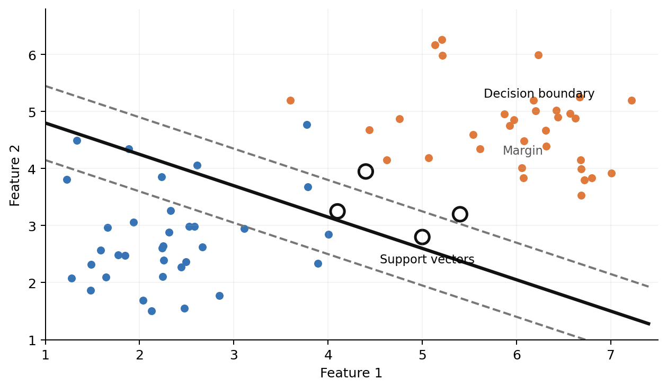
05 • MARGIN-BASED
Support Vector Machine
Maximum-margin decision boundary
Decision boundary
Hyperplane that separates classes.
Margin
Distance between boundary and closest points.
Support vectors
Closest observations that define the boundary.
Goal → maximize the margin
E-COMMERCE • SVM CLASSIFICATION
RBF kernel | Test accuracy = 86.44% | Confusion matrix: [[232,45],[30,246]]
Conclusion: the margin-based classifier separates High/Low sales; scaling is important for SVM.
Supervised Machine Learning
11

Slide 16
05 • MARGIN-BASED
SVM — C, kernels & key terms
C — penalty parameter
Other important terms
Small C → wider margin, more violations
Large C → narrower margin, fewer violations
Hard margin
perfect separation
Soft margin
allows violations
Kernel trick
Represent data in a higher-dimensional
pace to find nonlinear boundaries.
Hinge loss
classification loss
Kernels: Linear • Polynomial • RBF • Sigmoid
SVR
SVM for regression
Gamma (RBF)
Scaling
important for distance/margin
Small γ → broad influence / smoother
Large γ → local influence / complex boundary
Applications: text • image • spam • fraud • medical classification
E-COMMERCE • SVM TERMS IN PRACTICE
SVC used RBF kernel, C = 1.0 | Test accuracy = 86.44%
Conclusion: kernel and C control boundary flexibility and tolerance for classification errors.
Supervised Machine Learning
12

Slide 17
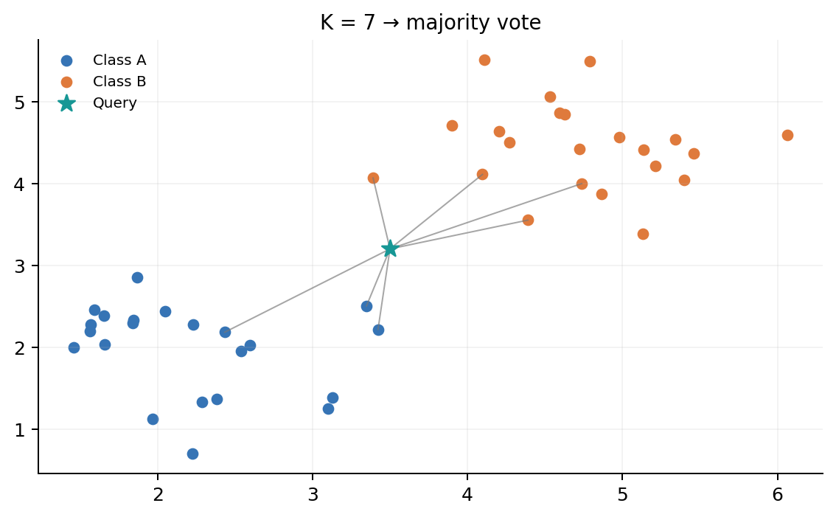
06 • INSTANCE-BASED
K-Nearest Neighbors — Classification
Lazy learner → predict from nearby observations
Lazy learner
No explicit model is learned during training; data is stored.
K
Number of nearest neighbors considered.
Classification rule
Majority vote among the K nearest points.
Common distance: Euclidean
E-COMMERCE • KNN CLASSIFICATION
K = 35 | Test accuracy = 77.94%
Conclusion: class is assigned by voting among the nearest scaled observations.
Supervised Machine Learning
13

Slide 18
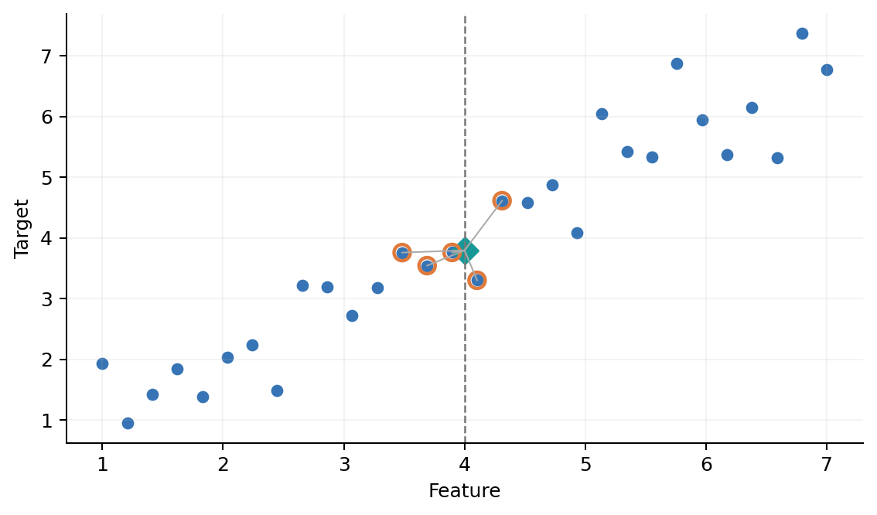
06 • INSTANCE-BASED
K-Nearest Neighbors — Regression
Predict a number from nearby target values
Regression rule
Average the target values of the K nearest neighbors.
Small K
Flexible • sensitive to noise • low bias
Large K
Smoother • more stable • may underfit
Key terms: distance • K • neighbors • averaging • feature scaling
E-COMMERCE • KNN REGRESSION
K = 5 | Net_Sales test RMSE ≈ 8,271 | R² = 0.496
Conclusion: predicted Net_Sales is the average target among the five nearest observations.
Supervised Machine Learning
14

Slide 19
BUSINESS INTERPRETATION • E-COMMERCE
E-commerce Results: What the Test Data Tells Us
CLASSIFICATION • Sales_Category (High / Low)
Model
Test accuracy
Business reading
Gradient Boosting
98.55%
A test-set classifier can help flag orders into High/Low sales groups for further review. Accuracy measures correct labels, but confusion-matrix errors and the cost of missed/highly flagged orders also matter.
Decision Tree
96.02%
Random Forest
94.39%
AdaBoost
93.67%
Logistic Regression
90.42%
REGRESSION • Target: Net_Sales
SVM (RBF)
86.44%
Linear Regression
MAE 1,474 • RMSE 2,975 • R² 0.818
KNN (K=35)
77.94%
Gradient Boosting
MAE 790 • RMSE 7,004 • R² 0.638
Decision Tree
MAE 869 • RMSE 7,152 • R² 0.623
Random Forest
MAE 785 • RMSE 7,552 • R² 0.580
Conclusion: classification results show separation of sales categories; regression metrics differ by error type and model. Validate before operational use.
SUPERVISED MACHINE LEARNING • VALLE RAMESH

Slide 20
COMPARISON
At a glance
What each algorithm learns and predicts
Algorithm
Core idea
Typical output
Scale-sensitive?
Linear Regression
Best-fit line
Continuous value
Usually no
Logistic Regression
Sigmoid probability
Class
Helpful
Decision Tree
Sequential splits
Class / value
No
Random Forest
Many trees + aggregation
Class / value
No
SVM
Maximum margin
Class / value
Yes
KNN
Nearest observations
Class / value
Yes
Regression → numeric target | Classification → class label
Supervised Machine Learning
15

Slide 21
BUSINESS INTERPRETATION • HOUSE-PRICE DATA
House-Price Practical: Findings and Business Limitations
Regression • Target: Price
Classification • Price_Category
Linear Regression
Logistic Regression: 53.0% accuracy
Test MAE ≈ ₹234,637
KNN: 53.25% • Decision Tree: 52.75%
Test RMSE ≈ ₹273,212
Random Forest: 50.75% • SVM: 52.75%
Test R² ≈ 0.001
With balanced test classes, results around 50–53% show limited class separation in this notebook run.
R² near zero indicates this model explains very little test-set price variation in this run.
Business conclusion: treat these outputs as baseline experiments, not dependable property valuations or automated pricing decisions. Review feature relevance, data quality, and model design before business deployment.
SUPERVISED MACHINE LEARNING • VALLE RAMESH

Slide 22
EVALUATION
Choosing the right metric
Match the metric to the task
Regression
Classification errors
MAE • MSE • RMSE • R²
Lower error is better; higher R² indicates more explained variation.
TP
FN
Correct +
Missed +
FP
TN
Classification
False +
Correct −
Accuracy • Precision • Recall • F1 Score
Use the confusion matrix to understand error types.
Always connect the metric to the business question.
Example: missing a positive case → Recall matters more.
False alarms are costly → Precision matters more.
Supervised Machine Learning
16

Slide 23
EVIDENCE-BASED TAKEAWAYS
Conclusion & Why These Conclusions Follow from the Results
E-commerce classification
Gradient Boosting test accuracy was 98.55%; Decision Tree 96.02% and Random Forest 94.39%. This supports the conclusion that the tested models learned useful High/Low sales-category patterns on the held-out split.
E-commerce Net_Sales regression
Linear Regression R² = 0.818 with RMSE ≈ 2,975, while tree/ensemble regressors had lower R² in this run. Therefore, the measured test results support a strong linear baseline for this target in this dataset—not a universal claim about algorithms.
House-price prediction
Linear Regression R² ≈ 0.001 and classification accuracies were about 50–53%. Therefore, the tested setup did not explain or separate price outcomes well enough for confident business use.
Overall learning
The same algorithm family can behave differently across datasets and targets. Conclusions are based on held-out test metrics, not training performance alone; further validation and business-cost analysis are needed.
Final message: models are decision-support tools; use them only after checking test performance, error costs, and business context.
SUPERVISED MACHINE LEARNING • VALLE RAMESH

Slide 24
CONCLUSION
Supervised Learning — Key Takeaways
Regression
Classification
Trees
Predict a continuous value
Predict a class / probability
Learn decision rules from splits
Ensembles
SVM
KNN
Combine models for robustness
Separate classes with maximum margin
Use nearby observations
Problem → Data → Train → Predict → Evaluate → Improve
Thank You
Supervised Machine Learning
17

