Slide 1
MUC01 – Retail Sales Pulse & Pipeline
Historical Retail Sales Analysis + Weekly API Pipeline
Presented by VALLE RAMESH

Slide 2
Part - 1: Retail Sales Pulse: Exploratory Data Analysis
5.1 — Basic Data Inspection
.read_csv()
Load the MUC01 retail sales CSV into a DataFrame.
Index(['transaction_id', 'date', 'store_id', 'store_city', 'category', 'product_name', 'units_sold', 'unit_price', 'revenue', 'discount_pct'], dtype='str')
df.columns
.shape
Output:- (107836, 10)
df.dtypes
df.dtypes provides data types of columns. Output:- date - str
date column to datetime format
df["date"] = pd.to_datetime(df["date"])
df.duplicated().sum()
Output:- np.int64(0)
2

Slide 3
5.1 — Inspection Results
head() — first 5 rows
transaction_id date store_id store_city category product_name units_sold unit_price revenue discount_pct TXN000001 2026-01-01 S01 Vijayawada Electronics Smart TV 2 3075.46 5843.37 5 TXN000002 2026-01-01 S01 Vijayawada Electronics Laptop 1 11598.06 11598.06 0 TXN000003 2026-01-01 S01 Vijayawada Electronics Tablet 3 5738.37 15493.60 10 TXN000004 2026-01-01 S01 Vijayawada Electronics Smart TV 3 3281.28 9351.65 5 TXN000005 2026-01-01 S01 Vijayawada Apparel Jeans 1 1917.14 1917.14 0
info() — structure
RangeIndex: 107836 entries, 0 to 107835 Data columns (total 10 columns) Non-Null Count: 107836 in all 10 columns Dtypes: float64(2), int64(2), object(6) Memory usage: ~8.2 MB
isnull().sum() — missing values
transaction_id 0 date 0 store_id 0 store_city 0 category 0 product_name 0 units_sold 0 unit_price 0 revenue 0 discount_pct 0
describe() — numeric summary
units_sold mean 2.58 | median 2 | max 13 unit_price mean ₹1,778 | median ₹488 | max ₹44,990 revenue mean ₹4,264 | median ₹1,035 | max ₹355,091 discount_pct mean 7.23% | median 5% | max 20%
Business observation: The dataset is complete, while the large gap between mean and median revenue indicates right- skewed transactions and possible high-value outliers.
3

Slide 4
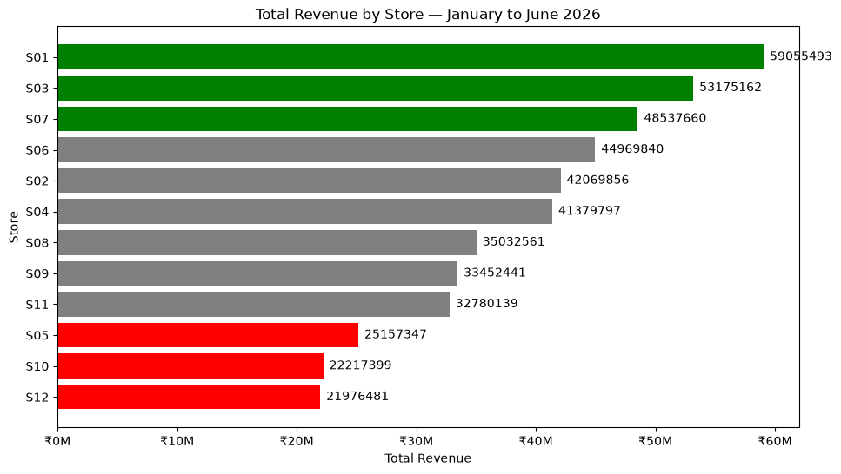
5.2 — Revenue by Store
Question: Which stores generated the most and least revenue over six months?
Steps to solve
1
Group revenue by store_id using sum().
2
Sort stores from highest to lowest
revenue.
3
Identify top 3 and bottom 3 stores.
4
Plot a ranked horizontal bar chart.
5
Interpret the performance gap for
Operations.
Graph output — Total Revenue by Store, January to June 2026
Outcome: S01 - ₹5.91 Cr is highest; S12 - ₹2.20 Cr is lowest.
4

Slide 5
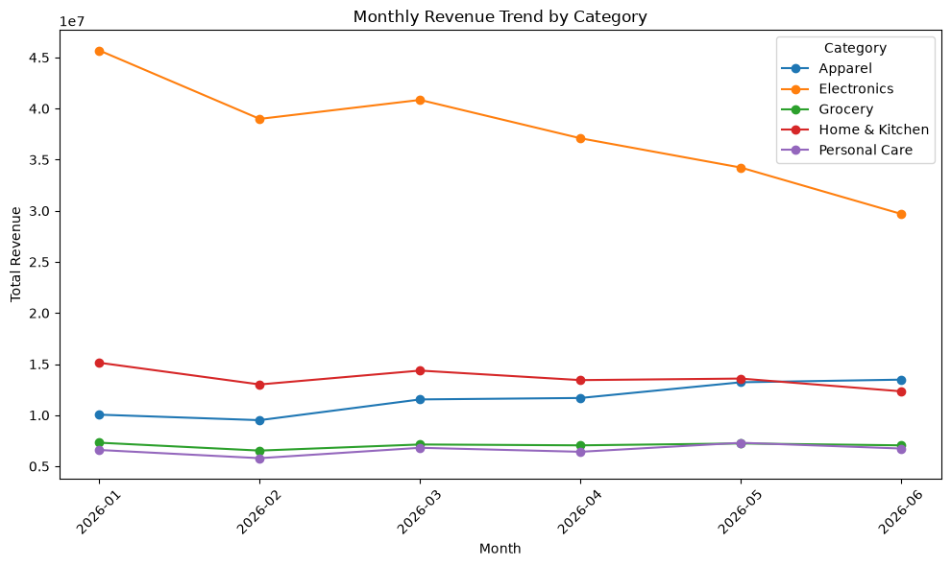
5.3 — Category Performance Over Time
Question: Which category is declining fastest and which is most stable?
Steps to solve
1
Convert date to monthly period.
2
Group revenue by category and month.
3
Create monthly revenue trend for all five categories.
4
Calculate January-to-June change.
5
Measure variation to identify the most
stable category.
6
Interpret the business signal.
Outcome: Electronics has the steepest decline (~₹1.60 Cr); Grocery is the most stable.
5

Slide 6
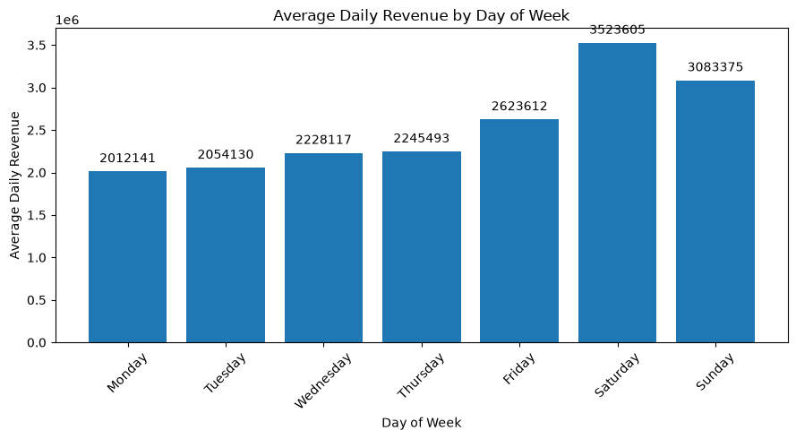
5.4 — Day-of-Week Pattern
Question: Which day performs best and worst?
Steps to solve
1
Extract day_of_week from the date
column.
2
Aggregate revenue for each actual date.
3
Calculate average daily revenue by
weekday.
4
Compare weekday averages.
5
Use the result to recommend promotion
timing.
Outcome: Saturday ₹35.24 lakh is best; Monday ₹20.12 lakh is worst.
6

Slide 7
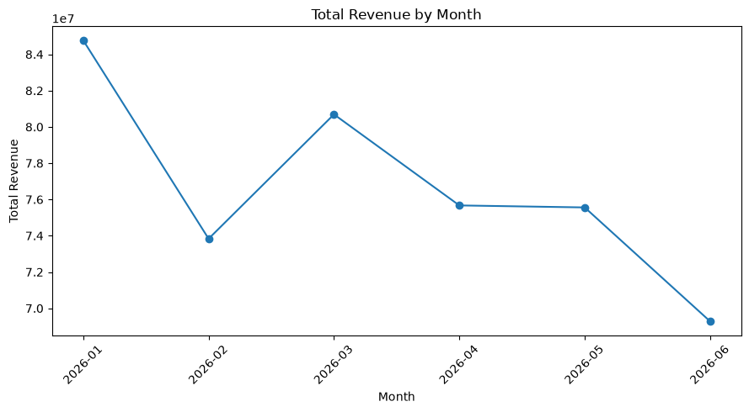
5.4 — Monthly Revenue Pattern
Second required output: total revenue by month
Steps to solve
1
Extract month from the date column.
2
Group all transactions by month.
3
Sum total revenue for each month.
4
Plot the monthly revenue trend.
5
Identify the strongest and weakest
month.
Outcome: January is highest (~₹8.48 Cr); June is lowest (~₹6.93 Cr).
7

Slide 8
5.5 — Anomaly Identification
Question: Which store’s weeks revenue fell more than 2 standard deviations below their own average?
Steps to solve
Text output — flagged anomalies
1
Create weekly periods from transaction dates.
Flagged store-week combinations S02 | May 18–24 | ₹11.73 lakh Possible reason: supply disruption S04 | Jun 8–14 | ₹11.37 lakh Possible reason: competitor activity S05 | Feb 9–15 | ₹6.56 lakh Possible reason: local event S10 | Apr 6–12 | ₹5.06 lakh Possible reason: pricing issue
2
Calculate weekly revenue for each store.
3
Calculate each store's mean and standard deviation.
4
Set threshold = mean − 2 × standard deviation.
5
Flag store-weeks below the threshold.
6
Suggest one possible business hypothesis per flag.
8

Slide 9
5.6 — Business Recommendation
Close Part 1 with one clear, data-backed action
Steps to solve
Business recommendation — text output
1
Select the most important finding.
Most important finding: Electronics declined by approximately ₹1.60 crore from January to June. Recommended action: Investigate the Electronics decline before allocating Q3 promotional spend. Supporting concern: S12 generated only ₹2.20 crore versus S01's ₹5.91 crore. Additional data required: Inventory availability, product-level pricing, competitor activity, store footfall and promotion data.
2
Name the category/store and
supporting number.
3
Recommend one specific operational
action.
4
State what additional data is needed
before final confidence.
9

Slide 10
5.7 — Weekly API Ingestion
Steps to solve
Text output — JSON structure
1
Open the clean JSON file.
Top-level JSON structure status request_id generated_at period record_count
data
data → list of transaction records Each transaction contains: transaction_id, date, store_id, store_city, category, product_name, units_sold, unit_price, revenue, discount_pct
2
Inspect the top-level structure.
3
Read metadata fields.
4
Extract the data list.
API period: 2026-06-24 to 2026-06-30
10

Slide 11
5.8 — Load & Verify Clean JSON
Question: Did the API metadata match the actual records loaded?
Steps to solve
Text output — clean JSON verification
1
Convert data list into a DataFrame.
Expected record count: 4291 Actual record count: 4291 Record count matches: True Period From: 2026-06-24 Period To: 2026-06-30 DataFrame created successfully.
2
Convert date to datetime.
3
Read expected record_count from
JSON.
4
Compare expected count with
DataFrame length.
5
Confirm the API period.
Outcome: Ingestion and metadata validation passed for all
4,291 weekly records.
11

Slide 12
5.9 — Validate Corrupt API Data
Question: What should the pipeline do when critical data quality issues are found?
Steps to solve
Text output — validation function
1
Load the corrupt JSON records.
Validation Summary ------------------ Total records checked: 4291 Null values found: 1 • row 12 → units_sold Negative revenue found: 1 • row 5 → revenue = -150.0 Invalid store IDs found: 1 • row 20 → store_id = S99 Status: FAILED — 3 issues detected. Pipeline halted.
2
Check for null values.
3
Check for negative revenue.
4
Check store IDs against valid stores.
5
Log every issue clearly.
6
Stop the pipeline when critical
issues exist.
12

Slide 13
5.10 — Transform & Aggregate
Question: Any category where this week's revenue is more than 20% below its 6-month daily average ?
Steps to solve
Text output — store summary
Text output — category summary
1
Calculate total weekly revenue
by store.
Top store: S03 — Guntur ₹20,37,560.19 Bottom store: S10 — Nellore ₹6,27,119.87 Top category: Electronics ₹57,64,693.85
Weekly category revenue Electronics ₹57,64,693.85 Apparel ₹32,28,573.10 Home & Kitchen ₹28,47,057.00 Grocery ₹16,17,278.70 Personal Care ₹15,57,807.63
2
Calculate total weekly revenue
by category.
3
Highest-revenue store —
top_store_this_week .
4
Calculate current daily category
revenue.
5
Compare with 6-month daily
baseline.
6
Flag categories more than
20% below baseline.
13

Slide 14
5.10 — Historical Baseline & Category Alert
Current weekly signal compared with the 6-month CSV baseline
Text output — category comparison
Interpretation
Category Change vs baseline ------------------------------------------ Apparel +20.2% Electronics -34.2% ← ALERT Grocery -1.1% Home & Kitchen -10.1% Personal Care +1.6% Alert rule: Current weekly daily average < 80% of the historical 6-month daily average.
• Electronics is the only category below the −20% threshold.
• Its current daily average is approximately ₹8.24 lakh.
• Historical daily average is approximately ₹12.52 lakh.
• The alert connects Part 1 historical analysis with Part 2 live monitoring.
Outcome: Electronics requires immediate investigation based on the defined 20% alert threshold.
14

Slide 15
5.11 — generate_weekly_summary()
Question: Can the pipeline produce the weekly Operations report automatically?
Steps to solve
Text output — final automated summary
1
Define generate_weekly_summary().
=== RETAIL SALES PULSE — WEEKLY SUMMARY === Period: 2026-06-24 to 2026-06-30 Records processed: 4291 Top store: S03 — Guntur (₹20.38 lakh) Bottom store: S10 — Nellore (₹6.27 lakh) Category alert: Electronics revenue down 34.2% vs 6-month baseline No alert: Apparel, Grocery, Home & Kitchen, Personal Care Pipeline status: COMPLETED SUCCESSFULLY
2
Load and process the clean JSON input.
3
Calculate top and bottom stores.
4
Calculate category alert against historical
baseline.
5
Print a structured weekly report.
6
Return a successful pipeline status.
15

Slide 16
Final Business Story
From historical exploration to an automated weekly sales pulse
PART 1
Understand
Explore six months of sales and identify store, category, time and anomaly patterns.
Prioritize
Electronics declined ~₹1.60 Cr from January to June and requires investigation.
KEY FINDING
PART 2
Automate
Ingest and validate the weekly JSON before transforming it.
LIVE SIGNAL
Alert
Electronics is 34.2% below its historical daily baseline.
BUSINESS VALUE
Act
Give the Operations Head a repeatable weekly signal for where to investigate.
Thank You — Any Queries ?
17

