Slide 1

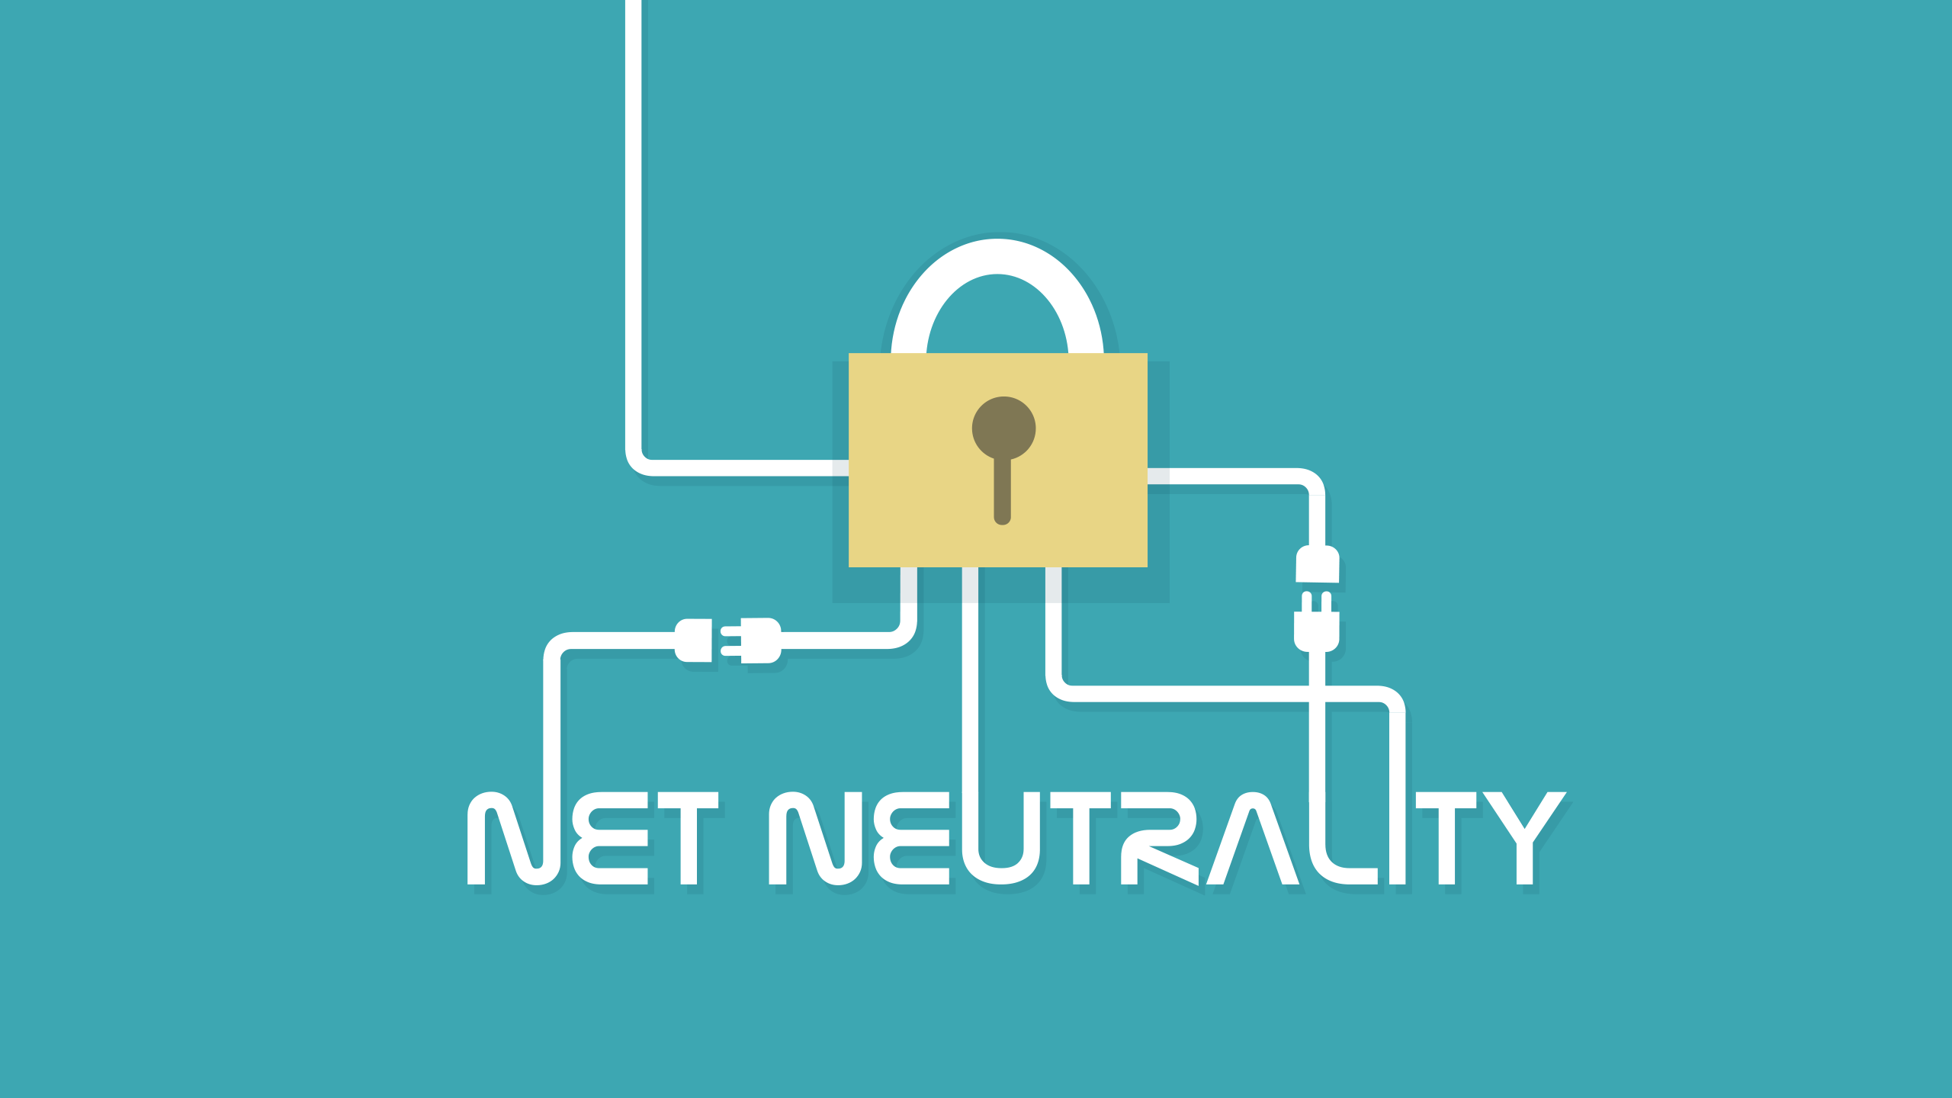
Advantages
Disadvantages
By: Ramesh Chapagain

Slide 2
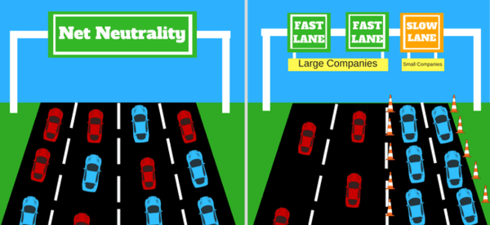
Network neutrality, or simply net neutrality, is the principle that Internet Service Providers (ISPs) must treat all internet communication equally, and not discriminate or charge differently based on user, content, website, platform, application, type of equipment, source address, destination address, or method of communication.
With
Without

Slide 3
History of Net Neutrality
-In early 2000, Internet Providers banned some customers using VPN and set up their own private network. This helped inspire net neutrality movement.
-The term “network neutrality” was first coined by Columbia University media law professor in 2003.
-In 2005, FCC (Federal Communications Commission) fined North Carolina service Provider Madison River and orders it to stop blocking phone calls over the internet. It was one of the first efforts to enforce net neutrality rules.
-In 2009, Apple was caught blocking iPhone users from making Skype calls. Apple stopped it under pressure from FCC.
-In 2015. FCC passes its sweeping net neutrality order, preventing the blocking or prioritizing of any internet traffic.
-In 2017, FCC votes to repeal the policies ending network neutrality regulations in US.

Slide 4
Advantages of Net Neutrality
Equality
Protection of innovation
Freedom of expression
Keeps price low for customers

Slide 5
Equality
Net neutrality ensures no one receive special treatment.
ISPs cannot slow down the websites or services of small businesses that cannot afford to pay for faster connections.
Small developers and web-content creators will be benefitted from this.

Slide 6
Protection of innovation
Freelancers and small businesses can have the same access as the big companies, which help them inspire to grow themselves in the business world.
There is no restriction on what parts of internet the people can access. This helps small companies and freelancers reach the people and market easily.
It promotes competition by providing a level playing field for new companies.

Slide 7
Freedom of Expression
There are no restrictions on what or how much anyone can upload or download besides connection rates.
ISPs cannot block or slow down webpages just because they don’t get benefit from them.
Web platforms can share their content without being censored by ISPs.

Slide 8
Keeps price low for customers
Net neutrality protects us from increasing prices and separate charges for accessing any websites or application.
ISPs cannot restrict certain contents and demand for additional price. There cannot be paid fast lanes and internet tolls.

Slide 9
Disadvantages of Net Neutrality
Unregulated aspects of the internet
Less income from internet may limit infrastructure improvements
Costly regulations
Same price for non-equivalent use of internet

Slide 10
Unregulated aspects of internet
Almost anything can be posted on the web because of freedom of speech and expression.
Illicit contents is widely available which can be dangerous, offensive, and Illegal. It might be difficult to remove from web.
It can be difficult to filter web contents to ISPs due to freedom of expression because some feelings that might be right to a group of people or religion might be offensive to other.

Slide 11
Less income from internet might limit infrastructure improvement
If ISPs do not charge extra for their services, they may not be able to invest more on the infrastructures.
Large amount of data are consumed without paying. This money could be used to expand the network.

Slide 12
Costly regulations
Federal Communications Commission (FCC) must monitor ISPs’ compliance with the net neutrality rules which might be very costly.
When the net neutrality was regulated back in 2017, CenturyLink estimated that meeting the net neutrality rules created over 5000 hours of extra paperwork, costing over $134,000 each year.
The money for net neutrality rule compliance can be used to develop better infrastructures.

Slide 13
Same price for non-equivalent use of internet
Unfair to both consumers and creators.
Low-Data consumers must pay as much as high-Data consumers.
Some data in the web carry more value than others. Net neutrality might create unfairness to the high-quality content creators.

Slide 14
Conclusion
Net neutrality is the topic whose debate is still going on.
There has been only few evidence of unfairness by ISPs.
I believe that internet grew well in the absence of net neutrality and big companies like, google, Facebook, YouTube, and twitter grew from small scale to big scale without compliance with net neutrality.
The cost used to maintain the policy is very high which can be used instead for technological development.
Some rules still can be regulated so that the small companies and freelancers can strive in the big market.

