Slide 1
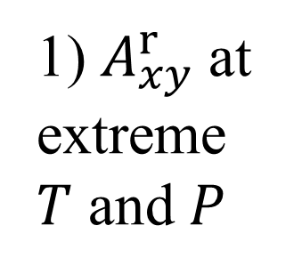
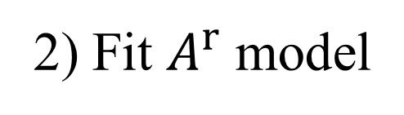
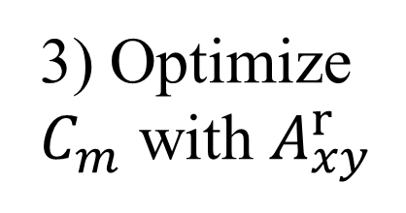
Exp. Data
ms2
No
Self-consistent?
Yes
Technical accuracy
ex-LJ
1) $A_{xy}^{r}$at extreme $T$ and $P$
3) Optimize
$C_{m}$ with $A_{xy}^{r}$
Hybrid Data Set
FEOS
2) Fit $A^{r}$ model

