Slide 1
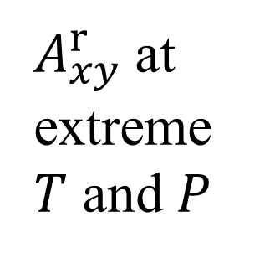
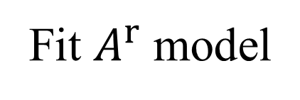
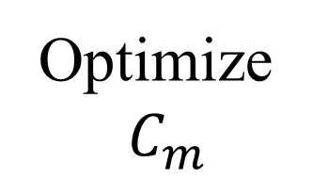
Exp. Data
ms2
FEOS
ex-LJ
No
Converged?
Yes
ex-LJ
$A_{xy}^{r}$at extreme $T$ and $P$
Optimize
$$C_{m}$$
Hybrid Data Set
FEOS
Fit $A^{r}$ model

