Slide 1



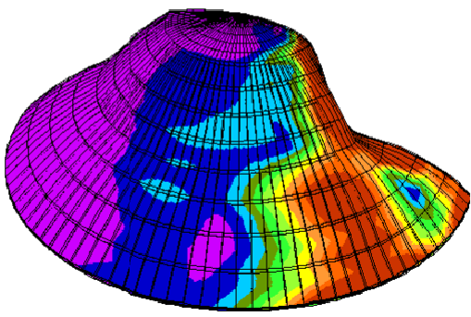
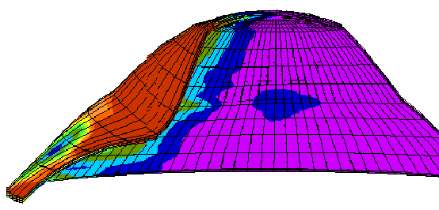
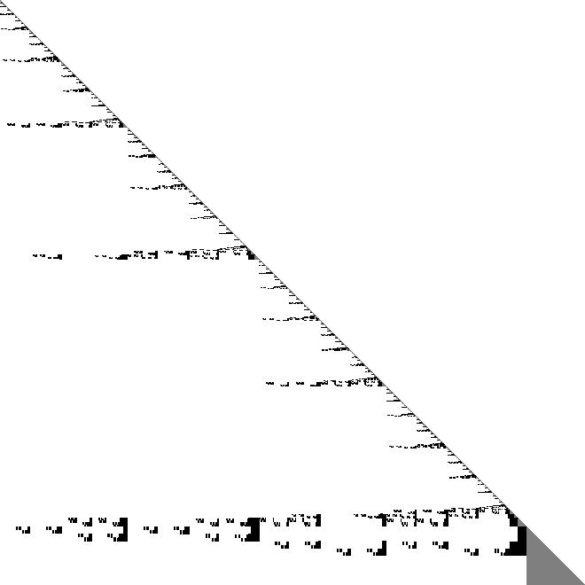
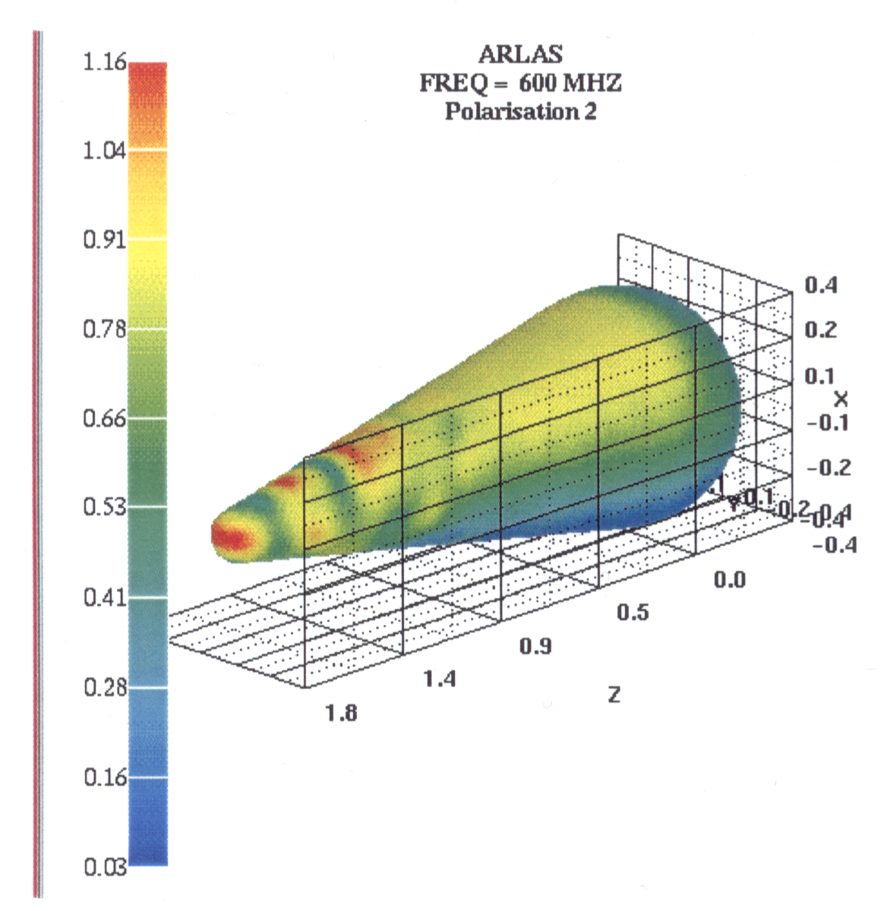
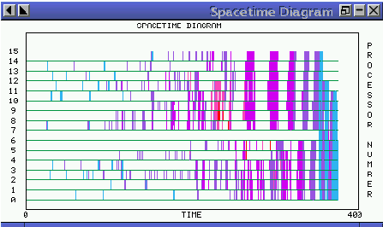
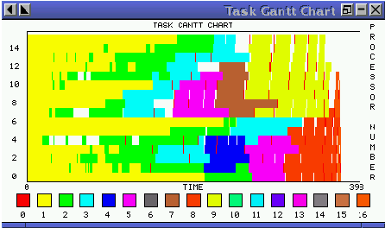
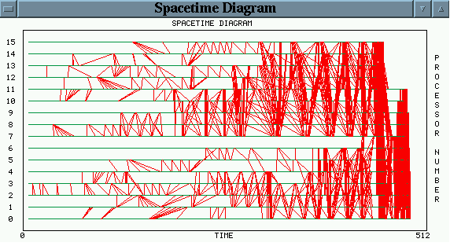
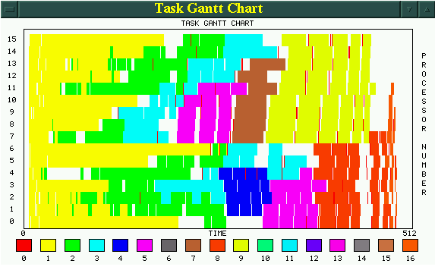
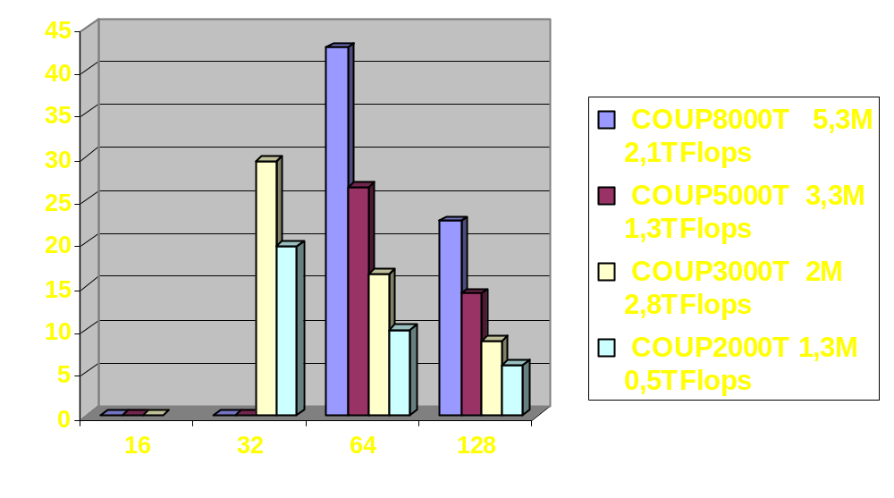
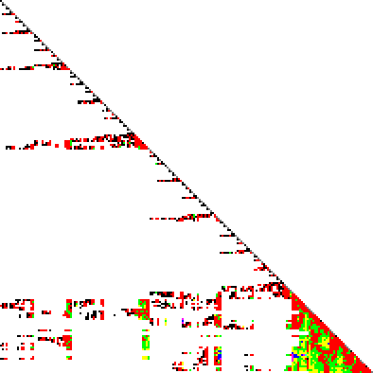
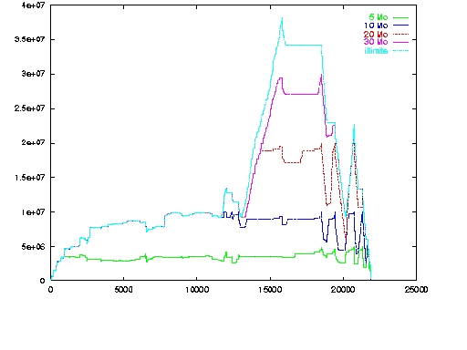
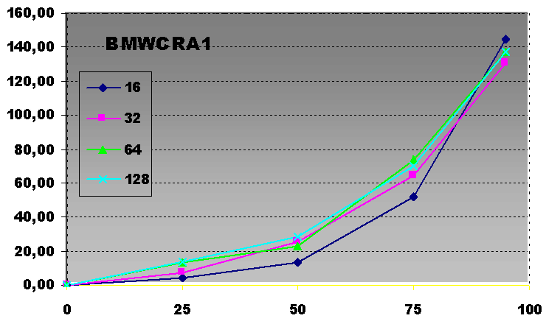
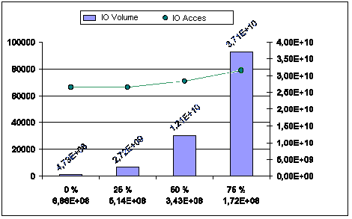







A Parallel Direct Solver for Very Large Sparse SPD Systems
http://www.labri.fr/~ramet/pastix/
http://www.labri.fr/scalapplix/
Solving large sparse symmetric positive definite systems Ax=b of linear equations is a crucial and time-consuming step, arising in many scientific and engineering applications.
This work is a research scope of the new INRIA project (UR Futurs)
is a scientific library that provides a high performance solver for very large sparse linear systems based on direct and ILU(k) iterative methods
Many factorization algorithms are implemented with simple or double precision (real or complex): LL^{t} (Cholesky), LDL^{t} (Crout) and LU with static pivoting (for non symetric matrices but with symetric structures)
The library uses the graph partitioning and sparse matrix block ordering package
is based on efficient static scheduling and memory management to solve problems with more than 10 millions unknowns
An available version of is currently developped
Software Overview
Crucial Issues
Scotch + HAMD
  Hybrid algorithm based on incomplete Nested Dissection, the resulting subgraphs being ordered with an Approximate Minimun Degree method with constraints (tight coupling)
Symbolic block factorization
  Linear time and space complexities
Static scheduling
  Logical simulation of computations of the block solver
  Cost modeling for the target machine
  Task scheduling & communication scheme
Parallel supernodal factorization
  Total/Partial aggregation of contributions
  Memory constraints
Block symbolic
matrix
BLAS and MPI
cost modeling
Number of
processors
Exploitingthree levels of parallelism
  Manage parallelism induced by sparsity (block elimination tree)
  Split and distribute the dense blocks in order to take into account the potential parallelism induced by dense computations
  Use optimal blocksize for pipelined BLAS3 operations
Partitioning and mapping problems
  Computation of precedence constraints laid down by the factorization algorithm
  (elimination tree)
  Workload estimation that must take into account BLAS effects and communication latency
  Locality of communications
  Concurrent task ordering for solver scheduling
  Taking into account the extra workload due to the aggregation approach of the solver
Heterogeneous architectures (SMP nodes)
Task graph
Matrix partitioning
Mapping and
Scheduling
Local data
Task scheduling
Communication
scheme
Memory
constraints
Parallel factorization
New communication
scheme
Reduction of
memory overhead
Mapping and Scheduling
Industrial Applications (CEA/CESTA)
Partitioning (step 1): a variant of the proportionnal mapping technique
Mapping (step 2): consists in a down-top mapping of the new elimination tree induced by a logical simulation of computations of the block solver
Yield 1D and 2D block distributions
  BLAS efficiency on compacted small supernodes → 1D
  Scalability on larger supernodes → 2D
Structural engineering 2D/3D problems (OSSAU)
  Computes the response of the structure to various physical constraints
  Non linear when plasticity occurs
  System is not well conditionned: not a M-matrix, not diagonally dominant
  Highly scalable parallel assembly for irregular meshes (generic step of the library)
  COUPOL40000 (>26 10⁶ unknowns, >10 Teraflops) has been factorized in 20sec on 768 EV68 procs → 500 Gigaflops/s (about 35% peak performance)
Electromagnetism problems (ARLAS)
  3D Finite Elements code on the internal domain
  Integral equation code on the separation frontier
  Schurr complement to realize the coupling
  2.5 10⁶ unknowns for sparse system and 8 10³ unknowns for dense system on 256 EV68 procs → 8min for sparse factorisation and 200min for Schurr complement (1.5sec per forward/backward substitution)
sparse
2D block distribution
coupling
dense
1D block distribution
IBM SP3 (CINES) with 28 NH2 SMP Nodes (16 power3) and 16 Go shared memory per node
Hybrid iterative-direct block solver
Allocated memory
Irregular (sparse)
Scalable problems
Partitioning
Scheduling
Mapping
HPC
Ressources
Communication
Applications
Memory Access during factorization
Level fill values for a 3D F.E. mesh
Homogeneous
network
In-Core
10⁶
OSSAU
Partial aggregation to reduce the memory overhead
  Memory overhead due to aggregations is limited to a user value
  Volume of additional communications is minimized
  Additional messages have an optimal priority order in the initial communication scheme
  A reduction about 50% of the memory overhead induces less than 20% of time penalty on many test problems
  AUDI matrix (PARASOL collection, n=943 10³, nnzl=1.21 10⁹, 5.3 Teraflops) has been factorized in 188sec on 64 Power3 procs with a reduction about 50% of the memory overhead (28 Gigaflops/s)
Toward a compromise between memory saving and numerical robustness
ILU(k) block preconditioner obtained by an incomplete block symbolic factorization
NSF/INRIA collaboration
Cluster of SMP
Partial Agg.
10⁷
ARLAS
Industrial
% Time penalty
Architecture complexity
Heterogeneous
network
Out-of-Core
3D unknowns
10⁸
Fluid Dyn.
Academic
% Reduction of the memory overhead
Mol. Chim.
P. Amestoy (Enseeiht-IRIT), S. Li and E. Ng (Berkeley), Y. Saad (Minneapolis)
Out-of-Core technique compatible with scheduling strategy
  Manage computation/IO overlap with Asynchronous IO library (AIO)
  General algorithm based on the knowlege of the data access
  Algorithmic minimization of the IO volume in function of a user memory limit
  Work in progress, preliminary experiments show moderate increasing of the number of disk requests
Articles in journal
Parallel Computing, 28(2):301-321, 2002. P. Hénon, P. Ramet, J. Roman
Numerical Algorithms, Baltzer, Science Publisher, 24:371-391, 2000. D. Goudin, P. Hénon, F.Pellegrini, P. Ramet, J. Roman, J.-J. Pesqué
Concurrency: Practice and Experience, 12:69-84, 2000. F. Pellegrini, J. Roman, P. Amestoy
Conference’s articles
Tenth SIAM Conference PPSC’2001, Portsmouth, Virginie, USA, March 2001. P. Hénon, P. Ramet, J. Roman
Irregular'2000, Cancun, Mexique, LNCS 1800, pages 519-525, May 2000. Springer Verlag. P. Hénon, P. Ramet, J. Roman
EuroPar'99, Toulouse, France, LNCS 1685, pages 1059-1067, September 1999. Springer Verlag. P. Hénon, P. Ramet, J. Roman

