Slide 1
Activation-Level Preference Unlearning for Robust LLM Recommenders
Final Project Presentation
ECE6514 Trustworthy Machine Learning | Fall 2025
Team Members: Mack Werner, Gary Ruppert, Chuan Liu, Jacob Ramey*
*Equal Contributors

Slide 2
Motivation
LLM recommenders often give different answers for prompts that mean the same thing
Small prompt changes → large output shifts
"What movie should I watch?"
"Any movie recommendations?"
LLM
Inception
The Matrix
Similar prompt, different results

Slide 3
Motivation Cont.
Goal: Make recommendations trustworthy and consistent.
"What movie should I watch?"
"Any movie recommendations?"
LLM
Inception

Slide 4
Method Overview
Prompt-perturbation experiments
Activation extraction & saliency maps
Identify sensitive neurons/heads
Apply selective dampening or gradient projection
Re-evaluate drift reduction

Slide 5


ARC Environment Setup / Github
Tinkercliffs : A100_normal_q partition
8 CPUs / 1 GPU / 64GB Memory
Docker image running via apptainer on ARC
rameyjm7/llm-preference-unlearning | Docker Hub
Github Repo: rameyjm7/llm-preference-unlearning
Github Repo 2: https://github.com/Thekicker35/Trustworthy-Machine-Learning-Final-Project/tree/main

Slide 6
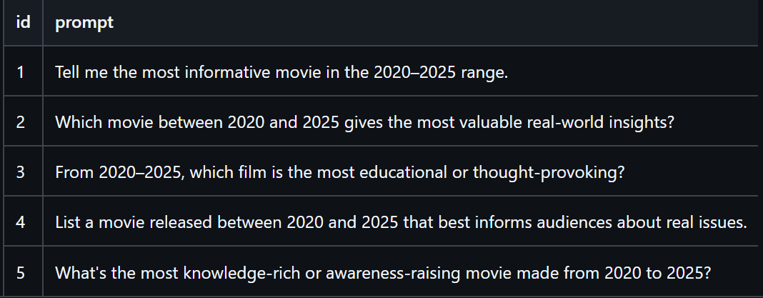
Prompt-perturbation experiments
Lets ask the same question in different ways

Slide 7
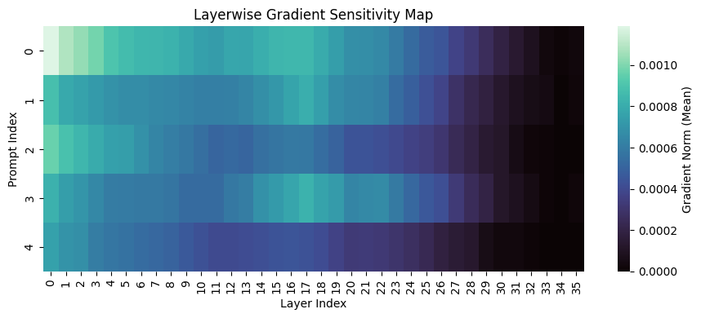
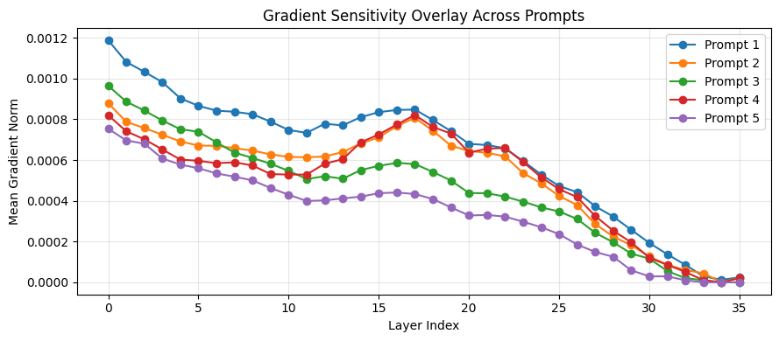
Activation extraction & saliency maps
Where is the model most sensitive to our inputs?
Identify sensitive neurons

Slide 8
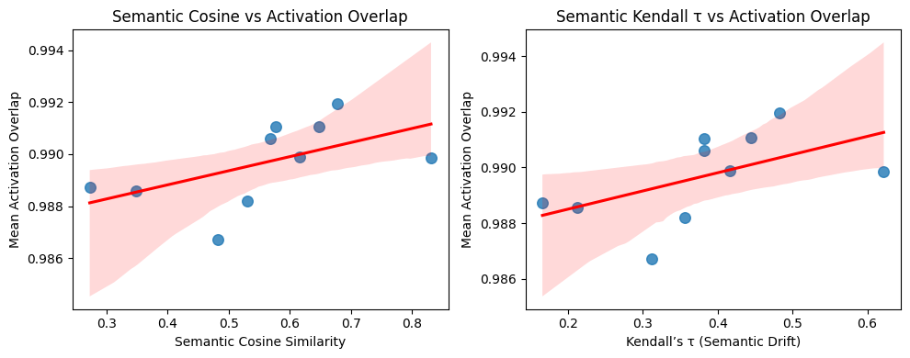
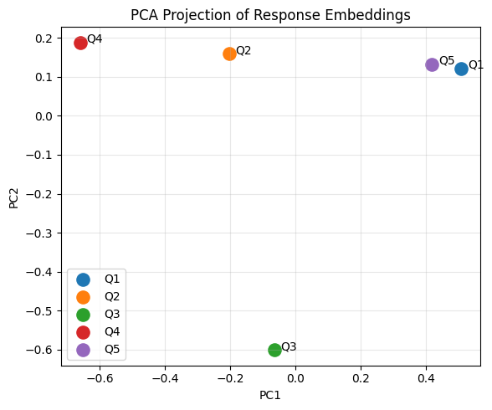
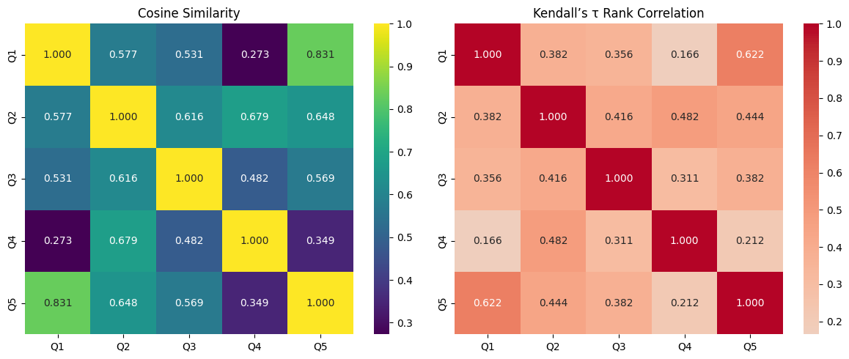
Other methods for similarity...
Cosine Similarity​
Activation Overlap​

Slide 9
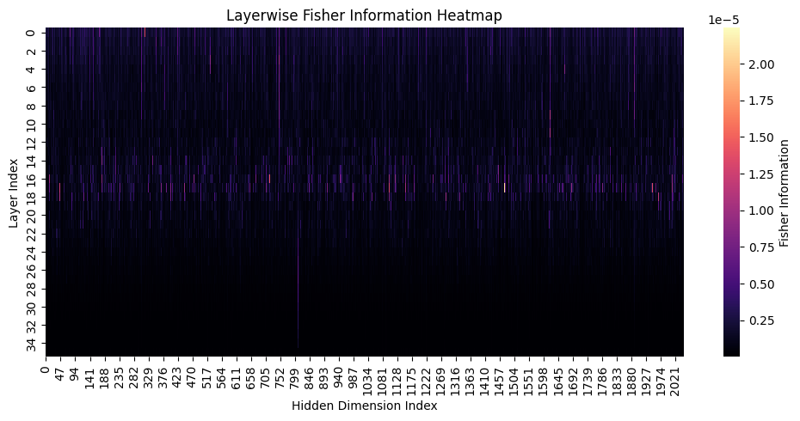
Other methods for similarity...
Fisher Information Heatmaps

Slide 10
Preliminary Results
"avg_embedding_similarity" | 0.860328062375386
"avg_ranking_correlation" | -0.197889182058047
"Recommend 5 movies similar to The Matrix"
Inception (2010)
Blade Runner 2049 (2017)
Ex Machina (2014)
Snowpiercer (2013)
The Truman Show (1998)
"What are some movies resembling the Matrix? Top 5."
Inception (2010)
Blade Runner 2049 (2017)
Terminator Genisys (2015)
Ex Machina (2014)
Ghost in the Shell (2017)
"Can you recommend five films akin to The Matrix?"
Inception (2010)
Blade Runner 2049 (2017)
Ex Machina (2014)
Snowpiercer (2013)
Neon Genesis Evangelion (anime series)
"Suggest five films like The Matrix"
Inception (2010)
District 9 (2009)
Blade Runner 2049 (2017)
Ghost in the Shell (2017)
Ex Machina (2014)
"List 5 movies that are similar to The Matrix."
Inception (2010)
Blade Runner 2049 (2017)
Cloud Atlas (2012)
Ghost in the Shell (2017)
Atomic Blonde (2017)
"Top 5 movie suggestions similar to The Matrix"
Inception (2010)
Ghost in the Shell** (2017)
Blade Runner 2049 (2017)
Ex Machina** (2014)
Ready Player One** (2018)

Slide 11
Key Insights
Fisher Information Matrices and Location of sensitive nuerons can provide valuable insights into how a model works
LLM responses can vary greatly with slight variations in how prompts are written
Next Steps
Re-evaluate and compare FIM from baseline to post-training

Slide 12
Questions?

Slide 13
References
Fan, C., Zhao, Y., & Liu, S. (2024). SalUn: Gradient-Based Saliency Unlearning for Deep Neural Networks. IEEE/CVF Conference on Computer Vision and Pattern Recognition. Retrieved from https://arxiv.org/abs/2403.04783
Foster, J., Sattigeri, P., & Zhou, S. (2024). Selective Synaptic Dampening: Towards Efficient and Targeted Machine Unlearning. AAAI Conference on Artificial Intelligence. Retrieved from https://arxiv.org/abs/2402.08728
Gandikota, R. (2023). Erasing Concepts from Diffusion Models. IEEE/CVF International Conference on Computer Vision. Retrieved from https://arxiv.org/abs/2303.07345
Golatkar, A., Achille, A., & Soatto, S. (2020). Eternal Sunshine of the Spotless Net: Selective Forgetting in Deep Networks. IEEE/CVF Conference on Computer Vision and Pattern Recognition. Retrieved from https://arxiv.org/abs/1911.04933
Hamad, M. (2025). Decoupling Popularity Bias and User Fairness in LLM-Based Recommendation Systems. Aalto University. Retrieved from https://aaltodoc.aalto.fi/items/68d19d5f-3e81-463a-93d8-9bdb52cfcf98
Hu, J., Zhang, D., & Li, X. (2025). Relearning Attacks: Recovering Forgotten Knowledge in Machine Unlearning Models. International Conference on Learning Representations. Retrieved from https://arxiv.org/abs/2503.05821
Jang, M., Kim, S., & Choi, E. (2025). Negative Preference Optimization for LLM Unlearning. arXiv. Retrieved from https://arxiv.org/abs/2502.09317
Kim, S., Kang, H., Choi, S., Kim, D., Yang, M., & Park, C. (2024). Large Language Models Meet Collaborative Filtering: An Efficient All-Round LLM-Based Recommender System. Proceedings of the 30th ACM SIGKDD Conference on Knowledge Discovery and Data Mining, (pp. 1395–1406). Retrieved from https://doi.org/10.1145/3637528.3671931
Ko, H., Park, J., & Lee, S. (2025). Rethinking Gradient Directions for Machine Unlearning. Neural Information Processing Systems. Retrieved from https://arxiv.org/abs/2501.01234
Kurmanji, M., Bernstein, J., & Ghalebikesabi, S. (2024). Machine Unlearning: From Data Deletion to Concept Erasure. arXiv. Retrieved from https://arxiv.org/abs/2408.08949
Kurmanji, M., Ghalebikesabi, S., & Bernstein, J. (2023). Selective Disobedience in Neural Networks: Targeted Forgetting via Gradient Reversal. Advances in Neural Information Processing Systems. Retrieved from https://arxiv.org/abs/2311.17082
Li, X., Zhao, C., Zhao, H., Wu, L., & He, M. (2024). GanPrompt: Enhancing Robustness in LLM-Based Recommendations with GAN-Enhanced Diversity Prompts. arXiv. Retrieved from https://arxiv.org/abs/2408.09671
Liu, J., Yan, X., Li, D., Zhang, G., Gu, H., Zhang, P., . . . Gu, N. (2025). Improving LLM-powered Recommendations with Personalized Information. Proceedings of the 45th International ACM SIGIR Conference on Research and Development in Information Retrieval, (pp. 2560–2565). Retrieved from https://doi.org/10.1145/3726302.3730211
Peng, Q., Liu, H., Huang, H., Yang, Q., & Shao, M. (2025). A Survey on LLM-Powered Agents for Recommender Systems. arXiv. Retrieved from https://arxiv.org/abs/2502.10050
Sun, C., Liang, Y., Yang, Y., Xu, S., Yang, T., & Tong, Y. (2024). Direct Preference Optimization for LLM-Enhanced Recommendation Systems. arXiv. Retrieved from https://arxiv.org/abs/2410.05939
Wang, Z., Gao, M., Yu, J., Gao, X., Nguyen, Q., Sadiq, S., & Yin, H. (2025). ID-Free Not Risk-Free: LLM-Powered Agents Unveil Risks in ID-Free Recommender Systems. Proceedings of the 45th International ACM SIGIR Conference on Research and Development in Information Retrieval, (pp. 1902–1911). Retrieved from https://doi.org/10.1145/3726302.3730003
Wu, L., Zheng, Z., & Qiu, Z. (2024). A Survey on Large Language Models for Recommendation. World Wide Web. Retrieved from https://doi.org/10.1007/s11280-024-01291-2
Zhu, K., Wang, J., Zhou, J., & Xie, X. (2024). PromptRobust: Towards Evaluating the Robustness of Large Language Models on Adversarial Prompts. Proceedings of the 1st ACM Workshop on Large AI Systems and Models with Privacy and Safety Analysis, (pp. 57–68). Retrieved from https://doi.org/10.1145/3689217.3690621
Zhu, X., & Jang, H. (2025). Representation-Based Machine Unlearning for Large Language Models. arXiv. Retrieved from https://arxiv.org/abs/2501.05542

