Slide 1

The Geography of Gender Pay Gap in THE UK: time for a reform
Group 5

Slide 2
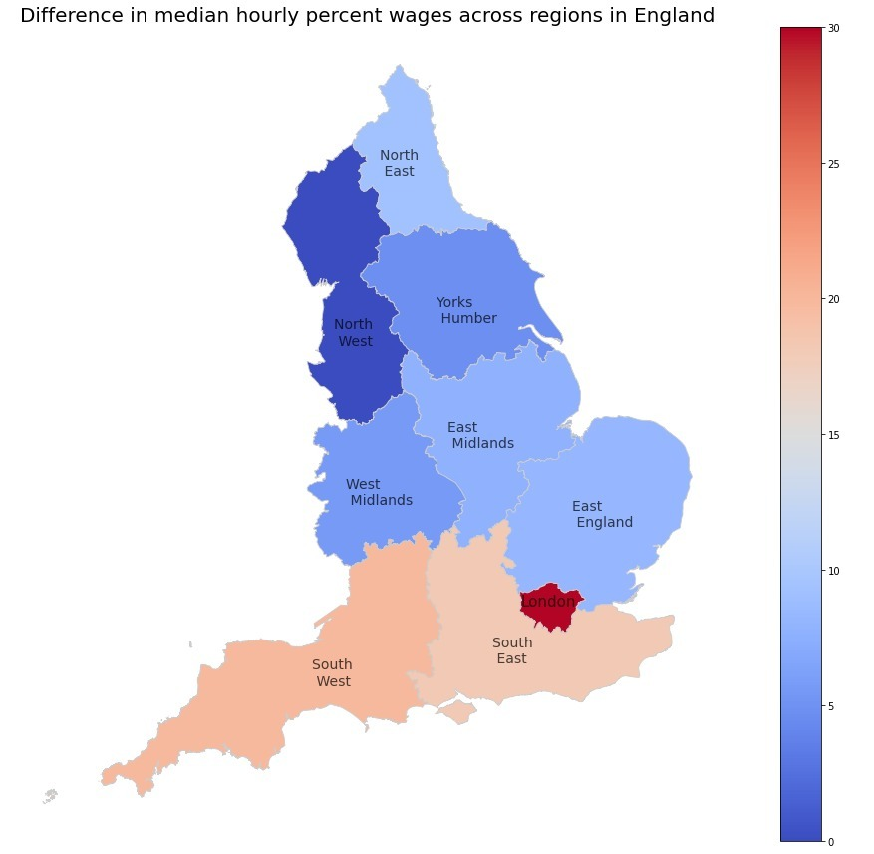
Wage gap is at least 10% in each region
Close to 30% wage gap on the South side
Policies should be implemented on each region/city
Regulatory body to monitor each region/city

Slide 3
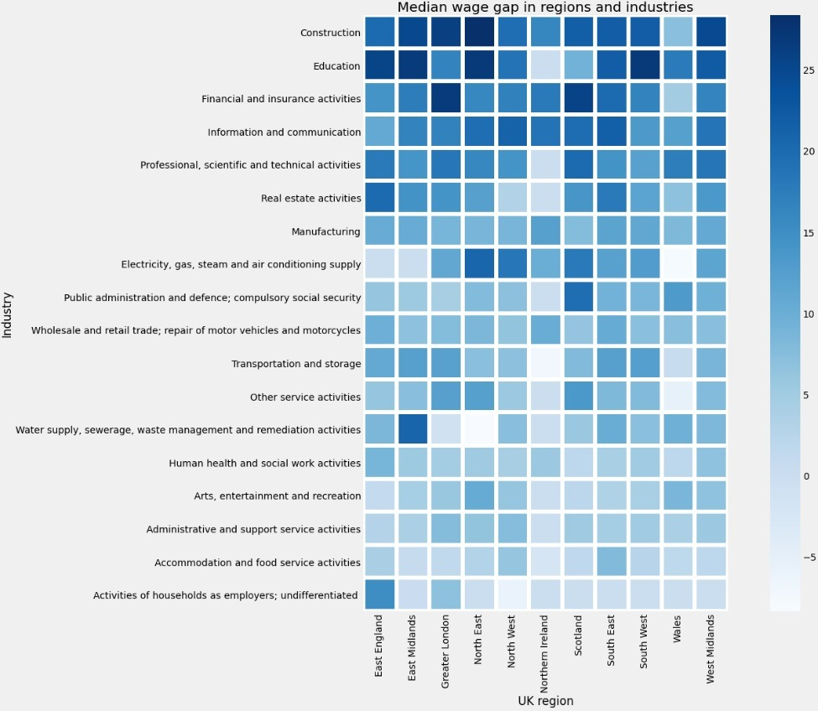
Average wage gaps are higher in industries rather than regions

Slide 4
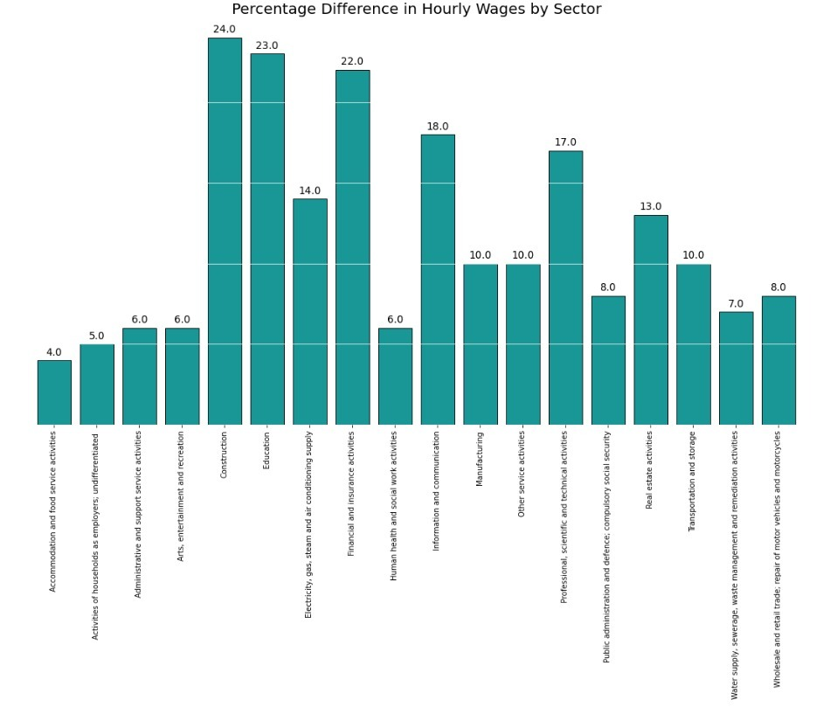
Top industries by highest wage gap are:
Construction sector
Education sector
Financial sector
Introduce female targeted career ads for open positions in top 3 sectors
Training for female inside top 3 industries
Scholarships for women pursuing degrees in one of the 3 sectors

Slide 5
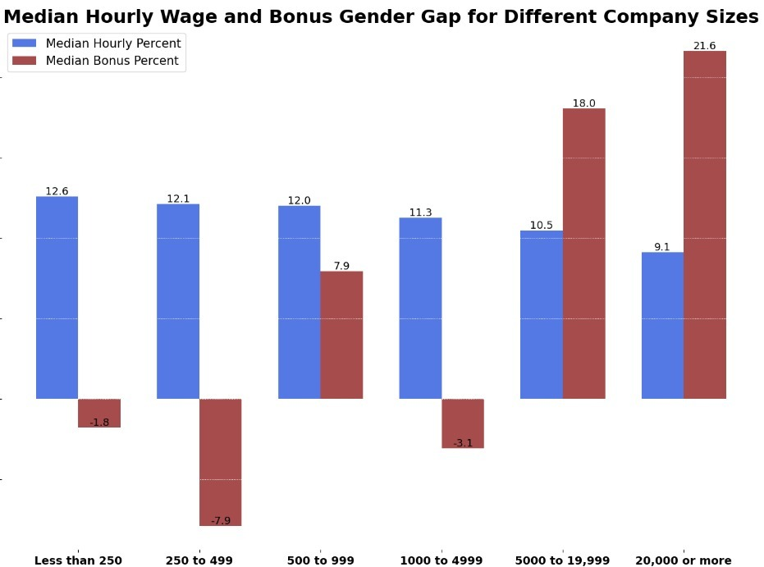
Anonymized gender pay gap data submitted annually to public sources
Regulatory body overlooking:
Median wage gap in smaller companies
Average bonuses and promotions for large corporations

Slide 6
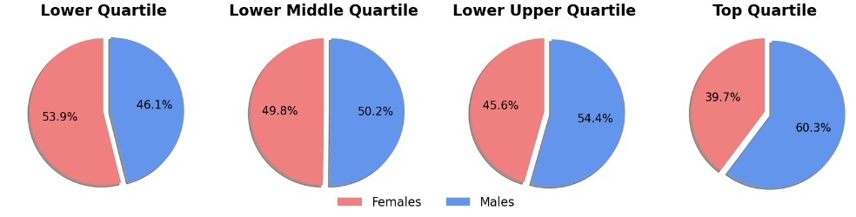
Mandatory promotion negations on yearly bases for each company
2030 target including 50/50 ratio in top 2 quartiles for each company
Workplace Equality Fund
Company tax relief for employees on maternity/paternity leave

Slide 7
“NO Gender 2030”
Regulatory body overlooking gender pay gap
Companies obligated to submit gender pay data to public sources
Company tax relief for employees on maternity/paternity leave
Mandatory yearly promotion negotiations
Gender pay gap in each wage quartile maximum 5%
Workplace equality fund to promote women in top management positions
Instruct company to revisit gender-neutrality policies

Slide 8
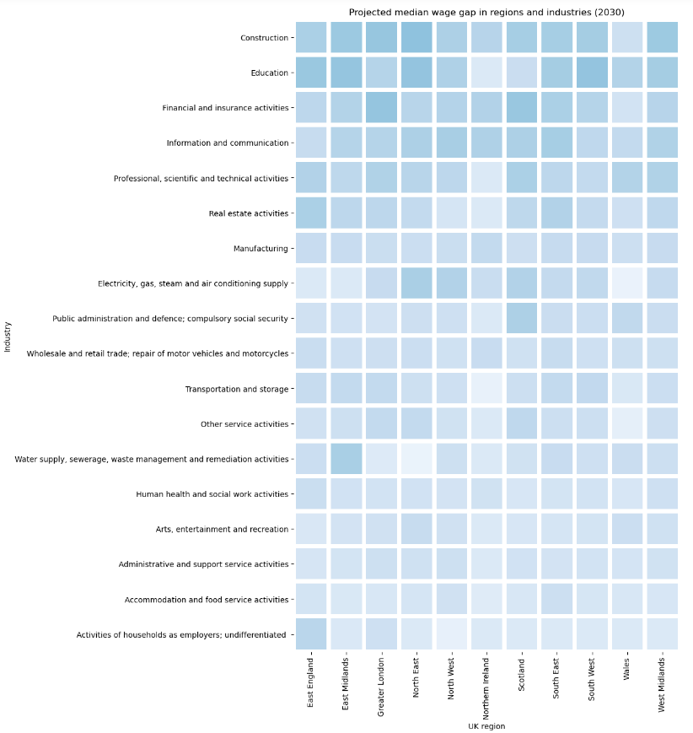
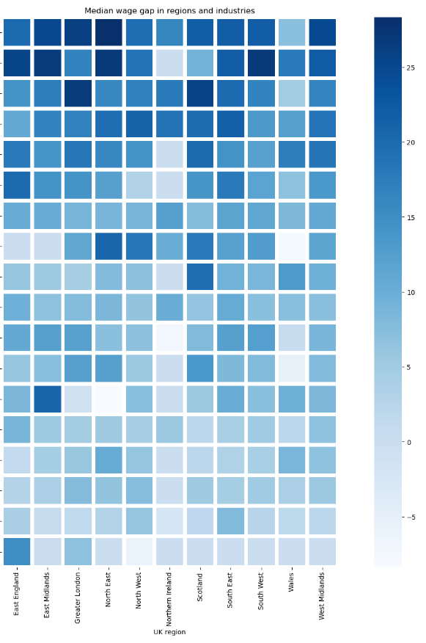

Slide 9

Thank you for viewing! Any questions?

