Slide 1



Phishing
Awareness Training
-Ram Gangul
Your Essential Guide to Recognizing Attacks & Staying Safe Online
Get Started

Slide 2
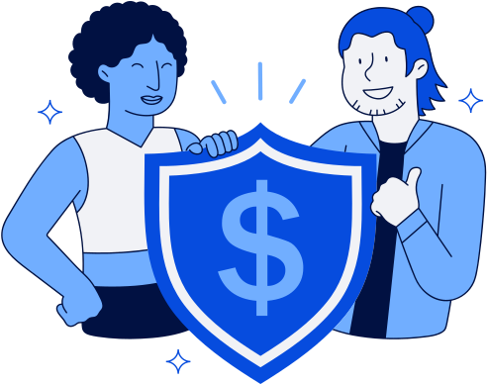

What is
Phishing?
Phishing is a type of cyber attack where criminals impersonate trusted entities — such as banks, companies, or colleagues — to trick individuals into revealing sensitive information like passwords, credit card numbers, or personal data.
It is the #1 cyber security threat worldwide, responsible for over 90% of data breaches. Attackers use deceptive emails, fake websites, and social engineering to exploit human trust rather than technical vulnerabilities.

Slide 3
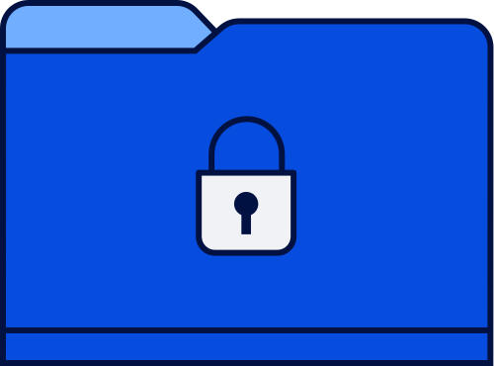
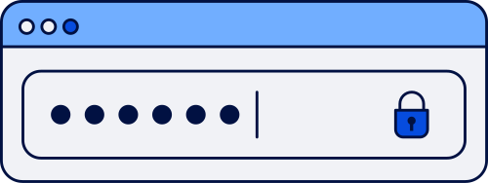
Thynk Unlimited
How to
Recognize Phishing Emails
Suspicious Sender
Urgent Language
Emails from unknown or misspelled domains (e.g., support@paypa1.com) are red flags. Always verify the sender's full email address carefully.
Phishing emails use urgency like "Act now!" or "Your account will be closed!" to pressure you into clicking links without thinking.
Spelling & Grammar Errors
Suspicious Links
Requests for Personal Info
Poor grammar, odd phrasing, and typos are common signs of phishing. Professional organizations send well-written, polished communications.
Hover over links before clicking. Phishing URLs often mimic real sites with subtle changes like extra characters or wrong domain endings.
Legitimate companies rarely ask for passwords, SSNs, or credit card numbers via email. Never share sensitive data through email links.

Slide 4
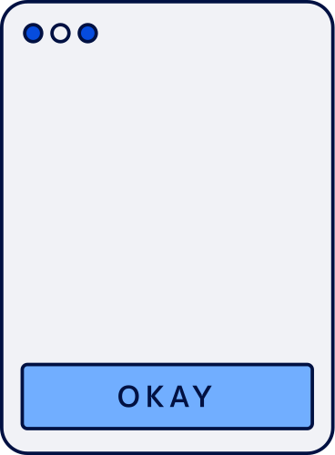
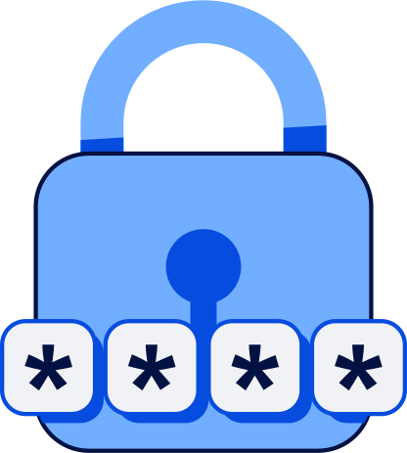
Spotting Fake
Websites
Check the URL carefully for misspellings or extra characters. Always look for HTTPS and a padlock icon in the browser bar. Verify the domain name matches the official site exactly.
Watch for poor design, broken layouts, or low-quality images. Never click links directly from emails — type the URL manually. When in doubt, close the page and contact the organization directly.

Slide 5





Social Engineering
Tactics Used by
Attackers
Pretexting: Attackers create a fabricated scenario (e.g., posing as IT support or a bank) to trick victims into revealing sensitive information or granting access.
Baiting: Attackers lure victims with something enticing — like a free download or USB drive — that secretly delivers malware or harvests credentials.

Slide 6


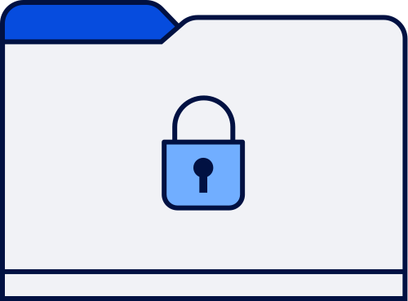


Best Practices to
Avoid Phishing
✔ Verify the sender's email address carefully before responding or clicking any links. Look for subtle misspellings or unusual domains that mimic legitimate organizations.
✔ Hover over links before clicking to preview the URL. Enable multi-factor authentication (MFA), report suspicious emails to IT, and keep your software and antivirus updated at all times.

Slide 7

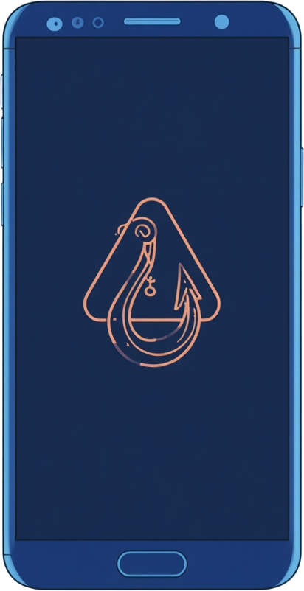
Real-World
Phishing Examples
Fake Invoice Scam: Employees at a mid-size firm received emails mimicking a trusted vendor, requesting urgent payment to a new account. The spoofed domain looked nearly identical, and thousands were transferred before fraud was detected.
CEO Fraud: Staff received emails appearing to be from their CEO requesting a wire transfer. The attacker used a lookalike domain and urgent language. Always verify financial requests through a secondary channel before acting.

Slide 8
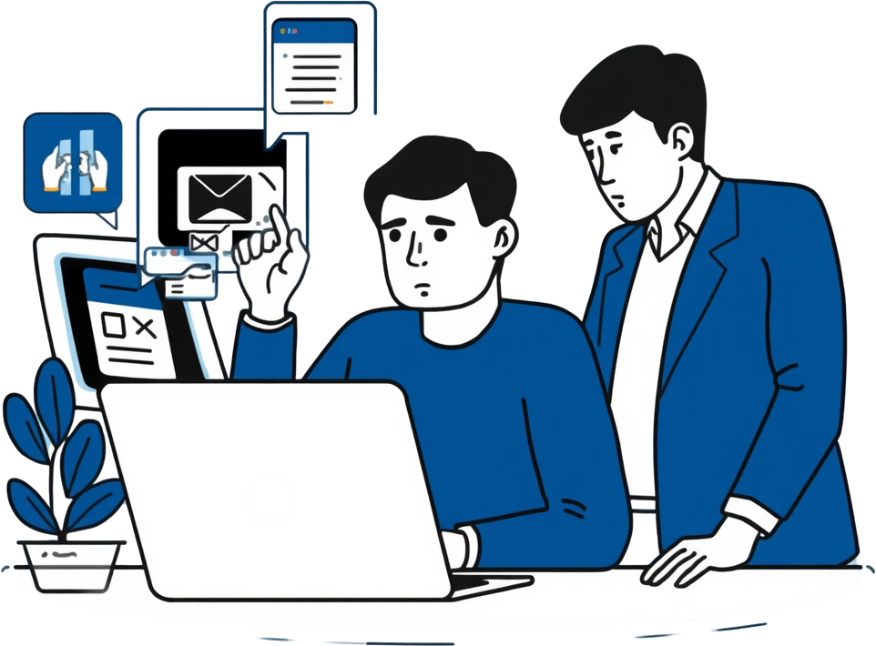
Test Your
Knowledge!
1. The sender’s address looks slightly misspelled. Is it safe? Answer: No, small changes often signal a fake sender.
2. An email claims your account will be closed in one hour unless you click a link. What does this mean? Answer: It’s a pressure tactic often used in scams.
3. A message asks you to download an attachment you weren’t expecting. What now? Answer: Avoid opening it; unexpected files can contain harmful software.

Slide 9
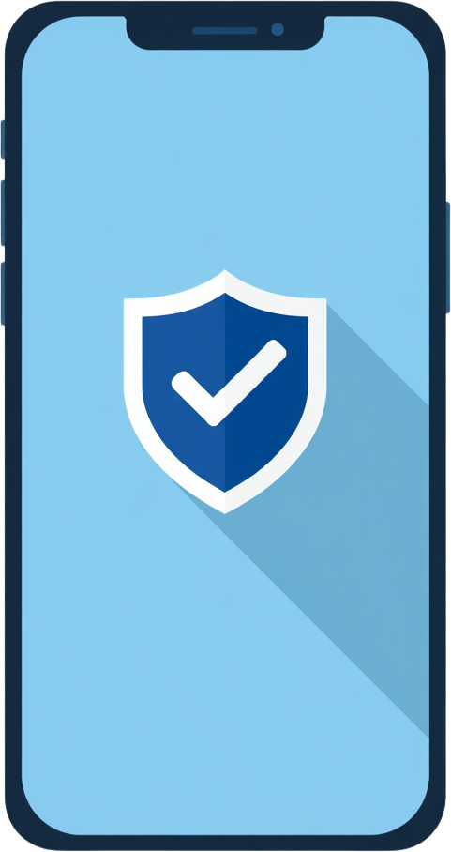

Your Next Steps
Remember the warning signs: check sender addresses, hover over links before clicking, and never share passwords or personal data via email. Report any suspicious emails or messages to your IT security team immediately.
Complete the phishing awareness quiz to test your knowledge, then share these best practices with your colleagues. Together, a vigilant team is your organization's strongest defense against phishing attacks.

Slide 10
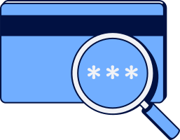

Thank You for Completing the Training!

