Slide 1
SECURE DATA HIDING IN IMAGES USING STEGANOGRAPHY
CAPSTONE PROJECT
Presented By:
Student Name : SriRam Leburi
College Name & Department : Kalasalingam University,BTech in CSE

Slide 2
OUTLINE
Problem Statement
Technology used
Wow factor
End users
Result
Conclusion
Git-hub Link
Future scope

Slide 3
Problem Statement
In today’s world, keeping messages private is very important.
Traditional encryption methods work well, but they can be easily noticed, making people suspicious.
A better way is to hide messages inside images so that no one can tell there’s a secret message. This is called image steganography—it allows people to send confidential information without drawing attention, adding an extra layer of security.

Slide 4
Technology used
Platform Used:
Python
Operating System: Windows
IDE/Editor: IDLE
Libraries Used:
OpenCV – for image processing
Tkinter – for creating the GUI
Concepts Used:
Image Steganography
Pixel Manipulation
GUI Development

Slide 5
Wow factors
Secret Messaging: The message is hidden inside an image without changing how it looks. No one will know it's there.
Easy to Use: No need to type commands—just click buttons to hide or reveal messages.
Password Protection: Only people with the right password can read the hidden message.
Fast and Simple: The program runs quickly and doesn’t need a powerful computer.

Slide 6
End users
Cybersecurity Learners & Tech Enthusiasts – To learn and experiment with hiding messages in images.
Government & Security Agencies – For sending secret messages without being detected.
Journalists & Whistleblowers – To share sensitive information safely without attracting attention.
Anyone Who Values Privacy – For personal, secure communication without risks.

Slide 7
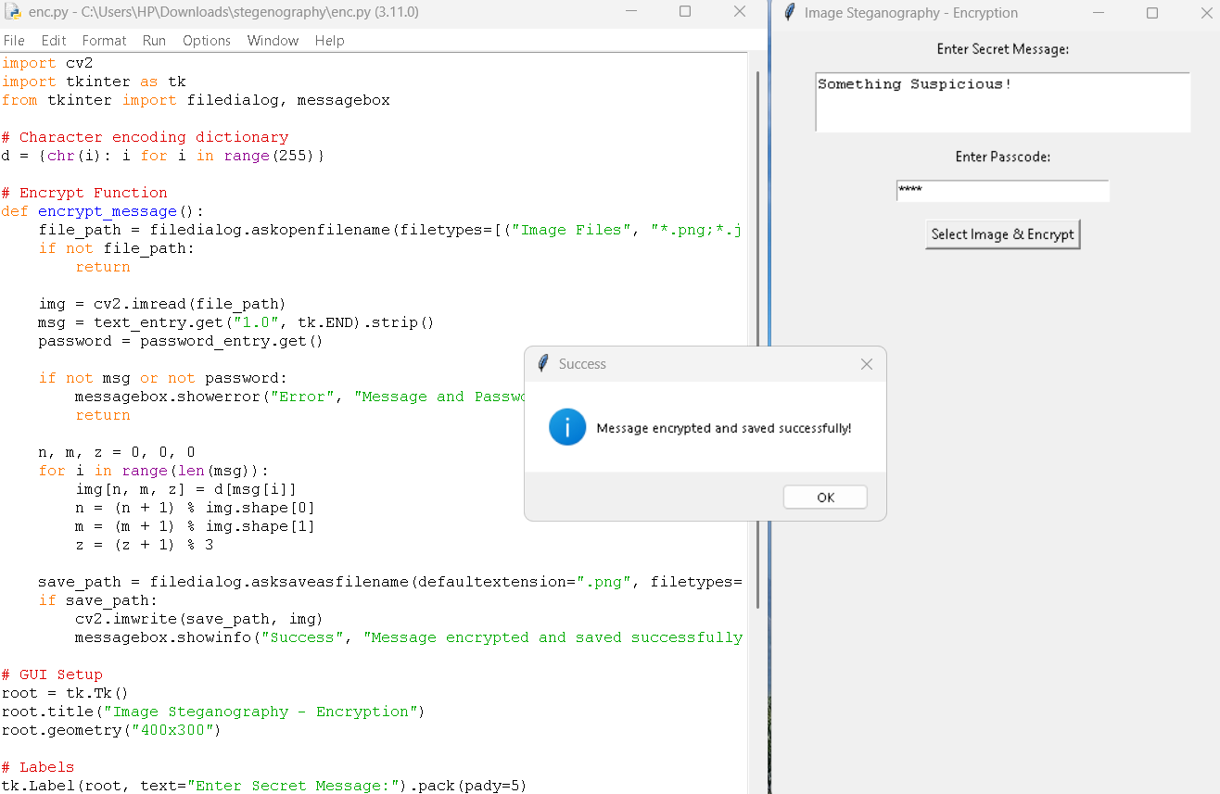
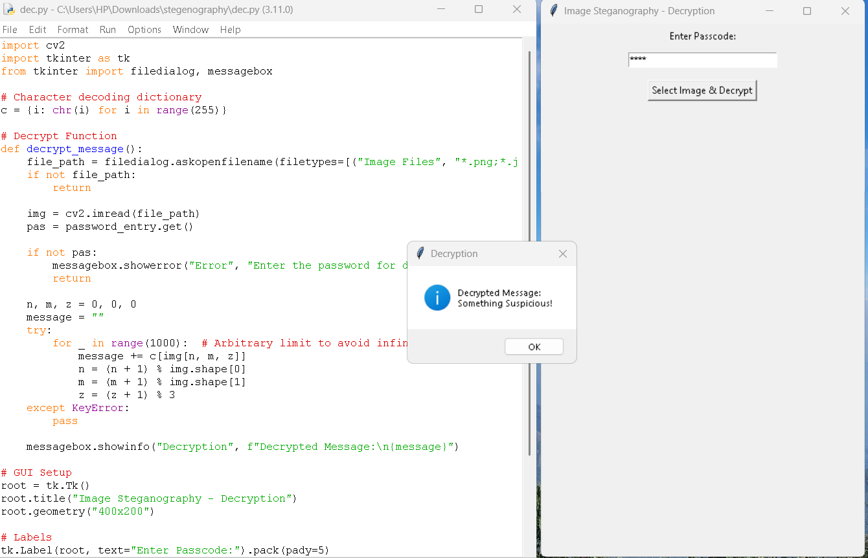
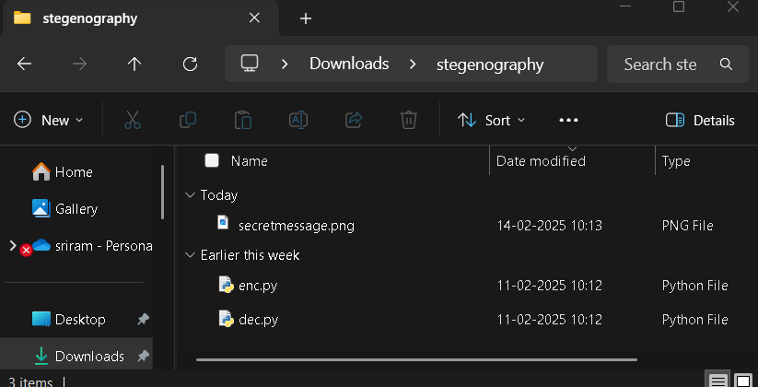
Results

Slide 8
Conclusion
In today’s world, keeping messages private is important, but regular encryption can be noticed and raise suspicion. This project solves that problem by hiding messages inside images, making them invisible to others.
With pixel manipulation and passcode protection, this tool makes it easy, secure, and secret to share information. The simple interface ensures that anyone, even without technical skills, can encrypt and decrypt messages easily.
In the future, we plan to add stronger security, support for more image types, and mobile/web versions to make it even better. This project proves that hiding information inside images is a smart and effective way to keep messages private and secure

Slide 9
GitHub Link
https://github.com/ramgh23/Privacy-Holder.git

Slide 10
Future scope
Better Security: Adding stronger encryption and requiring a passcode with letters, numbers, and special characters for extra protection.
More Image Options: Right now, it works with PNG and JPG, but in the future, it can support more formats.
Store More Text: Improving the method so that larger messages can be hidden inside images.
Harder to Detect: Making sure even experts can't easily find the hidden message.
Mobile & Web App: Creating a version for smartphones and websites so anyone can use it easily.

Slide 11
THANK YOU

