Slide 2
What is Entity Relationship Diagram?

Slide 3
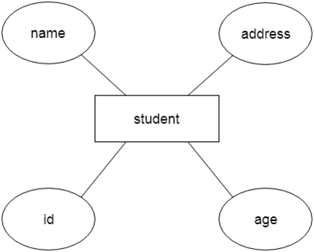
Entity Relationship Diagram (ER Diagram)
Use E-R model to get a high-level graphical view to describe the "ENTITIES" and their "RELATIONSHIP"
It is a high-level data model. This model is used to define the data elements and relationship for a specified system

Slide 4
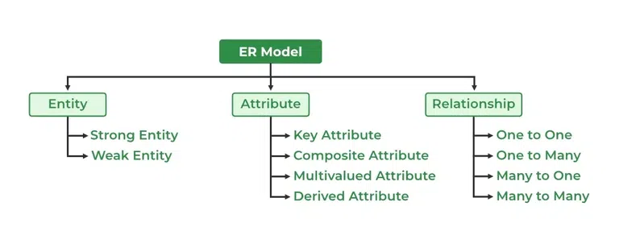
Component of ER Diagram
The basic constructs/components of ER Model are
Entity, Attributes and Relationships.

Slide 5
Why Use ER Diagrams
ER Diagram helps you conceptualize the database and lets you know which fields need to be embedded for a particular entity
ER Diagram gives a better understanding of the information to be stored in a database
It reduces complexity and allows database designers to build databases quickly
It helps to describe elements using Entity-Relationship models
It allows users to get a preview of the logical structure of the database

Slide 6
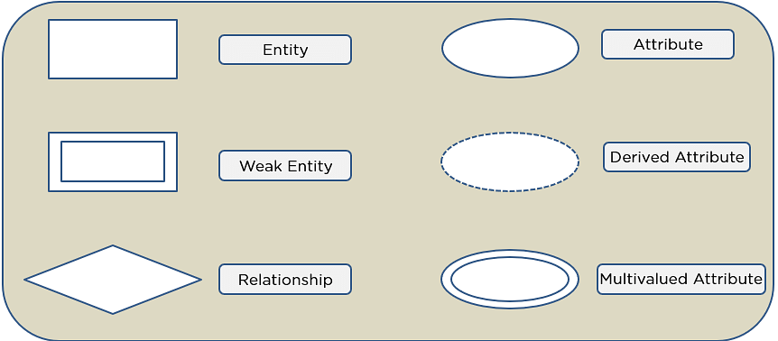
Entity Relationship Diagram Symbols

Slide 7
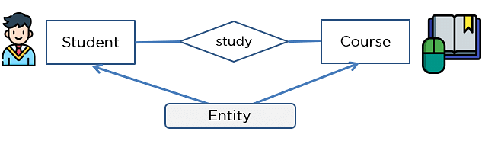
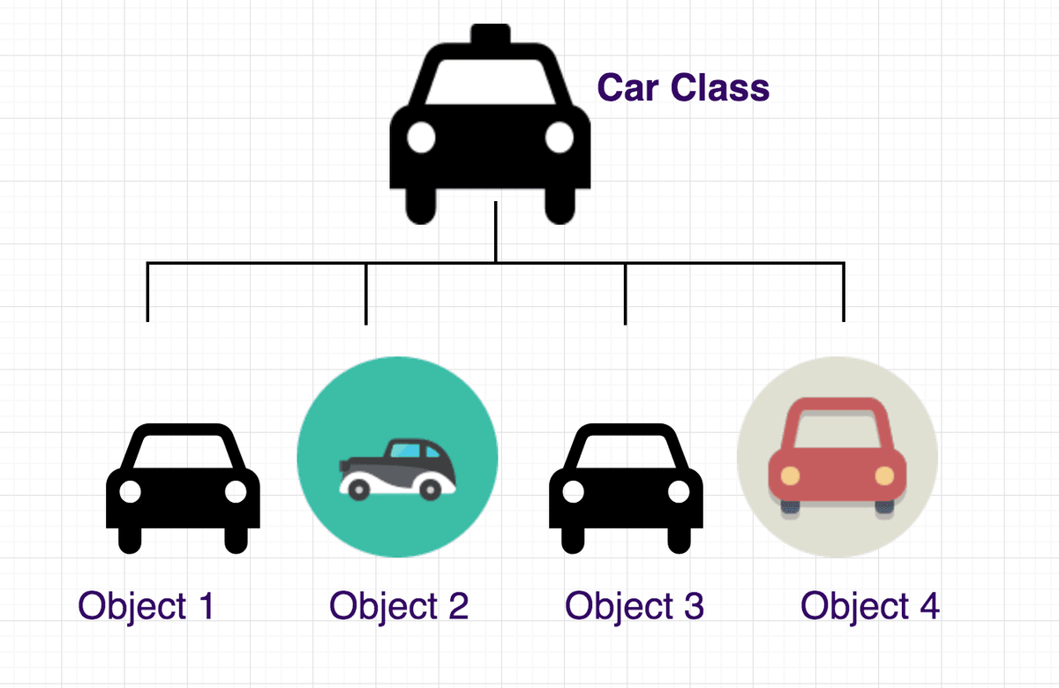
What is Entity?
An entity can be a real-world object or can be a living or non-living component.

Slide 8
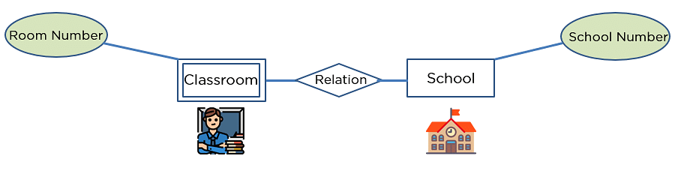
strong and weak entity
An entity may participate in a relation either totally or partially.
Strong Entity: A strong entity is not dependent on any other entity in the schema. A strong entity will always have a primary key. Strong entities are represented by a single rectangle.
Weak Entity: A weak entity is dependent on a strong entity to ensure its existence. Unlike a strong entity, a weak entity does not have any primary key. A weak entity is represented by a double rectangle. The relation between one strong and one weak entity is represented by a double diamond. This relationship is also known as identifying relationship.

Slide 9
entity
In relation to a database , an entity is a
Person(student, teacher, employee, department, …)
Place(classroom, building, …) --a particular position or area
Thing(computer, lab equipment, …) --an object that is not named
Concept(course, batch, student’s attendance, …) -- an idea,
about which data can be stored. All these entities have some attributes or properties that give them their identity.
Every entity has its own characteristics.

Slide 10
When you are designing attributes for your entities, you will sometimes find that an attribute does not have a value. For example, you might want an attribute for a person's middle name, but you can't require a value because some people have no middle name. For these, you can define the attribute so that it can contain null values.
In database management systems, null is used to represent missing or unknown data in a table column.
What is an Attribute?
Attributes are the properties that define a relation.
e.g. student(ID, firstName, middleName, lastName, city)
In some cases, you might not want a specific attribute to contain a null value, but you don't want to require that the user or program always provide a value. In this case, a default value might be appropriate. A default value is a value that applies to an attribute if no other valid value is available.
Entity
a₁
a₂
a₃
a₄
…
v₁
v₂
v₃
v₄
…

Slide 11
attributes
A table has rows and columns
In RDBMS, a table organizes data in rows and columns. The COLUMNS are known as ATTRIBUTES / FIELDS whereas the ROWS are known as RECORDS / TUPLE.
In Relation: EMP
Attributes
ID | EmployeeName | Job | Hiredate | Salary
1 | KING | PRESIDENT | 2017-02-15 | 5000
… | … | … | … | …
… | … | … | … | …
… | … | … | … | …
Rows

Slide 12
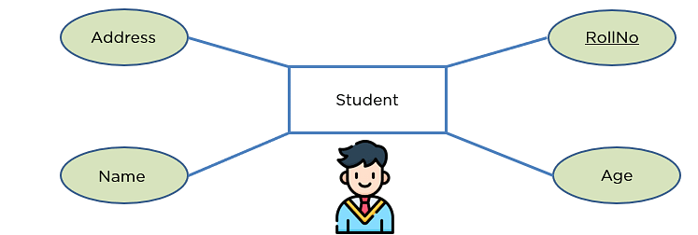
attributes
In Entity Relationship(ER) Model attributes can be classified into the following types.
Simple/Atomic and Composite Attribute
Single Valued and Multi Valued attribute
Stored and Derived Attributes
Complex Attribute
Key Attribute and Non-Key Attribute
Remember:
In SQL, the same name can be used for two (or more) attributes as long as the attributes are in different relations.

Slide 13
attributes
Simple / Atomic Attribute --VS-- Composite Attribute
(Can’t be divided further) (Can be divided further)
Single Value Attribute --VS-- Multi Valued Attribute
(Only One value) (Multiple values)
Stored Attribute --VS-- Derived Attribute
(Only One value) (Virtual)
Complex Attribute
(Composite & Multivalued)
Employee ID: An employee ID can be a composite attribute, which is composed of sub-attributes such as department code, job code, and employee number.
Atomic Attribute: An attribute that cannot be divided into smaller independent attribute is known as atomic attribute.
e.g. ID’s, PRN, age, gender, zip, marital status cannot further divide.
Single Value Attribute: An attribute that has only single value is known as single valued attribute.
e.g. manufactured part can have only one serial number, voter card, blood group, price, quantity, branch can have only one value.
Stored Attribute: The stored attribute are such attributes which are already stored in the database and from which the value of another attribute is derived.
e.g. (HRA, DA…) can be derive from salary, age can be derived from DoB, total marks or average marks of a student can be derived from marks.

Slide 14
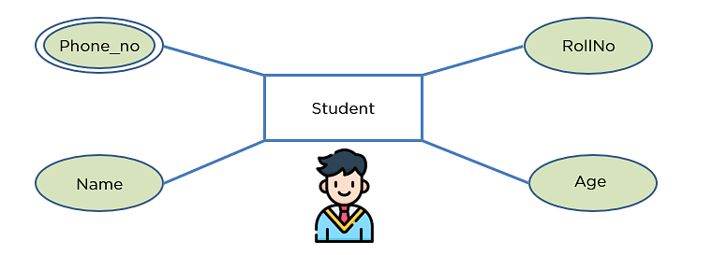
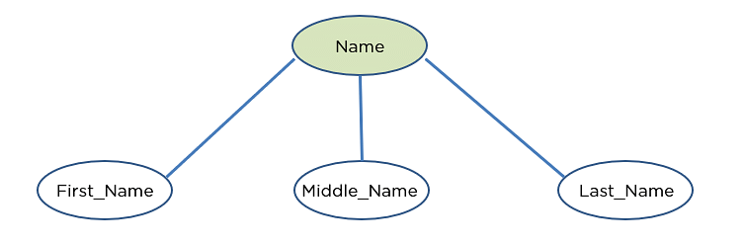
Composite VS Multi Valued Attribute

Slide 15

composite / multi valued attributes
Composite Attribute
Person Entity
Name attribute: ( firstName, middleName, and lastName )
PhoneNumber attribute: ( countryCode, cityCode, and phoneNumber )
Multi Valued Attribute
Person Entity
Hobbies attribute: [ reading, hiking, hockey, skiing, photography, . . . ]
SpokenLanguages attribute: [ Hindi, Marathi, Gujarati, English, . . . ]
Degrees attribute: [ 10th , 12th, BE, ME, PhD, . . . ]
emailID attribute: [ saleel@gmail.com, salil@yahoomail.com, . . . ]

Slide 16
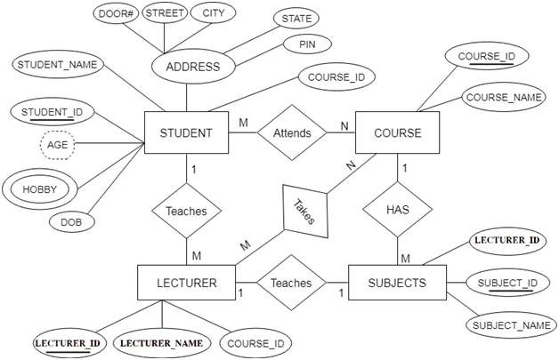
entity relationship diagram

Slide 17
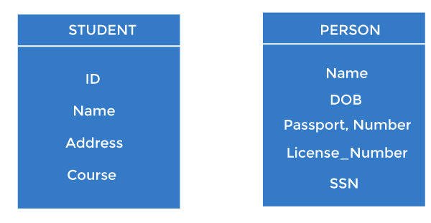
Keys
It is used to uniquely identify any record or row of data from the table. It is also used to establish and identify relationships between tables.
For example,
ID is used as a key in the Student table because it is unique for each student. In the PERSON table, passport_number, license_number, SSN are keys since they are unique for each person.

Slide 18
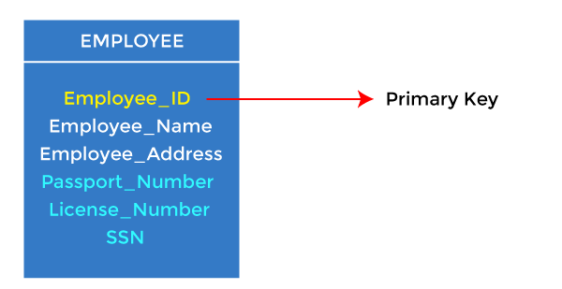
1. Primary key
It is the first key used to identify one and only one instance of an entity uniquely. An entity can contain multiple keys, as we saw in the PERSON table. The key which is most suitable from those lists becomes a primary key.
In the EMPLOYEE table, ID can be the primary key since it is unique for each employee. In the EMPLOYEE table, we can even select License_Number and Passport_Number as primary keys since they are also unique.
For each entity, the primary key selection is based on requirements and developers.

Slide 20
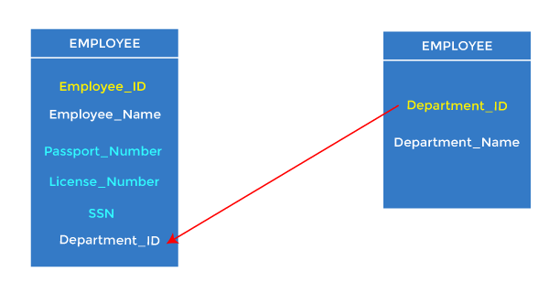
Foreign key
Foreign keys are the column of the table used to point to the primary key of another table.
Every employee works in a specific department in a company, and employee and department are two different entities. So we can't store the department's information in the employee table. That's why we link these two tables through the primary key of one table.
We add the primary key of the DEPARTMENT table, Department_Id, as a new attribute in the EMPLOYEE table.
In the EMPLOYEE table, Department_Id is the foreign key, and both the tables are related.

Slide 21
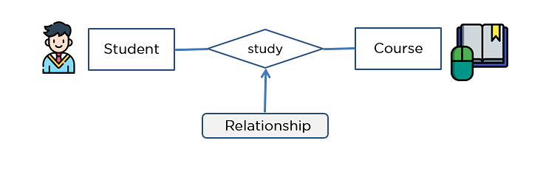
Common relationships

Slide 22

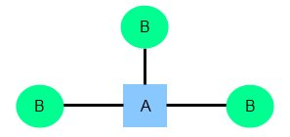
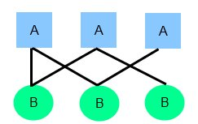
relationships
Common relationship
one-to-one (1:1)
one-to-many (1:M)
many-to-many (M:N)

Slide 23
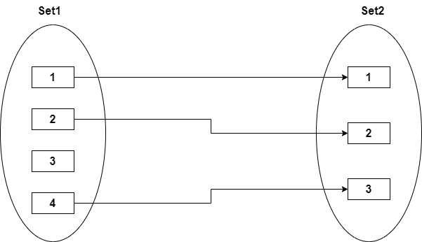

one-to-one relationship

Slide 24
one-to-one relationship
A one-to-one relationship between two tables means that a row in one table can only relate to zero/one row in the table on the other side of their relationship. This is the least common database relationship.
A one-to-one relationship is a type of cardinality that refers to the relationship between two entities R and S in which one element of entity R may only be linked to zero/one element of entity S, and vice versa.
Country
Capital
Country
Capital
Country
one-to-one relationship
Capital
Country
Capital
=
Country
Capital
Country
Capital

Slide 25
one-to-one relationship
A one-to-one relationship between two tables means that a row in one table can only relate to zero/one row in the table on the other side of their relationship. This is the least common database relationship.
A one-to-one relationship is a type of cardinality that refers to the relationship between two entities R and S in which one element of entity R may only be linked to zero/one element of entity S, and vice versa.
Person-1
Passport-1
Person-1
Passport-1
Person-2
Passport-1
Person-2
Passport-1
one-to-one relationship
=
Person-3
Passport-1
Person-4
Passport-1
Person-4

Slide 26
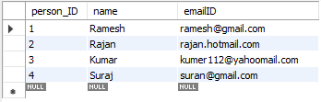

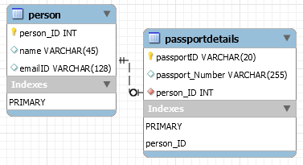
how to create one-to-one relationship
CREATE TABLE person (
person_ID INT PRIMARY KEY ,
name VARCHAR(45),
emailID VARCHAR(128)
);
CREATE TABLE passportDetails (
passportID VARCHAR(20) PRIMARY KEY,
passport_Number VARCHAR(255),
person_ID INT UNIQUE,
FOREIGN KEY(person_ID) REFERENCES person(person_ID)
);

Slide 27
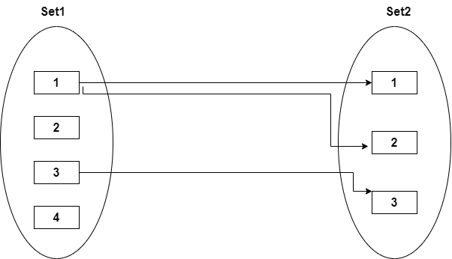

one-to-many relationship

Slide 28
one-to-many relationship
A one-to-many relationship between two tables means that a row in one table can have zero or more row in the table on the other side of their relationship.
a one-to-many relationship is a type of cardinality that refers to the relationship between two entities R and S in which an element of R may be linked to many elements of S, but a member of S is linked to only one element of R.
Customer-1
Order-1
Customer-1
Order-1
Customer-2
Order-1
Customer-2
Order-1
one-to-many relationship
Customer-3
Order-2
=
Customer-2
Order-2
Customer-4
Order-1
Customer-3
Order-1
Customer-5
Order-2
Customer-3
Order-2
Order-3
Customer-3
Order-3
Order-1
Customer-4
Order-1

Slide 29
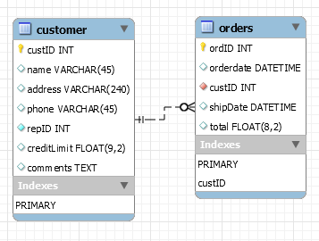
how to create one-to-many relationship
CREATE TABLE customer (
custID INT PRIMARY KEY,
name VARCHAR(45),
address VARCHAR(240),
phone VARCHAR(45),
repID INT NOT NULL,
creditLimit FLOAT(9,2),
comments TEXT,
constraint custid_zero CHECK(custID > 0)
);
CREATE TABLE orders (
ordID INT PRIMARY KEY,
orderdate DATETIME,
custID INT,
shipDate DATETIME,
total FLOAT(8,2),
FOREIGN KEY(custID) REFERENCES customer(custID),
constraint total_greater_zero CHECK(total >= 0)
);

Slide 30
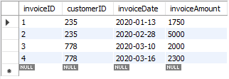
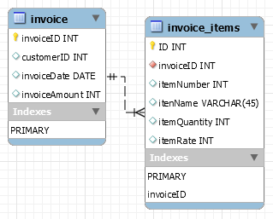
how to create one-to-many relationship
CREATE TABLE invoice (
invoiceID INT PRIMARY KEY,
customerID INT,
invoiceDate DATE,
invoiceAmount INT
);
CREATE TABLE invoice_items (
invoiceID INT,
itemID INT,
itenName VARCHAR(45),
itemQuantity INT,
itemRate INT,
PRIMARY KEY(invoiceID, itemID),
FOREIGN KEY(invoiceID) REFERENCES invoice(invoiceID)
);
CREATE TABLE invoice_items (
invoiceID INT NOT NULL,
itemID INT NOT NULL,
itenName VARCHAR(45),
itemQuantity INT,
itemRate INT,
UNIQUE(invoiceID, itemID),
FOREIGN KEY(invoiceID) REFERENCES invoice(invoiceID)
);

Slide 31
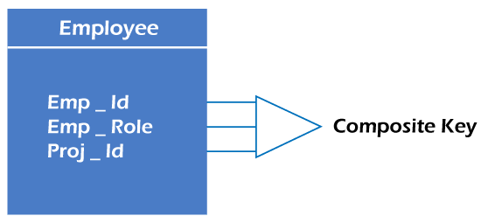
Composite key
Whenever a primary key consists of more than one attribute, it is known as a composite key. This key is also known as Concatenated Key.
For example,
in employee relations, we assume that an employee may be assigned multiple roles, and an employee may work on multiple projects simultaneously. So the primary key will be composed of all three attributes, namely Emp_ID, Emp_role, and Proj_ID in combination. So these attributes act as a composite key since the primary key comprises more than one attribute.

Slide 32
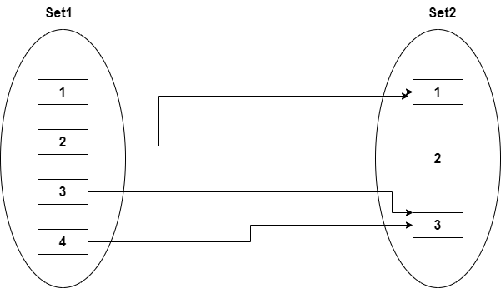

many-to-one relationship

Slide 33
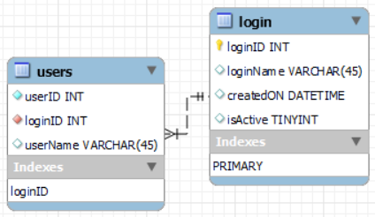
many-to-one relationship
CREATE TABLE users (
userID INT,
loginID INT,
userName VARCHAR(45),
PRIMARY KEY(loginID, userID),
constraint fk_users_login_loginID1 FOREIGN KEY(loginID)
REFERENCES login(loginID)
);
CREATE TABLE users (
userID INT NOT NULL,
loginID INT NOT NULL,
userName VARCHAR(45),
UNIQUE(loginID, userID),
constraint fk_users_login_loginID2 FOREIGN KEY(loginID)
REFERENCES login(loginID)
);
CREATE TABLE login (
loginID INT,
loginName VARCHAR(45),
createdON DATETIME,
isActive TINYINT,
PRIMARY KEY(loginID)
);

Slide 34
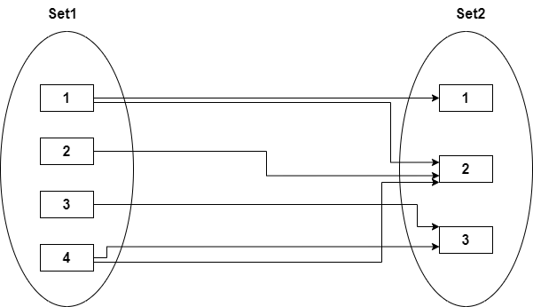

many-to-many relationship

Slide 35
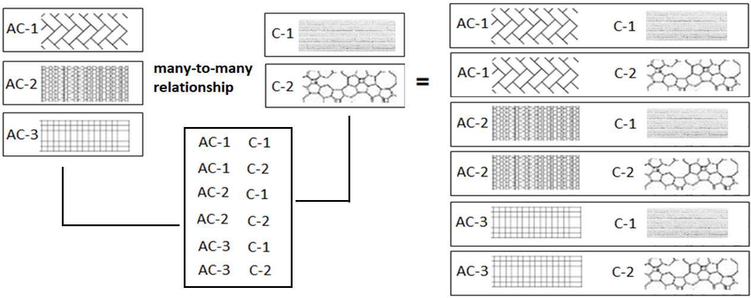
many-to-many relationship
A many-to-many relationship is a type of cardinality that refers to the relationship between two entities R and S in which R may contain a parent instance for which there are many children in S and vice versa.
=
=

Slide 36
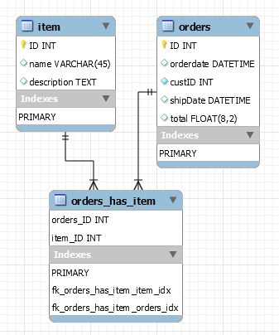
how to create many-to-many relationship
CREATE TABLE item (
ID INT PRIMARY KEY,
name VARCHAR(45),
description TEXT
);
CREATE TABLE orders (
ID INT PRIMARY KEY,
orderdate DATETIME,
custID INT NOT NULL,
shipDate DATETIME,
total FLOAT(8,2),
constraint total_greater_zero CHECK(total >= 0)
);
CREATE TABLE orders_has_item (
orders_ID INT NOT NULL,
item_ID INT NOT NULL,
PRIMARY KEY(orders_ID, item_ID),
constraint fk_orders_has_item_orders FOREIGN KEY(orders_ID)
REFERENCES orders(ID),
constraint fk_orders_has_item_item1 FOREIGN KEY(item_ID)
REFERENCES item(ID)
);

Slide 37
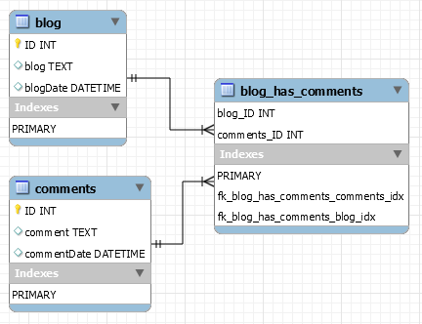
how to create many-to-many relationship
CREATE TABLE blog (
ID INT PRIMARY KEY,
blog TEXT,
blogDate DATETIME
);
CREATE TABLE comments (
ID INT PRIMARY KEY,
comment TEXT,
commentDate DATETIME
);
CREATE TABLE blog_has_comments (
blog_ID INT,
comments_ID INT,
PRIMARY KEY(blog_ID, comments_ID),
constraint fk_blog_has_comments_blog FOREIGN KEY(blog_ID) REFERENCES blog(ID),
constraint fk_blog_has_comments_comments FOREIGN KEY(comments_ID) REFERENCES comments(ID)
);

Slide 38
Add Example of many to many relation

Slide 39
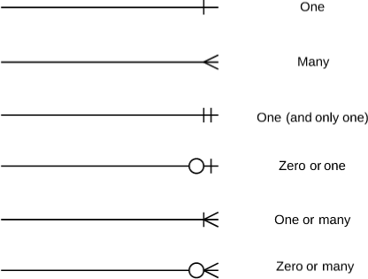
Notation of ER diagram

Slide 40
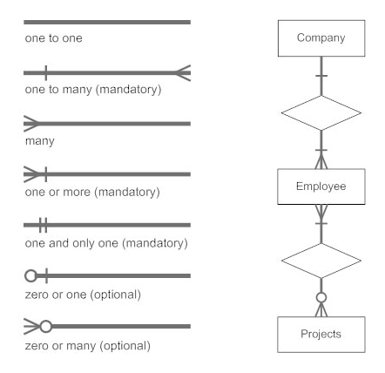
Notation of ER diagram

Slide 41
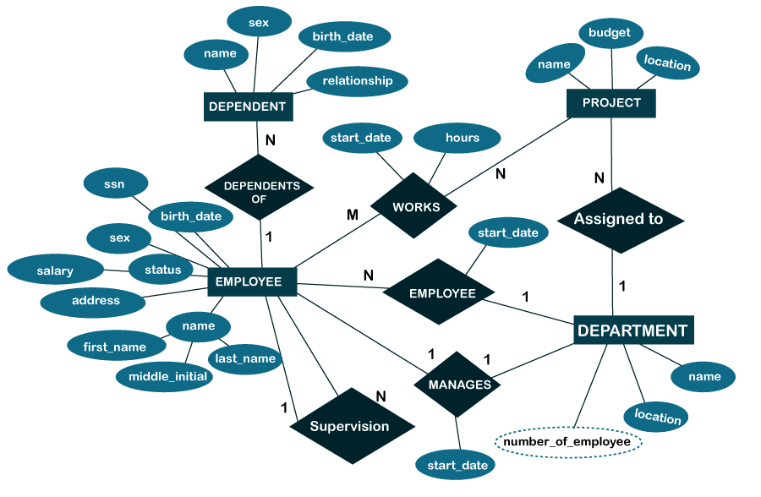

Slide 42
IS NULL
NULL
joins

Slide 43
joins
JOINS are used to retrieve data from multiple tables.
JOIN is performed whenever two or more tables are joined in a SQL statement.

Slide 44
joins
Type of JOINS
Cartesian or Product Join – Cross Join
Equijoin – Inner Join
Natural Join
Simple Join
Outer Join – Right Outer Join, Left Outer Join
Self Join

Slide 45
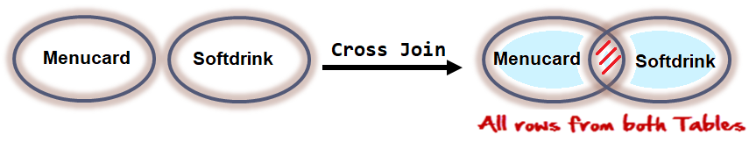

cartesian or product join
Cartesian/Product means Number of Rows present in Table 1 Multiplied by Number of Rows present in Table 2.
Cross Join in MySQL does not require any common column to join two table.
The result of R(A₁, A₂, . . . , A_{n}) × S(B₁, B₂, . . . , B_{m}) is a relation Q with degree n + m attributes Q(A₁, A₂, . . . , A_{n} , B₁, B₂, . . . , B_{m}), in that order.

Slide 46
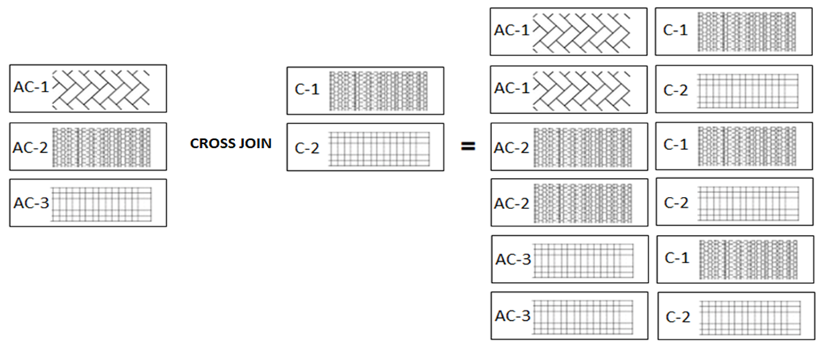
joins - cartesian or product
The CROSS JOIN gets a row from the first table (r₁) and then creates a new row for every row in the second table (r₂). It then does the same for the next row for in the first table (r₁) and so on.

Slide 47
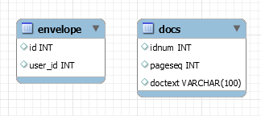


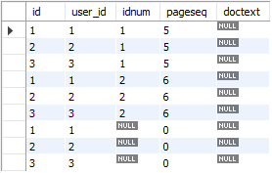
joins – cross join
The CROSS JOIN produced a result set which is the product of rows of two associated tables when no WHERE clause is used with CROSS JOIN. In this join, the result set appeared by multiplying each row of the first table with all rows in the second table if no condition introduced with CROSS JOIN.
SELECT A₁, A₂, A₃, . . . FROM r₁ CROSS JOIN r₂, . . .
envelope Table
docs Table
SELECT * FROM envelope CROSS JOIN docs;

Slide 48
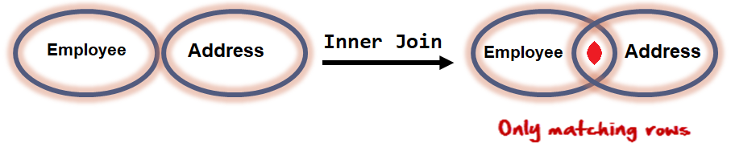
equi join
An equi join / Inner Join is a join with a join condition containing an equality operator. An equijoin returns only those rows that have equivalent values for the specified columns. Rows that match remain in the result, those that don't are rejected. The match condition is commonly called the join condition. equi join / Inner Join returns rows when there is at least one match in both tables.
The result of R(A₁, A₂, . . . , A_{n}) _{<join condition>} S(B₁, B₂, . . . , B_{m}) is a relation Q with degree n + m attributes Q(A₁, A₂, . . . , A_{n} , B₁, B₂, . . . , B_{m}), in that order. Q has one tuple for each combination of tuples—one from R and one from S—whenever the combination satisfies the join condition.

Slide 49
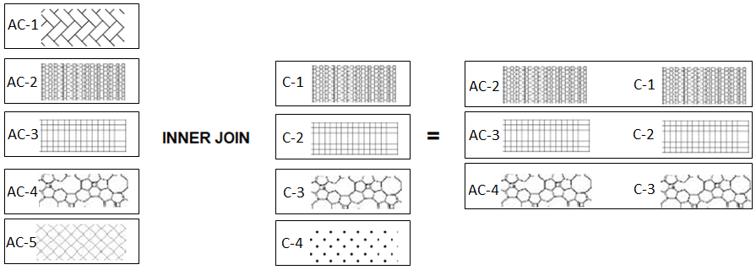
equi join example
The following table illustrates the inner join of two tables r₁(AC-1, AC-2, AC-3, AC-4, AC-5) and r₂(C-1, C-2, C-3, C-4). The result includes rows: (2,A), (3,B), and (4,C) as they have the same patterns.

Slide 50
inner join
The inner join is one of the most commonly used joins in SQL. The inner join clause allows you to query data from two or more related tables.

Slide 51
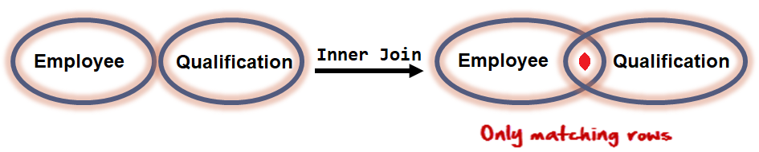
joins – inner join
INNER JOIN returns rows when there is at least one match in both tables.
The INNER JOIN selects all rows from both participating tables as long as there is a match between the columns. An SQL INNER JOIN is same as JOIN clause, combining rows from two or more tables.
SELECT A₁, A₂, A₃, . . . FROM r₁ [INNER] JOIN r₂ ON r₁. A₁ = r₂. A₁
SELECT * FROM employee emp INNER JOIN qualification quali ON emp.id = quali.employeeid;

Slide 52
natural join

Slide 53

joins – natural join
Joins two tables based on common column names. Hence one must confirm the common columns before using a NATURAL JOIN
The NATURAL JOIN is such a join that performs the same task as an INNER JOIN.
SELECT A₁, A₂, A₃, . . . FROM r₁ NATURAL [INNER] JOIN r₂ NATURAL [INNER] JOIN r₃ . . .
SELECT * FROM emp NATURAL JOIN dept;
The associated tables have one or more pairs of identically column-names.
The columns must be of the same name.
The columns datatype may differ.
Don't use ON / USING clause in a NATURAL JOIN.
When this join condition gets applied always the duplicates of the common columns get eliminated from the result.
A NATURAL JOIN can be used with a LEFT OUTER join, or a RIGHT OUTER join.
If the column-names are not same, then NATURAL JOIN will work as CROSS JOIN.

Slide 54
simple join
TODO

Slide 55
joins – simple join
The SIMPLE JOIN is such a join that performs the same task as an INNER JOIN.
SELECT A₁, A₂, A₃, . . . FROM r₁ SIMPLE JOIN r₂ USING (A₁, . . . )
SELECT * FROM emp SIMPLE JOIN dept USING(deptno)

Slide 56
outer joins
In an outer join, along with rows that satisfy the matching criteria, we also include some or all rows that do not match the criteria.

Slide 57
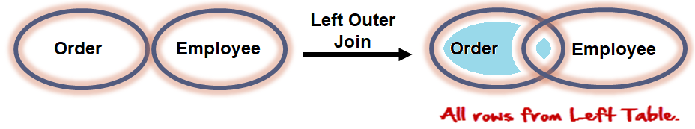
joins – left outer join
The LEFT JOIN keyword returns all rows from the left table (r₁), with the matching rows in the right table (r₂). The result is NULL in the right side when there is no match.
SELECT A₁, A₂, A₃, . . . FROM r₁ LEFT [OUTER ] JOIN r₂ ON r₁. A₁ = r₂. A₁
SELECT * FROM orders ord LEFT OUTER JOIN employee emp ON emp.id = ord.employeeid;

Slide 58
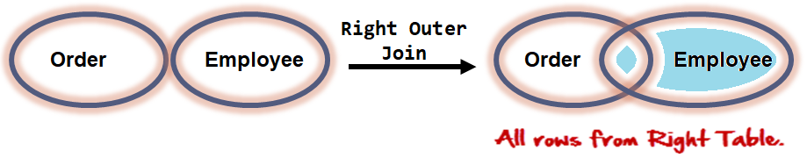
joins – right outer join
The RIGHT JOIN keyword returns all rows from the right table (r₂), with the matching rows in the left table (r₁). The result is NULL in the left side table when there is no match.
SELECT A₁, A₂, A₃, . . . FROM r₁ RIGHT [OUTER ] JOIN r₂ ON r₁. A₁ = r₂. A₁
SELECT * FROM orders ord RIGHT OUTER JOIN employee emp ON emp.id = ord.employeeid;

Slide 59
TODO
self joins
TODO

Slide 60
joins – self join
A SELF JOIN is a join in which a table is joined with itself (which is also called Unary relationships), especially when the table has a FOREIGN KEY which references its own PRIMARY KEY.
SELECT r_{x}.A₁, r_{x}.A₂, r_{y}.A₁, r_{y}.A₂, . . . FROM r₁ r_{x}, r₁ r_{y} WHERE r_{x}.A₁ = r_{y}.A₁

Slide 61
set operation in sql
Set operators are used to join the results of two (or more) SELECT statements.
Remember:
The result set column names are taken from the column names of the first SELECT statement.
SELECT statement should have the same data type. (Not in MySQL)

Slide 62
set operation
syntax
SELECT . . . UNION [ALL]
SELECT . . .
SELECT * FROM books UNION SELECT * FROM newbooks;
SELECT * FROM books UNION ALL SELECT * FROM newbooks;
syntax
SELECT . . . INTERSECT
SELECT . . .
SELECT * FROM books INTERSECT SELECT * FROM newbooks;
syntax
EXCEPT returns rows from first dataset, which are not available in the second dataset.
SELECT . . . EXCEPT
SELECT . . .
SELECT * FROM books EXCEPT SELECT * FROM newbooks;

Slide 63
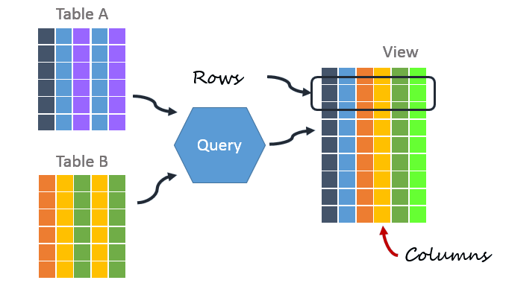
A VIEW in SQL as a logical subset of data from one or more tables. Views are used to restrict data access. A VIEW contains no data of its own but its like window through which data from tables can be viewed or changed. The table on which a View is based are called BASE Tables.
There are 2 types of Views in SQL:
Simple View : Simple views can only contain a single base table.
Complex View : Complex views can be constructed on more than one base table. In particular, complex views can contain: join conditions, a group by clause, a order by clause.
views

Slide 64
view
Views are not updatable in the following cases:
A table in the FROM clause is reference by a subquery in the WHERE statement.
There is a subquery in the SELECT clause.
The SQL statement defining the view joins tables.
One of the tables in the FROM clause is a non-updatable view.
The SELECT statement of the view contains an aggregate function such as SUM(), COUNT(), MAX(), MIN(), and so on.
The keywords DISTINCT, GROUP BY, HAVING clause, LIMIT clause, UNION, or UNION ALL appear in the defining SQL statement.

Slide 65
create view/ show create view
The select_statement is a SELECT statement that provides the definition of the view. The select_statement can select from base tables or other views.
CREATE [OR REPLACE] VIEW view_name [(column_list)]
AS select_statement [WITH CHECK OPTION]
SHOW CREATE VIEW view_name
show create VIEW v1;

Slide 66
alter / drop view
This statement changes the definition of a view, which must exist.
ALTER VIEW view_name [(column_list)]
AS select_statement
[WITH CHECK OPTION]
e.g.
ALTER VIEW studentview AS SELECT namefirst, namelast, emailid FROM student;
DROP VIEW removes one or more views.
DROP VIEW [IF EXISTS]
view_name [, view_name] ...
e.g.
DROP VIEW studentview;
DROP VIEW studentid10view, studentviewwithcheck;
DROP VIEW studentTotalMarksView, studentAddressView;

