Slide 1
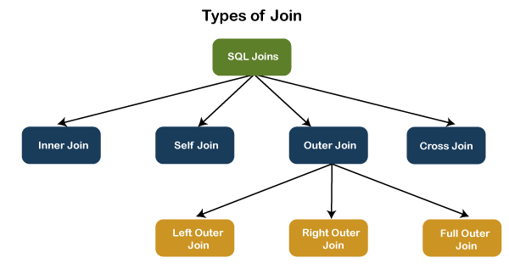
SQL JOINs
SQL JOINs are a powerful feature in the Structured Query Language (SQL) that allow you to combine data from multiple tables based on a related column between them. JOINs are essential for building complex queries and unlocking the full potential of relational databases.

Slide 2



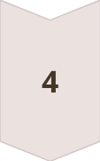
Implementing SQL JOINs
Identify Relationships
Understand the data model and the relationships between your tables. This will
help you determine which type of JOIN to use.
Write the JOIN Clause
Construct the appropriate JOIN clause (INNER, LEFT, RIGHT, FULL OUTER, or CROSS) and specify the ON condition to link the tables.
Select Columns
Decide which columns you want to retrieve from the joined tables, and include them in the SELECT statement.
Test and Refine
Execute the query and analyze the results. Adjust the JOIN conditions or column selections as needed to get the desired output.

Slide 3
Syntax of Joins
ANSI SQL Syntax
Legacy SQL Syntax
The ANSI SQL standard syntax for a join is:
Some older SQL dialects may use the following syntax for a join:
SELECT * FROM table1 JOIN table2;
SELECT * FROM table1, table2;

Slide 4
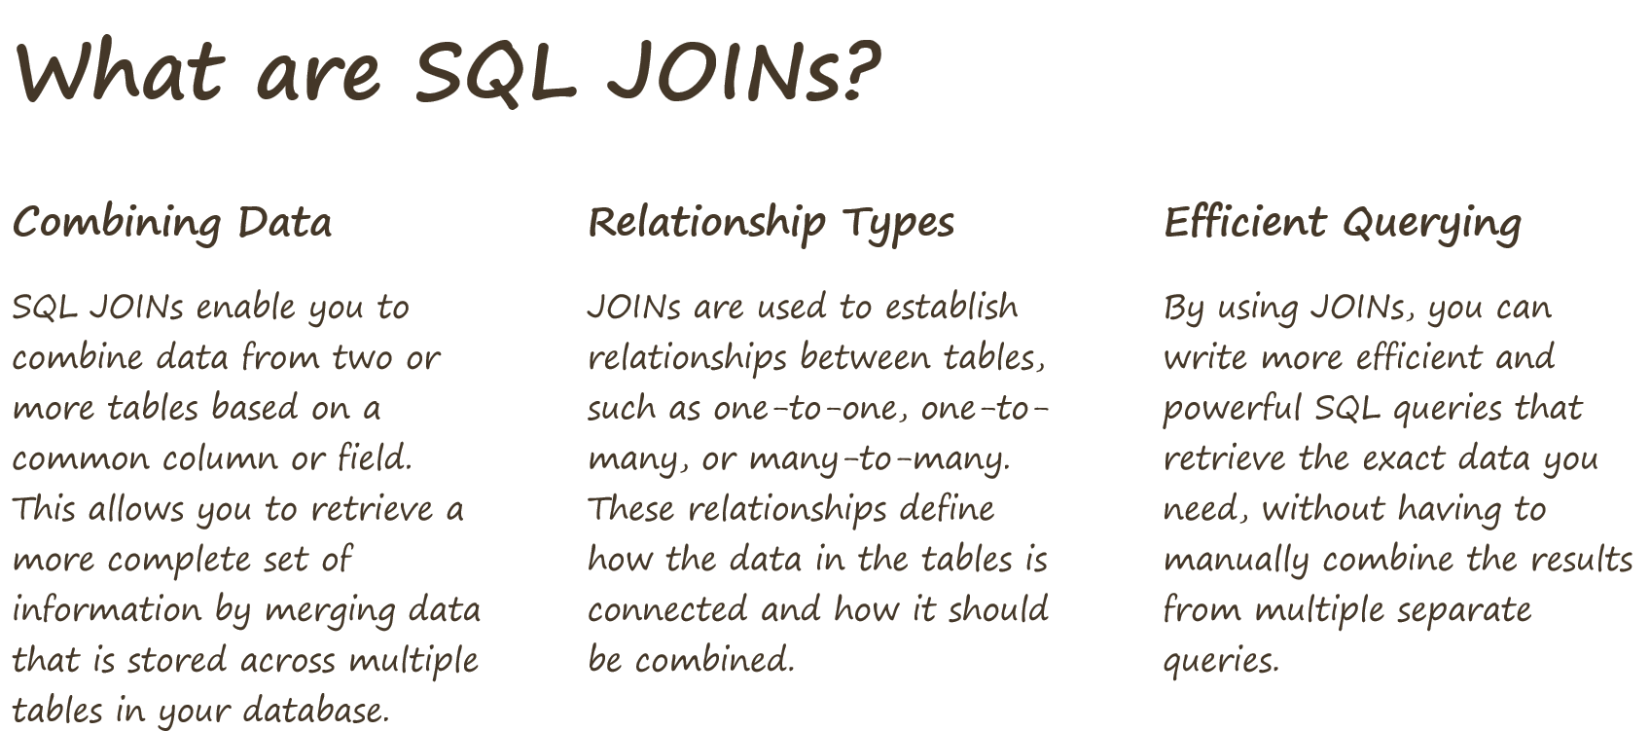

Slide 5

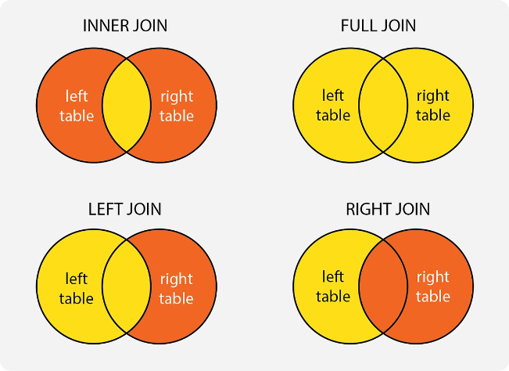
Types of Joins
1
Inner Join
Returns only the rows that have matching values in both tables.
2
Left Join
Returns all rows from the left table, and the matching rows from the right table.
3
Right Join
Returns all rows from the right table, and the matching rows from the left table.
4
Outer Join
Returns all rows from both tables, whether or not there is a match.

Slide 6


Introduction to Cross Join
A CROSS JOIN, also known as a Cartesian Join, combines all rows from two tables without any condition. The result set includes all possible combinations of rows from the two tables. The number of rows in the result set is the product of the number of rows in each table.

Slide 7
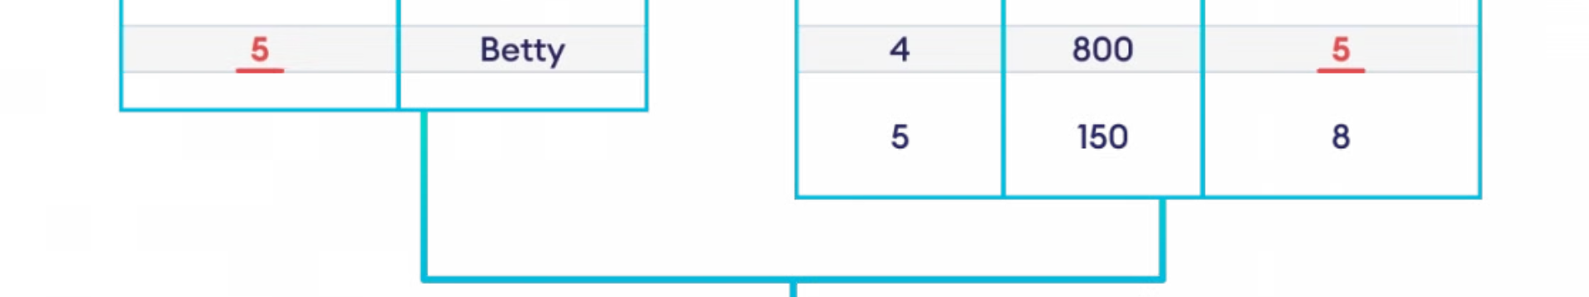
Syntax for Cross Join
The syntax for a cross join is:
SELECT columns
FROM table1
CROSS JOIN table2;
This means that each row from the first table is combined with each row from the second table

Slide 8
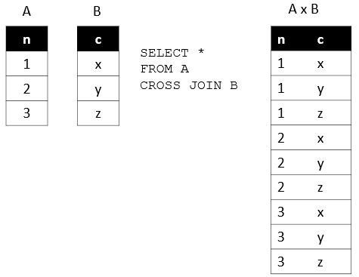
Cross Join
Example
SELECT *
FROM A
CROSS JOIN B ;

Slide 9
Introduction to Inner Join
Inner join is a type of SQL join that returns only the rows that have matching values in both of the joined tables. In other words, it combines the data from two tables based on a common column, and the result includes only the records that have a match in both tables. This is the most basic and widely used join type, as it allows you to efficiently retrieve relevant data by linking information from multiple sources.

Slide 10
Syntax for Inner Join
The syntax for a inner join is:
SELECT columns
FROM table1
INNER JOIN table2
ON table1.common_column = table2.common_column;
This will return only the rows that have matching values in both(table1 and table2) of the joined tables..

Slide 11

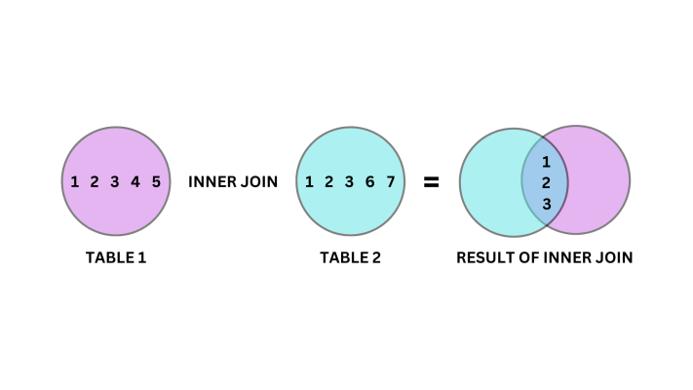
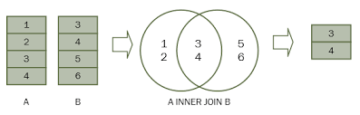
Inner Join
Example
SELECT
A
FROM
A
INNER JOIN
B
ON A.id = B.ID;

Slide 12
Q1) List all employees along with their family member names.
Q2) Display empno, deptno,deptname for all employees
Q3) Find employees who have a passport.
Q4) Find employees working in the 'Engineering' department.
Q5) Find employees working in the 'Finance' department.
Q6) List all departments with the Average Salaray of employees in each.
Q7) List all departments with the count of employees in each.
Q8) List employees along with their passport numbers and PAN card numbers

Slide 13
Introduction to Left Join
A left join, also known as a left outer join, left join is a type of SQL join that returns all rows from the left table, along with the matching rows from the right table. It ensures that all records from the left table are included in the result set, even if there are no matches in the right table.

Slide 14
Syntax for Left Join
The syntax for a left join is:
SELECT column1, column2, ... FROM table1 LEFT JOIN table2 ON table1.column = table2.column;
This will return all rows from the left table (table1), along with the matching rows from the right table (table2).

Slide 15
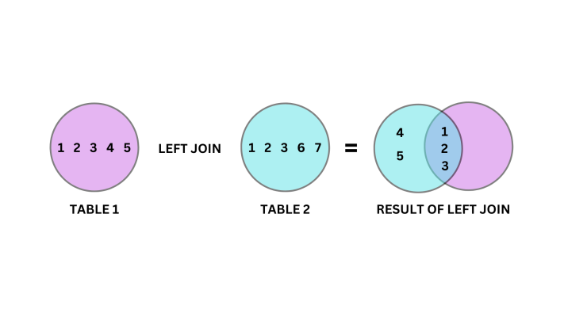
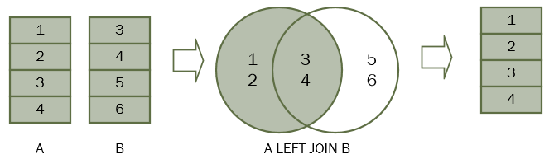
Left Join
Example
SELECT
A
FROM
A
LEFT JOIN
B
ON B.n = A.n;

Slide 16
Q) Retrieve all employees and their family members.
Q) Retrieve all employees and their passport members.
Q) To display empno, deptno,dname for all employees with sal>2000
Q) List all employees along with Pancard
Q) List all departments with the count of employees in each.
Q) Count of all employees who have passport
Q) List all employees dont have Pancard.

Slide 17
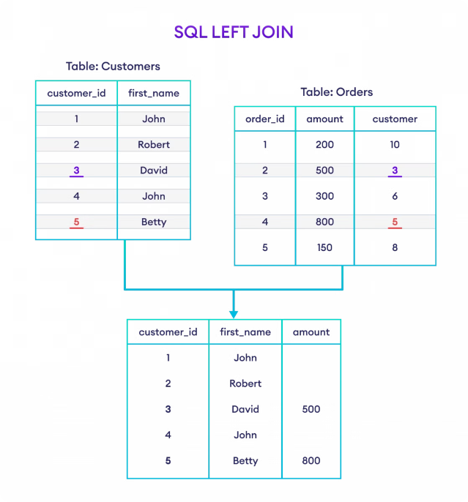
Introduction to Right Join
A right join, also known as a right outer join, right join is a type of SQL join that returns all rows from the right table, along with the matching rows from the left table. It ensures that all records from the right table are included in the result set, even if there are no matches in the right table.

Slide 18
Syntax for Right Join
The syntax for a right join is:
SELECT column1, column2, ... FROM table1 RIGHT JOIN table2 ON table1.column = table2.column;
This will return all rows from the right table (table2), along with the matching rows from the left table (table1).

Slide 19
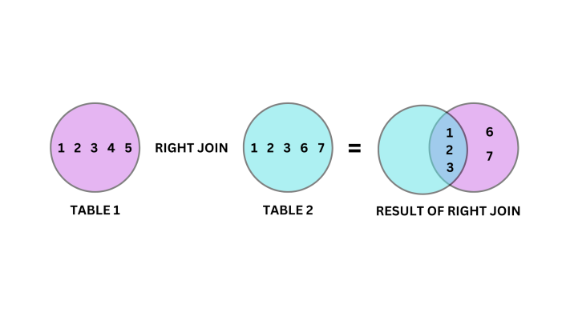
Right Join
Example
SELECT
A
FROM
A
RIGHT JOIN
B
ON B.n = A.n;

Slide 20
Introduction to Outer Join
In SQL, an outer join is a type of join operation that allows you to combine rows from two or more tables based on a related column between them. It includes unmatched rows from one or both tables, filling in NULL values for columns where no match is found. Outer joins are categorized into three types: left outer join, right outer join, and full outer join

Slide 21
Syntax for Outer Join
The syntax for a right join is:
SELECT columns
FROM table1
FULL OUTER JOIN table2 ON table1.column = table2.column;
Full outer join is not supported in MySQL, but can be simulated using set operators

Slide 22
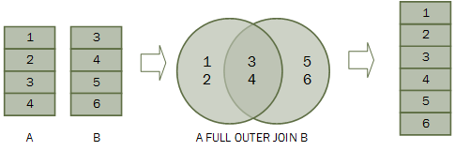
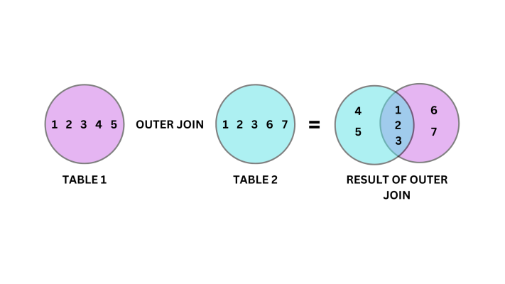
Outer Join
Example
SELECT column_list
FROM
A
FULL OUTER JOIN
B
ON A.Id = B.ID;

Slide 23
What is UNION?
UNION is a SQL set operation that allows you to combine the results of two or more SELECT statements into a single result set. It removes any duplicate rows, ensuring that the final result set contains only unique records. This makes UNION particularly useful when you need to combine data from multiple sources or tables, while eliminating redundant information.

Slide 24
Syntax for Union
Key Points
- The number and order of columns in each SELECT statement must be the same. - The data types of the corresponding columns must be compatible. - UNION removes any duplicate rows from the final result set.
The syntax for a Union is:
SELECT column1, column2, ... FROM table1 UNION SELECT column1, column2, ... FROM table2;

Slide 25
What is UNION ALL?
UNION ALL is another SQL set operation that is similar to UNION, but with one key difference: it does not remove duplicate rows from the final result set. Instead, UNION ALL combines the results of multiple SELECT statements, preserving all rows, even if they are duplicates.

Slide 26
Syntax for Union
Key Points
- The number and order of columns in each SELECT statement must be the same. - The data types of the corresponding columns must be compatible. - UNION ALL preserves all rows, including any duplicates, in the final result set.
The syntax for a Union All is:
SELECT column1, column2, ... FROM table1 UNION ALL SELECT column1, column2, ... FROM table2;

Slide 27
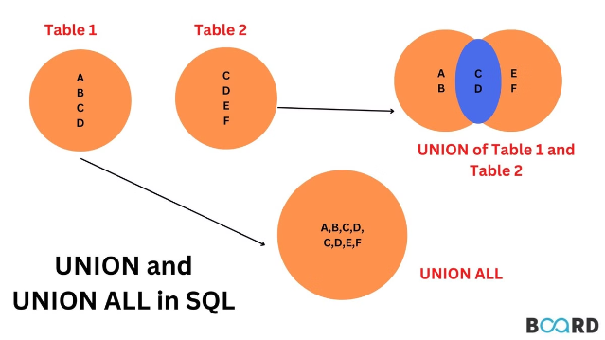
Outer Join
Example
SELECT * FROM Table1 UNION SELECT * FROM Table2;

Slide 28



Self Join
Syntax
SELECT column1, column2, ... FROM table1 t1 JOIN table1 t2 ON t1.column = t2.column;
Use Case
Self joins are used to join a table to itself, based on a related column. This is useful when you need to compare values within the same table, such as finding employees who have the same manager or finding the relationships between different parts of a hierarchical structure.
Example
SELECT e1.employee_name AS "Employee", e2.employee_name AS "Manager" FROM employees e1 JOIN employees e2 ON e1.manager_id = e2.employee_id;

Slide 29
