Slide 1
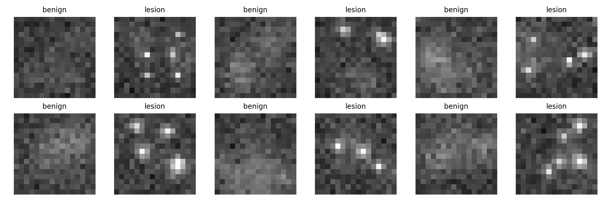
IBM Qiskit Fall Fest 2026
Updated: CV + noise + claim guardrails
Q-BioDiag
Quantum AI for Early Biomedical Diagnostics
4-qubit quantum-kernel classifier for benign vs lesion image patches, plus diagnostic case retrieval.
Safe claim: 100% on a 40-sample held-out prototype set - not clinical accuracy and not IBM hardware.
Track 8 • Healthcare & Biomedical Diagnostics

Slide 2
Problem & Motivation
Early disease signals are subtle, noisy, and label-limited.
Microscopic pathology patterns can appear as tiny texture changes, weak margins, or small lesion clusters.
Deep CNNs can perform well, but they usually need more labeled data and many trainable parameters.
Hackathon target: prove an end-to-end, reproducible quantum-classical diagnostic workflow.
Clinical framing
Classify benign vs early-lesion patches, then retrieve similar cases for explanation.
Q-BioDiag • Track 8: Quantum AI for Healthcare

Slide 3
Proposed Solution: End-to-End Workflow
A compact pipeline that judges can run and inspect in minutes.
Image patches
4 features
4 qubits
Quantum kernel
Prediction
Validation layer: held-out metrics + 5-fold CV + ideal/noisy quantum-kernel benchmark
Retrieval layer: Pinecone or local JSON stores compressed diagnostic embeddings and case metadata.
Runnable demo: python -m qbio_diagnostics.run_demo --samples 160 --qubits 4
Q-BioDiag • Track 8: Quantum AI for Healthcare

Slide 4
Quantum Implementation
Technical heart: ZZ-style feature map + fidelity kernel + SVM decision boundary.
Representation
feature_map = zz_feature_map(feature_dimension=4, reps=1, entanglement="full")
quantum_kernel = FidelityQuantumKernel(feature_map=feature_map)
model = QSVC(quantum_kernel=quantum_kernel)
Each 16x16 patch is compressed into 4 normalized descriptors: std, max intensity, bright ratio, local contrast.
Fallback honesty
If Qiskit is unavailable, the project uses a 4-qubit reference quantum-kernel simulator. It does not silently switch to a classical polynomial kernel.
Kernel: K(xi, xj) = |<phi(xi)|phi(xj)>|^2
Classifier: SVM trained over the quantum similarity matrix
IBM hardware path is optional and separately labeled as not_run until a QPU job completes.
Q-BioDiag • Track 8: Quantum AI for Healthcare

Slide 5
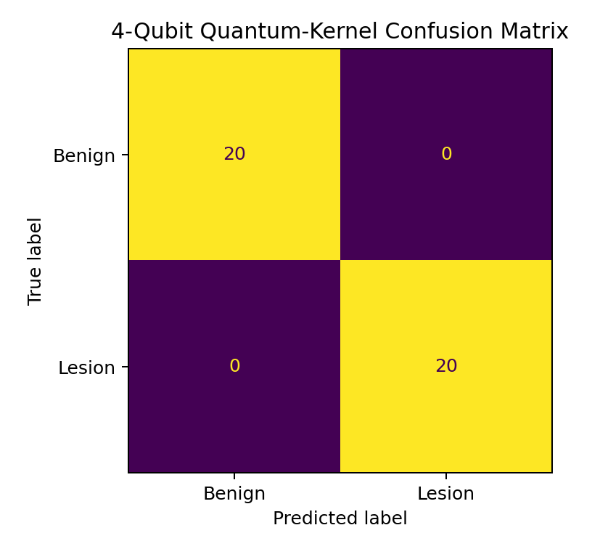
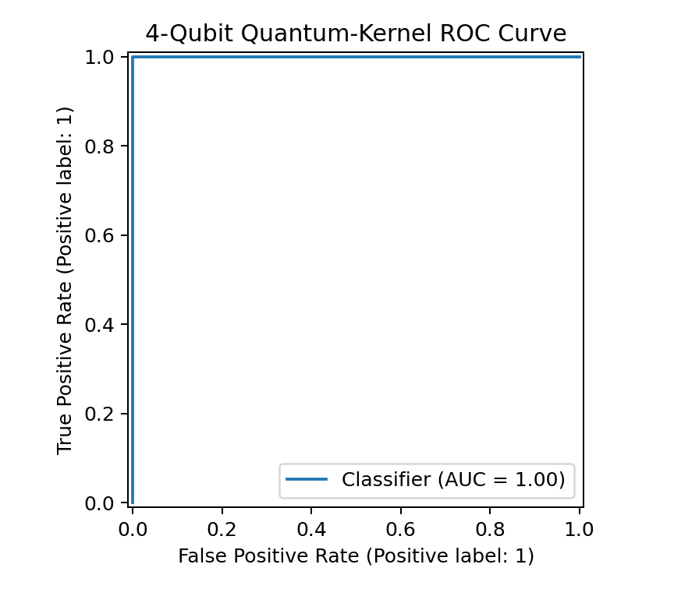
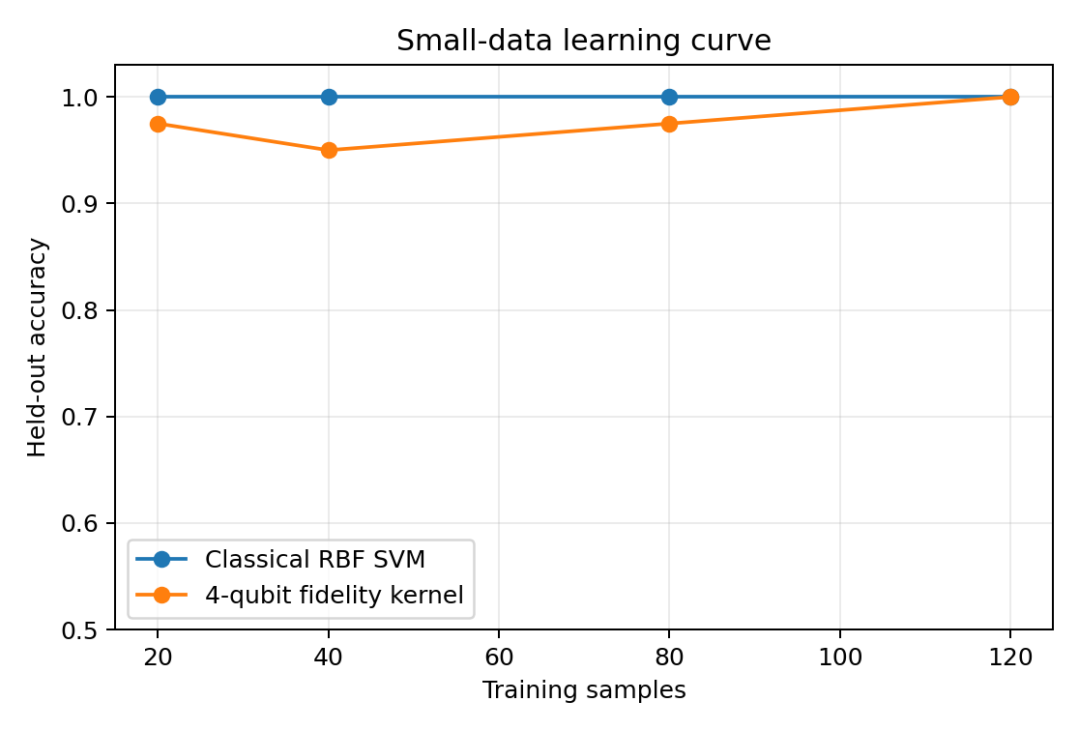
Results & Verification
Prototype metrics from 160 reproducible biomedical-style patches.
Say this: quantum-kernel evaluation achieved 100% accuracy on the 40-sample held-out evaluation set. Do not call it clinical accuracy or IBM hardware accuracy.
Q-BioDiag • Track 8: Quantum AI for Healthcare

Slide 6
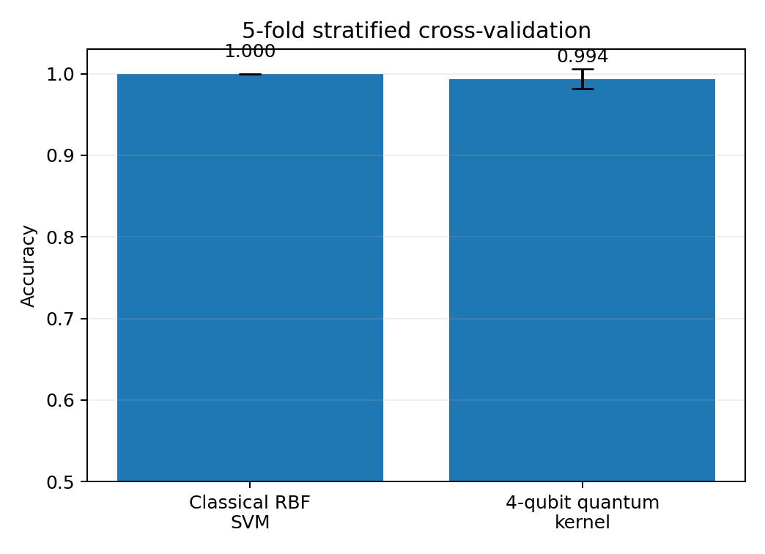
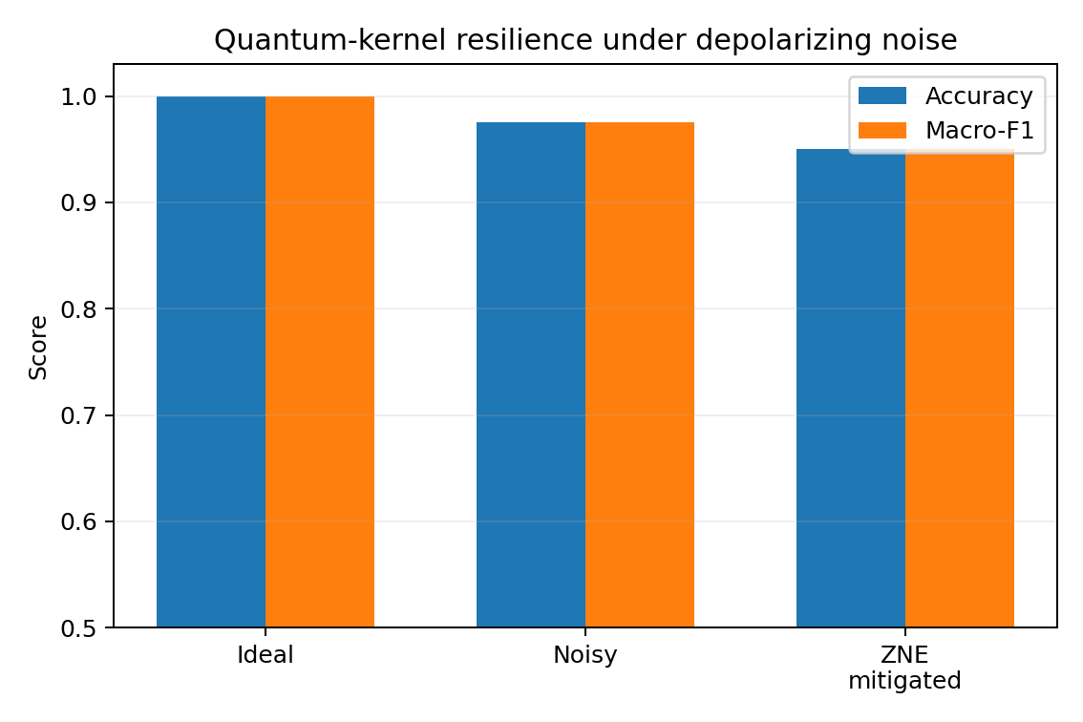
Robustness: Cross-Validation + Noise
The updated version adds the evidence judges are likely to ask for.
5-fold quantum-kernel CV mean accuracy: 0.9938
Noisy classifier accuracy in stress test: 0.975
IBM Quantum hardware status: not_run in packaged result; the repo includes an optional hardware benchmark starter.
Q-BioDiag • Track 8: Quantum AI for Healthcare

Slide 7
Future Scope & Submission Readiness
Ready for submission: repo + deck + demo-video script.
Upload the full folder to a public GitHub repo with README, requirements, notebook, and outputs.
Roadmap
1. Replace synthetic data with BreakHis/HAM10000/X-ray patches
2. Run IBM Runtime Sampler/Estimator jobs
3. Add readout mitigation and hardware-specific calibration
4. Build clinician review workflow
Record a 2-4 minute video showing terminal execution, metrics JSON, and output charts.
In the pitch, separate prototype simulation results from optional future IBM QPU execution.
Final pitch line
Q-BioDiag turns tiny biomedical image signals into quantum-kernel similarity patterns, tests robustness under noise, and retrieves explainable diagnostic cases.
Q-BioDiag • Track 8: Quantum AI for Healthcare

