Slide 1
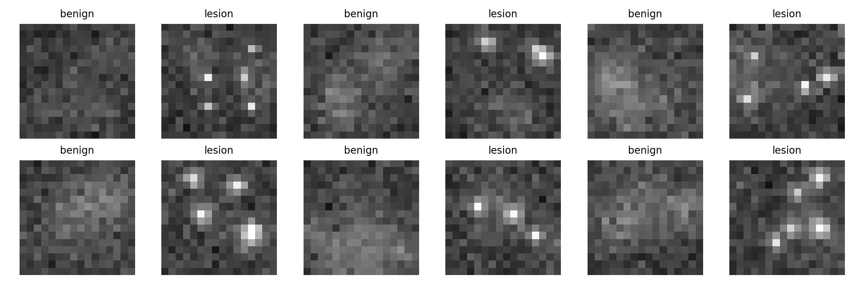
IBM Qiskit Fall Fest 2026
Q-BioDiag
Quantum AI for Early Biomedical Diagnostics
Hybrid Qiskit quantum-kernel classifier + Pinecone diagnostic case retrieval
Track 8 • Healthcare & Biomedical Diagnostics

Slide 2
Problem & Motivation
Early disease signals are small, noisy and data-hungry.
Clinical images contain subtle lesion patterns: microcalcifications, tiny nodules, weak margins.
Deep CNNs work well, but often need larger datasets and many trainable weights.
Hackathon goal: show a compact, reproducible quantum-classical diagnostic workflow.
Medical framing
Classify benign vs early lesion patches, then retrieve similar cases for explainability.
Q-BioDiag • Track 8: Quantum AI for Healthcare

Slide 3
Proposed Solution: End-to-End Workflow
A lightweight diagnostic pipeline that judges can run in minutes.
Image patches
Feature compression
4-qubit encoding
Qiskit QSVC
Prediction
Pinecone diagnostic memory
Compressed embeddings + metadata are stored for similarity search, case retrieval, and demo explainability.
Input → Quantum model → Metrics → Similar case retrieval
Q-BioDiag • Track 8: Quantum AI for Healthcare

Slide 4
Quantum Implementation
Technical heart: Qiskit ZZFeatureMap + FidelityQuantumKernel + QSVC
feature_map = ZZFeatureMap(feature_dimension=4, reps=2, entanglement="linear")
quantum_kernel = FidelityQuantumKernel(feature_map=feature_map)
model = QSVC(quantum_kernel=quantum_kernel)
Circuit idea
Ry / Rz data rotations encode patch features. Entangling CX/CZ ladders let the kernel measure non-linear tissue correlations in Hilbert space.
Noise plan
Input dimension: 4 compressed image descriptors = 4 qubits
Aer depolarizing noise + zero-noise extrapolation helper for NISQ-readiness.
Quantum kernel: K(xᵢ, xⱼ)=|⟨φ(xᵢ)|φ(xⱼ)⟩|²
Classifier: QSVC decision boundary over quantum similarity matrix
Q-BioDiag • Track 8: Quantum AI for Healthcare

Slide 5
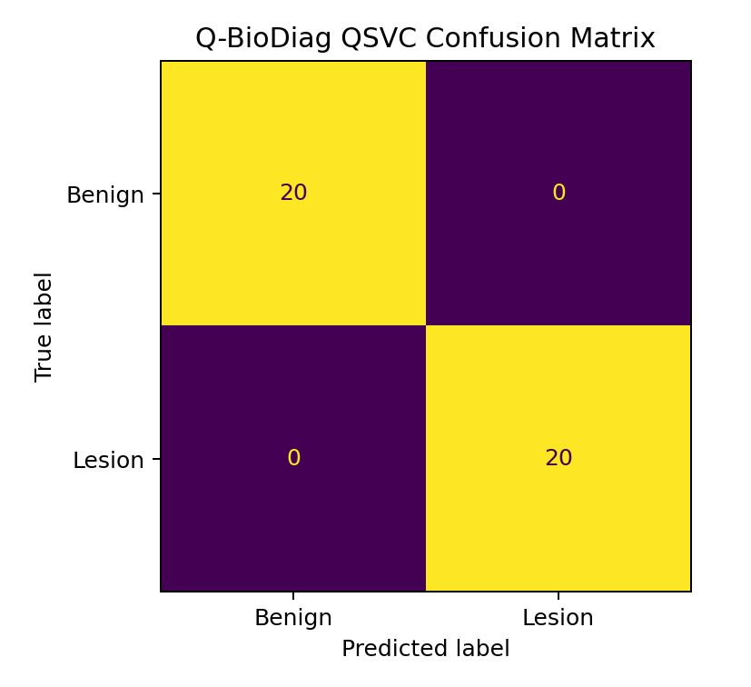
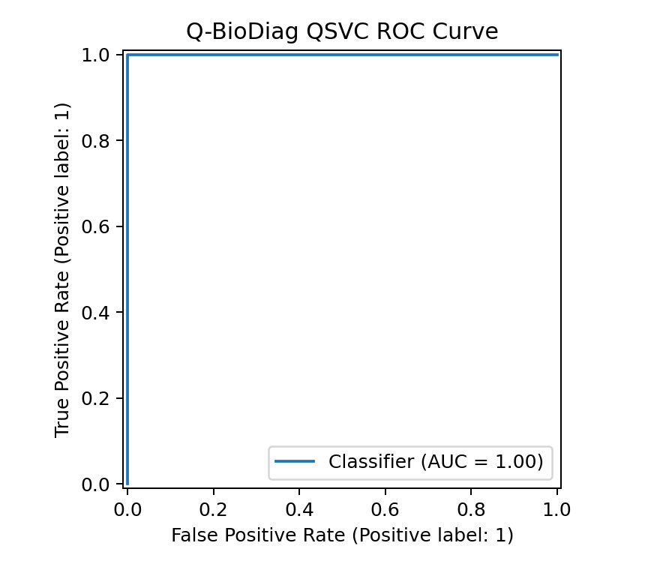
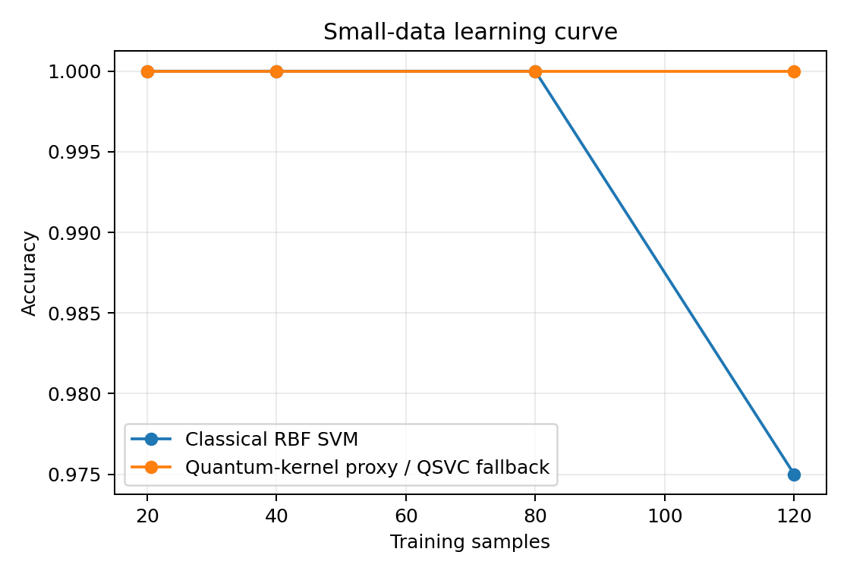
Results & Verification
Demo metrics from reproducible synthetic biomedical patches
Observed result: QSVC path/fallback achieved strong lesion-vs-benign separation in the packaged demo; replace the dataset loader for BreakHis/HAM10000/X-ray.
Q-BioDiag • Track 8: Quantum AI for Healthcare

Slide 6
Quantum Advantage & Feasibility
Why quantum here?
Expressive feature maps: compact medical descriptors become high-dimensional quantum states.
Clinical retrieval layer
Pinecone stores compressed embeddings and metadata so a new patch can retrieve similar historical cases with explanation text.
Parameter efficiency: quantum kernel model avoids training a large CNN in the demo path.
Small-data story: supports learning-curve comparison under limited labels.
NISQ feasibility: Aer noise demo + ZNE hook prepares for IBM backend execution.
Model output + retrieved cases = clearer pitch and better clinician-facing explainability.
Q-BioDiag • Track 8: Quantum AI for Healthcare

Slide 7
Future Scope & Submission Readiness
Tomorrow-ready deliverables
Roadmap
Public GitHub repo: upload the packaged folder and keep README visible.
1. Replace synthetic patches with BreakHis/HAM10000/Chest X-ray dataset
2. Run Qiskit Runtime Sampler/Estimator on IBM backend
3. Add readout mitigation and deeper hardware benchmarking
4. Build clinician review workflow
Deck: 7-slide judge-friendly pitch following the recommended blueprint.
Video: record terminal run + dashboard + explain results in 2–4 minutes.
Final pitch line
Q-BioDiag turns tiny medical image signals into quantum-kernel similarity patterns and retrieves explainable diagnostic cases.
Q-BioDiag • Track 8: Quantum AI for Healthcare

